Slide 1
May 27, 2009
University of South Florida
Marshall Center
1:30 – 4:00 pm

Slide 2
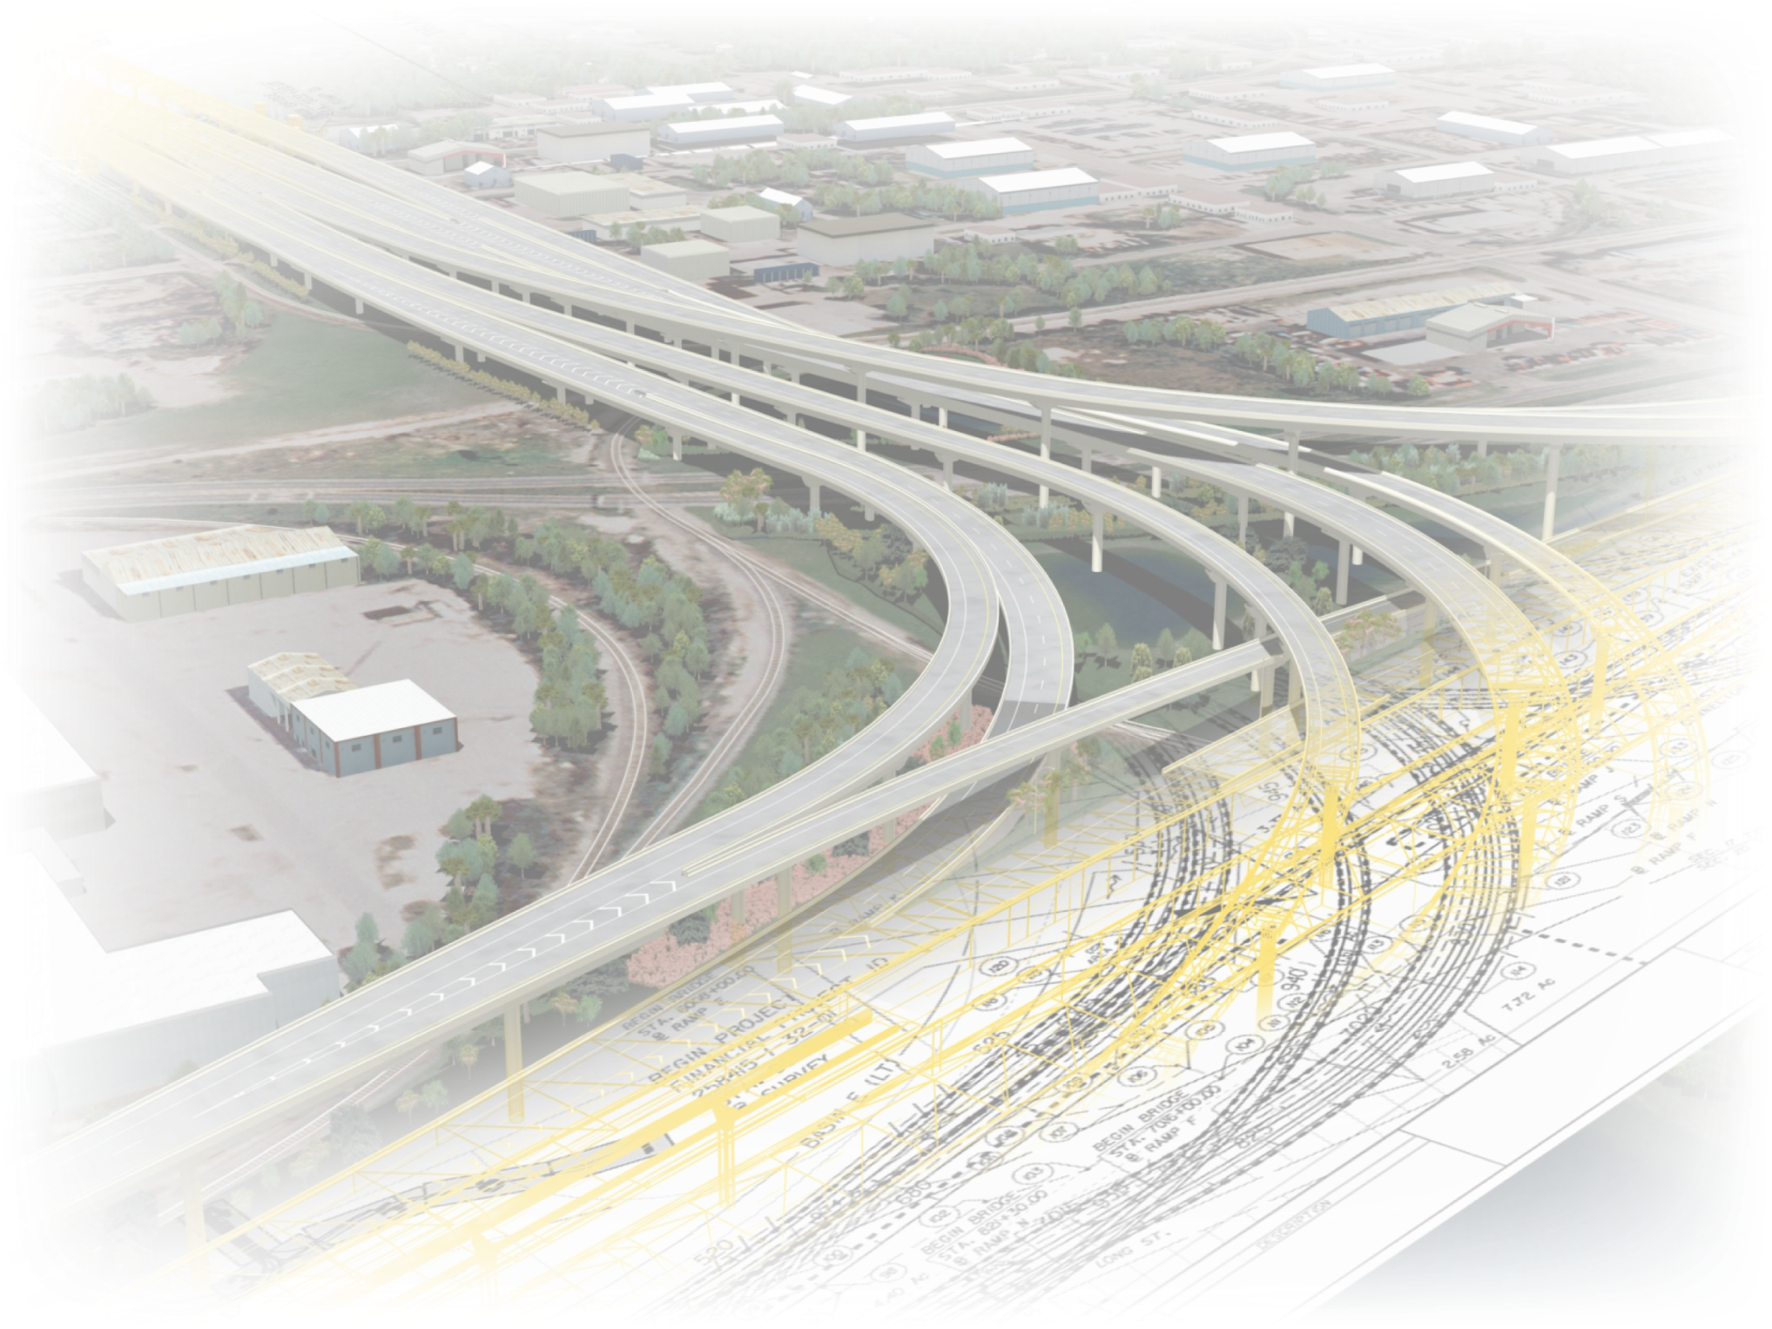
Agenda
Introduction
Project Overview
Agency Coordination
Contract Process
DBE
Financial Plan
Project Description
Pre-Bid Meeting Announcement
Questions & Answers
Traffic Control Phasing Video
Visit www.myTBI.com

Slide 3
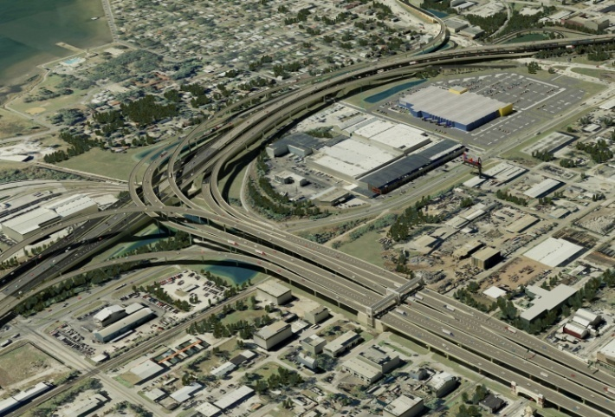
Introduction
Project Overview

Slide 4
Introduction
Agency Coordination
FDOT-Design Review Committee (DRC)
Tampa-Hillsborough Expressway Authority
Florida’s Turnpike Enterprise
City Of Tampa
Hillsborough County
Southwest Florida Water Management District
Hillsborough Area Regional Transit
CSX
Notes:
4

Slide 5
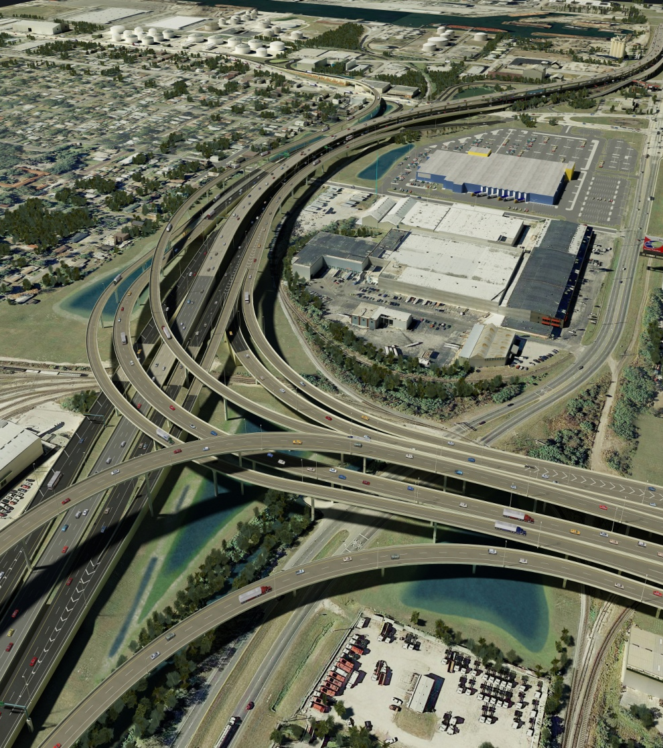
Contract Process
Qualification
Work Class
Major Bridge – Curved Steel Girders
Major Bridge – Concrete Segmental
Bidding Capacity
Bidding Capacity will be needed to cover the entire budget estimate for the project

Slide 6
Contract Process
Qualification – Joint Ventures (JV)
All parties in the JV must be prequalified.
At least one party in the JV must be prequalified in the required work class.
Each party in the JV must have the bidding capacity to cover the % of the project budget that equals their % in the JV.
The Declaration of Joint Venture Form must be completed and submitted for approval.

Slide 7
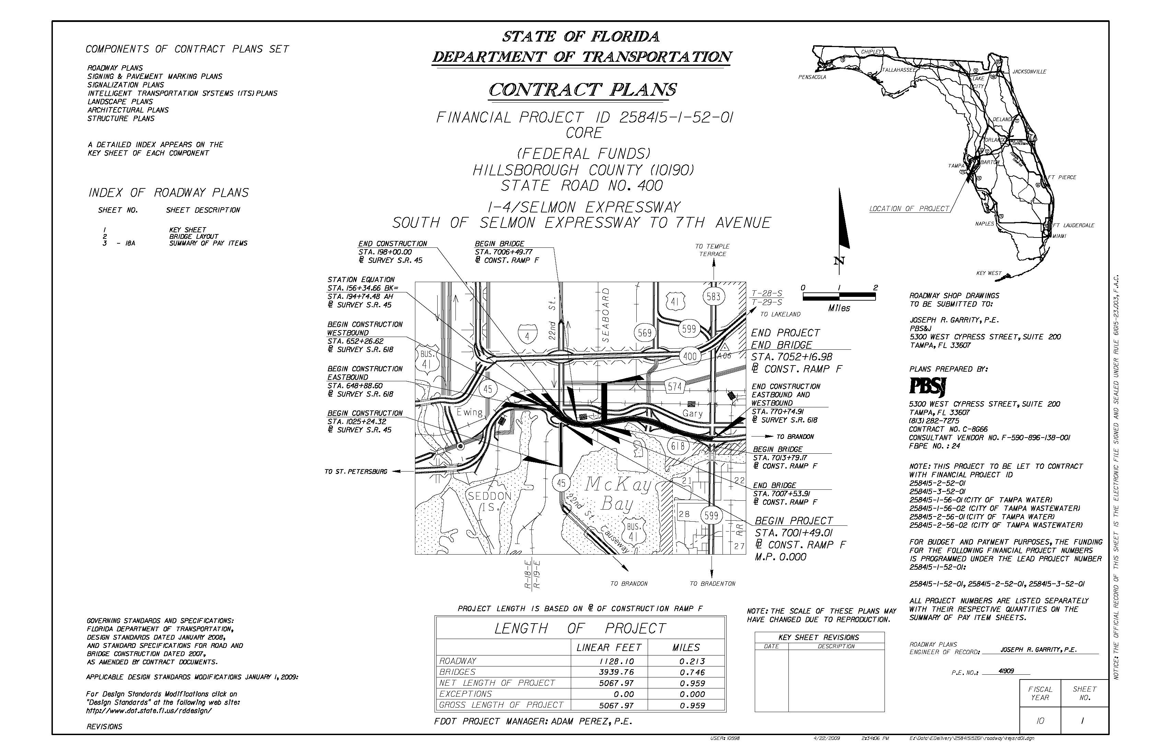
Contract Process
Documents
Plans/Specs Documents will be issued June 8, 2009
Bidders can bid on only One Alternate
Deadline for submission of questions
August 19, 2009 – 10:00 am Local Time

Slide 8
Contract Process
Financial Plan and Bid Submittal
All Documents will be submitted to:
Contracts Administration Office
Florida Department of Transportation
605 Suwannee Street, MS – 55
Tallahassee, FL 32399
The Financial Plan
5 Hard copied and 5 digital copies
Bid is submitted via Bid Express

Slide 9
Contract Process
Opening – Review – Award
Bid totals for each bid submitted will be read aloud for those present and available at 4:00 PM in Tallahassee on the day of the letting, or on the Contracts Administration website at: www.dot.state.fl.us/cc-admin.
Anyone needing special accommodations under the Americans with Disabilities Act of 1990 should send an e-mail to: contracts.admin@dot.state.fl.us or call telephone number (850) 414-4000.
Special accommodation requests under the Americans with Disabilities Act should be made at least seven days prior to the public meeting.

Slide 10
Contract Process
Advertisement Bid Solicitation Notice
Date | Event
May 27, 2009 | Contractor Information Forum - USF
June 8, 2009 | Advertisement Date
June 15, 2009 | Mandatory Pre-Bid Meeting 9:00am Local Time at District Seven Headquarters 11201 N. McKinley Drive, Tampa, FL 33612
August 19, 2009 | Deadline for submission of questions - 10:00 am Local Time
September 16, 2009 | Bid/Price Proposal and Financial Plan Proposal due before by 4:00 p.m. local time. All Documents will be submitted to: Contracts Administration Office, Florida Department of Transportation, 605 Suwannee Street, MS – 55, Tallahassee, FL 32399. The Financial Plan 5 Hard copied and 5 digital copies. Bid/Price Proposal will be submitted to the Department using the Expedite Proposal file by using the internet. (Bid Express)
TBD | Anticipated Award Date
TBD | Anticipated Execution Date

Slide 11
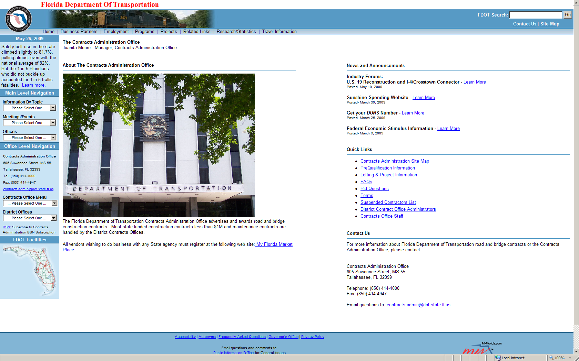
Contract Process
Contracts Administration Website
http://www.dot.state.fl.us/cc-admin/

Slide 12
Contract Process
DBE Participation
Objective – 8.1%
Assistance - Blackmon Roberts Group
Lakeland Office Miami Office
902 South Florida Avenue 4000 Ponce De Leon Blvd Suite 205 Suite 470 Lakeland, FL 33803 Coral Gables, FL 33145
(P) 863.802.1280 (P) 305.762.5836
(F) 863.802.1290 (F) 305.777.0449
Introductions

Slide 13
Contract Process
Project Financial Plan, including at a minimum:
All financial elements to finance the project as proposed.
Provision for all project costs.
Project Sources and Uses of Funds.
Audited Financial Statements for the most recent two (2) fiscal years. Required financial statements shall include:
Opinion Letter (Auditor’s Report)
Balance Sheet
Income Statement
Statement of Changes in Cash Flow
Footnotes
If financial statements are not prepared in accordance with U.S. Generally Accepted Accounting Principles (GAAP)
A letter from a CPA must be included to address how conversion to GAAP would be impacted.

Slide 14
Contract Process
If audited financials are not available,
Provide unaudited financial statements prepared in accordance with GAAP, certified as true, correct and complete by the Chief Financial Officer.
Interim Financial Statements must be submitted for each party of the Build-Finance Team providing financial support to the project.
Prepared in accordance with GAAP and certified by the entity’s Chief Financial Officer for the period since the last Audited Financial Statement.
Interim Financial Statements through the most recent completed fiscal quarter should be provided.
Letter of Commitment or Credit from Financial Institution.
If using debt financing as a source of funds or guarantee, a preliminary Letter of Commitment or Credit from the financial institution, must be submitted as part of the Financial Proposal
Final Letter of Commitment or Credit/Statement of No Change or updated firm commitment letter submitted prior to award of contract.
The Letter of Commitment or Credit should be specific to the project and meet the amount required as identified in the Project Financial Plan.

Slide 15
Contract Process
Chief Financial Officer Attestation
Required for accuracy and completeness of all financial information.
Ownership and Organizational structure
Required of all project entities, including financial relationships with other entities included or involved in project delivery.
Bonding company affidavit
Certifies contractor has the financial means and capacity to bond 100% payment and performance for the face amount of $250,000,000 for the project.
As appropriate
Any and all financial warranties, bonds, sureties, certifications and other commitments for the financial security of the project.

Slide 16
DRAFT - Contract Process - DRAFT
Cash Availability Schedule - Draft
Project Number: 258415-1-52
Fiscal Year | July 1 | October 1 | January 1 | April 1 | Total
2009 | $0 | $0 | $0 | $0 | $0
2010 | $91,380,329 | $0 | $0 | $0 | $91,380,329
2011 | $0 | $0 | $0 | $0 | $0
2012 | $0 | $0 | $0 | $0 | $0
2013 | $80,000,001 | $137,513 | $1,673,611 | $4,992,191 | $86,803,316
2014 | $8,175,854 | $11,315,499 | $15,348,747 | $18,000,089 | $52,840,189
2015 | $19,582,298 | $21,881,937 | $23,096,191 | $22,024,368 | $86,584,794
2016 | $21,225,113 | $20,068,409 | $17,673,127 | $14,517,948 | $73,484,597
2017 | $12,862,606 | $10,081,074 | $7,519,252 | $9,650,466 | $40,113,398
2018 | $3,236,978 | $2,095,439 | $1,285,115 | $3,353,932 | $9,971,464
Total | $236,463,179 | $65,579,871 | $66,596,043 | $72,538,994 | $441,178,087

Slide 17
DRAFT - Contract Process - DRAFT
Cash Availability Schedule - Draft
Project Number: 258415-1-56
Fiscal Year | July 1 | October 1 | January 1 | April 1 | Total
2009 | $0 | $0 | $0 | $0 | $0
2010 | $0 | $0 | $0 | $0 | $0
2011 | $0 | $0 | $0 | $0 | $0
2012 | $0 | $0 | $0 | $0 | $0
2013 | $0 | $4,072 | $49,561 | $147,836 | $201,469
2014 | $242,124 | $332,684 | $425,171 | $445,379 | $1,445,358
2015 | $436,271 | $450,654 | $431,685 | $387,907 | $1,706,517
2016 | $369,639 | $326,796 | $267,101 | $199,656 | $1,163,192
2017 | $161,464 | $104,528 | $64,106 | $167,294 | $497,392
2018 | $0 | $0 | $0 | $0 | $0
Total | $1,209,498 | $1,218,734 | $1,237,624 | $1,348,072 | $5,013,928

Slide 18
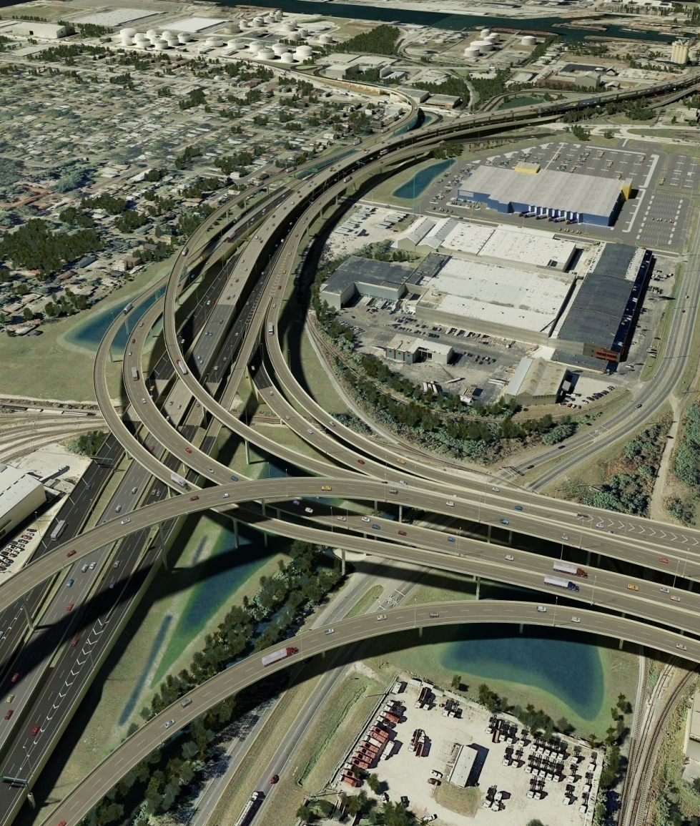
Project Description
Overview of FPID Packages
Core Project
Bid Alternatives
Construction Highlights
Toll Gantry
Deck Panel Replacement
Hazardous Materials
Utilities
CSX Coordination
Aesthetics
Traffic Control Phasing

Slide 19
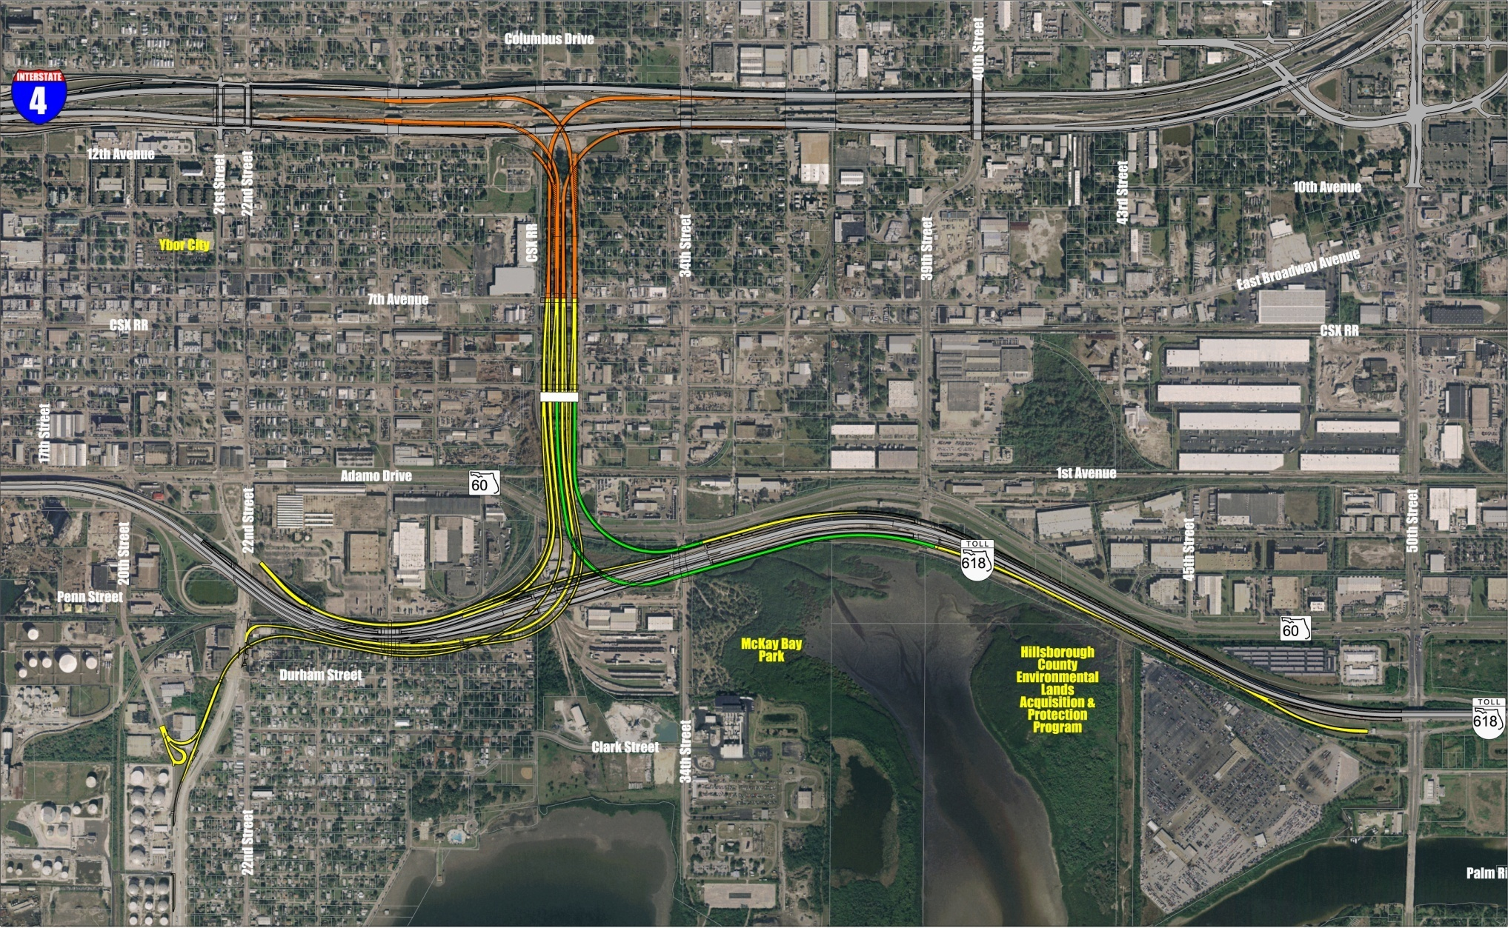
Project Description
Overview of FPID Packages
Toll Gantry
FPID: 258415-1
FPID: 258415-2
FPID: 258415-3

Slide 20
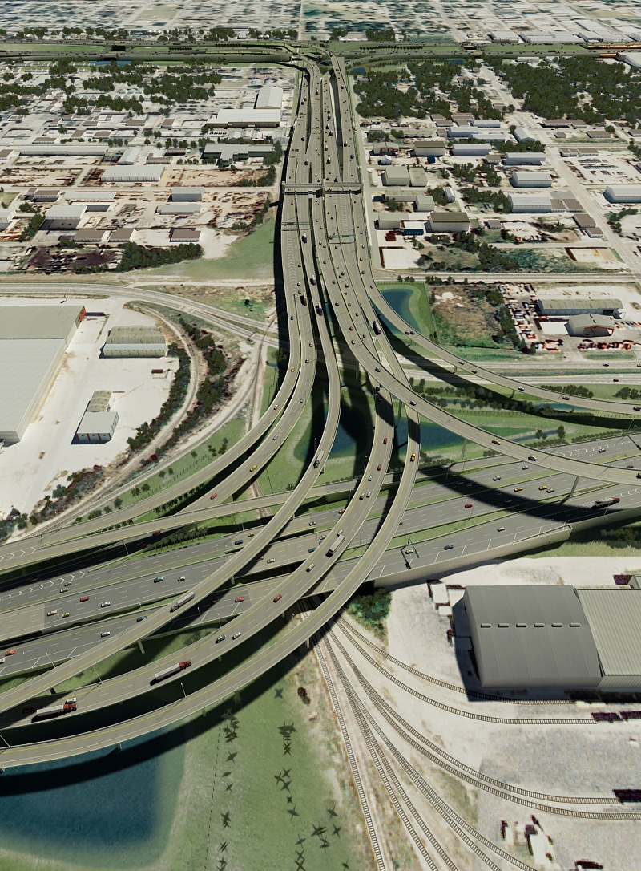
Project Description
Core Project
Architecture Plans
Signing
Signals
ITS
Landscape Plans
McKay Bay Bridge
Deck Panel Bridges
I-4 over 26th Street Bridges
Notes:
20

Slide 21
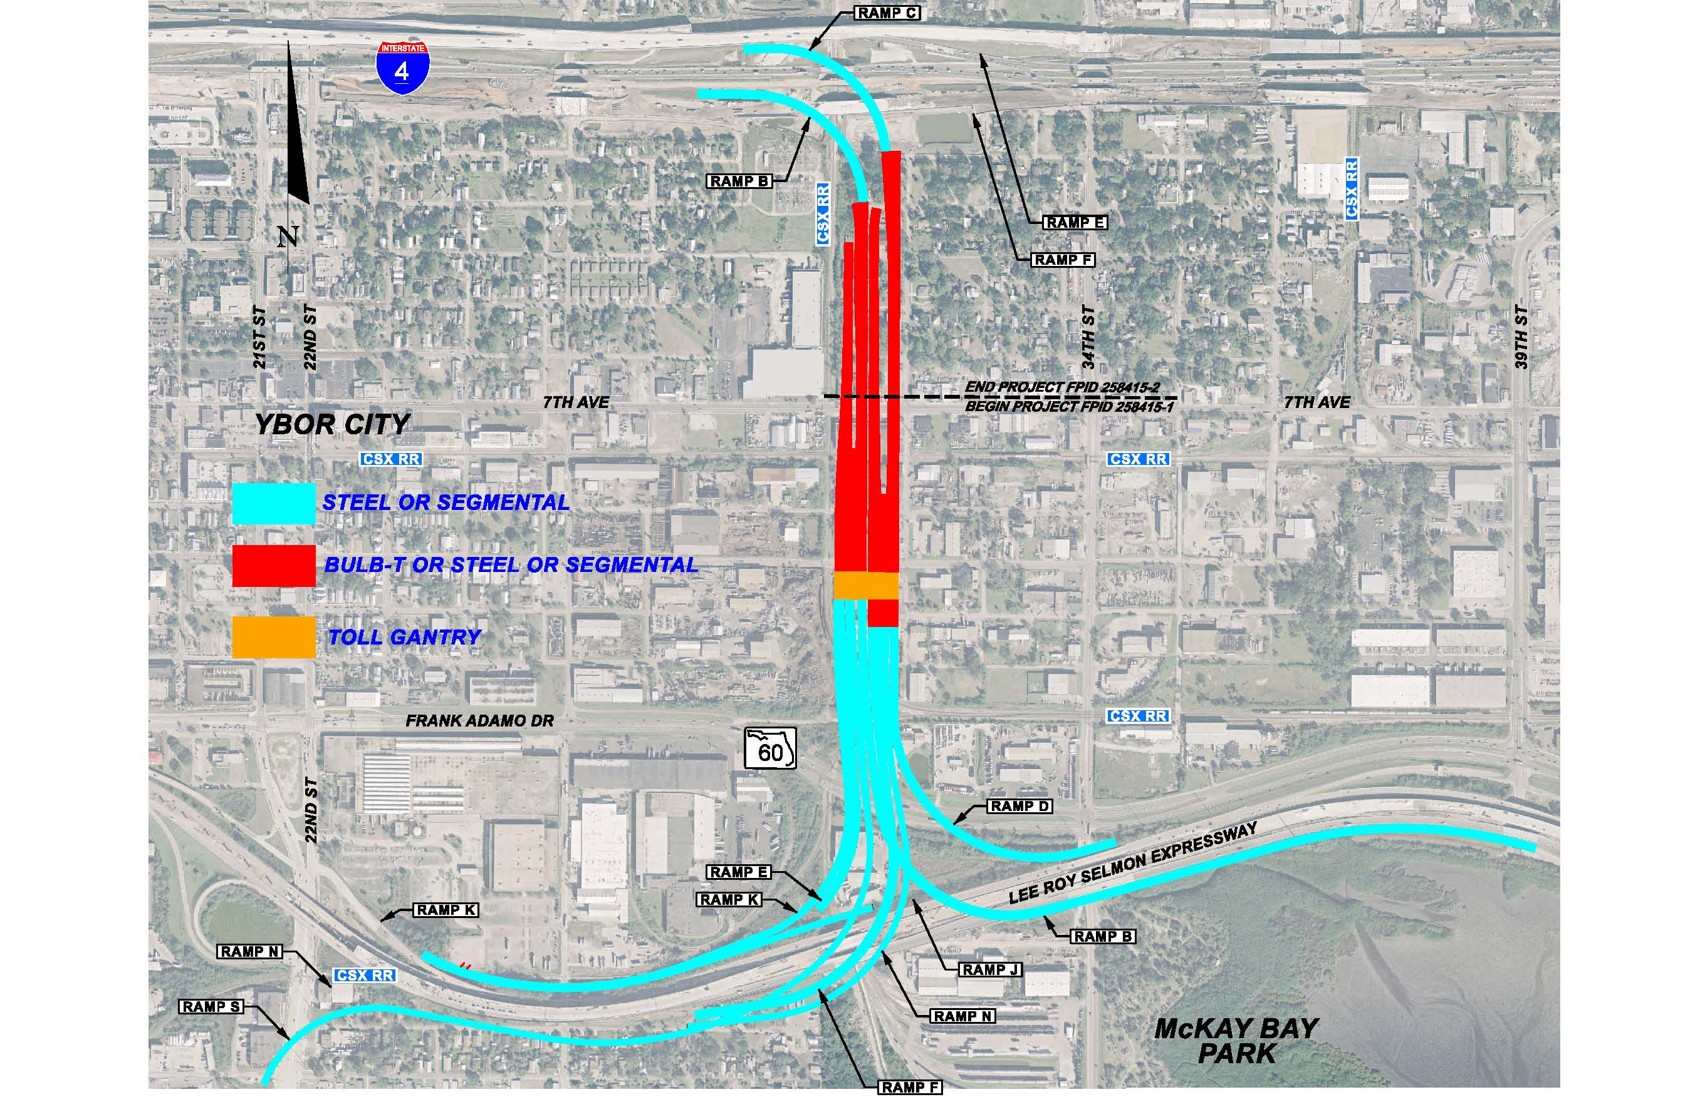
Project Description
Bid Alternatives
Bid Alternative 1: Core + AA1 Steel Girder Bridges
Bid Alternative 2: Core + AA2 Segmental Concrete Bridges
Bid Alternative 3: Core + AA3 Steel Girder Bridges with Bulb T Alternate
Bid Alternative 4: Core + AA4 Segmental Concrete Bridges with Bulb T Alternate
Notes:
21

Slide 22
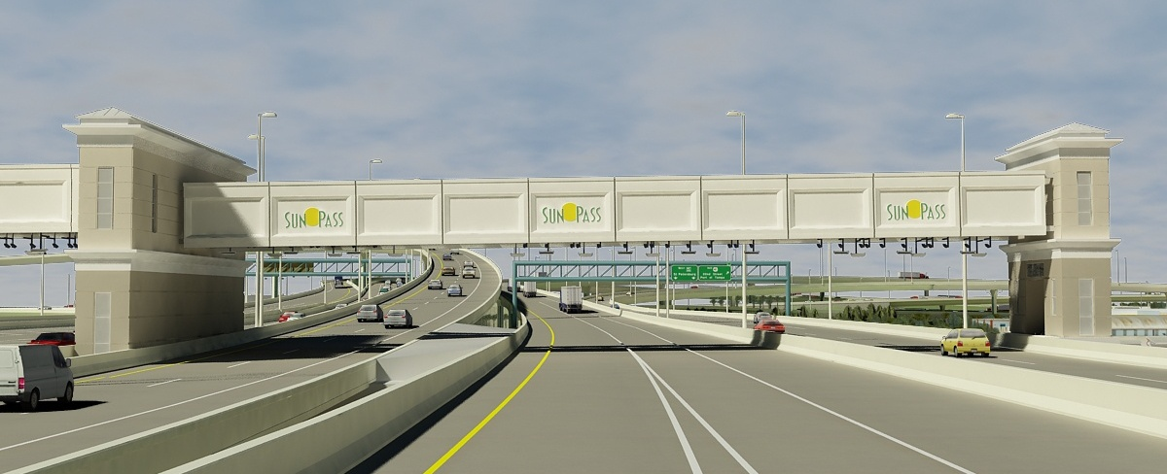
Project Description
Toll Gantry
Coordination with Turnpike
ITS at I-4

Slide 23
Project Description
22nd Street
Deck Panels
Lane Closures
ITS
26th Street
34th Street
CSX RR
39th Street

Slide 24
Project Description
Detours

Slide 25
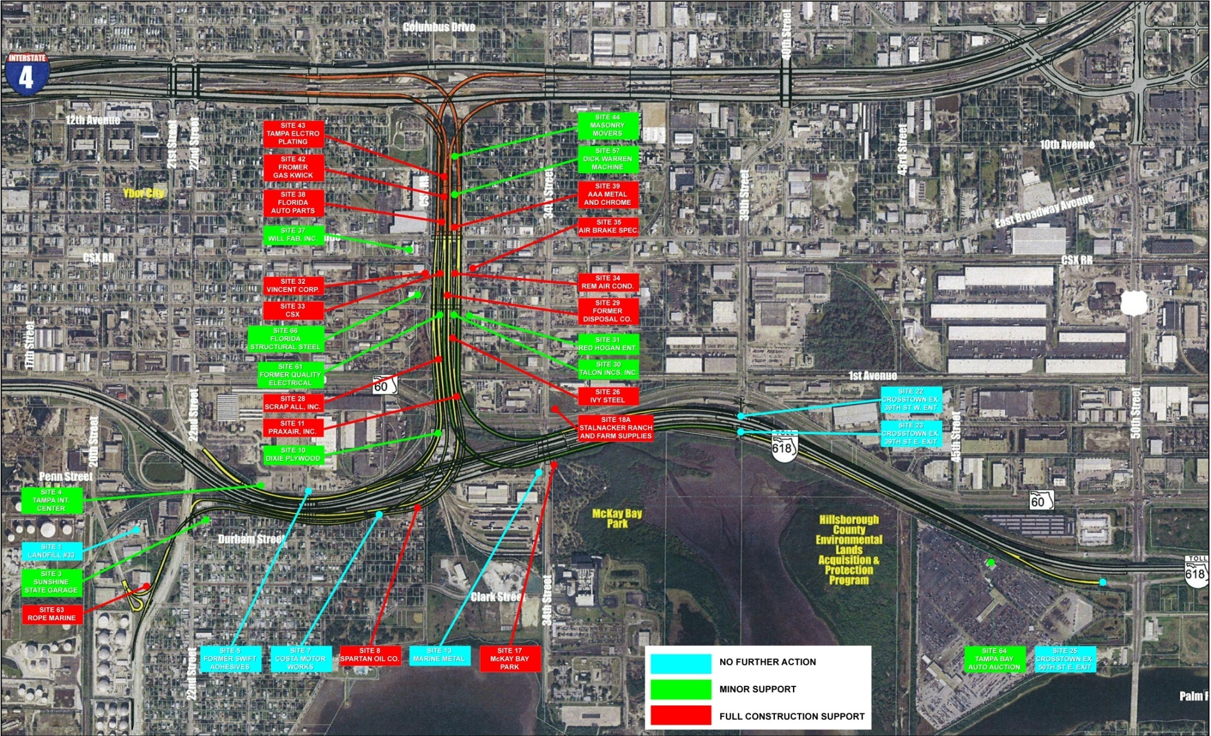
Project Description
Hazardous Material Remediation
Notes:
25

Slide 26
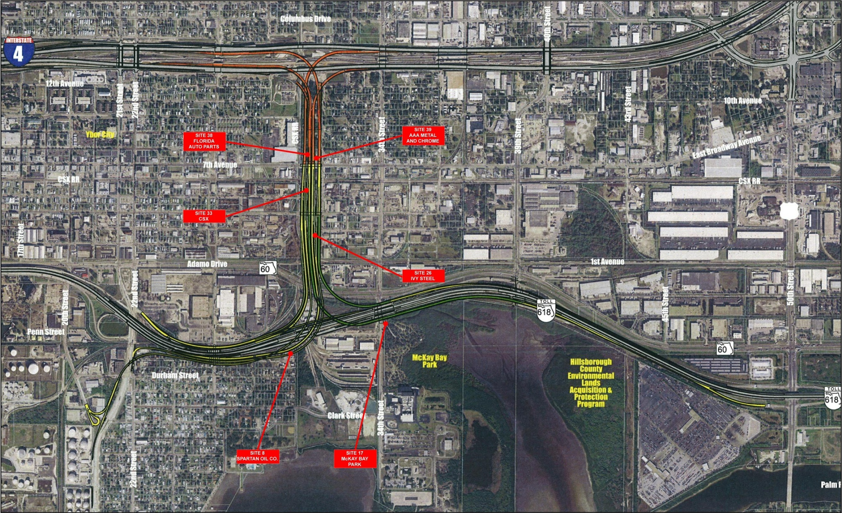
Project Description
Soil Remediation Sites
Notes:
26

Slide 27
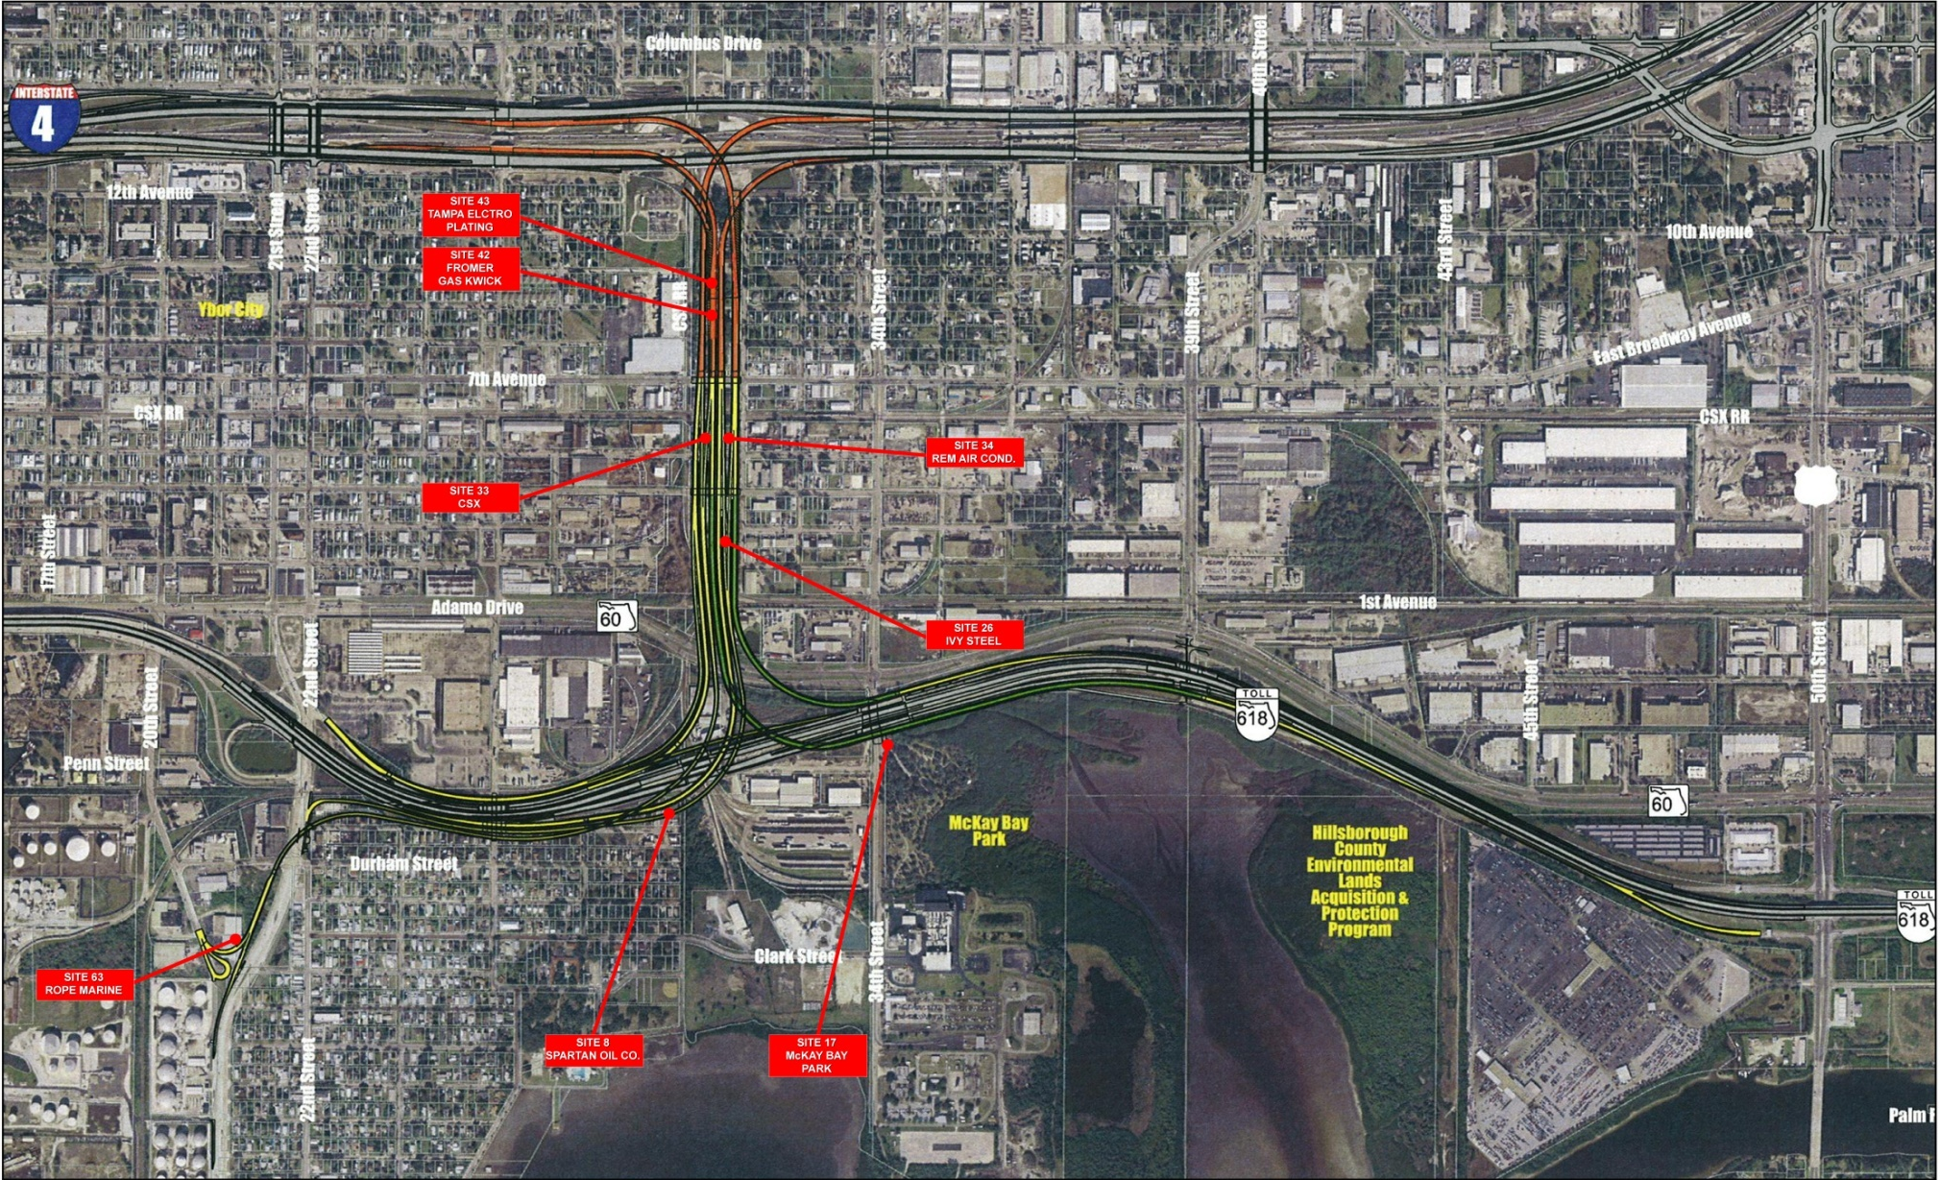
Project Description
Sites with Future Construction Issues
Notes:
27

Slide 28
Project Description
Utilities
TAMPA ELECTRIC (TECO)
DISTRIBUTION
TRANSMISSION
PEOPLE’S GAS
TAMPA WATER DEPT.
TAMPA WASTEWATER DEPT.
CENTRAL FLORIDA PIPELINE
VERIZON FLORIDA
SPRINT
BRIGHTHOUSE NETWORKS
LEVEL 3 COMMUNICATIONS
MCI WORLDCOM
FPL FIBERNET
FIBER LIGHT
P.E.A., INC.
GLOBAL CROSSING TELECOMMUNICATIONS, INC.
HILLSBOROUGH COUNTY TRAFFIC SERVICE UNIT
ITC DELTA COM
QWEST COMMUNICATIONS
PROGRESS TELECOM
XO COMMUNICATIONS
Notes:
28

Slide 29
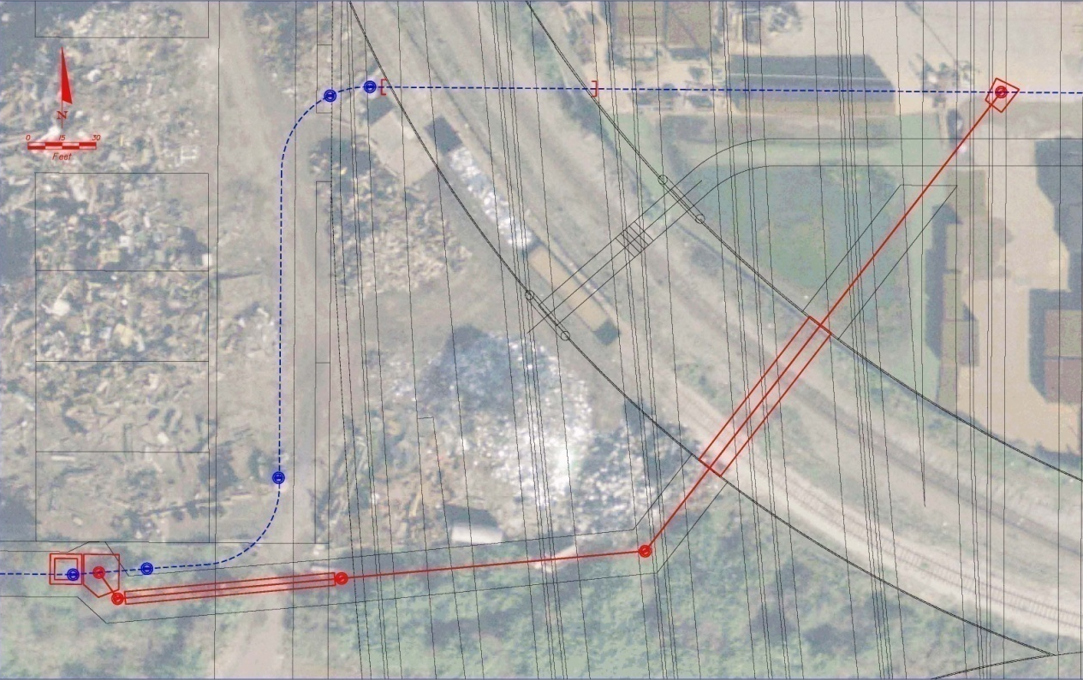
Project Description
Utilities – Performing Ongoing Relocations
TECO Peoples
Gas
Bright House
Central Florida
Pipeline
Qwest
Communications
42” Sanitary Sewer from 31st Street to south of Trademark Metals Recycling
Trademark
Metals
Recycling
Notes:
29

Slide 30
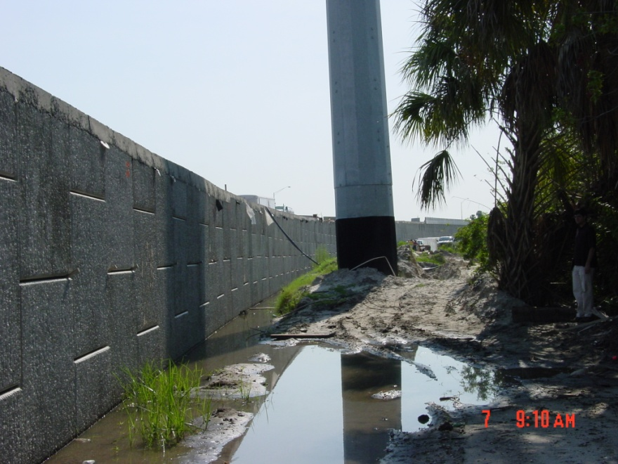
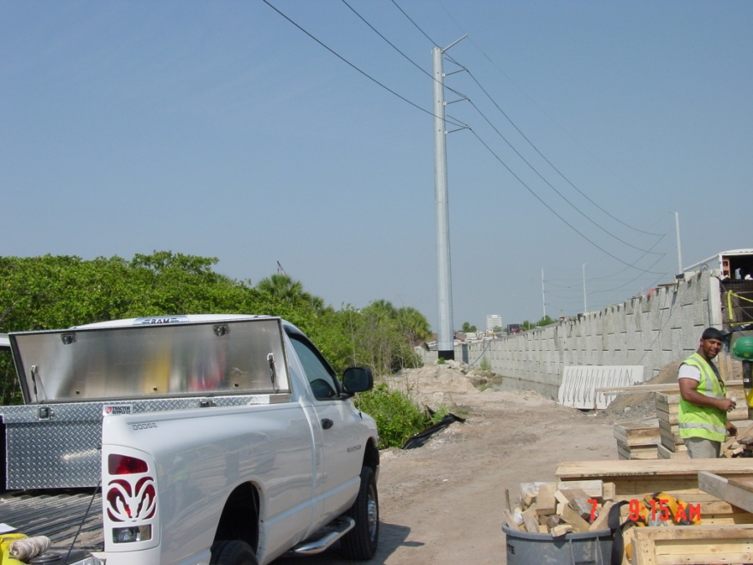
Project Description
Utilities
Owner Relocations During Construction
TECO Distribution
TECO Transmission
Fiber Light, LLC
Notes:
30

Slide 31
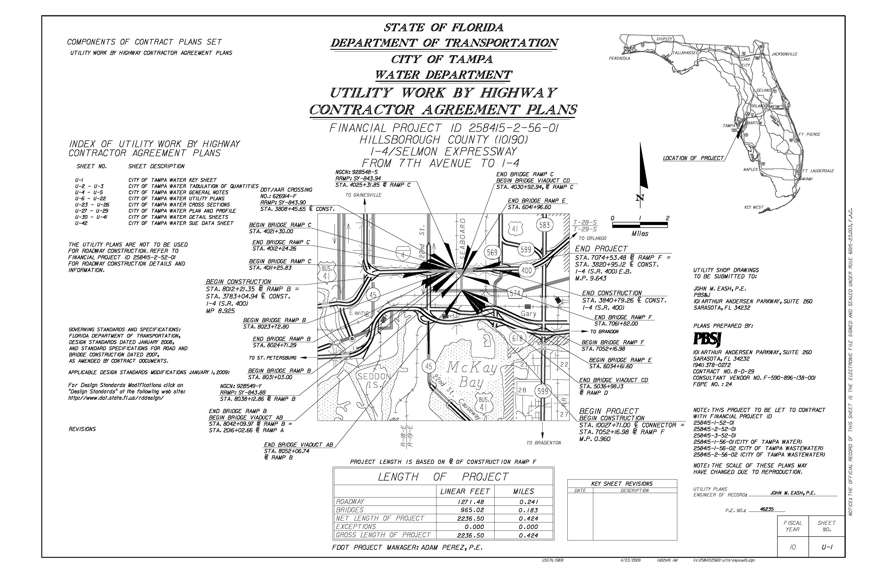
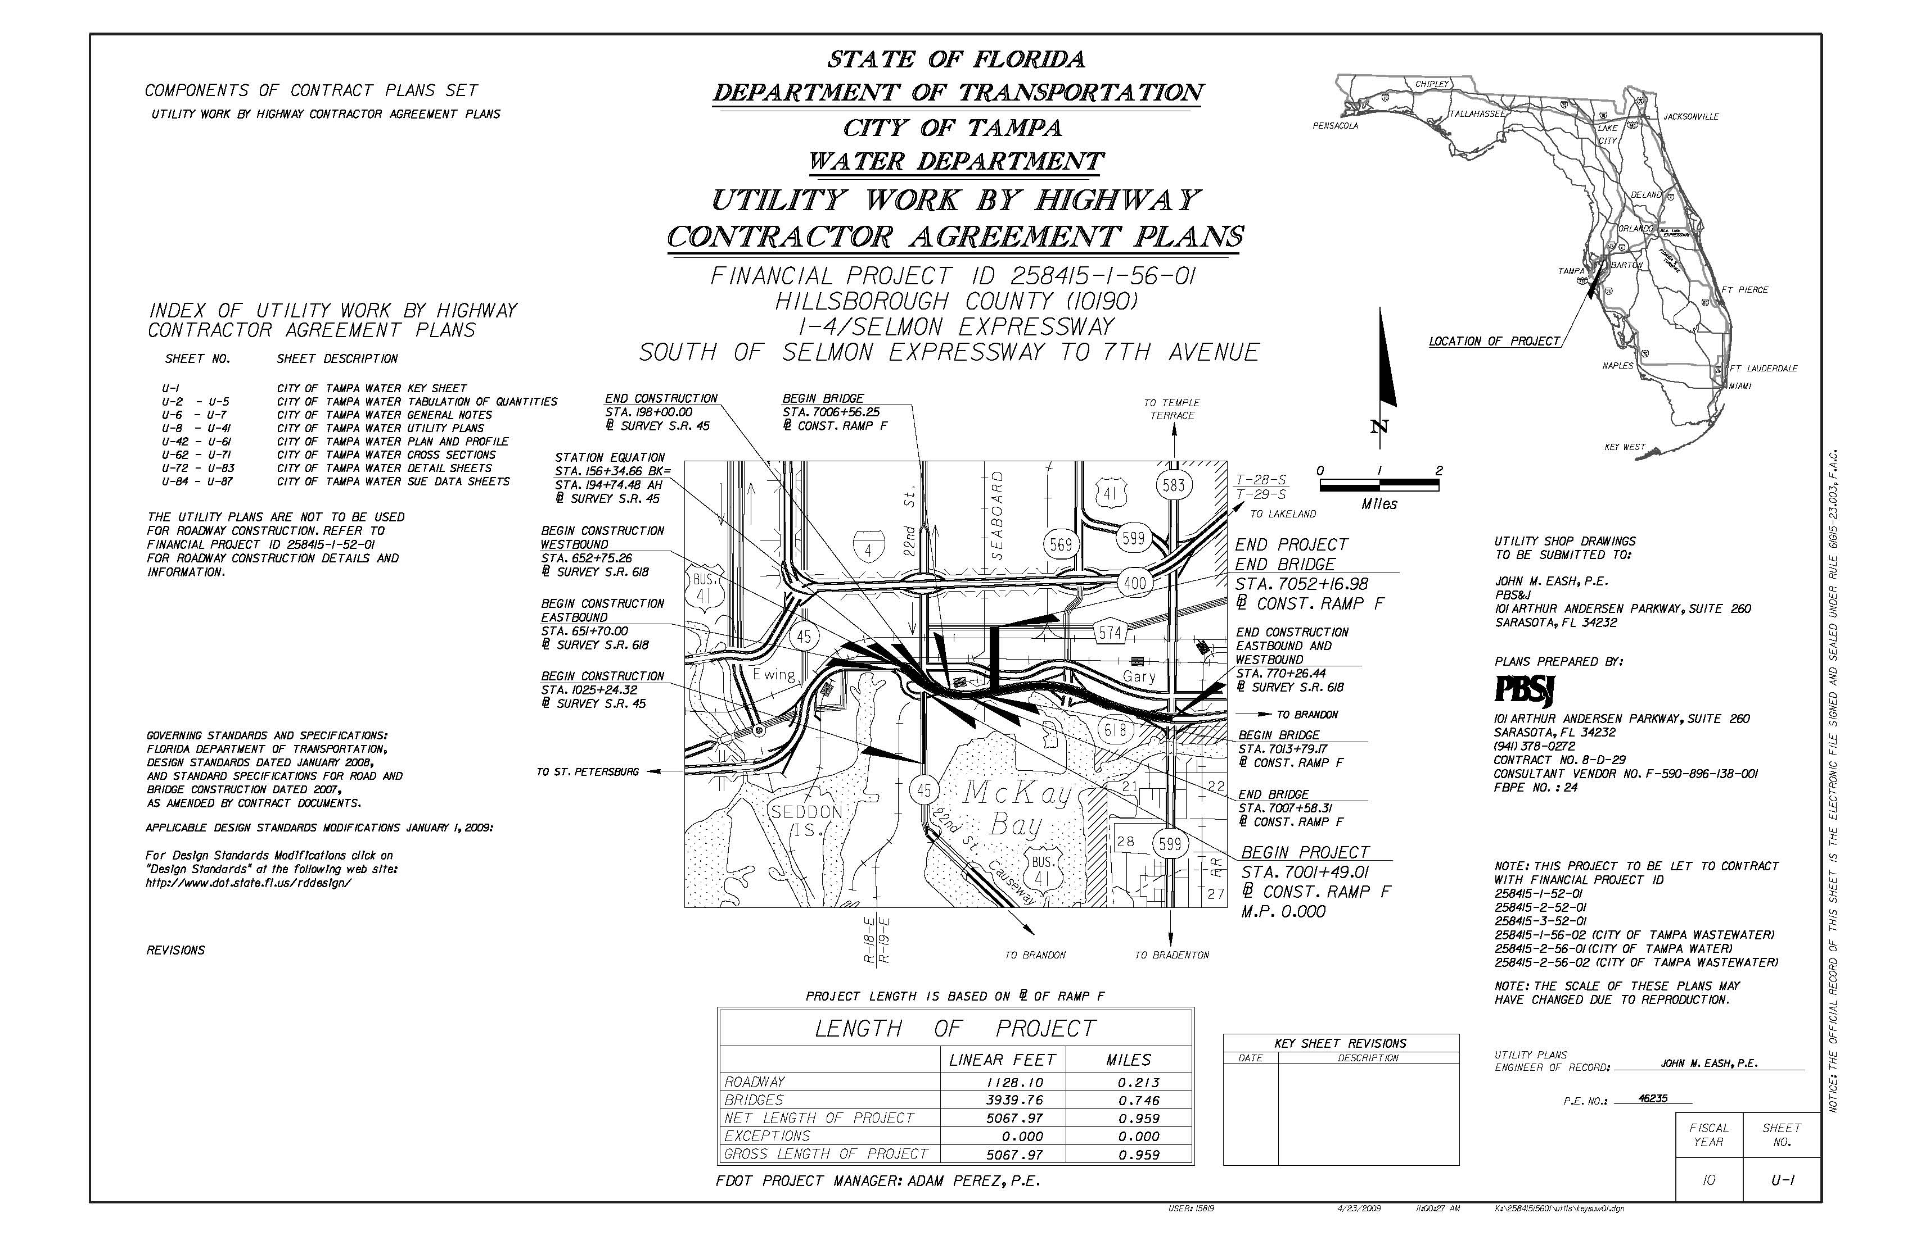
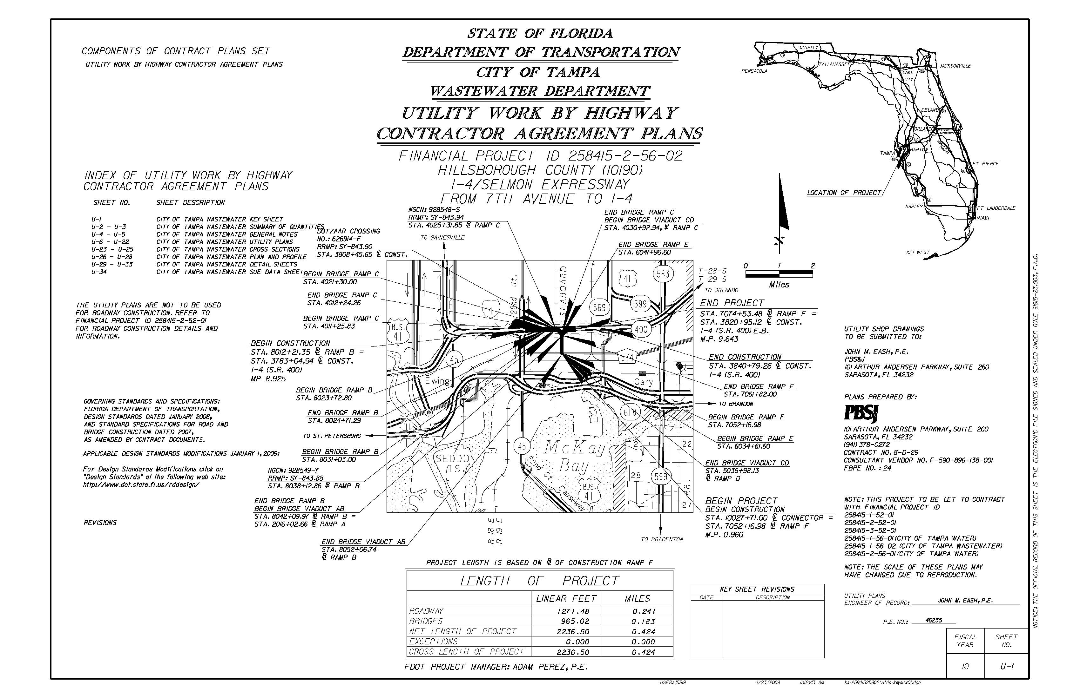
Project Description
Utilities
Utility Work by Highway Contractor Agreements (UWHCA)
City of Tampa Water
Size: 2” to 24”
Lengths: 8’ to 747’
City of Tampa Wastewater
Size: 4” to 36”
Lengths: 20’ to 390’
Notes:
31

Slide 32
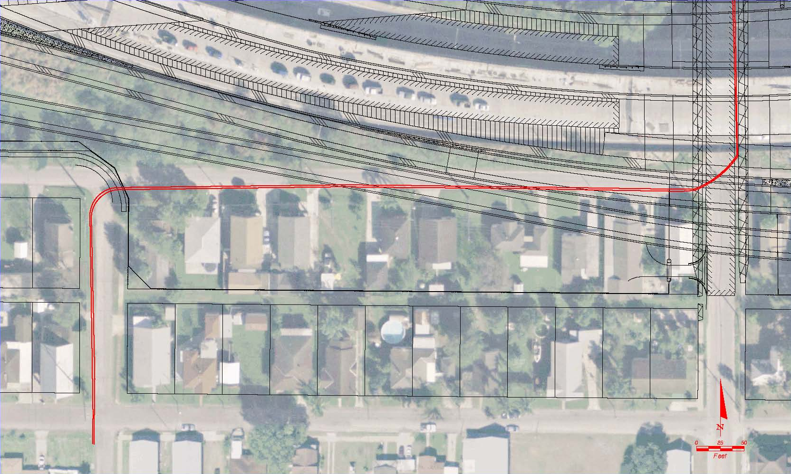
Project Description
Utilities
Utility Awareness – TECO Transmission
Two buried oil encased 69 kilovolt transmission lines in the Long Street right-of-way from 24th Street to 26th Street, and along 26th Street from Long Street north to the CSXT railroad crossing. These lines are to remain in place and are to be protected.
Long Street
26th Street
24th Street
Durham Street
Notes:
32

Slide 33
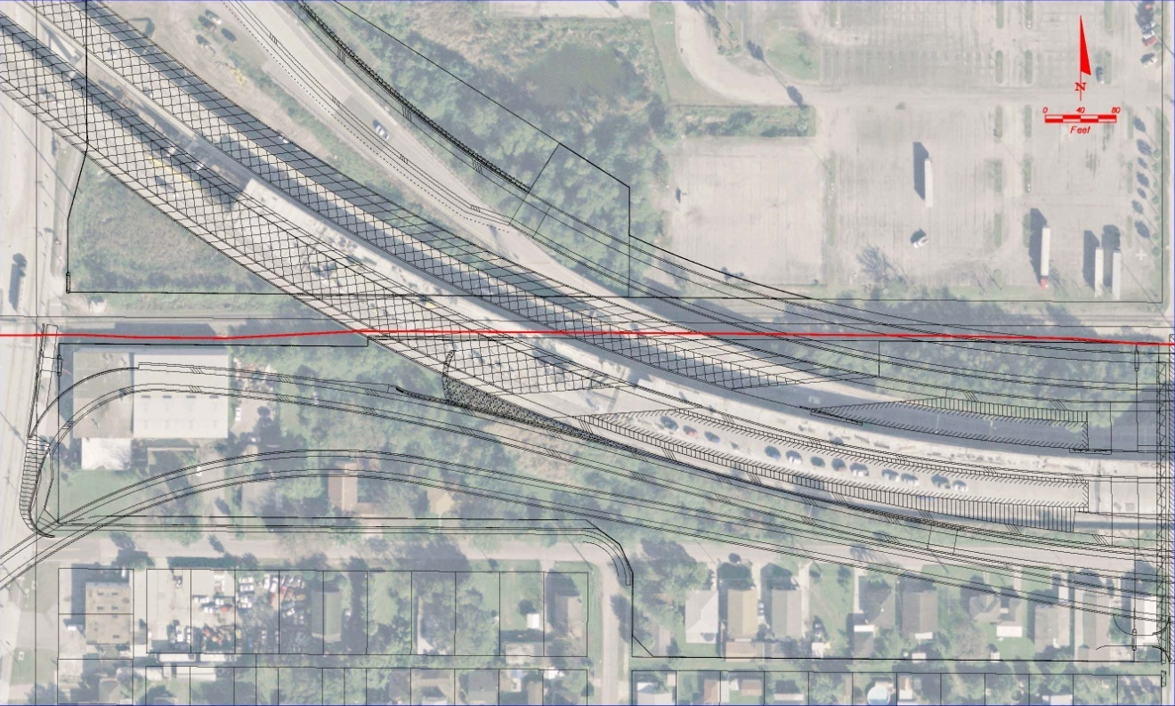
Project Description
Utilities
Utility Awareness – Central Florida Pipeline
The contractor cannot work within 10 feet of the Central Florida 10" pipeline without a Kinder Morgan representative on site. The contractor cannot dig with any mechanical equipment within 2 feet of the pipeline. The contractor must hand dig within 2 feet of the pipeline.
22nd Street
Long Street
24th Street
Notes:
33

Slide 34
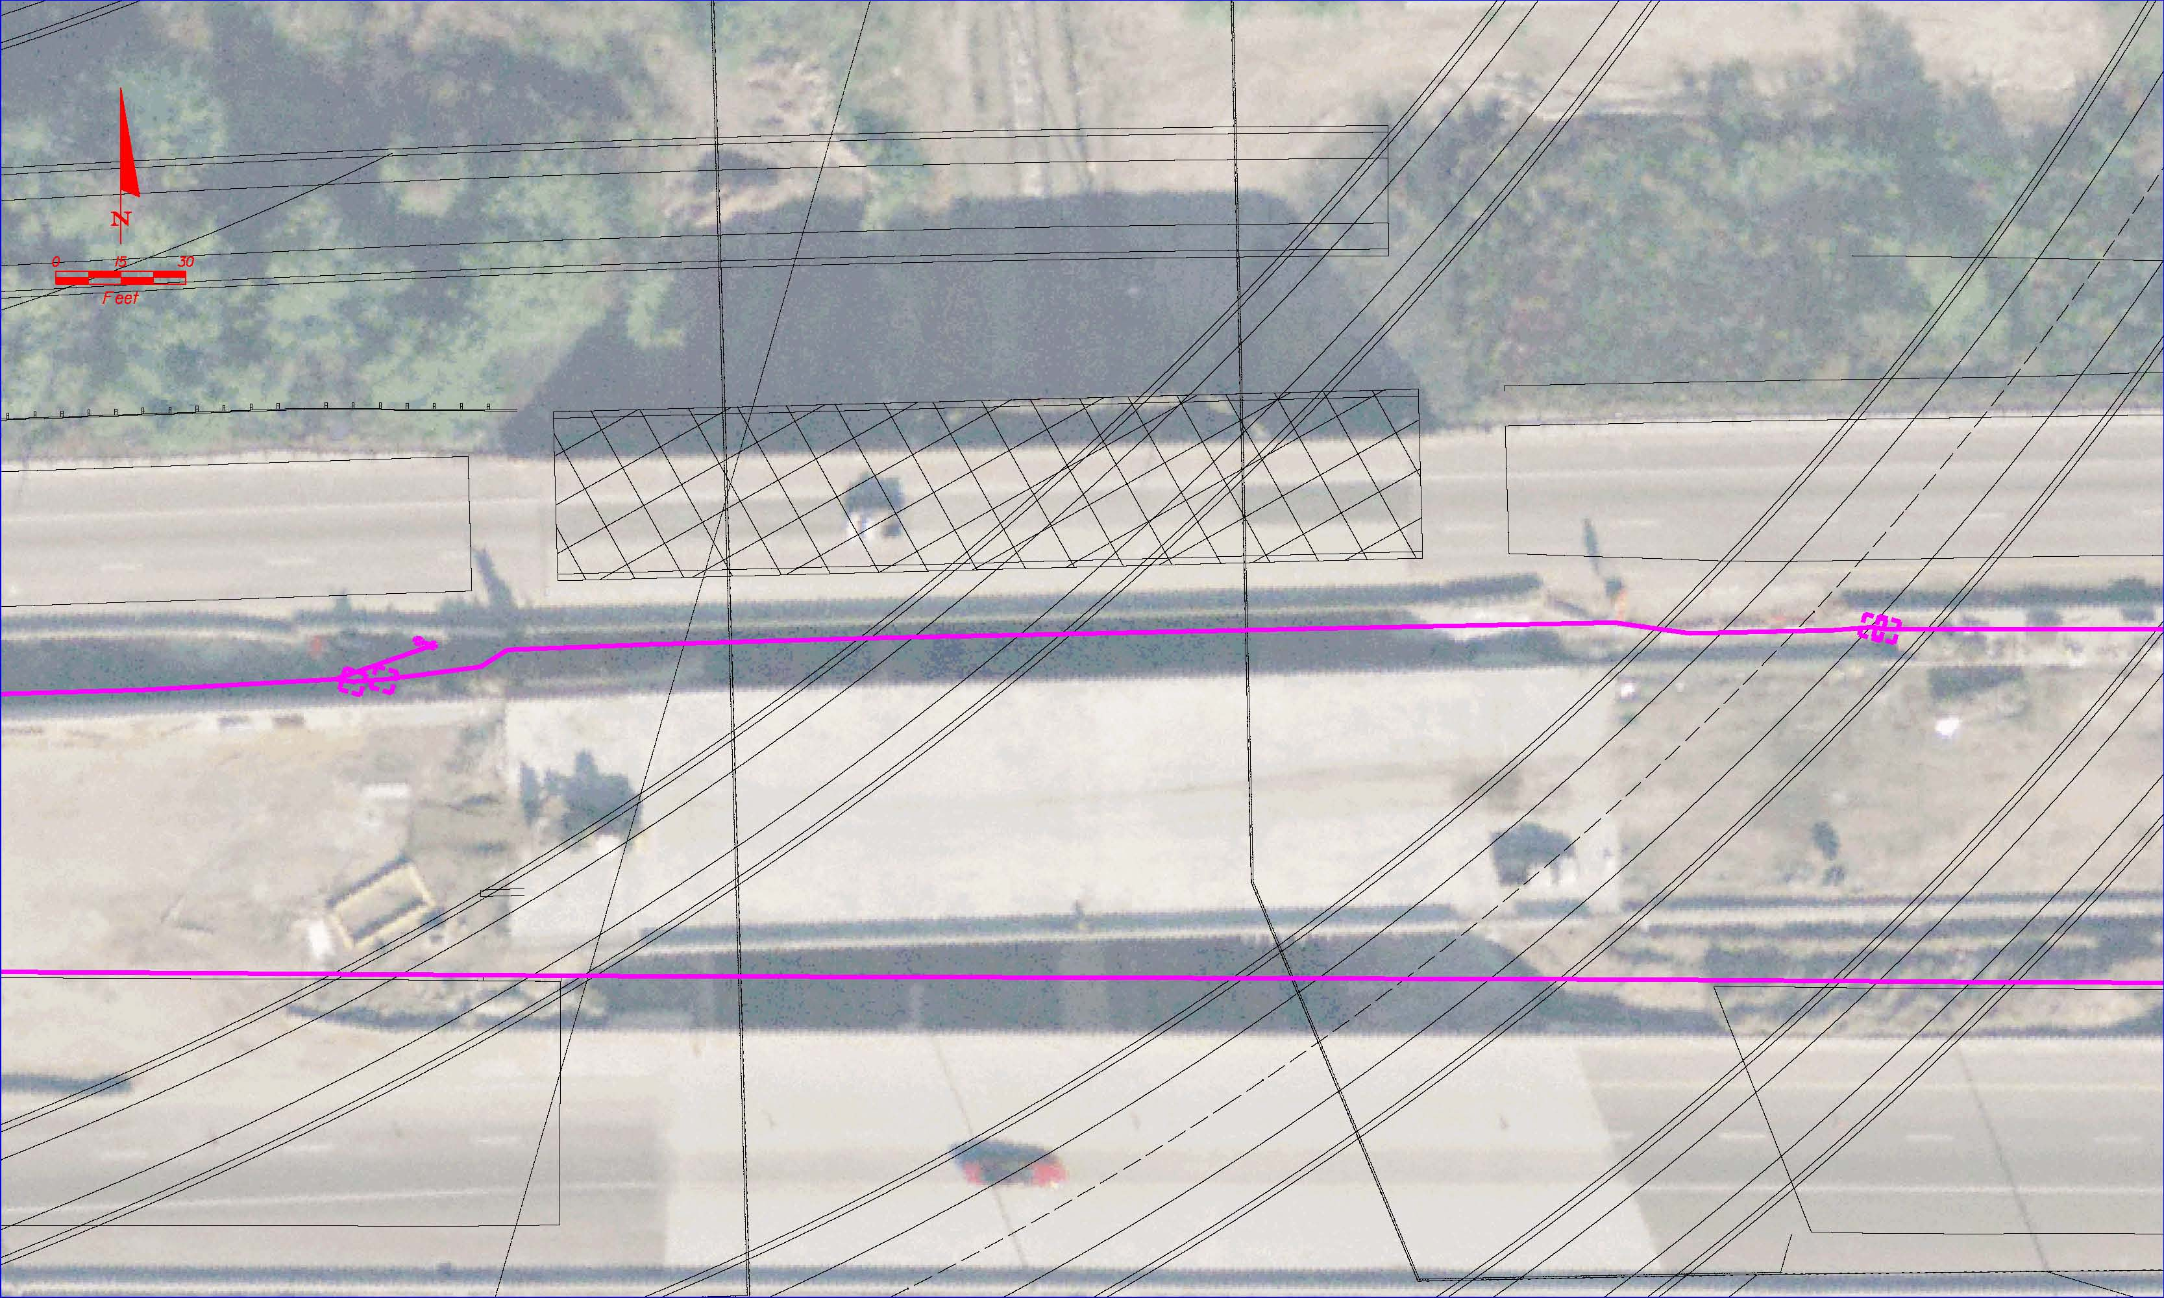
Project Description
Utilities
Utility Awareness – THEA ITS
CSX
Lee Roy Selmon Expressway
Notes:
34

Slide 35
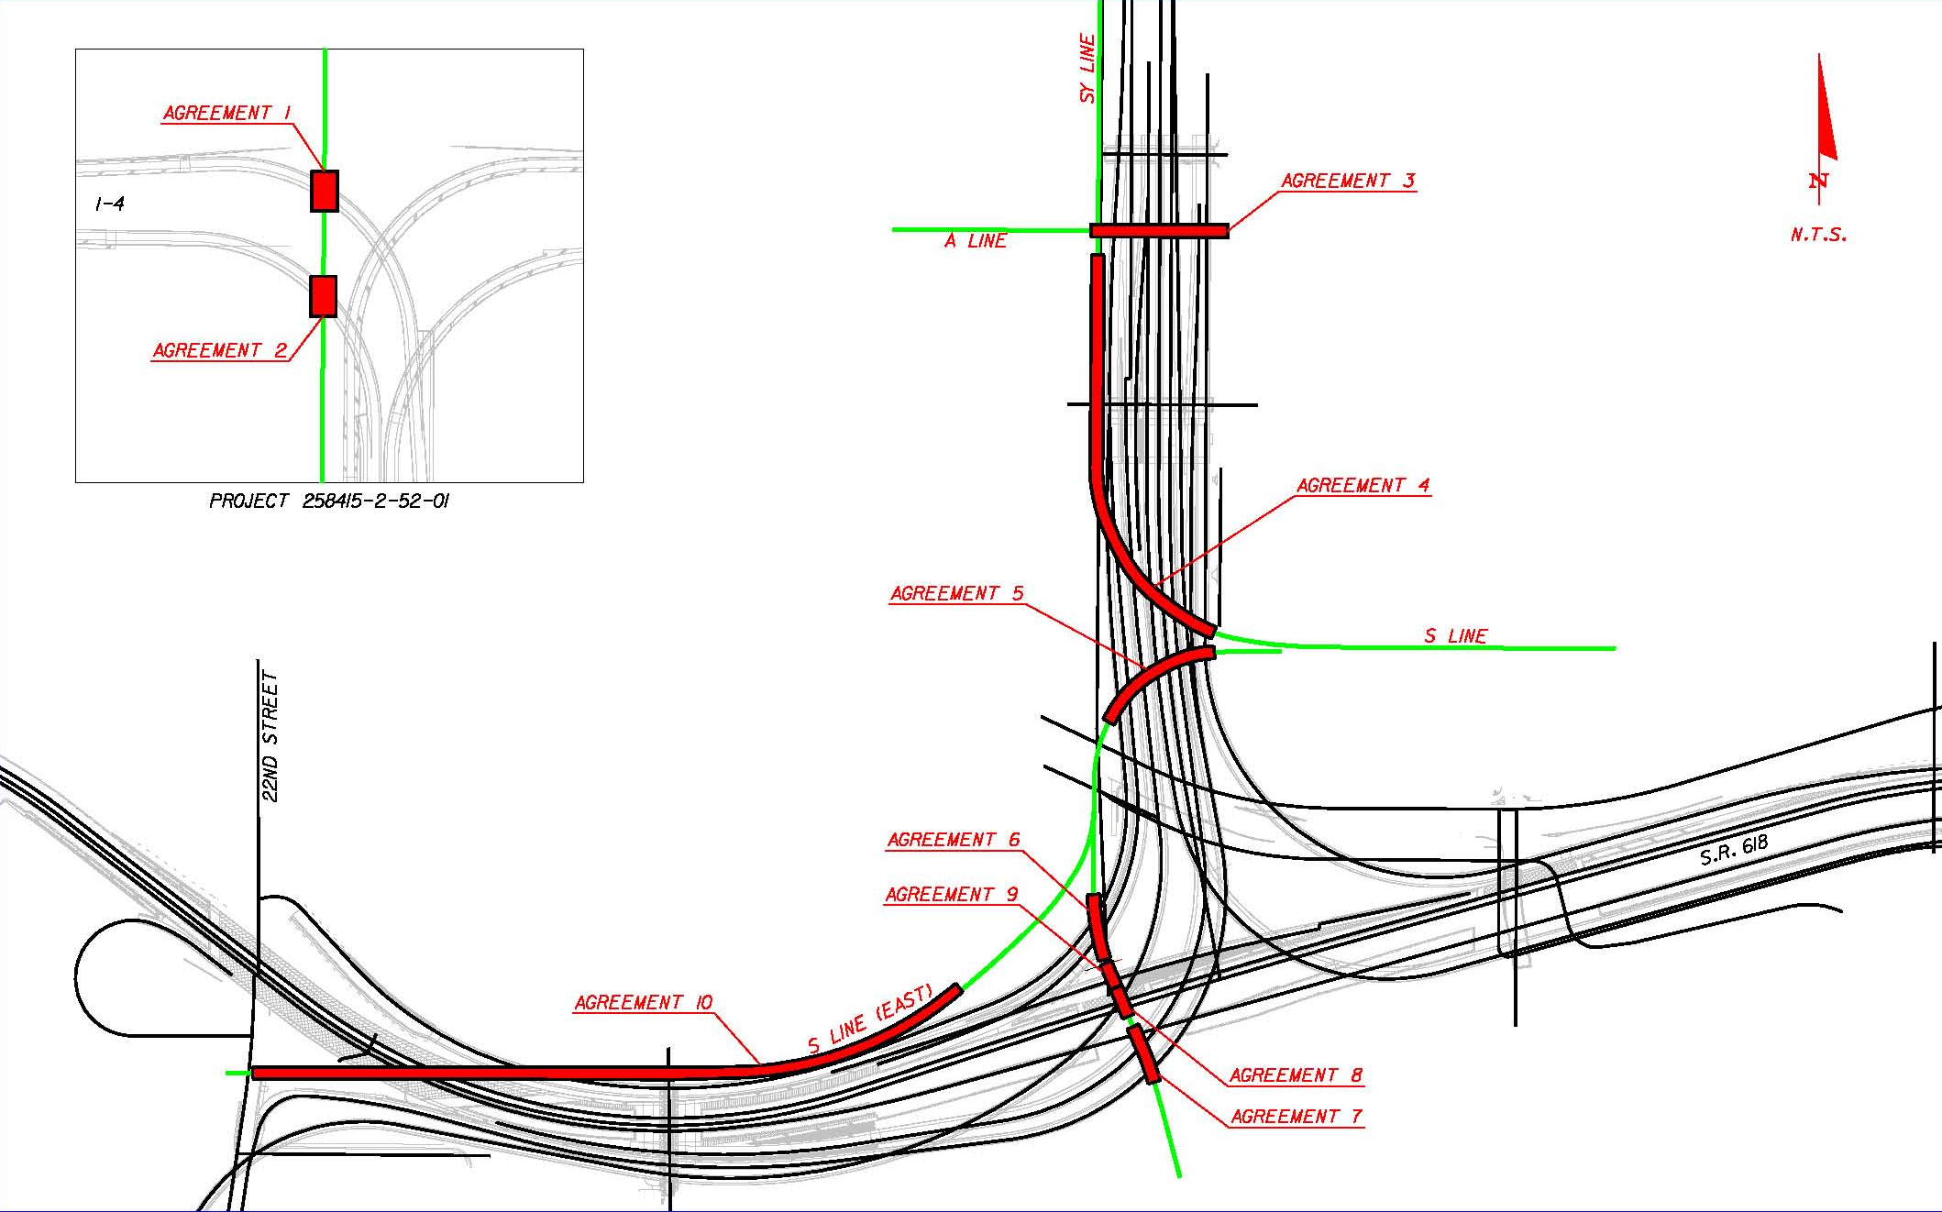
Project Description
CSX Railroad Coordination
Notes:
35

Slide 36
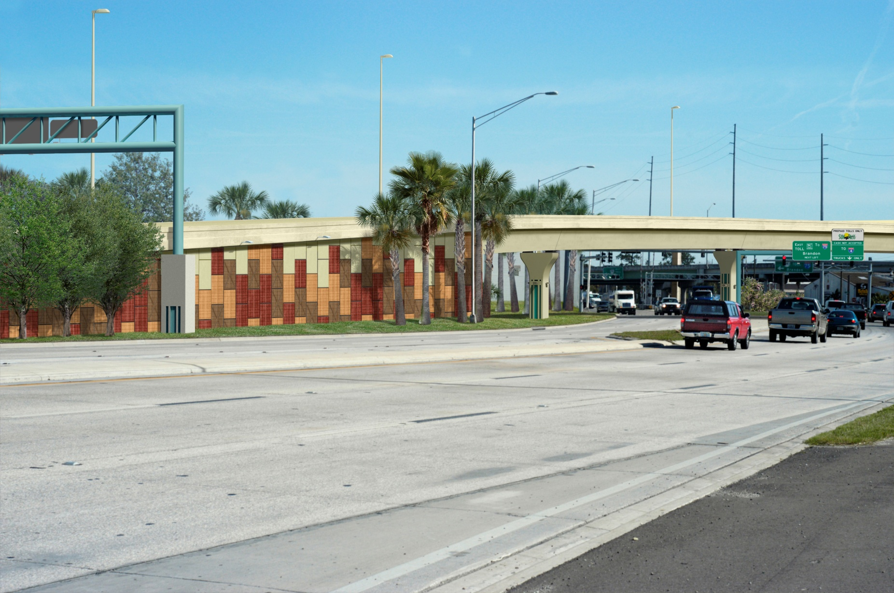
Project Description
Aesthetics

Slide 37
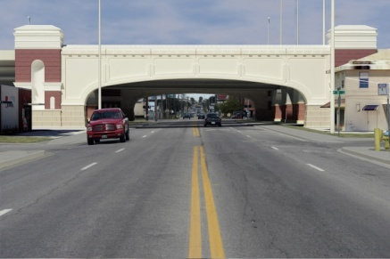
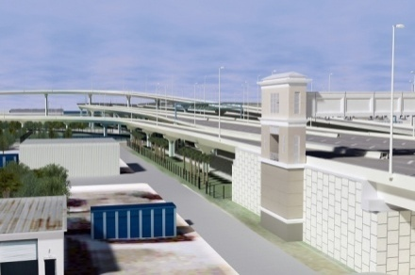
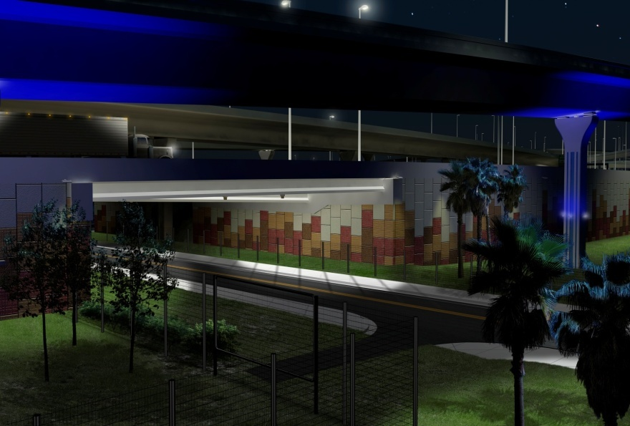
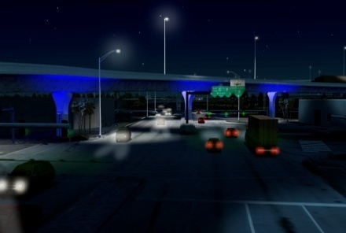
Project Description
Aesthetics
7th Avenue Gateway
Toll Gantry
26th Street
22nd Street

Slide 38
Project Description
Traffic Control Phasing

Slide 39
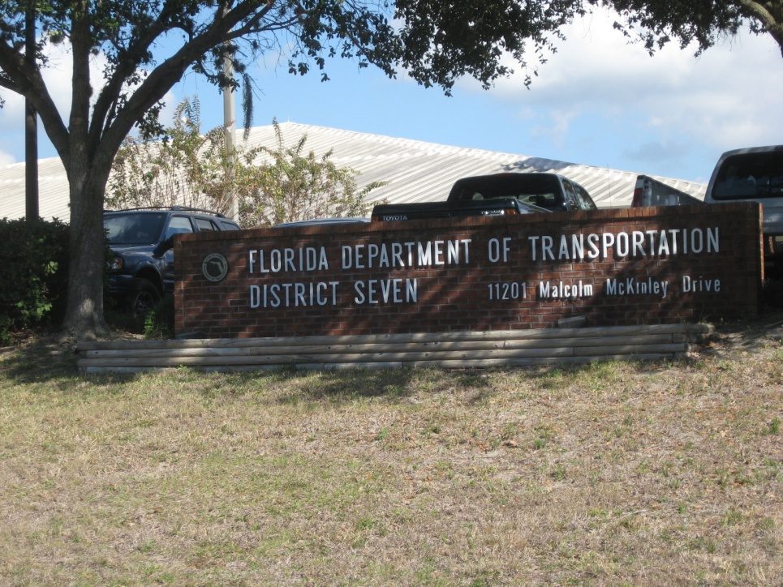
Pre-Bid Meeting Announcement
Mandatory Pre-Bid Meeting
Date: June 15, 2009
Time: 9:00 am
Location: Florida Department of Transportation
District Seven Headquarter
11201 North McKinley Drive
Tampa, Florida 33612

Slide 40
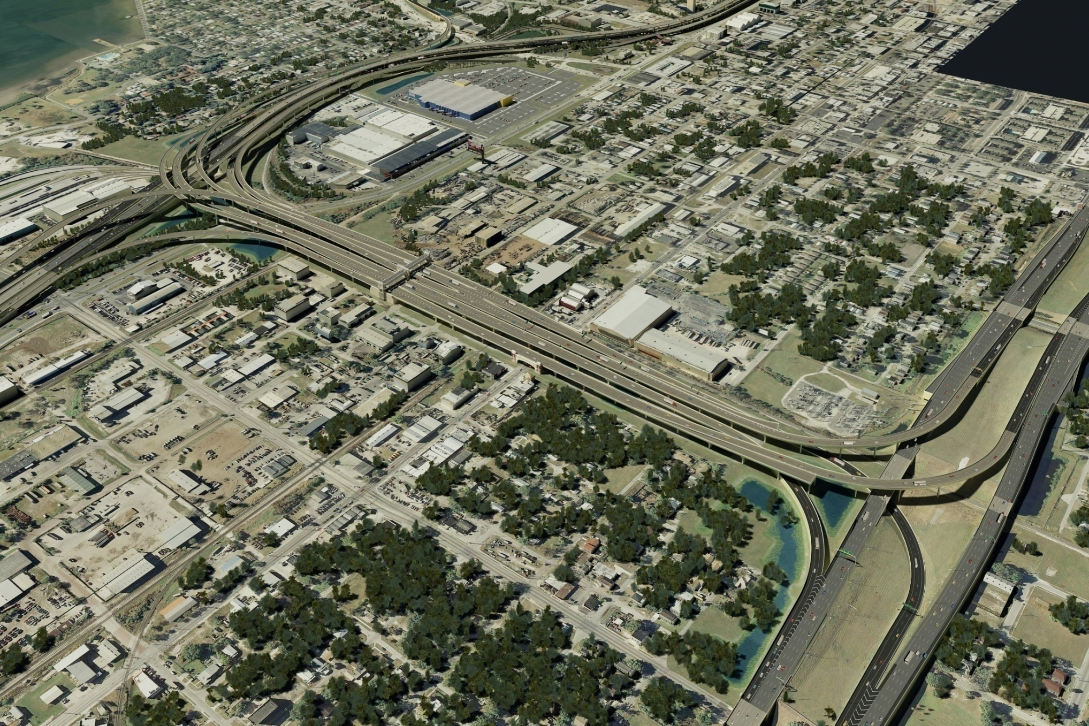
Questions & Answers
I-4/Lee Roy Selmon Expressway Interchange
Visit www.myTBI.com

Slide 41
Traffic Control Phasing
I-4/Lee Roy Selmon Expressway Interchange

