Slide 1
FDOTSS4 Update

Slide 2
Topics Covered
Installation & Configuration Details
FDOT Workspace Changes

Slide 3
System Requirements
Microsoft Windows 7
32 bit or 64 bit Operating Systems
Microsoft .NET Framework 3.5
Microsoft Office 2013 (can be configured for Office 2003, 2007 or 2010)
PowerGEOPAK 08.11.09.845
-or-
MicroStation 08.11.09.714
GEOPAK Suite 08.11.09.845
NOTE: The system requirements are based on the FDOT standard software for CADD workstations. Older versions of Office can be used.

Slide 4
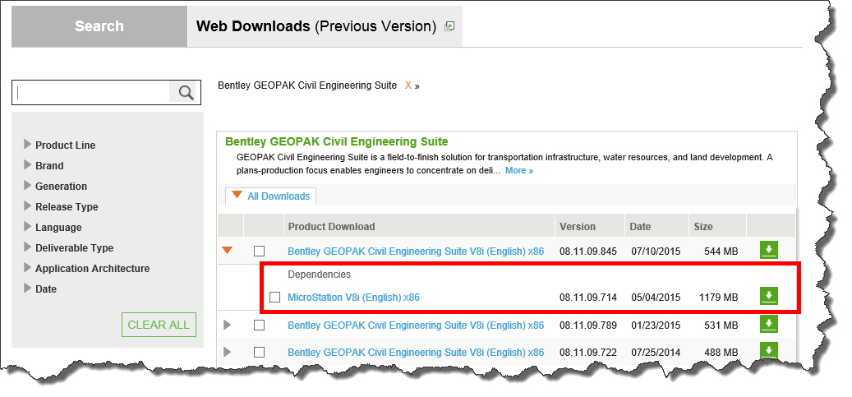
MicroStation 08.11.09.714
The best way access and download MicroStation from Bentley's SELECTServices site is to Search for the 08.11.09.845 version of the BENTLEY GEOPAK Civil Engineering Suite and download it with its dependent version of MicroStation as Shown below.

Slide 5
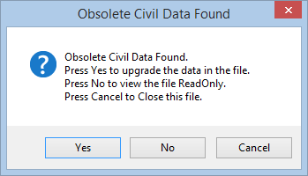
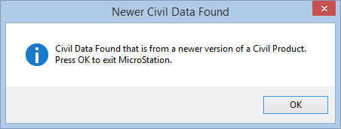
Differences between SS3 and SS4
Many bug fixes. FDOT testers and other agencies report it being more stable.
The primary change to GEOPAK in SS4 is an updated Civil Model format. The Civil Model was updated to provide a direct data exchange with Trimble via I-Models.
Once upgraded to SS4, a file cannot be opened again in SS3.
SS4 files can be opened in SS2 but the Civil intelligence is lost.
Only files containing “Civil Data” created using the OpenRoads technology require the upgrade

Slide 6
SS4 Replaces SS3
The SS4 version of GEOAK cannot be installed on the same computer with SS3 GEOPAK.
SS2 and SS4 can be installed on the same computer.
Here are the steps to get SS2 and SS4 set up:
Uninstall all GEOPAK, MicroStation and FDOT software.
Install MicroStation version 08.11.09.714
Install GEOPAK version 08.11.07.615
Install GEOPAK version 08.11.09.845
Install FDOTSS2
Install FDOTSS4.
NOTE: FDOTSS2 will no longer be maintained.
This means that any changes to design criteria (Design Standards, Plans Preparations Manual, Basis of Estimates, …) after July 2015 will only be available in FDOTSS4.

Slide 7
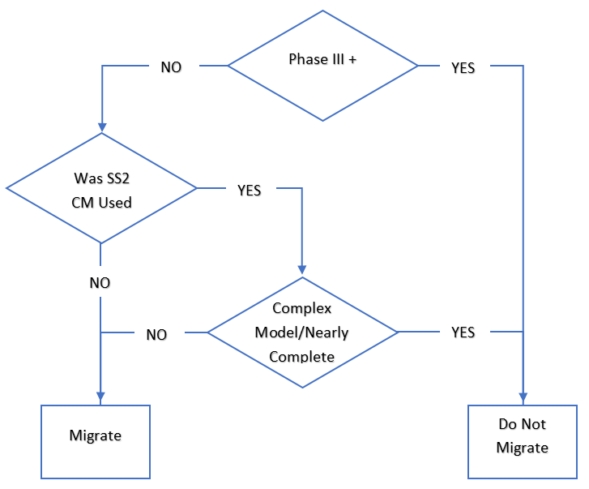
Software Upgrade Consideration
Evaluate each project individually
There are two primary considerations
Phase of Project
Was SS2 Corridor Modeling applied
Any project in early phases should brought forward.

Slide 8
GEOPAK “Product Add-Ins”
There are now several additional products distributed by Bentley with PowerGEOPAK and the GEOPAK Suite. These products can be activated using the “Tools > Product Add-Ins” menu.

Slide 9
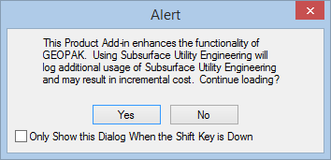
GEOPAK “Product Add-Ins”
Although distributed with GEOPAK these “Product Add-Ins” are not covered as part of PowerGEOPAK and GEOPAK Suite license agreements.
It is strongly recommended that you contact your Bentley account representative to get detailed information on how these additional “Product Add-Ins” are licensed, and to review your account coverage.
If activated, these “Product Add-Ins” will alert the user that activating the selected “Product Add-In” will log additional license usage and may result in additional cost.

Slide 10
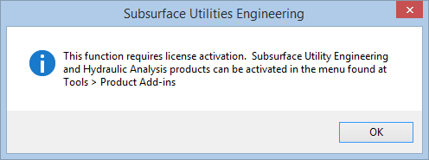
Subsurface Utility Engineering (SUE)
The Subsurface Utility Engineering module has three main functions:
Model Utilities
Clash Detection (Requires Product Add-In)
Enhanced Utility Attribution (Requires Product Add-In)
The modeling of utilities is provided for in PowerGEOPAK and the GEOPAK Suite licensing. However, the use of tools related to clash detection, or enhanced attribution of utilities will require the SUE Product Add-In” to be activated.
If a user tries to utilize the enhanced features a message directing them to the “Tools > Product Add-Ins” menu will appear.

Slide 11
Disable “Product Add-Ins”
If CADD managers would like to exercise more control over the activation of “Product Add-Ins” to reduce the chance of unexpected costs, some minor customization can be done.
A customized DGNLIB is provided with the FDOTSS4 workspace which gives CADD managers the ability to disable each of the “Product Add-Ins” using configuration variables.
CONFIG VARIABLES
FDOT_DISABLE_DESCARTES=TRUE
FDOT_DISABLE_SUE=TRUE
FDOT_DISABLE_STORMCADUNLIMITED=TRUE
FDOT_DISABLE_CIVILSTORM=TRUE
FDOT_DISABLE_SEWERCAD=TRUE
FDOT_DISABLE_SEWERGEMS=TRUE
Copy the CivilCommands.dgnlib from the \FDOTSS4 \RESOURCES\Dgnlibs\General folder on the server to the C:\Program Files (x86)\Common Files\Bentley Shared\Civil Platform\08.11.09 folder on each client PC.
Add these variables to a file named CustomVars.txt file in the \FDOTSS4\Workspace\Users folder on the server.

Slide 12
New\Updated Features in FDOTSS4
User Interface Changes
Function Keys
Context Menus
LDM and Sheet Navigator Enhancements
Level Filter Controls
Level Changes
Temporary Traffic Control Changes

Slide 13
Function Keys
F8: Toggles off MS AccuDraw and toggles on Civil AccuDraw.
F9: Prepares the file for a 3D deliverable by turning off the solids in the 3D view, leaving on the surface elements.
F10: Turns the solids back on after they have been turned off by F9.
F11: Opens Project Explorer.
F12: Opens the Template Library.
Alt+F3: Exaggerate Z
F1: Help
Ctrl+F1: Opens 1 View (moved)
F2: Opens the 2D and 3D views (Doesn’t fits views)
F3: Opens 3 Views
F4: Opens 4 views
F5: Dims References
F6: Exists out of any command and activates Element Selector.
F7: Toggles on/off Construction elements.

Slide 14
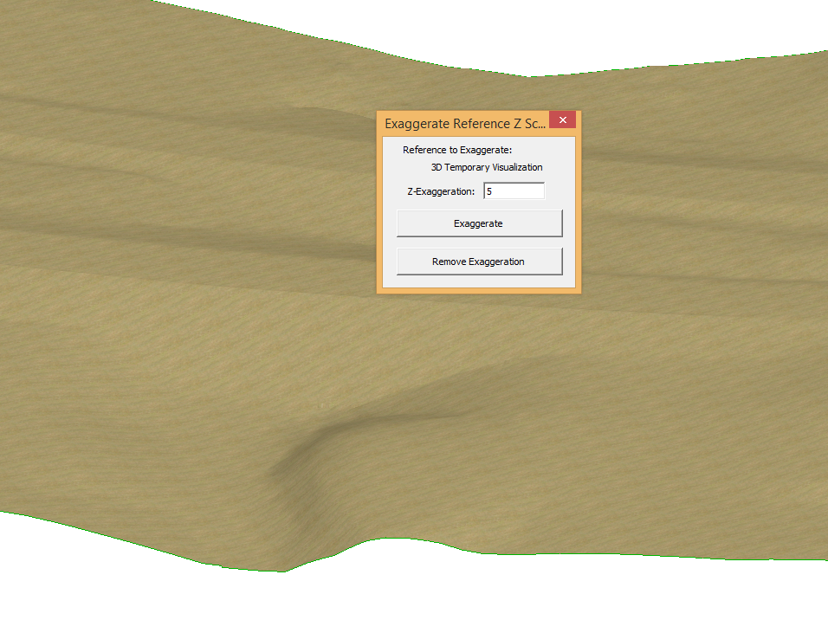
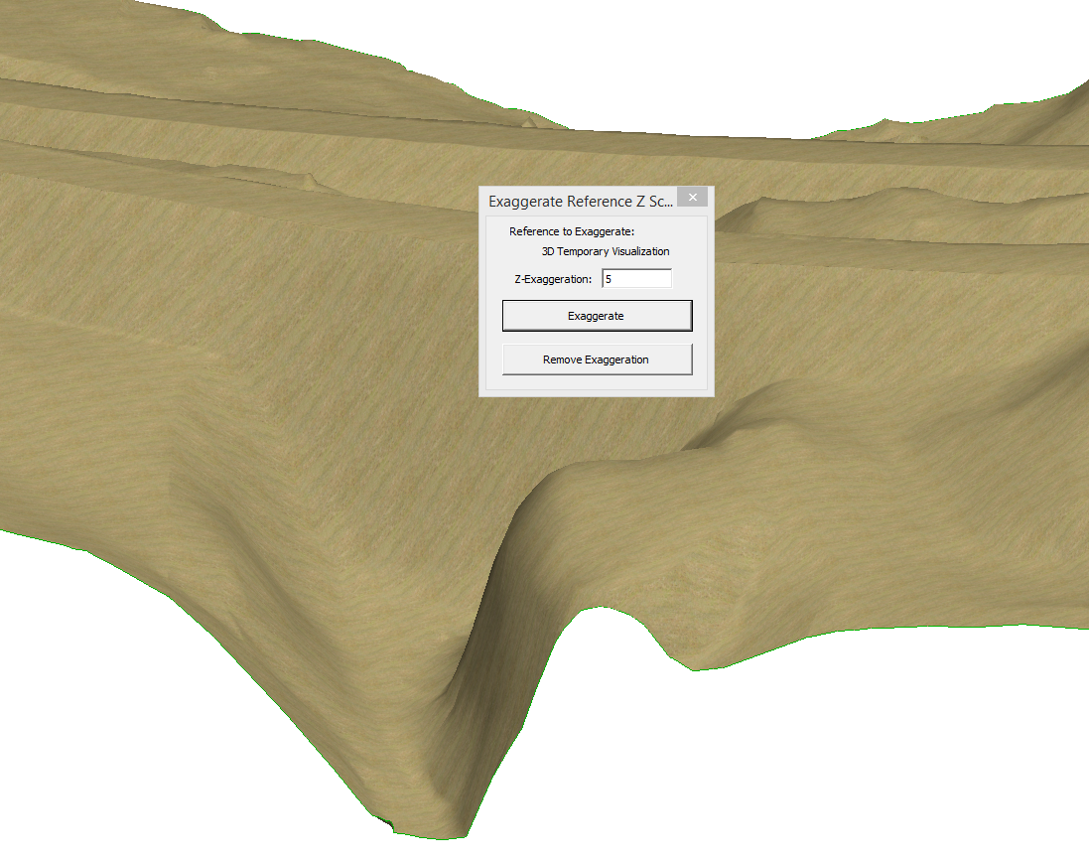
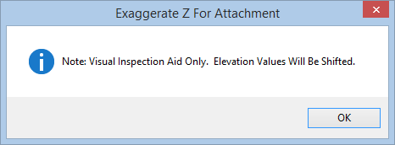
Exaggerate Z
Exaggerate Z is a new tool that allows you to apply a vertical exaggeration to a 3D file.
It is for viewing purposes only and should only be run from the actual terrain model file.
Creates a temporary visualization DGN model.
When the application is dismissed, the temporary DGN model will be removed.

Slide 15
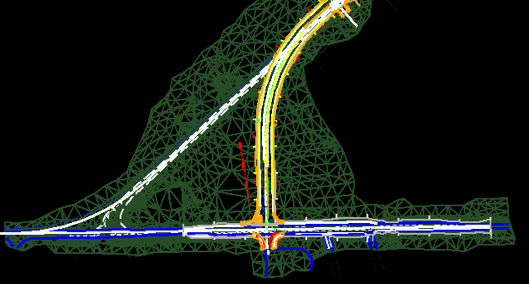
Dim References
Dim References is a toggle that softens all of the reference files and sets the active file to draw last so the elements in the active file stand out more.
Press F5 to toggle on and off

Slide 16
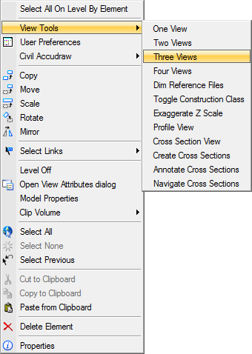
Context Menus
There are additional options that are available from the right-click. The files listed below have right-click options.
View Tools - DSGNRD, GDTMRD, GKLNRD, RDXSRD
All Key sheet files for all disciplines - KEYSXX
All Sheet Border Files – BDXXXX
Typical Sections - TYPSRD
Summary of Quantities - SUMQRD
Summary of Drainage - SUMDRD
Clip Border file - CLIPRD
Quantity Area files - QTDSRD

Slide 17
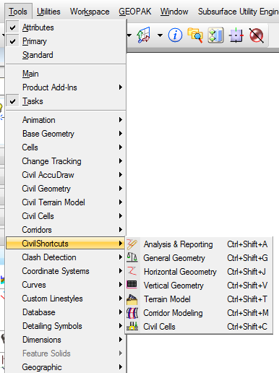
Key Shortcuts
Ctrl + Shift + A: Opens the Analysis & Reporting tools.
Ctrl + Shift + G: Opens the General Geometry tools.
Ctrl + Shift + J: Opens the Horizontal Geometry tools.
Ctrl + Shift + V: Opens the Vertical Geometry tools.
Ctrl + Shift + T: Opens the Terrain Model tools.
Ctrl + Shift + M: Opens the Corridor Modeling tools.
Ctrl + Shift + C: Opens the Civil Cell tools.

Slide 18
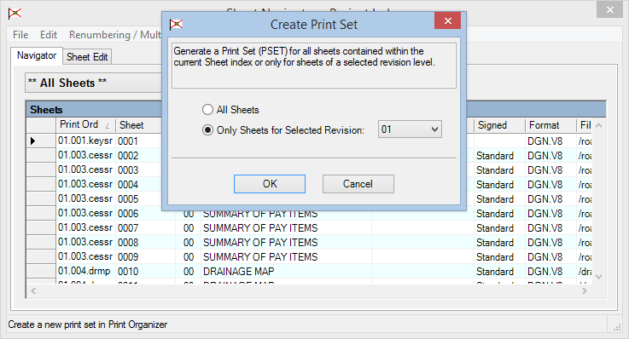
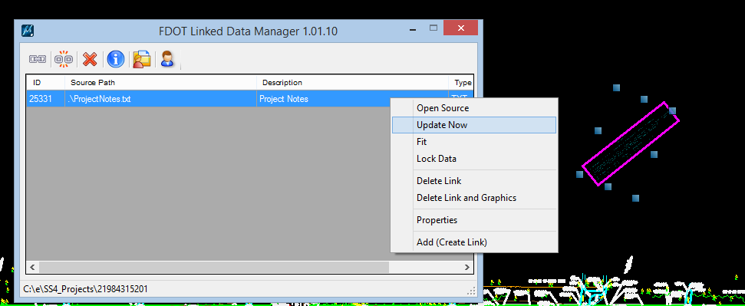
LDM and Sheet Navigator Enhancements
Sheet Navigator can now make Revision PSETs.
LDM now remembers if linked data is scaled or rotated and redraws the same way when updated.

Slide 19
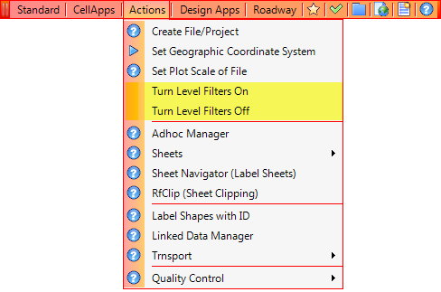
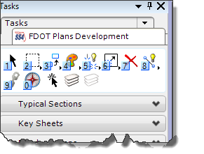
Level Filter Controls
New functionality has been added to allow you to better control when Level Filters are applied.
Actions Menu
Plans Development Workflow

Slide 20
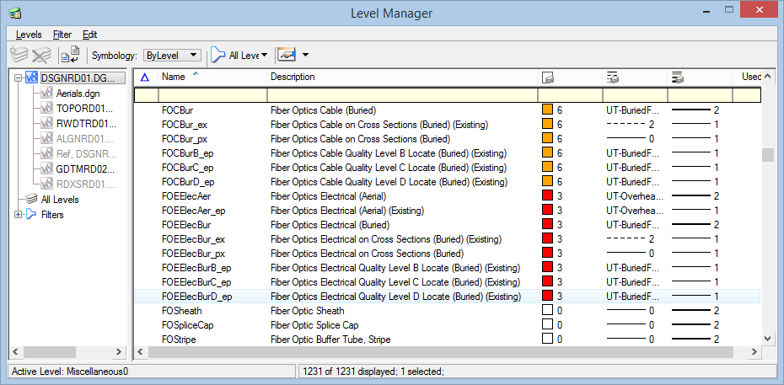
Level Changes
An effort was made to address consistency issues in the naming and descriptions of utility related levels.
Many of the existing utility levels have changed.
The underground utility levels will now only include B, C, & D quality line styles.
Fiber Optic levels and linestyles were added

Slide 21
Temporary Traffic Control Updates
In an effort to address concerns from Construction several changes relating to Temporary Traffic Control items were made.
Proprietary channelizing devices should not be shown in plan view.
Levels
Deleted some plan view levels
Added new levels for typical view
Misc. changes to address consistency and minor fixes
Custom Linestyles
Deleted all except Pedestrian Longitudinal Channelizing Device (LCD)
Cells
Broken into two cell libraries (Plan and Typical)
Removed lights, flags and proprietary channelizing devices.

Slide 22
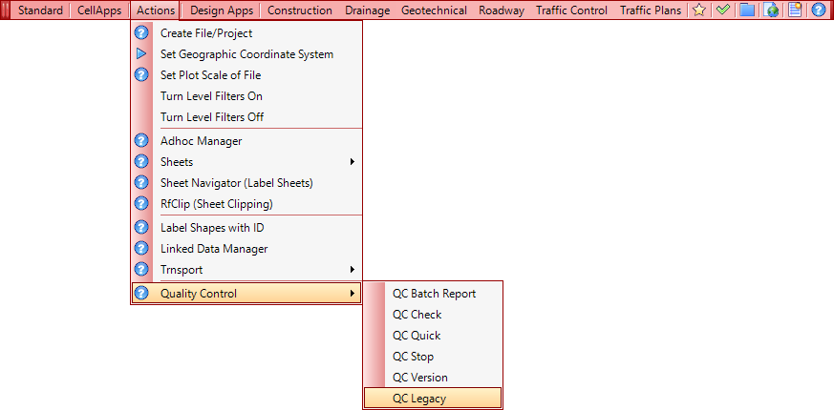
QC Legacy
QC Legacy is a new application that allows you to move elements on old levels to new valid levels.

Slide 23
Contact Information
Jimmie Prow CADD Support Coordinator Phone no: (850) 414-4863 Toll Free no: (866) 374-3368 extension 4863
email ecso.support@dot.state.fl.us
jimmie.prow@dot.state.fl.us
web: http://www.dot.state.fl.us/ecso

