Slide 1
Accessing the FDOT Aerial Photography Collection Using APLUS
Stuart Korte
FDOT Surveying & Mapping Office

Slide 2
Where can I get Aerials? Sources of Aerial Photography
State Agencies
FDOT Surveying & Mapping - Aerial Photo Archive Collection
Statewide Orthophoto Program FDOR – FDOT - FDEP – WMD
Universities (such as UF Smathers Library - ASCS)
Map Services or application basemaps
Federal
USGS Earth Explorer – Aerials, Satellite, Landsat and more
USDA Farm Services Agency - NAIP, NAPP, FSA
Vendors
Google / Bing Maps
Commercial Providers

Slide 3
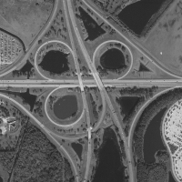
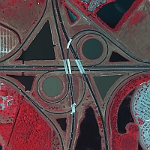
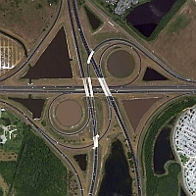
FDOT Aerial Photo Archive Collection
By Film or Sensor Type
Black & White
Color Infrared
Color
Notes:
Bulk is B/W Film
Routine Color started with digital cameras – 2003-2004
CIR for some dataset.

Slide 4
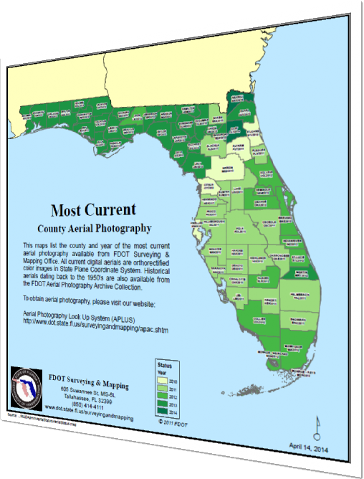
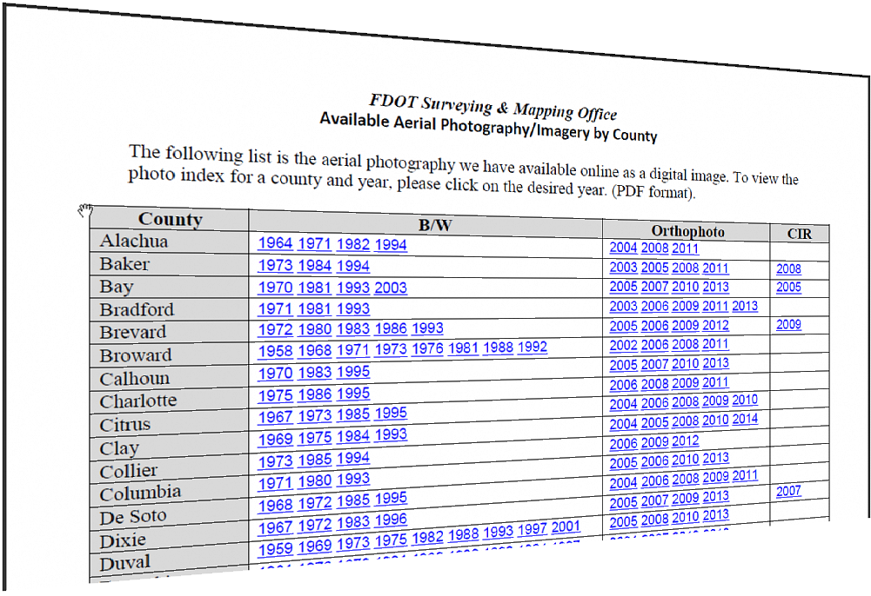
FDOT Aerial Photo Archive Collection
Notes:
Two documents that list the Where and When
Photo Index List
Most Current Aerials
Visit the Get_Aerials page of our site.

Slide 5
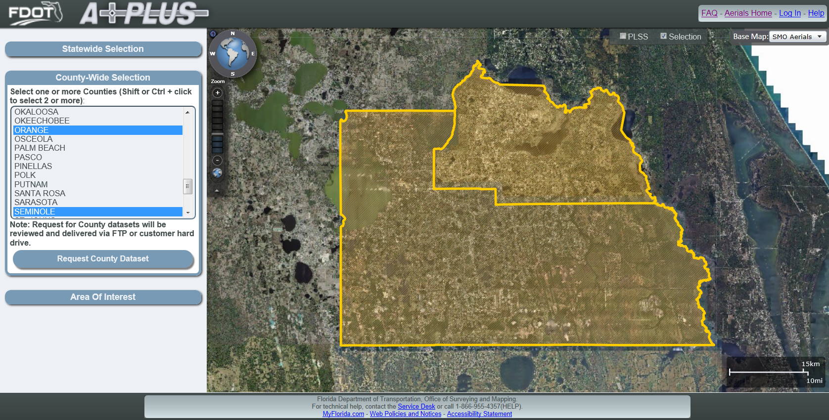
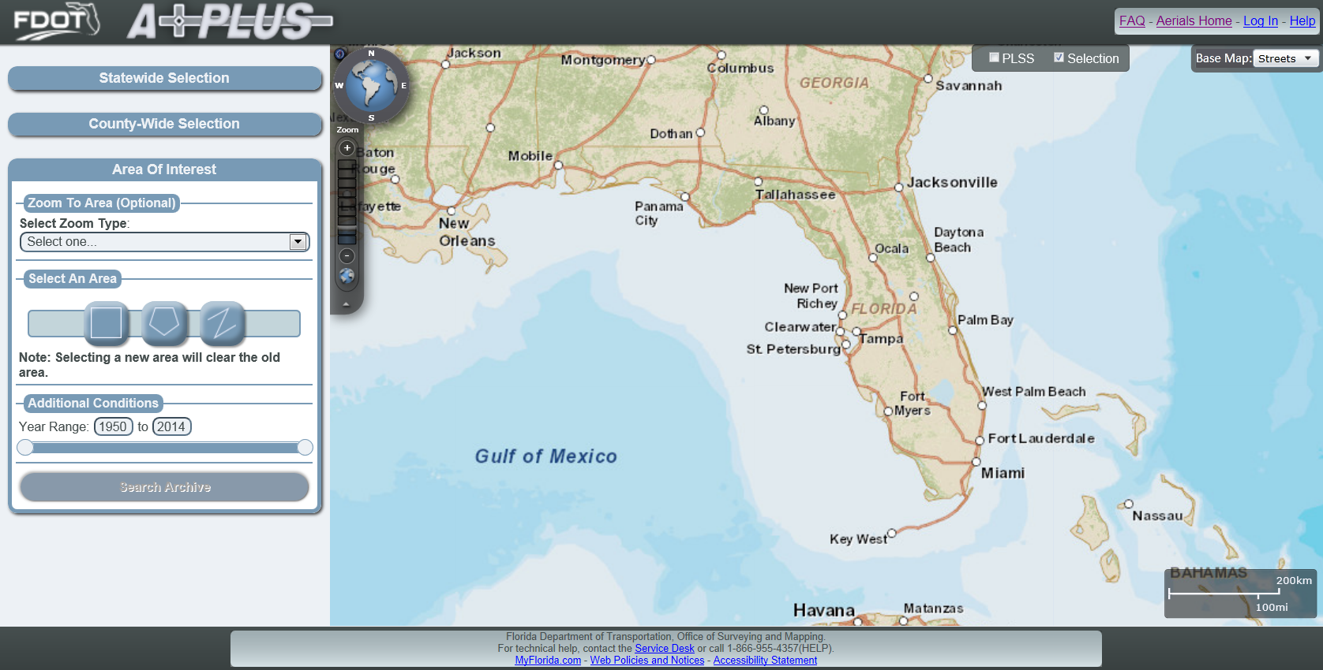
New APLUS

Slide 6
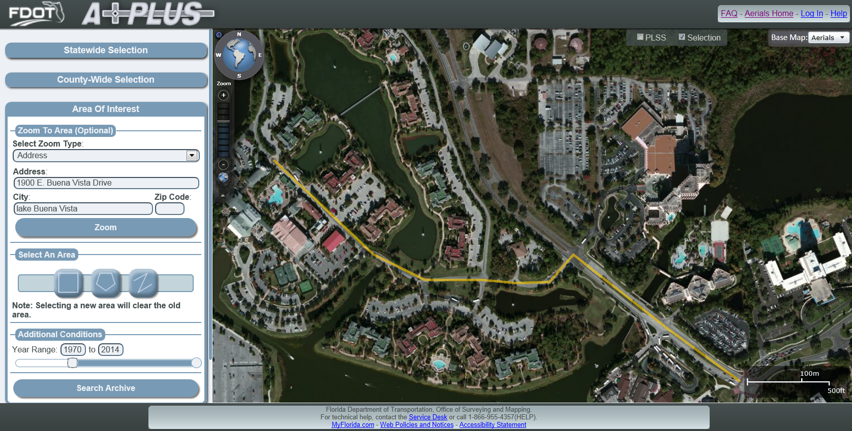
Selections

Slide 7
Preview & Metadata

Slide 8
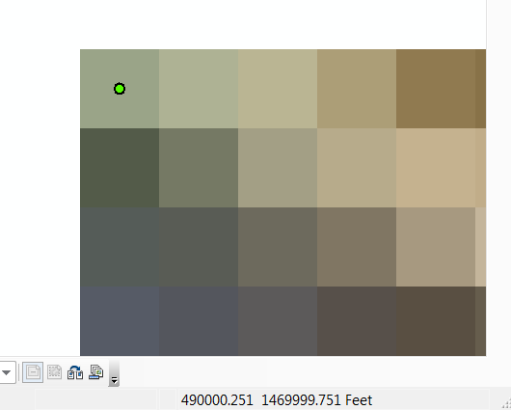
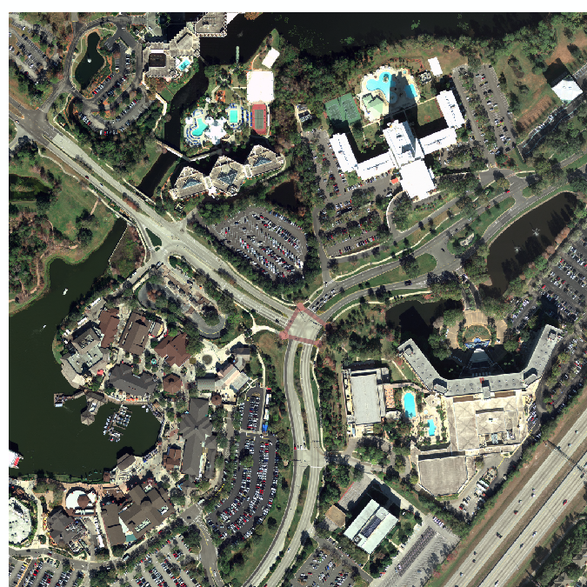
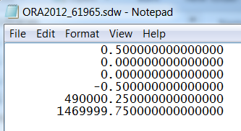
Spatial Reference World Files
World file
Filename – sdw, jpw, tfw
Ambiguous coordinate system
Inside the world file
Pixel Size – x
Rotation
Rotation
Pixel Size – y
X coordinate (center, upper left)
Y coordinate (center, upper left)
Wikipedia/world_file

Slide 9
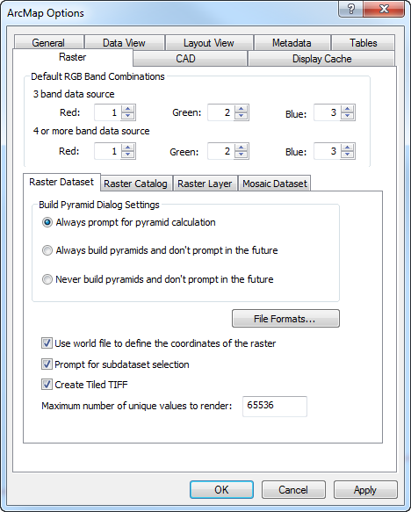
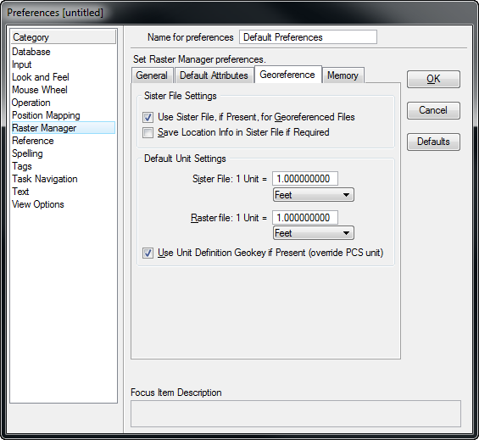
CAD & GIS
Notes:
Great news is that CAD is moving towards feature type elements. Tools and interoperability is getting better.

Slide 10
Useful Links & Information
Aerial Photo Archive Collection
http://www.dot.state.fl.us/surveyingandmapping/aerial_main.shtm
List of online aerial datasets by county
http://www.dot.state.fl.us/surveyingandmapping/documentsandpubs/aerial_years.pdf
Map of Most Current datasets by county
http://www.dot.state.fl.us/surveyingandmapping/documentsandpubs/Aerial_Status.pdf
Email address:
imageservices@dot.state.fl.us
Contact Information
Stuart Korte
Image Services Supervisor
Stuart.korte@dot.state.fl.us
(850) 414-4399
(850) 414-4111

