Slide 1
Bicycle and Pedestrian Partnership Council Meeting
May 31

Slide 2
Agenda
Welcome & Debrief
Florida Bicycle Association Awards
Complete Streets Overview
Transportation Choices Study Update
Roundtable
Notes:
CARMEN-
Overview of agenda for today’s meeting.

Slide 3
Welcome & Debrief
Notes:
CARMEN-
Welcomes the Council and begins meeting by leading a debrief of the FDOT Test Bed Site Visit and Cycling Savvy class 5/30.

Slide 4

Florida Bicycle Association Awards
Notes:
CARMEN-
Hands over to Becky for awards.
BECKY-
Presents Florida Bicycle Association Awards.
Volunteer of the Year going to Hans van Tol of the Capital City Cyclists
Special Recognition to Kurt Eichin

Slide 5
Complete streets overview
Notes:
DEWAYNE-
Introduction

Slide 6
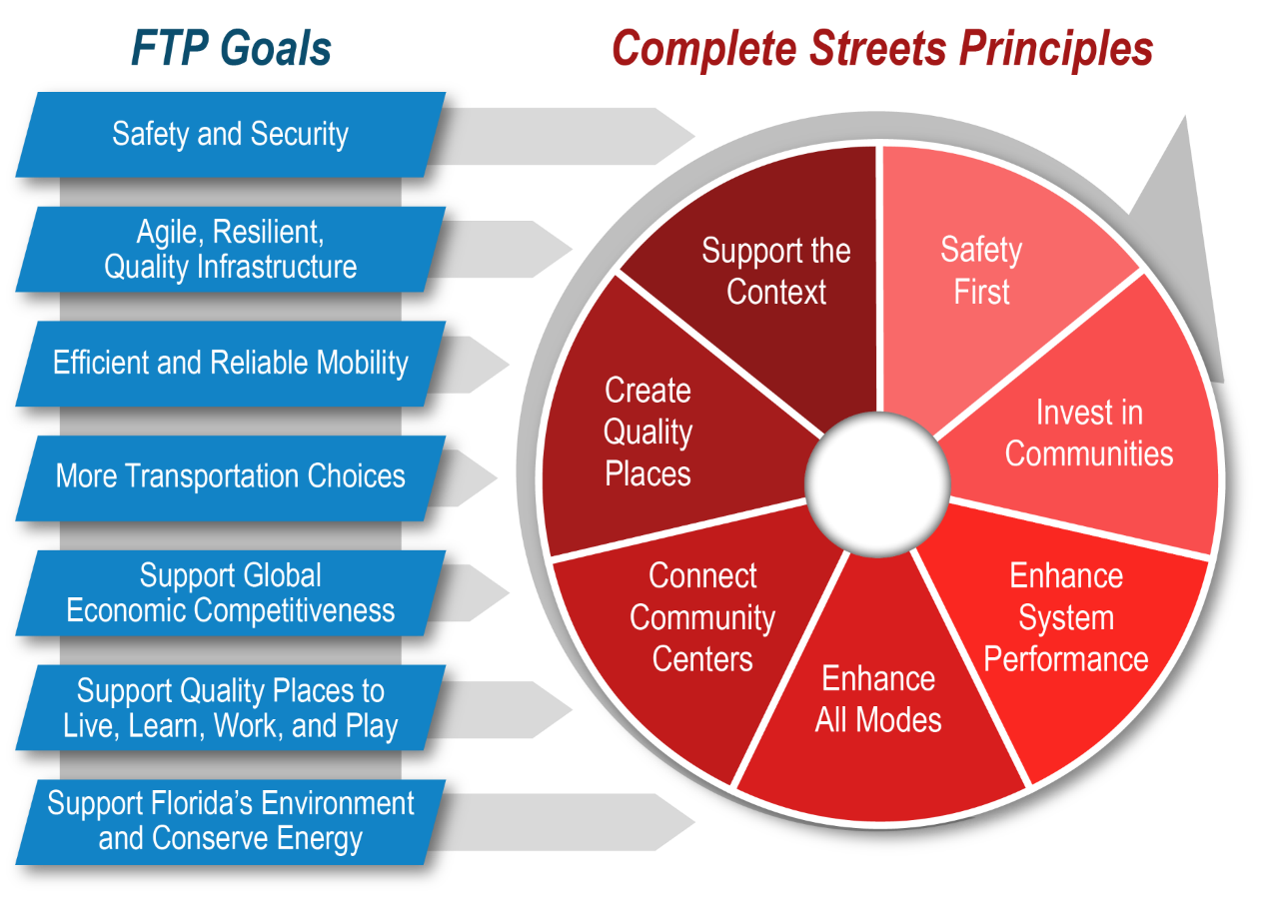
FTP & Complete Streets
Notes:
DEWAYNE-
The Complete Streets approach for implementing state projects is fully supportive of the FTP, and vice versa. You can think of Complete Streets as another aspect of FTP implementation.
This graphic shows the 7 FTP goals and the 7 Complete Streets Principles. In both cases, implementing a specific project may, and often does, support multiple goals and principles. Balancing the needs and purposes across the multiple goals and principles is part of the planning and design approach proposed.

Slide 7

Complete Streets on State Roads
Flexibility in Planning & Design
  For state roads, similar to existing processes for regional and local roads
  Standardizing flexibility into tools and decisions
Context Classifications
  Common language
  Not new to many communities or local governments
Planning & Design Approach
Notes:
DEWAYNE-
FDOT’s implementation of a complete streets planning and design approach for implementing state projects is another area where the Department has been working to implement the FTP.
FDOT’s complete street approach is geared to provide flexibility in planning and design (including maintenance) of state facilities based on the context of the community the facility supports.
===========
Note to Presenter, if questioned:
For design criteria, flexibility means greater opportunity to use the AASHTO minimum criteria in the more urban contexts (C4-C6, and C2T.) The criteria will be contained in the FDM and will reflect the AASHTO criteria in many instances. The districts will have the flexibility to use design criteria that more closely match the context. There is greater flexibility in the AASHTO criteria than in our current FDOT criteria; Complete Streets will let us access that flexibility.

Slide 8
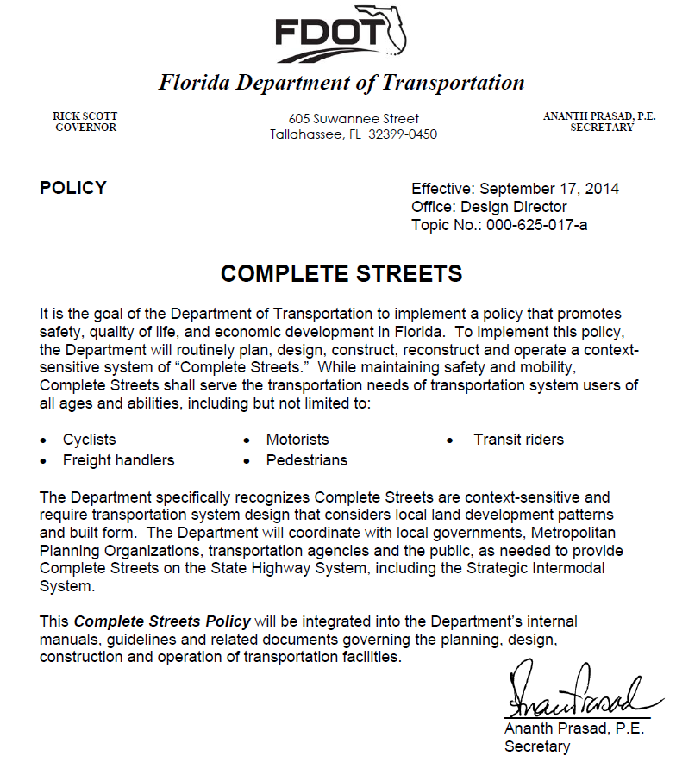
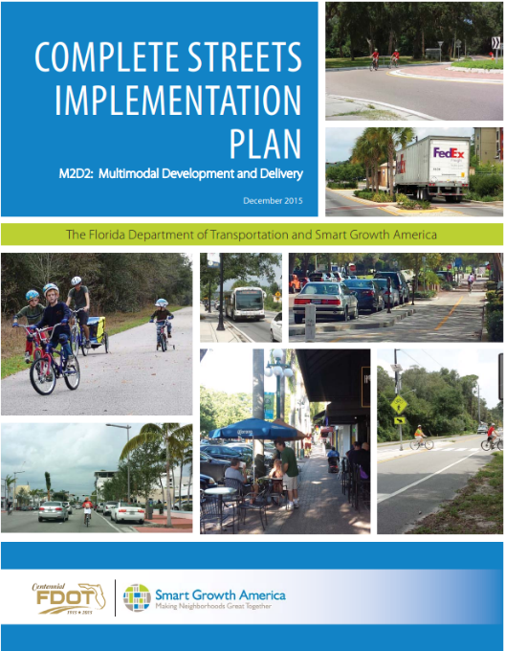
2014
Policy:
2015
Implementation Plan:
Notes:
DEWAYNE-
As background, FDOT adopted a Complete Streets policy in 2014, with a goal to promote safety, quality of life, and economic development in Florida.
To implement this policy, FDOT will plan, design, construct, reconstruct and operate a context sensitive system of “Complete Streets.” serving the transportation needs of users of all ages and abilities, including but not limited to: Cyclists, Freight handlers, Motorists, Pedestrians, Transit riders.
FDOT specifically recognizes Complete Streets are context-sensitive and require transportation system design that considers local land development patterns and built form. FDOT will coordinate as needed to provide Complete Streets on the State Highway System, including the Strategic Intermodal System.
In 2015, the Department came out with an Implementation Plan to help identify and guide the process, procedure, and manual modifications needed to fulfill the policy.

Slide 9
2017:
DRAFT
Notes:
DEWAYNE-
In 2017, FDOT is releasing a Complete Streets Handbook to inform FDOT staff and FDOT partners about how to the Department will determine and use context to inform our planning and design decisions.
The FDOT Design Manual (FDM), previously known as the Plans Preparation Manual (PPM) also is in the process of being updated to address design criteria and flexibility for state roads. The FDM will require the use of Context Classifications to select appropriate design criteria.

Slide 10
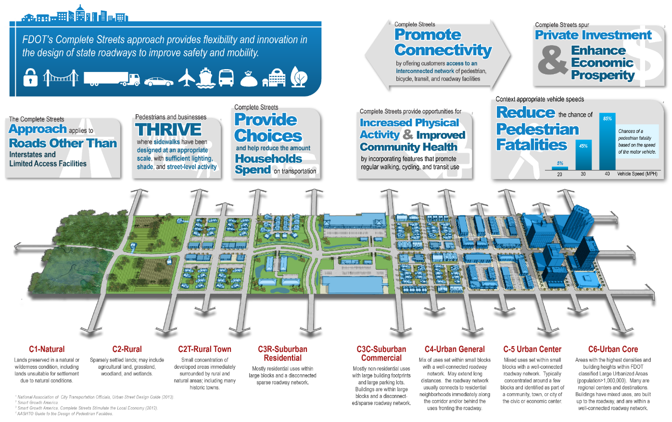
Context Classifications
Notes:
DEWAYNE-
A major emphasis of the handbook is to describe the community contexts that FDOT will use when planning and designing state projects, which we call “context classifications”.
Context Classification allows us to describe where we are in space with greater certainty than ever before. This allows us to offer greater flexibility in our designs than ever before and match our roads to their locations. We want to “put the right road in the right place.” But we still have to use the same funding pots as always. To make best use of these opportunities, we need to plan more carefully for what we want, and where, and line up the appropriate funding to make it happen. There is no new funding, but we have the chance to use our old funding sources in more specific ways than before, because we can understand place better than we have before.

Slide 11
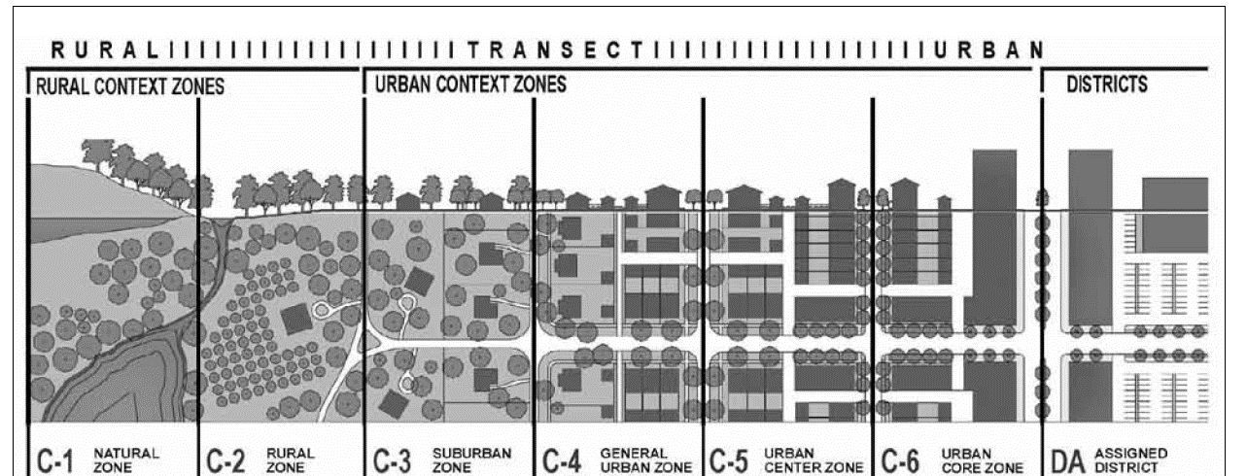
Context Classifications:
Common Language
ITE/CNU Context Zones
Notes:
DEWAYNE-
Cities that already have some sort of form-based code in place will be in a great position to work with FDOT. Our Context Classifications are similar, but not identical, to the New Urbanist Transects, as described in the ITE/CNU Recommended Practice: Designing Walkable Urban Thoroughfares. Local governments, planners, and decision makers may benefit from greater familiarity with these concepts. Communities that do not use these concepts can keep as they are – FDOT will work with each community, regardless. If we are speaking the same language, however, we’ll have a better chance of a mutually-favorable outcome.
===========
Note to Presenter
It may be useful to flip back and forth between this and the preceding slide to show how our Context Classifications relate to the Transect/Context Zones. In some Districts, it may be useful to point out the new C2T Rural Town classification – even the New Urbanists don’t have this!

Slide 12
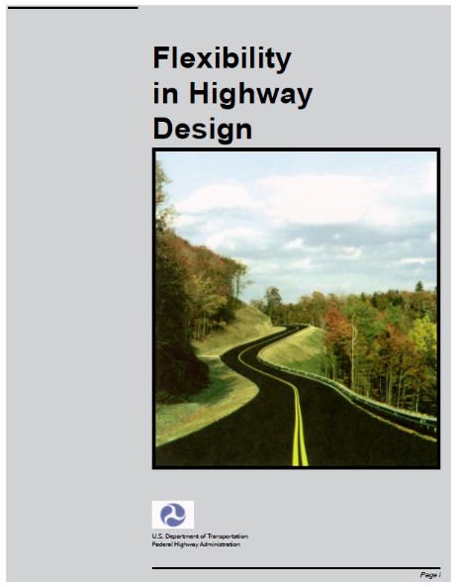
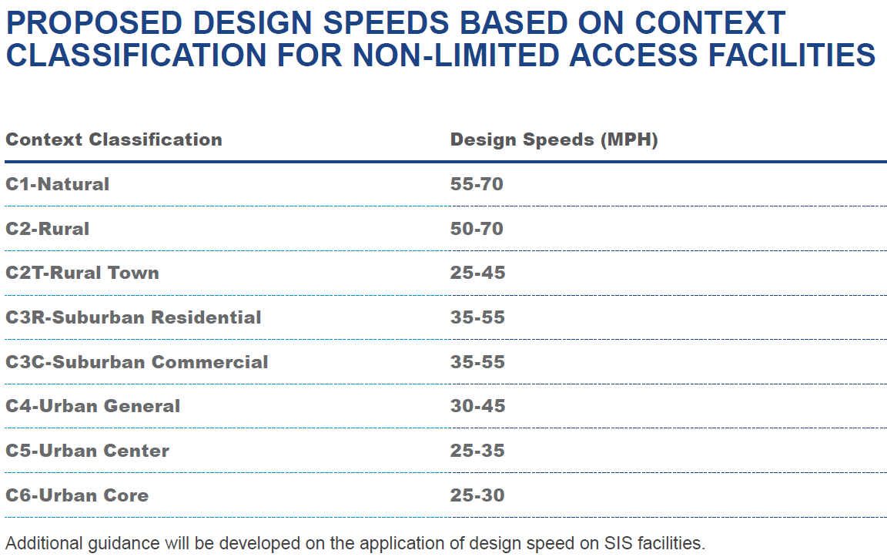
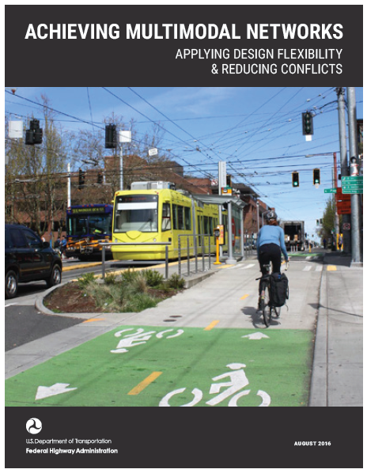
Planning & Design Flexibility
Notes:
DEWAYNE-
With one major exception, namely design speeds for non-limited access facilities, the Complete Streets handbook does not introduce new material but rather makes it easier (and in some cases, standard) to use the flexibility FDOT has had for many years on our projects. Here is the “ice cream shop” analogy: FDOT has been like an ice cream shop, but the only flavor we have on display is vanilla. We actually have all kinds of flavors, sprinkles, and toppings in the back of the store, but we don’t tell anyone about them. We may not even tell the kid working the counter about them! By using a Complete Streets planning and design approach, we’ll be able to offer more of the flavors, in more places, than we have before. The key to this is a new way of looking at place – the Context Classification.
Keep in mind, that interstates and limited access facilities are not subject to the complete street planning approach. You can think of them as already meeting the needs of their intended users.

Slide 13

Complete Streets Handbook
Handbook:
  Integrates Complete Streets approach in planning & design of state roads
  Explains importance of collaboration with regional & local partners
  Establishes context classification
Final Complete Streets Handbook for State Roads - June 2017
Notes:
DEWAYNE-
The handbook will provide the different contexts FDOT will use in planning and designing state roads. It will define community characteristics to use when gauging the context most appropriate for a road or segment.
Collaboration with local and regional partners and governments on the context is critical, which is why we are letting you know about the handbook even before it is released.

Slide 14
Planning & Designing for Complete Streets
DOT planning manuals and processes
  Community planning
  ETDM
DOT project manuals and processes
  Project Development Process
  FDOT Design Manual
  Access Management Manual
Maintenance & Operations
Notes:
DEWAYNE-
In addition to the Complete Streets Handbook, FDOT will be integrating a complete streets planning and design approach into our planning and project manuals, as well as maintenance and operations procedures and processes.
For example, our community planning process will incorporate enhanced collaboration on contexts and consideration given as to how to incorporate community contexts in the environmental screening tool.
The project development process is being updated to ensure the right road for the right place approach is considered in all phases of project development.
And, our design and access management manuals are being updated to address the flexibility and tradeoffs that occur in designing state projects using a complete streets paradigm.

Slide 15
“a system of Complete Streets cannot be accomplished entirely within the State roadway system and solely within FDOT’s right of way”
Notes:
DEWAYNE-
===========
Note to Presenter
Source: Complete Streets Handbook

Slide 16
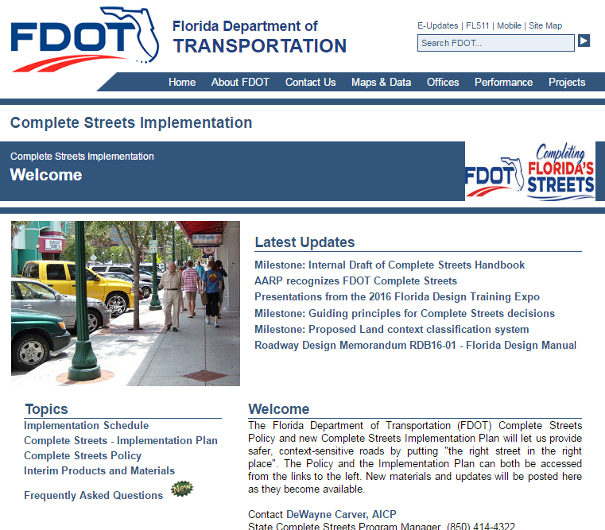
www.flcompletestreets.com
Notes:
DEWAYNE-
Draft is available on the website as well as a link to submit comments. Comment period will end Friday, May 26. Questions?

Slide 17
Transportation Choices Study Update
Notes:
CARMEN-
Update on the Transportation Choices study:
Coordination with Safety Office, modal offices, etc. for a systems-wide look at the implementation of this goal area
Statewide plans, Florida MPO LRTPS, and national scan of bicycle, pedestrian, and choices plans

Slide 18
Roundtable
Notes:
CARMEN-
OPP updates then each Council member will have the opportunity to provide organizational updates.

Slide 19
Questions?
Samantha Parks
  850-414-4821
  Samantha.Parks@dot.state.fl.us
Carmen Monroy
  850-414-4814
  Carmen.Monroy@dot.state.fl.us
Notes:
CARMEN-
The meeting summary and meeting materials will be posted on the BPPC site by end of June. Contact us with any questions.

