Slide 1

Guide to using the FPRN
Speaker:
Ron Hanson, PSM
FPRN Manager
Notes:
The Florida Permanent Reference Network or FPRN is a taxpayer funded Global Navigation Satellite System reference network that is owned and maintained by the Florida Department of Transportation, Office of Design, Surveying and Mapping Division.
<CLICK>

Slide 2
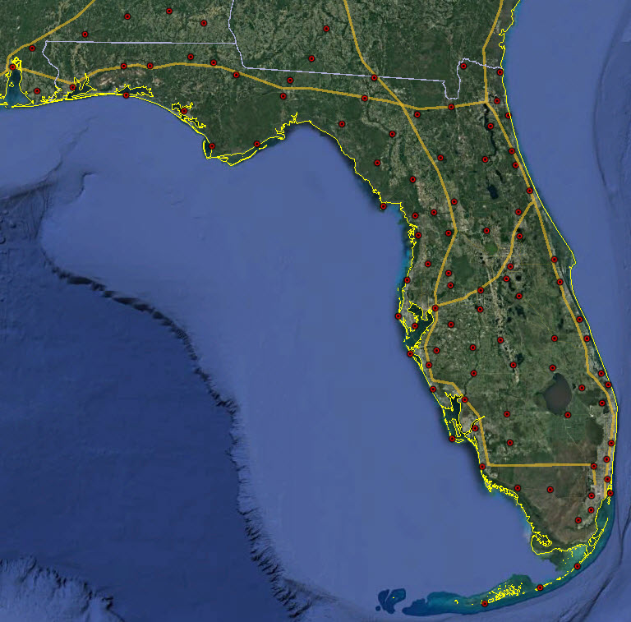
Network Overview
Notes:
Currently the FPRN has 100 stations operating throughout Florida, Georgia and Alabama.
In the last three years there has been very little “down” time for the network.
<CLICK>

Slide 3
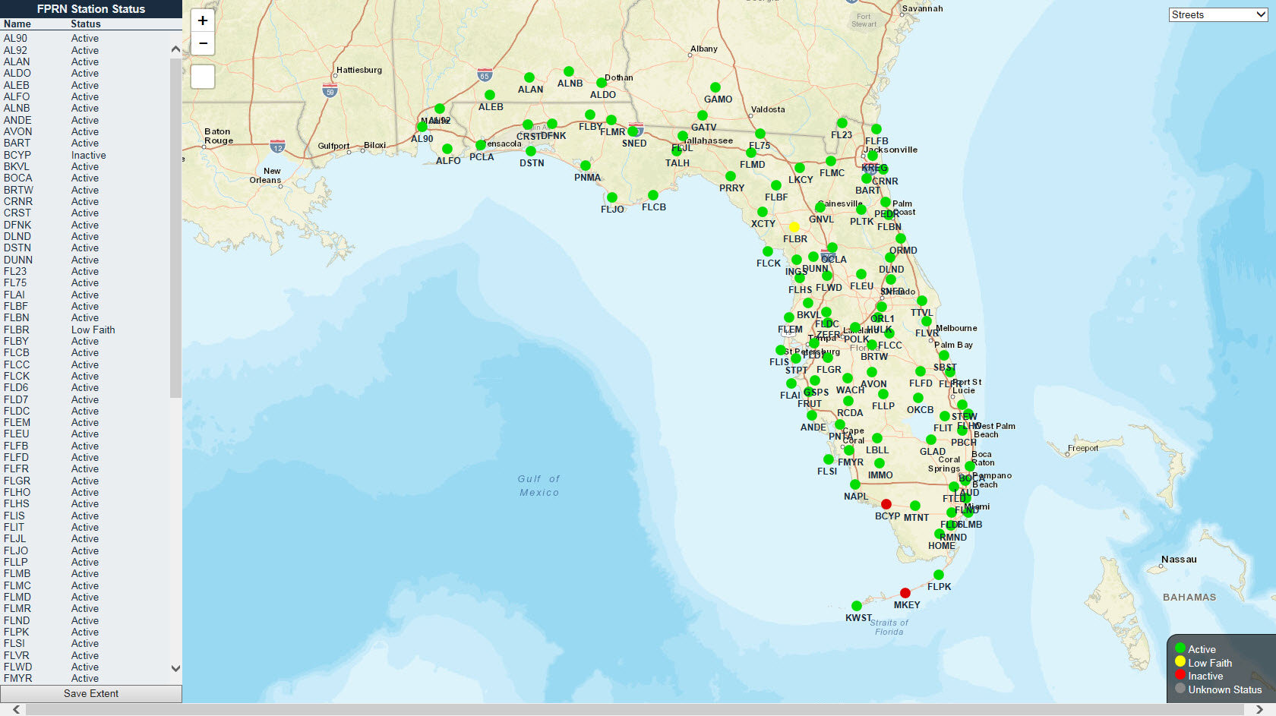
Dynamic Map
Notes:
When doing mission planning the best place to view station availability is the FPRN Dynamic Map.
Station availability is updated every fifteen minutes.
<CLICK>

Slide 4
Products
Real-Time
Real-Time Corrections
  Single Baseline
Network Real-Time Corrections
  Flaechen-Korrektur-Parameter (FKP)
  Master Auxiliary Concept (MAX) (iMAX)
  Virtual Reference Station (VRS)
Static
Computation Service
  Similar to OPUS
RINEX Downloads
  Recurring Jobs
  Virtual Rinex
Notes:
The FPRN provides two basic type of products:
<CLICK>
Real-Time and Static
Real-Time Products are broadcast in five different open source languages:
RTCM 2.3
CMR Plus
RTCM 3.1
RTCM-3 MSM4
RTCM-3 MSM5
The products are offered across two different protocols:
TCP/IP
NTRIP
<CLICK>
Real-Time Products consist of Single Baseline Solutions for each station and Network Corrections:
The network solutions include:
Flaechen-Korrektur-Parameter (FKP)
Master Auxiliary Concept (MAX or iMAX)
Virtual Reference Station (VRS)
<CLICK>
The FPRN offers a computation service that is similar to OPUS as well as a RINEX download program that includes recurring jobs and Virtual Rinex.
<CLICK>

Slide 5
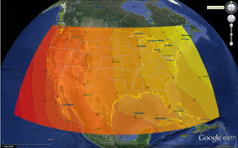
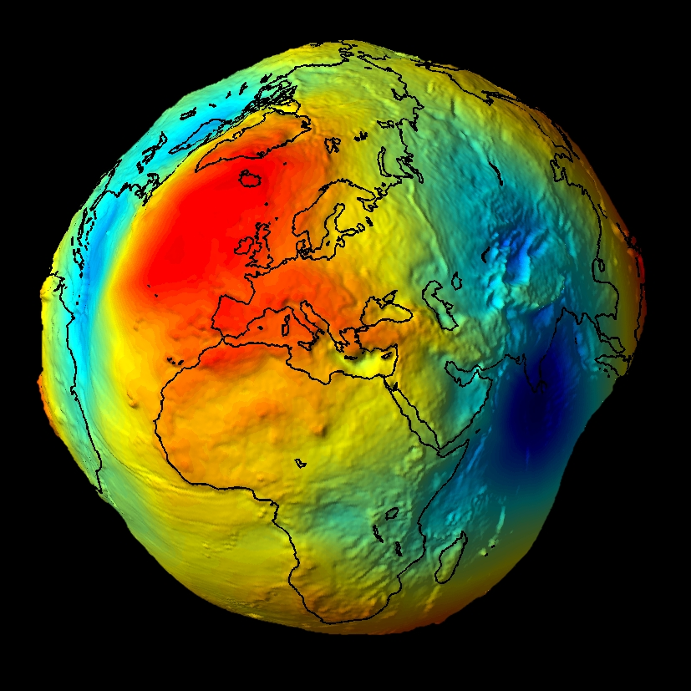
Datums & geoids
Datum
NAD 27
NAD 83 (1986)
NAD 83 (1992)
NAD 83 (1996)
NAD 83 (2007)
NAD 83 (2011)
Geoid
Geoid 96
Geoid 99
Geoid 06
Geoid 03
Geoid 09
Geoid 12 (A&B)
FPRN
Notes:
When using GPS it is important to know which Datum and Geoid you are operating in. There have been two geodetic datums used by most Surveyors.
<CLICK>
NAD 27 is the original Geodetic Datum and NAD 83 (and all of its realizations) is the most common datum being used today.
<CLICK>
In order to obtain elevations when using GPS the user must apply a Geoid model. The first geoid model was Geoid 96 and the most current is Geoid 12B.
<CLICK>
The FPRN is aligned with NAD83 (2011) and the best Geoid model to use is Geoid 12B.
<CLICK>
Unless using the Florida Custom Geoid (FPRNGD16B) developed by the FDOT.
<CLICK>

Slide 6
204.90.21.205
Notes:
To receive Real-Time corrections you must have internet access and connect to IP address 204.90.21.205.
<CLICK>

Slide 7
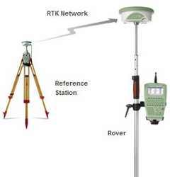
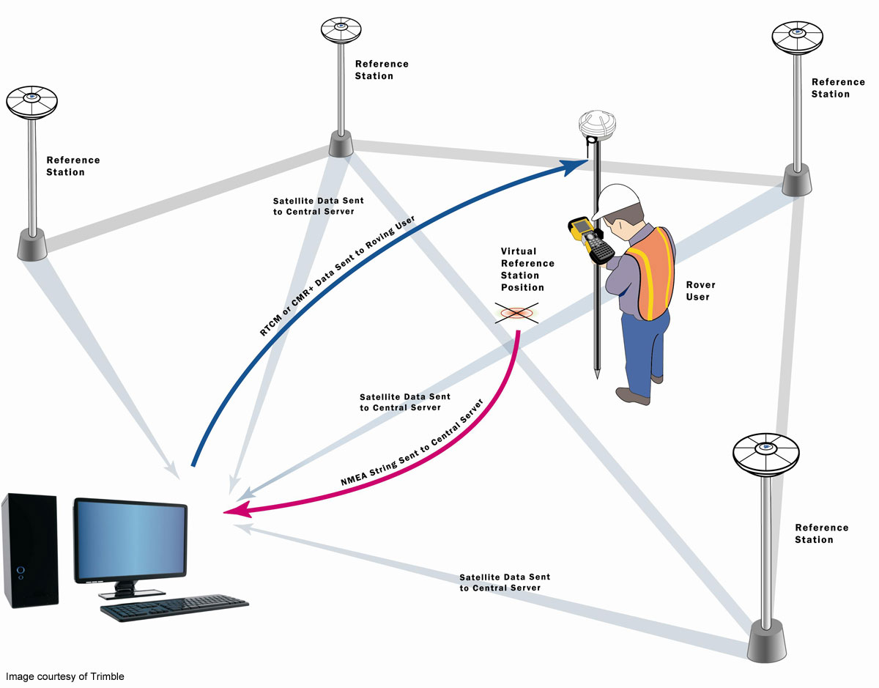
Single baseline versus network solution
Notes:
As a General guideline when using a Real-Time Reference Network when within 12 kilometers or 7 miles of a reference station you should use the single baseline correction.
<CLICK>
If outside the 12km range you should use one of the Network solutions.
<CLICK>

Slide 8
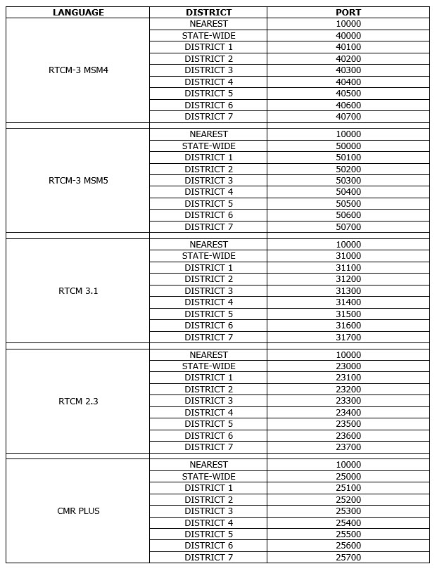
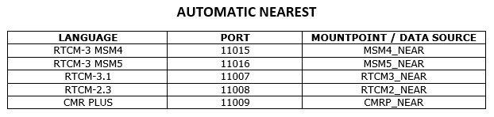
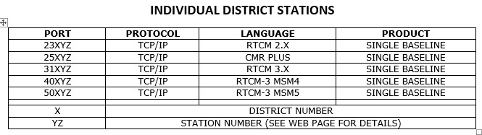
Single Baseline Ports
NTRIP Protocol
TCP/IP Protocol
Notes:
Here are the current Single baseline products and associated ports offered by the FPRN.
<CLICK>

Slide 9
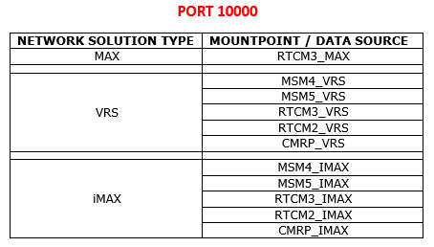
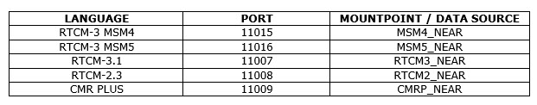
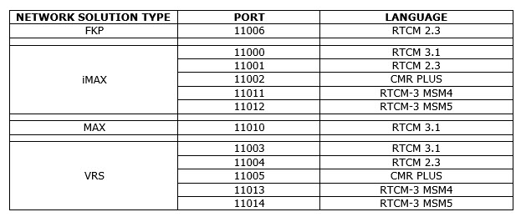
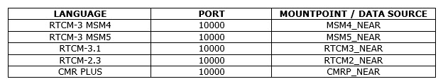
NETWORK SOLUTIONS
NTRIP Protocol
TCP/IP Protocol
Notes:
These are the current Network solution products and ports.
<CLICK>

Slide 10
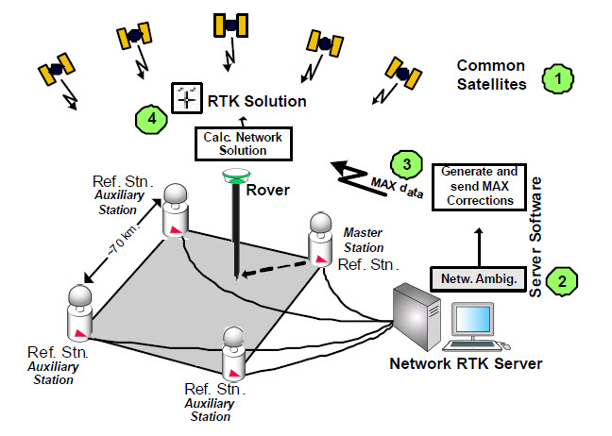
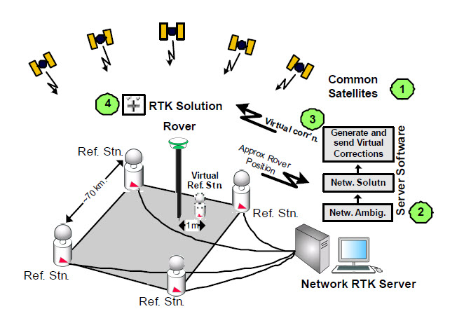
Network Solutions
MAX
VRS
Notes:
So, which Network solution is right for me?
<CLICK>
Discuss MAX
<CLICK>
Discuss VRS
<CLICK>

Slide 11
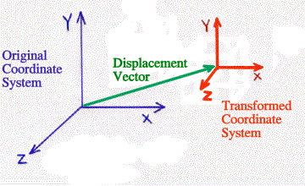
localization
Notes:
Finally, when using Real-Time corrections, whether single baseline or network solution, you should “localize” to known control.
Localizing is basically a “Live” coordinate transformation.
<CLICK>

Slide 12
FPRN WEB PAGE
Notes:
Let’s explore the FPRN Web Page.
<CLICK>

Slide 13
Common Mistakes
Bad User Name or Password
NMEA / GPGGA message not turned on
  Bad position for NMEA / GPGGA
Concurrent Connection
Not Localizing
Notes:
Discuss common mistakes
<CLICK>

Slide 14
Questions?

