Slide 1
New Datums of
2022
Notes:
Let’s discuss the New Datums of 2022
(CLICK)

Slide 2
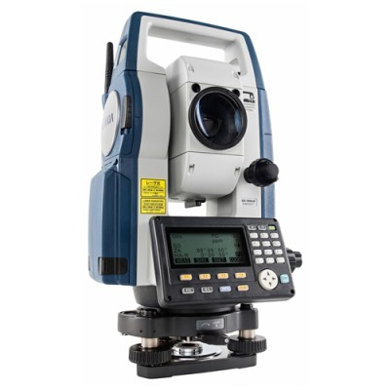
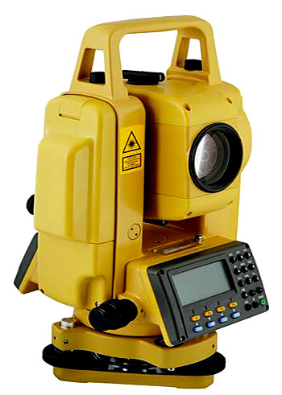
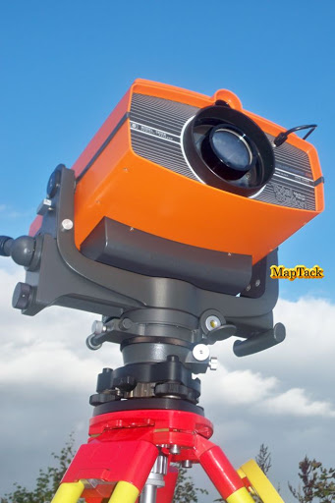
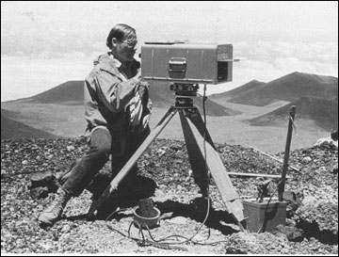
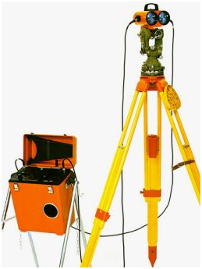


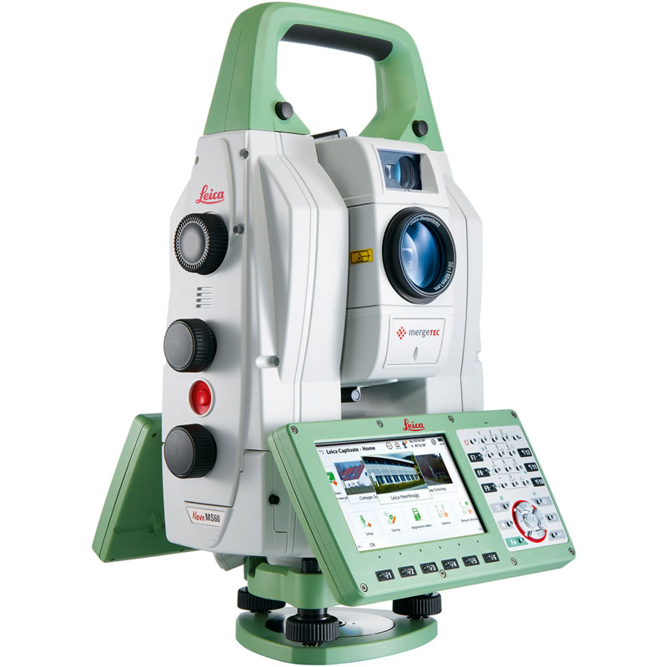
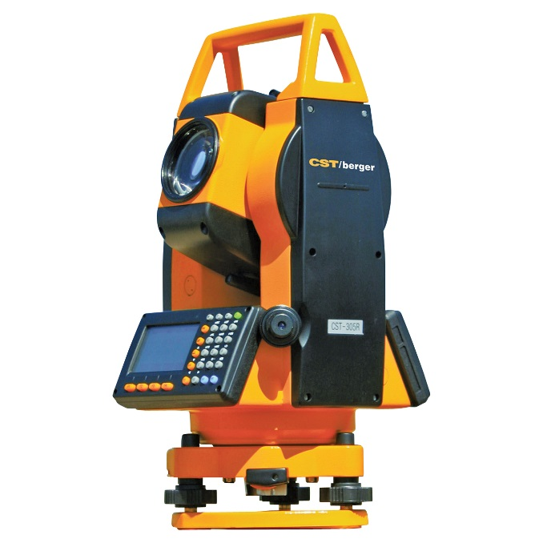
What is a Geodetic Datum?
Notes:
What is a datum and why do we care?
Before the advent of GPS we started a survey with 10,000 -10,000 horizontally and a railroad spike in a telephone pole or tree with an elevation assumed elevation of 1000. Surveyors dreamed about a magic black box that would allow them to measure without chains and chaining pins and perhaps allow us to go through or around the woods without cutting line. Along came the electronic distance measuring machine.
(CLICK)
This allowed us to put the chain away, but we still did not need to worry about datums.
(CLICK)
Next came Total Stations. Hewlett Packard was one of the first to create a Total Station, the HP 3810.
(CLICK)
Several manufacturers of Total Stations got into the act before GPS/GNSS.
Finally, however
(CLICK)

Slide 3
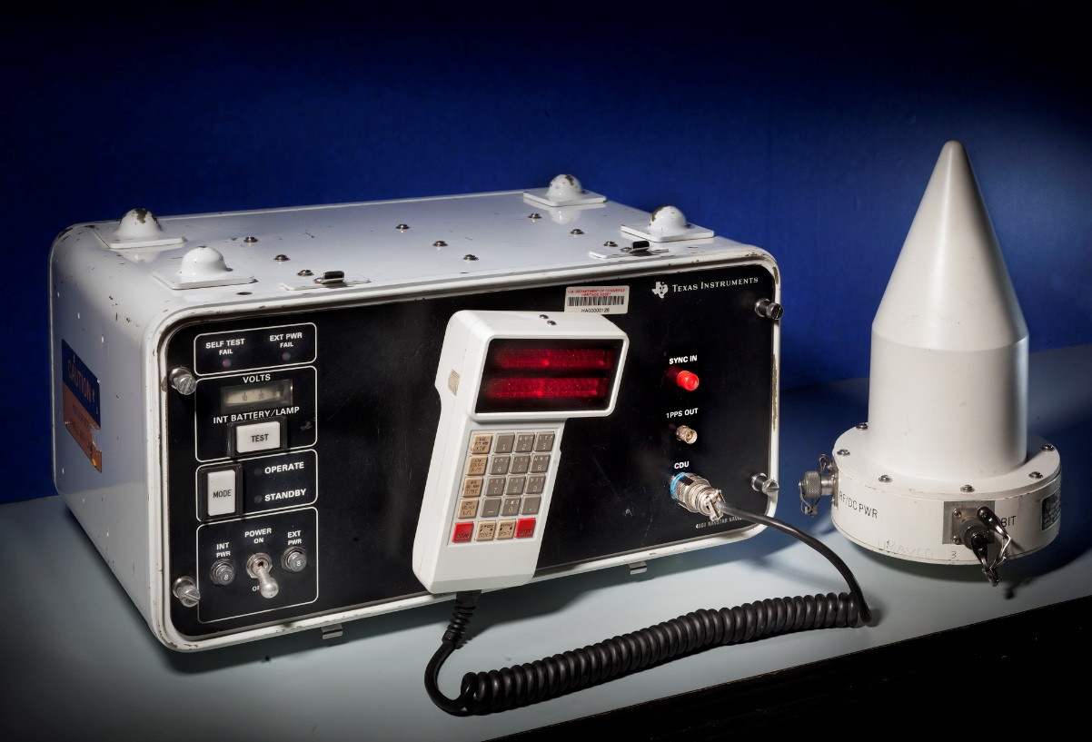


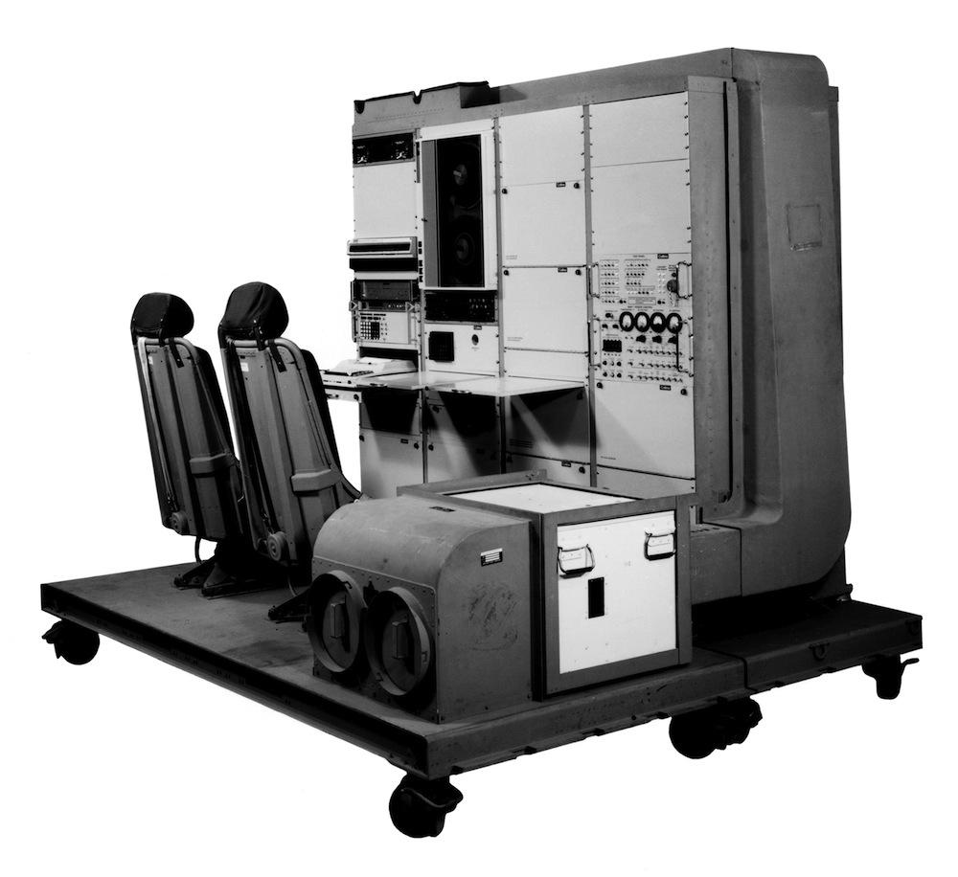
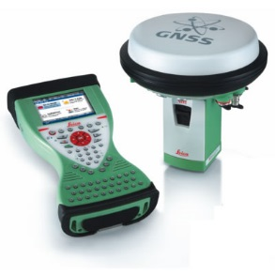
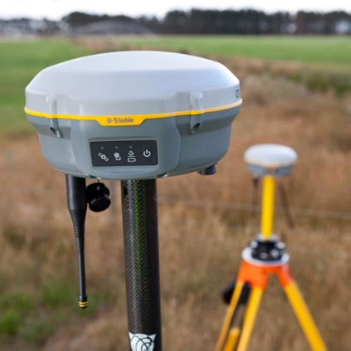
Notes:
There was something that would get us over or around the woods but it came with a price:
(CLICK)
That price was having to use datums.
We use datums to place ourselves on the earth.
(CLICK)

Slide 8

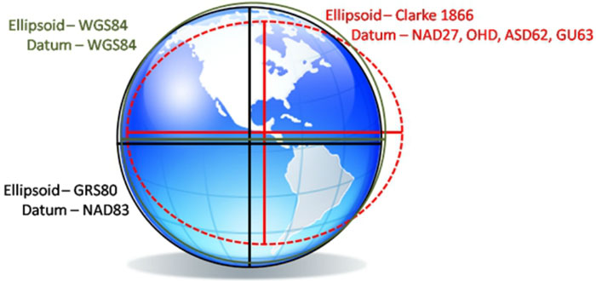
Notes:
In the 1930s the United States Coast and Geodetic Survey started using State Plane Coordinates to provide a common reference system to surveyors and mappers.
(CLICK)
There are two phases of the SPCS system, SPCS27 and SPCS83, and they are quite different.
While SPCS 27 is based on the Clarke Ellipsoid of 1866 and the local datum NAD27.
SPCS83 is based on the updated geocentric datum of NAD83.
(CLICK)

Slide 9
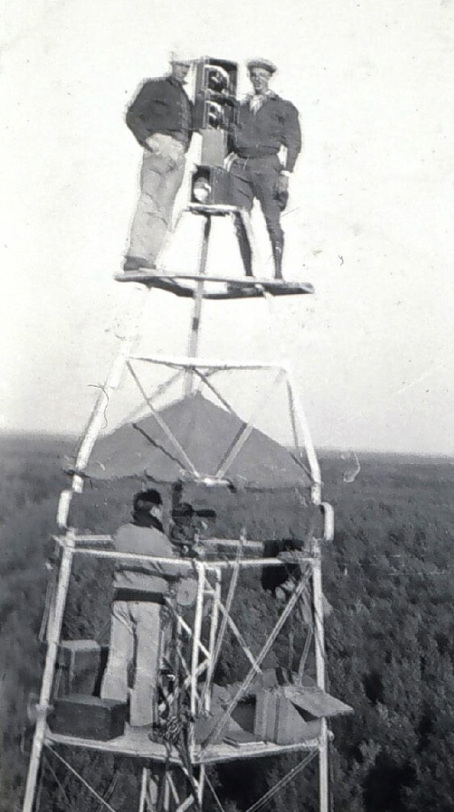
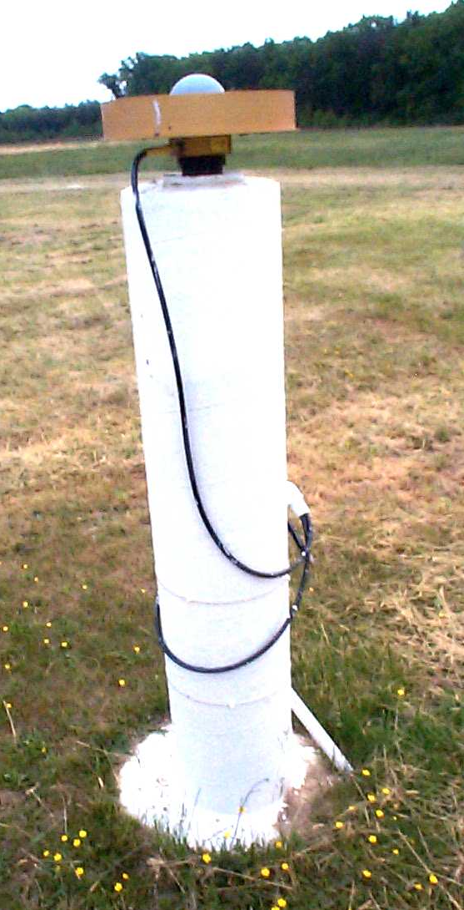
A brief overview of NAD 83
Original realization completed in 1986
  Almost entirely classical (optical) observations
“High Accuracy Reference Network” (HARN) realizations (1990s)
  Done essentially state-by-state
  Based on GNSS but classical stations included
National Re-Adjustment of 2007
  NAD 83(NSRS2007/CORS96) epoch 2002.00
  Nationwide adjustment (GNSS only)
NAD 83 (2011/PA11/MA11) epoch 2010.00
  Also nationwide GNSS-only adjustment
  This is NOT a new datum! (still NAD 83)
Notes:
NAD83 has not changed since 1986 when it was first instituted. Different realizations of the NAD83 have been used but the datum remains the same.
(CLICK)
The HARNS were done in the 90’s on a state by state basis with GPS but they were tied to the passive marks in the ground, thereby, warping the data to fit what was on the ground.
(CLICK)
In 2007 another realization was created but this time it was tied to a specific point in time, epoch 2002.00. In other words, the coordinates displayed on the data sheet were where the mark was on 1 January 2002.
(CLICK)
NAD83(2011) is a similar realization in that it is tied to a specific epoch, in this case 2010.00.
(CLICK)
Remember, this is the same datum that was created in 1986. Also realize that the coordinates you see on the data sheet are where the mark was on 1 January 2010, not where it is today, almost 7 years later.
(CLICK)

Slide 10
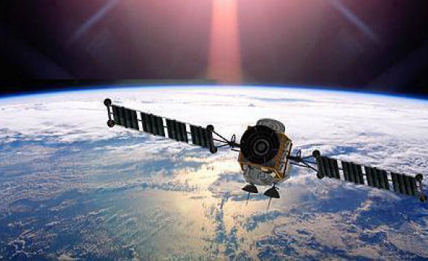
A (very) brief history of WGS 84
Original realization completed in 1987
  “Same” as original NAD 83 (to within ±1-2 m)
WGS 84 (G730) — adopted Jan 1994
  Aligned with ITRF91
WGS 84 (G873) — adopted Sep 1996
  Aligned with ITRF94
WGS 84 (G1150) — adopted Jan 2002
  Aligned with ITRF2000 (at epoch 2001.00)
WGS 84 (G1674) — adopted Feb 2012
  Aligned with ITRF2008 (at epoch 2005.00)
WGS 84 (G1762) — adopted Oct 2013
  Also aligned with ITRF2008 (at epoch 2005.00)
Notes:
There are several realizations of WGS84. The “G” number following WGS84 is the GPS week number. In the beginning, WGS84 and NAD83 were coincident. Over the years, the origin of WGS84 has been revised but the origin of NAD83 has not been revised so they have drifted apart and are now approximately 2 meters in separation.

Slide 11
Geodetic Datums: Today

Slide 12
Geodetic Datums: Future

Slide 13
Questions

Slide 14
Terminology
Old Terminology
New Terminology
Horizontal Datum
Vertical Datum
Geometric Reference Frame
  Geocentric X, Y, Z
  Latitude, Longitude, Ellipsoid Height
Geopotential Reference Frame
  Gravity
  Geoid undulation
  Orthometric height
  Deflection of the Vertical
Notes:
Let’s review some terminology
<CLICK>
The term Horizontal Datum will no longer exist
<CLICK>
it will be replaced with Geometric Reference Frame. Which will consist of Geocentric coordinates or Latitude, Longitude and Ellipsoid height.
<CLICK>
Also, the term Vertical Datum is being replaced with
<CLICK>
Geopotential Reference Frame.
We must have relationship between the ellipsoid height and the more complex gravity based geoid. We will also need to take into account the deflection of the vertical to obtain an accurate orthometric height.
<CLICK>

Slide 15
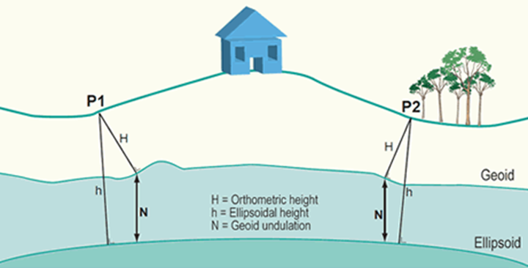
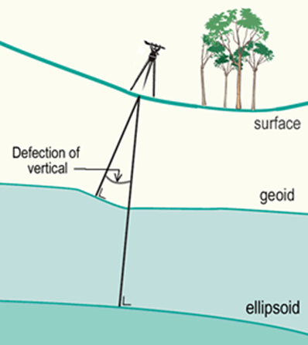
Deflection of the Vertical
We are used to seeing this formula for obtaining heights when using GNSS:
h=H+N
Notes:
The formula, h=H+N or Ellipsoid height = Orthometric height + Geoid undulation is familiar to us when using GNSS.
<CLICK>
But, as you can see from this picture that the vertical is not truly perpendicular to the ellipsoid but is perpendicular to the geoid, therefore we must take into account the deflection of the vertical in order to obtain the best orthometric height we can.
<CLICK>

Slide 16
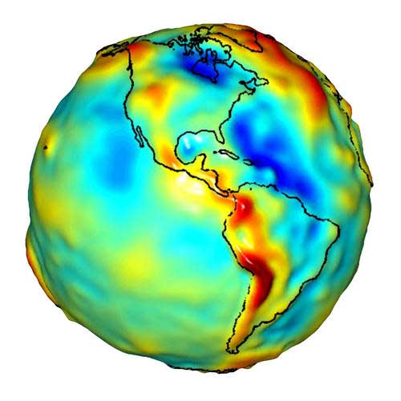
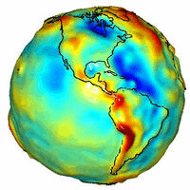
Earth
GRS 80
NAD 83
  b = 6,356,752.31414 m
Squash the sphere to fit at the poles
  a= 637813.000007 meters
  b= 6356752.31414 meters
  f= 1/((a-b)/a) = 298.2572220972
  a = 6,378,137.00000 m
Notes:
This shape
<CLICK>
is our reference for NAD83 and the GPS system. Both horizontal and vertical coordinates originate with this surface. The Pythagorean concept of a spherical Earth offers a simple surface which is mathematically easy to deal with.
While the sphere is a close approximation of the Earth and satisfactory for many purposes, it does not give us the accuracy necessary.
So we
<CLICK>
squash the sphere at the poles.
<CLICK>
Then we put that figure in revolution and this is what we call the reference ellipsoid.
<CLICK>

Slide 17
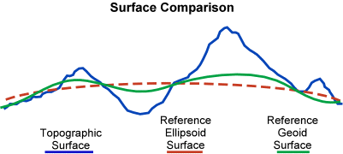
Notes:
This is the relationship between the reference ellipsoid, the reference geoid, and the actual surface of the Earth. Keep in mind geoid exists approximately at mean sea level (MSL).
<CLICK>

Slide 18
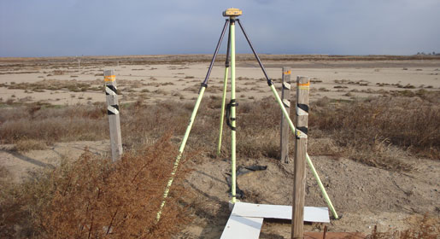
New Datums are coming in 2022!
Both a new geometric (horizontal) and a new geopotential (vertical) datum will
be released in 2022.
The realization of the new datums will be through GNSS receivers.
NGS will provide the tools to easily transform between the new and old datums.
Notes:
Yes, we just changed from NAD83(CORS96) to NAD83(2011) but now is the time to think about the next generation of horizontal and vertical datums because this will be a huge change.
<CLICK>
Soon to be gone are the days of traditional Monumentation. With the release of the new datums, all coordinates will be accessed through GNSS receivers.
<CLICK>

Slide 19
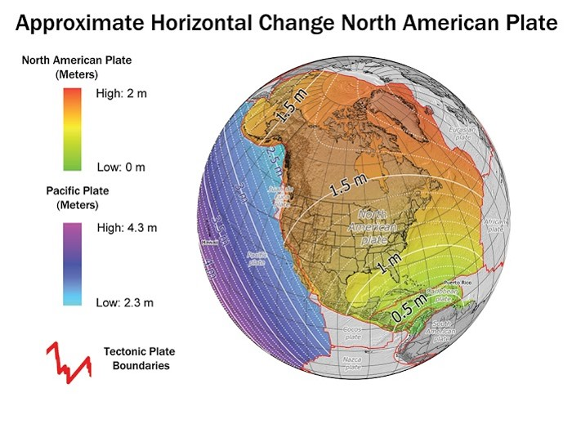
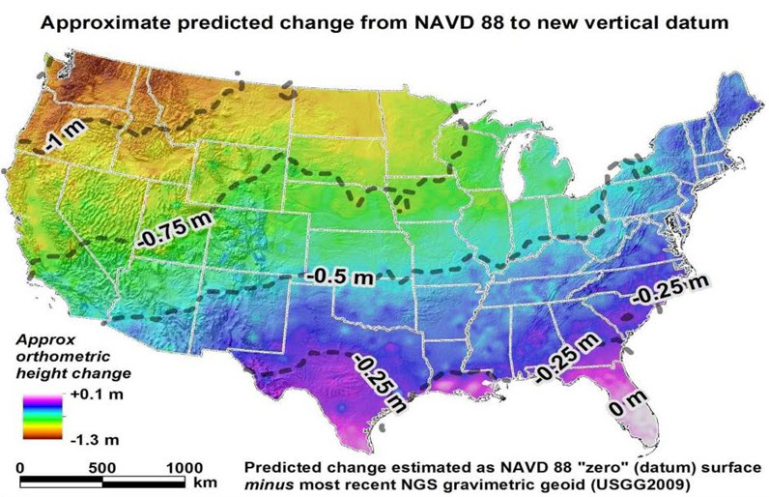
How will the New Datums affect you?
The new geometric (Horizontal) datum
will change latitude, longitude, and ellipsoid height by between 1 and 2 meters.
The new vertical (geopotential) datum will change heights on average 50 cm (20''), with a 1 meter (39'') tilt towards the Pacific Northwest.
Notes:
As noted, this will not be a minor change as we have been seeing in recent years. The coming changes will be more like the previous big changes, NAD27 to NAD83 and NGVD29 to NAVD88. There will be both a change in horizontal and vertical positions of every point in the state.
<CLICK>
The shift in elevation on average will be about 50 cm.
From the map it appears that there isn’t much vertical change caused by the geopotential datum in Florida but there will be change due to the shift in origin of the ellipsoid. In other words the change from hybrid geoid to geopotential geoid will not cause as much change as the shift in origins.
<CLICK>

Slide 20
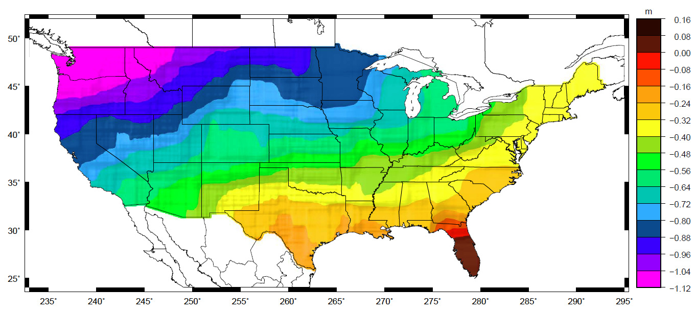
Why isn’t NAVD 88 good enough anymore?
Approximate level of geoid mismatch known to exist in the NAVD 88 zero surface:
Notes:
This map indicates that the current geoid is relatively good in Florida, but remember with the new datums, there will be a 1.6 meter shift in the origin of the ellipsoid which will cause the elevations to change.
<CLICK>
Why the shift?
<CLICK>

Slide 21
Simplified Concept of NAD 83 vs. ITRF
Earth’s Surface
h_{NAD83}
h_{ITRF}
h_{NAD83} – h_{ITRF} varies
smoothly by latitude
and longitude
ITRFxx origin
~1.6 m
NAD 83 origin
Notes:
The ITRF or WGS84 does not have the same origin point as NAD83. Better knowledge of the center of mass of the earth has caused a revision of the world geodetic system but NAD83 has remained fixed where it was placed in 1986.
It is the shift <CLICK> from the 1986 origin to the current ITRF origin that will occur in 2022.
Online Poll
With all this in mind, how often would you like coordinates updated?
Yearly
Monthly
Weekly
Or
Daily
<CLICK>

Slide 22
Questions?

