Slide 1
Florida Permanent Reference Network
Florida Custom Geoid and
New Datums
Ron Hanson, PSM
FPRN Manager
Notes:
INTRODUCTION
Let’s Start with an online poll.
Do you currently use the FPRN?
<CLICK>

Slide 2
FPRN GEOID 2016
WHY?
Usefulness of any Geoid model is limited by data density and distribution.
NGS Hybrid Geoid philosophy limits current usefulness to surveyors.
Rigorous Math vs. Survey Practical
Geoid 12A/B is good in a relative sense – not so good in an absolute sense.
FPRN (RTK mode) requires a Geoid to be functional in the absolute sense.
Gravity based Geoid model from NGS will not be available until 2022 +.
Notes:
Why would we take the time to develop another geoid model?
Well, there are five reasons behind the development of the FPRN Geoid.
<CLICK>
First, the usefulness of any Geoid model is limited by data density and data distribution.
<CLICK>
Second, the philosophy behind the Hybrid Geoid (Geoid 12B) limits its current usefulness.
<CLICK>
Third, Geoid 12A/B is good in a relative or differential sense – not so good in an absolute sense.
<CLICK>
Fourth, the FPRN users require the system to be functional in an absolute sense.
<CLICK>
Finally, a Gravity based Geoid Model will not officially be available at least 2022.
<CLICK>

Slide 3
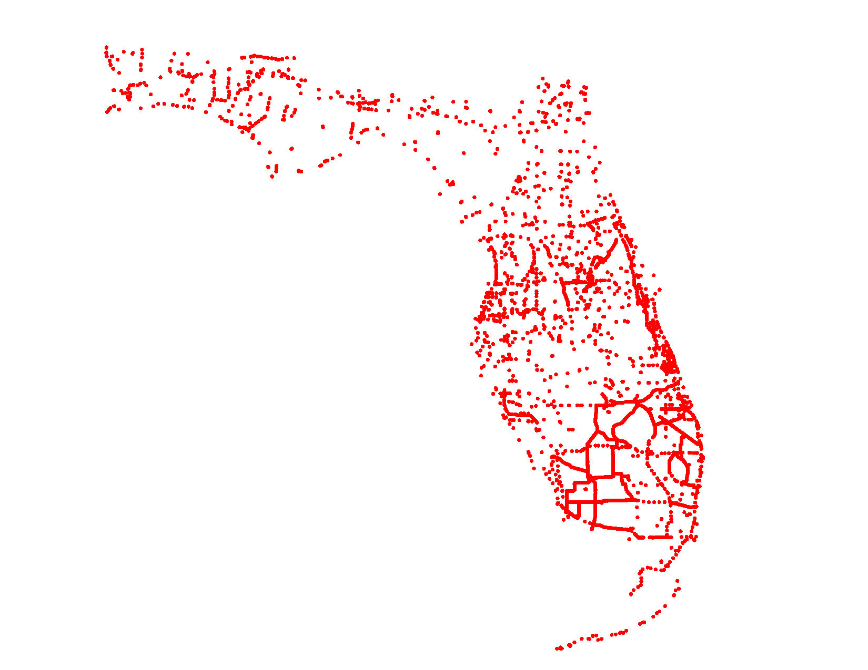
Notes:
Shown here is a map representing the location of the benchmarks used in Geoid12B plus the additional benchmarks added to the model for FPRNGD16b.
<CLICK>

Slide 4
GEOID COMPARISON
Geoid 12B
FPRNGD16B
NGS Grid spacing held
0.08 m tolerance applied
2470 Benchmarks used
Overall RMS of 0.022 m
1712 BM’s fit better than 0.01 m
NGS Grid spacing held
0.08 m tolerance applied
3472 Benchmarks used
Overall RMS of 0.008 m
3025 BM’s fit better than 0.01 m
Notes:
Let’s compare the two Geoids
<CLICK>
The NGS Grid spacing for Geoid 12B was held for both models.
<CLICK>
Both Geoids were subjected to a 0.08 m tolerance for rejecting benchmarks.
<CLICK>
Geoid 12B used 2470 benchmarks in the State, while FPRNGD16B added an extra 1002 benchmarks.
853 were historic FDOT Benchmarks that were never Bluebooked and the additional 149 were submitted to NGS but not in time for inclusion in Geoid 12B.
<CLICK>
The overall Root Mean Square for Geoid 12B was 0.022 m while the FPRNGD16B was 0.008 m.
<CLICK>
After the smoke cleared, Geoid 12B had 1712 Benchmarks that fit better than 0.01 m and the FPRNGD16B had 3025.
So, why the dramatic difference in results?
<CLICK>

Slide 5
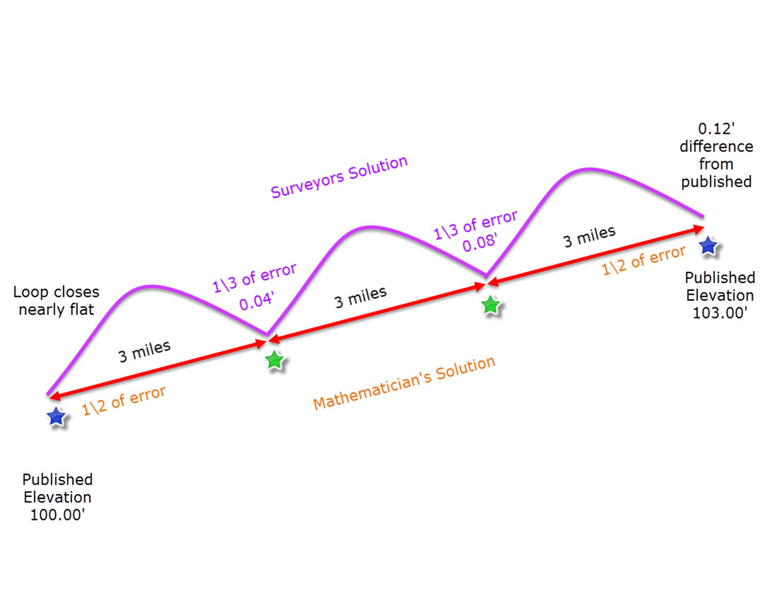
Difference in Theory
Surveyors
Adjust loop based on historical data
Mathematicians
Adjust loop based on precision of measurement
Notes:
<CLICK>
What we have is a difference in Theory.
Let me give you an overly simplistic analogy. Let’s say you used a new barcode level in good adjustment to run a bench loop between two published benchmarks that are nine miles apart, setting two new marks along the way. You are required to meet the Standards of Practice error closure requirements which is 0.15’. You miss the published orthometric height on the second mark by .12’. How do you adjust the loop?
As a surveyor, I would hold the published orthometric heights on the two known marks and let the level loop take .12’ adjustment.
NGS would let both published mark orthometric heights float and constrain to the new benchmarks. The result would be new orthometric heights on the two existing marks. So each existing mark would now have a new orthometric height in my work that would probably be about .06’ different from their previously published values. The justification for doing this is that the previously published orthometric heights on the two existing benchmarks are a result of measurements that contain errors much greater than the .12’ they were allowed to adjust in this analogy.
NGS treated benchmark geoid heights in Geoid 12B as measurements which were allowed to take adjustment.
Dr. Ray Hintz with the University of Maine produced our Geoid model. He treated benchmark geoid heights in FPRN Geoid 2016 as fixed values.
<CLICK>
So basically, Surveyors would adjust the loop based on historical data, while Mathematicians adjust the loop based on precision of measurement.
<CLICK>

Slide 6
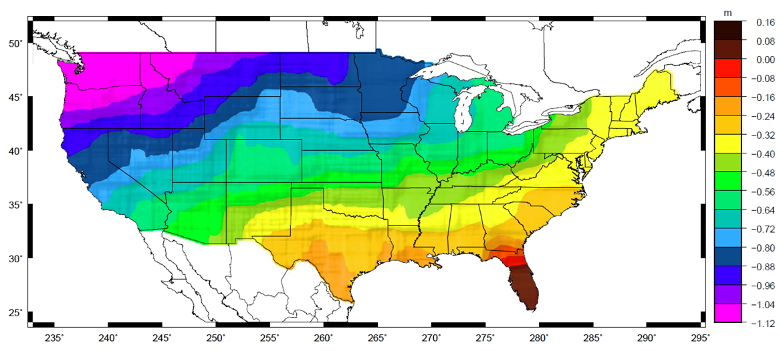
The Big Picture
Notes:
The NGS is tasked with creating a Geoid Model that works across the Nation.
<CLICK>
And since Geoid 12B is good in a relative sense it fits this task very well.
In a relative sense general systematic biases can be self-canceling. In an absolute sense the biases remain.
NGS understands this and plans to remove a lot of systematic error from their current model when they produce a gravity-based model.
<CLICK>

Slide 7
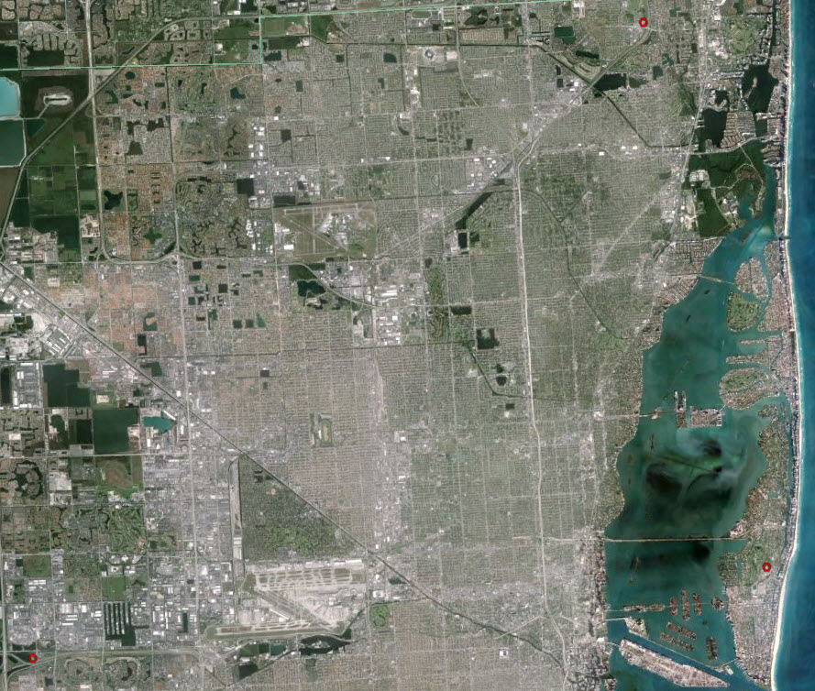
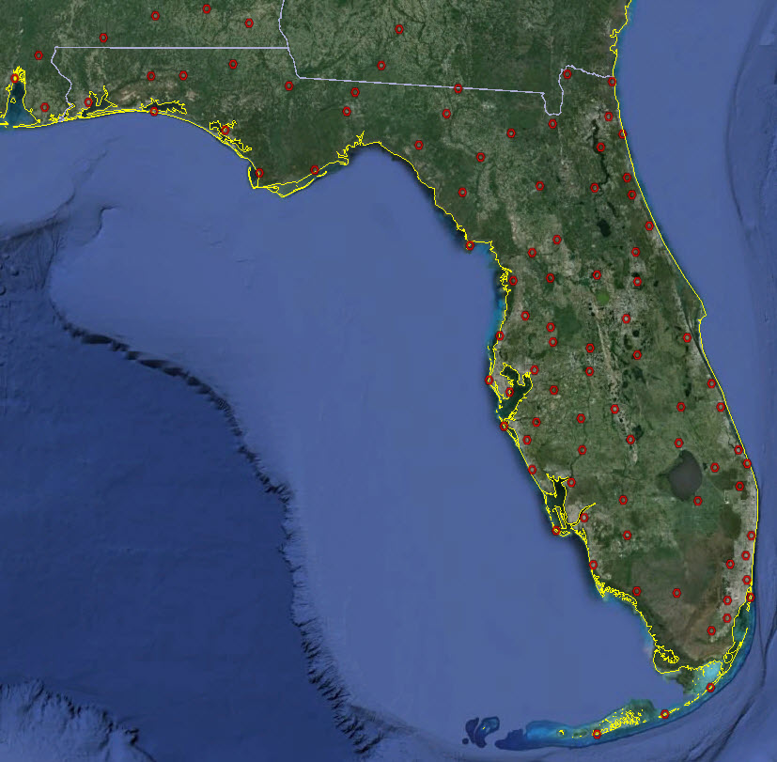
In the weeds
Notes:
While we at FDOT are forced to apply a Geoid across a much smaller area.
<CLICK>
And the FPRN users are looking at an even smaller area.
<CLICK>

Slide 8

Time is wasting
Notes:
Gravity based Geoid model from NGS will not be available until 2022 +.
We look forward to using it in conjunction with the FPRN but we wanted a better model now.
Online Poll
Have you requested the Florida Custom Geoid?
<CLICK>

Slide 9
New Datums of
2022
Notes:
Online Poll:
What form would you like coordinates reported with new Datums or Realizations?
Word
PDF
HTML
XML
ASCii
Now since we are talking about the future, lets discuss the New Datums of 2022
<CLICK>

Slide 10
Terminology
Old Terminology
New Terminology
Horizontal Datum
Vertical Datum
Geometric Reference Frame
  Geocentric X, Y, Z
  Latitude, Longitude, Ellipsoid Height
Geopotential Reference Frame
  Gravity
  Geoid undulation
  Orthometric height
  Deflection of the Vertical
Notes:
Let’s review some terminology
<CLICK>
The term Horizontal Datum will no longer exist
<CLICK>
it will be replaced with Geometric Reference Frame. Which will consist of Geocentric coordinates or Latitude, Longitude and Ellipsoid height.
<CLICK>
Also, the term Vertical Datum is being replaced with
<CLICK>
Geopotential Reference Frame.
We must have relationship between the ellipsoid height and the more complex gravity based geoid. We will also need to take into account the deflection of the vertical to obtain an accurate orthometric height.
<CLICK>

Slide 11
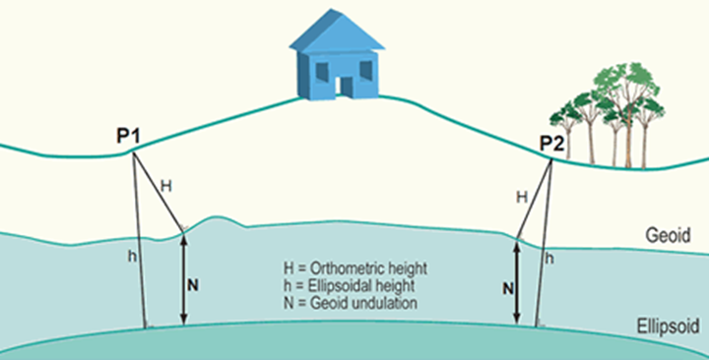
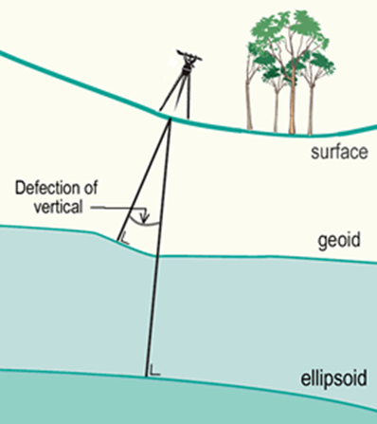
Deflection of the Vertical
We are used to seeing this formula for obtaining heights when using GNSS:
h=H+N
Notes:
The formula, h=H+N or Ellipsoid height = Orthometric height + Geoid undulation is familiar to us when using GNSS.
<CLICK>
But, as you can see from this picture that the vertical is not truly perpendicular to the ellipsoid but is perpendicular to the geoid, therefore we must take into account the deflection of the vertical in order to obtain the best orthometric height we can.
<CLICK>

Slide 12
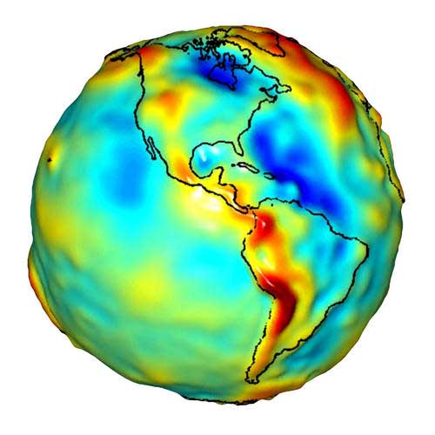
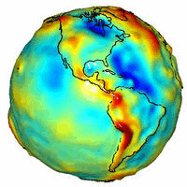
Earth
GRS 80
NAD 83
  b = 6,356,752.31414 m
Squash the sphere to fit at the poles
  a= 637813.000007 meters
  b= 6356752.31414 meters
  f= 1/((a-b)/a) = 298.2572220972
  a = 6,378,137.00000 m
Notes:
This shape
<CLICK>
is our reference for NAD83 and the GPS system. Both horizontal and vertical coordinates originate with this surface. The Pythagorean concept of a spherical Earth offers a simple surface which is mathematically easy to deal with.
While the sphere is a close approximation of the Earth and satisfactory for many purposes, it does not give us the accuracy necessary.
So we
<CLICK>
squash the sphere at the poles.
<CLICK>
Then we put that figure in revolution and this is what we call the reference ellipsoid.
<CLICK>

Slide 13
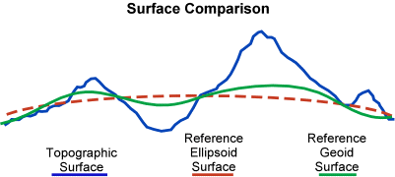
Notes:
This is the relationship between the reference ellipsoid, the reference geoid, and the actual surface of the Earth. Keep in mind geoid exists approximately at mean sea level (MSL).
<CLICK>

Slide 14
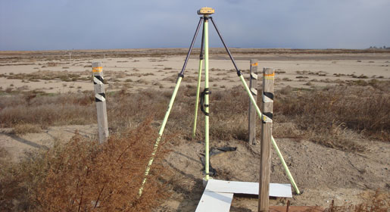
New Datums are coming in 2022!
Both a new geometric (horizontal) and a new geopotential (vertical) datum will
be released in 2022.
The realization of the new datums will be through GNSS receivers.
NGS will provide the tools to easily transform between the new and old datums.
Notes:
Yes, we just changed from NAD83(CORS96) to NAD83(2011) but now is the time to think about the next generation of horizontal and vertical datums because this will be a huge change.
<CLICK>
Soon to be gone are the days of traditional Monumentation. With the release of the new datums, all coordinates will be accessed through GNSS receivers.
<CLICK>

Slide 15
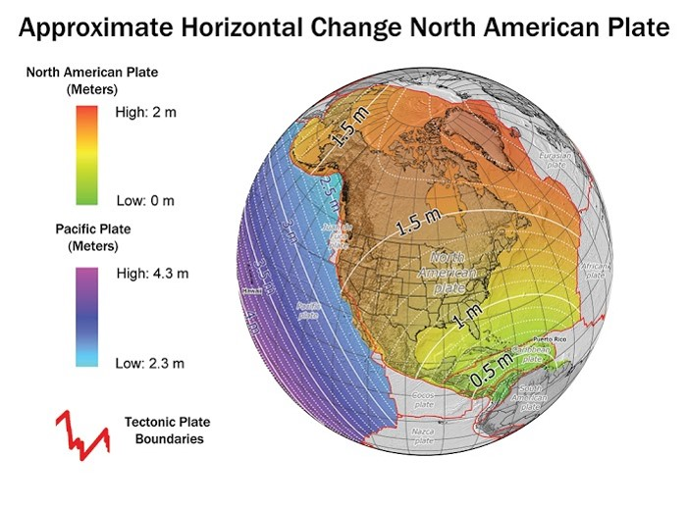
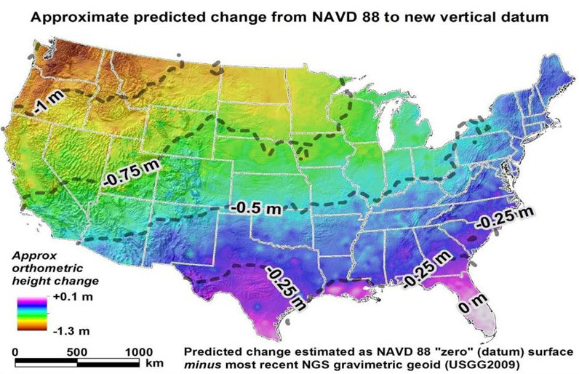
How will the New Datums affect you?
The new geometric (Horizontal) datum
will change latitude, longitude, and ellipsoid height by between 1 and 2 meters.
The new vertical (geopotential) datum will change heights on average 50 cm (20''), with a 1 meter (39'') tilt towards the Pacific Northwest.
Notes:
As noted, this will not be a minor change as we have been seeing in recent years. The coming changes will be more like the previous big changes, NAD27 to NAD83 and NGVD29 to NAVD88. There will be both a change in horizontal and vertical positions of every point in the state.
<CLICK>
The shift in elevation on average will be about 50 cm.
From the map it appears that there isn’t much vertical change caused by the geopotential datum in Florida but there will be change due to the shift in origin of the ellipsoid. In other words the change from hybrid geoid to geopotential geoid will not cause as much change as the shift in origins.
<CLICK>

Slide 16

Why isn’t NAVD 88 good enough anymore?
Approximate level of geoid mismatch known to exist in the NAVD 88 zero surface:
Notes:
This map indicates that the current geoid is relatively good in Florida, but remember with the new datums, there will be a 1.6 meter shift in the origin of the ellipsoid which will cause the elevations to change.
<CLICK>
Why the shift?
<CLICK>

Slide 17
Simplified Concept of NAD 83 vs. ITRF
Earth’s Surface
h_{NAD83}
h_{ITRF}
h_{NAD83} – h_{ITRF} varies
smoothly by latitude
and longitude
ITRFxx origin
~1.6 m
NAD 83 origin
Notes:
The ITRF or WGS84 does not have the same origin point as NAD83. Better knowledge of the center of mass of the earth has caused a revision of the world geodetic system but NAD83 has remained fixed where it was placed in 1986.
It is the shift <CLICK> from the 1986 origin to the current ITRF origin that will occur in 2022.
Online Poll
With all this in mind, how often would you like coordinates updated?
Yearly
Monthly
Weekly
Or
Daily
<CLICK>

Slide 18
Questions?

