Slide 1
FPRN GEOID 2016
Presented by George Massey, PSM
Florida Department of Transportation

Slide 2
FPRN GEOID 2016
WHY?
Usefulness of any Geoid model is limited by data density and distribution.
NGS Hybrid Geoid philosophy limits current usefulness to surveyors.
Rigorous Math vs. Survey Practical
Geoid 12A/B is good in a relative sense – not so good in an absolute sense.
FPRN (RTK mode) requires a Geoid to be functional in the absolute sense.
Gravity based Geoid model from NGS will not be available until 2022 +.
Notes:
Why would we take the time to develop another geoid model?
Usefulness of any Geoid model is limited by data density and data distribution.
NGS Hybrid Geoid philosophy limits current usefulness of Geoid12B..
Rigorous Math vs. Survey Practical
Let me give you an overly simplistic analogy. Let’s say you run a bench loop between two published benchmarks that are one mile apart, setting two new marks along the way. Then you run back to the first benchmark. You are required to meet the Standards of Practice error closure requirements. You used a new barcode level in good adjustment and your error of closure back on the first mark is .002’, which is very typical for your crew using this instrument. But you missed the published orthometric height on the second mark by .03’. How do you adjust the loop?
As a surveyor, I would hold the published orthometric heights on the two known marks and let the level loop take .03’ adjustment.
As a mathematician I would let both published mark orthometric heights float and constrain the new measurements to .002”. The result would be new orthometric heights on the two existing marks. So each existing mark would now have a new orthometric height in my work that would probably be about .02’ different from their previously published values. The justification for doing this is that the previously published orthometric heights on the two existing benchmarks are a result of measurements that contain errors much greater than the .03’ they were allowed to adjust in this analogy.
NGS treated benchmark geoid heights in Geoid 12B as measurements which were allowed to take adjustment.
Dr. Hintz, who produced our Geoid model, treated benchmark geoid heights in FPRN Geoid 2016 as fixed values.
Geoid 12A/B is good in a relative or differential sense – not so good in an absolute sense.
In a relative sense general systematic biases can be self-canceling. In an absolute sense the biases remain.
NGS understands this and plans to remove a lot of systematic error from their current model when they produce a gravity-based model in 2022.
FPRN (in RTK mode) requires a Geoid to be functional in the absolute sense.
The FPRN station ellipsoid height values were not developed through the application of a Geoid model. They are directly measured from the NGS CORS Network.
Gravity based Geoid model from NGS will not be available until 2022 +.
We look forward to using it in conjunction with the FPRN but we wanted a better model now.

Slide 3
FPRN GEOID 2016
WHY NOT…
Densify the data? (FDOT has 1000+ Florida benchmarks with horizontal positions and measured ellipsoid heights not used in Geoid12A/B)
Remove NGS style mathematical correctness? (To fit Survey thinking)
Do it now?
Notes:
Read the slide

Slide 4
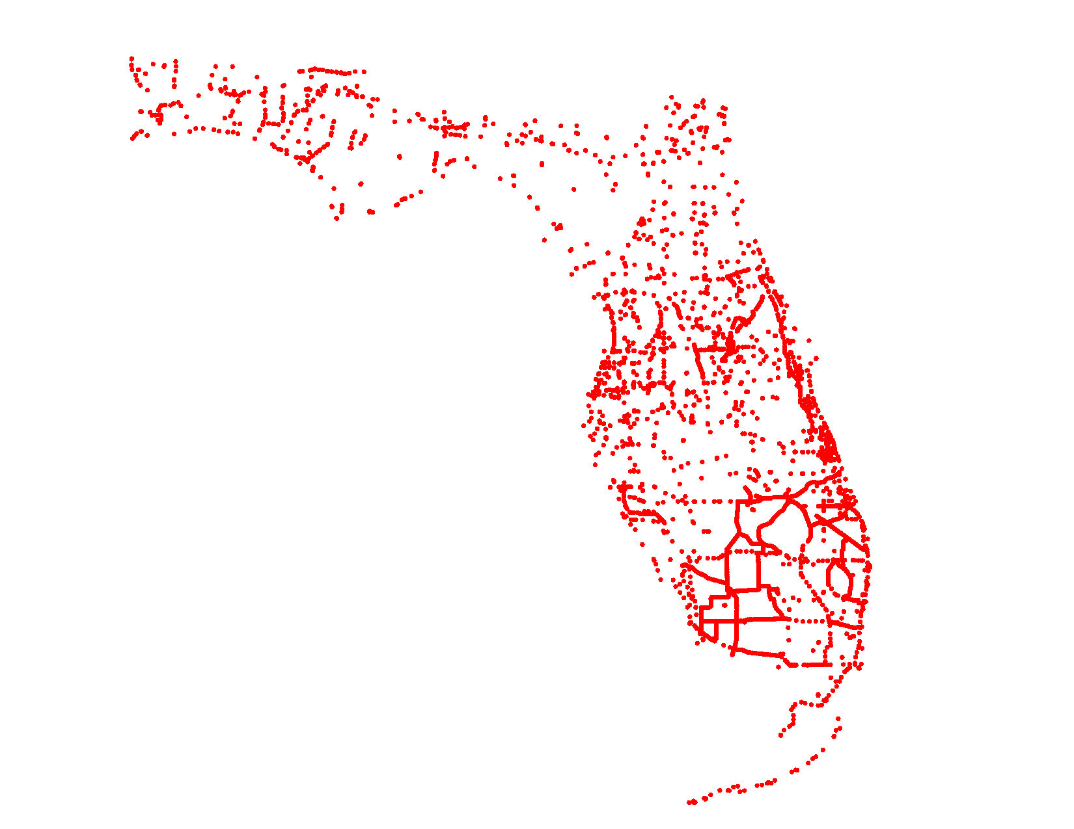
Benchmark Locations in FPRNGD16
2470 BM’s available for Florida Geoid12B
.08 m tolerance used as in FPRNGD16
Resulting in RMS of fit .022 m
Resulting in 1712 BM’s fitting better than .01 m
3472 BM’s available for FPRNGD16
3354 BM’s met .08 m tolerance
Resulting in RMS of fit .008 m
Resulting in 3025 BM’s fitting better than .01 m
Notes:
Shown here is a map of red dots representing the location of the benchmarks used in Geoid12B plus the additional benchmarks added to the model for FPRNGD16.
Dr. Hintz performed some statistical comparisons between Geoid12B and FPRNGD16
He subjected both Geoids to the same tolerance of .08 meters for rejecting benchmarks. Both models share the NGS grid spacing for their respective data files. For the comparisons Dr. Hintz did not interfere with the basic underlying philosophy attached to each network. The results were an RMS of fit for Geoid12B of .022 meters and .008 meters for FPRNGD16.
When the smoke settled Geoid12B had 1712 benchmarks that fit better than .01 meters while FPRNGD16 had 3025 benchmarks that fit better than .01 meters.

Slide 5
FPRN GEOID 2016
Where did the extra Benchmarks come from?
FDOT Benchmarks that were never Bluebooked
(853 BMs)
FDOT Height Mod participation
(149 BMs published in OPUS)
Notes:
Where did the extra Benchmarks come from?
853 historic FDOT Benchmarks that were never Bluebooked
149 benchmarks that were observed in 2014 and 2015 for the NGS height mod program. FDOT submitted these benchmark observation to OPUS for publication but they were obviously observed and submitted too late for inclusion in Geoid12B.

Slide 6
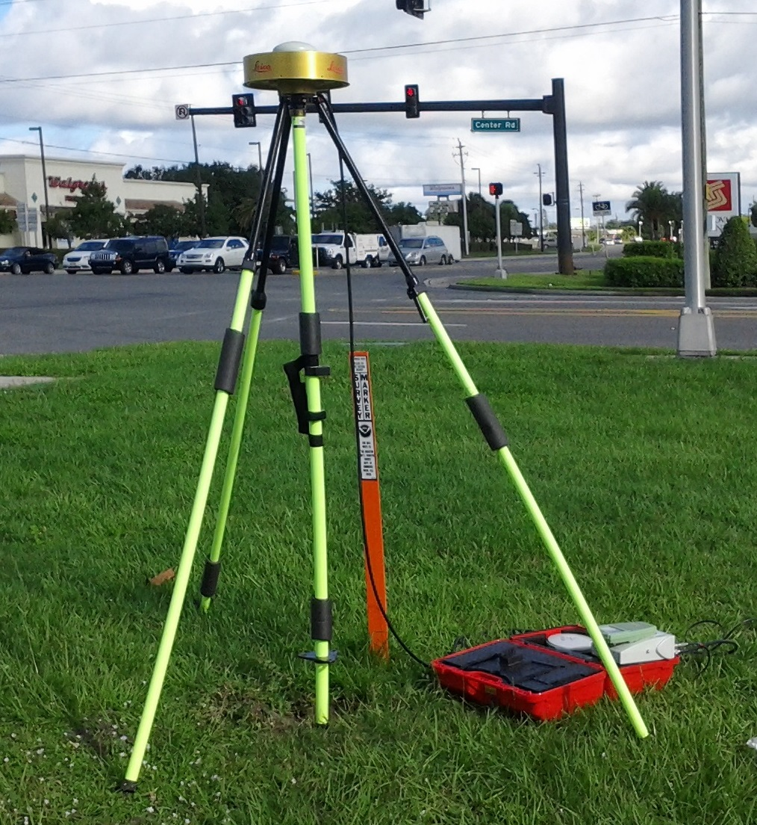
FPRN GEOID 2016
Height Mod Data Collection Rig
AR20 Choke Ring antenna
(same as FDOT CORS)
2-meter fixed height pole
Duel frequency GPS/GLONASS receiver
Notes:
All of the benchmarks observations submitted to OPUS were collected with the rig you see on this slide. A choke ring antenna and a 2 meter fixed height pole were used and duel frequency GPS and GLONASS data were recorded for a minimum of 4 hours at each benchmark. Data was not submitted to OPUS until the final precise satellite ephemerides were published. Additional processing of the data was performed in Leica GeoOffice and at the Canadian Precise Point Positioning website.
As a side note, the antennas used to occupy the benchmarks were identical to the antennas receiving data at the FDOT CORS sites. So, in addition to the benefits of multipath rejection with this antenna, we eliminated any potential antenna bias when we performed differential processing between FPRN CORS data and the benchmark data. Though there probably would not have been much antenna bias had we used a different antenna as we incorporated absolute antenna calibration data supplied by NGS in all our processing.
We ended up using the results from the Canadian processing for the coordinates (including ellipsoid heights) for building the FPRNGD16 data set.

Slide 7
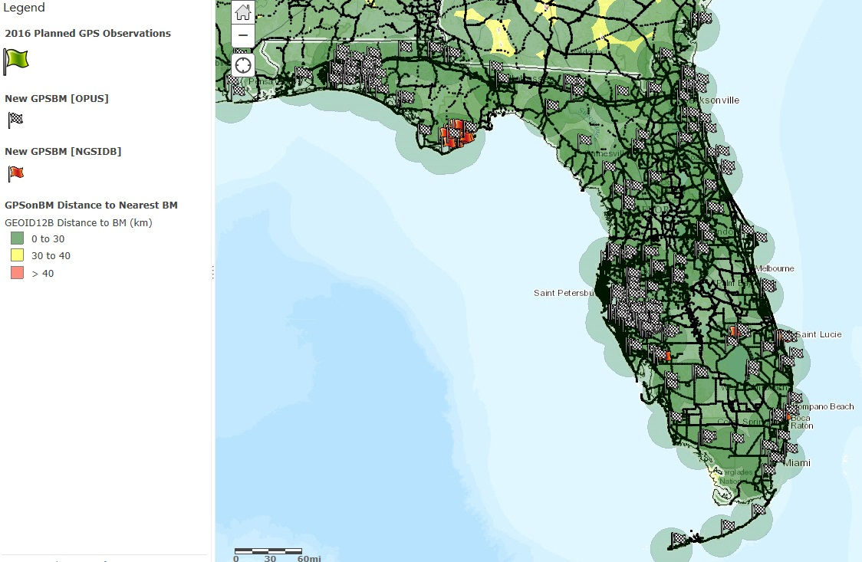
149 of the checkered flags represent OPUS BMs included in FPRNGD16
Notes:
This slide was borrowed from the NGS website. It shows all the OPUS published benchmarks in Florida as checkered flags, many of which were submitted by the Florida DOT.

Slide 8
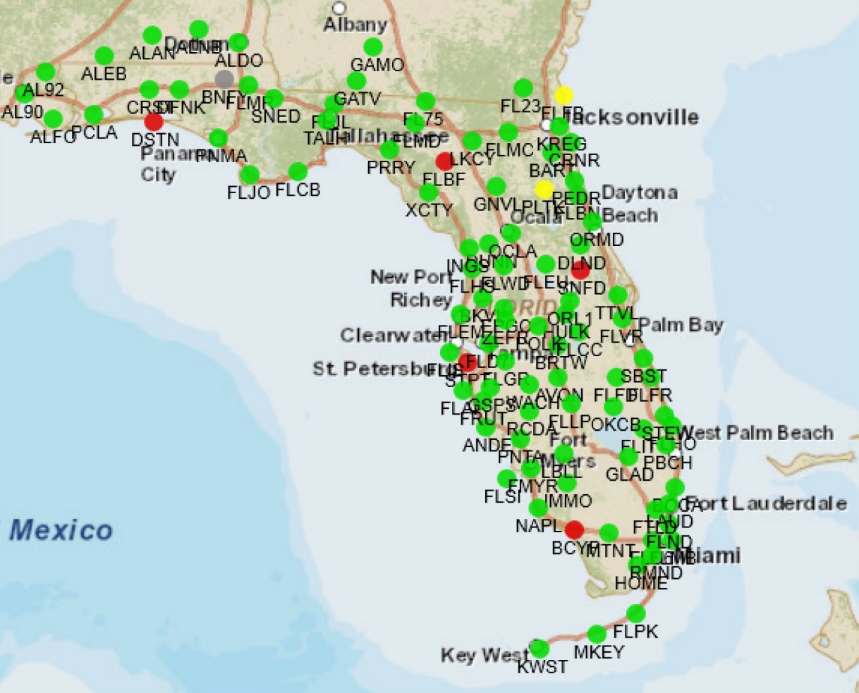
http://www.dot.state.fl.us/surveyingandmapping/fprnstat/index.html
Of the 29 CORS sites registered in NGS system, 22 were established by FDOT
The other sites include FDOT CORS (not in NGS System) and various co-op sites.
Notes:
This is a screen capture from a couple of weeks back of the FPRN network. We collected GNSS benchmark data for OPUS in the vicinity of every station in the State of Florida shown on this map.

Slide 9
FPRN GEOID 2016
How do you make use of FPRNGD16?
If you use the NGS interpolation program (intg.exe) for Geoid12B, substitute our g2012bu7.bin for the NGS-supplied file with the same name. Then execute intg.exe as before.
If you use Leica LGO software, create a FPRNGD16B folder, populated with FPRNGD16B.exe and g2003u07.bin. Then within LGO create a Geoid called FPRNGD16B that points to the folder by the same name.
For data collectors requiring special files we have available FPRNGD16B.gem for Leica, FPRNGD16B.GGF (thank you GPServ.Inc) for Trimble and FPRNGD16.GSF (thank you Carlson Software) for Carlson.
Notes:
How do you make use of FPRNGD16?
If you use the NGS interpolation program (intg.exe) for Geoid12B, substitute our g2012bu7.bin for the NGS-supplied file with the same name. Then execute intg.exe as before.
However, our data file only covers the State of Florida where the NGS data file with the same name covers large portions of southeastern United States beyond the Florida border.
If you use Leica LGO software, create a FPRNGD16B folder, populated with FPRNGD16B.exe and g2003u07.bin. Then within LGO create a Geoid called FPRNGD16B that points to the folder by the same name.
For data collectors requiring special files we have available FPRNGD16B.gem for Leica, FPRNGD16B.GGF (thank you GPServ.Inc) for Trimble and FPRNGD16.GSF (thank you Carlson Software) for Carlson.

Slide 10
FPRN GEOID 2016
We are currently in Beta test mode
The geoid related files must currently be requested from FPRN support staff
We are asking Beta testers to supply feedback when collecting GNSS data on existing benchmarks

Slide 11
Support
FPRN GEOID 2016
www.dot.state.fl.us/surveyingandmapping/fprn.shtm
Ron Hanson (Tuesday – Saturday)
  (850) 414-4254 Office
  (850) 510-8596 Cell
  ronald.hanson@dot.state.fl.us
Scott Harper (Sunday – Thursday)
  (850) 414-4596 Office
  (850) 728-1240 Cell
  scott.harper@dot.state.fl.us
Notes:
If you are interested in obtaining our Geoid model please go to our website
Or
contact either Ron
Or
Scott
either will set you up.
I will put this slide back up at the end of my presentation so you will have time to write their contact information down.

Slide 12
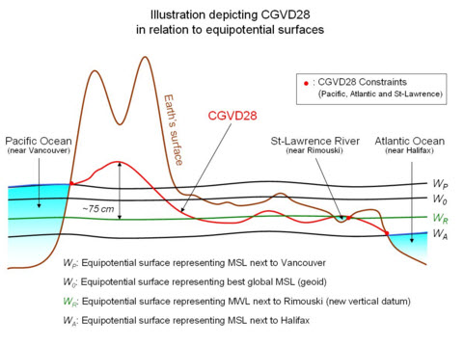
Notes:
These next 2 slides show vertical datum fundamentals and relationships that are obligatory for any geoid/ellipsoid discussion. I borrowed them from a Canadian website to give you something a little different to look at. The red wavy line labeled CGVD28 on this slide is very comparable to our NGVD29 datum that was constrained by sea level on both the Atlantic and Pacific coastlines. It also shows the effects of the mountain ranges out west. The green wavy line is the Canadian version of NAVD88 and shows the common benchmark at Father’s Point near Rimouski Canada on the St. Lawrence River that was common to all three previous data that were combined to form NAVD88. Namely CGVD28, NGVD29 and the Great Lakes Datum.
As a side note, I do not believe Canada ever formally adopted the NAVD88 datum labeled the new vertical datum on this slide.

Slide 13
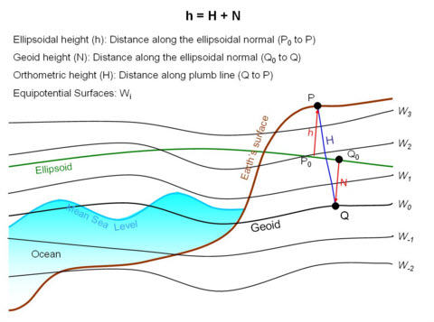
Notes:
And this slide, also borrowed from a Canadian website, shows the fundamental relationships between ellipsoid height, geoid height and orthometric height with equipotential surfaces and the earth’s surface thrown in for reference.

Slide 14
FPRN GEOID 2016
Questions?
Notes:
Let me display the contact information I said I would go back to at the end of my presentation while I attempt to answer any questions you may have.

Slide 15
Support
FPRN GEOID 2016
www.dot.state.fl.us/surveyingandmapping/fprn.shtm
Ron Hanson (Tuesday – Saturday)
  (850) 414-4254 Office
  (850) 510-8596 Cell
  ronald.hanson@dot.state.fl.us
Scott Harper (Sunday – Thursday)
  (850) 414-4596 Office
  (850) 728-1240 Cell
  scott.harper@dot.state.fl.us

