Slide 1
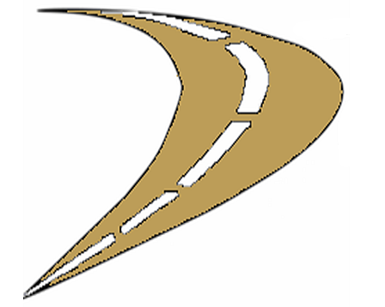
Florida Permanent Reference Network Where are we headed now?
2015

Slide 2
Network Realignment
L5 Broadcast
Height Modernization
Gulf Coast Spatial Reference Consortium
Gravity Measurements
Future Technologies

Slide 3
Network Realignment
All stations within network will offer GLONASS
30 new stations
18 stations decommissioned
7 stations transferred to FDOT control
Possible Off-Shore stations

Slide 4
Notes:
Existing NGS CORS Sites not in FPRN network

Slide 5
Notes:
FDOT - NGS-CORS Sites

Slide 6
Notes:
FPRN & Cooperative Sites within National CORS Network

Slide 7
Notes:
FPRN Network June 2014

Slide 8
Notes:
Sites to be decommissioned

Slide 9
Notes:
Sites transferred to FDOT control

Slide 10
Notes:
Proposed Sites

Slide 11
Notes:
Final Proposed Network

Slide 12
Notes:
Proposed Network showing 35 km coverage areas

Slide 13
Notes:
Proposed network with USCG stations

Slide 14
Notes:
Entire network with 35 km coverage areas

Slide 15
L5 Broadcast
Most advanced Civilian signal
Increased multipath mitigation
Trilaning – achieve sub-meter accuracy without augmentation
Future: No need for codeless or semi-codeless receivers

Slide 16
Height Modernization
GPS observations on 1st order NGS Benchmarks
Adjust ellipsoid heights to match local benchmarks
GEOID 12A will match orthometric heights

Slide 17
Gulf Coast Spatial Reference Consortium
Texas, Louisiana, Mississippi, Alabama, and Florida
Gulf Coast Height Modernization
Gulf Coast Digital Elevation Model
Gravity measurements at GNSS Reference Stations
Monitor subsidence along Gulf Coast
Sedimentation monitoring

Slide 18
Gravity Measurements
GCSRC partner (TA&MCC) has purchased A10 Gravimeter
Gravimetric measurements at FPRN stations along Gulf

Slide 19
Future Technologies
SBAS
Locata
Low Orbit Satellites

Slide 20
Title

