Slide 1

Okay I’m Connected . . .
Now what ???
Speaker: Ron Hanson
Notes:
The Florida Permanent Reference Network or FPRN is a taxpayer funded Global Navigation Satellite System reference network that supplies Real-Time Kinematic (RTK) solutions to its end-users. One of the biggest problems with RTK users is the selection of a “product”. Hopefully this discussion will steer you in the right direction.
<CLICK>

Slide 2
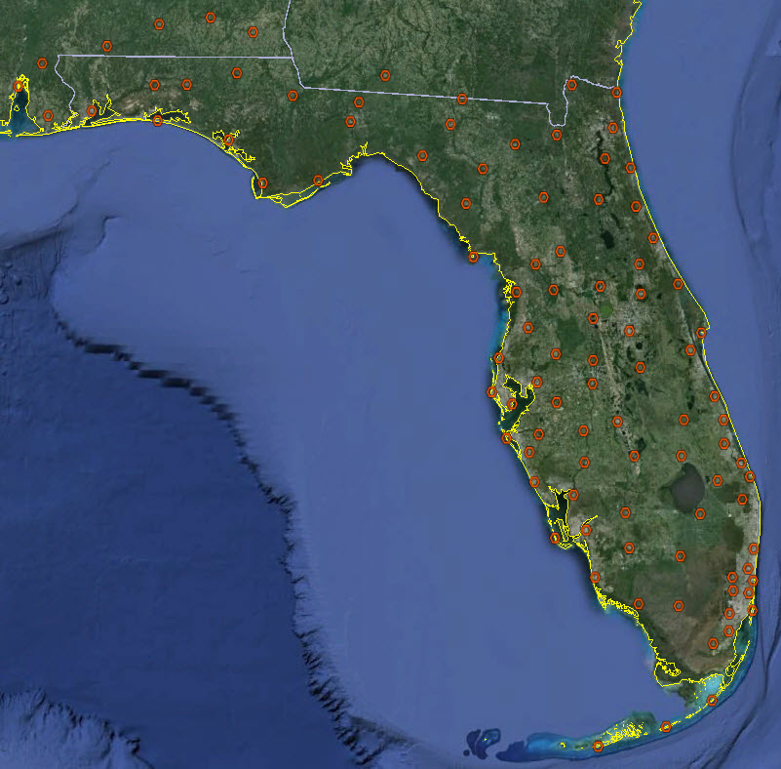
Notes:
Now that you have connected to the FPRN . . . Where do you go from here???
<CLICK>
We will need to know a few things before we can collect data.
What language will be used.
What protocol will be used.
What FPRN product will be used.

Slide 3
Supported Languages
RTCM 2.x
  Used for RTK
  Includes NRTK
  Includes GLONASS
  Ideal for Legacy Sensors
CMR(+)
  Used for RTK
  Includes NRTK
  More efficient than RTCM 2.x
  Only for GPS
  GLONASS extension still proprietary
RTCM 3.x
  Used for RTK
  Includes NRTK
  Includes GLONASS
  More efficient than RTCM 2.x
  Lower bandwidth than CMR(+)
Notes:
Let’s start with language, the FPRN supports the three major open source languages:
<CLICK>
RTCM 2.x which is used for Real Time Kinematic (RTK), Networked Real Time Kinematic (NRTK), uses GLONASS signal, and is ideal for legacy Sensors.
<CLICK>
CMR+ is used for RTK, NRTK, and is more efficient the RTCM 2.x
However it can only be used with GPS since the GLONASS extension is still proprietary.
<CLICK>
And finally, RTCM 3.x which is also used for RTK, NRTK, includes GLONASS, is more efficient that RTCM 2.x, and has a lower bandwidth that CMR+.
<CLICK>

Slide 4
Supported Protocols
NTRIP
  Multiple languages per port
  Multiple products per port
  Works with NRTK
  Works with Automatic Nearest
  Works with Zones
TCP/IP
  One language per port
  One product per port
  Works with NRTK
  Works with Automatic Nearest
Notes:
Followed by protocol, the FPRN supports two basic protocols for receiving real time corrections:
<CLICK>
NTRIP supports multiple languages per port, multiple products per port, supports NRTK products such as MAX, VRS, and Automatic Nearest.
<CLICK>
And TCP/IP which only supports one language per port and one product per port, however it does support NRTK products MAX, VRS, and Automatic Nearest.
<CLICK>

Slide 5
FPRN Products
Single Baseline
  Direct Connect (TCP/IP)
  State Wide (NTRIP)
  District Wide (NTRIP)
Network Solutions
  Automatic Nearest
  FKP
  MAX
  VRS
GIS Corrections
Notes:
Finally Product, the FPRN offers three types of real-time products:
<CLICK>
Single Baseline can be accessed through direct connect (TCP/IP), a State-wide NTRIP caster, and a District-wide NTRIP caster.
<CLICK>
The Network solutions offered by the FPRN are: Automatic Nearest, FKP, MAX (including iMAX), and VRS.
<CLICK>
We also provide GIS corrections through a NTRIP caster.
<CLICK>

Slide 6
What solution is best for me ?
FKP iMAX MAX VRS
Notes:
Single baselines are pretty simple concepts, so lets discuss Real Time Network Solutions.
<CLICK>
ALL these acronyms can be very confusing. How do you pick the right solution?
<CLICK>

Slide 7
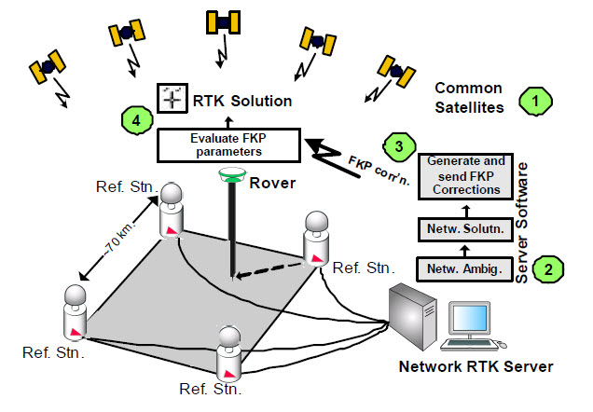
FKP
Notes:
FKP is the oldest Network RTK solution and was developed in the late 1990s.
The FKP method is a broadcast method and does not require the RTK rover to send its current position to the network central server. Instead,
the server models the distance dependent errors and sends RTK data from one reference station within the network to the rover, along with
the model.
The FKP method creates area corrections parameters represented as simple planes (East-West and North-South gradients) that are valid for a
limited area around a single reference station.
The method uses unpublished algorithms to generate Network RTK corrections and is therefore non-standardized.
Since the method is non-standardized, we cannot be sure if FKP maximizes the use of all satellite data or not.
In this method the server calculates the network solution (area correction parameters) to reduce the distance dependent errors. This means the
network solution is not optimized for the rover’s position and might be limiting the RTK solution.
The RTK corrections are related back to a real reference station and are therefore traceable and repeatable.
The rover evaluates the area correction parameters at its current position to generate corrections. Combining these corrections with the RTK
data from one of the reference stations, consistent RTK solutions (positions and accuracies) can be computed – provided that the rover does
not move far from the reference station that the FTP parameters are linked to.

Slide 8
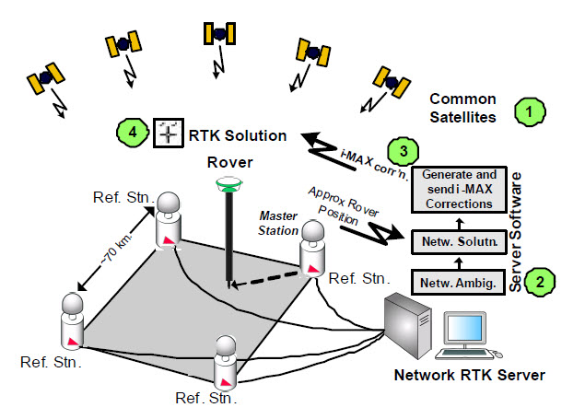
imax
Notes:
i-MAX or individualized Master Auxiliary Concept is classed as individualized that require the rover to send an approximate
position to the server.
i-MAX uses unpublished algorithms to generate Network RTK corrections and is therefore non-standardized.
The server calculates the network solution to reduce the distance dependent errors. This means the network solution is not
optimized for the rover’s position and might be limiting the RTK solution.
i-MAX generates RTK corrections that simulate single reference RTK. This limits the satellite data made available to the rover, therefore
risking that in certain circumstances an RTK solution will not be possible.
The i-MAX method generates corrections for a real reference station.
Since the corrections are related back to a master station. This means that the baseline between the master station and the measured
point can always be directly re-measured. Therefore, the measurements are traceable and repeatable.
The i-MAX corrections are dynamically updated to follow the movement of the rover. In addition, i-MAX corrections are related
back to a real reference station (the master station). This means that the resulting positions and accuracies are consistent.

Slide 9
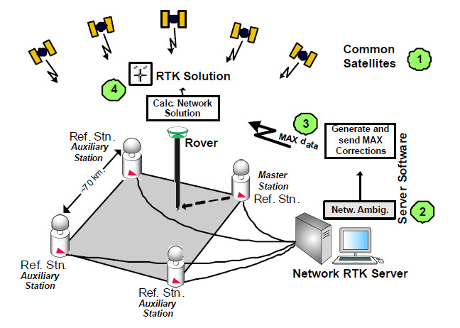
MAX
Notes:
In the Master Auxiliary Concept the Network RTK server sends full raw observations and coordinate information for a single reference station,
the Master Station. For all other stations in the network (or a suitable subset of stations), known as auxiliary stations, their ambiguity reduced
observations and coordinate differences (to the Master Station observations and coordinates) are transmitted.
MAX uses published algorithms to generate and send Network RTK corrections and is therefore a standardized method. In addition, the data is
always traceable to real reference stations.
The Master Auxiliary Concept gives the rover the flexibility to perform either a simple interpolation of the network corrections like FKP, or a more
rigorous calculation (e.g. calculate multiple baselines from the auxiliary reference stations). This means the rover can monitor the RTK solution
and change its calculation on-the-fly to optimize the RTK solution.
With these MAX data the rover can reconstruct the ambiguity-reduced data of every reference station. Therefore, maximizing the use of all
satellite data to calculate the best possible RTK solution.
The rover has the possibility to adapt to the prevailing atmospheric conditions by using an appropriate number of reference stations (e.g. to
model larger scale atmospheric activity). This means the rover can ensure that the RTK solutions (positions and accuracies) are consistent
throughout a survey.
The MAX corrections allow the rover to measure a baseline to the master station – a real reference station. Therefore, the measurements are
traceable and repeatable.

Slide 10
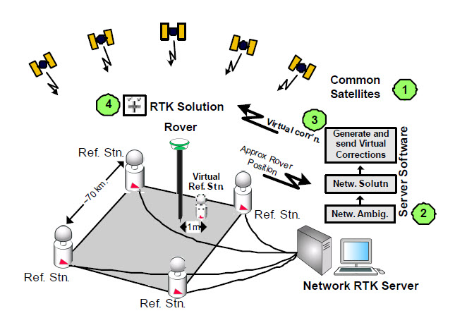
VRS
Notes:
VRS is classified as individualized which requires the rover to send an approximate position to the server.
VRS uses unpublished algorithms to generate Network RTK corrections and is therefore non-standardized.
The server calculates the network solution to reduce the distance dependent errors. This means the network solution is not
optimized for the rover’s position and might be limiting the RTK solution.
VRS generates RTK corrections that simulate single reference RTK. This limits the satellite data made available to the rover, therefore
risking that in certain circumstances an RTK solution will not be possible.
The VRS method generates corrections based on a virtual reference station.
With the Virtual Reference Station method the rover does not receive any observations related to a real reference station. This means that the
baseline between the virtual reference station and the measured point cannot be directly re-measured. This violates the fundamental surveying
principles of traceability and repeatability
The VRS corrections are optimized for the rover position at the beginning of the RTK session (i.e. after connecting to the Network RTK service).
If the rover then moves a considerable distance within the same session (i.e. without disconnecting and reconnecting) the corrections might
not be appropriate for the new rover location.

Slide 11
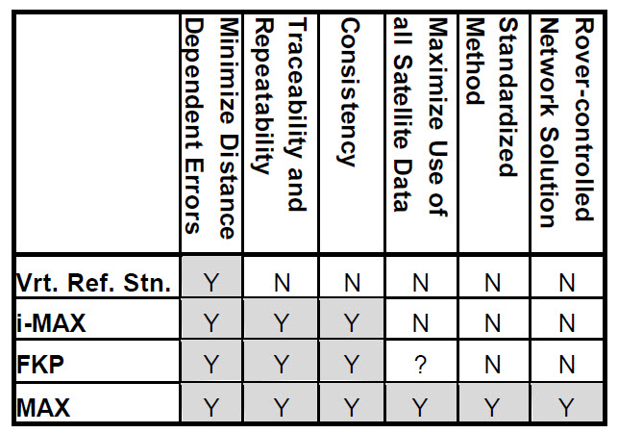
Conclusion
Notes:
This chart shows the pros and cons of each of the discussed Network RTK solutions.

