Slide 1
Florida Permanent Reference Network
Today and Tomorrow
Speaker: Ron Hanson
Course number: 8493
Notes:
The Florida Permanent Reference Network or FPRN is a taxpayer funded Global Navigation Satellite System reference network that is owned and maintained by the Florida Department of Transportation, Office of Design, Surveying and Mapping Division.
Since its creation in 2001, the FPRN has changed very little, with the exception of having a station added every so often.
<CLICK>

Slide 2
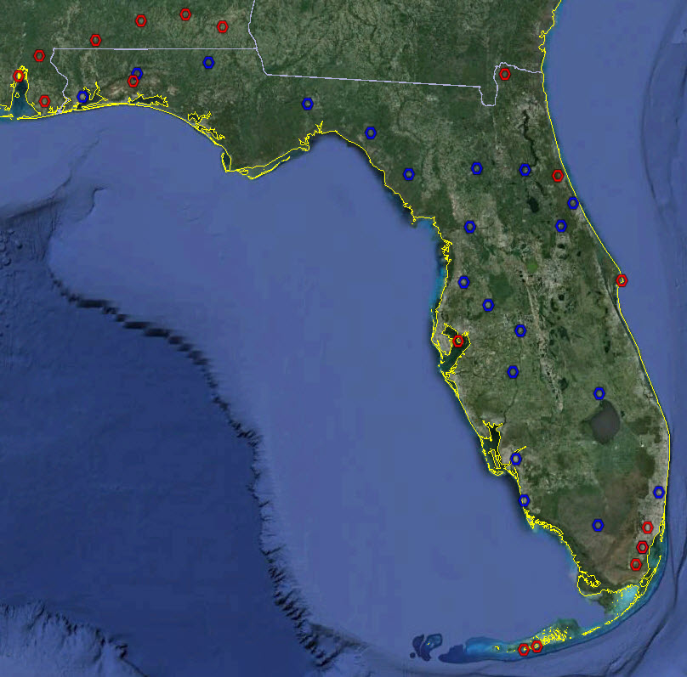
Notes:
In the Beginning the FPRN augmented the National CORS network and provided static GPS data
<CLICK>

Slide 3
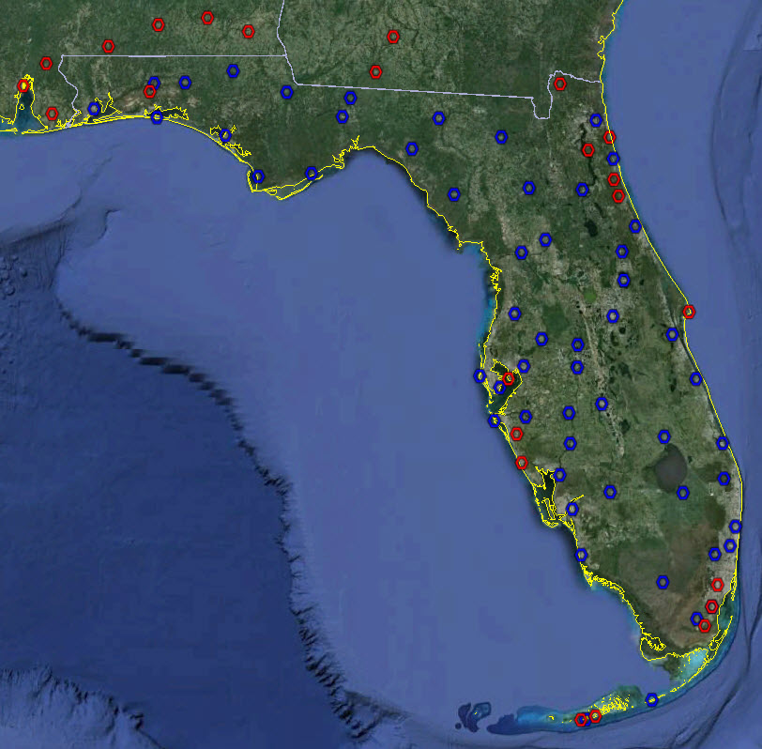
Notes:
Over the next ten years stations were added and real-time corrections were provided. Now the FDOT operates over 60 GNSS stations throughout the State.
<CLICK>

Slide 4

Notes:
Together with our partner agencies the FPRN is working toward the goal of having State-wide coverage.
<CLICK>

Slide 5
Important FPRN Information
204.90.21.205
www.myfloridagps.com
www.dot.state.fl.us/surveyingandmapping/FPRN
Notes:
Now, Let’s talk about some important information when using the FPRN
<CLICK>
In order to receive real time corrections your GPS sensor must connect to IP address 204.90.21.205 and a specific port depending on the type of product you wish to receive. We will discuss those specific products in upcoming slides.
<CLICK>
Some of you are familiar with the web site www.myfloridagps.com.
<CLICK>
This site is being phased out In favor of our new web site.
<CLICK>
When using the FPRN to view the Dynamic Status Map, Download Rinex Data, Request Computations or simply learn more about the services offered you should navigate to www.dot.state.fl.us/surveyingandmapping/FPRN
<CLICK>

Slide 6
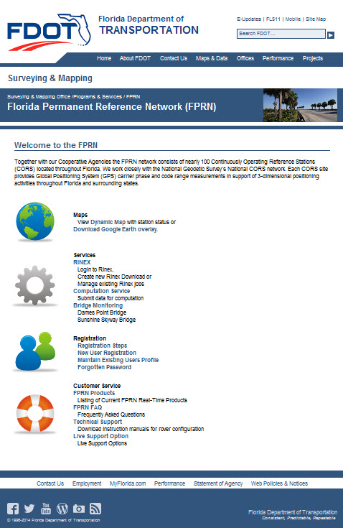
New FPRN Web Site
Maps
  Dynamic Site Status
    FDOT Enterprise GIS foundation
  Google Earth Overlay
Computation Service
  OPUS utilizes 32 sites
  FPRN utilizes 97 sites
Rinex Availability
  NGS/CORS provides data for 32 sites
  FPRN provides data for 97 sites
Notes:
Here’s a look at the new FPRN Web Site. Some of the key features are:
<CLICK>
Maps
We now have a dynamic status map that shows the status of each FPRN station. The Dynamic Map is built on the foundation of the FDOT Enterprise GIS.
We also offer a Google Earth overlay
<CLICK>
The FPRN offers a computation service similar to the NGS OPUS product but offers nearly 3 times the number of reference stations
<CLICK>
As always, the FPRN offers Rinex files for each of its 93 reference stations, which is almost 3 times the number of stations offered by NGS in the state of Florida.
<CLICK>

Slide 7
Supported Languages
RTCM 2.x
  Used for RTK
  Includes NRTK
  Includes GLONASS
  Ideal for Legacy Sensors
CMR(+)
  Used for RTK
  Includes NRTK
  More efficient than RTCM 2.x
  Only for GPS
  GLONASS extension still proprietary
RTCM 3.x
  Used for RTK
  Includes NRTK
  Includes GLONASS
  More efficient than RTCM 2.x
  Lower bandwidth than CMR(+)
Notes:
The FPRN supports the three major open source languages
<CLICK>
RTCM 2.x which is used for Real Time Kinematic (RTK), Networked Real Time Kinematic (NRTK), uses GLONASS signal, and is ideal for legacy Sensors.
<CLICK>
CMR+ is used for RTK, NRTK, and is more efficient the RTCM 2.x
However it can only be used with GPS since the GLONASS extension is still proprietary.
<CLICK>
And finally, RTCM 3.x which is also used for RTK, NRTK, includes GLONASS, is more efficient that RTCM 2.x, and has a lower bandwidth that CMR+.
<CLICK>

Slide 8
Supported Protocols
NTRIP
  Multiple languages per port
  Multiple products per port
  Works with NRTK
  Works with Automatic Nearest
  Works with Zones
TCP/IP
  One language per port
  One product per port
  Works with NRTK
  Works with Automatic Nearest
Notes:
The FPRN supports two basic protocols for receiving real time corrections:
<CLICK>
NTRIP supports multiple languages per port, multiple products per port, supports NRTK products such as MAX, VRS, Automatic Nearest, and also works with zones.
<CLICK>
And TCP/IP which only supports one language per port and one product per port, however it does support NRTK products MAX, VRS, and Automatic Nearest.
<CLICK>

Slide 9
FPRN Products
Single Baseline
  Direct Connect (TCP/IP)
  State Wide (NTRIP)
  District Wide (NTRIP)
Network Solutions
  Automatic Nearest
  FKP
  MAX
  VRS
GIS Corrections
Notes:
The FPRN offers three basic types of real-time products
<CLICK>
Single Baseline can be accessed through direct connect (TCP/IP), a State-wide NTRIP caster, and a District-wide NTRIP caster.
<CLICK>
The Network solutions offered by the FPRN are: Automatic Nearest, FKP, MAX (includes iMAX), and VRS.
<CLICK>
We also provide GIS corrections through a NTRIP caster.
<CLICK>

Slide 10
Port Schema
Port 10000 - Network Solutions (NTRIP)
iMAX Max Nearest FKP VRS
11000 series – Network Solutions (TCP/IP)
iMAX Max Nearest FKP VRS
Port 10800 – GIS Solutions
Panhandle North Central South
Notes:
We have tried to make the port schema as simple as possible.
<CLICK>
Port 10000 offers all Network solutions, in any of the three languages, through an NTRIP caster.
<CLICK>
The 11000 series ports also offer all Network Solutions just through a direct connect rather than an NRTIP caster.
<CLICK>
Port 10800 offers a GIS solution broadcast over a NTRIP caster. We have created the GIS product to work in four different zones.
<CLICK>

Slide 11
Port Schema
ABCDE
AB - Language
  23 – RTCM 2.3
  25 – CMR+
  31 – RTCM 3.1
C – District
DE – Station Designation
Notes:
Ever since we migrated the FPRN servers to a high availability network the port numbers have been five digits
<CLICK>
The first two digits represent the language of the product
<CLICK>
23 represents RTCM 2.x
25 represents CMR+
And 31 represents RTCM 3.x
<CLICK>
The third digit represents the FDOT District Number of the product
<CLICK>
And the forth and fifth digits represent the individual station designation
<CLICK>

Slide 12
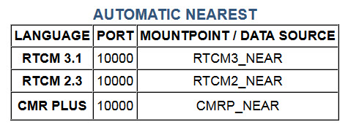
SINGLE BASELINE automatic (ntrip)
204.90.21.205
Notes:
The FPRN offers two basic solutions.
Single Baseline and Network Solution
One of the Single Baseline products is Automatic Nearest.
Here is a listing of the IP address, Port and Mountpoint for each of the three languages offered.
<CLICK>

Slide 13
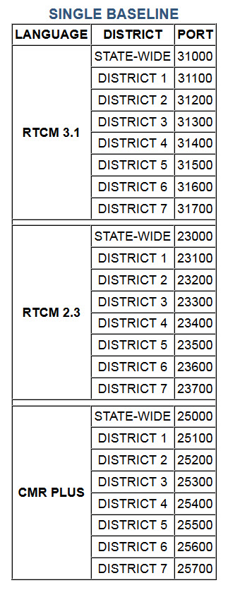
SINGLE BASELINE (ntrip)
204.90.21.205
Notes:
Other Single Baseline products are the State-wide caster and District-wide caster.
Here is a listing of the IP address and Port for the two wide-area casters in each of the offered languages.
The mountpoints will display on your rover once the sourcetable is loaded.
<CLICK>

Slide 14
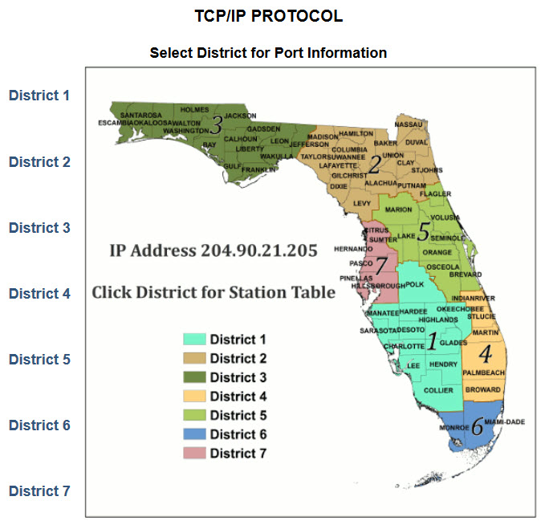
SINGLE BASELINE (tcp/ip)
204.90.21.205
Notes:
In case you are unfamiliar with the FDOT districts … here is a map showing the seven districts.
<CLICK>

Slide 15
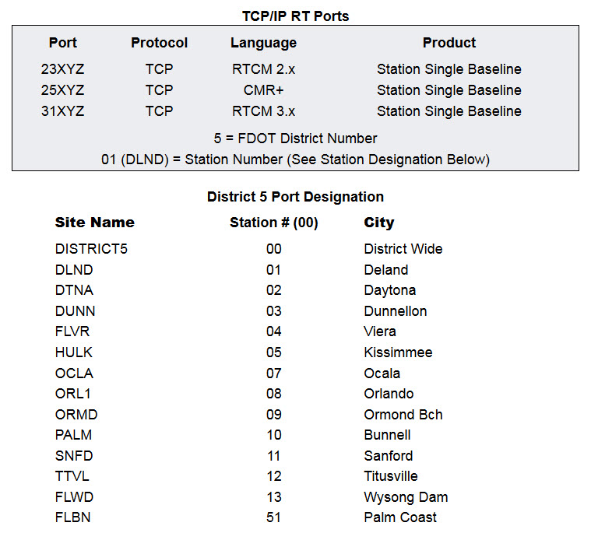
Single baseline (tcp/ip)
204.90.21.205
Notes:
Yet another single baseline product is offered through the TCP/IP. Use this attached matrix to obtain IP address, port number and mountpoint.
<CLICK>

Slide 16
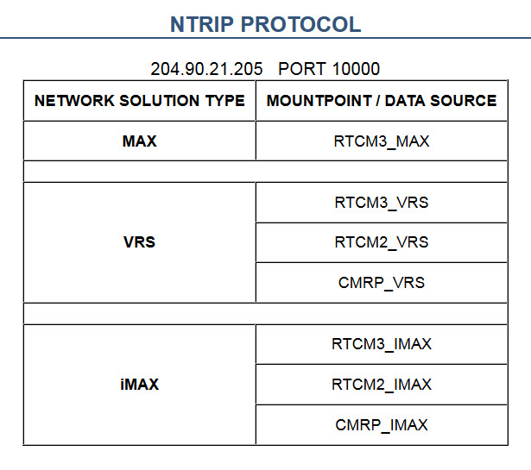
Network solutions (ntrip)
204.90.21.205
Notes:
The other solution type is network. Use this matrix to obtain IP address, Port, and Mountpoint for each protocol and language.
<CLICK>

Slide 17
Hardware Improvements
Server Migration
  Moved FPRN Servers to High Availability Network
Station Upgrades
  Upgraded to provide GLONASS
Communication Upgrades
  Upgrading from analog to digital
Coordinate Adjustment
  Adjusted coordinates to match NSRS - NAD 83 – 2011 (epoch 2010.00)
Notes:
In the past eight moths we have made significant improvements to the FPRN.
<CLICK>
First we migrated the Network software from the old FPRN servers to new high availability servers
<CLICK>
Second, we upgraded all the station hardware in order to provide the GLONASS constellation
<CLICK>
Currently, we are upgrading the communications segment from analog to all digital
<CLICK>

Slide 18
Scheduled Network Improvements
Height Modernization
  Obtaining precise ellipsoid heights for each station
Network Realignment
  Realigning stations to eliminate “gaps” in coverage
  Partner Agencies using FDOT “surplus equipment”
Notes:
What type of improvements can be expected from the FPRN in the future?
<CLICK>
First, we finished a network adjustment on August 2, 2014, so the FPRN matches NGS coordinates
<CLICK>
We are also working on height modernization across the entire network. Our goals are to provide and broadcast accurate local ellipsoid heights from each station. Which will result in better vertical accuracy for the end user.
<CLICK>
Finally, together with our partner agencies we are adding new stations in the areas of the state where the network is “weak”
<CLICK>

Slide 19

Notes:
Proposed stations will extend network coverage to the coastlines, the northern border, and increase coverage in Miami as well as rural areas.
<CLICK>

Slide 20
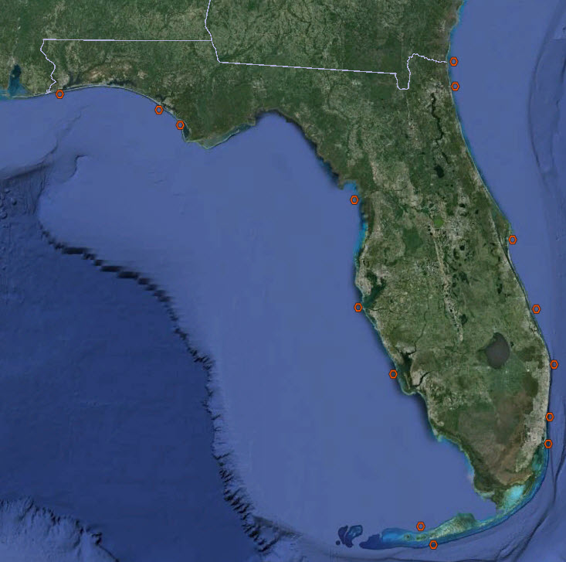
Notes:
We are also looking at placing reference stations on U.S Coast Guard range markers located 3 miles offshore.
<CLICK>

Slide 21
Network Limitations
Only as strong as weakest link
  GPS only in some areas
Outside Network?
  No Network Solution
Notes:
However not everything is perfect, the FPRN does have a few limitations
<CLICK>
The network is only as strong as its weakest link. Meaning in areas that have GPS only reference stations … only a GPS solution will be provided until realignment has taken place.
<CLICK>
What happens if you are outside the network?
If you are more than 3 kilometers outside the network, network solutions will NOT be provided. The system will automatically roll back to a single baseline nearest reference station product.
However, after realignment every location in Florida will be able to receive a network solution.
<CLICK>

Slide 22
Support
www.dot.state.fl.us/surveyingandmapping/fprn
Ron Hanson (Tuesday – Saturday)
  (850) 414-4254 Office
  (850) 510-8596 Cell
  ronald.hanson@dot.state.fl.us
Scott Harper (Sunday – Thursday)
  (850) 414-4596 Office
  (850) 728-1240 Cell
  scott.harper@dot.state.fl.us
Notes:
FPRN Products, frequently asked questions, and technical support can be found on our new web site.
<CLICK>
For live support options you can contact myself:
<CLICK>
Or Scott Harper
<CLICK>
Thank you
<CLICK>

Slide 23
http://www.dot.state.fl.us/surveyingandmapping/fprnstat/index.html
Notes:
FPRN Products, frequently asked questions, and technical support can be found on our new web site.
<CLICK>
For live support options you can contact myself:
<CLICK>
Or Scott Harper
<CLICK>
Thank you
<CLICK>

