Slide 1

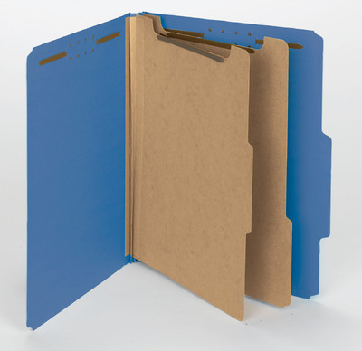
Close-out
  Documentation
  DISTRICT WIDE REQUIREMENT – The District has implemented the requirement of the “Blue Folder” for final LAP documentation. This needs to be used on every LAP project in Broward, Palm Beach and the Treasure Coast.
  The “Blue Folder” typically used is the SMEAD Legal Size 19021 with 2 dividers.

Slide 2
Close-out
  Documentation
  Tab 1
    CHECK LIST
    RECORD OF FINAL PLANS (FDOT – Form # 525-010-47)
    OVERRUN/UNDER RUN (if applicable)
    TIME DAY COUNTS – Similar to a Calendar File.
    NTP
    CHANGE ORDER WITH TIME (if applicable)
    L.D. ANALYSIS (Part of Form # 525-010-47)

Slide 3
Close-out
  Documentation
  Tab 2
    FINAL INVOICE
        Will be sent to the Program Coordinator by the Local Agency and reviewed by CEI/FDOT Oversight
    FINAL RELEASE OF LIEN
    CERTIFICATION OF PAYMENTS
        Certification of Compliance with EEO Form # 700-011-13 and
        Construction Compliance with Specs. And Plans Form # 700-020-02
    CONTRACTOR AFFIDAVIT AND SURETY CONSENT – Form # 700-050-21

Slide 4
Close-out
  Documentation
  Tab 3
    FINAL INSPECTION AND ACCEPTANCE FORM –
      Local Agency Program Final Inspection and Acceptance of Federal Aid Project Form # 525-010-42
  Tab 4
    MATERIALS CERTIFICATION LETTER
      Form # 525-010-300 is a sample
      This will have the Local Agency’s letterhead

Slide 5
Close-out
  Documentation
  Tab 5
  DBE SUBCONTRACTS – (If applicable)
Tab 6
  Form # 525-010-29 LAP Performance Evaluation
  CONSTRUCTION FINAL AUDIT – Will be done by CEI Oversight
  CONSTRUCTION INITIAL AUDIT – Will be done by CEI Oversight
  PHOTOS
    (a) Progress photos need to be taken before, during and at project completion by the CEI oversight and uploaded into LAPIT along with a monthly progress report.

