Slide 1
Stewardship and Oversight of
Local Public Agencies
Carolyn Winborne James
Office of Real Estate Services
May 24, 2011

Slide 2
Learning Objectives
Learn about the background that has led to an elevated interest in LPA administered Federal-aid projects.
Learn of the current status of the oversight of LPA administered projects nationally.
Develop a common understanding of the issues and concerns pertaining to LPAs and the Federal-aid Highway Program.
Learn about current initiatives going on regarding the oversight of LPA administered projects.
Be made aware of various Interest Group concerns and activities.
Notes:
Learning Objectives
Learn about the background that has led to an elevated interest in LPA administered Federal-aid projects.
Learn of the current status of the oversight of LPA administered projects nationally.
Develop a common understanding of the issues and concerns pertaining to LPAs and the Federal-aid Highway Program.
Learn about current initiatives going on regarding the oversight of LPA administered projects.
Be made aware of various Interest Group concerns and activities.

Slide 3
Dimensions of the Issue
Notes:
This section focuses on the details of trying to ascertain the extent of the LPA universe!

Slide 4
Why the recent focus on LPA Program Administration
In FY 2006:
High Priority area for national review by FHWA field and program offices.
Identified High Risk Area (In Divisions Top 10).
$6 - $8 Billion per year (approx. 20% of Federal-aid program).
28,000+ Local Government Entities.
Eligibility to receive Federal funds depends upon compliance with Federal and State laws, regulations and policies.
Identified in the2011-12 FHWA Strategic Implementation Plan under Project Delivery to develop procedures, training, and oversight guidance for the delivery of LPA projects.
Notes:
For FY 2006 the Office of Corporate Development’s Program Improvement Team solicited our field offices and various program offices for input as to what program areas the Agency needed to focus as part of its national review work. The LPA program ranked as the number one area in need of review. This was reinforced by the Agency, as part of its strategic planning process for FY2007, when it conducted program area risk assessments for which the oversight of the LPA program surfaced as high among the top ten risk areas reported by our Division offices. This program area has also been identified in the 2011-12 FHWA Strategic Implementation Plan under Project Delivery to develop procedures, training, and oversight guidance for the delivery of LPA projects.

Slide 5
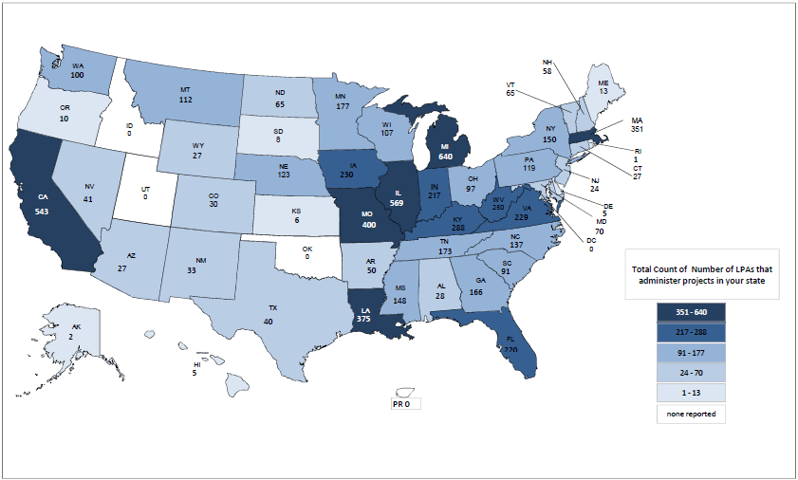
Number of LPAs Administering FA Projects
Source: HIF 2009 Survey
Notes:
The number of LPAs reported to be administering federal-aid projects in October 2009.

Slide 6
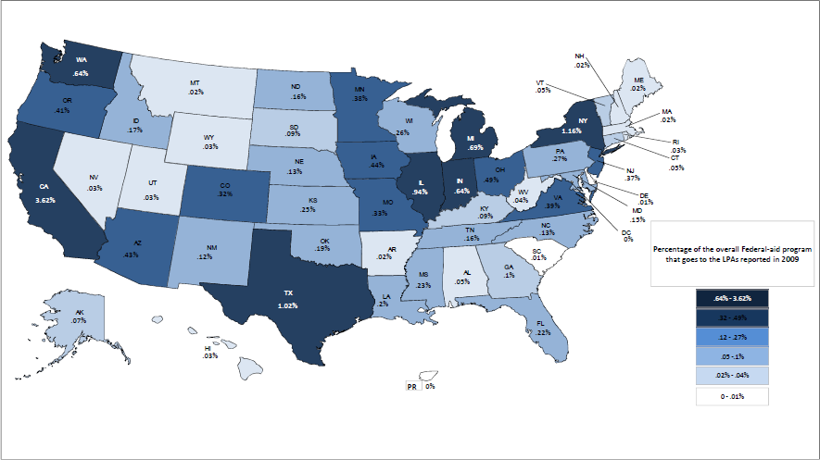
Percent of Total FA Program $ to LPAs
Source: HIF 2009 Survey
Notes:
This the percentage of federal funds that goes to LPAs as computed from the total funding pot.

Slide 7
What the Maps Say
5 States account for ½ of the FA Program $ that went to LPAs in 2009
  CA, NY, TX, IL, MI
8 States account for ½ of the LPAs That Administered FA Projects in 2009
  MI, IL, CA, MO, LA, MA, KY WV
7 States account for ½ of the FA Projects that were administered by LPAs in 2008
  MI, CA, IL, MO, WA, IA, VA
Only ¼ of the 28,000 potential LPAs administered FA Projects in 2009. The LPA issue could get larger.
Notes:
The data shows that program funds whether regular or ARRA funds is notably concentrated (New term coined: Program Density).
What the data and MAPs also show is that there is much we don’t know!
Can’t easily identify or track local projects
FMIS can’t trace local projects
RADS as data inaccuracy issues
Interpretation of questions focus on a need to discern local project vs. locally administered project .

Slide 8
Review of LPA Program
Oversight and Stewardship
Conducted in FY 2006
Reviewed focused on the core federal-aid program areas of the project development /project implementation process.
Review presented to FHWA National Leadership at the 2010 Fall Business Meeting
Notes:
As a result an LPA review team was formed to conduct a national review of the LPA Program in February of 2006. Their results efforts are documented in the final December 2006 report, titled, The Administration of Federal-Aid Projects by Local Agencies. The purpose of the review was to assess the administration, stewardship, and oversight of Federal-aid projects administered by LPAs.
LPA Update – Successfully Delivering Projects at the Local Level – “The State of LPA” was presented at the 2010 Fall Business Meeting

Slide 9
Core Federal-aid Program Areas Reviewed
Program Management
Project Development
  Environment
  Right-of-Way
  Design
Contract Award
Construction Administration
  Inspection
  Billing
Notes:
Various components of the Federal-aid project development and implementation process were reviewed .

Slide 10
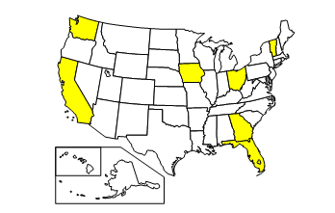
National Program Review
  The Team looked at:
  7 States
  39 projects
  35 local jurisdictions
Notes:
This review was a sampling from our largest state programs, our medium sized programs, and our smaller programs!

Slide 11
The General Observations
Extreme differences in LPA projects in terms of type and level of activities.
The project risk level varied significantly.
State LPA oversight activities were varied, limited or non-existent.
Earmark projects directed to LPAs are particularly problematic (Frequently outside the STIP and under-funded!).
Federal-aid program guidance to LPAs is lacking.
FHWA oversight of State’s LPA administration was inconsistent, varied and often without structure.
Notes:
The Team observed a variety of issues. On the plus side they saw good practices in place, good guidance manuals developed, etc. However on the negative side they saw LPAs not aware of the guidance and/or not following the established procedures. Breakdowns in the oversight of the LPA program was occurring at all three levels of government! A lot of the issues mainly pertained to a need for better information dissemination and training, along with appropriate program controls and compliance checks!

Slide 12
Review Findings
The administration of Federal-aid projects by LPAs may lack a systematic or comprehensive oversight approach;
Current oversight activities, as a whole, may be inconsistent from State to State; and
Current oversight activities may be ineffective for ensuring that Federal-aid requirements are met on LPA-administered projects.
Notes:
Overall Review Findings:
The administration of Federal-aid projects by LPAs may lack a systematic or comprehensive oversight approach;
Current oversight activities, as a whole, may be inconsistent from State to State; and
Current oversight activities may be ineffective for ensuring that Federal-aid requirements are met on LPA-administered projects.

Slide 13
Review Team Conclusions
LPA Program is a high risk area that requires attention.
State DOTs must fulfill their responsibilities regarding local projects.
Appears to be a need for a more systematic approach to fulfilling these program responsibilities.
Mechanisms and tools need to be developed to improve stewardship and oversight of local projects.
Notes:
The concluded that action must be taken to restore confidence!
Special Note: What was not found was evidence of fraud, waste and abuse!!

Slide 14
FHWA’s Position and Call for Action
FHWA Leadership views the team’s findings as “a call to action.”
  FHWA must take steps to make certain that the State DOTs are fulfilling their oversight responsibilities to ensure that LPA-administered Federal-aid projects are carried out in accordance with Federal requirements
  FHWA Leadership supports taking appropriate steps to ensure that Federal-aid funds are properly expended on Locally Administered projects.
Administrator in October 2007 self-declared the LPA Program to be “programmatically and materially weak.
Field Actions Required:
  Review the State DOTs’ existing oversight processes and procedures for LPA-administered projects.
  Make the determination as to whether or not the State DOT has a comprehensive LPA project oversight program.
  Prepare comprehensive Action Plans Due January 31, 2008.
  Annual and quarterly reporting requirements.
  2011-12 FHWA Strategic Implementation Plan
    Develop procedures, training, and oversight guidance for the delivery of LPA projects.
Notes:
Leadership made a “call for action.”
Programmatic Material Weakness determination declared.
Field actions:
review states’ LPA Programs
make determination about their LPA Programs
prepare action plans
report
FY 2007 report echoed the findings of the 2006 National Review.
Identified in the2011-12 FHWA Strategic Implementation Plan under Project Delivery to develop procedures, training, and oversight guidance for the delivery of LPA projects.

Slide 15
FHWA Strategic Plan
Program Delivery. The Federal Highway Programs are effectively and consistently delivered through successful partnerships, value-added stewardship, and risk-based oversight.
Program Integrity - Continually improves program integrity through risk-based oversight.
Notes:
The FHWA Strategic Plan addresses our stewardship and oversight requirements. The Goals is that Federal Highway Programs are effectively and consistently delivered through successful partnerships, value-added stewardship, and risk-based oversight.
Our Objective is Program Integrity – to continually improve program integrity through risk-based oversight.

Slide 16
Basic Things to Know About the LPA Program and LPA Program Oversight.
Notes:
Basic LPA Oversight Requirements

Slide 17

Applicable Federal Regulations for Realty
49 CFR Part 24 –Department of Transportation
23 CFR Part 710 - Highways
Notes:
The regulations, 49 CFR Part 24 and 23 CFR Part 710, drive the right of way transportation projects.
49 CFR Part 24 implements the Uniform Act. It regulates acquisition and relocation activities on federally–assisted projects. The Federal Highway Administration (FHWA), by its delegated authority as the Lead Agency for the Uniform Act, is responsible for the promulgation and maintenance of this regulation.
23 CFR Part 710 are program specific regulations governing acquisition, relocation, and other matters specific to FHWA-funded real property acquisition projects (highway projects).
Both of these CFR requirements impose conditions of compliance to obtain Federal aid reimbursement. An LPA must follow these rules to qualify for receiving the Federal funding, regardless of what project phase is Federally funded.

Slide 18
When is it a Federal Project
Per 49 CFR 24.4, the requirement to follow the Uniform Act and its regulation applies when Federal financial assistance is made available for a project which results in real property acquisition or relocation.
FHWA policy states that a project becomes a Federal project as soon as $1.00 of Federal money is used in any phase of the project.
Notes:
Per 49 CFR 24.4, the requirement to follow the Uniform Act and its regulation applies when Federal financial assistance is made available for a project which results in real property acquisition or relocation. This means that it does not matter whether Federal funds are being used, or not used, in the right-of-way acquisition phase of the project. FHWA policy guidance states that a project becomes a Federal project for our purposes as soon as $1.00 of Federal money is used in any phase of the project.
We often see LPAs with draw Federal funds from a project, when it becomes apparent that they have not followed Federal procedures. They do this when they can spend the money more readily on a project which is in compliance.

Slide 19
When Must an Agency Follow The Uniform Act
When any phase of a project is federally-funded, and:
Real property is acquired, and/or
Property owners and/or tenants are displaced as a direct result of land acquisition, demolition or property redevelopment
Notes:
The Uniform Act applies when an Agency receives Federal funds or Federal financial assistance on any phase or portion of a project.
If an Agency acquires real property or displaces persons as a result of land acquisition, demolition or property redevelopment for a project, and the Agency receives Federal funds in any phase of that project, then the provisions of the Uniform Act apply.
That means that if your Agency is receiving Federal funds for the construction phase of a project, say sewer improvements, you must acquire any right-of-way needed for the project in accordance with the Uniform Act and the Federal Regulations, even if there are no Federal funds in the right-of-way phase. If your Agency spends even $1.00 of Federal funds on a project, the Uniform Act applies.

Slide 20
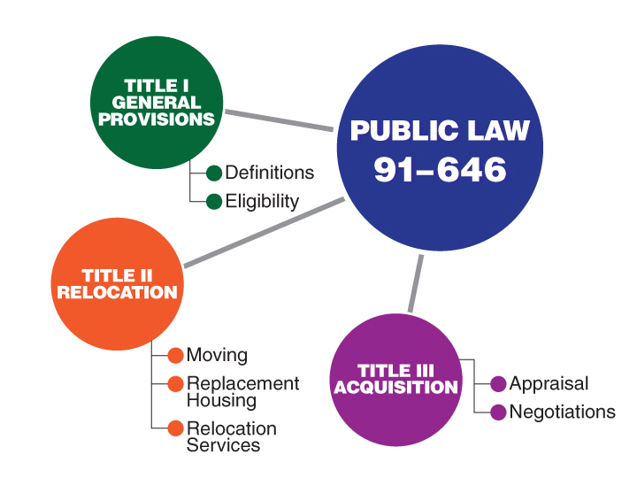
Major Components of the Uniform Act
Notes:
The Uniform Act consists of three titles, or parts. Title I, the General Provisions, contains definitions and eligibility as a displaced person.
Title II of the Uniform Act addresses Relocation Assistance. This part contains housing payments for owners and tenants and assures that comparable replacement housing is provided prior to displacement. This section also includes moving and related expenses as well as relocation planning and advisory services.
Although Title III is labeled as Uniform Real Property Acquisition Policy, this section includes appraisal and compensation issues. Offers must be for at least the fair market value of the property so that means an Agency cannot make ‘lowball offers’. Negotiation standards are established in this part, which include the requirement for an appraisal, an appraisal review, a written offer to the owner, and giving the owner time to consider the offer. This part also provides an assurance that residential occupants and business owners will receive a written notice giving them at least ninety days to move.

Slide 21
Local Public Agency Oversight
23 CFR 710.201(b) says that the State DOT shall have responsibility for the acquisition, management, and disposal of real property on Federal-aid projects.
Thus, the State DOT is ultimately responsible for the acquisition activities of LPAs on Federal-aid projects.
Notes:
23 CFR 710.201(b) says that the state DOT shall have responsibility for the acquisition, management, and disposal of real property on Federal-aid projects. The term acquisition, as used in the CFR, is used in the broad sense and encompasses all elements related to acquiring real property, including relocation. Thus, the state DOT is ultimately responsible for the acquisition activities of LPAs on Federal-aid projects. It is advisable, therefore, that the state DOT and the LPA work closely during the entire acquisition process to expedite the acquisitions and assure all Federal and state requirements are met.
Normally, the state DOTs have the larger, more experienced staff which can serve as a resource for the LPA. Acquisition activities should be coordinated to assure that the appraisal, negotiation, relocation, property management, and utility related work efforts are accomplished in a professional and timely manner.

Slide 22

FHWA Oversight
Agreements
Agreement between FHWA Division Office and State DOT
Addresses property-related FHWA oversight and approval actions for non-interstate projects
State DOT responsible for oversight of LPAs
                23 CFR 710.210
Notes:
Under the provisions of 23 CFR 710.201, the State DOTs and the FHWA Division offices agree on the extent of oversight and approval actions that FHWA will be responsible for and also to the ROW acquisition program. This oversight agreement does not apply to the Interstate system.
The State DOT - ROW operations/procedure manual must reflect the content of this oversight agreement.
The State DOT is responsible for the acquisition, management, and disposal of real property on Federal-aid projects, and assuring that these activities are conducted in compliance with State and Federal laws and regulations. If the State DOT enters into a written agreement with another governmental entity to carry out these activities, the entities must comply with the policies and practices of the State DOT. The State DOT must also monitor the property acquisition activities to assure compliance with State and Federal laws.

Slide 23
Components of an LPA Project Oversight Program at State DOT Level
Program Stewardship and the Oversight Agreement for locally administered projects.
Dedicated and knowledgeable Staffing.
Oversight and Monitoring Program.
Qualification Program for Local Public Agencies.
Local Public Agency Guidance Manual.
On-going Training Program
Notes:
Local Project Stewardship Agreement:
Supplement to the overall Stewardship/Oversight agreement.
May take the form of an Appendix or an Addendum to the agreement.
Include such topics as monitoring, qualifications, staffing, and technical manuals, etc.
Dedicated Staffing:
Focus is on both project level oversight by the State DOT as well as program level oversight.
Include a description of the staffing dedicated to monitoring subrecipients of Federal funds.
- General description of the organization of the subrecipient monitoring staff, along with the relationship to the overall State DOT organization.
- May include number, location, titles, and duties of the State staff.
Oversight and Monitoring Program:
Include a combination of quality assurance, project reviews, program reviews and evaluation.
State DOT provides engineering expertise, technical assistance, technology deployment, program assistance, and program delivery.
Qualification Program for Local Public Agencies:
Sets specific evaluation criteria that is used to determine the ability of the LPA to adequately administer various aspects of the Federal-aid program.
Should include a training component to assist local agencies in obtaining the necessary skills and knowledge.
Local Public Agency Guidance Manual:
Describes development requirements and outlines procedures for obtaining approval.
May be organized to reflect the flow of a project through the major phases of development and to incorporate the differing developmental needs of different projects.
Manual may be referenced in project specific agreement.
On-going Training Program
Training is needed on both state and federal requirements and procedures to deal with changing LPA entities and staffing turnover.

Slide 24
Agency Responsibilities
FHWA
Policies
$$$
Property Owners
State DOT
Policies
$$$
Real Estate Acquisition Activities
LPAs
Notes:
FHWA is responsible for setting policy and program direction for acquisition/relocation activities, and providing oversight and funds to State DOTs. The State DOTs also implement State policy and regulations for land acquisition and are a funding source for the LPAs. Each LPA identifies future transportation needs and determines road system maintenance and improvements. The LPAs are responsible for property acquisition activities, including managing the appraisal and acquisition of properties and providing relocation services. Property owners are impacted by the policies implemented, funding provided and the road projects built and maintained. Property owners also have rights guaranteed during the acquisition process by the Uniform Act, Federal Regulations and policies as well as State laws, regulations and policies.

Slide 25

State DOT and LPA Relationship
State DOT oversees LPA’s administration of project
LPAs should consult State DOT for assistance
23 CFR 710.201
Notes:
The State DOT and the LPA should establish and maintain a good working relationship throughout the ROW process.
23 CFR Part 710.201
Communication between the State DOT and LPA is essential for the DOT to carry out its oversight responsibility.
Since the LPA works with property owners and displaced persons, it should also maintain close contact with the State DOT for assistance with acquisition and relocation issues, when needed. They are the experts.
The LPA should also consult with the State DOT for advice as to what is or is not compensable. The court will determine just compensation in the context of State eminent domain statutes and case law.

Slide 26
State DOT Assistance to LPAs
LPA coordinator in real estate section.
Training for LPA personnel in real estate requirements.
LPA Guidance or Manual which is State specific.
Monitoring on a regular and ongoing basis.
Technical service to LPAs on a regular basis.
Advisory service, brochures, forms, and sample letters developed to meet Federal and state requirements.
Notes:
Many state DOTs have programs for providing realty assistance and guidance to LPAs. This coordination is designed to assist LPAs in complying with Federal and state requirements. Some of the methods used include:
Designating an LPA real estate coordinator within the state DOT organization to provide information and coordinate with other state DOT staff.
Providing training for LPA personnel, especially in the acquisition and relocation.
Providing a guidance manual to assist with local projects.
Monitoring LPA activity on a regular and ongoing basis.
Providing technical service to LPAs that require such assistance.
Providing advisory service, brochures, forms, and sample letters developed to meet Federal and state requirements.

Slide 27
Lead Time
It is critical that LPA coordinators are aware of Uniform Act time requirements
Time to consider just Compensation Offer
Time requirement for each Relocation Notice
Notes:
It is important that LPA program manager be aware of the length of time necessary to accomplish the acquisition program function. Sufficient time is required to perform the statutory requirements of the Uniform Act. When other project activities such as environmental studies and/or design functions encroach on the necessary right-of-way time, the construction letting date may be impacted.

Slide 28
Approved Right-of-Way Procedures
23 CFR 710.201(c) requires the state DOT to have a right-of-way operations manual that has been approved by the FHWA Division office.
Notes:
23 CFR 710.201(c) requires the state DOT to have a right-of-way operations manual that has been approved by the FHWA Division office. The state DOT is responsible for establishing the appraisal, acquisition and relocation program requirements and procedures for Federal-aid transportation projects in its state. An LPA (city or county) has the option of accepting the state DOT’s procedures, or it may submit its own to the state DOT for approval, if they wish to deviate from the state's FHWA approved procedural manual.

Slide 29
The Current Status of LPA Programs Nationally
Notes:
This is current status as of FY 2009!

Slide 30
Commons Issues, Problems and Concerns
Weak knowledge of federal requirements and/or the need for training LPAs
Poor policy/procedural guidance for LPAs
Lack of statewide policy and/or procedural consistency
Poor project documentation
Inadequate staffing and resources
Financial controls and billing issues
Lack of proper project inspection
Poor quality control
Consultant selection and oversight issues
Project eligibility issues
Improper application of standards
Notes:
Issues are ordered by their noted frequency of occurrence among the Divisions.
Staffing and resource issues were more notably elevated in review of FY 2009 data.
No additionally significant issues appeared to have surfaced for FY 2009.
For FY 2009 27 Divisions report no new issues surfaced that pertained to LPA administered projects versus State administered non-Recovery Act Federal-aid projects. Of the remaining 12, there were a few new issues to surface in FY 2009 but no patterns of significance were noted.

Slide 31
Where Do We Currently Stand
Since FY 2006:
  Risk in the oversight of LPA administered Federal-aid projects has decreased.
  The level of program oversight vigilance has increased.
Notes:
It was also noted that several Divisions were conducting more “routine” types of federal-aid program reviews that incorporated a sampling from the LPA community. This demonstrated a movement toward achieving the Agency’s goal of re-integration of LPA administered federal-aid projects into the Divisions’ overall stewardship/program monitoring efforts.
Only 24 Divisions indicated ongoing training efforts with regard to LPAs. The training being conducted varied notably from generalist overview type training (i.e. Federal 101, certification training, LPA Manual training, etc.) to an array of specialty program areas (i.e. NEPA, contract administration, R/W, etc.) It was noted that the training development trends were toward webinar and/or web-based/on-line training packages to reduce the cost to the states and LPAs.
Conclusions:
The report for FY 2009 reflects improvement from the FY 2008 baseline in terms of the overall administrative and oversight program health of the Federal-aid program as it pertains to LPA administered Federal-aid projects. We have gone from 17 states classified as “Red” (Those needing additional progress to resolve programmatic material weaknesses) in FY 2008 to 9 in FY 2009. This is especially significant in light of Agency Leadership concerns for State LPA programs with the implementation of the Recovery Act.
The time frame for most of the field offices to get to an acceptable state of “qualified confidence” (“Green” status) has been met well ahead of the “tentative” time frame established in the in the Agency’s overall encompassing Comprehensive Action Plan (CAP) as of the end of FY 2010. The remaining 9 states still in “Red” status have more notable programmatic issues and as such are still suggesting “Green” status achievement will still more likely occur in the 2011 to 2013 time frame.
For FY 2009 it was noted that several Divisions were conducting more “routine” types of federal-aid program/process type reviews where LPA projects were represented in the sample from a broader oversight context. This demonstrated movement toward achieving the Agency’s goal of re-integration of LPA administered federal-aid projects into the Divisions’ overall stewardship/program monitoring efforts.
In terms of program issues, no “new” issues surfaced in FY 2009 that pertained to LPA administered projects that had not been revealed in prior years and this includes projects funded from the Recovery Act. With regard to implementation of the Recovery Act, while it was noted that many state and LPA resources were strained, many state DOTs utilized a range of strategies to deal resource concerns and issues of delay. No significant breaches of Federal-aid requirements were reported. No problems with “fraud, waste and abuse” were reported, either.
While the self-declaration of a programmatic material weakness in October of 2007 helped to bring attention and focus to the risk and concerns of LPA administered federal-aid projects; implementation of the Recovery Act has significantly elevated State DOT and Division office involvement in LPA project oversight and reviews across the board. The implementation experiences associated with the Recovery Act has further exposed the scope and breadth of many of the already identified existing problems associated with the oversight and federal requirement compliance of LPA administered federal-aid projects. The experience in many cases helped to redirect action plans and brought a higher sense of urgency in addressing previously established review findings, issues and concerns. In many cases the Recovery Act served as a good intense check and balance of LPA project administration and oversight.
Field training efforts continued to vary notably in terms of subject matter and training format. The trend, due to budgetary constraints from the State DOTs and LPAs, was toward more webinar and/or web-based/on-line training packages. LTAP centers, which were new to the LPA program implementation/program administrative concerns in FY 2007, were notably more engaged in varying degrees with their State DOT partners in FY 2009.
The most significant issue to continue to require attention for FY 2009 is the issue of “adequate staffing/resources” for both the state DOT operations and that of the LPAs. Thus, the related policy issues of adequate staffing, responsible charge, and consultant conflict of interest are policy issues Headquarters will stayed focused on in terms of new/clarifying guidance. These three policy initiatives are a part of the FY 2011 FHWA Strategic Implementation Plan.
Recommendations:
Based on the results for FY 2009, input from the Divisions does not appear to suggest a need for changes in terms of new or modified initiatives to the Agency’s encompassing overall Comprehensive Action Plan (CAP) at this time. Most of the needed changes have been addressed at the Division level, in their action plans, mainly due to the impacts of implementing the Recovery Act.
While the data does suggest that the tentative time frame for the target date to achieve a status of non-programmatic material weakness for LPA project oversight still may need to be adjusted beyond 2010. Of the 9 remaining “Red” states, 4 to 5 are still indicating achievement of 2011 to 2013 at the earliest. The FY 2009 report, while noting that the Recovery Act may have actually aided our LPA initiatives, noted that several Divisions reported that action plans were revised and scheduled reviews/follow-up reviews were delayed due to the demands stemming from the Recovery Act. It is recommended that the target date be adjusted incrementally by initially adjusting it to the end of 2011 and evaluate the need for further adjustments annually until the programmatic material weaknesses in the remaining “Red” states have been sufficiently resolved to the Divisions’ satisfaction. In the meantime discussions with the Division leadership in the remaining “Red” states need to be conducted with the Office of Program Administration in order to ascertain if additional measures need to be taken and/or what additional support from Headquarters is needed to achieve resolution.
One training question that has risen is the possible need for a NEPA overview training course for LPAs. This notion comes on the cusp of the Office of Real Estate Services’ update of their right-of way course for LPAs and its welcome reception from LPAs together with the noted issues that members of NACE (National Association of county Engineers) and APWA (American Public Works Association) have with our environmental requirements. Development of such training is recommended with the possibility of a half day module for LPA political leadership. Otherwise, input from our field offices, including some of our LTAP centers, continues to indicate that State and FHWA Divisions are addressing their training needs adequately with their own respective resources and are expanding the use of their respective LTAP , NHI resources, etc.

Slide 32
Conclusions &
Things to think about!
Notes:
Things to think about as we move forward with the program challenges of LPA administered Federal-aid projects!

Slide 33
Challenges for the Future:
Federal, State and Local Government working toward the vision of a better LPA Program.
Information Dissemination and Training
Coping with Federal and State Requirements.
Understanding and supporting the facets of public expectation.
Determining the best alternatives (Optimal Alternative vs. the Least Cost Alternative)
Communication and Cooperation among government levels.
Process improvement/Process re-engineering.
Notes:
Initiatives for the future will require a hard look at improving our communication, cooperation and coordination.
These bullets list is of the areas of concern from the “locals perspective!”

Slide 34
Headquarters
Current and Planned Initiatives
LPA Peer Exchange ( Held Kick-off Webinar – March 2010)
LPA Program Public Website
Policy Initiatives
Updated NHI Right-of-Way Training for LPAs
Notes:
LPA Peer Exchange:
Efforts to deal with issues, problems and concerns from our FHWA field offices has manifested in an effort, with the help of a steering committee made of some key Division LPA Program Coordinators and the Resource Center, in the establishment of an LPA Peer Exchange. The plan is to have web conferences quarterly to showcase best practices, provide timely presentations and serve as a forum to discuss LPA program oversight issues and concerns.
There is a SharePoint site for discussion purposes including specific area “Discussion Topics.”
LPA Websites (Public and Staffnet):
LPA Public Website has been launched!!
Site includes access to appropriate federal requirements, training links, contact lists, state websites, etc.
Continue to expand and update the LPA Oversight Program website on Staffnet. Hope to have in the future more focus on good/best practices elements, a Q an A section, and various field office and Resource Center and HQ materials and links.
Policy Initiatives –
From a national perspective there is a need to look at the issues of adequate staffing and responsible charge and potentially develop policies/guidance to better address the identified policy concerns.
Concern about staffing resources is a concern that surfaced early in the LPA oversight corrective initiatives. A guidance document that discusses the current statutes and regulations on adequate staffing and to provide a diagnostic tool to assess state DOT staffing has been proposed. This effort came to focus as a result of Division office concerns with state DOT staffing for implementation of the Recovery Act in FY 2009.
The issue of Responsible Charge was an issue that surfaced in FY 2008. A second draft of a policy paper has been prepared which discusses the current policy and its application/practice with the state DOTs and LPAs. The second draft was completed in its circulation with the Office of Infrastructure but was tabled once the State Staffing Working Group initiated its efforts in the summer of 2009. Adequate Staffing and Responsible Charge are very interrelated and thus a policy/guidance on adequate staffing needs to be issued first.
The issue of Consultant Conflict of Interest (COI) emerged more so in FY 2009. It has not been much on the radar since the mid to late 1990’s. Mr. Jon Obenberger of the Pre-Construction Group has the responsibility for our policies on COI and has plans to revisit and possibly beef-up/clarify our current regulations and policies on COI.
Other Information, Outreach and Training Efforts:
The effort to assess, determine, develop and implement an appropriate course of action toward address training needs for LPAs from HQ’s perspective has been ongoing. Efforts in this area are on-going and include:
Initial conclusions are that adequate materials already exist to customize a training package for LPA on a state by state basis. General consensus and practice to date suggests that training on project requirements needs to include a discussion of state requirements, processes and procedures as the state DOT’s often develop their requirements intertwined with the federal requirements. Efforts will continue to post examples of good presentations on federal requirements.
LPA training development may be more beneficial in the focus areas of the project development and implementation process. Examples include contract administration training whose current format can easily be customized for an LPA target audience and Right-of-Way, which has been developed for LPAs and is currently being updated. I currently am serving on the technical review panel. The updated R/W Course recently had its first pilot in Phoenix in February and it was very well received
Federal Requirements Matrix:
Development of a comprehensive list of federal requirements that pertain to LPA’s for easy reference including links to more information on these requirements elsewhere on the Agency’s public website.
LPA Interest Group Activities ( See slides to follow)
Miscellaneous LPA Program Efforts:
Continued to respond to various inquiries about the aspects of LPA oversight programs, including issues on policy such as “responsible charge,” single audit requirements, contract administration, sub granting limitations, conflict of interest, etc.
Continued to participate in discipline initiatives involving financial management, right-of-way, and safety.
*Initiative Updates:
Modifications to the CAP will address recommendations from the
FY 2011 FHWA Strategic Implementation Plan
The Blue Team Report – Building a Foundation for Visionary Leadership
NRT Review Recommendations
State of LPA 2010 Presentation – September 23, 2010 Leadership Team Meeting

Slide 35
Common Field Action Plan Initiatives
  Changes to state DOT oversight/stewardship/organization structure
  (HI, KY, ME, NE, NH, NC, PA, VA, & WI)
  Development of policy/procedures/guidance documents (AL, AK, AZ, CA, FL, GA, HI, IN, KY, LA, MD, ME, MO, MT, NE, NV, NH, NJ, NM, NC, ND, OK, OR, PA SC, SD, TN, TX, VA, WI, & WY)
  Training Initiatives (CA, FL, IL, IN, IA, LA, ME, MO, NE, NV, NH, NJ, NM, NC, OH, OK, OR, PA, TX, WI, & WY)
  Checklist Development (AK,IA, MN, NH, NJ & SC)
  Certification Program Development/Update
  (AZ, GA,ME, NH, NJ, IN, OR, & WI)
  Website efforts (KY, NH)
  On-going Process Reviews and Follow-up Reviews
Notes:
The Division initiatives/action plans are key to resolving our overall programmatic material weakness determination and are an integral part of the Agency’s Comprehensive Action Plan. Most will reach a sufficient level of accomplishment by the end of FY 2010.
FY 2009
Of the remaining 25 Divisions with on-going actions plans several can be characterized as mainly focusing on policy, procedure, guidance initiatives with 7 working on some sort of LPA Manual/Handbook. AL will not authorize a LPA project until it approves of the guidance developed. Training also continues to be a noted initiative as identified by 14 Divisions. Other noted efforts include staffing improvements, website work, certification process improvement, organization structure changes, tighter financial controls, audit process improvement, checklist development, improved QA/QC, etc.
Only 24 Divisions indicated ongoing training efforts with regard to LPAs. The training being conducted varied notably from generalist overview type training (i.e. Federal 101, certification training, LPA Manual training, etc.) to an array of specialty program areas (i.e. NEPA, contract administration, R/W, etc.) It was noted that the training development trends were toward webinar and/or web-based/on-line training packages to reduce the cost to the states and LPAs.

Slide 36
Sources of Information, References and Training
FHWA LPA Website posts background information, field contacts including both State and FHWA Division Coordinators, important reference information, and training resources.
www.fhwa.dot.gov/federalaid/lpa/index.cfm
National LPA Peer Exchange
State DOT Contacts and LPA Program Websites
NHI (National Highway Institute)
http://www.nhi.fhwa.dot.gov/Home.aspx
Notes:
Some current information links and forums!
Others sites include Staffnet, SharePoint and Resource Center Sites!

Slide 37
Online NHI Course#141047
Self-paced Modules
Explain the statutory basis for Federal requirements.
Explain the intent of the Uniform Act and describe needed actions.
Describe how a typical project is developed .
Describe the LPA role in the appraisal process and determine the appropriate valuation format.
Describe the sequence for land acquisition and options.
Explain what relocation advisory services are to be provided to property owners and tenants.
Summarize various property management activities .
Notes:
Learning objectives for #141047 Modules:
1.Explain the statutory basis for Federal requirements and relate these to State and local laws, regulations and procedures.
2.Explain the intent of the Uniform Act and describe what States and LPAs must do to comply.
3.Describe how a typical project is developed and strategies for enhancing project delivery.
4.Describe the LPA role in the appraisal process and determine the appropriate valuation format for specific situations.
5.Describe the sequence for land acquisition and options available to the negotiator.
6.Explain what relocation advisory services are to be provided to property owners and tenants and differentiate the residential and nonresidential relocation processes.
7.Summarize various property management activities and evaluate property management actions using specific case studies.

Slide 38
FHWA LPA Working Group
In 2010, the Office of Real Estate Services established a working group of Division Office realty staff.
This working group has posted many useful tools on this Realty DSS website, https://one.dot.gov/fhwa/RealtyDSS/Local%20Public%20Agencies/Forms/AllItems.aspx
Notes:
In 2010, the Office of Real Estate Services established a working group of Division Office realty staff. This working group has posted many useful tools on this Realty DSS website, https://one.dot.gov/fhwa/RealtyDSS/Local%20Public%20Agencies/Forms/AllItems.aspx
This website is internal to FHWA staff. Useful items include Realty LPA Review Checklists and Links to State DOT LPA Manuals.

Slide 39
FHWA Stewardship Portal
This is an internal FHWA website
http://rc.fhwa.dot.gov/processreviews/category.cfm?category=Right-of-Way%20and%20Utilities
2008 Illinois (#45) LPA Program Review
2009 California (#68) LPA program Review
Notes:
Stewardship Portal
This is an internal FHWA website:
http://rc.fhwa.dot.gov/processreviews/category.cfm?category=Right-of-Way%20and%20Utilities
If you would like to review other reports before you embark on an LPA Program Review, please see the 2008 review by Illinois Division (#45) or the 2009 LPA Program Review by California (#68).

Slide 40
For more information on LPA Right of Way Program matters please contact:
Carolyn Winborne James
LPA Realty Program Coordinator
FHWA Headquarters in Washington DC
202-493-0353
carolyn.james@dot.gov
Notes:
Contact for further inquiries!

Slide 41
Thank You!
Questions?
Notes:
Questions? Discussion?

