Slide 1
WORK PROGRAM UPDATE CYCLE
PROGRAM MANAGEMENT
District 4 Acting Director of Transportation Development – Mark Plass, P.E.
February 20, 2018

Slide 2
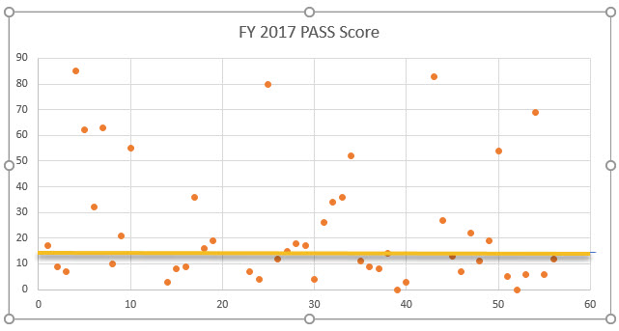
Our Initial Quality Indicator

Slide 3
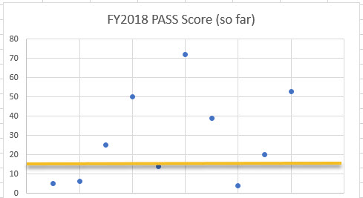
Our Initial Quality Indicator

Slide 4
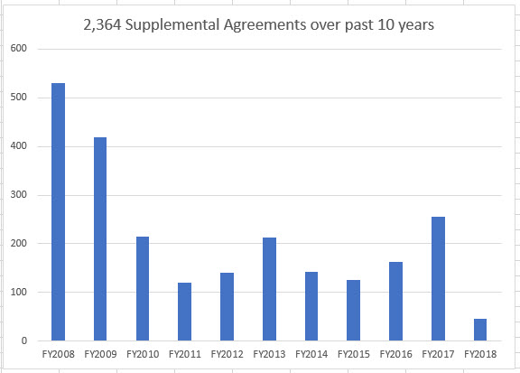
The Real Measure:
Time and Money
2,364 Supplemental Agreements added 6,120 days during construction

Slide 5
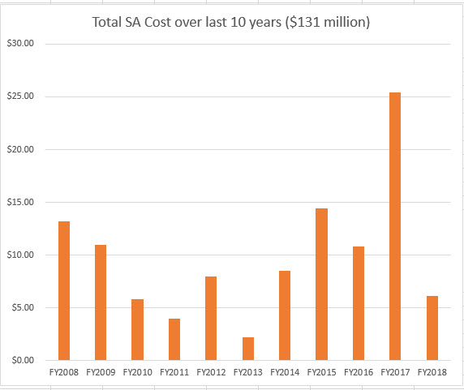
The Real Measure:
Time and Money
$131 million dollars added over the last 10 years during construction

Slide 6
Work Program Discussion Topics by Mark Madgar
Status of FY 2019-23 Tentative Work Program (TWP)
FY 2020-FY2024 TWP Development Overview
Project Sequencing and Description
Roll Forward and Unexecuted Agreements

Slide 7
Status of FY19-23 TWP
Progress
  LRE Count: over 300
  Successful CO & Secretary Review (12-5-2017)
  FTC Statewide Public Hearing (Jan 8, 2018)
  State Legislature Session (Jan 8 – March 9, 2018)
March Estimate Updates for LRE & Right-of-Way
  FM opens for LRE update for construction projects and right of way cost estimates for FY2019 only
  All FY19 estimates are due to Final Plans by March 6, 2018.

Slide 8
FY 20-24 TWP Development
FEBRUARY 2018
Work Program/LRE/Right of Way Kick-off meeting
LRE opens for project updating FY2020-2024
Process begins for
  Evaluate Bridges
  Conduct pavement condition survey for resurfacing
  Begin development of other programs
APRIL 2018
PM commit to project letting months (Lockdown of FY19, 2020, 2021, 2022 and 2023)

Slide 9
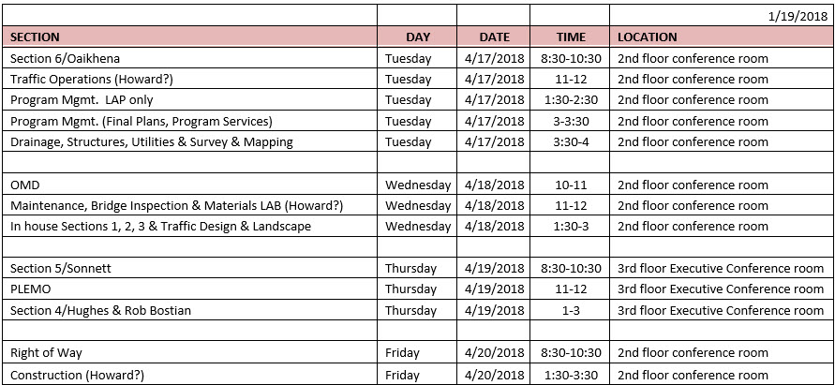
FY 2020-24 TWP Development
Lockdown Meetings
Current dates for the lockdown meeting…remember this is the Schedule Meetings

Slide 10
FY 2020-24 TWP Development
May 2018
Work Program/Project Manager Meetings begin
  Focus Area:
    Project descriptions and extra descriptions
    PM Coordination with Support Offices
    Appropriate Funding Levels
    APP Possibilities
    Programming cost for commercial steel inspection

Slide 11
FY 2020-24 TWP Development
Work Program Project Manager Meeting
The 1 – 3 hour meetings with Work Program will start early
May 2018 and run thru June 2018. Look for the calendar invite.
REMEMBER...this is the MONEY meeting

Slide 12
FY 2020-24 TWP Development
Commercial Inspection of Steel (Phase 62 Sequence 40)
Pay Item | Component | Comm. Insp. Estimate | Quantity
460 - Structural Steel & Misc Metal | Bascule (New) Bridge Components | ± 1.50% of Project Budget | Per Project
460 - Structural Steel & Misc Metal | Bascule Bridge Rehab Components | ± 0.50% of Project Budget | Per Project
460 - Structural Steel & Misc Metal | Gantry | ± $28,000 | Each
460 - Structural Steel & Misc Metal | Pedestrian Bridge | ± 1.50% of Project Budget | Per Project
460 - Structural Steel & Misc Metal | Steel (New) Bridge Components | ± 1.50% of Project Budget | Per Project
460 - Structural Steel & Misc Metal | Steel Bridge Rehab Components | ± 0.50% of Project Budget | Per Project
465 - Movable Bridges | Movable (New) Bridge Components | ± 1.50% of Project Budget | Per Project
465 - Movable Bridges | Movable Bridge Rehab Components | ± 0.50% of Project Budget | Per Project
700 - Highway Signing | Overhead Truss Cantilever | ± $18,000 | Each
700 - Highway Signing | Overhead Truss Monotube | ± $18,000 | Each
700 - Highway Signing | Overhead Truss Span | ± $18,000 | Each
700 - Highway Signing | Sign Panel Overhead Mount | ± $18,000 | Each
781 - ITS System Components | Cantilevered Sign | ± $18,000 | Each
± dependent on the size of the structure, the number of fabricators used, and the total number of structures being fabricated per shop.
Note: This is only to be used to gain ball-park information. Actual costs will be different from any estimate derived using this spreadsheet.

Slide 13
FY 2020-24 TWP Development
MAY - JUNE 2018
All LRES & right-of-way cost estimates due to Work Program
Complete Work Program/Project Manager meetings
JULY 2018
Secretary Adopts Work Program FY 2019 – 2023
TWP Opens on July 6 for TWP FY2020 – FY2024
AUG 2018
Review of Draft Work Program Instructions

Slide 14
FY 2020-24 TWP Development
OCTOBER 2018
MPO/TPO Priorities due to FDOT
NOVEMBER 2018
Technical Advisory Committee Hearings
DECEMBER 2018
Public Hearings
MPO/TPO Board Meetings
January 2019
TWP closes on January 3, 2019

Slide 15
Project Sequencing
Various Work Types Need to be separated in the LRE
Requires separation and entry of pay items by sequence when more than one work type exists for:
WORK TYPE PROGRAM NO.
    Roadway 02
    Bridge Replacement 03
    Bridge Rehabilitation 04
    Resurfacing 05
    Safety 06
    Traffic Operations 07
    Retrofit Lighting SL
Separate pay items that are funded with Local Funds

Slide 16
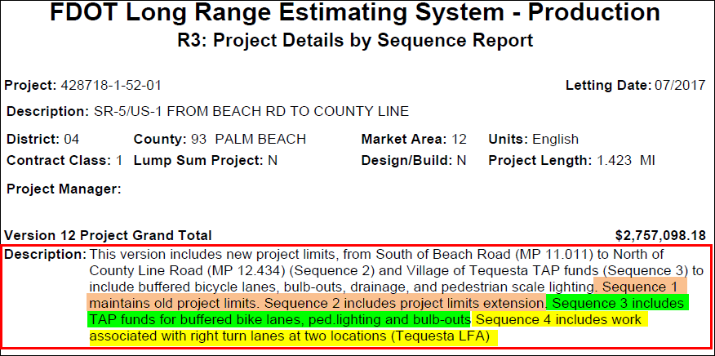
Project Sequencing Example
Under the Description field: if the LRE contains more than one work type, each work type must be defined and separated under a different sequence.

Slide 17
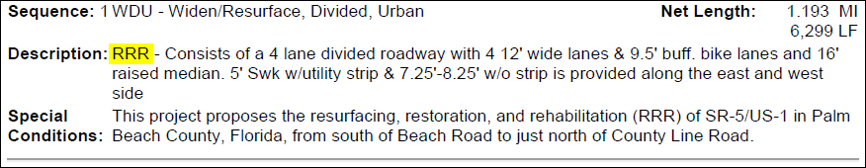
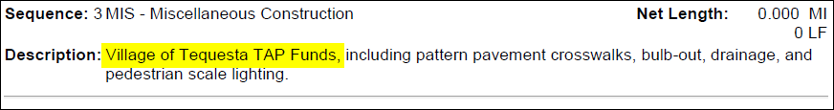
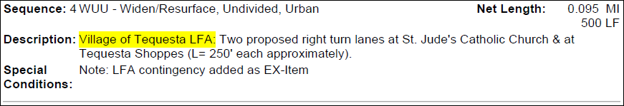
Project Sequencing Example
Under the Sequence Description field: define the work type and indicate whether LFA, special fund source, etc.

Slide 18
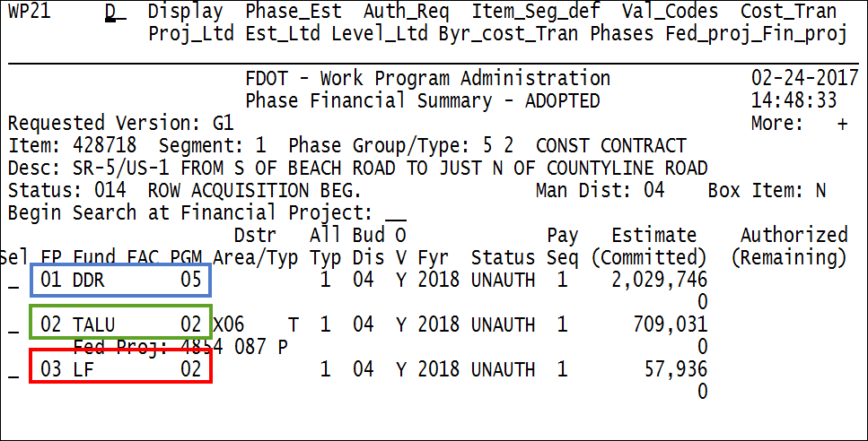
Project Sequencing Example
  Sequence 01: Resurfacing
  Sequence 02: TAP
  Sequence 03: Local Funds

Slide 19
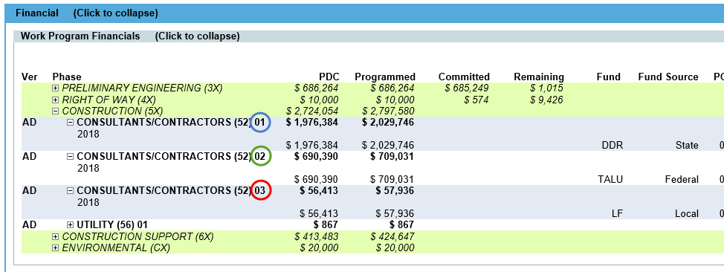
Project Sequencing Example
  Sequence 01: Resurfacing
  Sequence 02: TAP
  Sequence 03: Local Funds
PSEE Work Program Financial screen can depict if multiple financial sequence exist on the project.

Slide 20
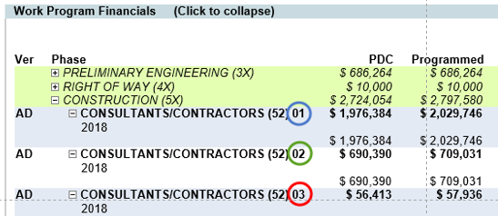
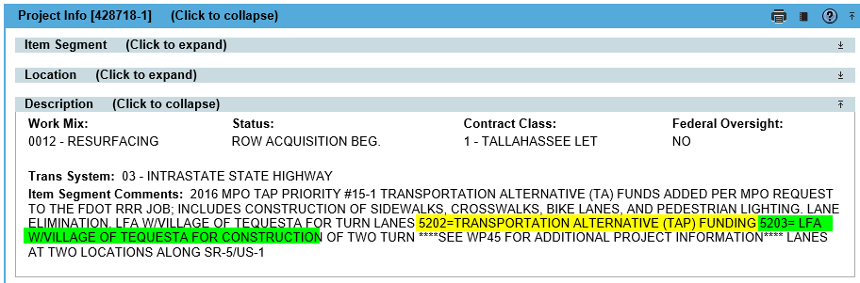
Project Sequencing Example
PSEE Item Segment Description screen defines the various financial sequences

Slide 21
Work Program Discussion Topic
Roll Forward and Unexecuted Agreements

Slide 22
Roll Forward
What is Roll Forward?
Any funding programmed in current year that will not be encumbered/committed by the beginning of June.
  example: new agreements, supplemental, task work order
Reason for Roll Forward:
  Agreements not executed prior to the beginning of June
  Right-of-way land not purchased
  Bid rejections/protests on PSU/CSU projects not allowing for encumbrance by the end of June
  Contingency being maintained for: estimate increases, supplemental agreements, cost overruns, claims & litigation, etc.

Slide 23
Unexecuted Agreement Report
What is Unexecuted Agreement Report?
A report identifying Supplemental Agreements/Work Orders that have been encumbered however, the agreements have not yet been fully executed in FLAIR (Status 10).
Key Facts:
  Agreements must be executed by early June to avoid having the encumbrance cancelled at year end.
  Agreements not executed by early June, will be un-encumbered and must be re-encumbered the following Fiscal Year.
  Affects both budget and roll forward.
  The Report is Aged to indicate how long the agreements have been encumbered but not fully executed.

Slide 24
2018 LRE KICKOFF
RIGHT OF WAY
COST ESTIMATES
Presented by
Carlos Martinez
February 20, 2018

Slide 25

How Do You Know You
Have a R/W Project?
Do you need to obtain any property rights?
Fee title
Permanent easements
Temporary construction easements
  TCE vs. license agreement
Do you think there will be donations?
Donations are not always donations
Must advise owners of their rights
If needed for the project, cannot count on getting a donation

Slide 26
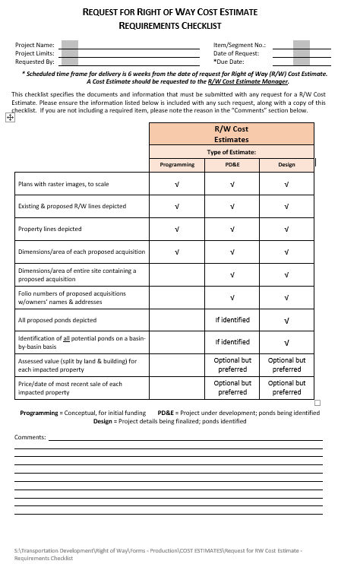
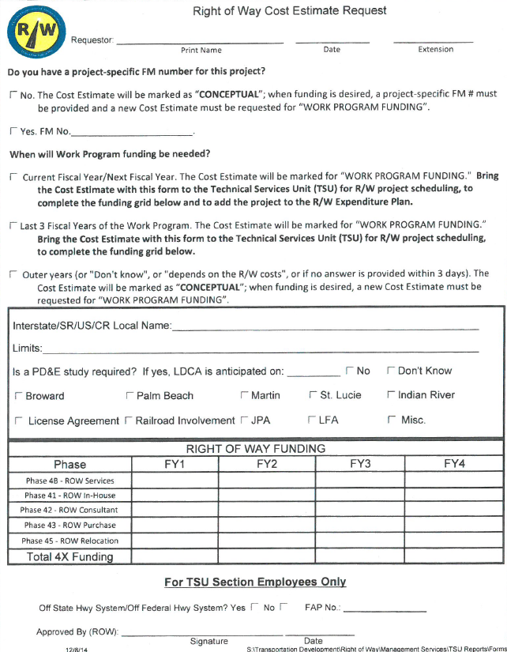
How Do You Initiate a R/W Project?
Which comes first – the chicken or the egg?
A cost estimate AND a schedule are needed when R/W needs are identified for a project. NOTE: If an estimate is conceptual, the PM must follow up to request funding when it is no longer just a concept.
It is considered a R/W project if any real estate interest needs to be acquired, including a temporary or permanent easement, and even if a donation is anticipated.
R/W will request any Phase 4X funding regardless of timing – this is a new process.

Slide 27
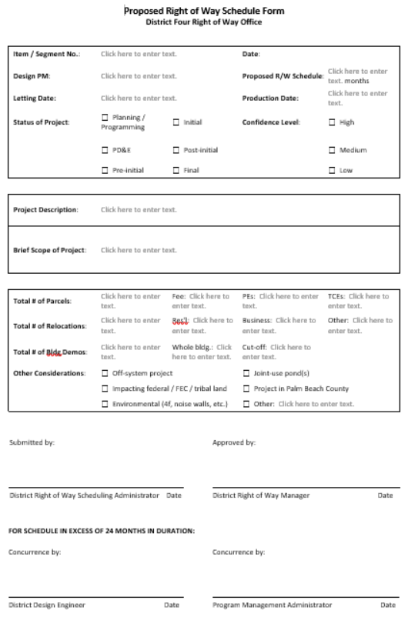

Slide 28
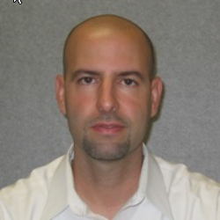
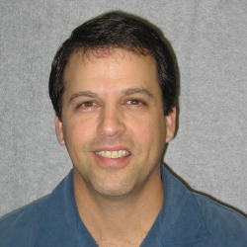
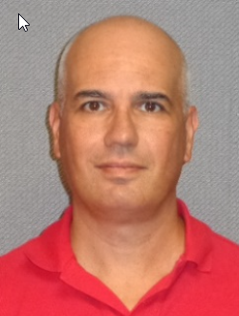
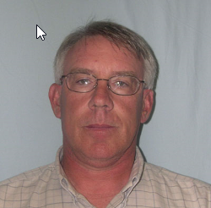
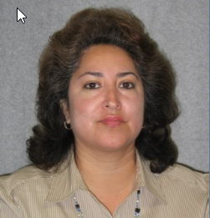
Who Do You Contact?
Carlos Martinez
Deputy R/W Manager – Management Services
Victor Ramos
Deputy R/W Manager – Valuation
Vacant
R/W Support Administrator - Operations
Tony Conde
Cost Estimator
Mark Rodwell
R/W Scheduling & Data Administrator
Cristine Balderes
Finance Coordinator

Slide 29

What Are the Deadlines?
Monday, March 26th – Deadline for R/W to submit updates to R/W cost estimates for funded and (unfunded) PD&E projects to Program Management
Monday, April 30th – Deadline for PMs to request new R/W cost estimates

Slide 30
2018 LRE KICKOFF
FINAL PLANS
Presented by
Tim Brock
February 20, 2018

Slide 31

Final Plans
LRE Guidelines
Submittal Process
Project Unknowns
The New Timeline

Slide 32
Introduction
System Access
LRE versus Trns*Port
Items to Verify
Landscape
Special Features
Summary

Slide 33
1. System Access
The FDOT PM will contact OIT for the following:
For the Creation, Modification or Termination of a Security Profile.
For a revoked and/ or expired User-ID.
For a revoked and/ or expired Password.
For transferring an account from district to district.

Slide 34
System Access - continued
CONTACT the FDOT Project Manager:
  When a user needs to be created in the LRE System only.
  TRNS*PORT access is provided by Tallahassee.
  When a user needs to be added or removed from Projects and/or Versions.
  When a user needs to be re-assigned from one Project or Version to another.
  *PROJECT MANAGER WILL CONTACT FINAL PLANS*

Slide 35
2. LRE versus Trns*Port
LRE
The primary tool used to produce budget estimates for the 5-Yr Work Program.
Is used before final design quantities are available.
Is typically used from the PD&E phase to just before the Biddability phase.
Trns*Port
Is used for the Plans, Specs and Estimates package and Bidding Proposal.
Normally used for Biddability Phase and Production.
If your project is either a Lump Sum or Design Build, you will need to load the itemized pay items into a secondary TRNS*PORT. The TRNS*PORT will be created as either xxxxxx-x-52-0xLS or xxxxxx-x-52-0xDB respectively.
Note: If your project is near the transition into the Biddability Phase, the PM should use the estimate (LRE or Trns*Port) which reflects the current approved scope and project cost at the time of Submittal.

Slide 36
WHICH PROJECTS NEED AN LRE?
EVERY PROJECT NEEDS AN LRE.
ALL PROJECTS WITH PHASES 22 AND/OR 32, REGARDLESS OF HAVING A PHASE 52, MUST SUBMIT AN LRE TO FINAL PLANS.

Slide 37
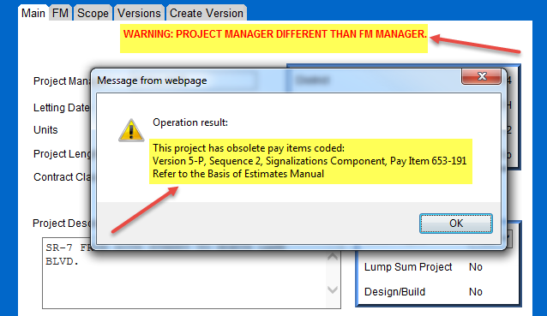
3. Items to Verify
The project information in the LRE Header shall match the FM System, i.e.- Project Manager, Letting Date, Project Length, etc. If different, check with Work Program to correct.
The LRE or Trns*Port shall not contain Obsolete Pay Items.

Slide 38
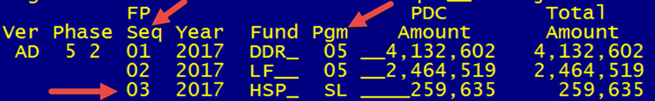
Items to Verify - continued
For projects that contain multiple Sequences and/ or Programs in FM, a separate sequence in the LRE shall be used to reflect each one. There are many Program Types, but the most common ones to keep a look out for are: 02- Roadway, 03 – Bridge Replacement, 04 – Bridge Rehabilitation, 05 – Resurfacing, 06 – Safety and 29 – Rail.
KEEP IN MIND THAT IF YOUR PROJECT WAS FULLY FUNDED WITH STATE FUNDS AND FEDERAL FUNDS WERE ADDED FOR LIGHTING RETROFITS, YOUR PROJECT BECOMES FEDERALIZED AND THE SEQUENCE OF THE FEDERAL FUNDS IS THE LEAD SEQUENCE.
Multiple Sequences & Programs:

Slide 39

Items to Verify - continued
TIP/ STIP - Last Minute Cost Adjustments:
If project is Federally Funded.
If project cost increases in excess of $2 Million AND 20%, a TIP/ STIP needs to be processed.
It may take 3 months or longer to process which may cause the project to miss the letting.

Slide 40
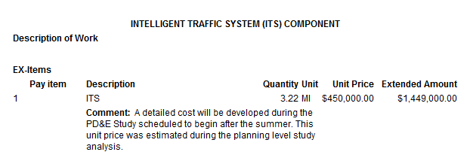
Items to Verify - continued
Use of EX-Items.
-Use only when a pay item does not exist for an activity.
-Do not enter as a Lump Sum, Per/ Mile cost or Design Fees for DB.
-If trying to use for an already used X-Item, include the quantity in the existing X-Item and describe both quantities in the “Comment Field”.
-Remember…no MOT or Asphalt contingencies.

Slide 41
Items to Verify - continued
Do not include additional Adjustments / Contingencies for items such as:
  -MOT Items, Earthwork, Asphalt, Wetland Mitigation, Contamination, ETC.
  -If Adjustments are needed then remember to load adjustments into the specific Sequence and use the comment field to describe.
  Use the proper percentages:
-MOB shall be 8%.
-MOT shall be 10%.
-Partnering: include if project duration > 1yr OR project cost > $2 Million.
(Use 2 DA @ $3,000/ DA)
-Disputes Review Board: include if project cost > $15 Million.
(Follow BOE for instructions on how to calculate number of meetings)
REMEMBER…every time you use 999-20-1 you will ALSO need to load 999-20-2
PLUS…every project requires the Initial Contingency pay item (999-25)
NOTE: All projects should have the standard 999-25 contingency.
Projects that have a LF contribution, need to have an EX-item for 20% contingency (of the LF amount). This is in addition to the standard 999-25 contingency.
OFF SYSTEM ROADWAYS:
DO NOT include Mowing and Litter Removal pay items on off-system roadways.

Slide 42
4. Landscaping
Two types of Landscaping projects:
1) Dependant, Stand-Alone Landscaping Project:
-Associated with a Roadway Construction project.
-Programmed in the year that the Roadway Construction project is anticipated for completion.
Coordination on who will be responsible for the establishment and maintenance of the installed landscaping… District Maintenance or Local Agency (MMOA required for the latter) needs to happen. Discuss with Elisabeth Hassett.
(Joint Memo Landscape dated February 13, 2015)
2)Independent, Stand-Alone Landscaping Project:
-Not associated with a Roadway Construction project.
-Programmed in the year that the Landscaping project is ready for production. Discuss with Elisabeth Hassett.
VERY IMPORTANT: The RLA and ITS coordinate the ITS view zones within the ODA view zones.
The FDOT PM will need to coordinate with both the District Landscape Architect and Work Program to make sure that the project not only complies with both the Department Environmental and Highway Beautification Policies, but also complies with the funding guidelines (5-year Work Program’s 1.5% funding controls).
(Engineering & Operations Memo 13-1: Knowledge Base> Prgm Management)
Notes:
The emphasis needs to be said that any new landscape project cannot be automatically established even if it is in the PDE, or the MPO, or the Agency that is asking. It is the 5-year work program’s 1.5% funding that that guides whether that project can be accommodated. So, they should not be putting it in the LRE without discussing their project with me first.

Slide 43

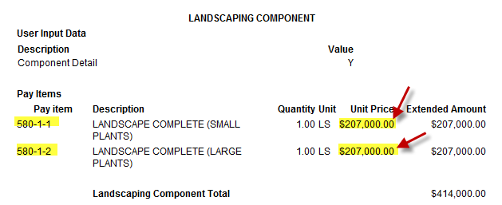
Landscaping – cont.

Slide 44
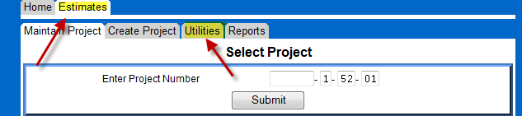

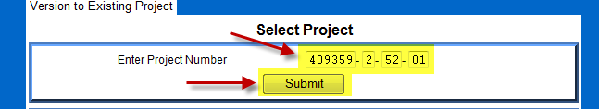
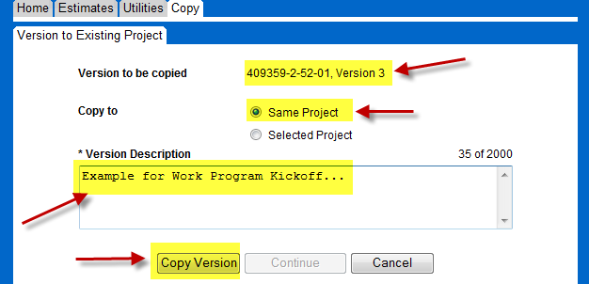
5. Special Features
Copying a LRE Version:
Allows the PM or consultant to continue to prepare the project, or prepare multiple alternatives, for its scheduled phase submittals outside of the Work Program Cycle.

Slide 45

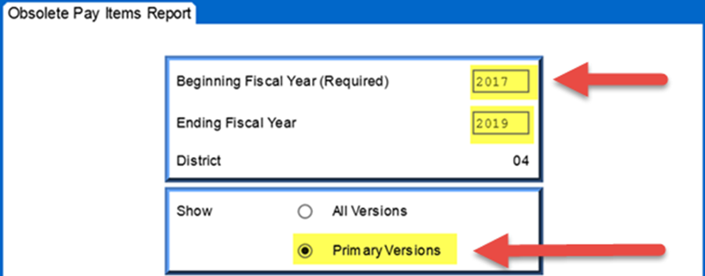
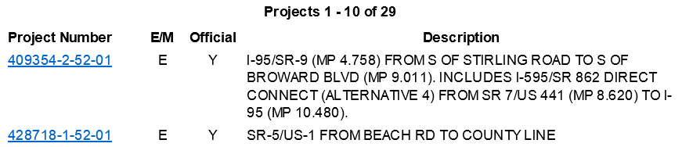
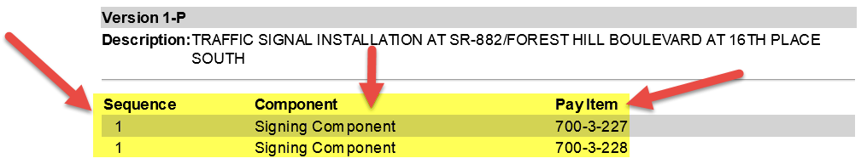
Special Features – continued
Run the “Obsolete Pay Item Report” to check for obsolete items in the LRE.
Notes:
Select “Estimates” tab; then “Reports” tab; then “R33”.

Slide 46
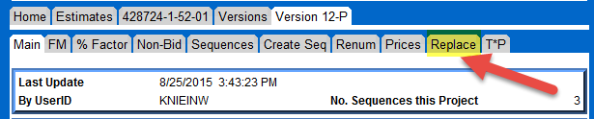
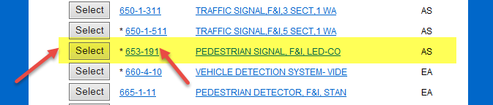
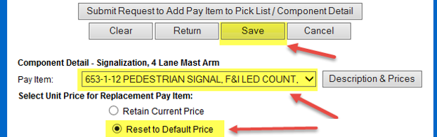
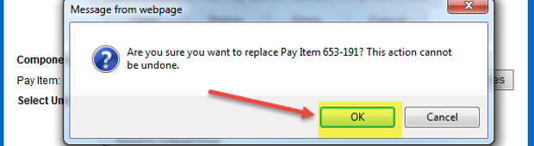
Special Features - continued
Use the “Find and Replace” function to help in replacing obsolete pay items in the LRE.
Notes:
Select “Replace”; Find pay item with Asterisk (*); Find new pay item in drop-down; Reset to Default Price; Click “Save”.

Slide 47
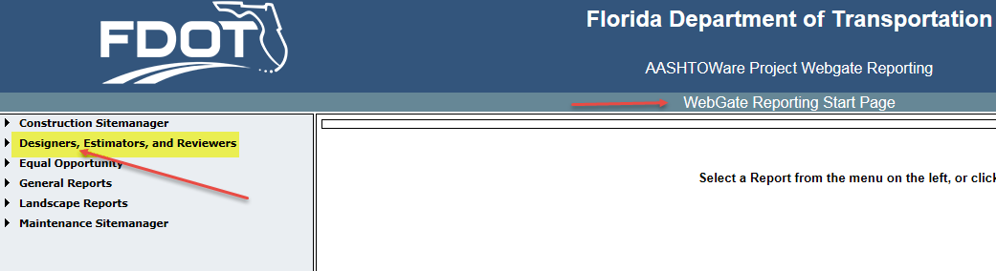
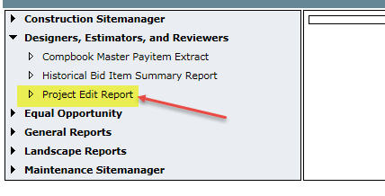
Special Features - continued
Run the “Project Edit Report” to check for obsolete items in the Trns*port.

Slide 48
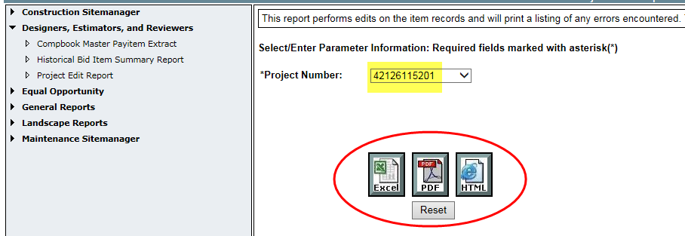
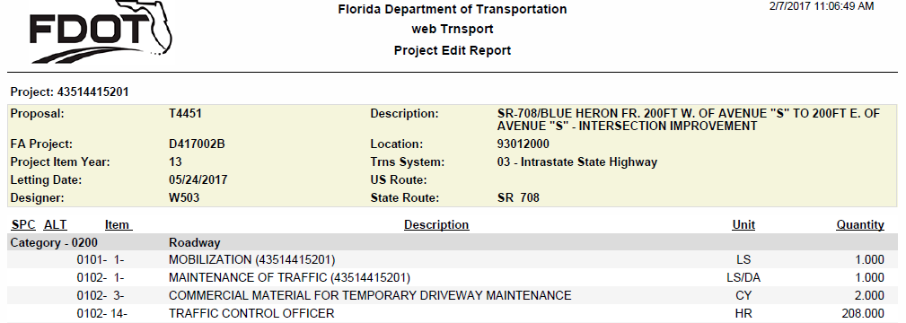
Project Edit Report – cont.

Slide 49
6. Summary
For new accounts or re-setting existing accounts, have the FDOT PM contact OIT to correct any security profile issues. FDOT PM to contact Final Plans for project specific access.
Most data errors we see relate to inconsistencies between the LRE and the Project Scope History.
Remember to use separate sequences when appropriate… i.e.- Local Funds or Safety.
Minimize the use of EX-Items.
Refer to the LRE Guidelines for the proper adjustment values, and do not add miscellaneous adjustments / contingencies to your project.
(Knowledge Base>Prgm Mngt>Final Plans>Estimates)
Refer to the LRE Guidelines for the proper values for MOT, MOB and Non-Bid Pay Items.
Remember to check the Knowledge Base to see how you should be handling the Landscaping Construction.
(Knowledge Base>Prgm Mngt>Engineering & Operations Memo 13-1 and Joint Memo Landscape February 13, 2015)

Slide 50
Summary - continued
Use the Special Features, “Copy Version”, “Obsolete Pay Item Report”, “Find & Replace” and “Project Edit Report” to simplify your work.
Remember to use the LRE Checklist. Final Plans website
If you have any questions pertaining to the LRE reviews, please contact one of the following Final Plans staff:
Jessie Smiley x-4613
Maria Benavides x-4191
Kyaw Win x-4330 Tim Brock x-4125

Slide 51
LRE Submittals
LRE Submittal Overview
by: Reggie Dugue
Checklist
Guidelines
Submitting an LRE

Slide 52
Electronic Navigation
How to Submit
  Electronic Submittals

Slide 53
Electronic Requirements to Submit
2018 LRE Checklist – Completed (found in Final Plans Website.)
LRE R3 Report of Primary Version.
Approved Scope in PSEE.
Risk Summary & Register (only if including Project Risk).
The above items need to be submitted as attached documents through the PSEE WPUC.

Slide 54
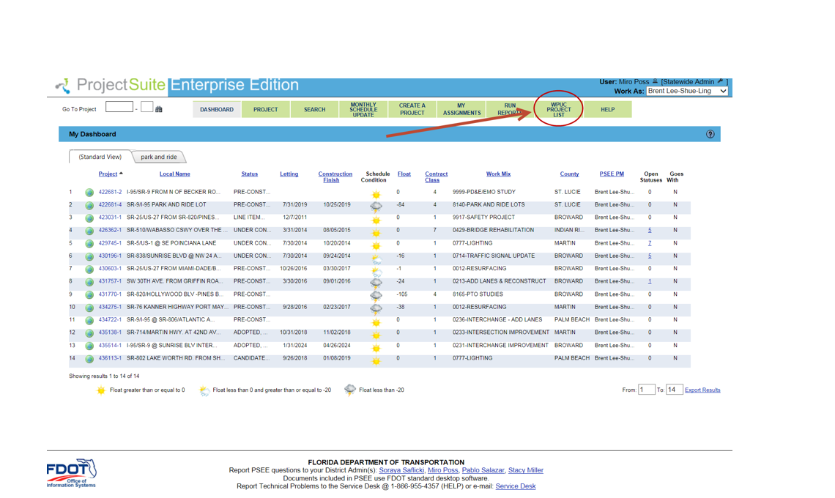
Electronic Submittal Process
Step 1:

Slide 55
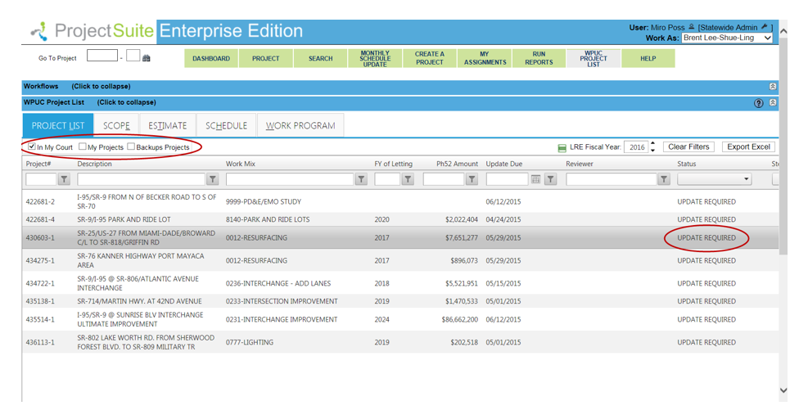
Electronic Submittal – cont.
Step 2:

Slide 56
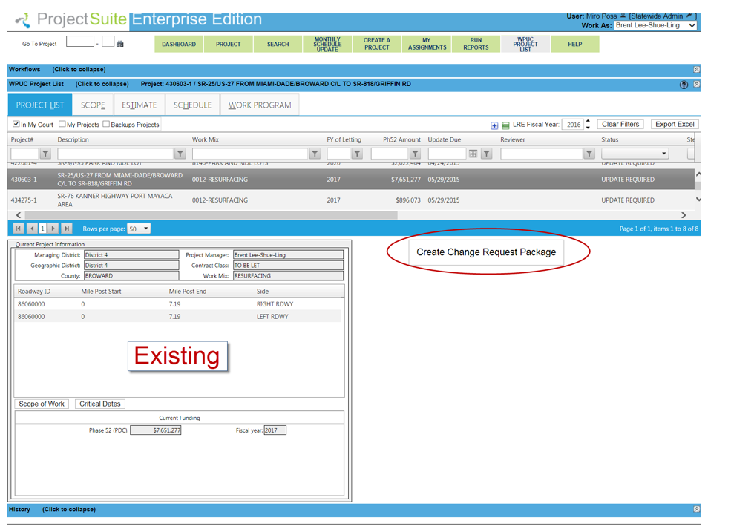
Electronic Submittal – cont.
Step 3:

Slide 57
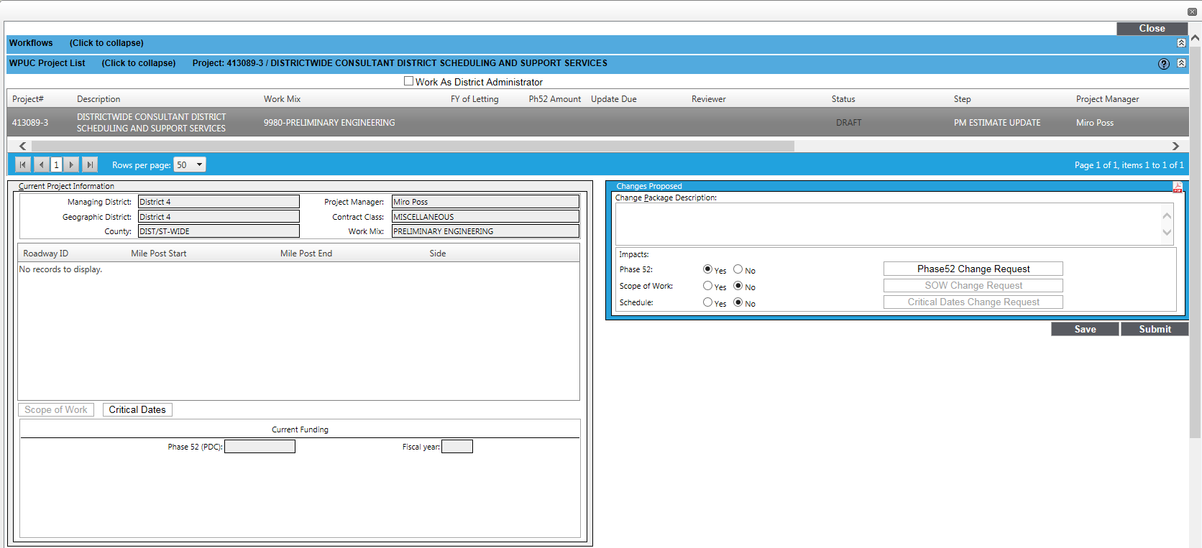
Electronic Submittal – cont.
Step 4:
Select “Yes”

Slide 58
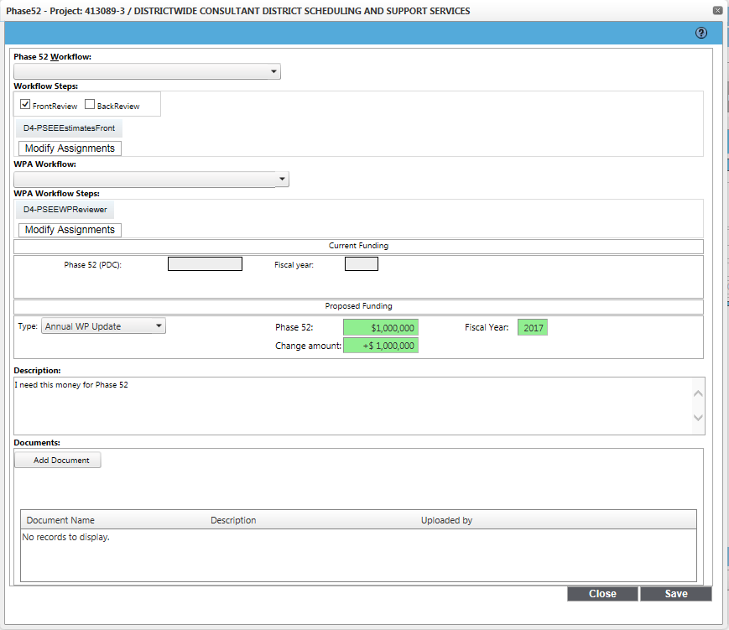

Electronic Submittal – cont.
Select both workflows:
“Front/Back”
“WPA Completion”
Type new Phase 52 Total
Type Fiscal Year
Type Phase 52 description here (primary or version #)
Click “Add Document”, but “Save” first (then save again)

Slide 59
Electronic Submittal – cont.
Step 5:
Click to edit what you just did in Phase 52
Click other radio buttons to add package components
Or select “Submit”

Slide 60
Electronic Submittal – cont.
Where is my project?
If your project is not in WPUC
  Please email d4-workprogram@dot.state.fl.us
    Request that your project be added to the List
  You can only have one change request package in progress.
  Training will be offered on February 22nd , 2018
    Please contact Kathy Shurte to sign up.

Slide 61


Project Unknowns
Risk
Meet
By Tim Brock

Slide 62
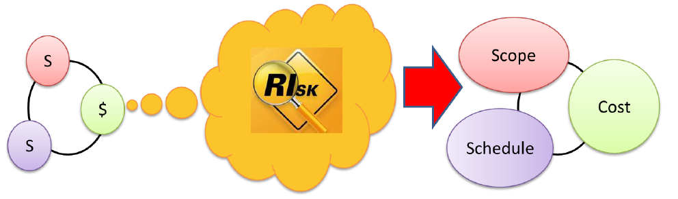
What Is Risk?
Project Management Institute (PMI) Says:
“An uncertain event or condition that, if it occurs, has a positive or negative effect on the project’s objectives.”

Slide 63
What Is Risk Analysis?
Traditional Estimating
Contingency is intended to include all risk known/unknown
Little control of cost and schedule
Reactive
Risk-Based Estimating
Risks are clearly identified and quantified in estimate
Reasonable control of cost and schedule
Threat
1, 2,3,etc
Contingency
Opportunity
1, 2, 3, etc

Slide 64
Why Risk Analysis?
Stabilize & Support Work Program with better cost estimates and schedules
  Validate cost & schedule for accurate project delivery
  Replace general project contingency with risk-based cost
Enhance Project Management activities by including risk assessment and mitigation
Support FHWA requirement for financial plans on major projects by providing risk-based cost estimates
Maximizes the Likelihood of Meeting Time & Budget Goals

Slide 65
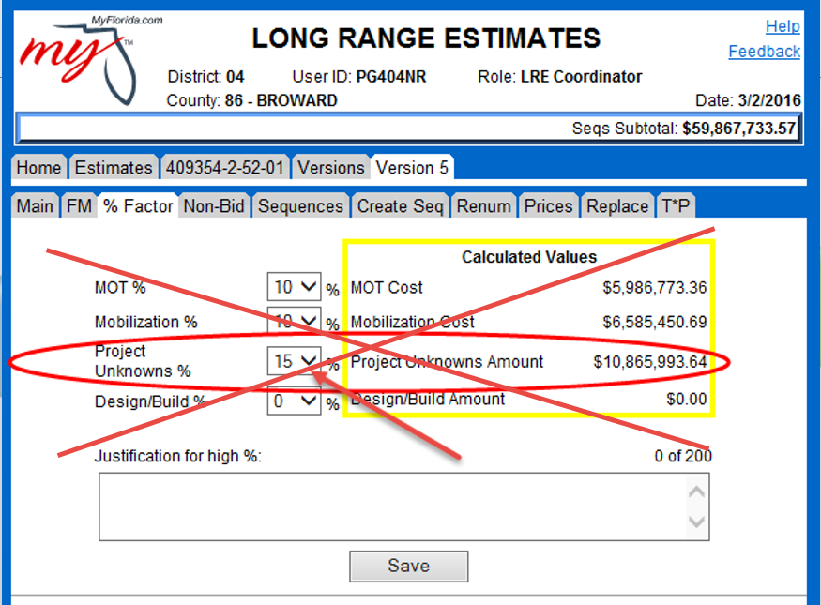

Slide 66
Project Unknowns/Contingencies
Funded & Unfunded Projects
  Project Unknown % Factor in LRE not used
  EX-Item labeled “Project Risks/Unknowns” used
    Exact dollar value entered, no percent factor.
  -Risk Summary & Register (Backup)
    All info can be found on the Program Management -> Final Plans -> Estimates sharepoint site
      “Guide to Including Project Risks/Unknowns in LRE”

Slide 67
How to Determine the Dollar amount for the LRE Project Unknown
Identify project risks in self modeling risk software(Guidance given in User Manual)
Threat or Opportunity?
Determine probability of each risk occurring Determine cost and schedule impacts
Create a risk register (in the self modeling software)
Run to model
Determine the difference between the LRE and the 70% likely not to exceed

Slide 68
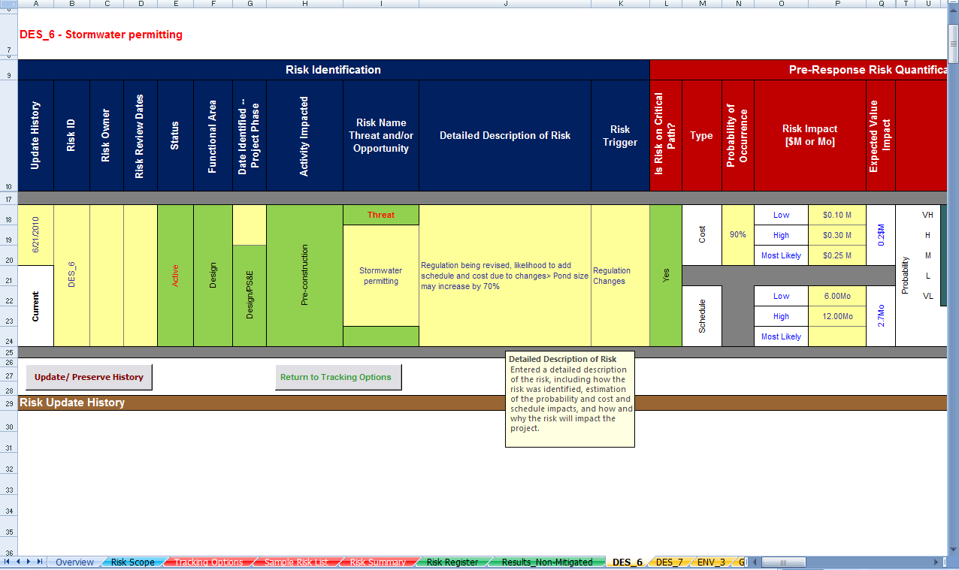
Risk Management Process
Analysis
Quantitative Analysis Tool

Slide 69
Understanding How Risk Works
5
12
15
60
15
75
4.5
5.5
11.5
12.5
14
16
68.75
14
16
65.75
84.75
Outputs = f
50%
51.75
50%
x
+
=
+
=
Qty
Unit Cost
Risk
Base Cost
Risk
Risk-based Cost
Confidence | Cost
 | Pre-Mit.
5% | $54.9
10% | $56.3
25% | $59.2
50% | $66.4
70% | $73.3
80% | $75.2
90% | $77.2
95% | $78.5
Source: FHWA

Slide 70
Risk Analysis – Post-Mitigated Results
Confidence | Cost
 | Pre-Mit. | Post-Mit.
5% | $55.2 | $54.5
10% | $56.5 | $55.6
25% | $59.4 | $57.9
50% | $67.1 | $61.0
70% | $73.5 | $64.4
80% | $75.3 | $71.5
90% | $77.4 | $75.3
95% | $78.8 | $77.4
Same base cost of $60.3…so now the LRE update for risk is $4.1 Million Dollars

Slide 71
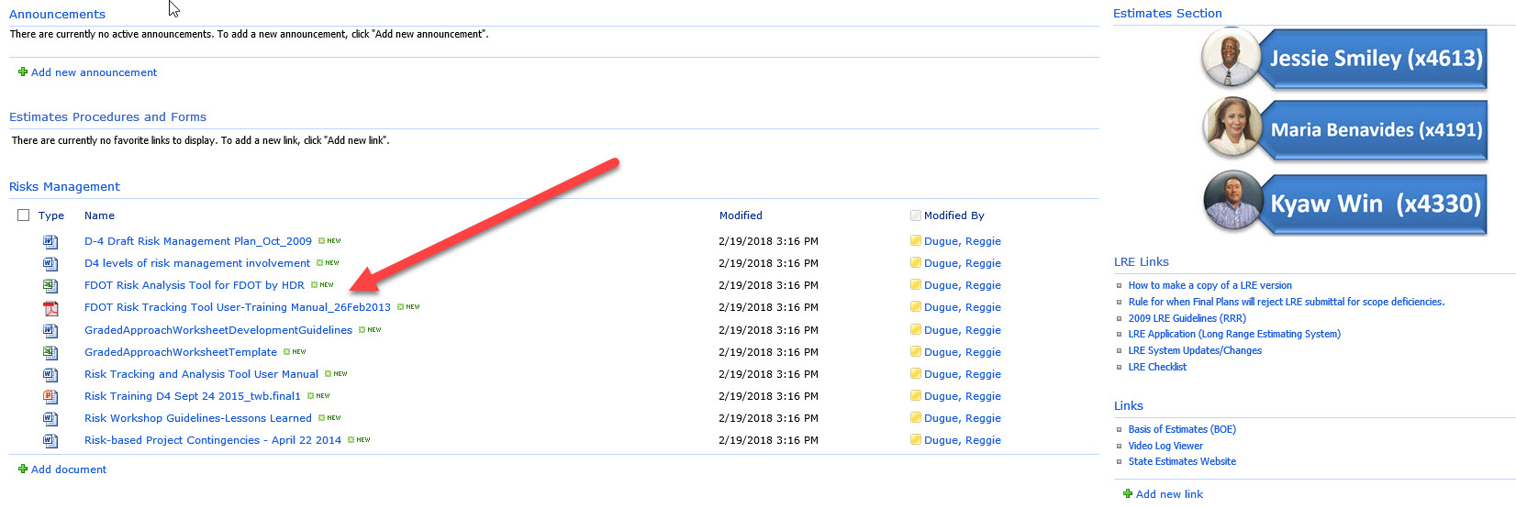
D4 Program Management – Estimates Sharepoint site

Slide 72
Finding Historical Cost on Website
1st Choice – Find 12 month moving Area (11 & 12) Average for pay item.
2nd Choice – Find annual statewide average for pay item.

Slide 73
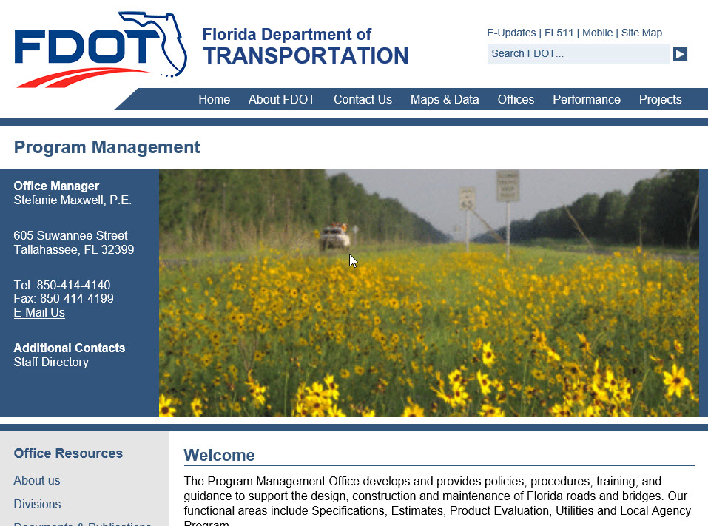
PROGRAM MANAGEMENT OFFICE WEBSITE

Slide 74
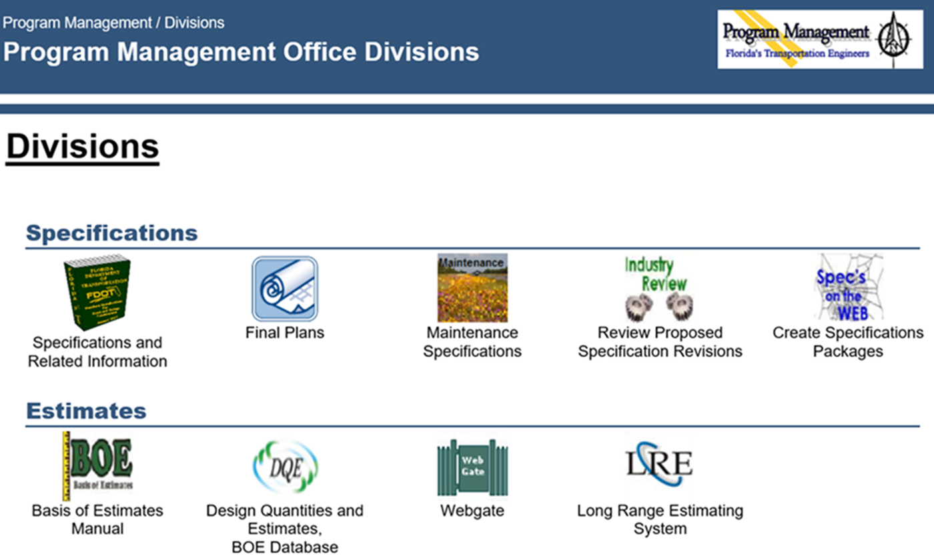

Slide 75

Go to the Estimates Office

Slide 76
Where to load Project Risks/ Unknowns?
EX-Item loaded into sequence 1 of the LRE labeled: “Project Risks/Unknowns”
    - Enter the difference between your LRE cost and the 70% likely not to exceed value from the total construction cost curve after running the model. The difference is a dollar amount and will be loaded in the LRE as an EX-Item.

Slide 77

Identified Risk ≠ Major Scope Unknowns
(According to Final Plans)
Major scope unknown = Separate LRE
Most likely scope/LRE submitted
  Example: PD&E Alternate Alignments
Notes:
Separate LRE means separate version of the LRE, not a separate FPID number.

Slide 78
How can I get more information?
Knowledge Base
  “Guide to Including Project Risks/Unknowns in LRE”
    Location: Program Management->Final Plans-> Estimates
  Ask your District Four Risk Team (Tim Brock, Dianne Forte, Deb Ihsan)!
  Also for reference - This presentation!
  “2018 Work Program / Right of Way / LRE Kickoff Presentation”
    Location: Program Management->Final Plans

Slide 79
References
  Project Management Handbook Chapter 19
  http://www.fdot.gov/designsupport/PMhandbook/
  Washington State Department of Transportation
  http://www.wsdot.wa.gov/Projects/ProjectMgmt/RiskAssessment/
  FHWA Risk Assessment
  https://international.fhwa.dot.gov/scan/12030/12030.pdf

Slide 80
LRE Due Dates – 2018 Update Year
Adopted (2018-2019) March 06, 2018
FY2022-2023 March 20, 2018
FY2021-2022 April 03, 2018
FY2020-2021 April 17, 2018
All new R/W cost estimate requests
due in R/W office April 30, 2018
FY2019-2020 May 01, 2018
Unfunded/Others May 15, 2018
FY2023 (Candidates) May 15, 2018
IMPORTANT!! THESE DATES ARE THE DATES LREs MUST BE IN FINAL PLANS. PLAN ACCORDINGLY AND ENSURE THE SCOPE IS FULLY APPROVED PRIOR TO THESE DATES.

Slide 81
To RECAP
Every Project Needs an LRE
District Four Manages the entire project costs including risks
John and Scott’s deadline is not Final Plan’s deadline

Slide 82
What questions do you have?
THANK YOU!

