Slide 1

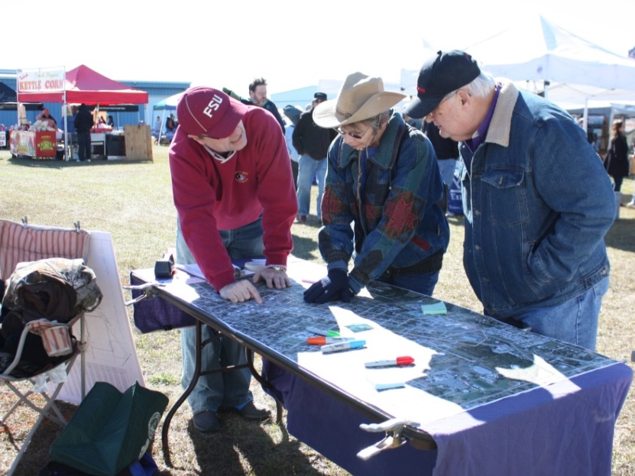
Who’s at the Table & Who’s Not?
Techniques for identifying and engaging affected and interested publics.
Tammy Vrana, moderator

Slide 2
Agenda
Introduction
Four Table Rotations
  Listen for the signal
  Move to a different table
Report Out
  Table hosts and scribes summarize key points

Slide 3
Topics
Polling for Real-time Feedback
Northeast Florida Freight Movement Study – Partner and Stakeholder Engagement
North Florida Transportation Planning Organization’s Clean Fuels
Stakeholder Engagement in the ETDM Process
Techniques for Engaging Hard-to-Reach People
Expanding Public Outreach for the Tentative Work Program

