Slide 1
Using Data in the Environmental Screening Tool to Support Community Impact Assessment
Chris Sands, AECOM
August 10, 2017

Slide 2
Agenda
Analysis Tools in the Environmental Screening Tool (EST)
  Hardcopy Maps
  Interactive Map Viewer
  GIS Analysis
  Sociocultural Data Report (SDR)
Products
  Preliminary Environmental Discussion (PED)
  Sociocultural Effects Analysis (SCE) / Community Impact Assessment (CIA)

Slide 3
Agenda
Resources
  EST Public Website
  FDOT SCE Guides

Slide 4
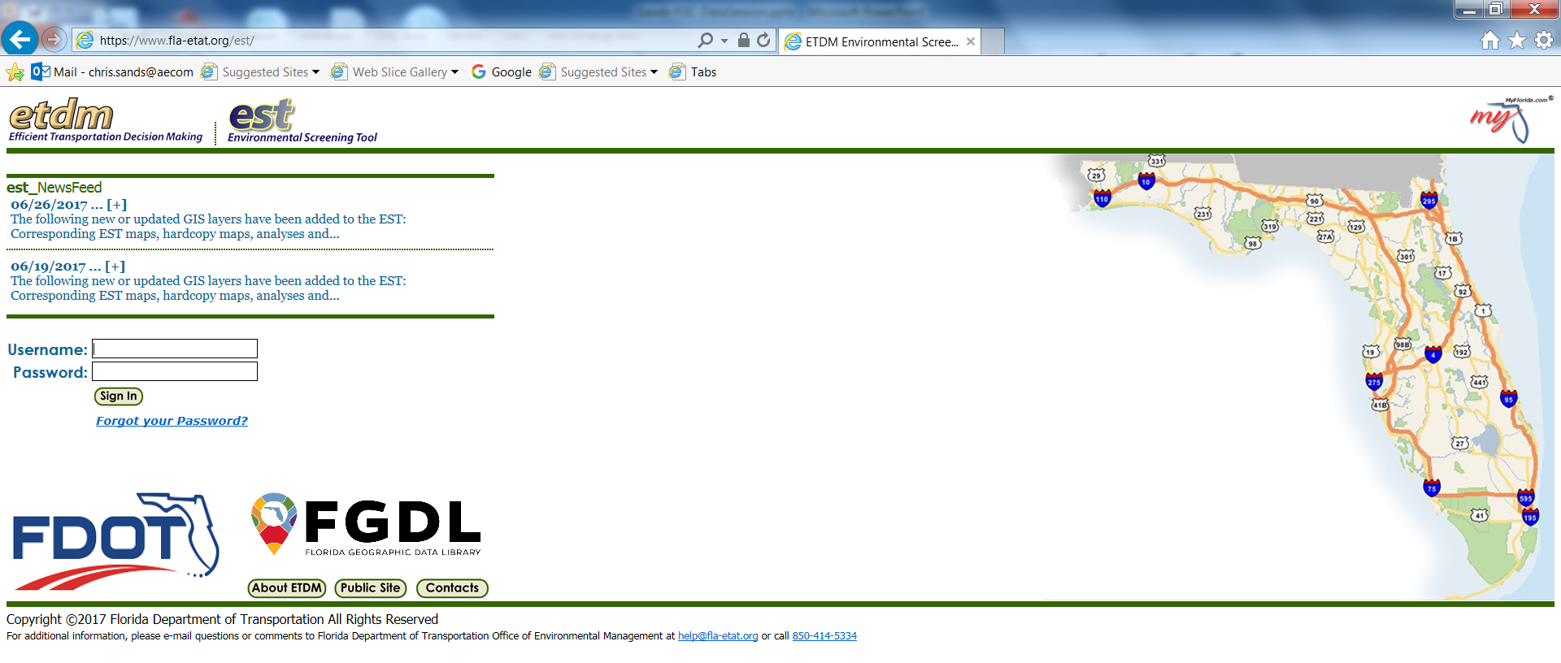
The Environmental Screening Tool (EST)

Slide 5
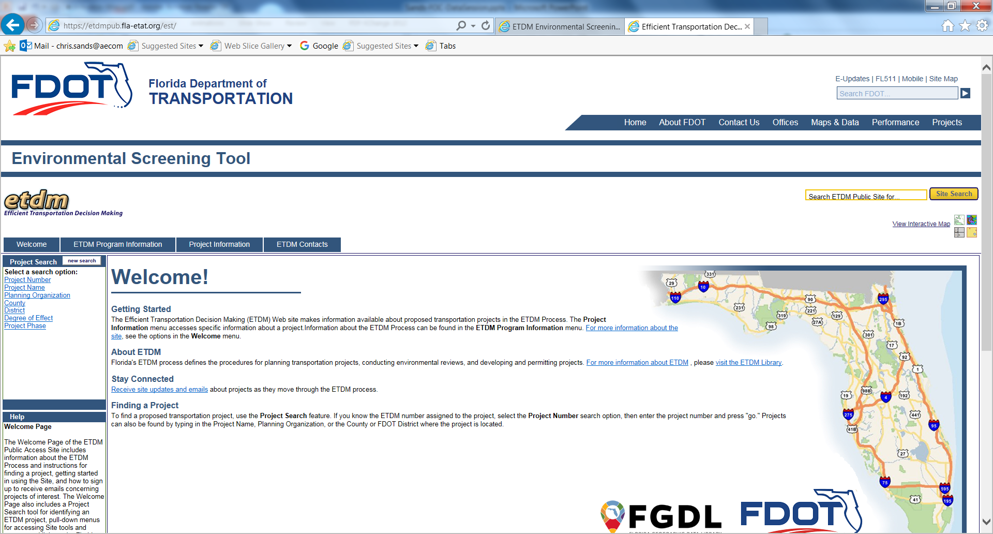
EST Public Access Website
https://etdmpub.fla-etat.org

Slide 6
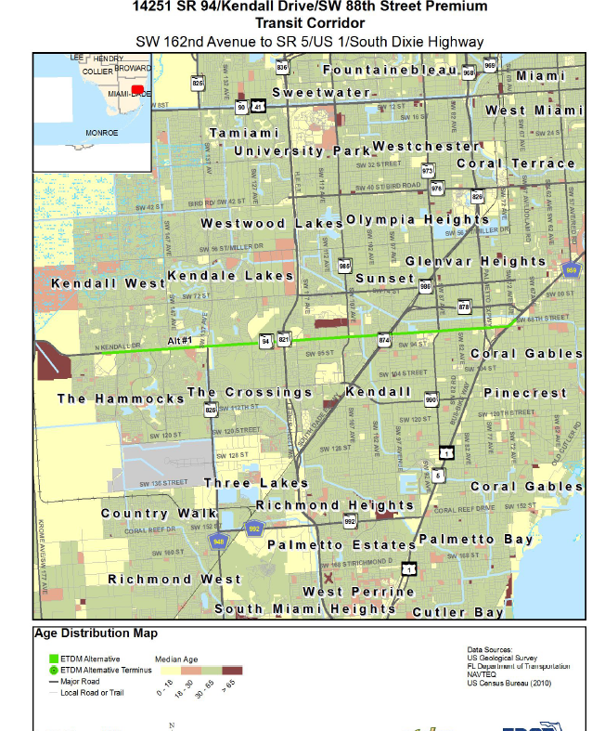
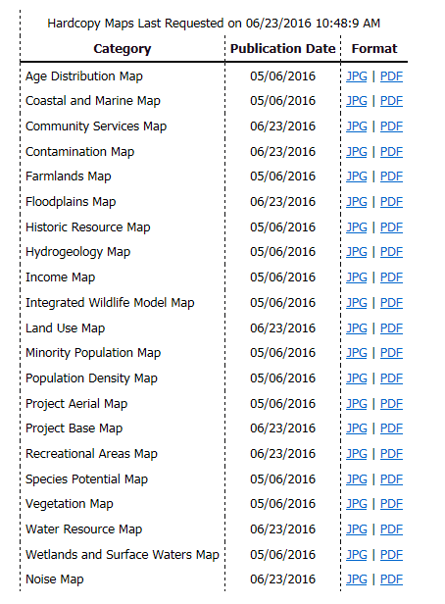
Hardcopy Maps
Age Distribution
Community Services
Income
Land Use
Minority Population
Population Density

Slide 7
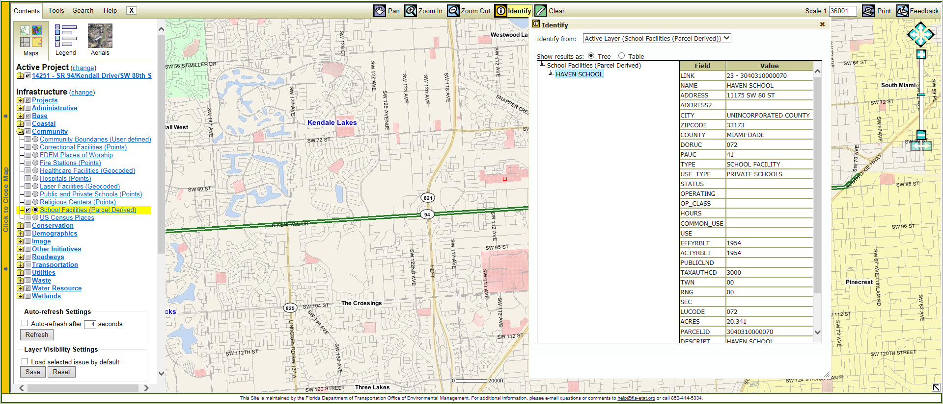
Interactive Map Viewer

Slide 8
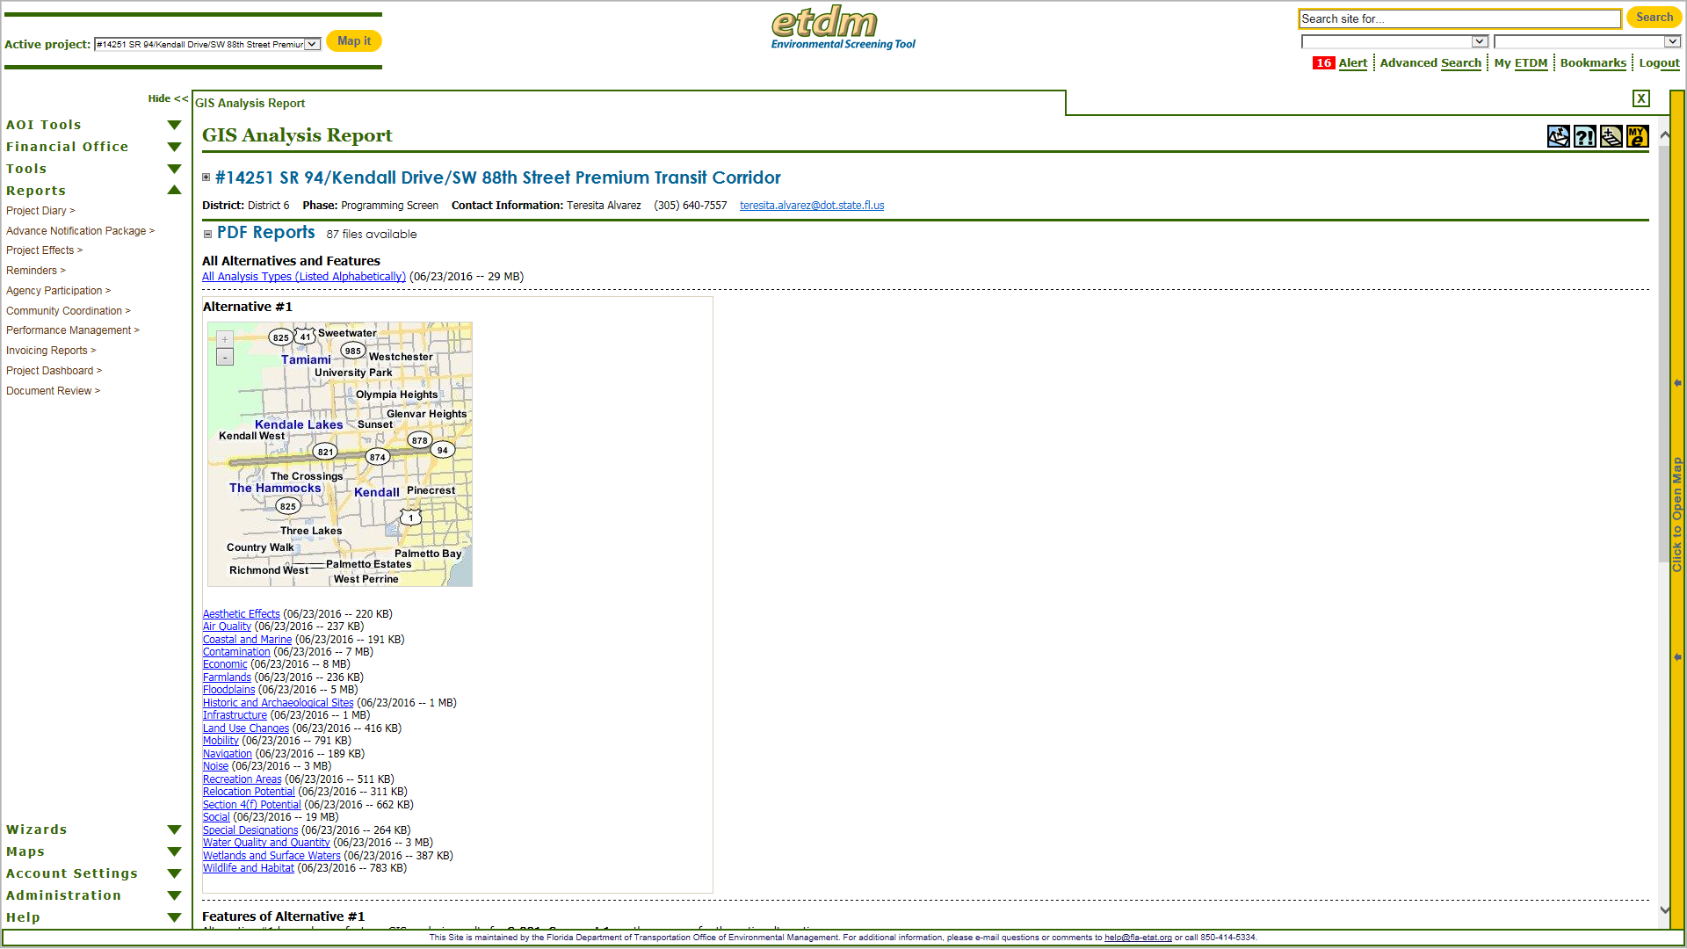
GIS Analysis
Primary source for the
Preliminary Environmental Discussion
Informs reviews by review agencies
Starting point for SCE analysis

Slide 9
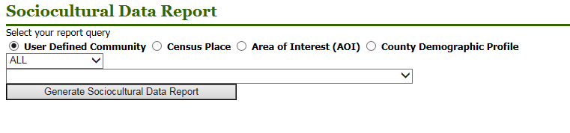
Sociocultural Data Report
Available for a variety of geographic shapes
Includes county profile for comparison
Cites data sources
Lists census blocks and block groups

Slide 10
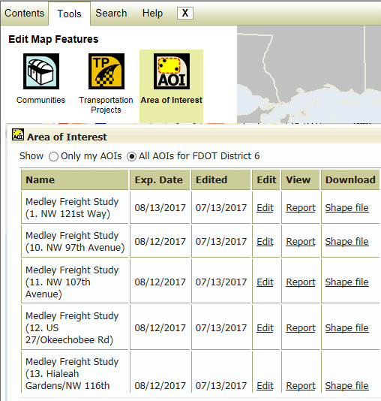
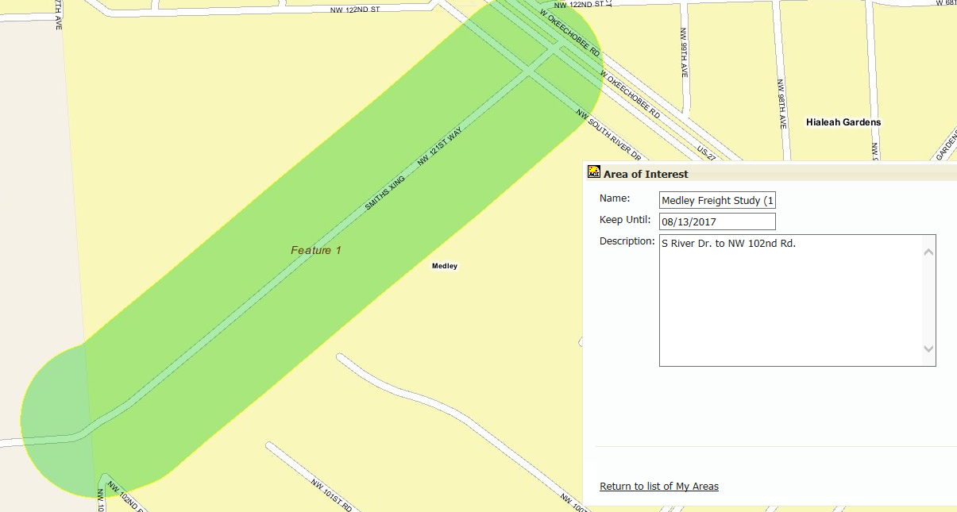
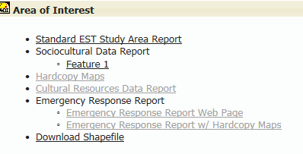
Area of Interest Tool

Slide 11
GIS Analysis Report

Slide 12
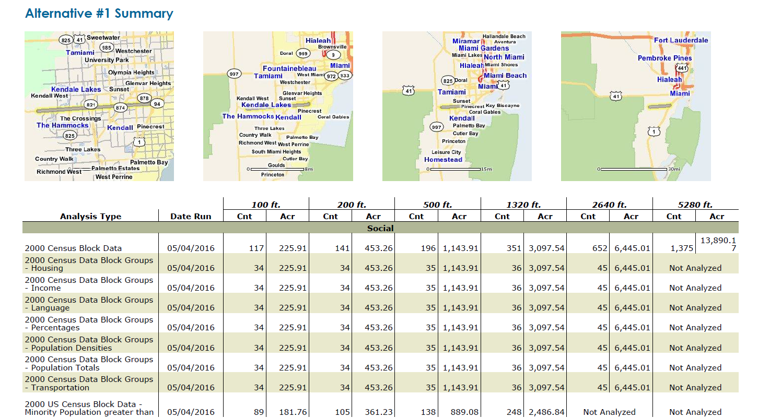
GIS Analysis Summary Table

Slide 13
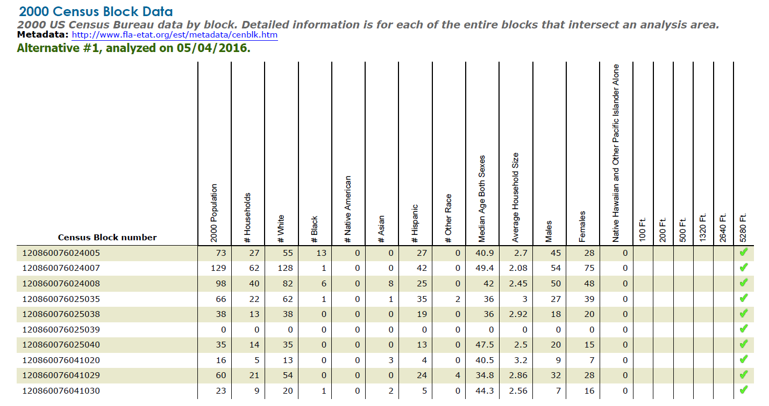
GIS Analysis Census Blocks

Slide 14
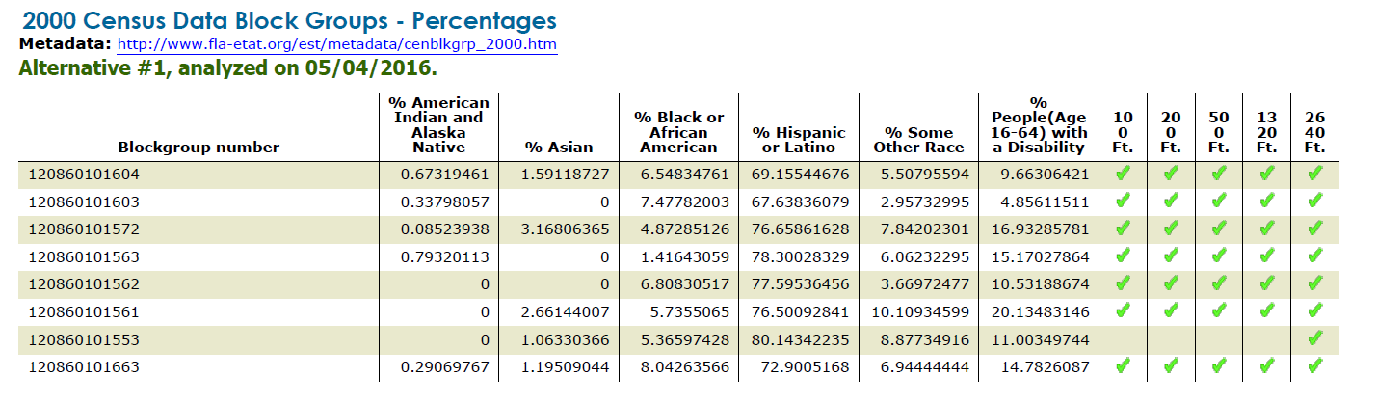
Demographics - Race

Slide 15
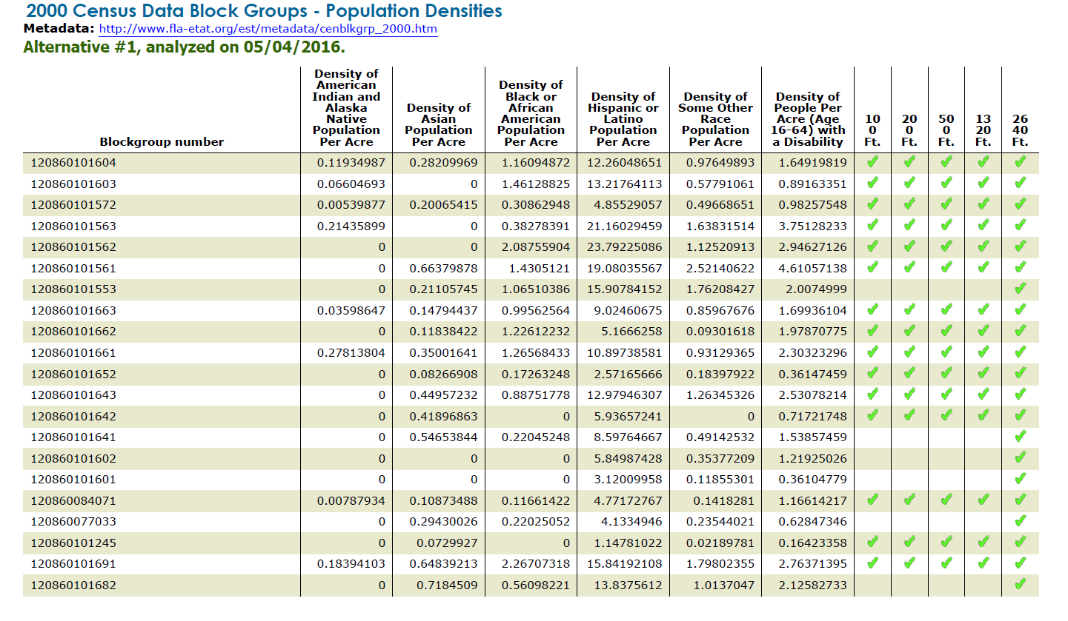
Demographics – Population Density

Slide 16
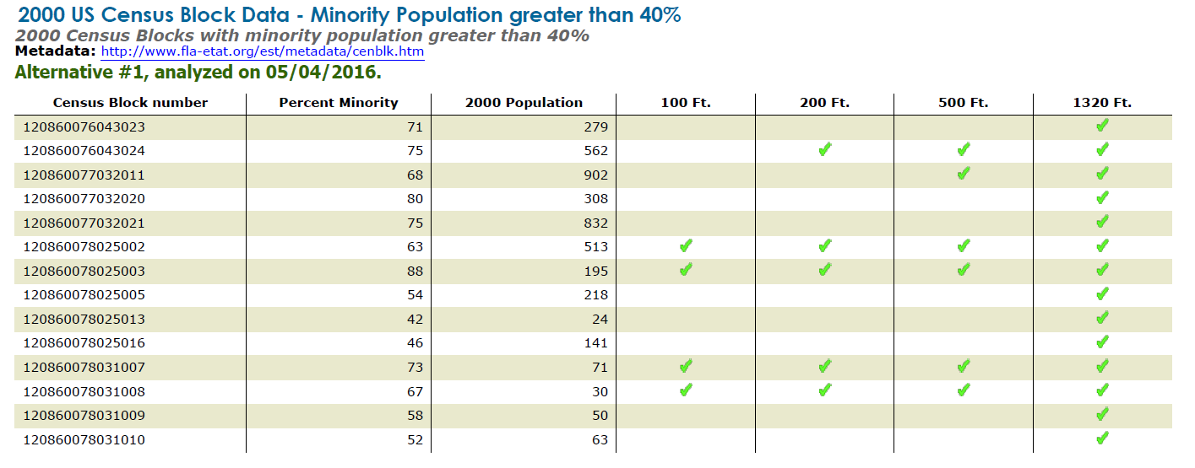
Demographics – Minority Populations

Slide 17
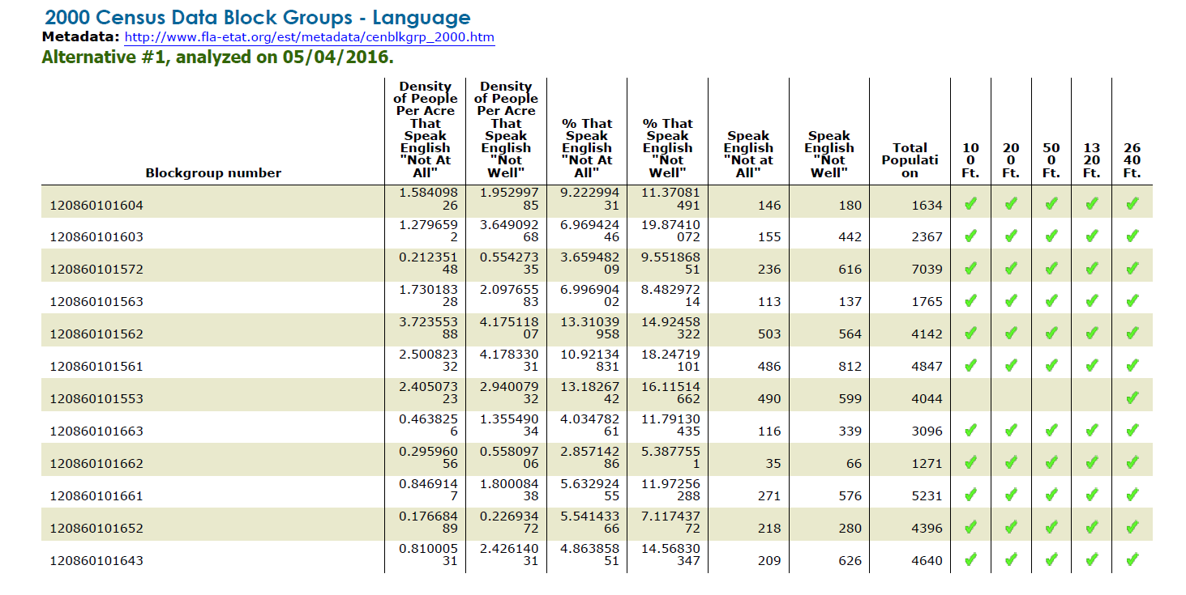
Demographics - Language

Slide 18
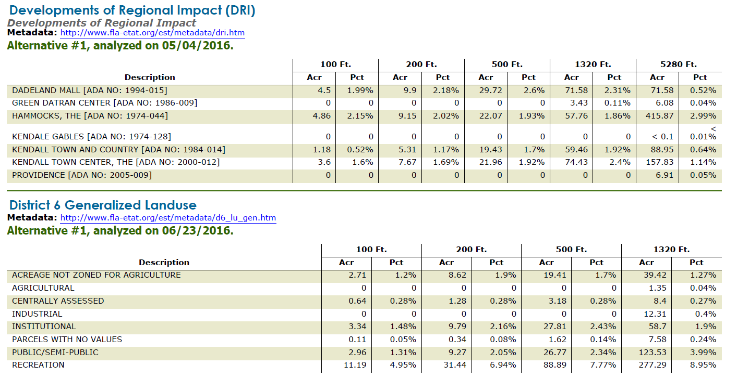
GIS Analysis – Other Data

Slide 19
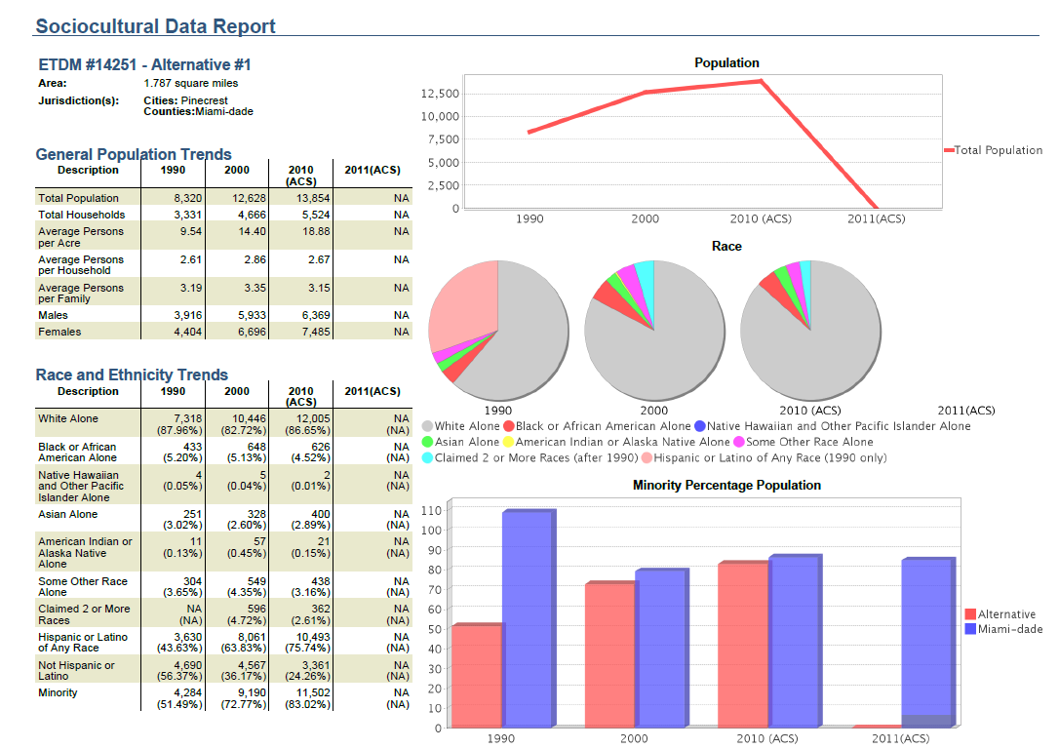
SDR - Population

Slide 20
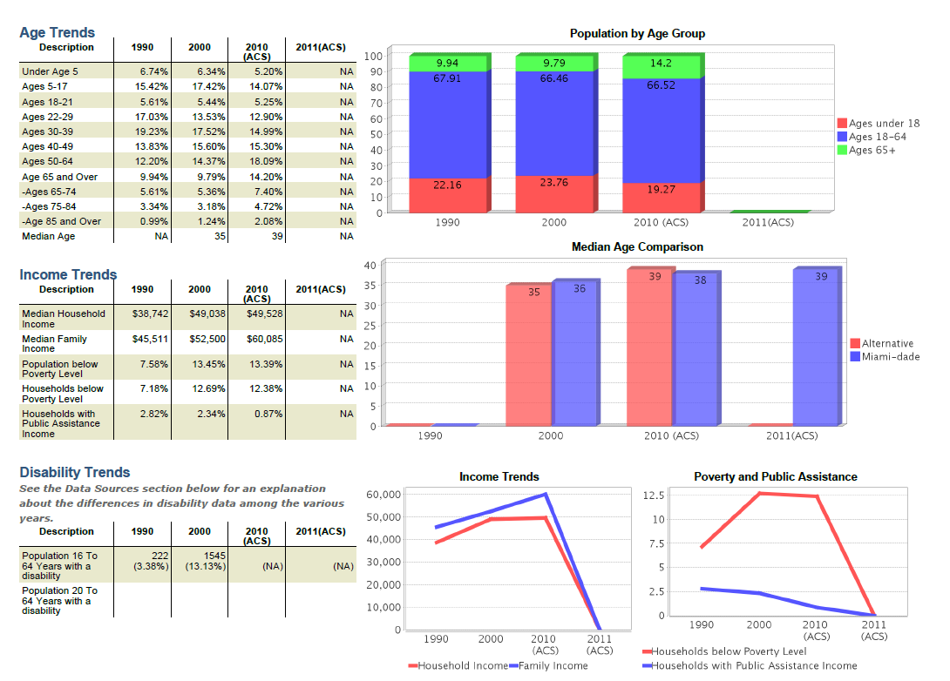
SDR – Age, Income, and Disability

Slide 21
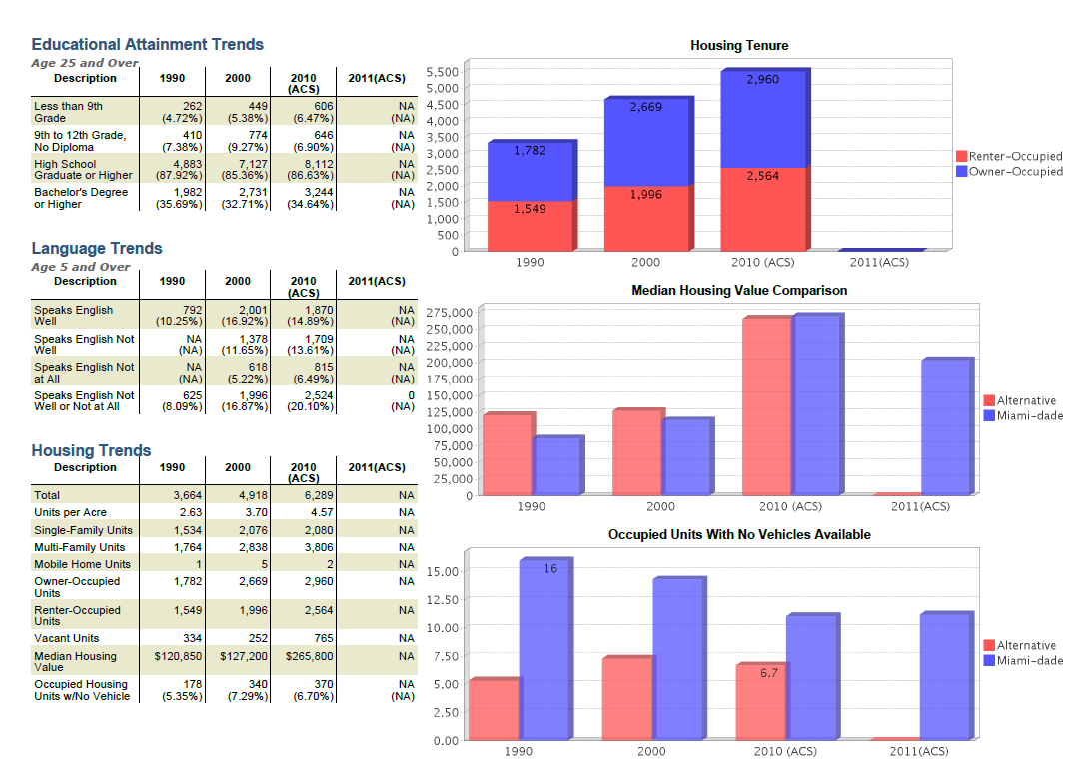
SDR – Education, Language, and Housing

Slide 22
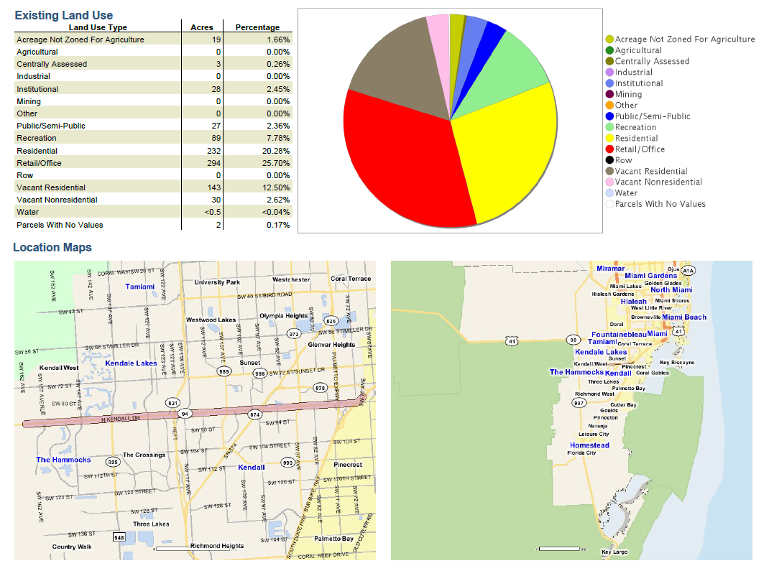
SDR – Land Use

Slide 23
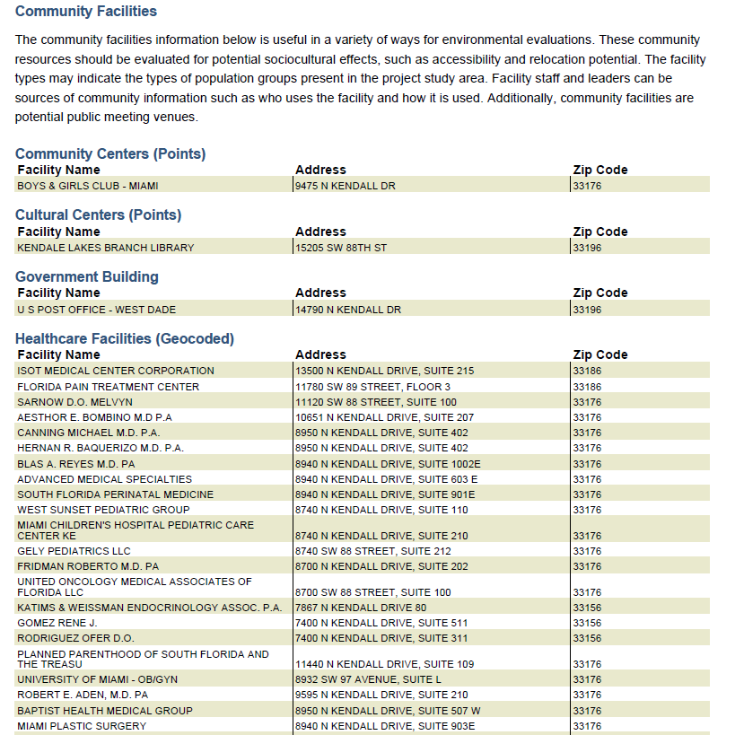
SDR – Community Facilities

Slide 24
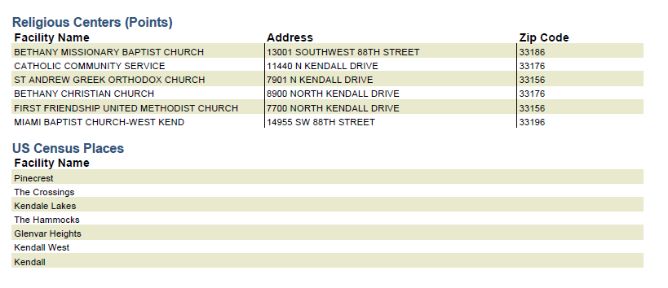
SDR – Census Places

Slide 25
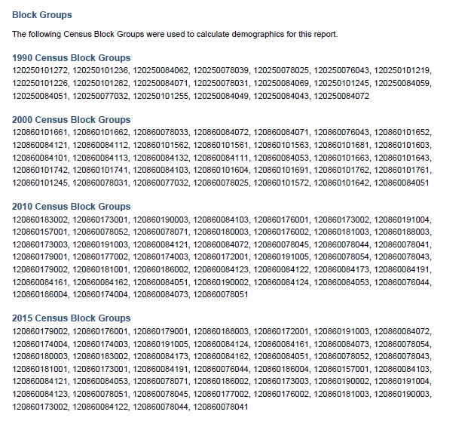
SDR- Block Groups

Slide 26
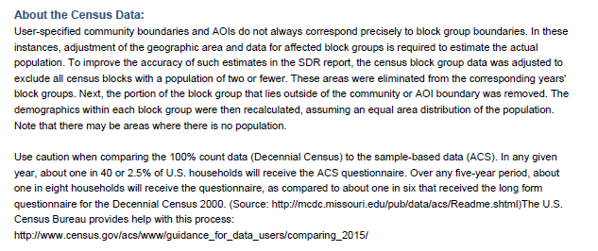
SDR – About the Census

Slide 27
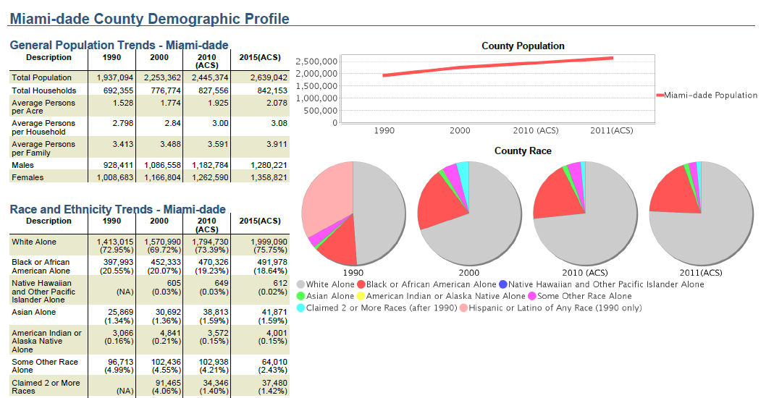
SDR – County Profile

Slide 28
EST Public Access Website
https://etdmpub.fla-etat.org

Slide 29
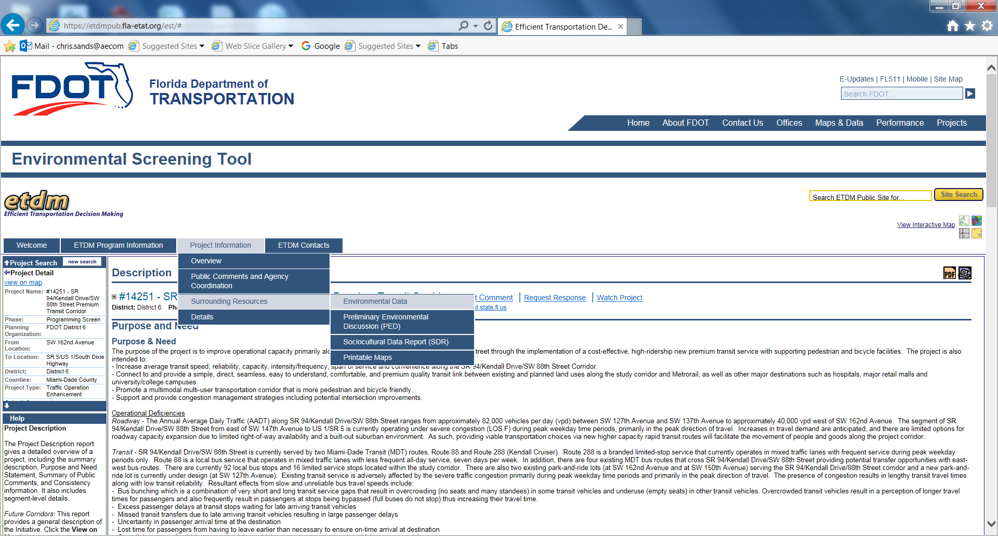

Slide 30
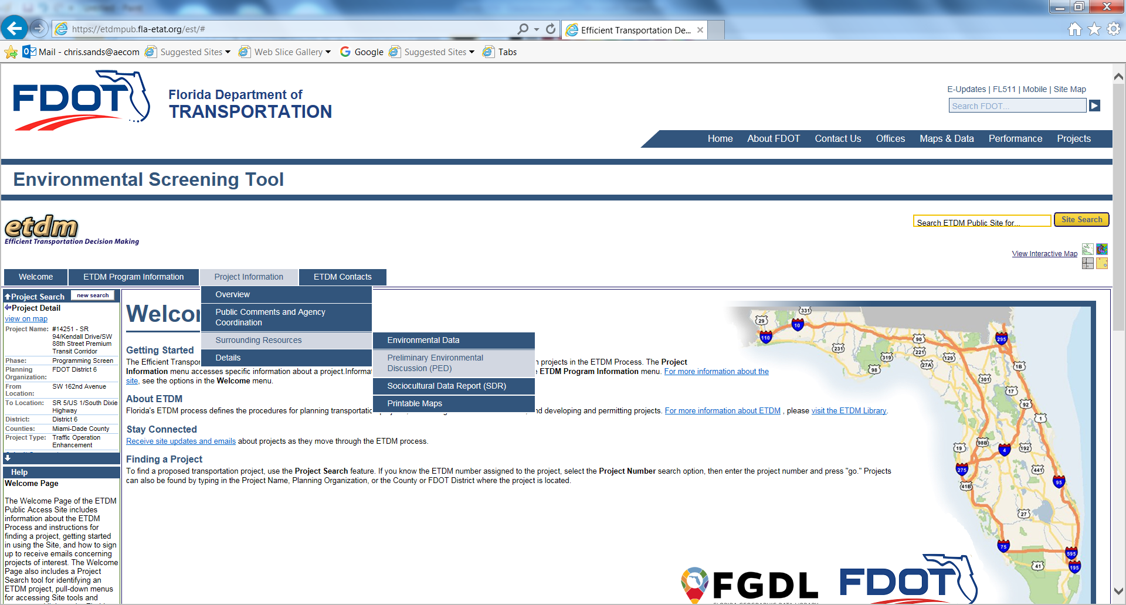

Slide 31


Slide 32
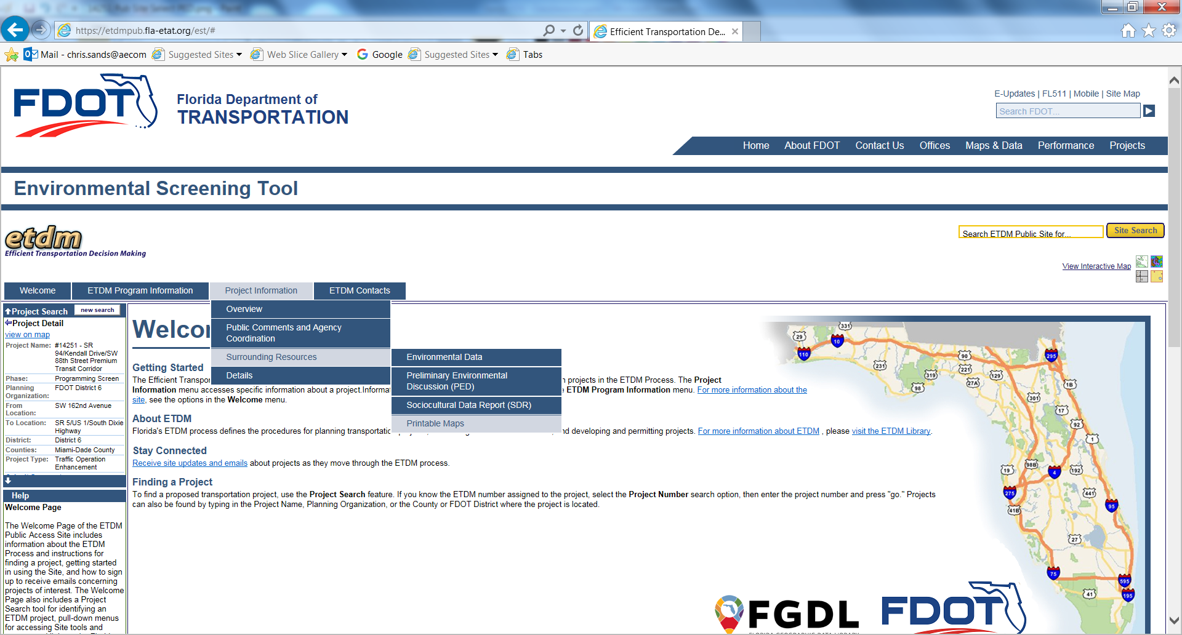

Slide 33
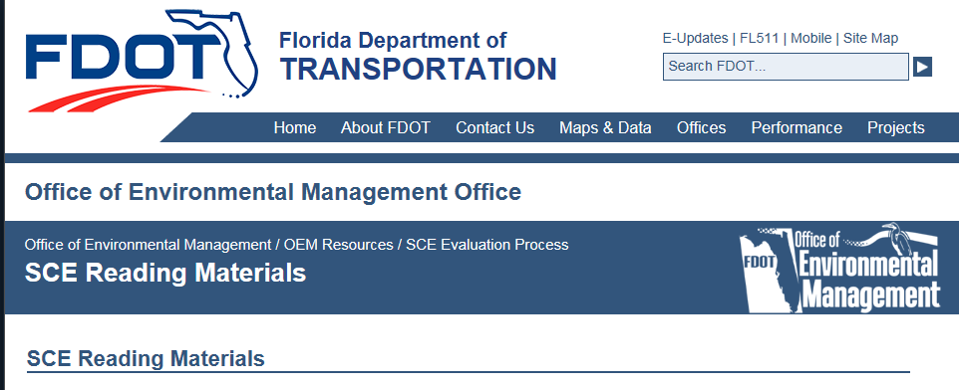
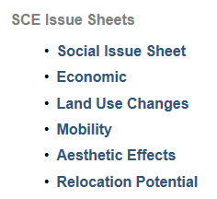
FDOT – SCE Resources
http://www.fdot.gov/environment/pubs/sce/sceReading.shtm

Slide 34
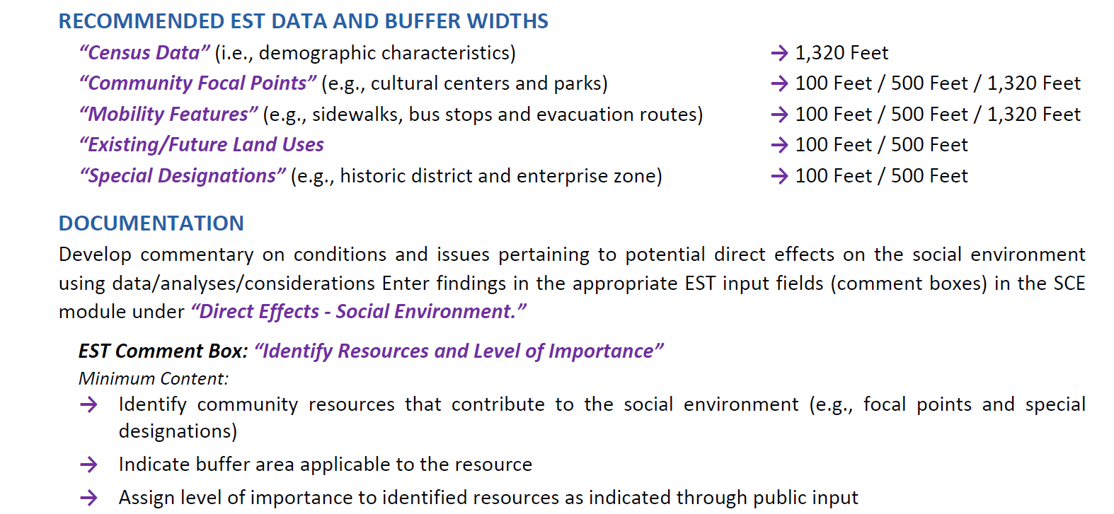
SCE Issue Sheets – Example (Social)

Slide 35
Get Started
These are a Starting Point for SCE
  Hardcopy Maps
  Interactive Map Viewer
  GIS Analysis
  Sociocultural Data Report (SDR)
Also use
  Local knowledge
  Windshield surveys
  Your expertise

Slide 36
Questions?
Chris Sands
Staff Programmer, Aecom
OEM Help Desk
850-414-5334
help@fla-etat.org
Rusty Ennemoser, PhD
Statewide Community Resource and Public Involvement Coordinator
Office of Policy Planning
Florida Department of Transportation
(850) 414-5337

