Slide 1
Community Engagement in Frenchtown
Lauren Chappell
Frenchtown Heritage Hub

Slide 2
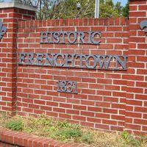
Introduction

Slide 3
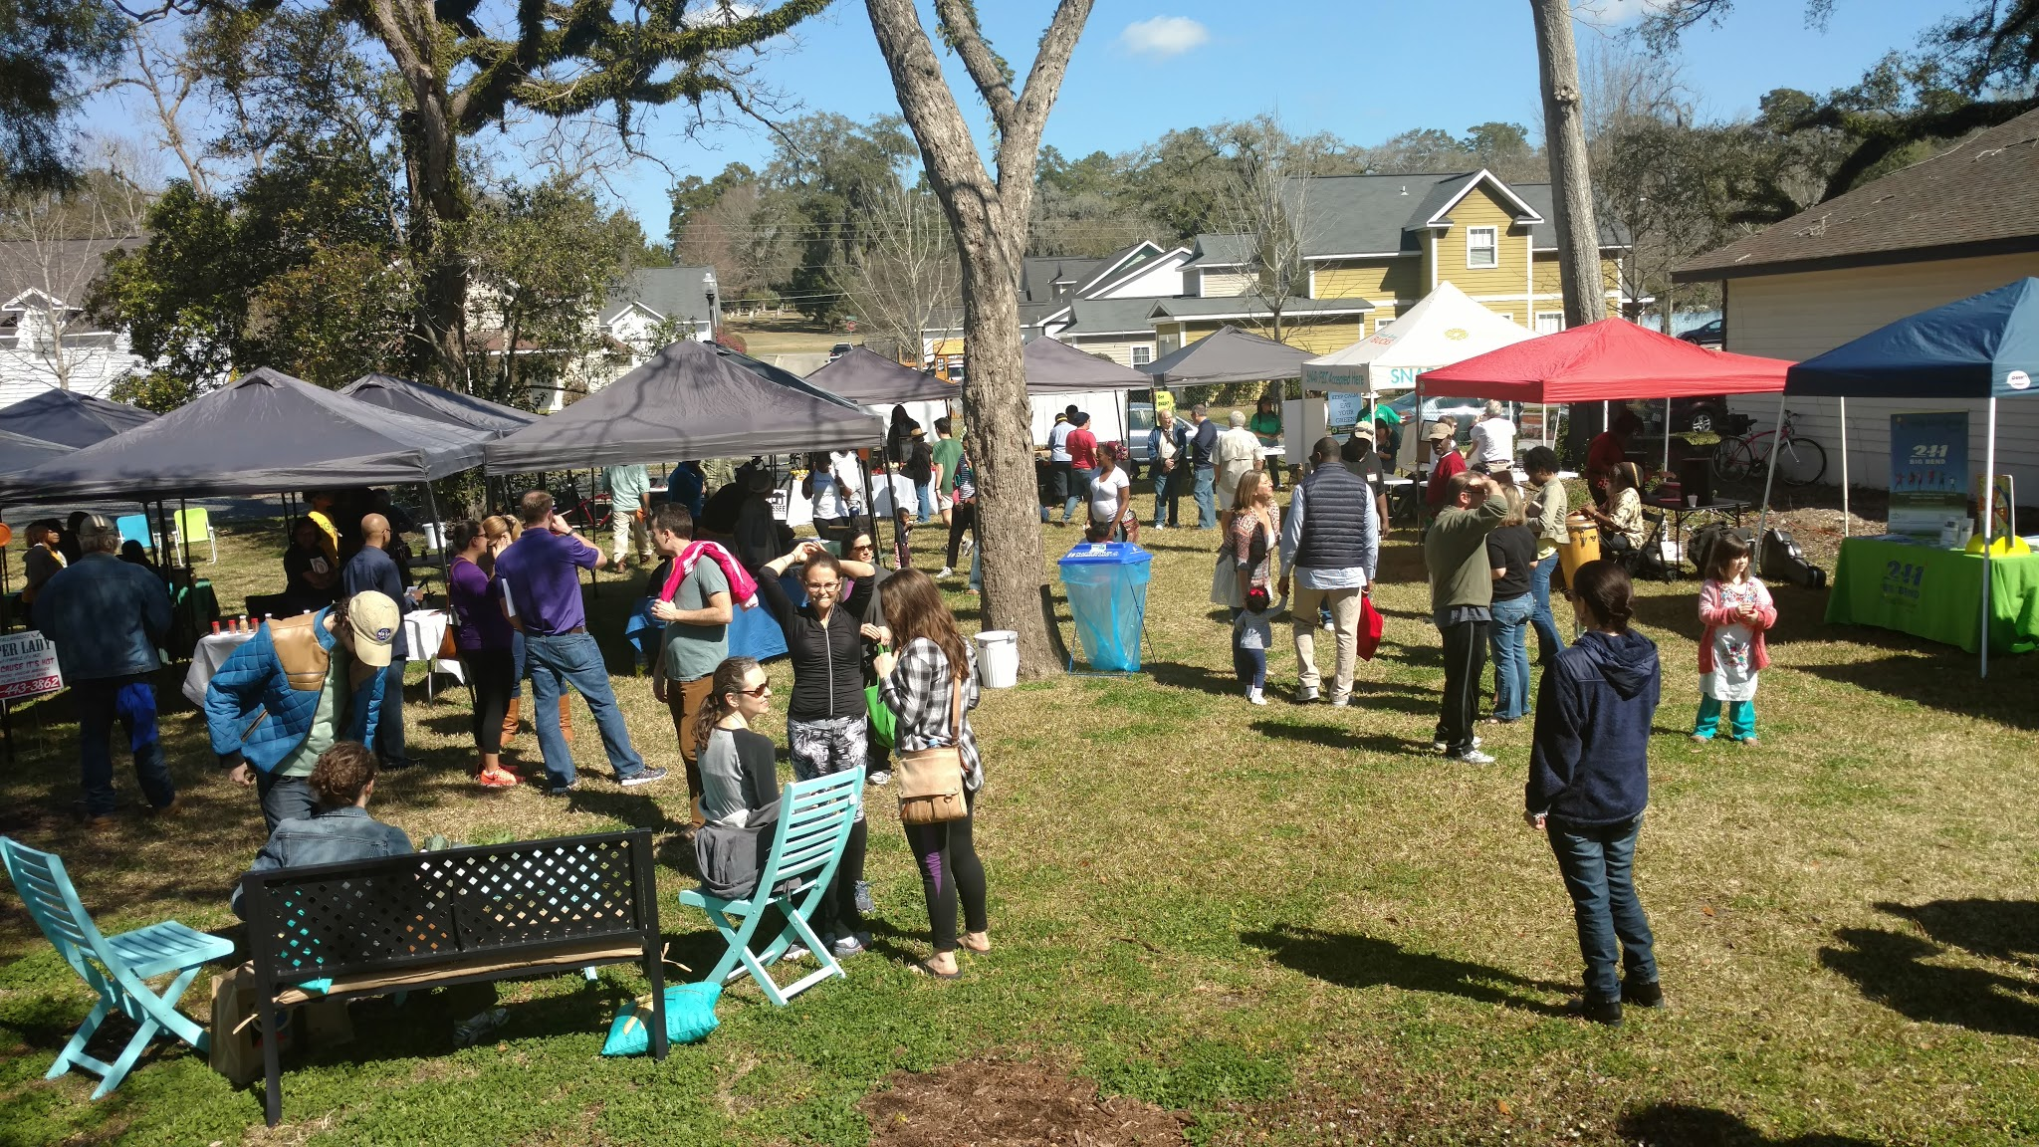
Farmers Market

Slide 4
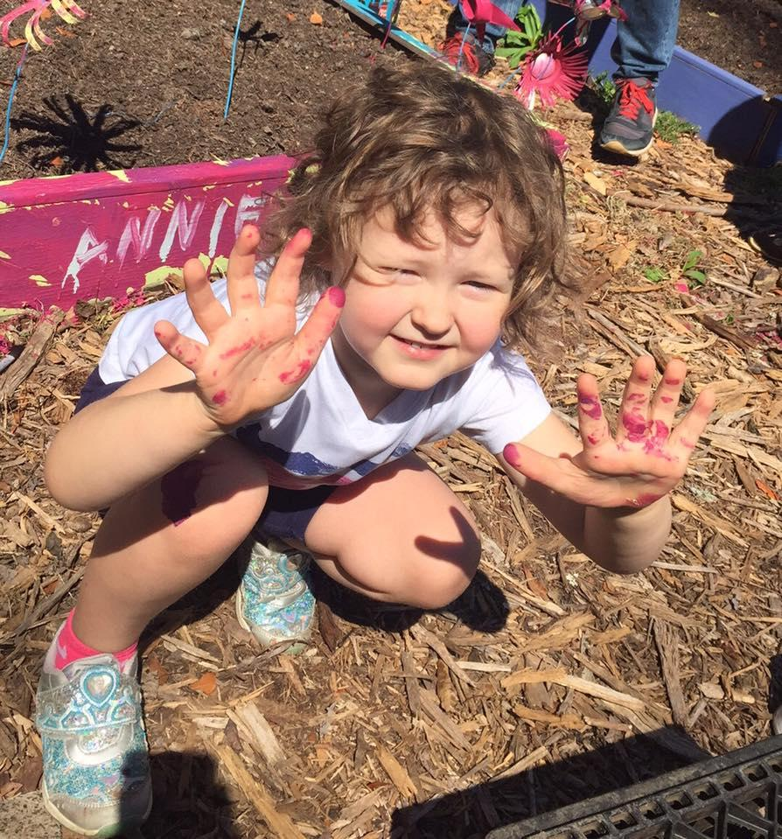
Living Classroom

Slide 5
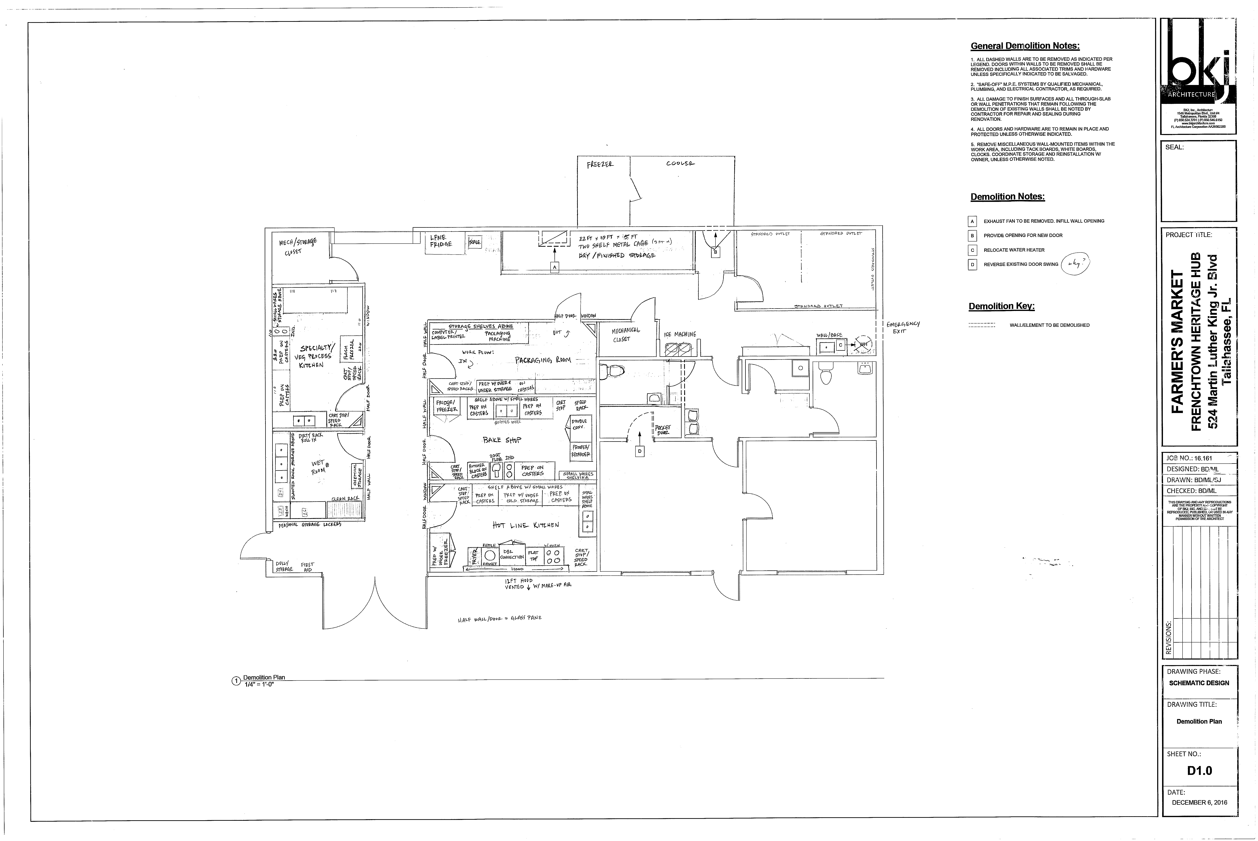
KitchenShare

Slide 6
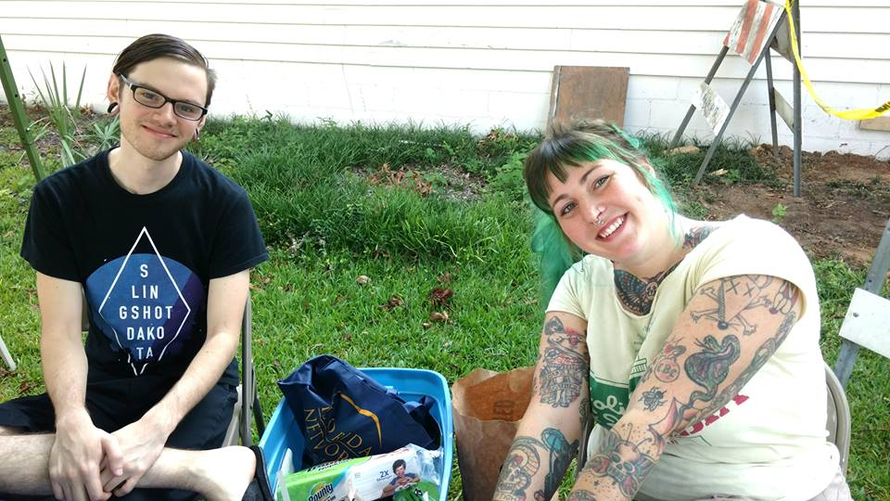
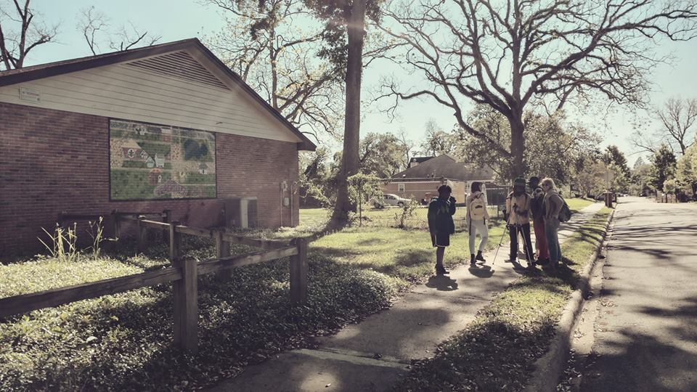
Community Engagement

Slide 7
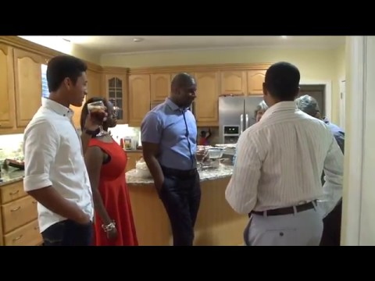
Longest Table

Slide 8
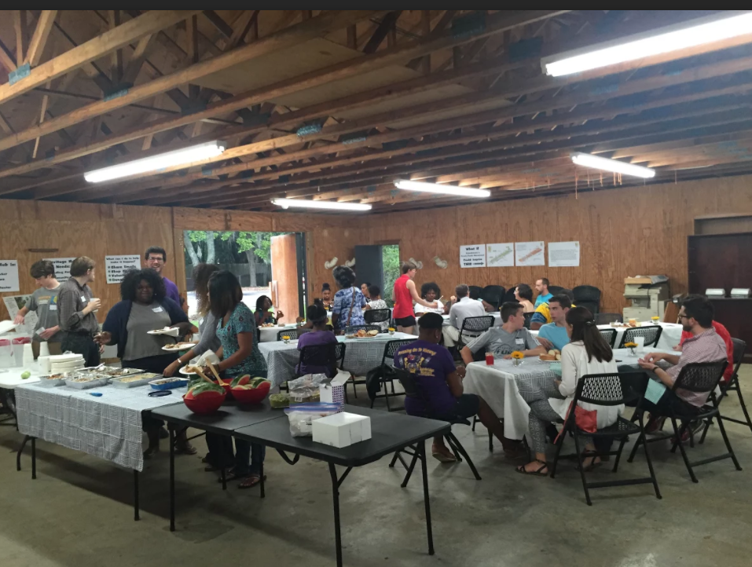
Longest Table

Slide 9
Find us online and Social Media
Frenchtownheritage.org
KitchenShareTLH.org
Facebook: https://www.facebook.com/FTFarmersMarket/
Instagram: frenchtownmarketplace

