Slide 1
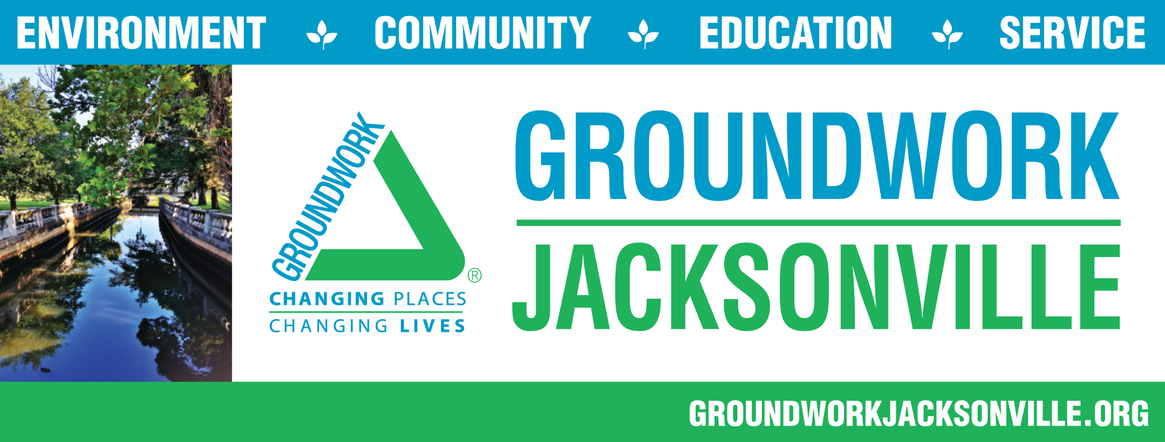
Presented by: Alyssa Bourgoyne Interim Executive Director

Slide 2
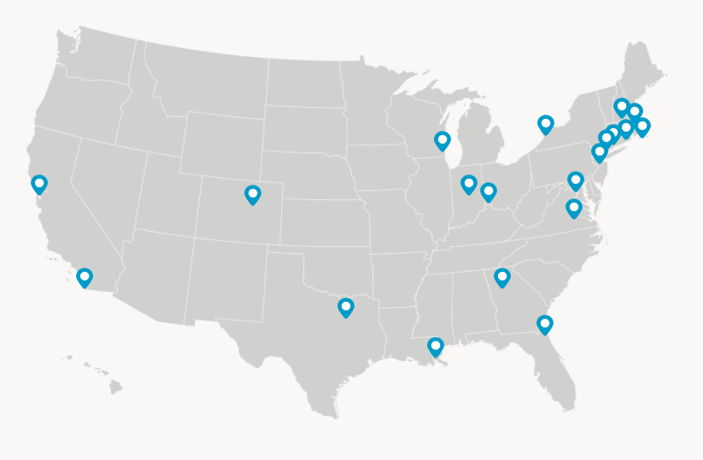
Groundwork USA
Created about 20 years ago in partnership with the national park service and the environmental protection agency.
A national enterprise with local roots, working at the intersection of the environment, equity and civic engagement.
Transform blighted communities for the long term.

Slide 3
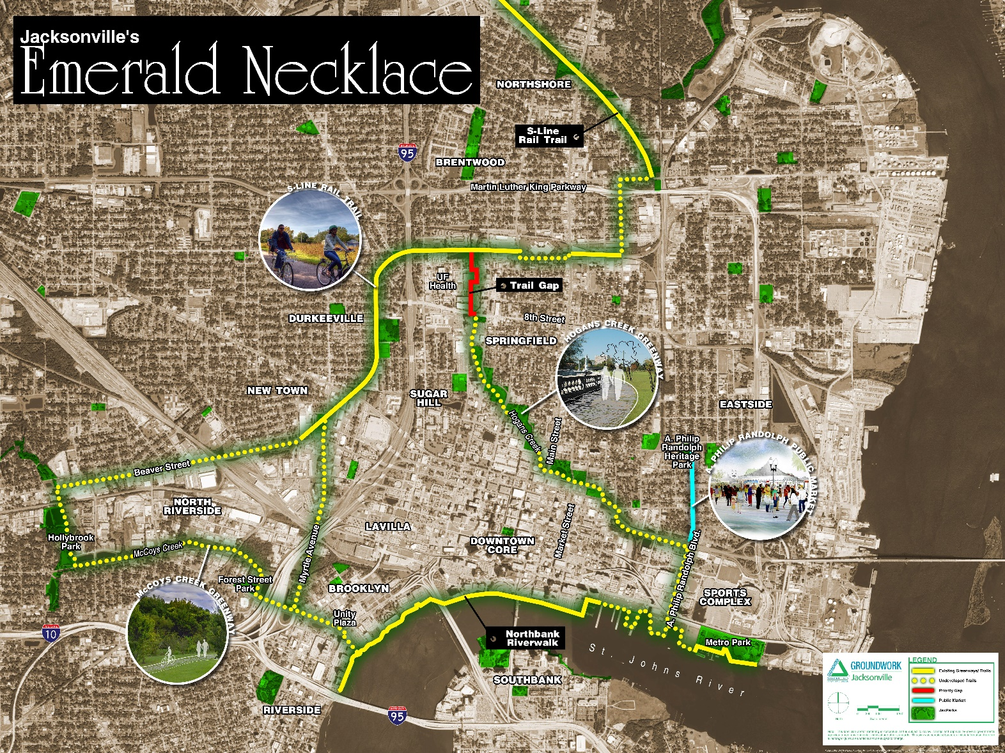
Groundwork Jacksonville
2013: Groundwork Jacksonville Steering Committee formed.
Late 2013: Groundwork Jacksonville application submitted to Groundwork USA by the City of Jacksonville.
2014: Feasibility study conducted in.
Late 2014: Jacksonville (and Atlanta) awarded the first Trust designation in the South.
2015: On boarding of Board of Directors, FT Green Team Coordinator and CEO.
2017: Groundwork Jax team consists of FT seasonal staff, FT program staff, PR/Marketing consulting team, bookkeeper and soon the on-boarding of a permanent executive director.

Slide 4
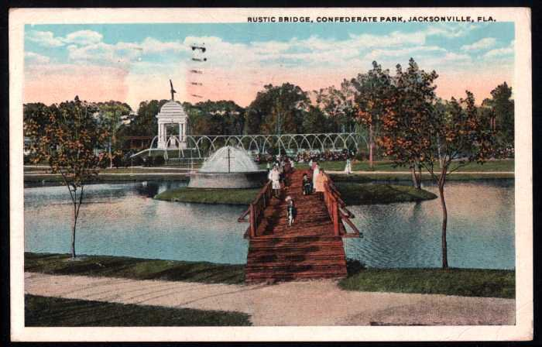
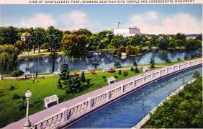
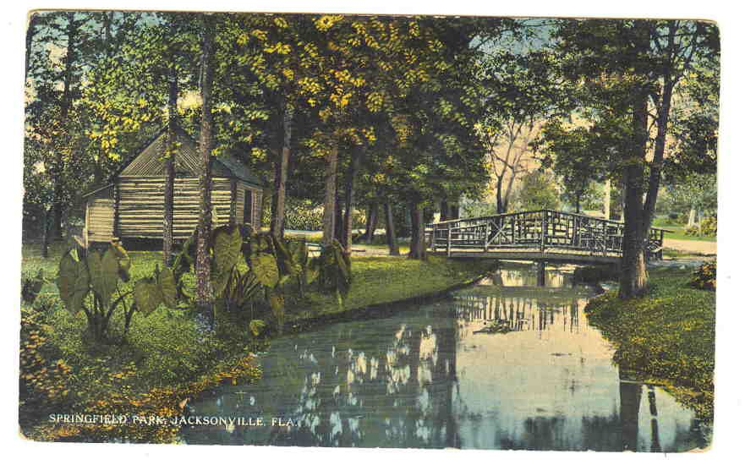
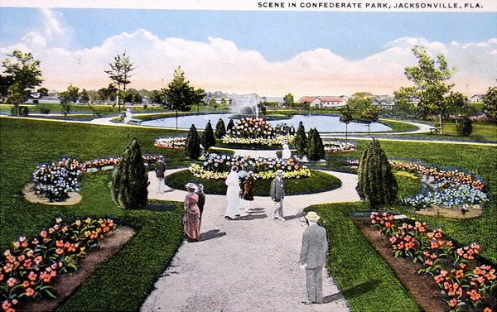
The Gems (and the Challenges) of the Emerald Necklace
McCoys Creek
  3 miles
S-Line Urban Rail Trail
  4.8 miles
Hogans Creek
  2.5 miles
St. Johns River Northbank Riverwalk
  3 miles
Concept was first proposed by the late 1920’s by famed architect Henry J. Klutho

Slide 5
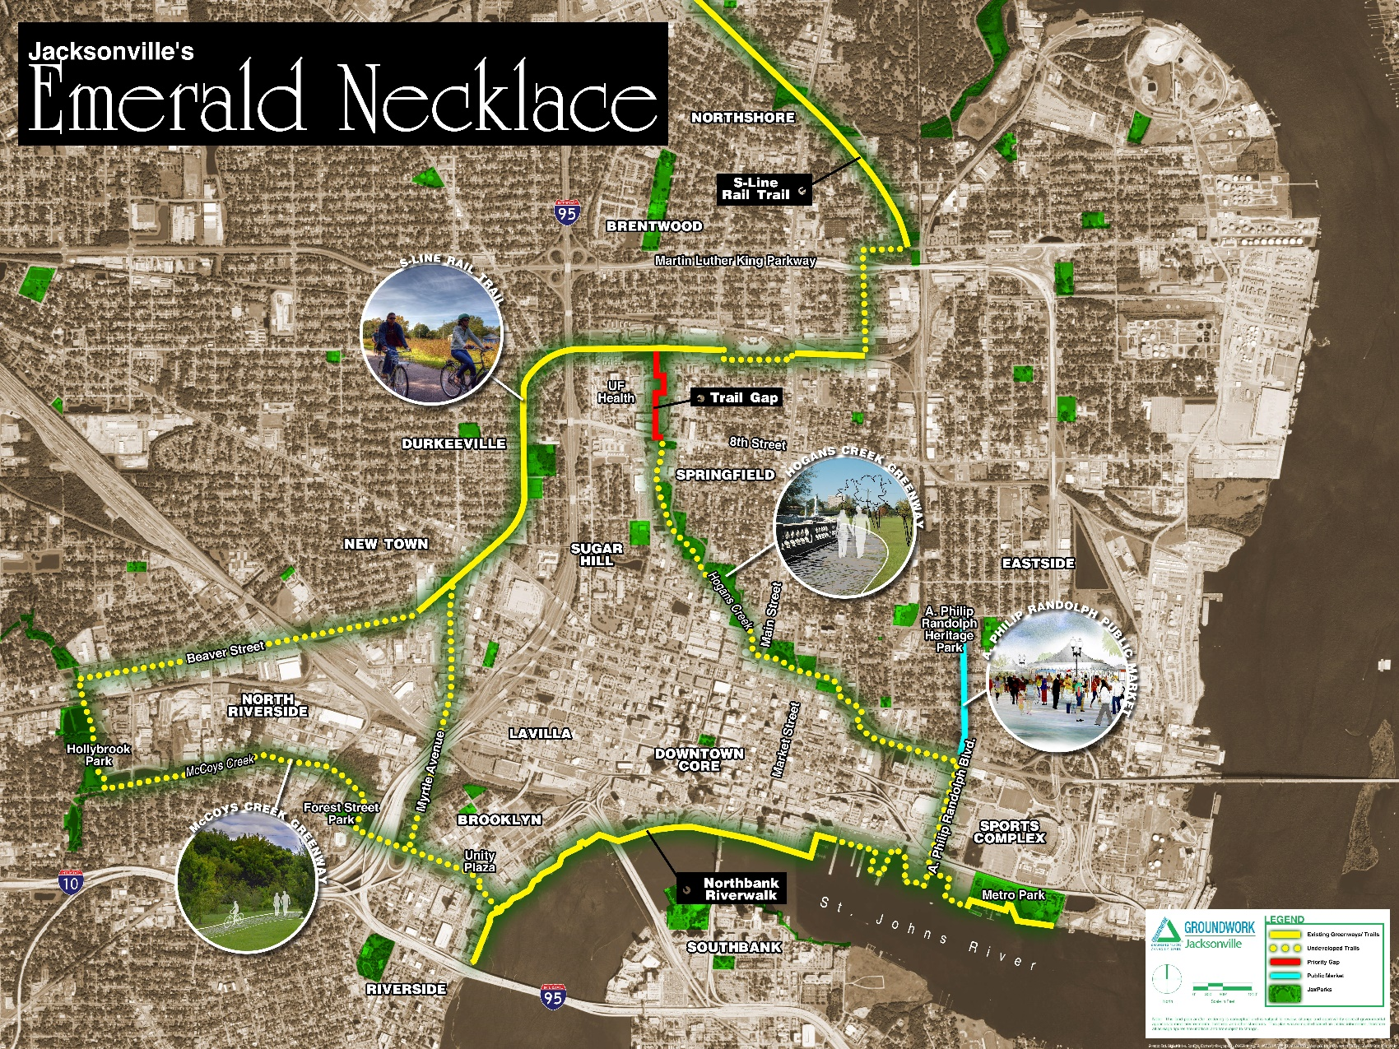
The Vision
The Emerald Necklace is a
nationally recognized centerpiece attracting people to Jacksonville.
It connects urban core neighborhoods that are valued as vital and desirable places to live, work, and visit.
Jacksonville’s urban core neighborhoods are economically diverse and economically healthy.
Urban core neighborhoods have a community ethic of active living and an outdoor orientation.
Working together, neighbors are engaged in creating and sustaining their clean environment.

Slide 6
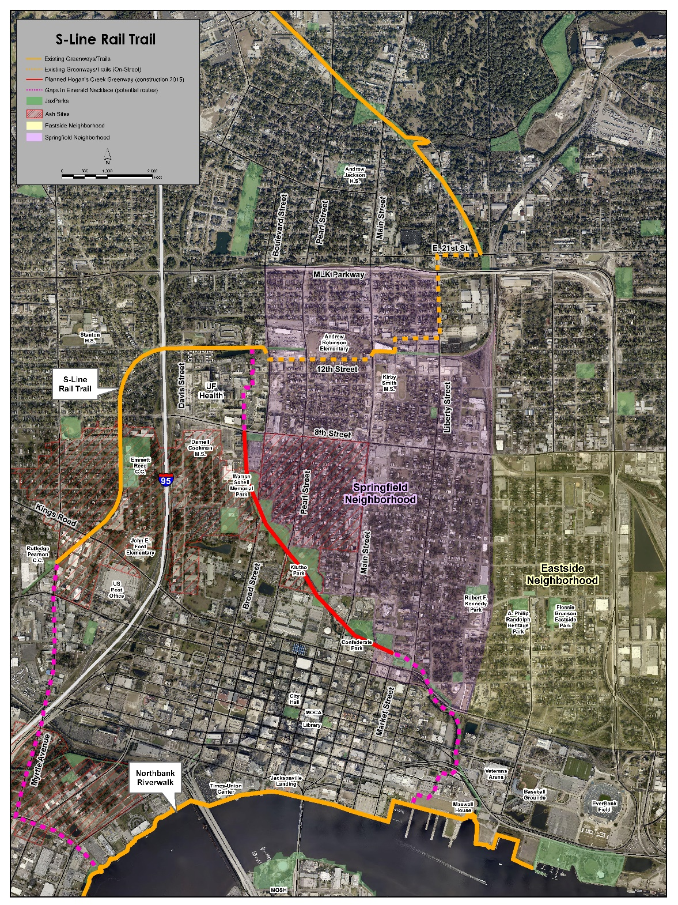
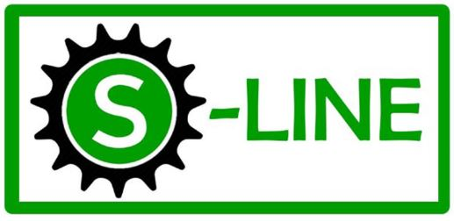
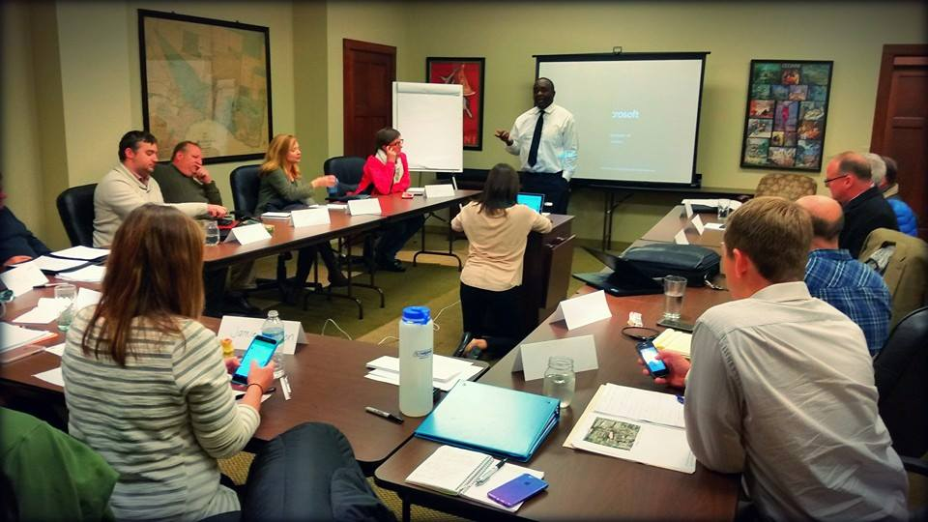
Groundworkers for the S-Line
A 11-member steering committee charged with making short-term trail development recommendations a reality by late 2017
Short term recommendations:
  1. Establish Maintenance Program
    COJ Parks and Recreation
  2. Seek Partnerships for Art in Public Places
    Local artists and the Cultural Council of Greater Jacksonville
  3. Signage/Wayfinding
    JTA
  4. Make the Northern Connection of Hogan’s Creek Greenway to the S-Line
    COJ Bicycle and Pedestrian Coordinator

Slide 7
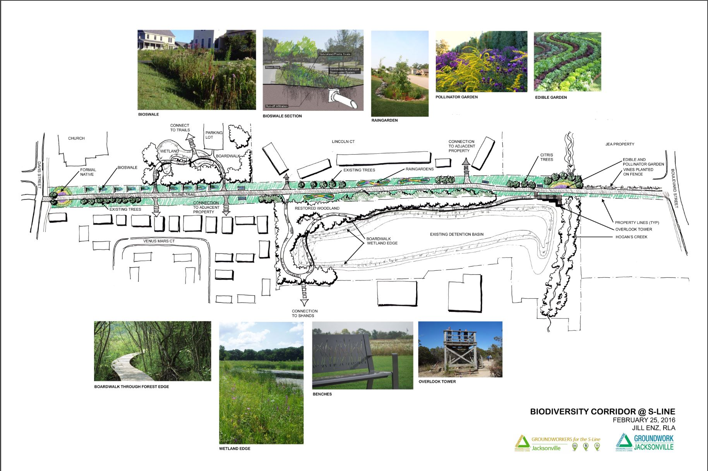

Slide 8
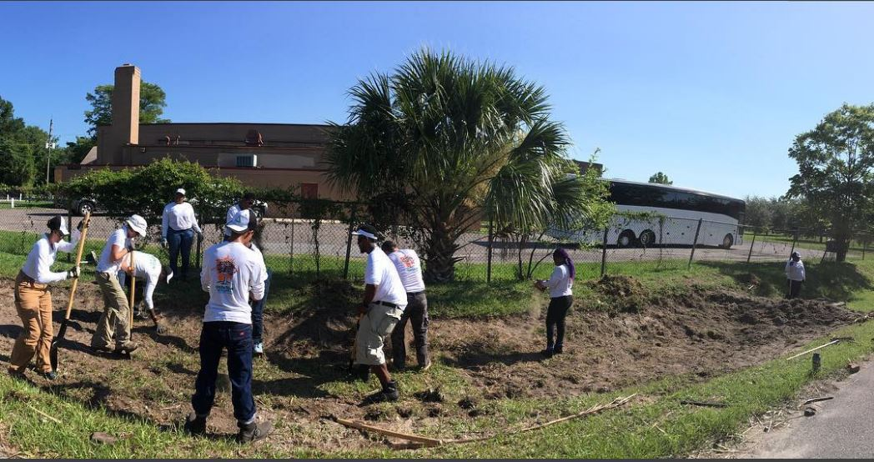
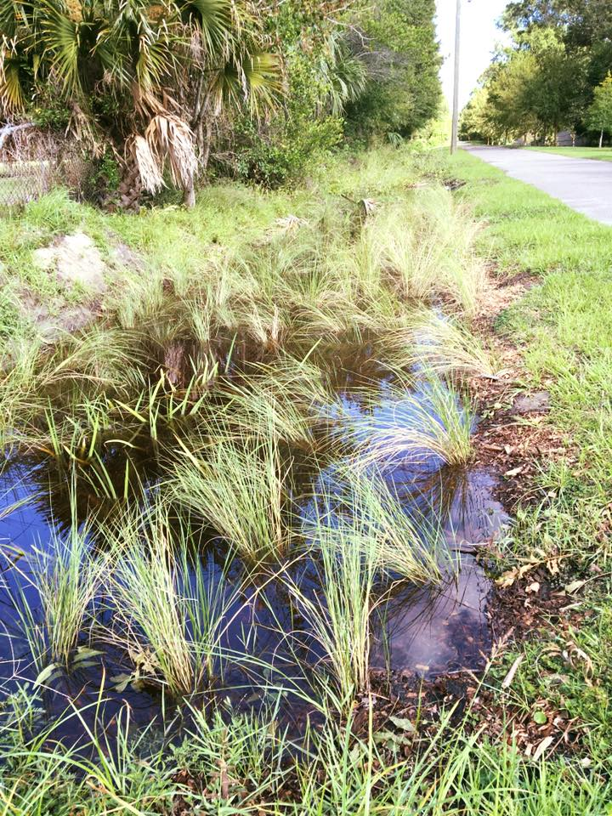
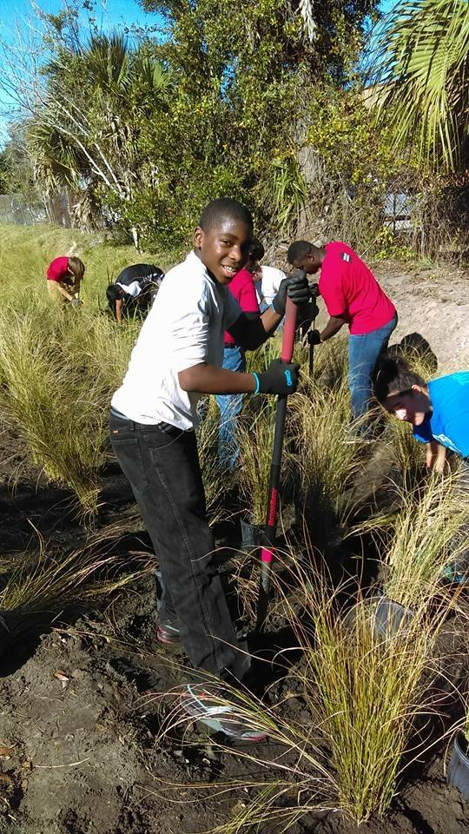
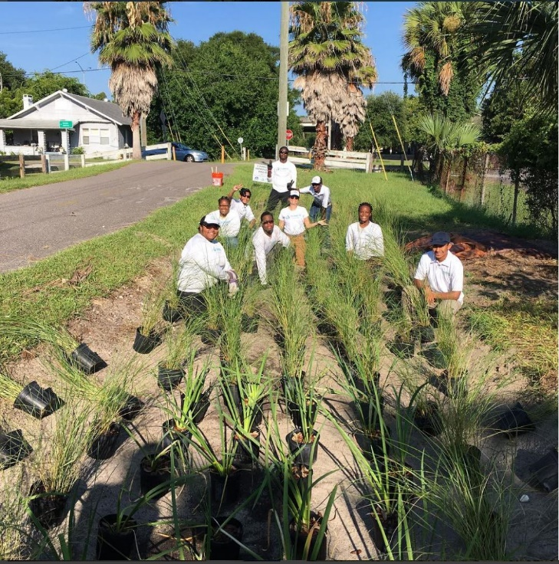
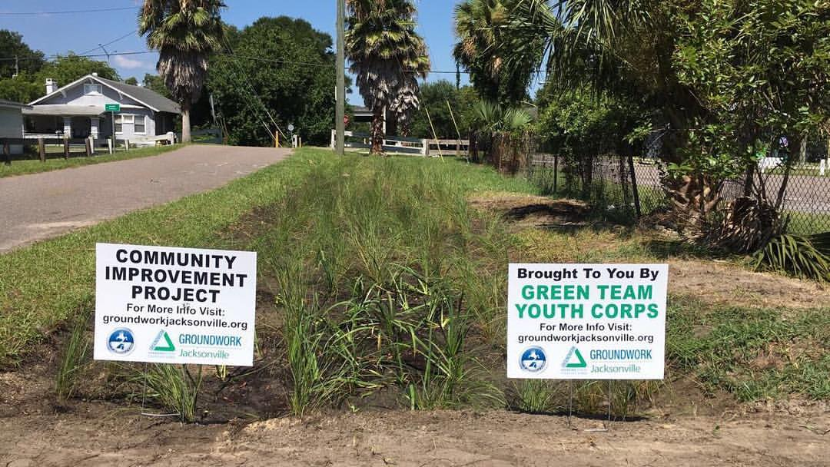
Green Infrastructure on the S-Line Biodiversity Corridor

Slide 9
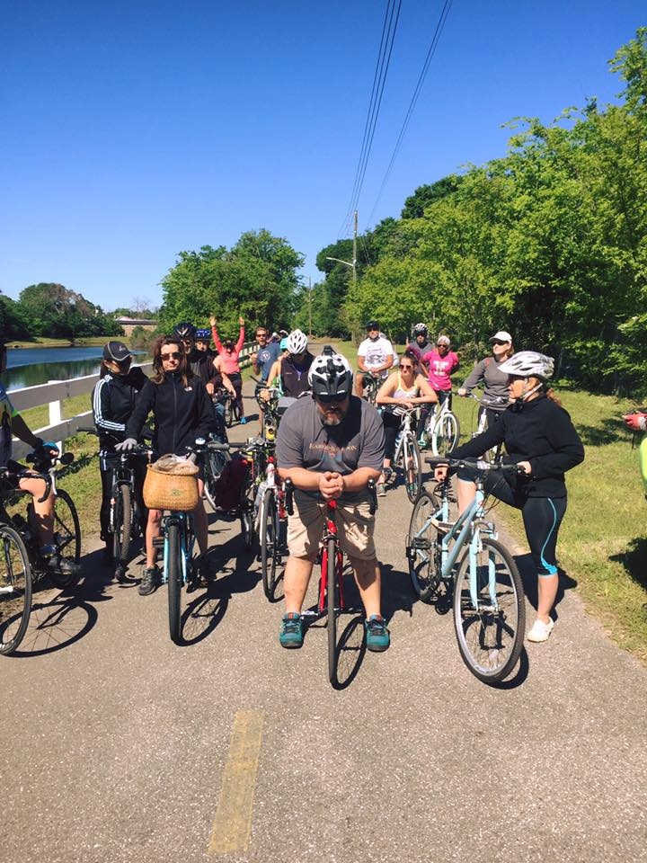
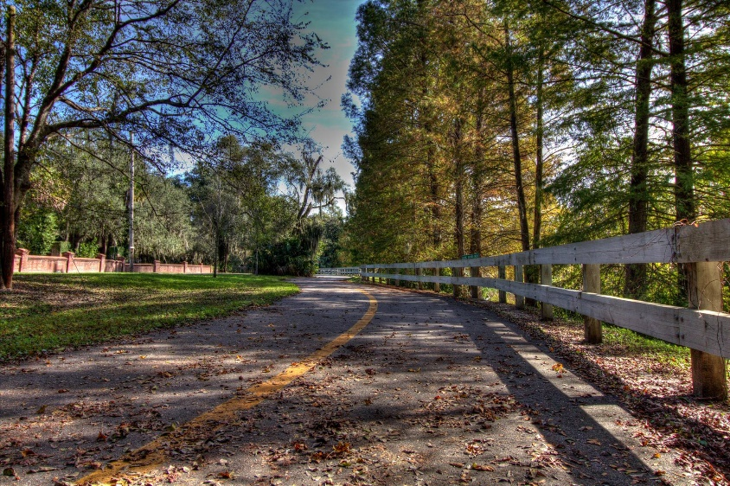
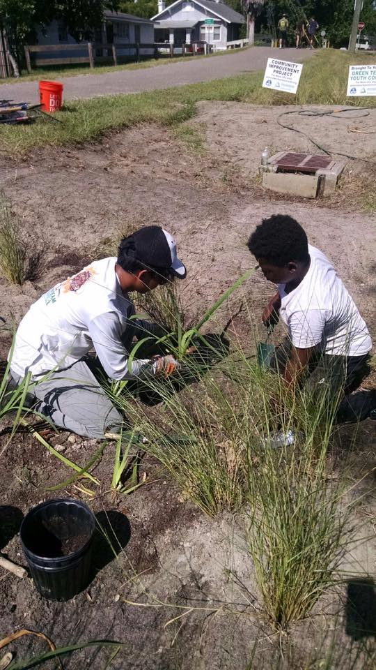
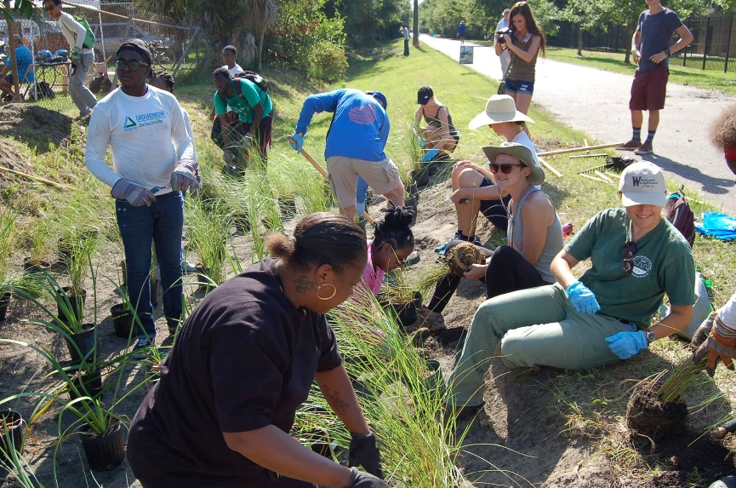
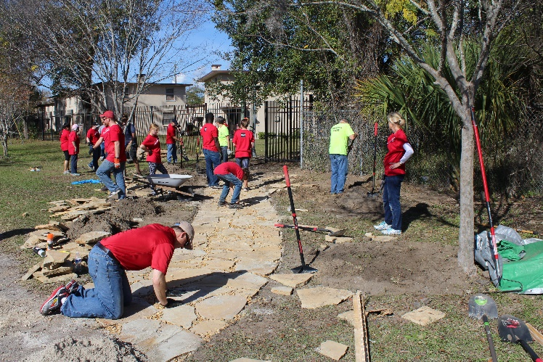
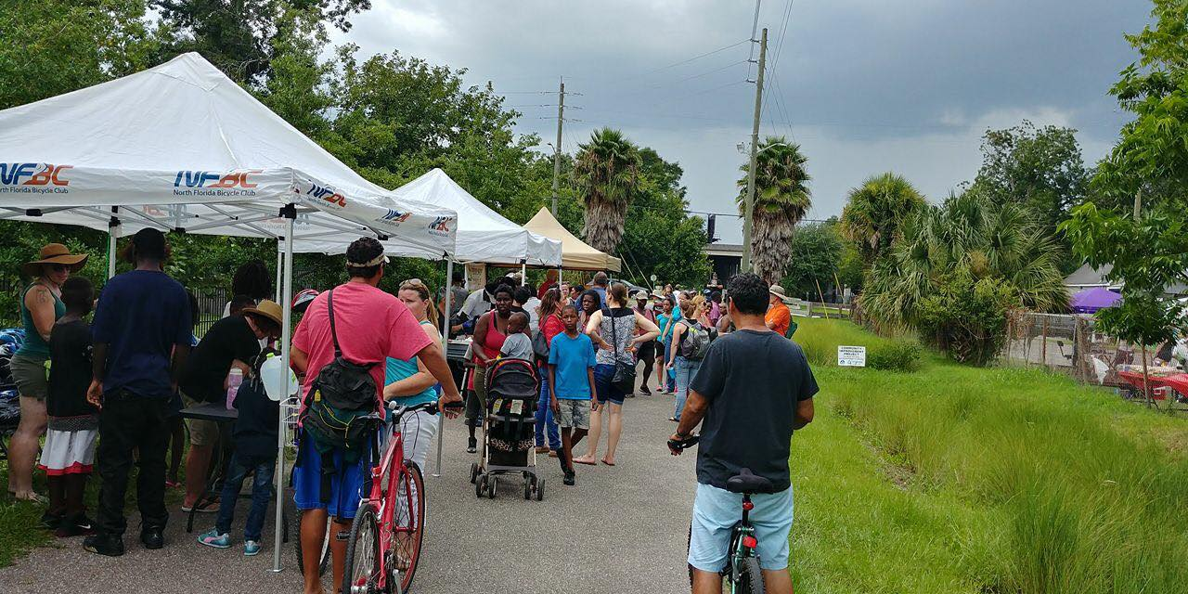
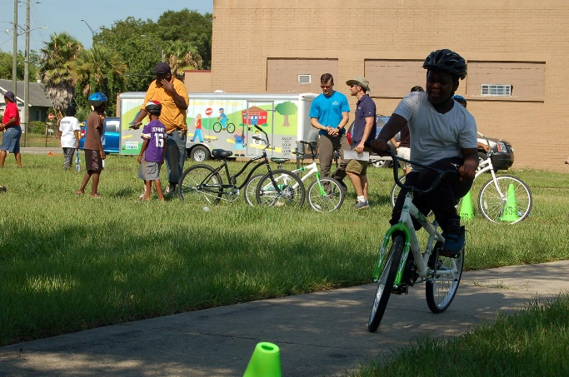
Awareness and engagement
  Monthly S-Line social bike rides
  Quarterly trail cleanups and service projects
  Annual Burgers & Bikes event
  Implementation of the Urban Biodiversity Corridor

Slide 10
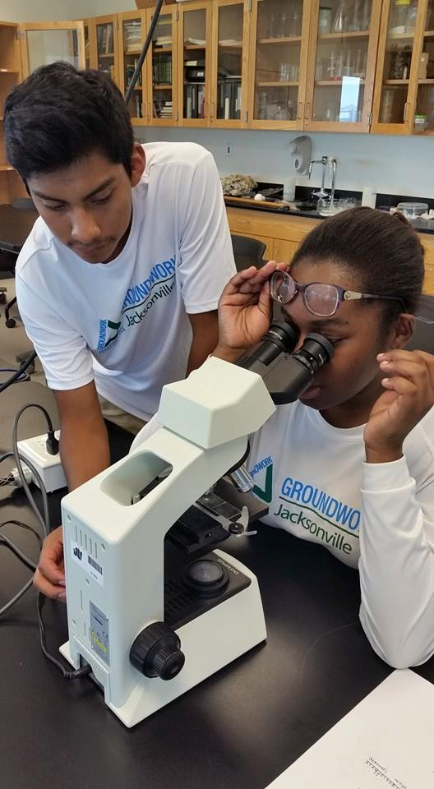
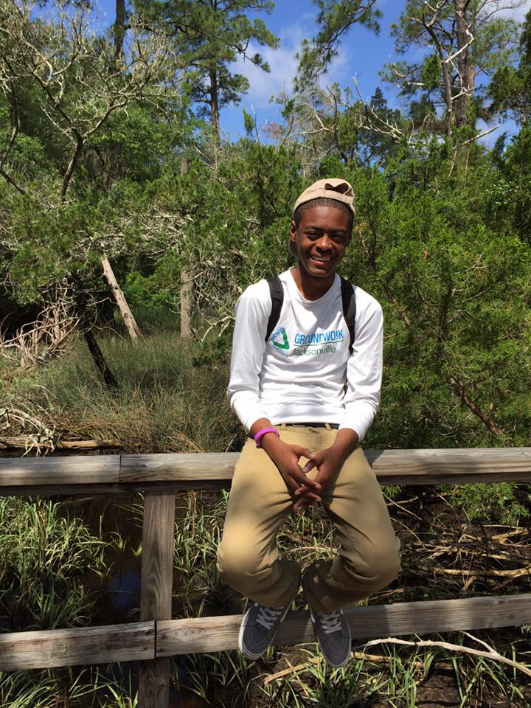
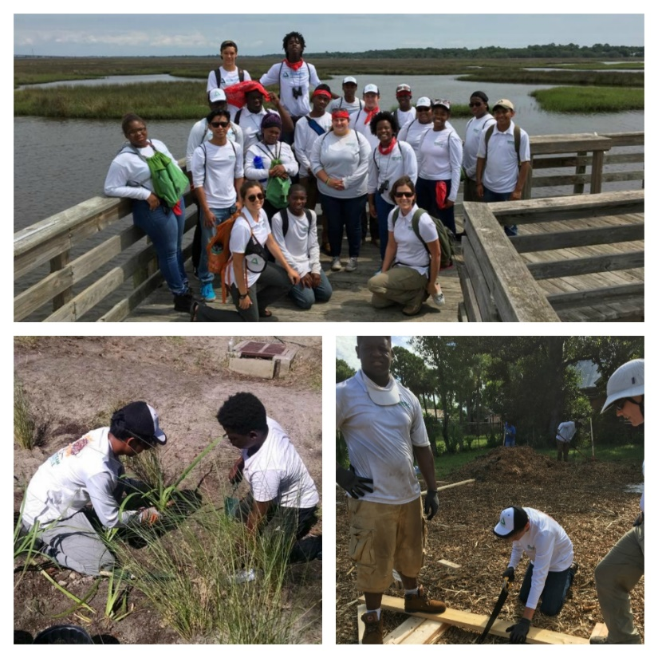
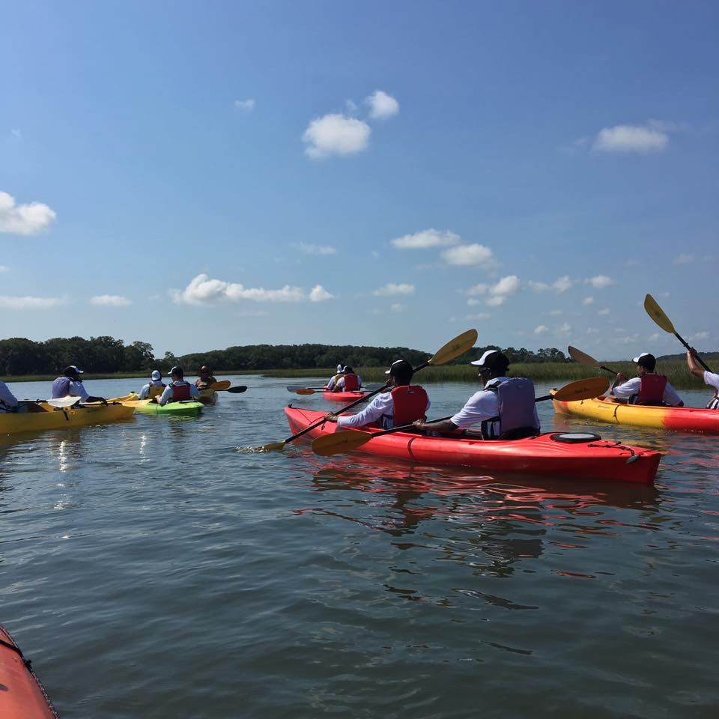
Green Team Youth Corps
Based on four guiding principles
  Connecting youth to the ‘wild’ in their neighborhoods
  Leadership
  STEM learning
  Environmental empathy
Two tracts:
  Fellowship: Community service events during the school year
  Summer Apprenticeship: 8 -10 week program with a mix of work, learn, play and service
2015: 10 neighborhood teens employed
2016: 20 neighborhood teens employed

Slide 11
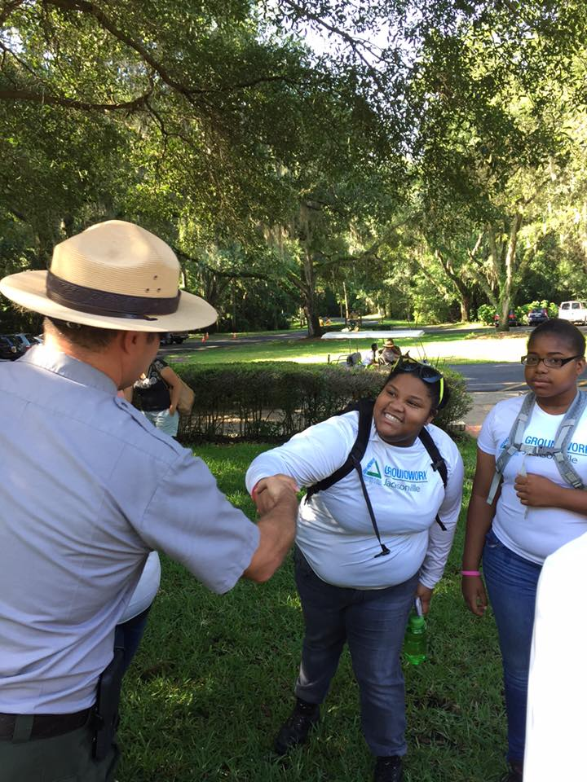
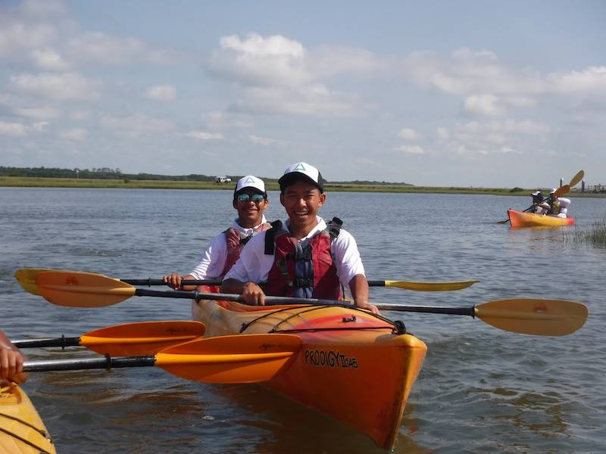
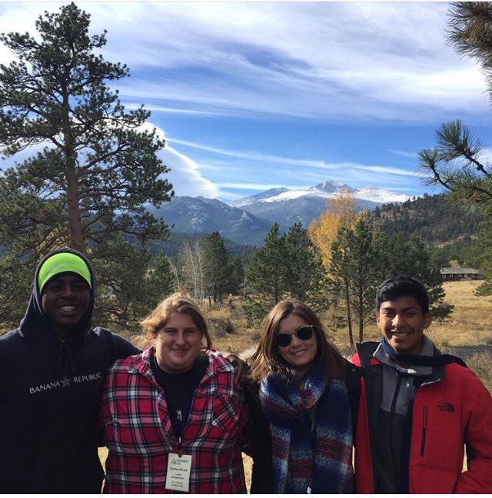
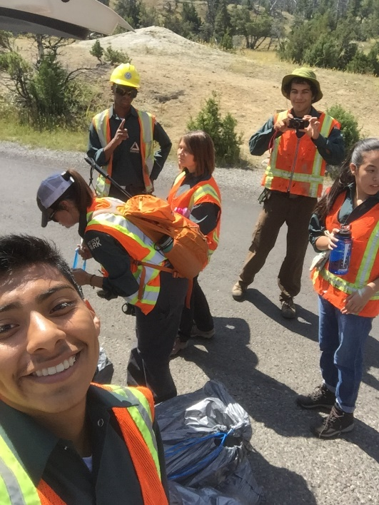
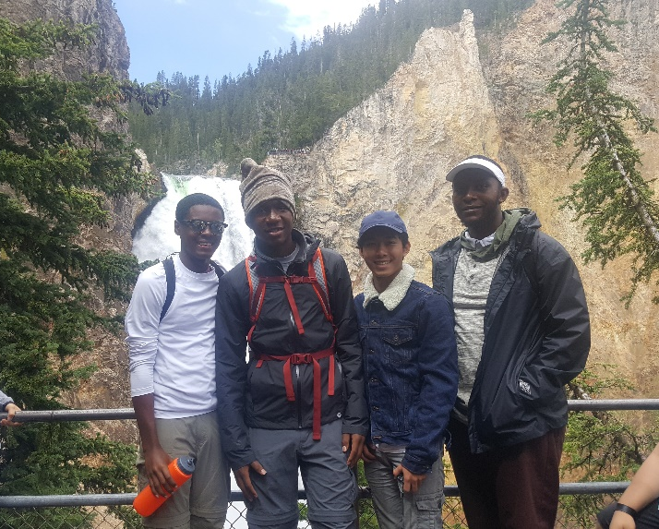
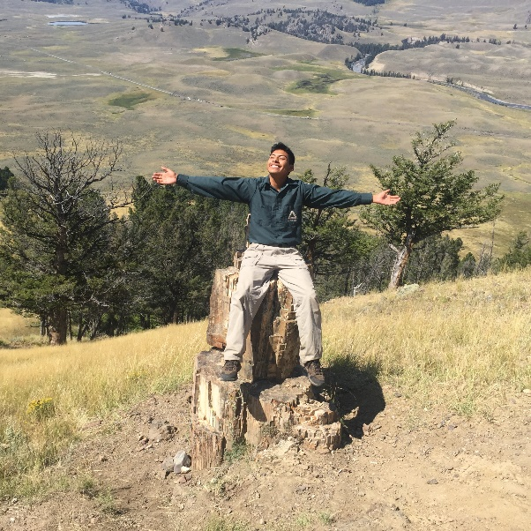
Green Team Accomplishments
Built a community garden in a food desert.
Built the city’s longest linear bioswale along the S-Line.
Engaged nearly 70 community partners.
Collected 150 bags of trash…. 3,750 tonnes!!
Engaged nearly 200 volunteers.
Planted 950 river-friendly plants in the ground.

Slide 12
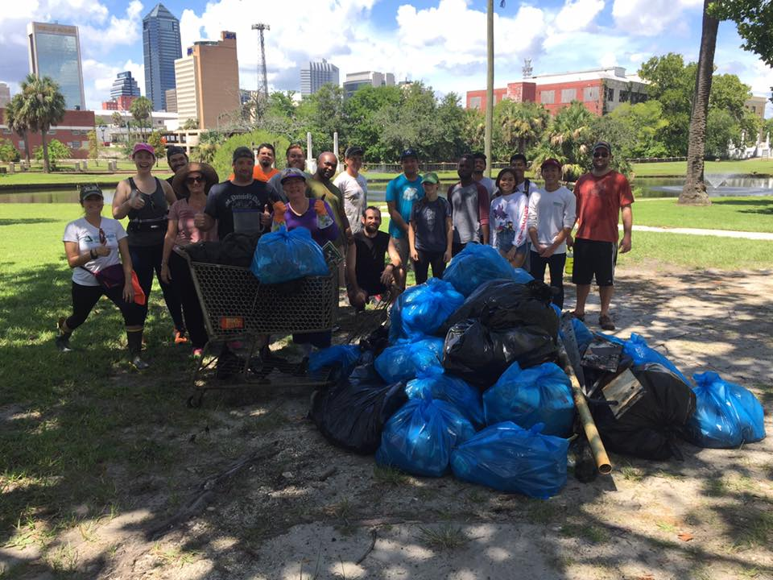
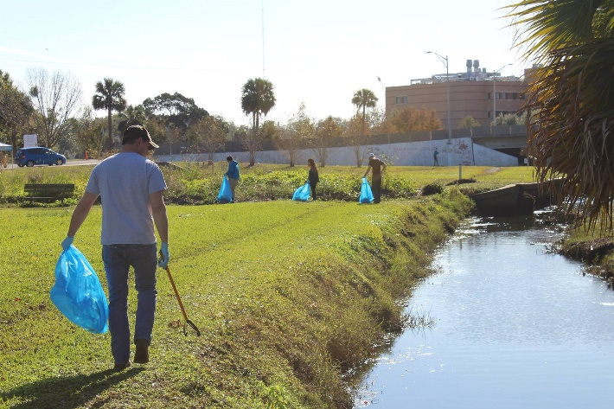
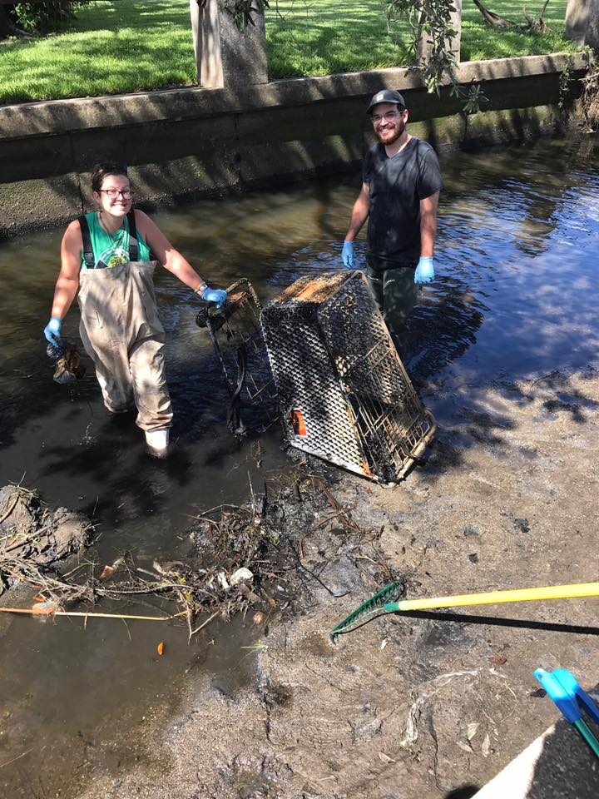
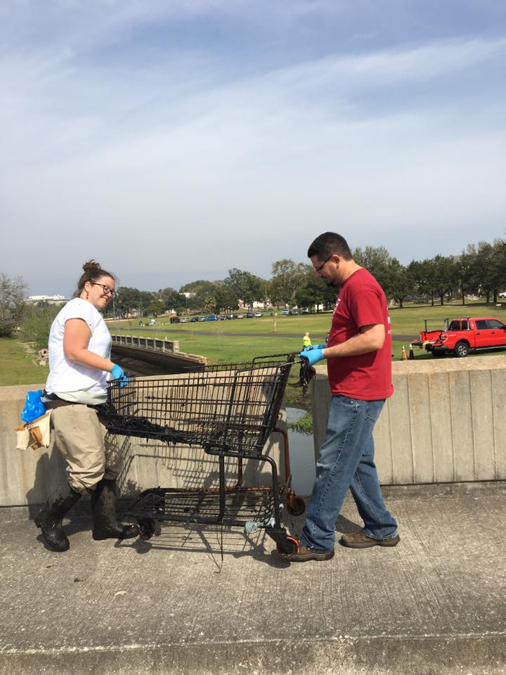
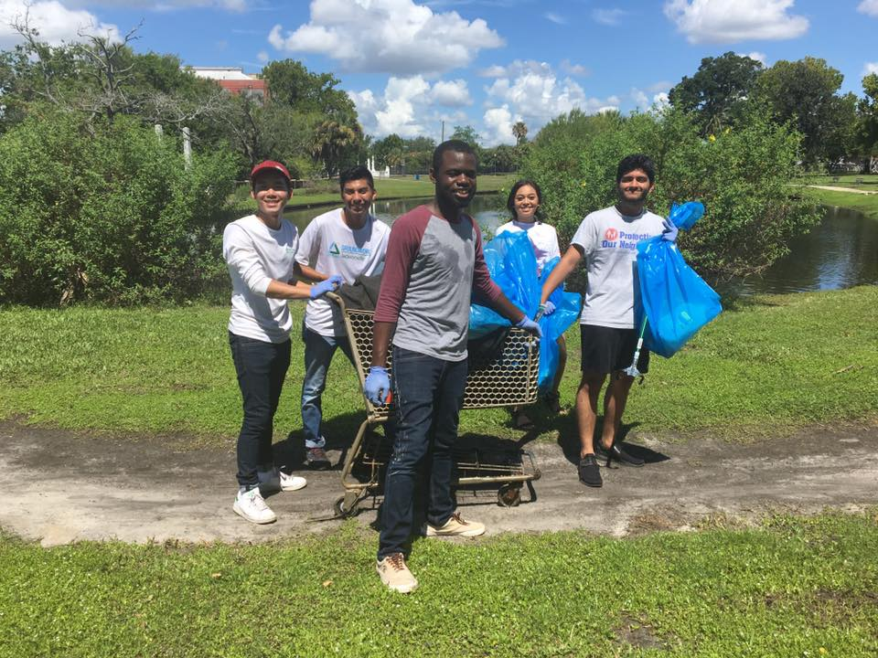
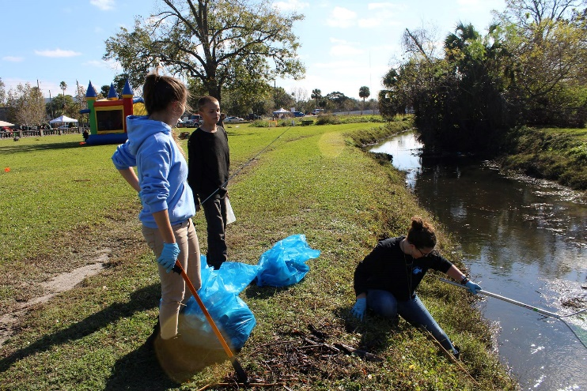
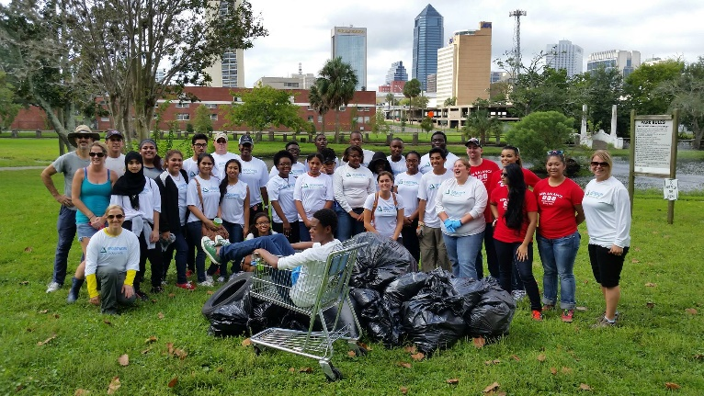
Hogans Creek litter cleanups
monthly Hogans Creek cleanups
Removed nearly 2 tonnes of trash from Hogans Creek, in partnership with the City of Jacksonville
Engaged 125 volunteers from all over Jacksonville

Slide 13
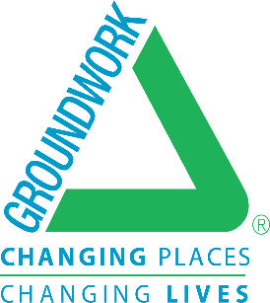



Stay Connected
www.groundworkjacksonville.org
GroundworkJacksonville
@groundworkjax
@groundworkjacksonville

