Slide 1
SW 10th Street Consensus Building
August 9, 2017
Paul Calvaresi
Local Governmental Services Manager

Slide 3
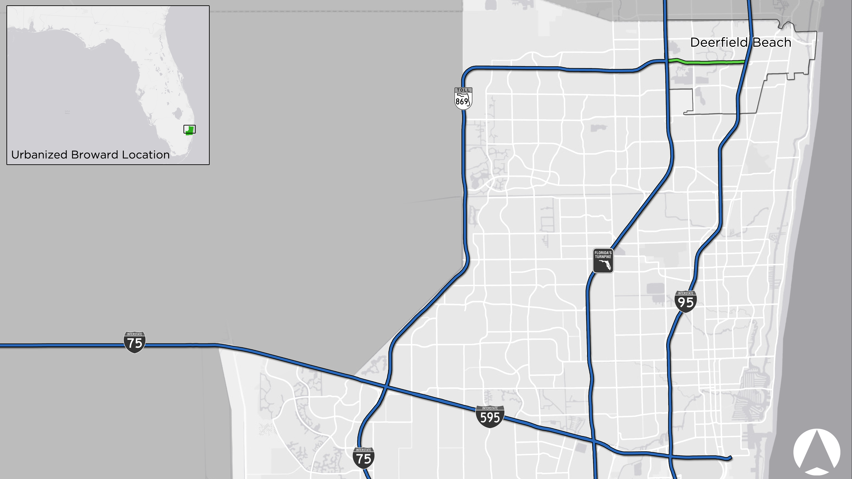

Context
Connects 3 major highways:
  I-95
  FL Turnpike
  Sawgrass Expressway
Within the city of Deerfield Beach
Local road
8 signalized intersections

Slide 4
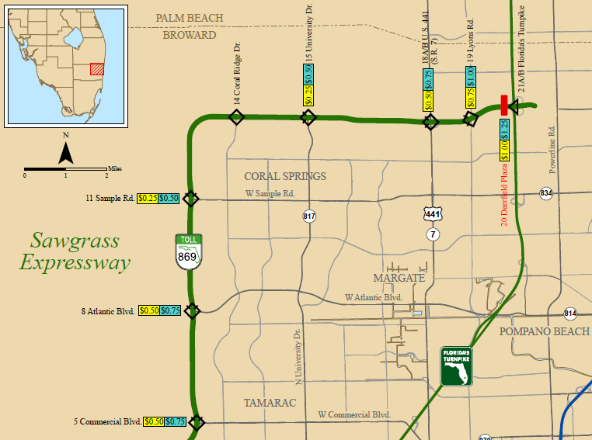
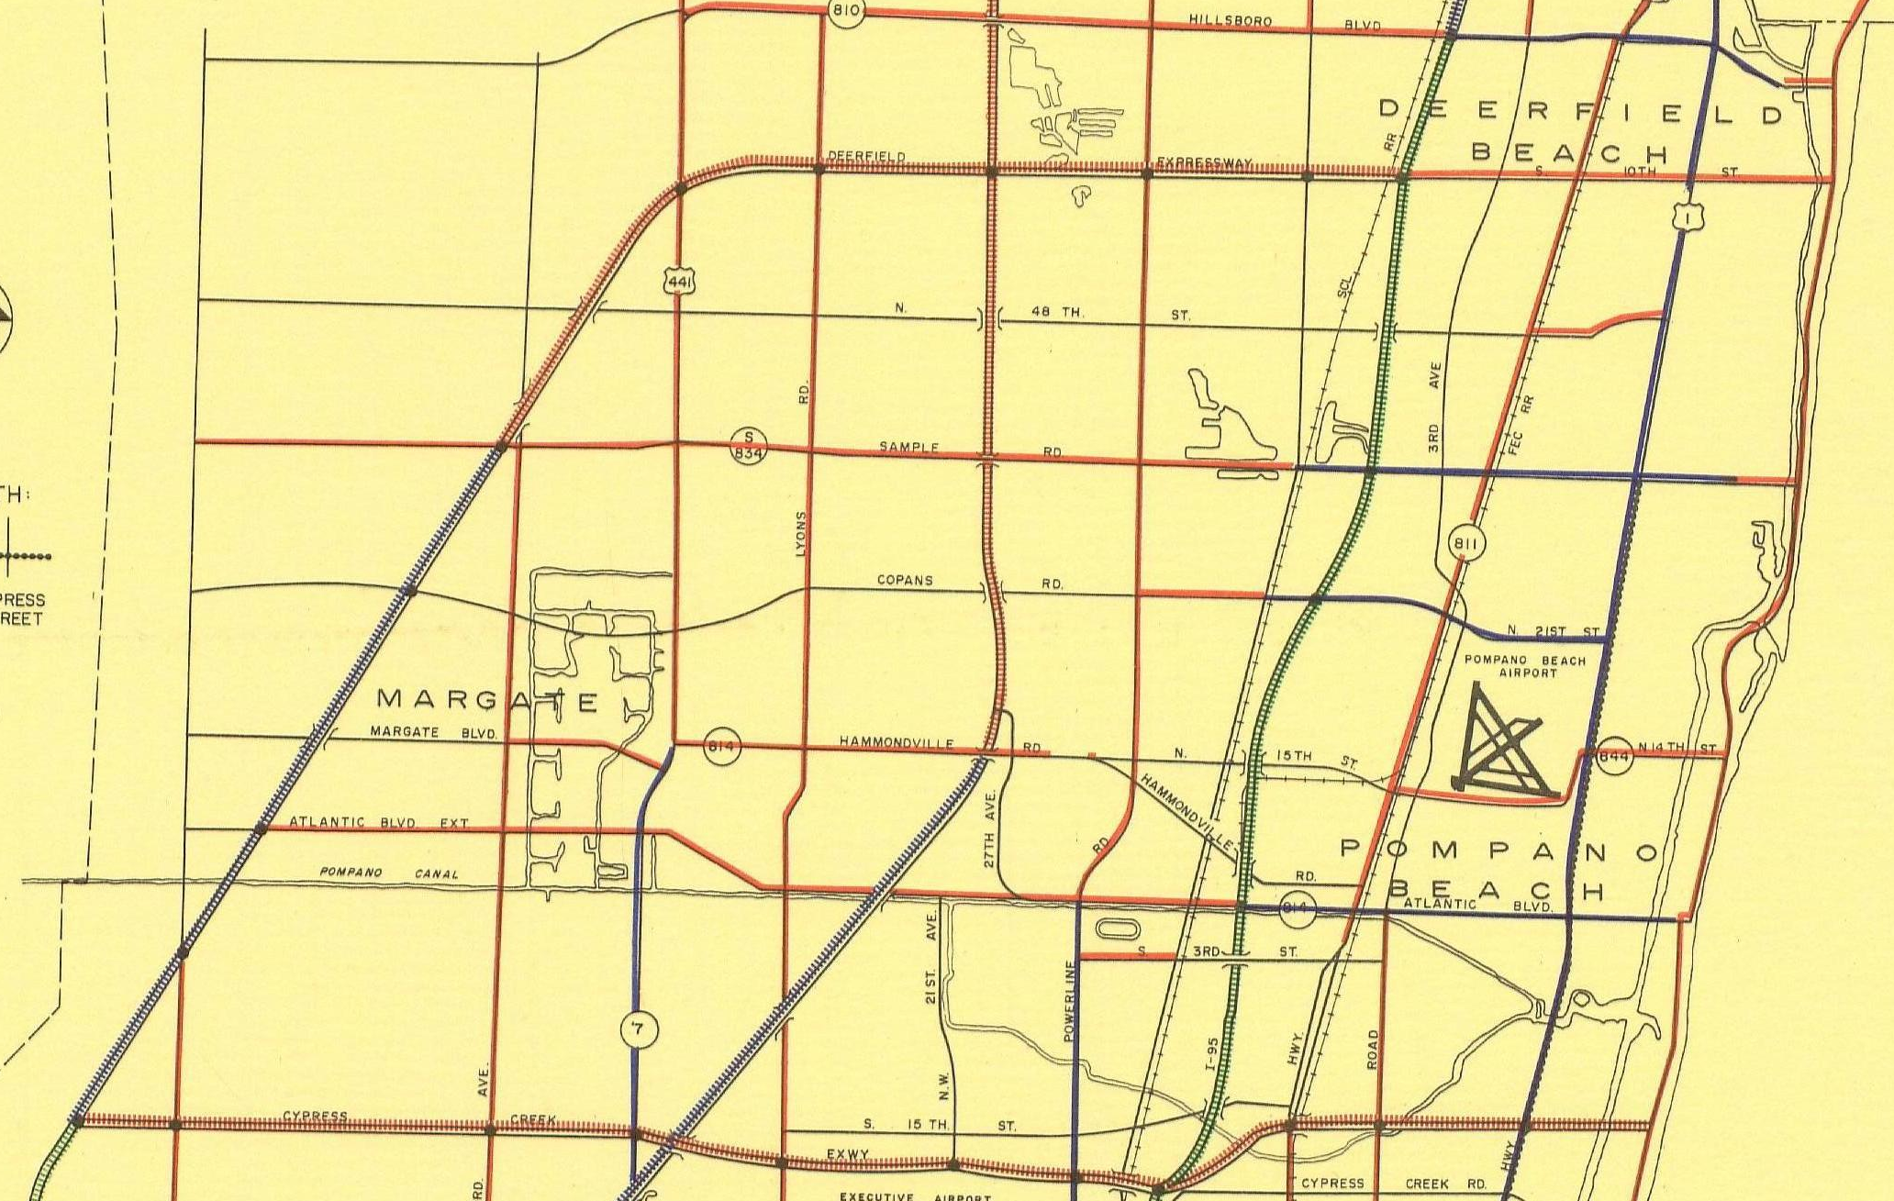
History
1960-88
1988
1985
1960
1985: planned connect between FL TPK and I-95
1960: planned to connect the northern and western parts of the county before I-95 was constructed.
1988: Sawgrass Expressway opens. Link to be constructed

Slide 5
History
1993
2008
Project Development & Environmental (PD&E)
Developed alternatives to move traffic
Standard outreach process
Feasibility Analysis
Developed alternatives to move traffic
Standard outreach process
Technically driven
Strong public dislike
Little political support
Rejected by BMPO
SW 10th St Express
Over Powerline Rd
SW 10th St Express
Over Military Trail
SW 10th St Express at ground level
Separated by a barrier from the SW 10th St
General Purpose lanes, also at ground level

Slide 6

History
2014
Citizen letter sent to the BMPO Board
BMPO Board directs staff to build consensus on the need for improvements
The goal is to start with public outreach and weigh support
Recommend a study if support exists

Slide 7
Lessons Learned
Commit to Continuous Stakeholder Engagement
Manage the Meetings
Have Flexibility to Meet Stakeholder Needs
Continued Focus on the Objective
Bring Experts to the Table

Slide 8
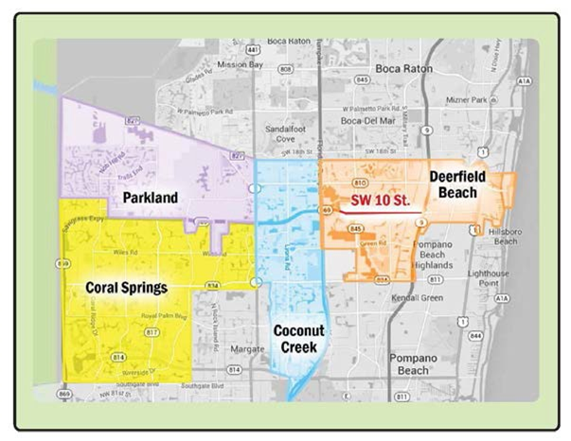
Commit to Stakeholder Engagement
Meet with…
  Elected officials of jurisdictions directly and indirectly affected
  Home Owner’s Associations
  Chambers of Commerce
  Local businesses large and small
  Local staff
Paint a picture with a variety of viewpoints
Be Honest About Outcomes

Slide 9

Commit to Stakeholder Engagement
Real estate values would increase if SW 10th Street was more business/user friendly
The I-95 Interchange is the cause of the problem and needs to be fixed
Roadway improvements will generate additional traffic and noise
Air quality will improve if stop and go traffic is minimized
Widening the roadway, and the addition of noise walls will reduce property values
I-95 Interchange improvements will increase traffic volumes
Noise will get worse if nothing is done and congestion increases
Circulating dirt and dust from SW 10th Street will worsen with construction

Slide 10
Commit to Stakeholder Engagement
Formation of the Community Oversight Advisory Team (COAT)
9 Members from the City of Deerfield Beach
  4 residents from communities adjacent to SW 10th Street
  2 business representatives
  3 citywide representatives
8 Members from the SW 10th Street Study Area
  2 from the City of Coconut Creek
  2 from the City of Coral Springs
  2 from the City of Parkland
  2 representing area wide Broward County interests

Slide 11
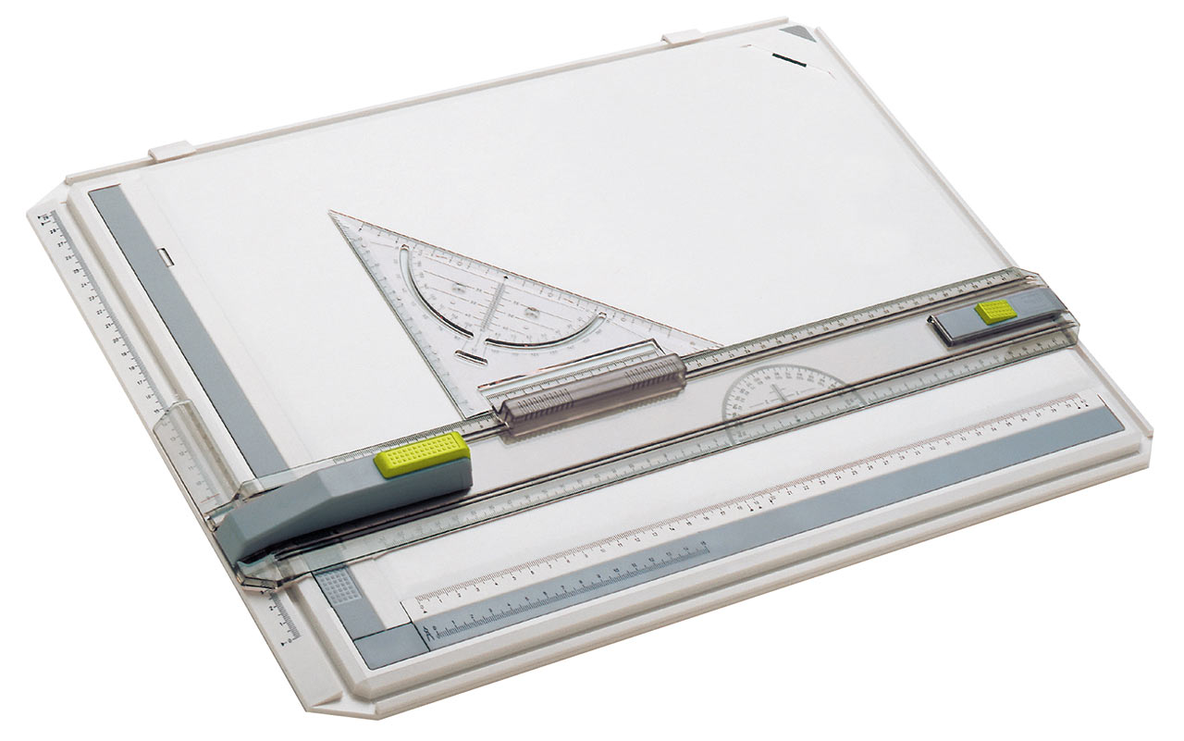
Continued Focus on the Objective
The purpose of the SW 10th Street initiative was to build consensus and members were continually reminded of this.
Working towards a goal helps to overcome the “us vs. them” mentality.
Encourage positive and constructive interaction and dialog.
Respond to all questions, even those that can’t be answered at the time.
Set an expiration date.
Be honest about outcomes.

Slide 12
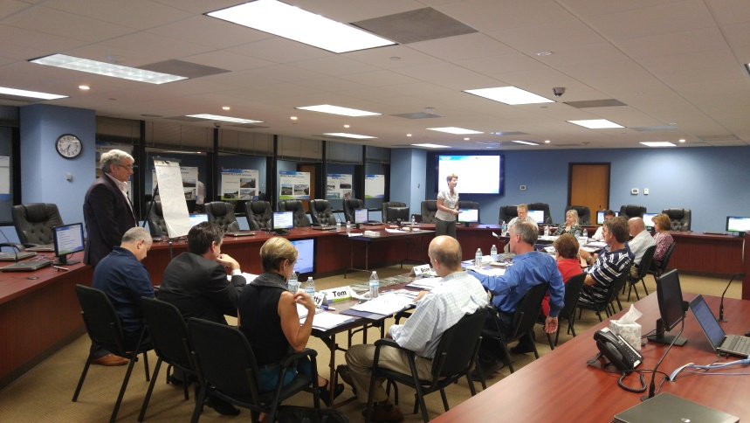
Manage the Meetings
Present in pairs
  Capitalize on strengths
  Take mental breaks
Agree on norms/rules for the meetings
  Decorum
  Public comments
  One conversation
Stick to the agenda
  “Parking Lot”

Slide 13
Manage the Meetings
Norms and Expectations

Slide 14
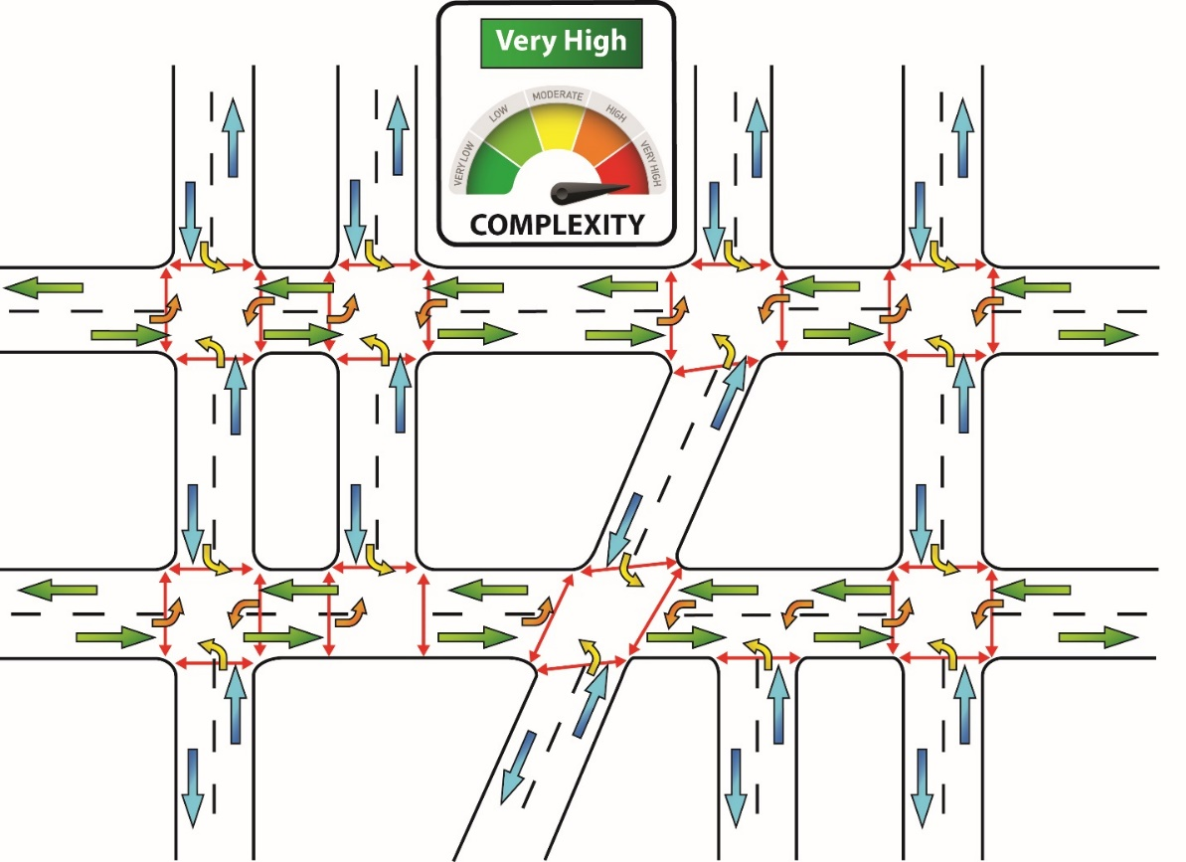
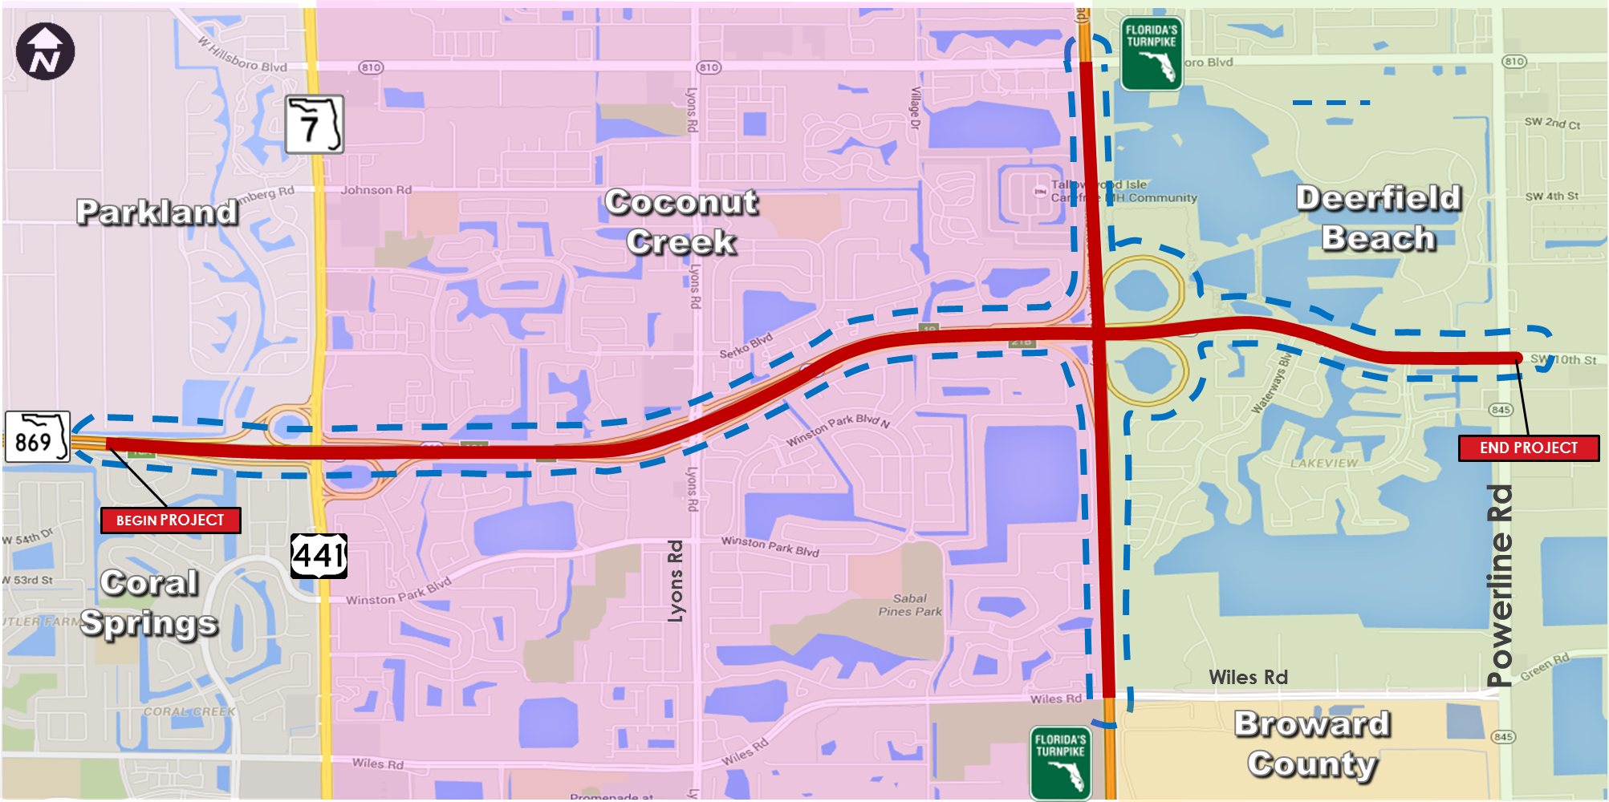
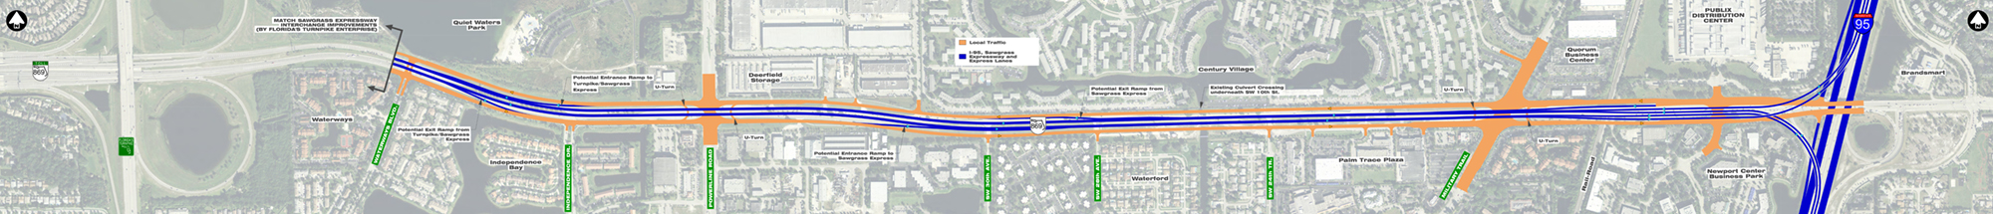
Bring Experts to the Table
Broward County Government: Traffic engineers, land use planners
FDOT: design engineers, provided data, truth testing
Florida’s Turnpike Enterprise: explained long term plans
Broward MPO: planning process
Consultants: gathered data, facilitation

Slide 15
Have Flexibility to Meet
Stakeholder Needs
Staff realized that the COAT members needed a better understanding planning principles
Provided a 2 hour “primer”
class on:
  Land use: History and Present
  Traffic
  Regional Projects

Slide 16
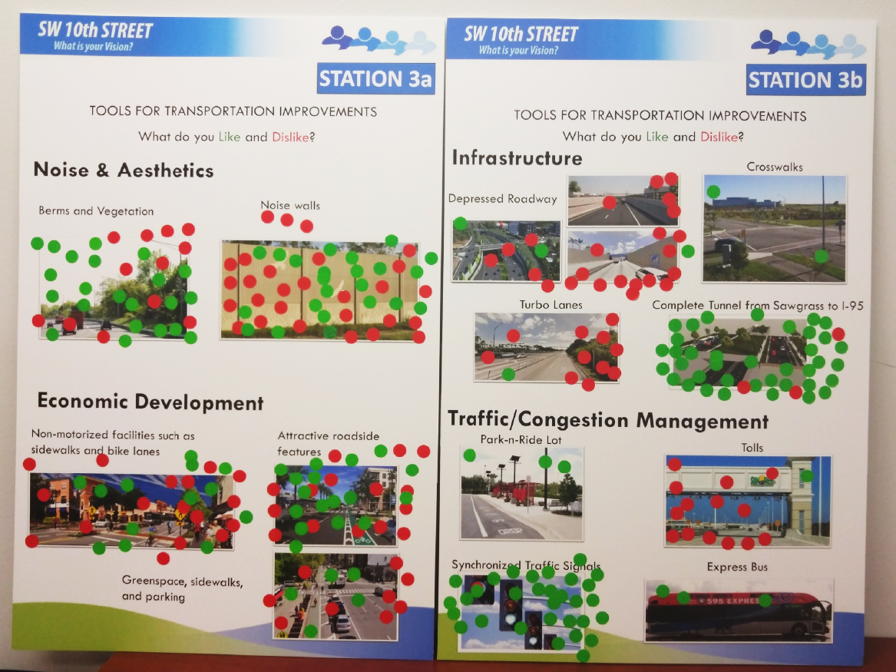
Have Flexibility to Meet Stakeholder Needs
Open House
7 interactive and informative stations designed to be visited in progression
20 professional staff to engage in one-on-one discussions
Written and video feedback station
200 attendees

Slide 17
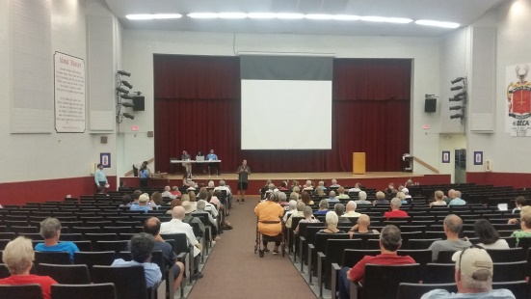
Have Flexibility to Meet Stakeholder Needs
Public Meeting
Format was dictated by the COAT in detail
Held in local High School Auditorium
Formal Presentation
Public Comment Period

Slide 18
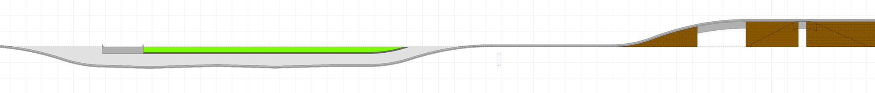
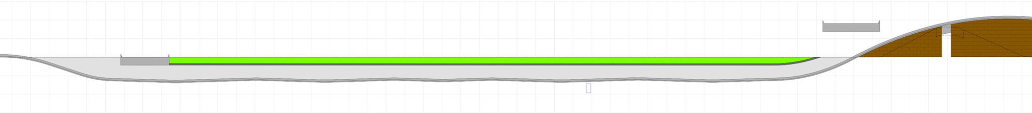
Outcomes - Concepts
Powerline Rd Over
SW 10th St Express
SW 10th St General Purpose Lanes at ground level
SW 10th St Express
Over Military Trail
INDEPENDENCE DR
POWERLINE RD
SW 30th Ave
SW 28th Ave
SW 24th Tr
SW 10th St General Purpose Lanes at ground level at Military Trail
Military Trail
Tri-Rail
SW 10th St Express Lanes depressed under the SW 10th St General Purpose Lanes
Existing Culvert Crossing underneath SW 10th St (no impact)
18
Powerline Rd Over
SW 10th St Express
Military Trail over
SW 10th St Express
INDEPENDENCE DR
POWERLINE RD
SW 30th Ave
SW 28th Ave
SW 24th Tr
Relocate existing Culvert Crossing underneath depressed roadway
Military Trail
Tri-Rail

Slide 19
Outcomes - In July 2016…
…an advisory group, through evaluation of the community needs and concerns, envisions improvements along SW 10th Street which:
Minimize visual obstructions
Enhance community connectivity
Minimize traffic noise
Promote economic development and access to businesses
Preserve local access
Provide community greenspace
Minimize negative impacts to the environment
Reduce SOV demand for travel by encouraging tolling, carpooling and transit

Slide 20
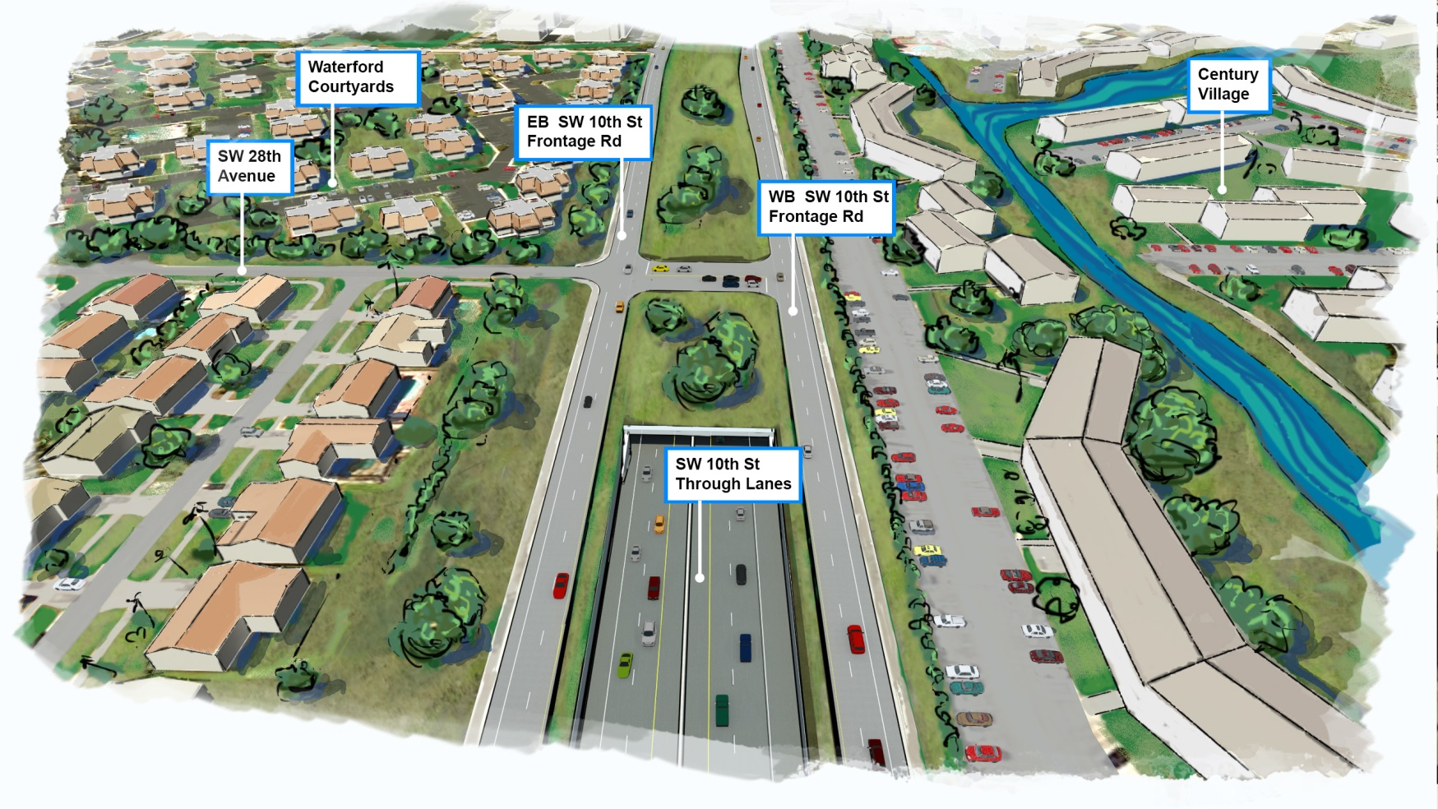
Outcomes
Potential Sound
Wall
Notes:
MICHELLE – LABEL “POTENTIAL SOUND WALL” AND BREAK LINE AT THE WB SW 1OTH ST LABEL. NOISE WALL IS BLACK LINE I ADDED ON THE RIGHT SIDE OF THE WB FRONTAGE ROAD.

Slide 21
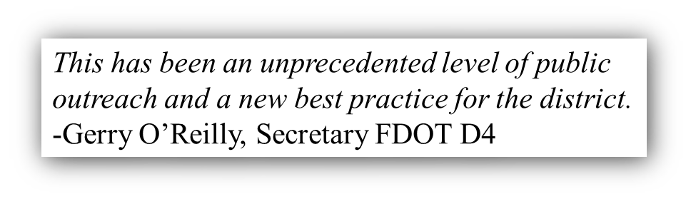
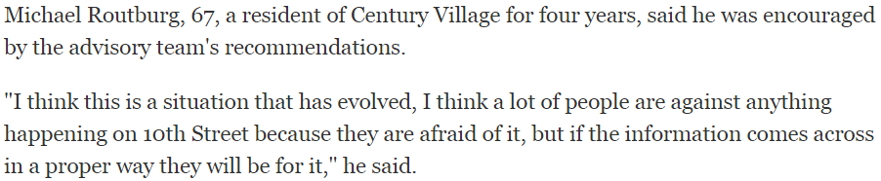
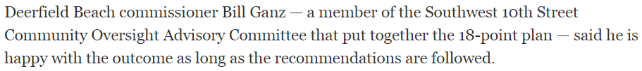
Outcomes
This has been an unprecedented level of public outreach and a new best practice for the district.
-Gerry O’Reilly, Secretary FDOT D4

Slide 22
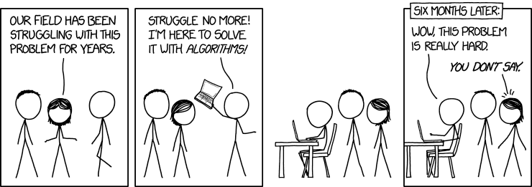
Moving Forward
BMPO approved funding for PD&E (LRTP Amendment)
FDOT holds regular meetings to coordinate projects along the corridor
COAT will continue to represent community interests

Slide 23
Contact Us
Paul Calvaresi
Local Governmental Services, Manager
(954) 876-0037
calvaresip@browardmpo.org

Slide 24
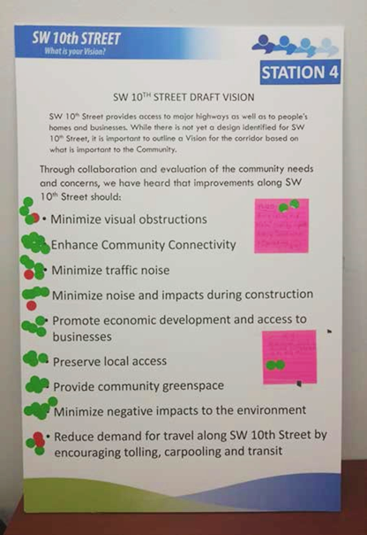

Slide 25
