Slide 1
black swan
[ˌblak ˈswän]
NOUN
1. a mainly black swan with white flight feathers, which is common in Australia and Tasmania and has been introduced widely elsewhere.
2. an unpredictable or unforeseen event, typically one with extreme consequences
Notes:
Good afternoon. If you’re an engineer, designer or planner, please raise your hand. Awesome.
If you’ve designed an intersection to be deadly, keep your hand up.
Nobody? Bueller?

Slide 2
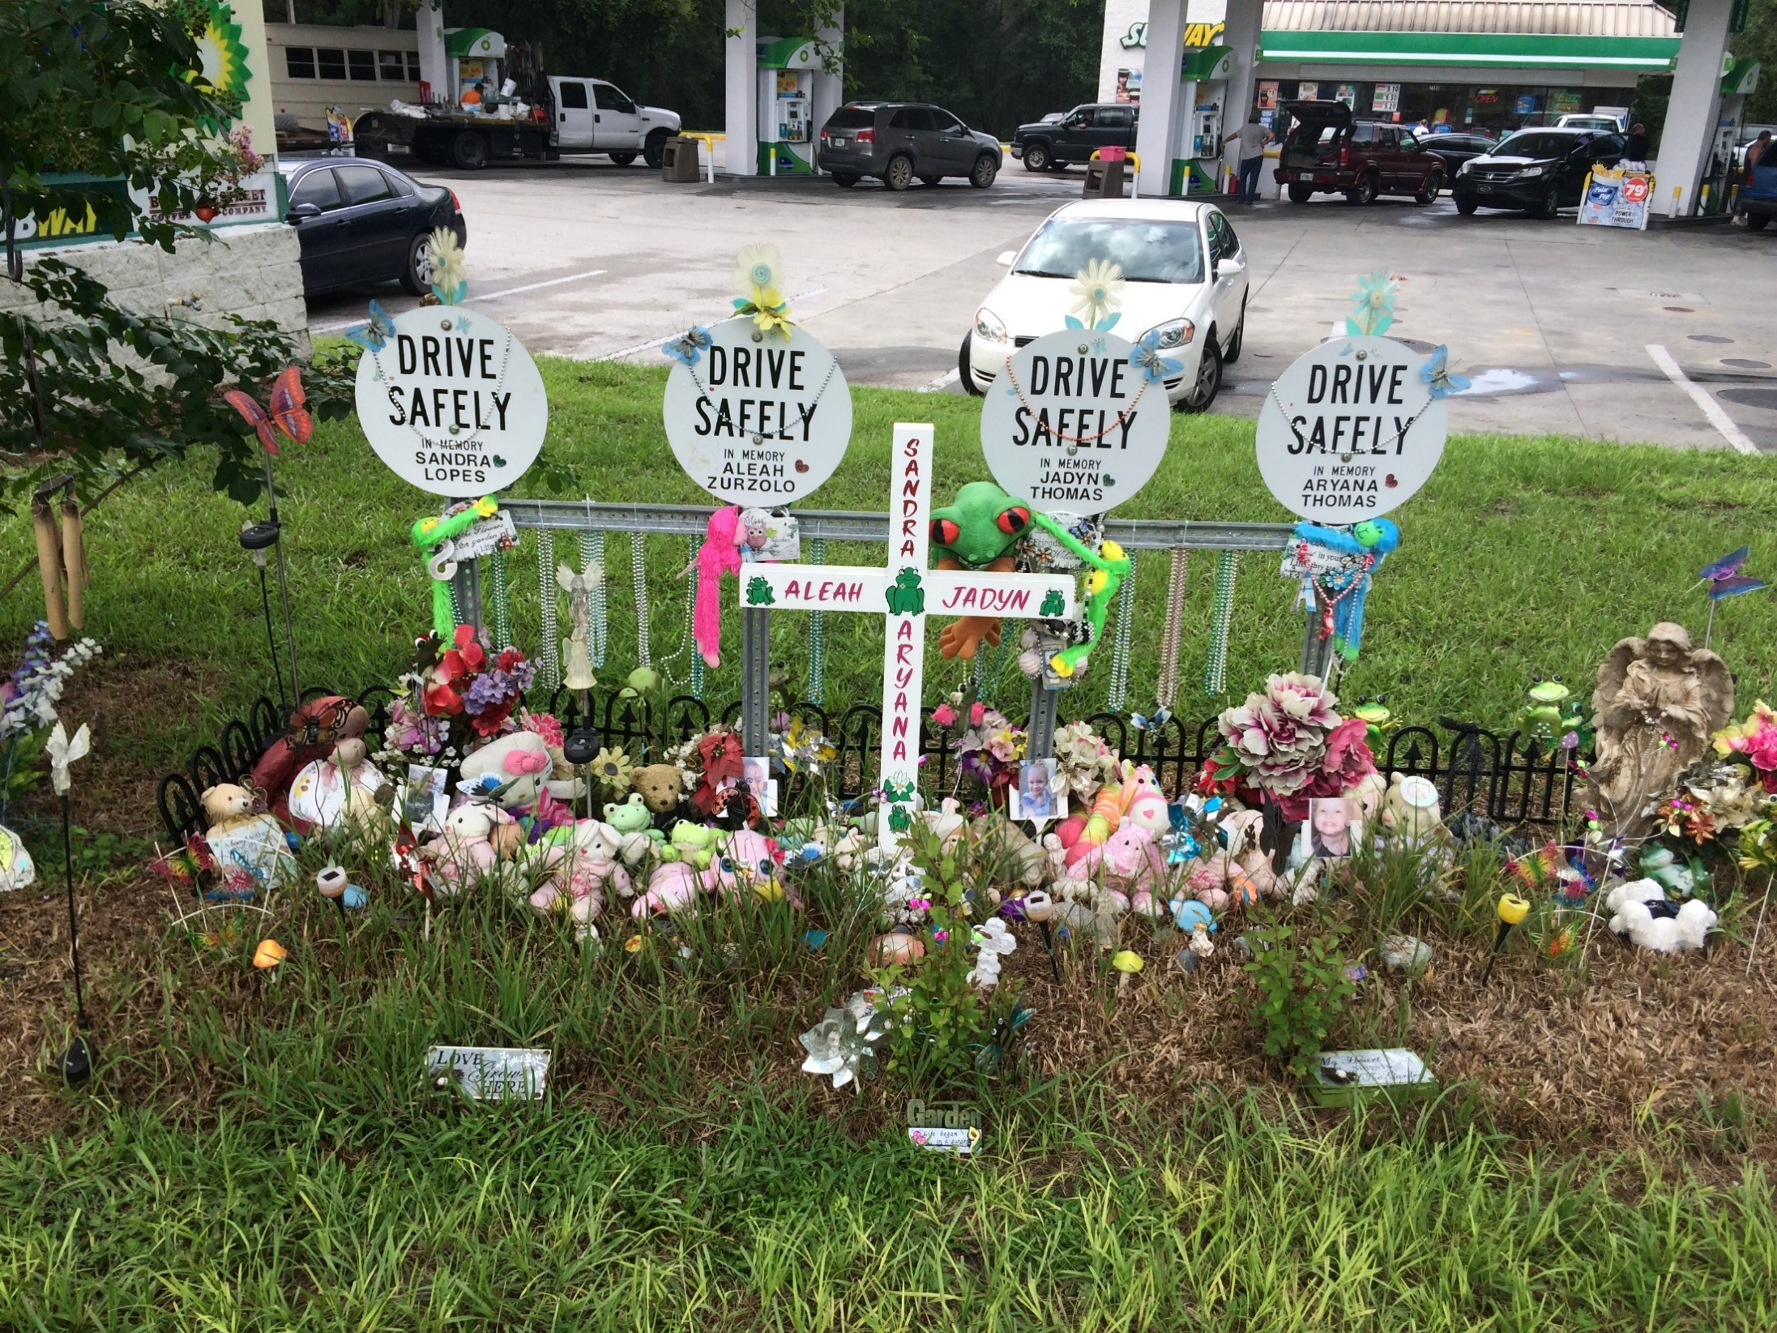

Slide 3
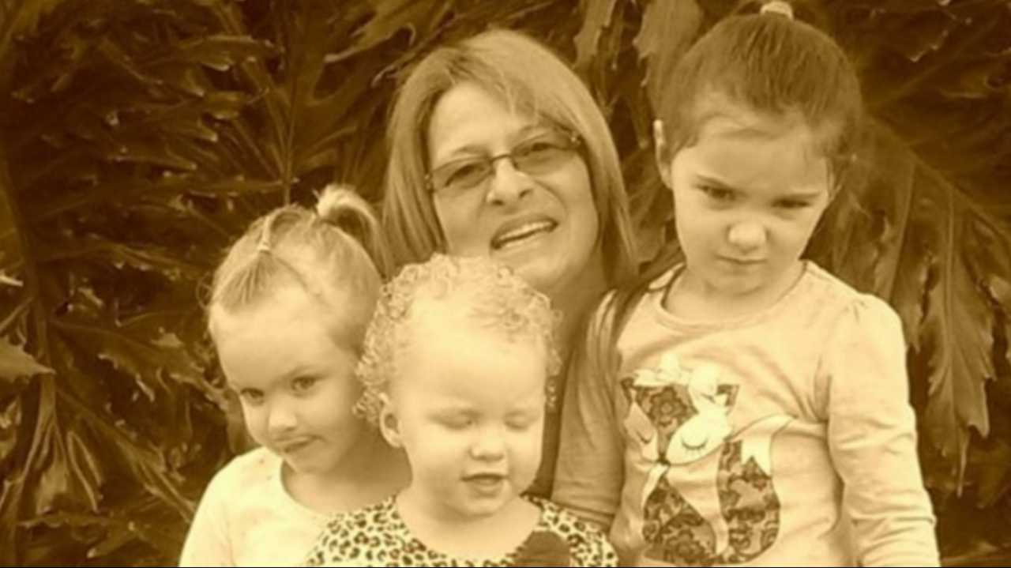

Slide 4
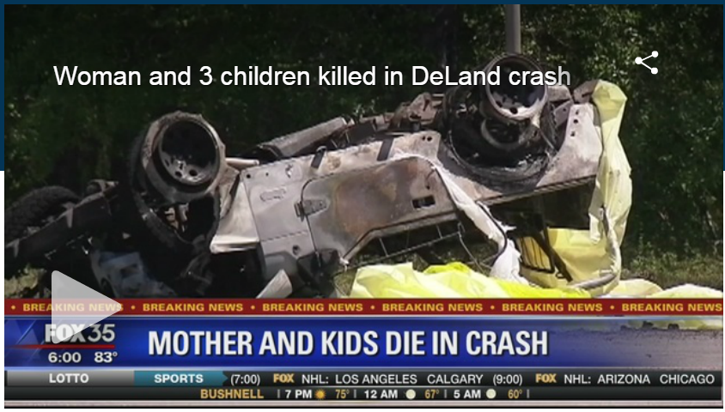
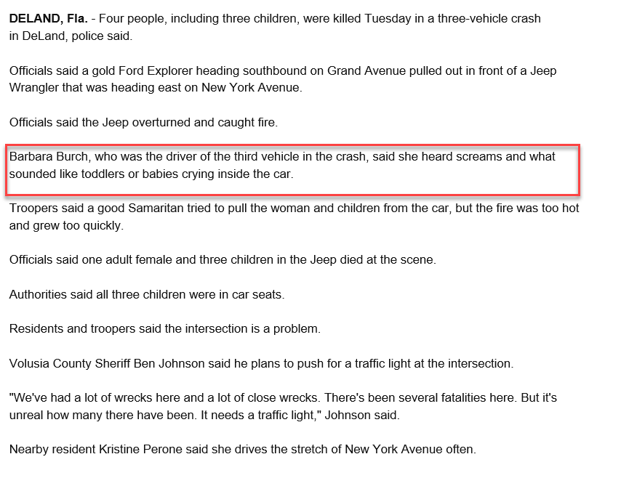
SR 44 at Grand Avenue – DeLand, FL
Deadly accident occurred in April 5, 2016
Barbara Burch, who was the driver of the third vehicle in the crash, said she heard screams and what sounded like toddlers or babies crying inside the car.

Slide 5
Headlines
Family of DeLand crash victims want traffic light at deadly intersection
By Nadeen Yanes, WKMG Channel 6
April 6, 2016
http://www.clickorlando.com/news/family-of-deland-crash-victims-speaks-out-for-traffic-light-at-deadly-intersection
Woman, 3 children killed in fiery DeLand crash, FHP says
By Staff, WKMG Channel 6
April 5, 2016
http://www.clickorlando.com/traffic/4-dead-in-deland-crash-fhp-says
Memorial grows where three children, adult killed in fiery DeLand crash
By Staff, WFTV Channel 9
April 5, 2016
http://www.wftv.com/news/local/1-adult-3-children-dead-after-crash-in-deland/198234544
Volusia County Sheriff Ben Johnson will go to the County Council on Thursday to request safety measures be added at an accident-prone intersection west of DeLand where four people were killed this week.
Granddad of kids killed in fiery crash: 'The hurt is so deep'
By Bailey Myers and Sauel Saenz, Channel 13
April 6, 2016
http://www.mynews13.com/content/news/cfnews13/news/article.html/content/news/articles/cfn/2016/4/6/investigation_contin.html

Slide 6
Headlines
Family's death in fiery crash prompts push for change to DeLand intersection
By Staff, WFTV Channel 9
April 7, 2016
http://www.wftv.com/news/local/family-of-4-killed-in-deland-fiery-says-victims-were-were-so-precious/199547241
WATCH LIVE: Volusia County Council addresses deadly intersection
By Lyda Longa, Daytona Beach News-Journal
April 7, 2016
http://www.news-journalonline.com/article/20160406/NEWS/160409707/101040?Title=Volusia-County-Council-addresses-deadly-intersection
County Presses State For Fix To Deadly S.R. 44 Crash Site Near DeLand
By Leslie Taylor, WNDB AM 1150
April 7, 2016
http://www.newsdaytonabeach.com/wndb-news/county-presses-state-for-fix-to-deadly-s-r-44-crash-site-near-deland/

Slide 7
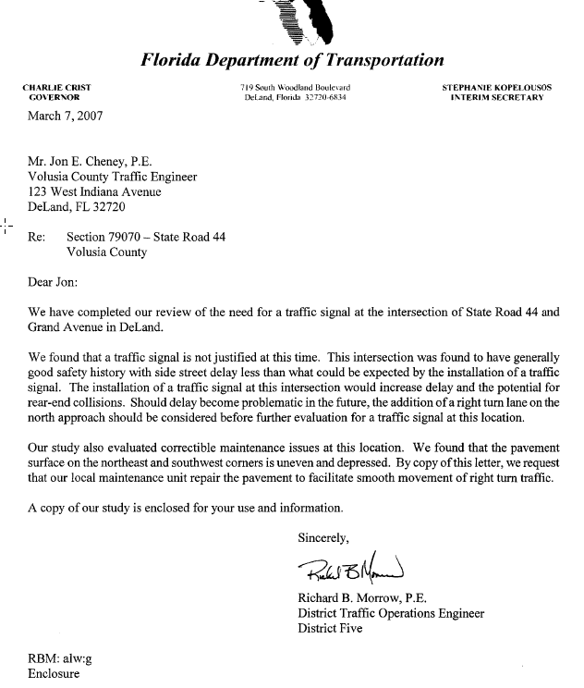
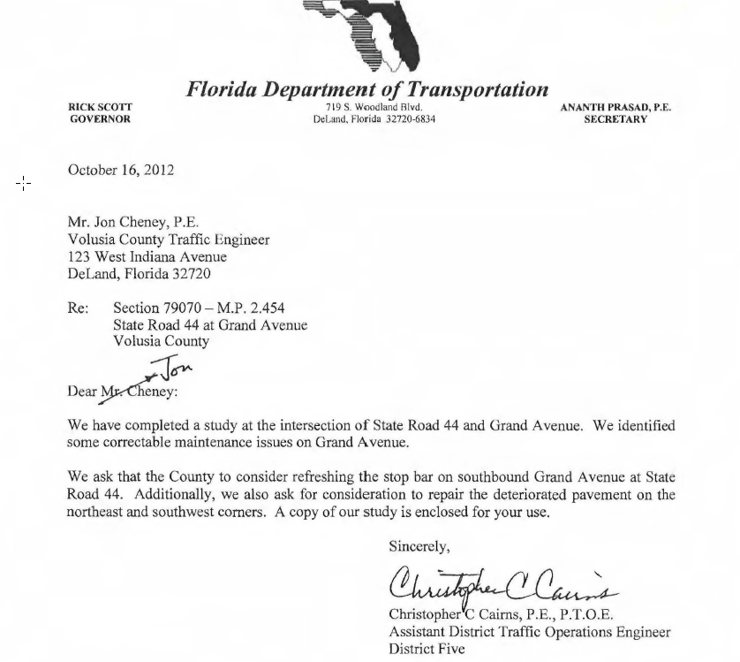
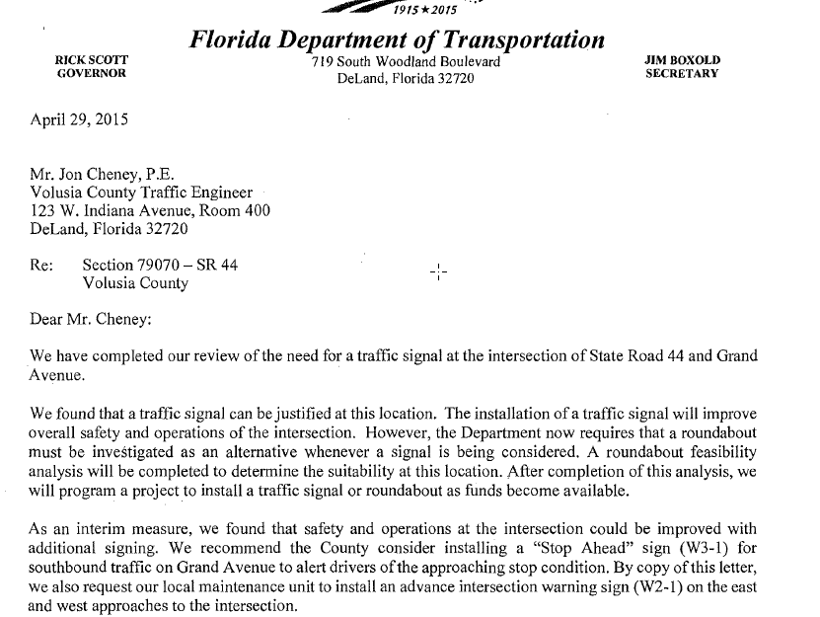

Slide 8
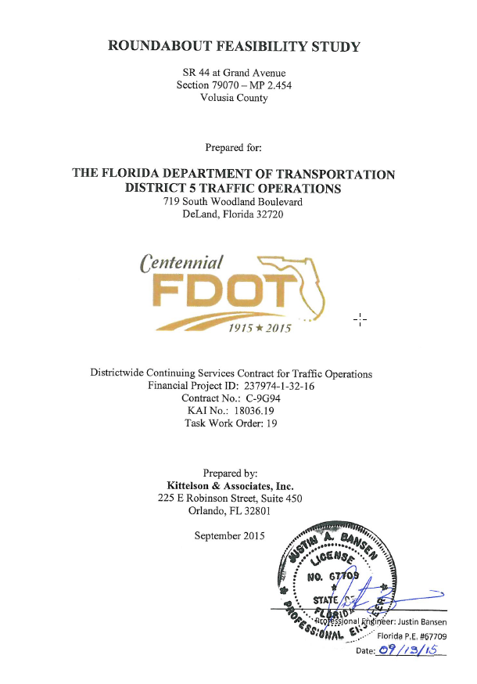

Slide 9
SR 44 at Grand Avenue – DeLand, FL
Former Secretary Boxold committed to start construction of roundabout within 10 months
Decision met with opposition:
  1,000 signatures against roundabout was received
  Government partners were against (TPO and City)

Slide 10
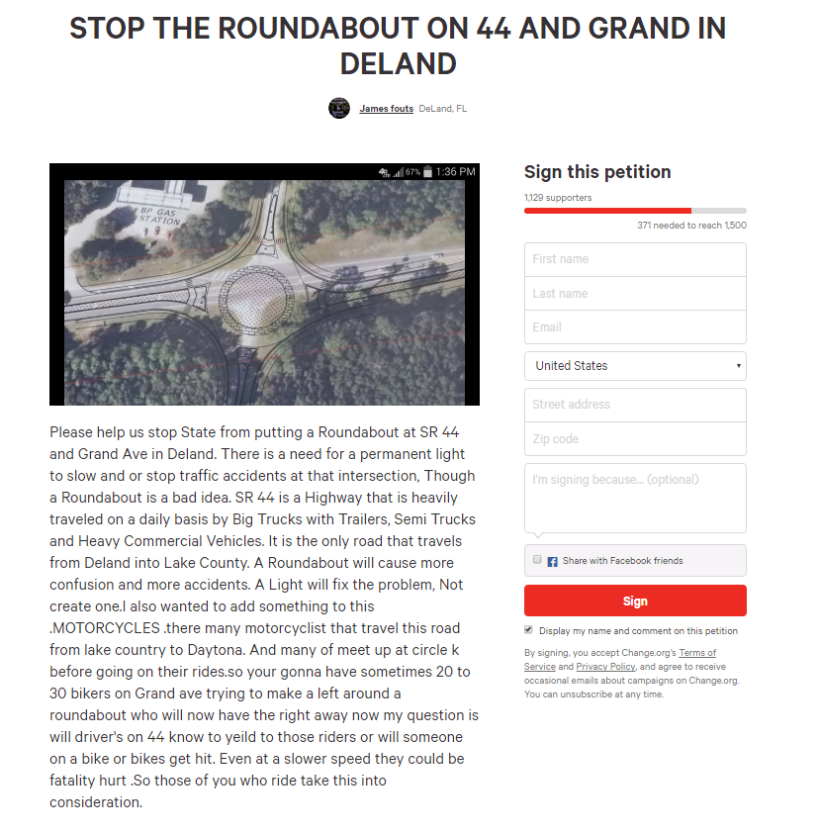
Project Example

Slide 11
SR 44 at Grand Avenue – DeLand, FL
D5 rolled out educational campaign
  Presentations to TPO and City of DeLand
  Notified property owners beyond the 300’ minimum requirement
  Community meeting on July 14, 2016 to educate public about roundabouts – not specific to SR 44 project
  Q/A with media partners

Slide 12
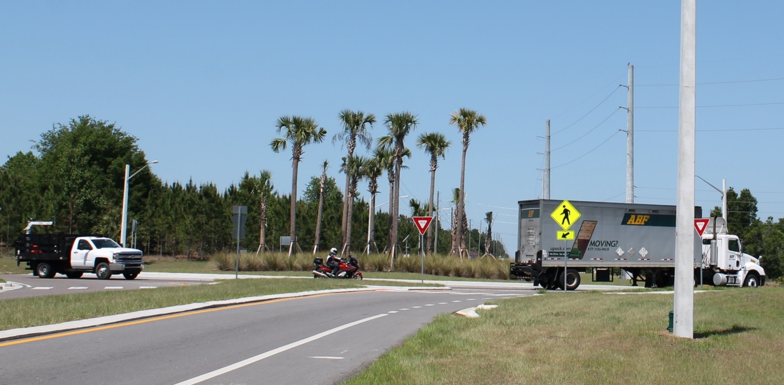
SR 44 at Grand Avenue – DeLand, FL
D5 highlighted nearby roundabout in Lake County
CR 561 at CR 455
Since Roundabout Opened (June 2015)
  No crashes

Slide 13
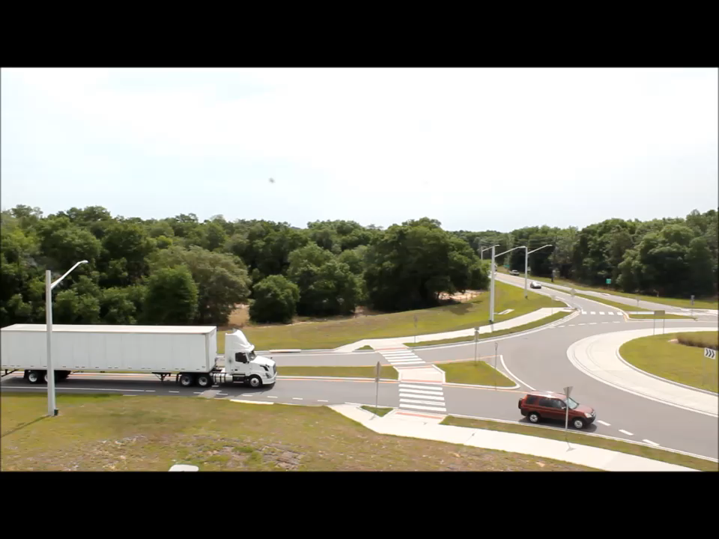
SR 44 at Grand Avenue – DeLand, FL
Video of nearby roundabout shown to Elected Officials

Slide 14
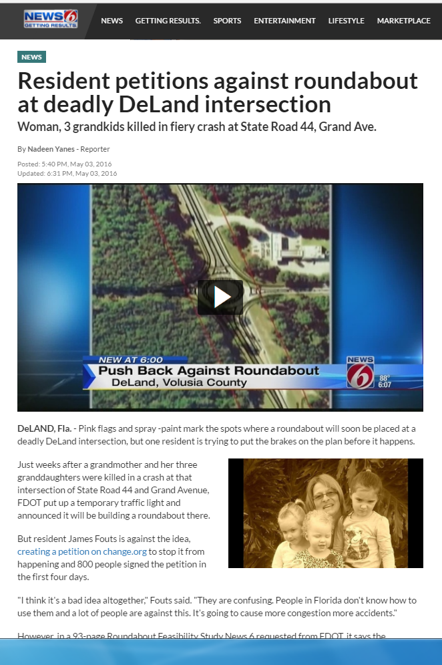
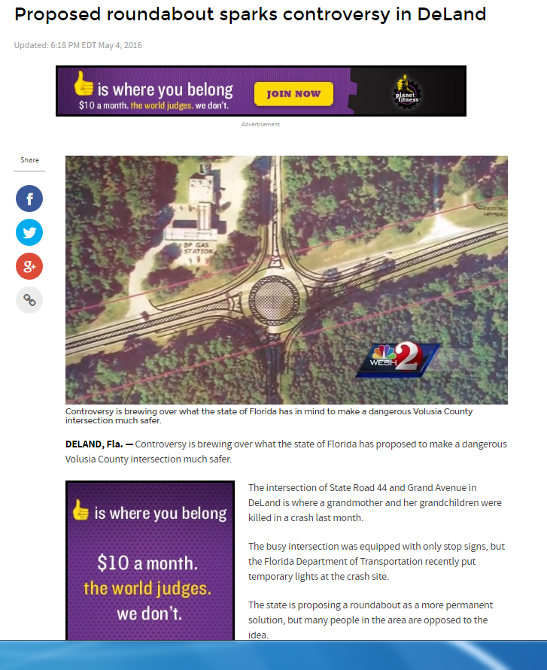
From Bad News..

Slide 15
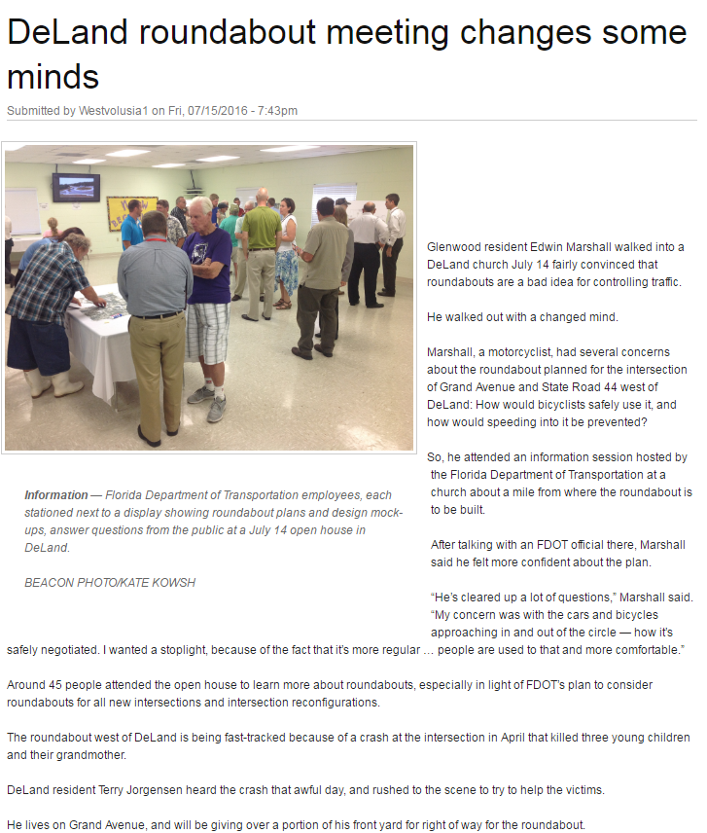
…To Good News
“Glenwood resident Edwin Marshall walked into a DeLand church July 14 fairly convinced that roundabouts are a bad idea for controlling traffic…He walked out with a changed mind.”
-West Volusia Beacon, July 15, 2016

Slide 16
Media partnerships
Crews to begin traffic shift at site of DeLand roundabout; Cars diverted to north side of intersection
By Cathleigh Winningham, WKMG Channel 6
December 1, 2016
http://www.clickorlando.com/traffic/crews-to-begin-traffic-shift-at-site-of-deland-roundabout
State planners say roundabouts save lives (Video)
By Gail Paschall-Brown, WESH
December 2, 2016
http://www.wesh.com/article/deland-roundabout-to-be-completed-by-spring-2017/8459352
Traffic pattern shifts at DeLand roundabout site
By Casmira Harrison, Daytona Beach News Journal
December 2, 2016
http://www.news-journalonline.com/news/20161202/traffic-pattern-shifts-at-deland-roundabout-site

Slide 17
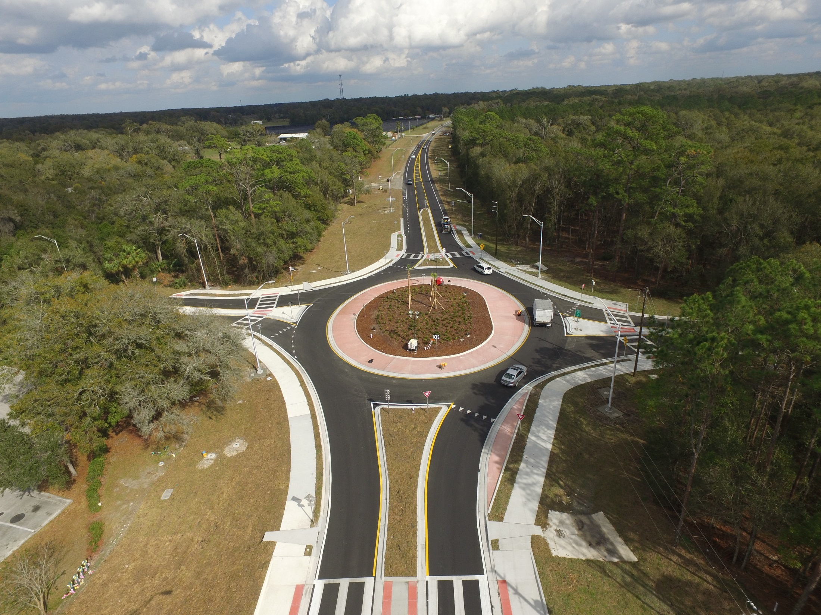

Slide 19
Jennifer “Jen” Horton
Communications Specialist
Florida Department of Transportation District Five
719 S. Woodland Blvd., DeLand, FL 32720
386-943-5497
Jennifer.Horton@dot.state.fl.us

