Slide 1

Handling the unexpected
Christopher Speese
Bicycle/Pedestrian & Public Involvement Coordinator
FDOT, District 7
Notes:
15 minute presentation. (The session is 1 hour and 15 minutes)
The focus of the session is to discuss unexpected events or challenges with the community and how we responded. (highlight a few stories?)
Black Swans can be described as unexpected events that may disrupt our plans or expectations. In this panel discussion, speakers will discuss their experiences with disruptive behaviors and the threats they pose to achieving project acceptance. Participants will learn about ways to avoid disruptions, remain flexible, and react to the unexpected to keep their plans and projects on track to produce the desired objectives.

Slide 2
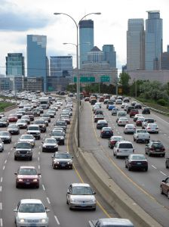
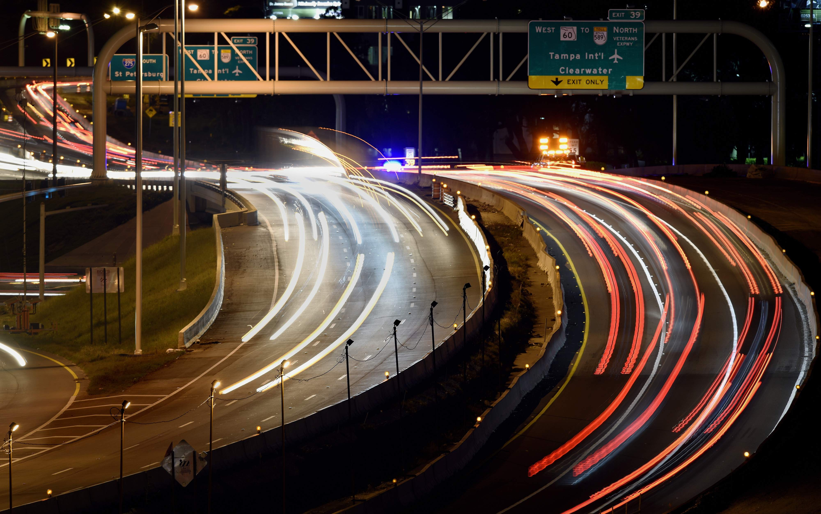
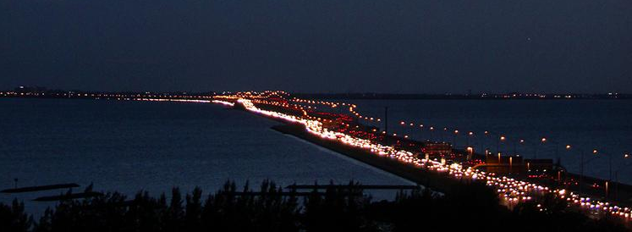
Tampa Bay has a traffic problem.

Slide 3
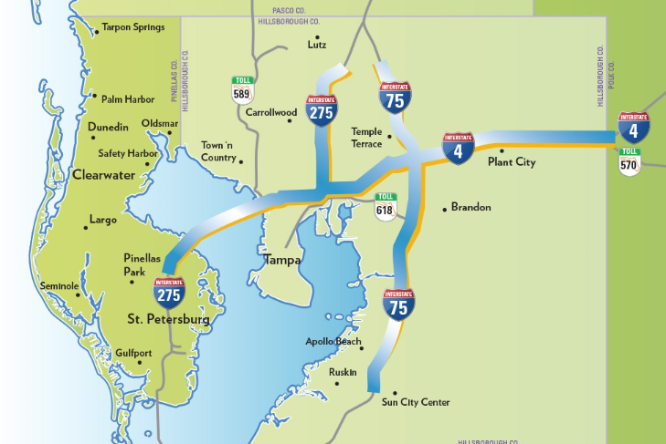
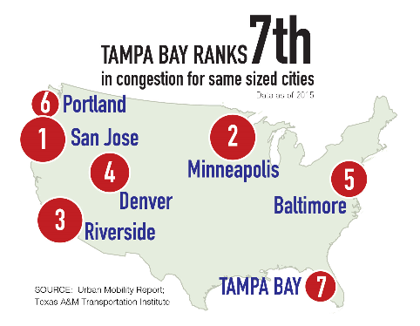
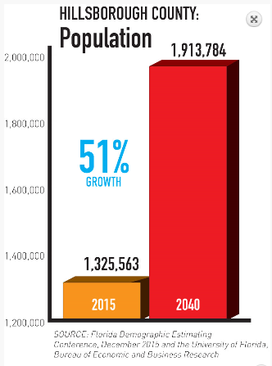

Slide 4
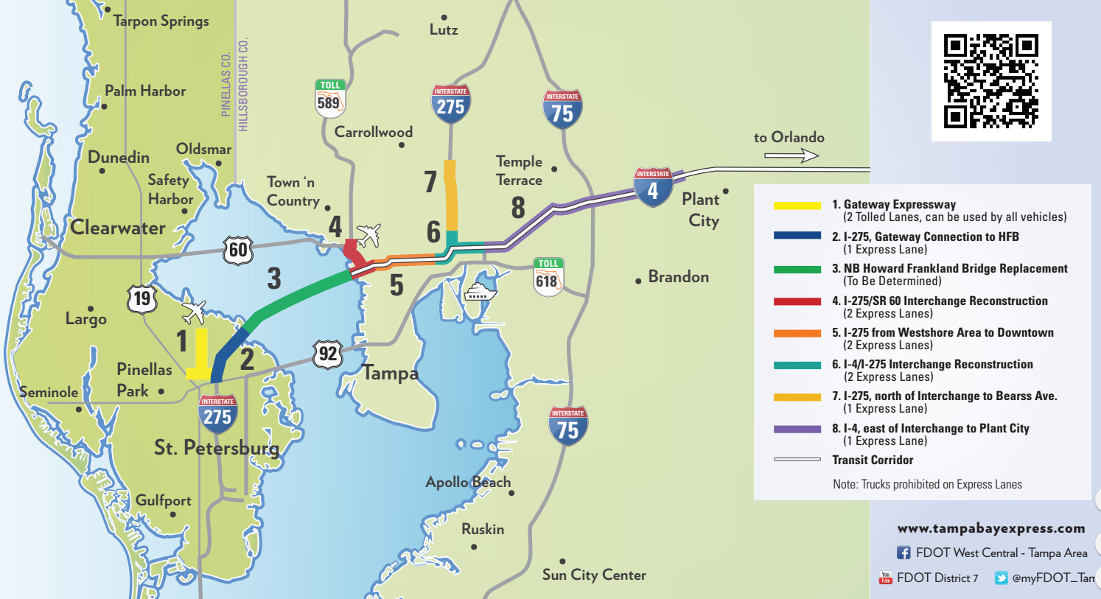

Slide 5

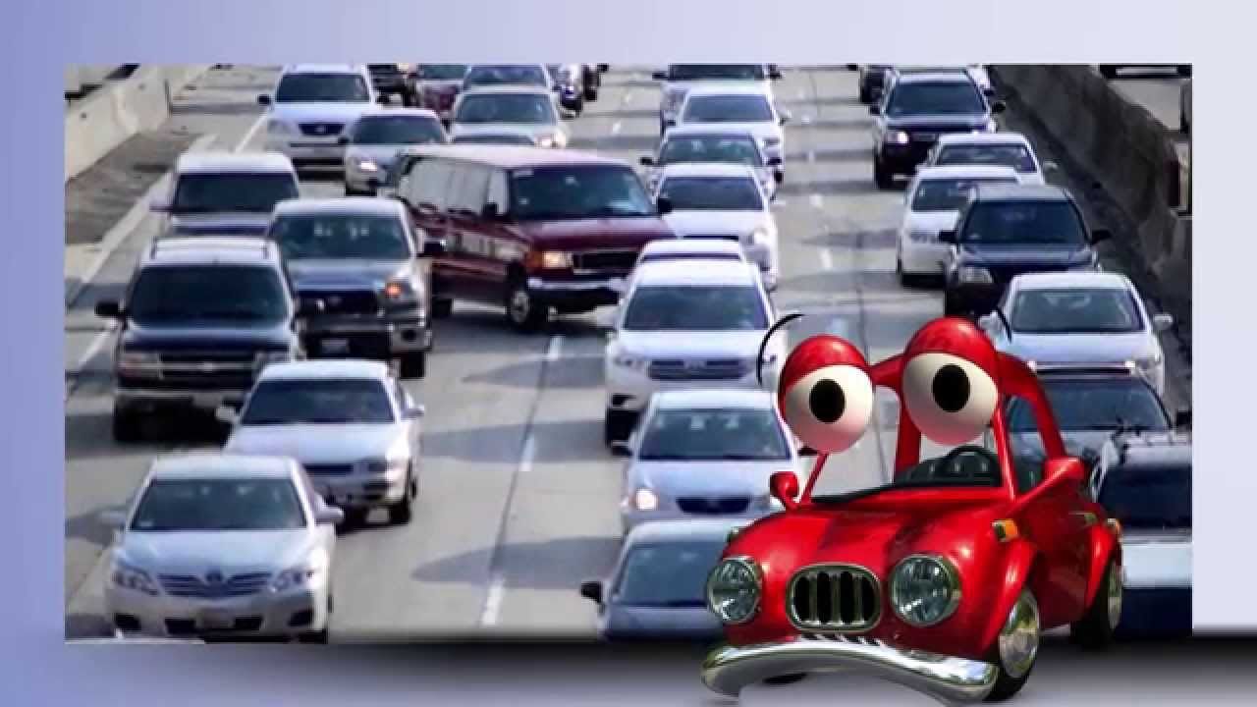
Tampa Bay Express

Slide 6
Tampa Interstate Milestones
I-275 from Pinellas Gateway to Howard Frankland
I-275 SB from Westshore Blvd to Hillsborough River
Howard Frankland Bridge Reconstruction
I-275/I-4 Interchange Reconstruction
Downtown Tampa Interchange Operational Improvements
I-275/SR 60 Interchange Reconstruction
I-275 NB from Himes Ave to North Blvd
I-275 Lois Ave to E of Rome Ave
Tampa Interstate Study FEIS
Florida High Speed Rail Study FEIS ROD
Express Lanes Master Plan
Tampa Interstate Study Master Plan
ROD 3A, 3B, 3C, portions of 1A & Operational Improvements of 2B
I-4 from 14th/15th St. to 50th St.
Right of way acquisition begins
ROD for 2A and remainder of 1A
I-4 Selmon Exp. Connector
I-275 N of MLK to Bearss Ave.
Florida’s Transportation Vision for the 21st Century
Historic Preservation MOA
Olympic studies
Mobility 2000
1996
1999
1989
1996
2000
2005
1997
2002
2006
2008
2011
2015
1997
2010
2014
2016
Tampa Bay Next
1990
1995
2000
2005
2010
2015
6
Community Engagement and Agency Coordination
Notes:
(1) This timeline is the basis for our presentation today. Planning for the Tampa Bay interstates began in the late 1980s and was approved by FHWA in the late 1990s. Right of way acquisition began in the late 1990s. Extensive community engagement and agency coordination has taken place throughout the years. Let’s start with the TIS Master Plan.
(2) The master plan was the foundation for the TIS Final Environmental Impact Statement and related documentation.
(3) The TIS is more than a planning document that just sits on a shelf collecting dust. With FHWA as a partner, FDOT has taken steps to implement the plan as funding became available. Referring back to our timeline, this portion of the presentation will provide an overview of those projects.

Slide 7
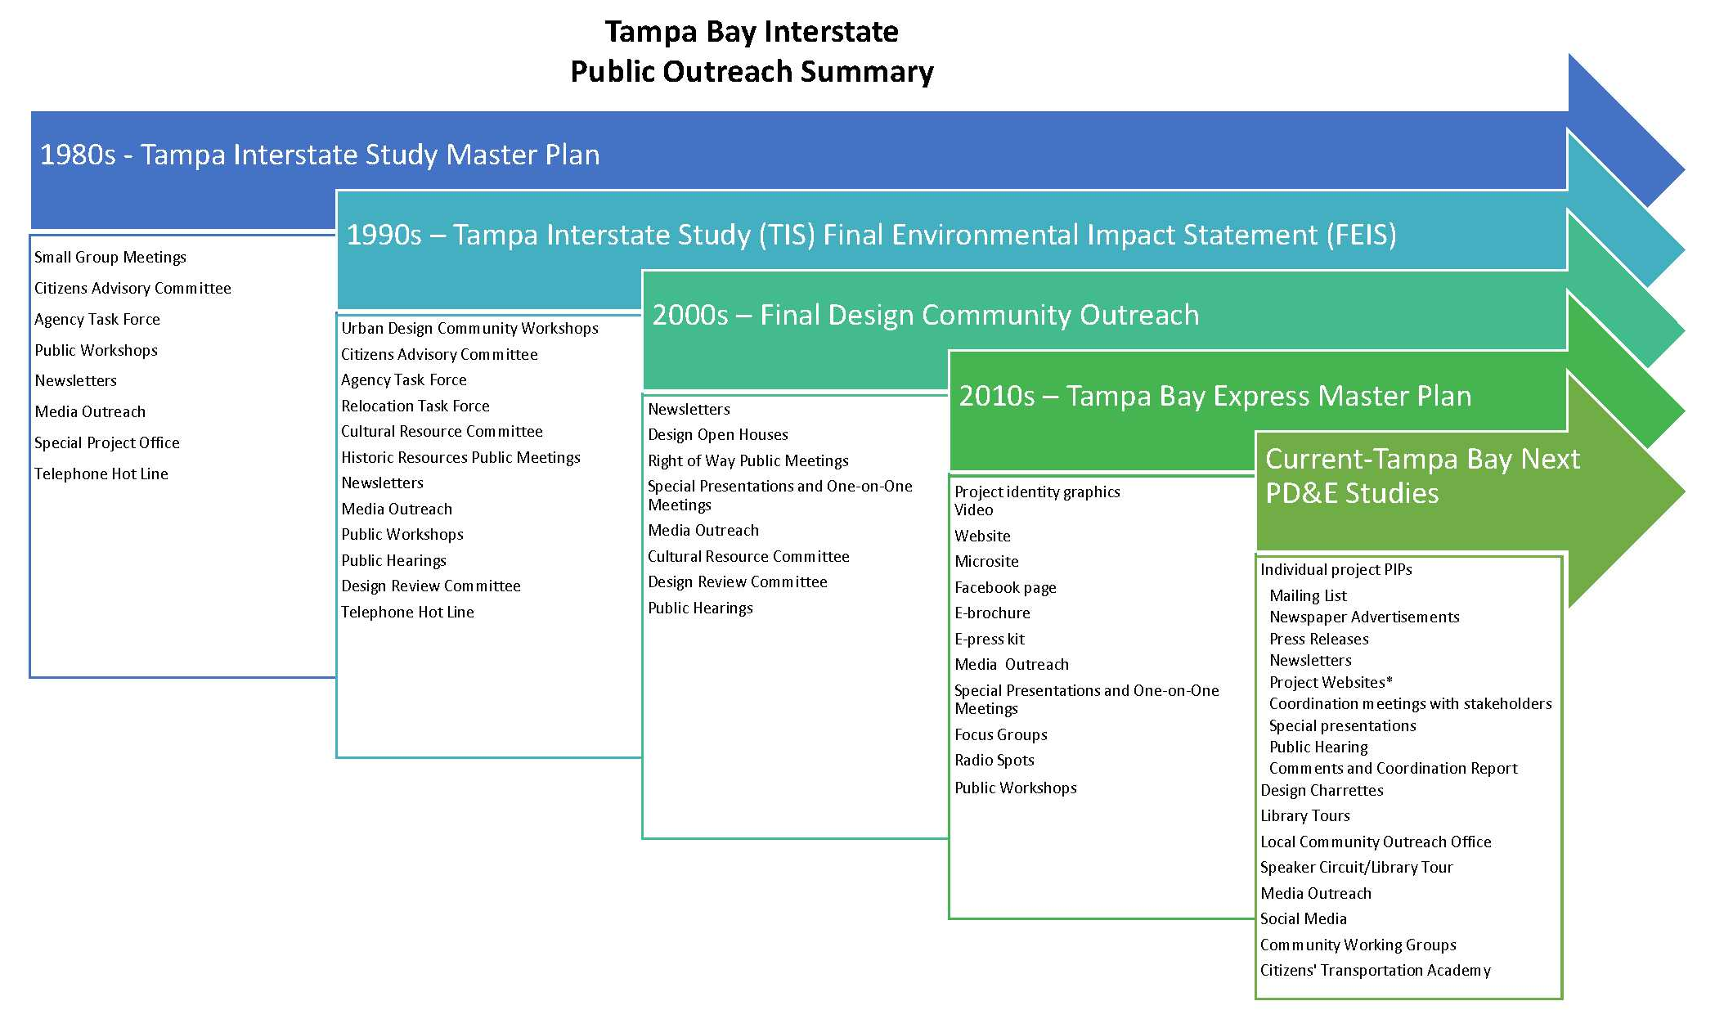
Public Outreach Summary
7
Notes:
In addition, we continued the robust outreach program during design and construction.

Slide 8

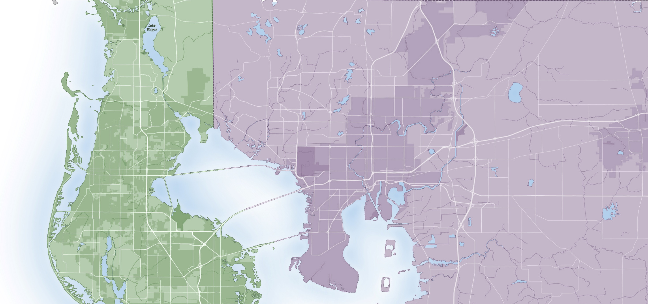
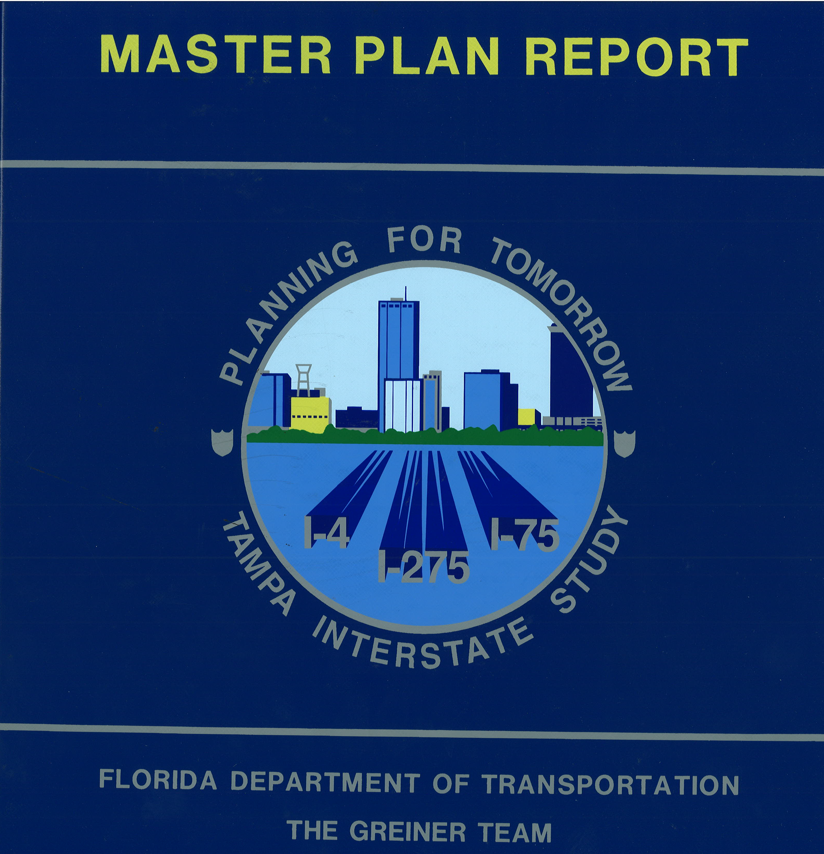

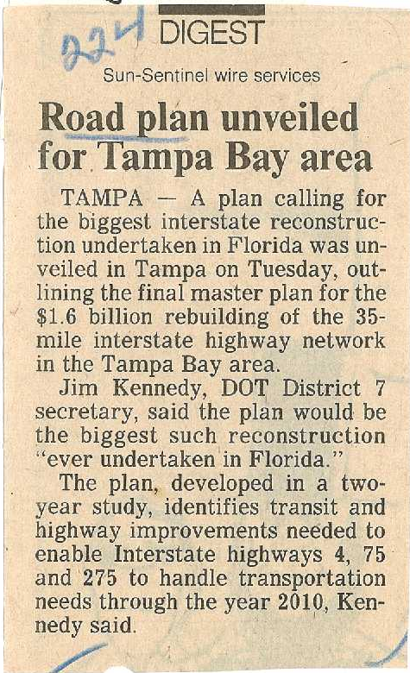






Tampa Interstate Study (TIS) Master Plan
ALT
19
41
301
581
589
COMPLETED 1989
Pinellas
7
8
ALT
19
4
6
60
3
5
618
60
1
2
92
Hillsborough
“A balanced transportation system, particularly an integrated system encompassing aviation, marine, rail, transit, and highway, is an integral element of the region’s economic viability.”
8
Notes:
The original interstate was constructed in the 1960s prior to the National Environmental Policy Act (NEPA) and other important legislation. By the late 1970s/early 1980s, it was evident that the Tampa Bay interstate system needed to be upgraded. The Tampa Interstate Study (TIS) Master Plan was initiated in 1987 and covered the area highlighted here, including I-275 from the Westshore Business District to downtown Tampa and north to I-75 and I-4 from downtown to I-75. FHWA approved the master plan in 1989.
The original FEIS previously documented SIGNIFICANT impacts to the social/EJ communities (and other environmental categories).

Slide 9
Community Outreach

Slide 10
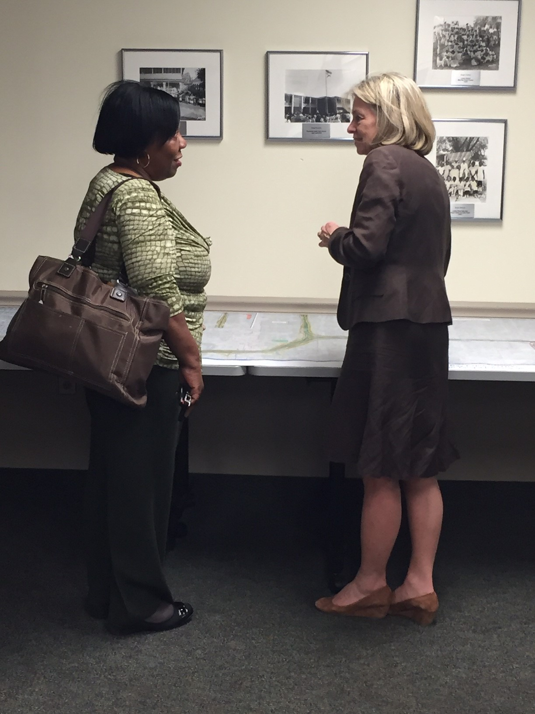
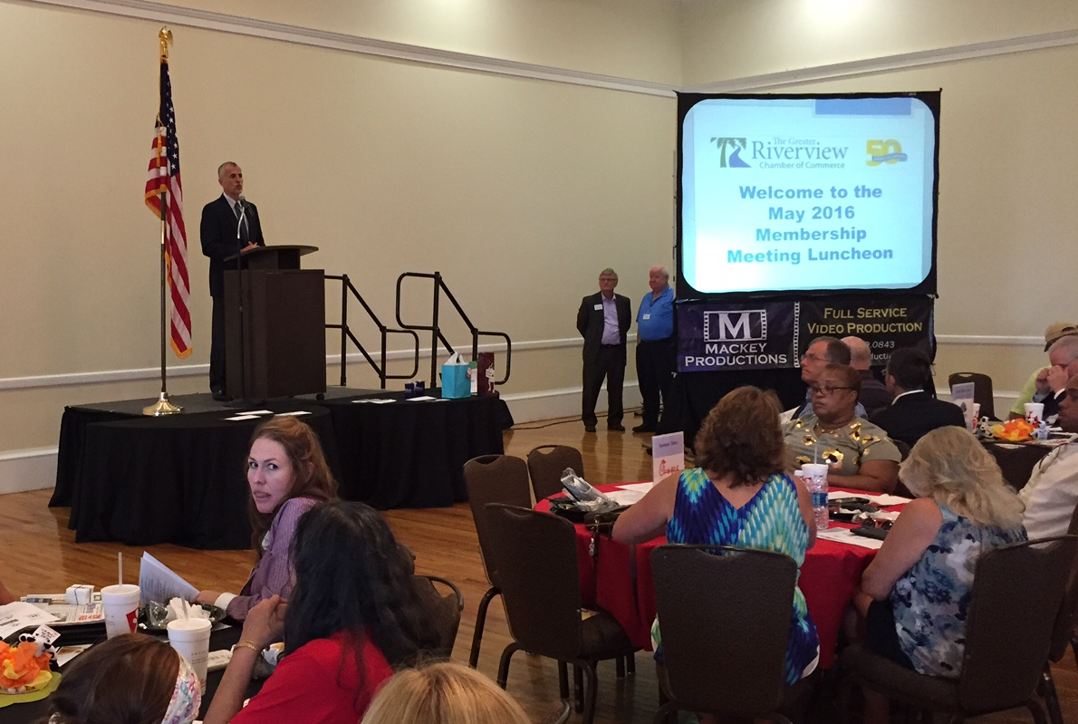
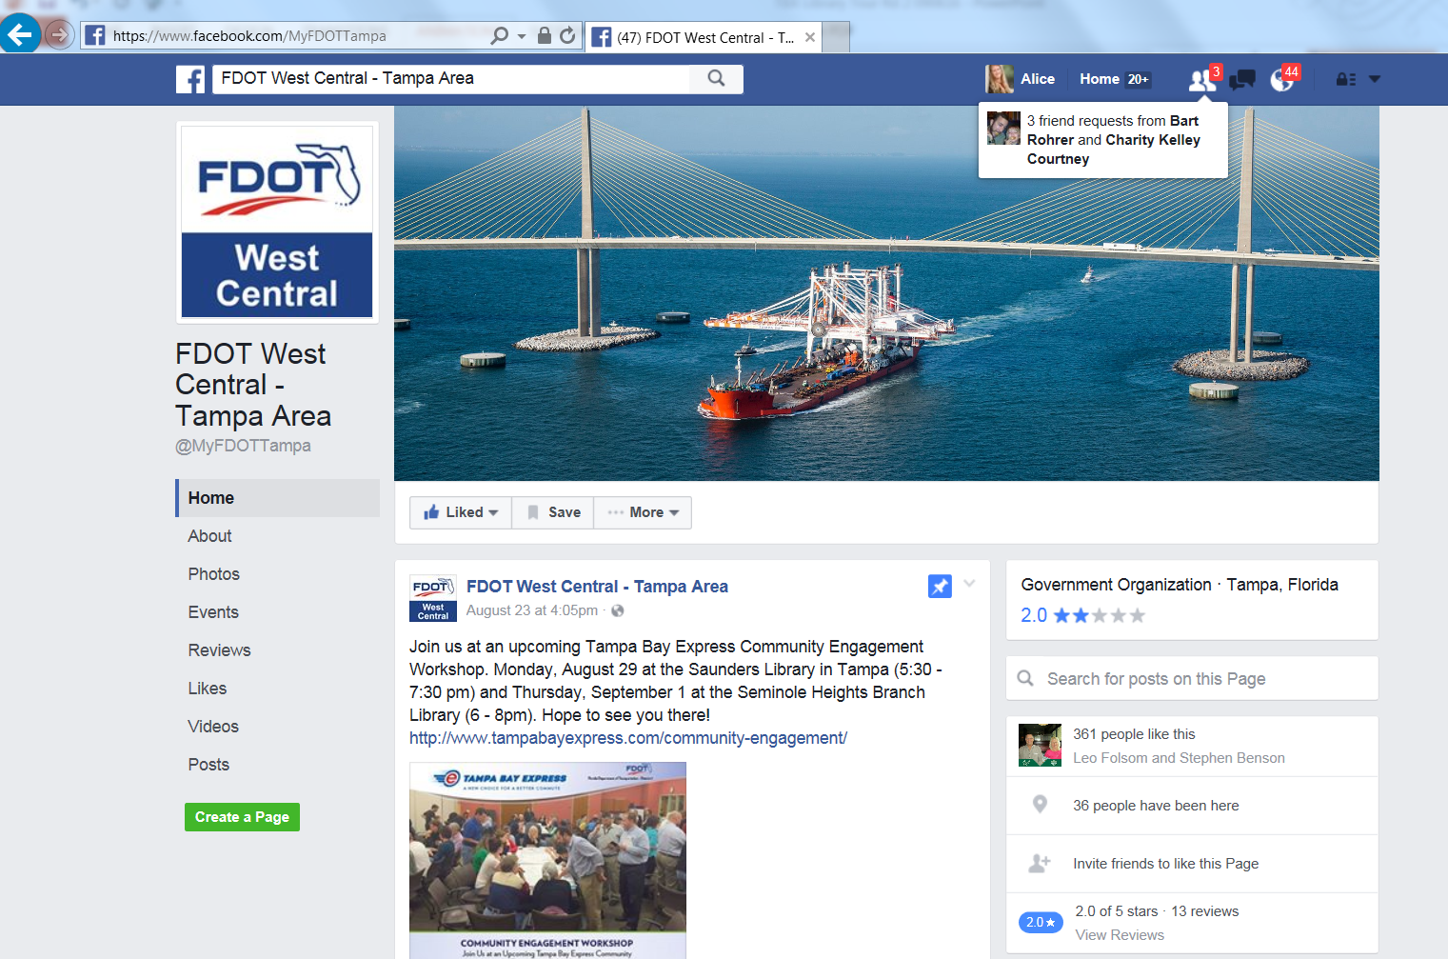
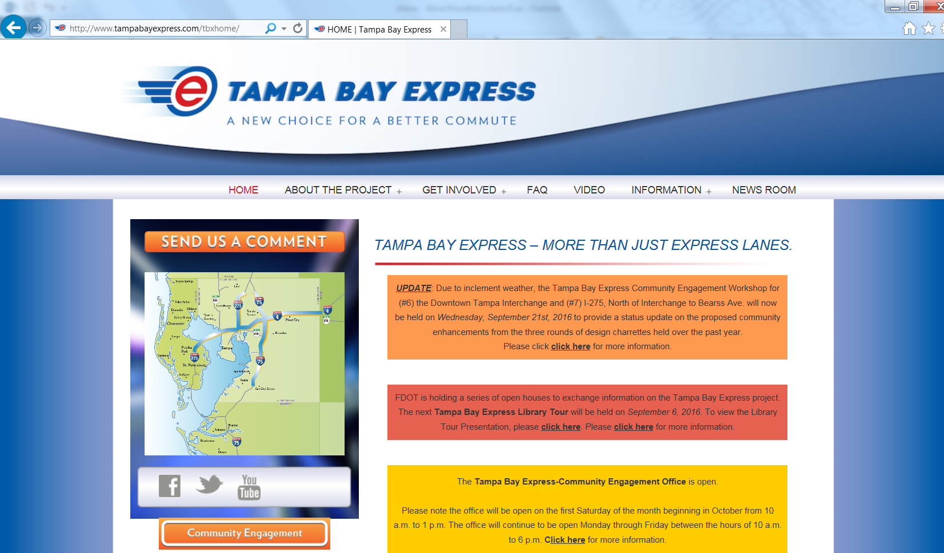
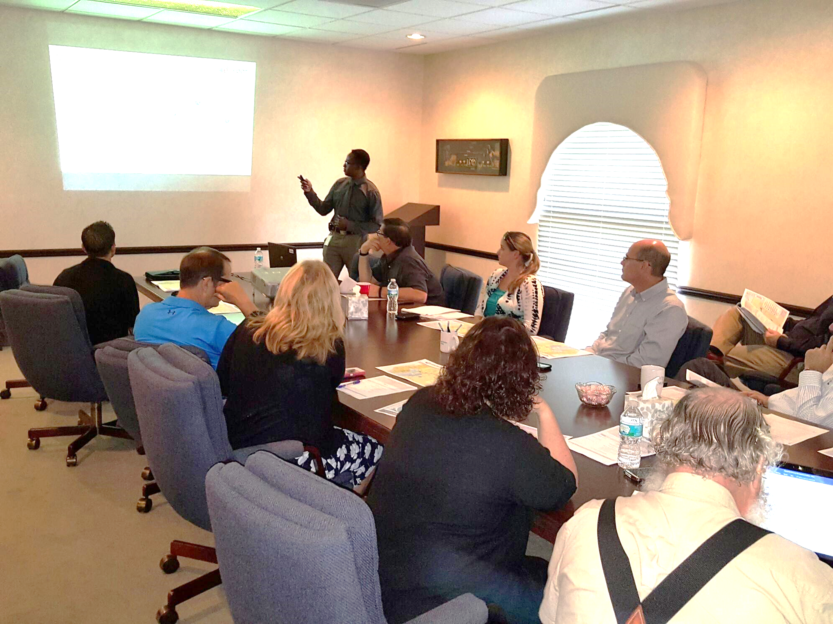
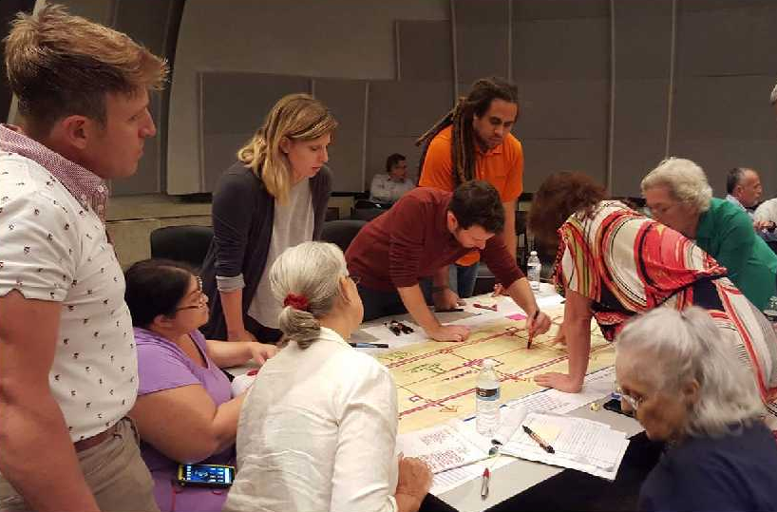
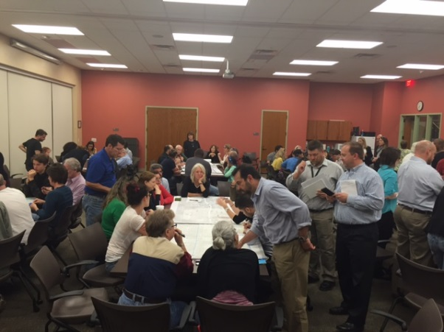
Small Group Meetings
Periodic Briefing of Elected Officials
Charrettes
Library Tours
Community Engagement Office
Website
Social Media
Mail-outs/Newspaper Ads
Notes:
FDOT has reached thousands of people throughout the past three and a half decades through small group meetings, special advisory groups, workshops, and other tools. In the past three years alone, FDOT distributed over 80,000 mailers, participated over 250 special presentations, hosted more than 50 public meetings, and reached 500-1,000 people each month by web and social media.

Slide 11
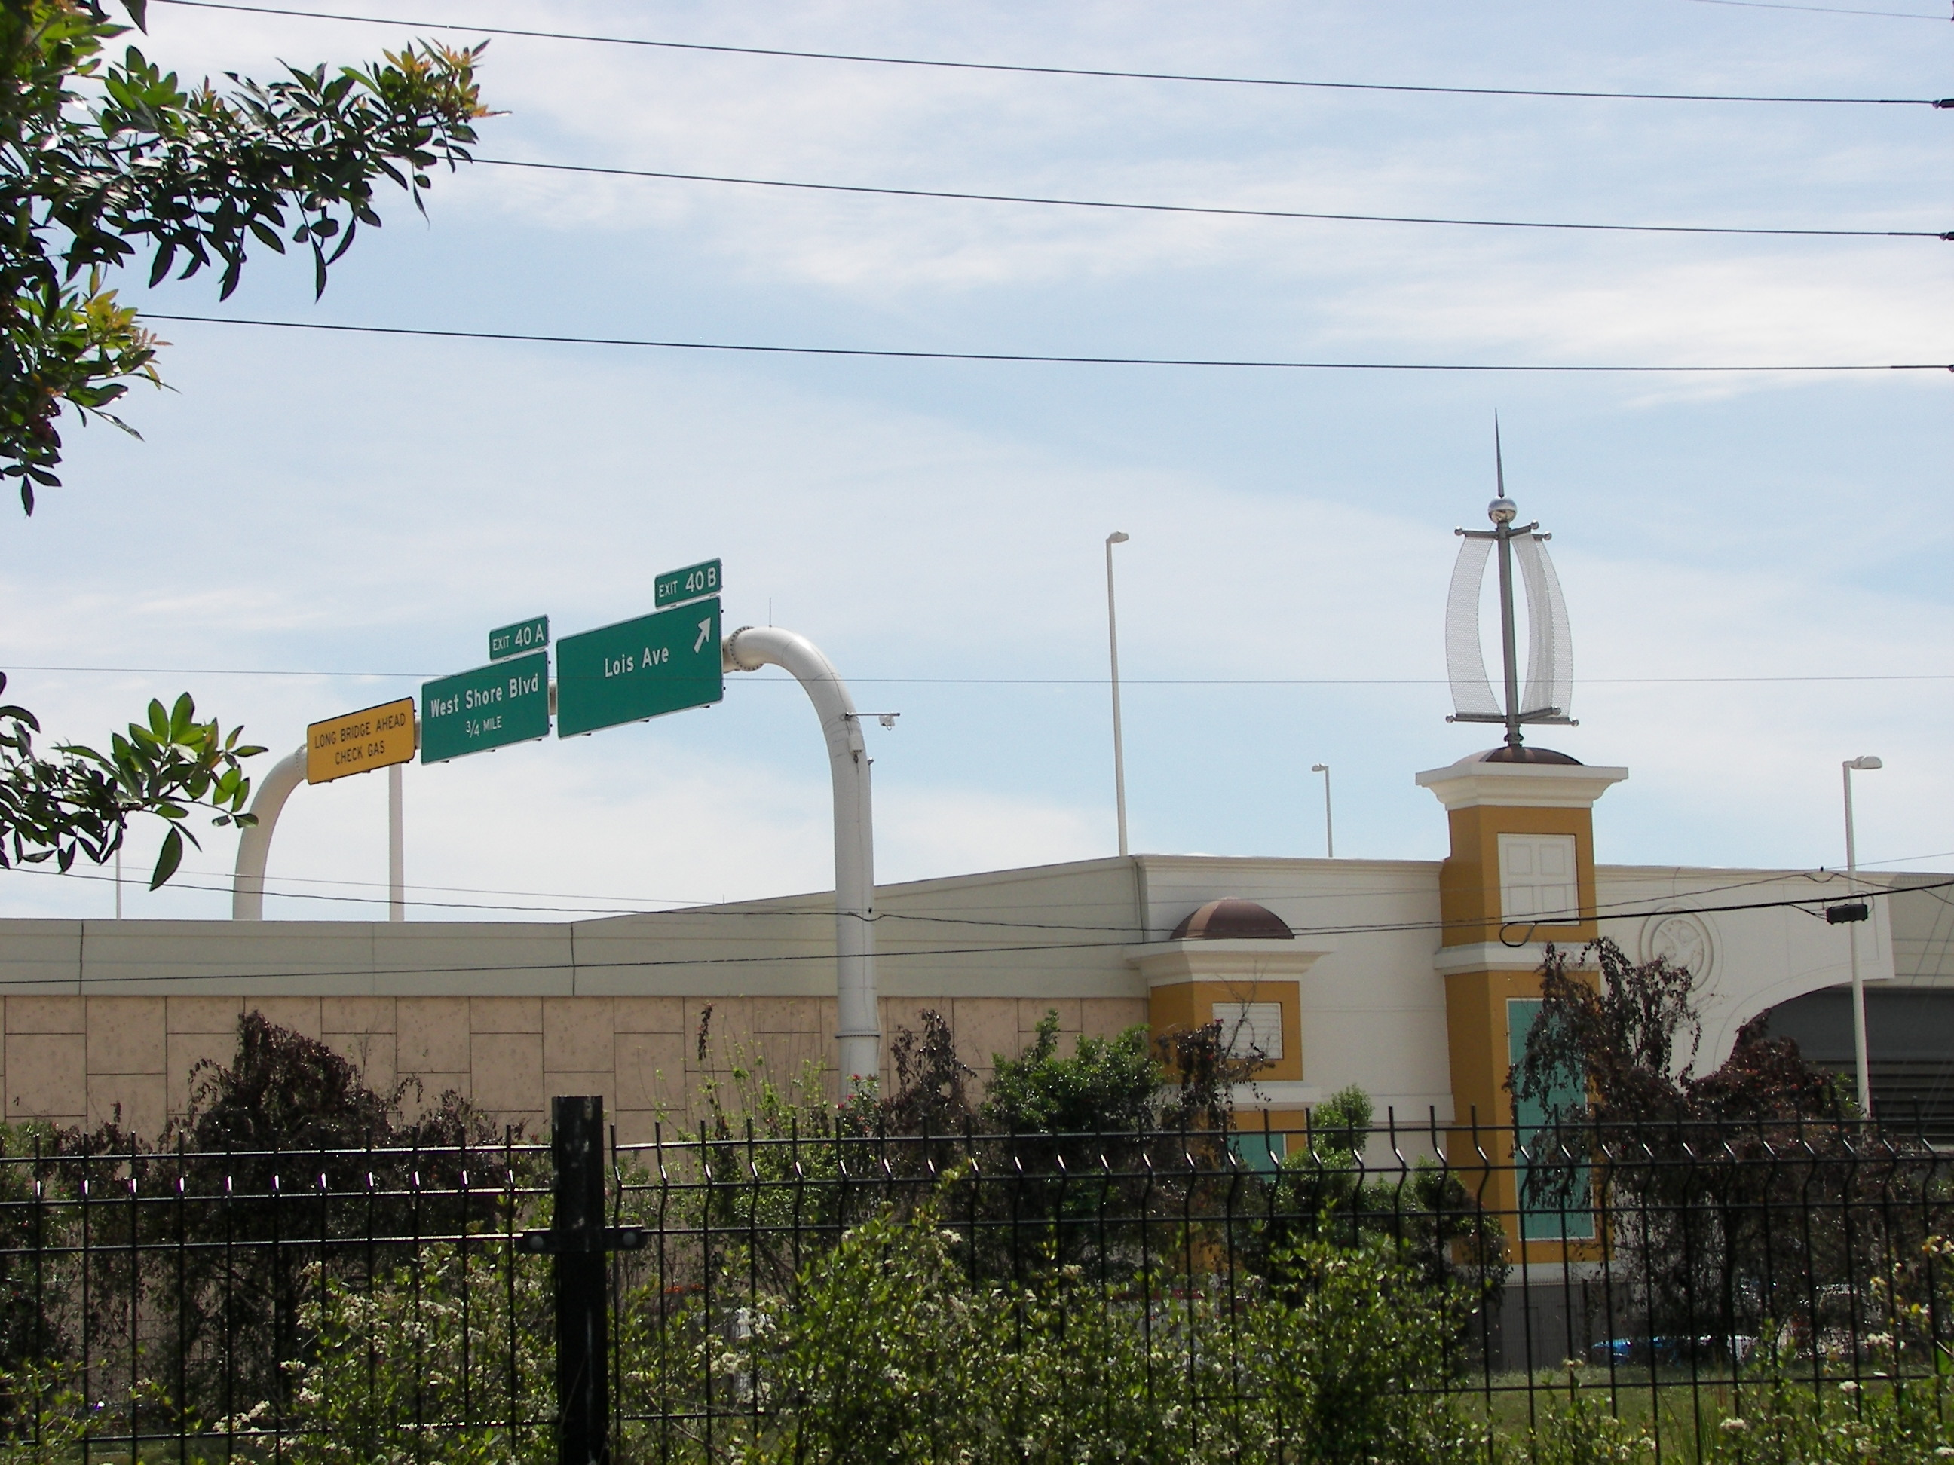
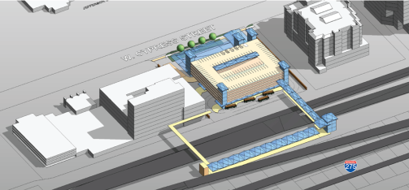
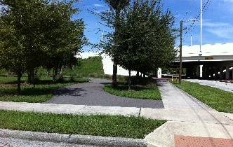
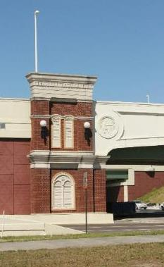

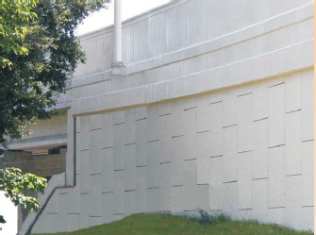
Original Community
Commitments
I-275 at Dale Mabry Highway
Relocating Historic Structures
Sound Walls
Urban Design Guidelines
Relocating Historic Structures
Historic Preservation
Tampa Heights Greenway
Howard Avenue
Tampa Heights Greenway
Bicycle and Pedestrian
Multimodal Center
Construction Techniques
HART North Terminal*
Parks and Rec Facilities*
*Fulfilled or no longer applicable.
11
Sound Walls
Pedestrian Connectivty

Slide 12
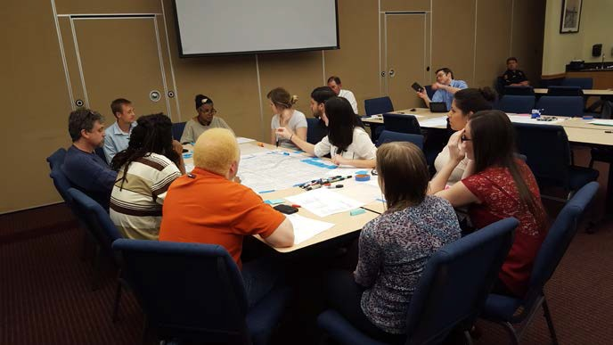
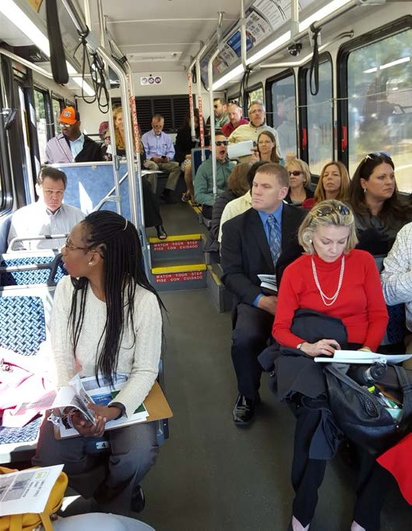
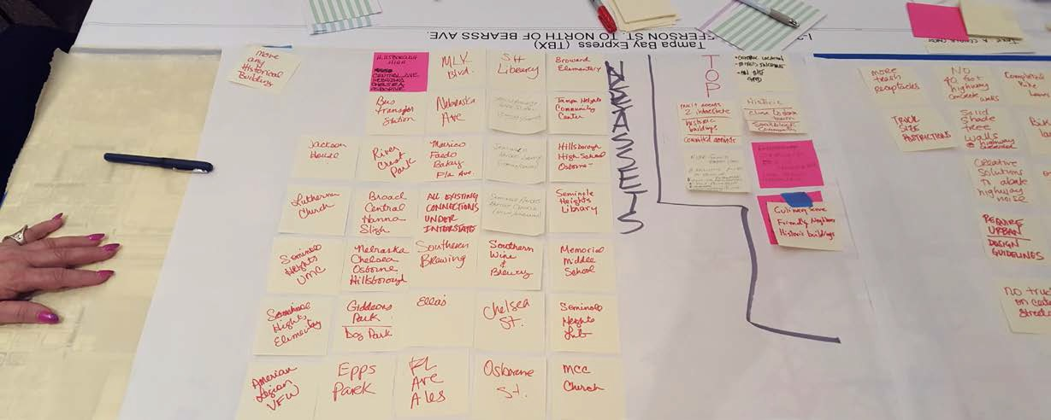

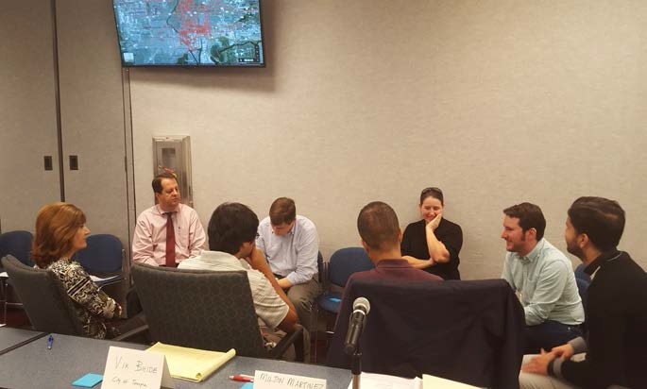
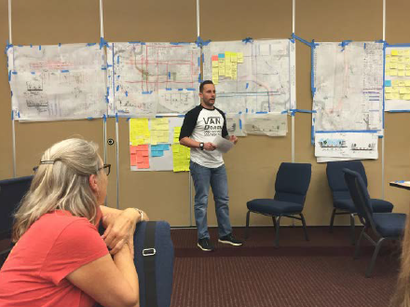
Design Charrette Purpose
Supplement the Project Development & Environment (PD&E) process
Better define community enhancements that should be included as part of TBX
Update community’s vision and goals since the last project update
Final Report – July 2016
12

Slide 13
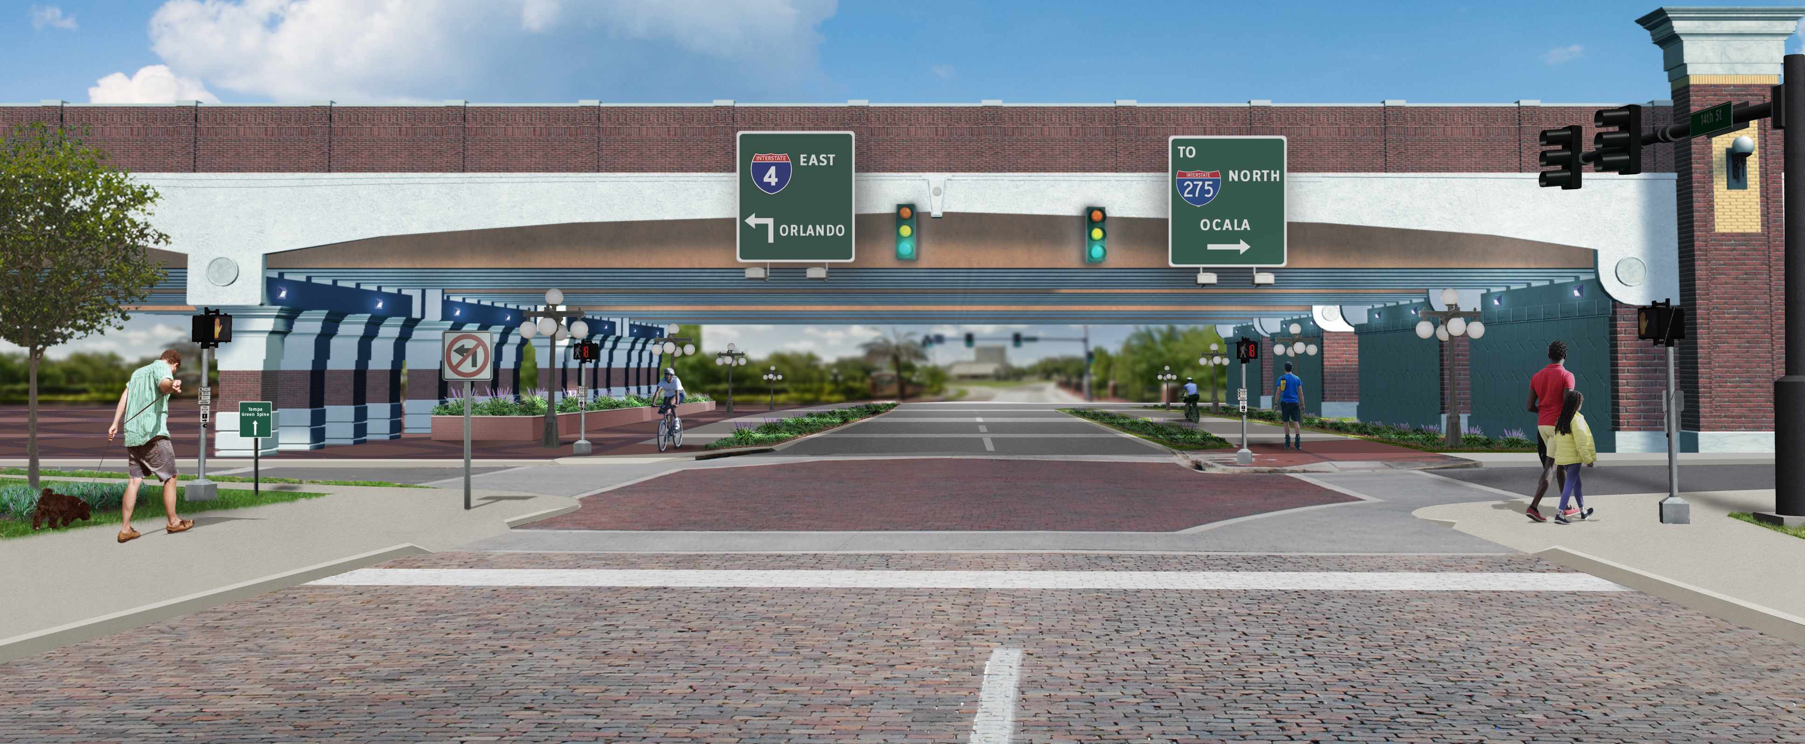
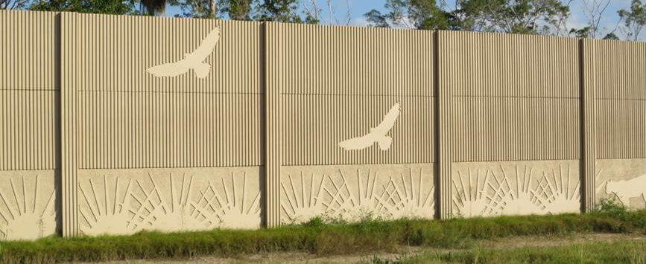
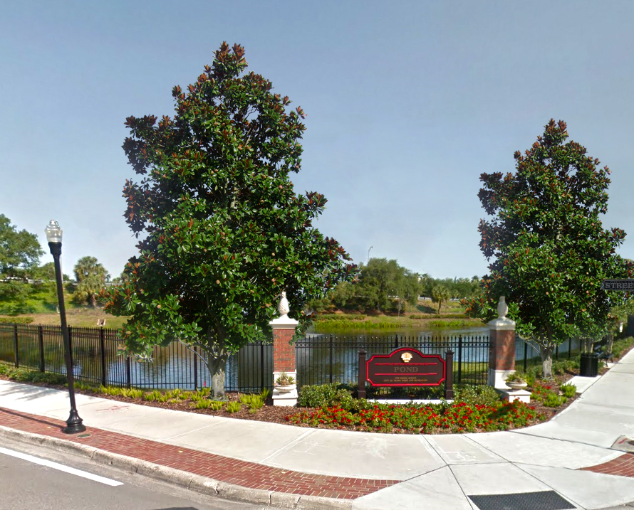
TBX Community Focus
Better Connectivity and Street Corridor Design
Pedestrian Friendly Underpasses
Attractive Sound Walls
Stormwater Ponds as Community Features
More Canopy Trees
Public Art
Community-Sensitive Construction Techniques
Artist’s Rendering of Future Condition at 14th Street
Sample Noise Walls
Sample Stormwater Pond
13
Notes:
Through the design charrette process, these communities identified several opportunities for design enhancements, like making the underpasses more pedestrian friendly, constructing attractive sound walls, designing storm water ponds with community features, and other great suggestions. The following slides highlight just a few of those opportunities.

Slide 14
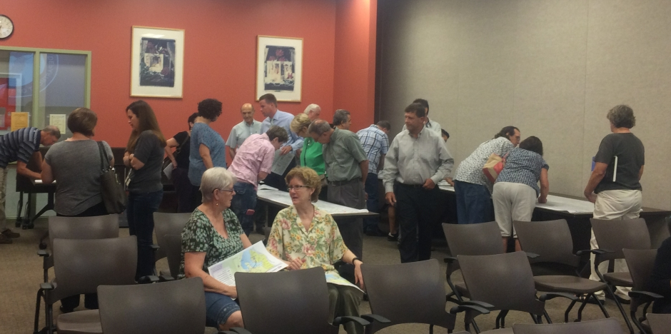
Library Tours
The Library Tours are a series of open houses to exchange information on the project. Knowledgeable staff are available throughout the evening to present the latest plans, answer questions, and accept public comments.

Slide 15
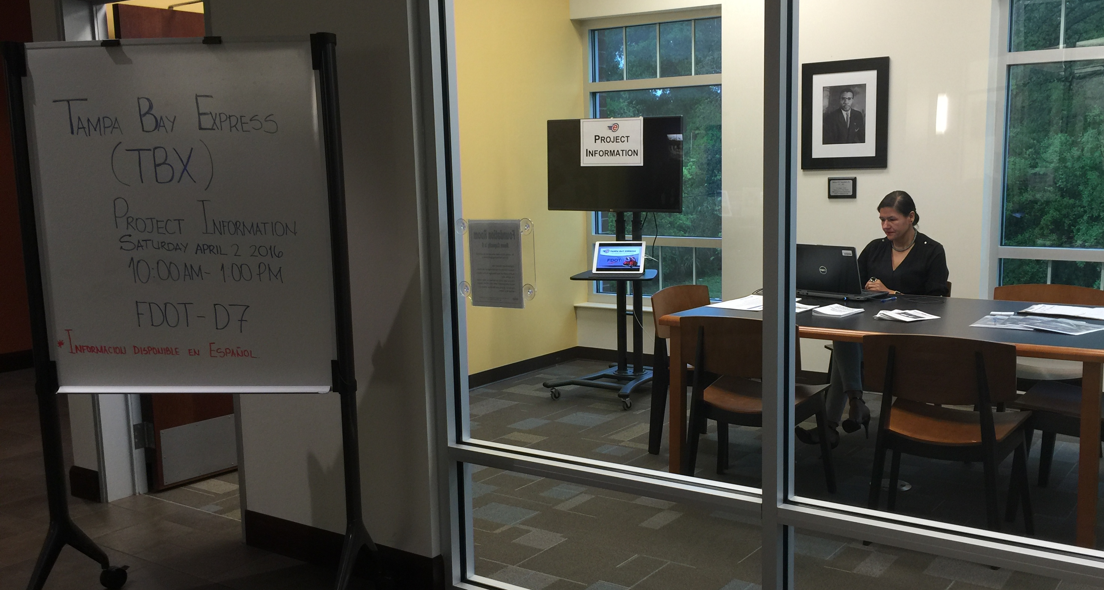
Community Engagement Office
The Community Engagement Office was established to provide the local community convenient access to a knowledgeable FDOT staffer that can answers questions regarding the Tampa Bay Express project.

Slide 16
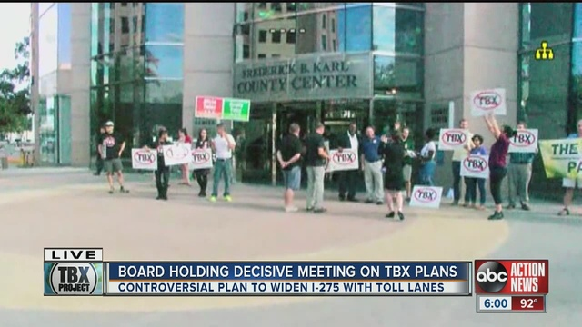
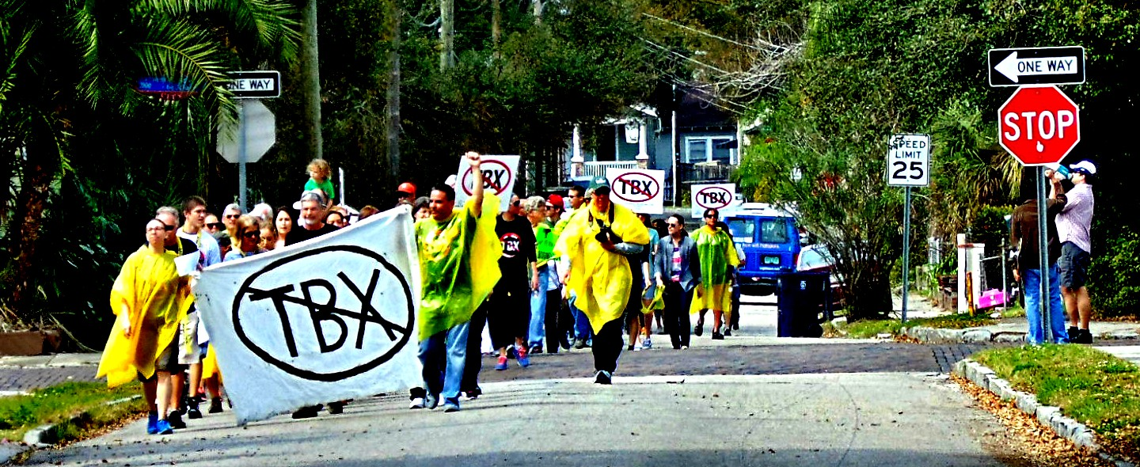

Slide 17
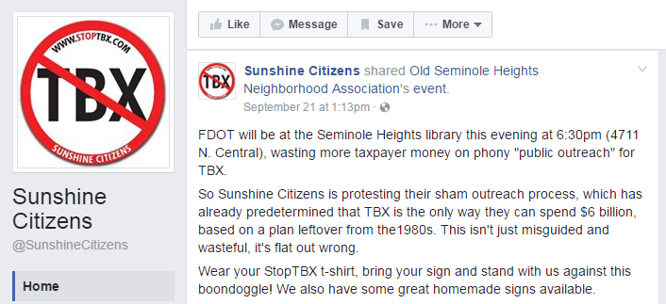
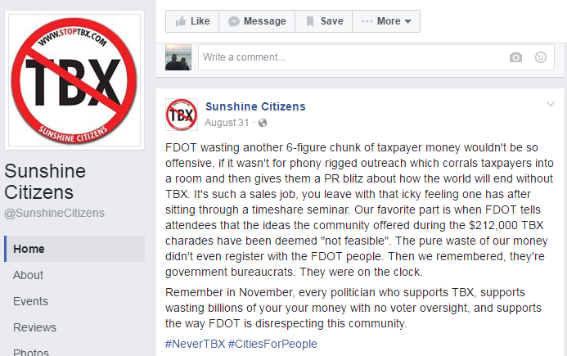
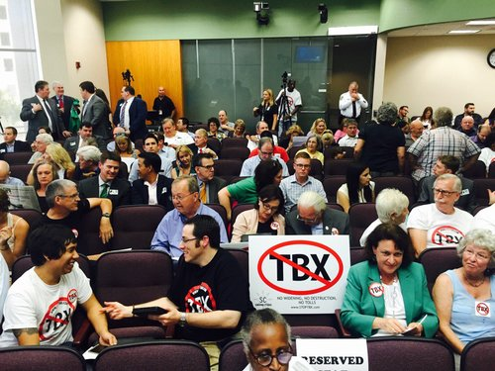

Slide 18
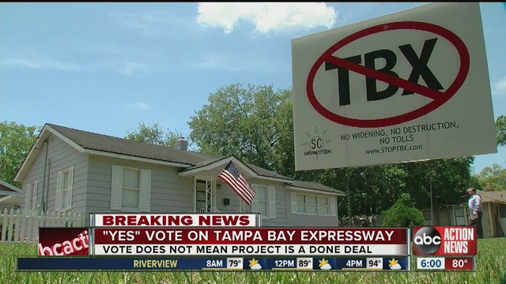

Slide 19
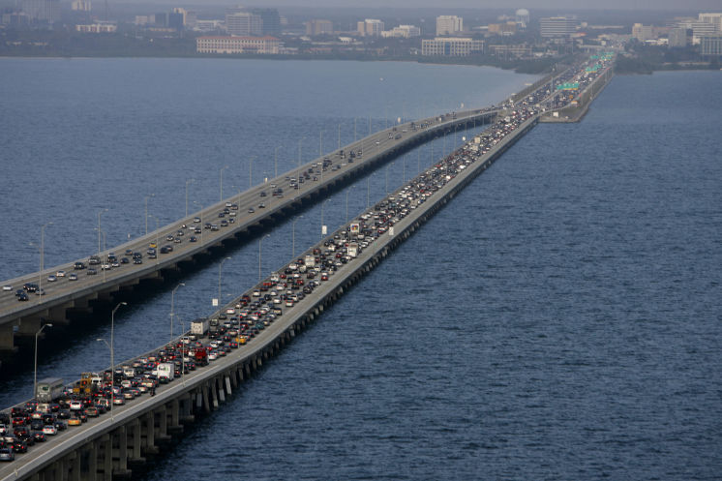
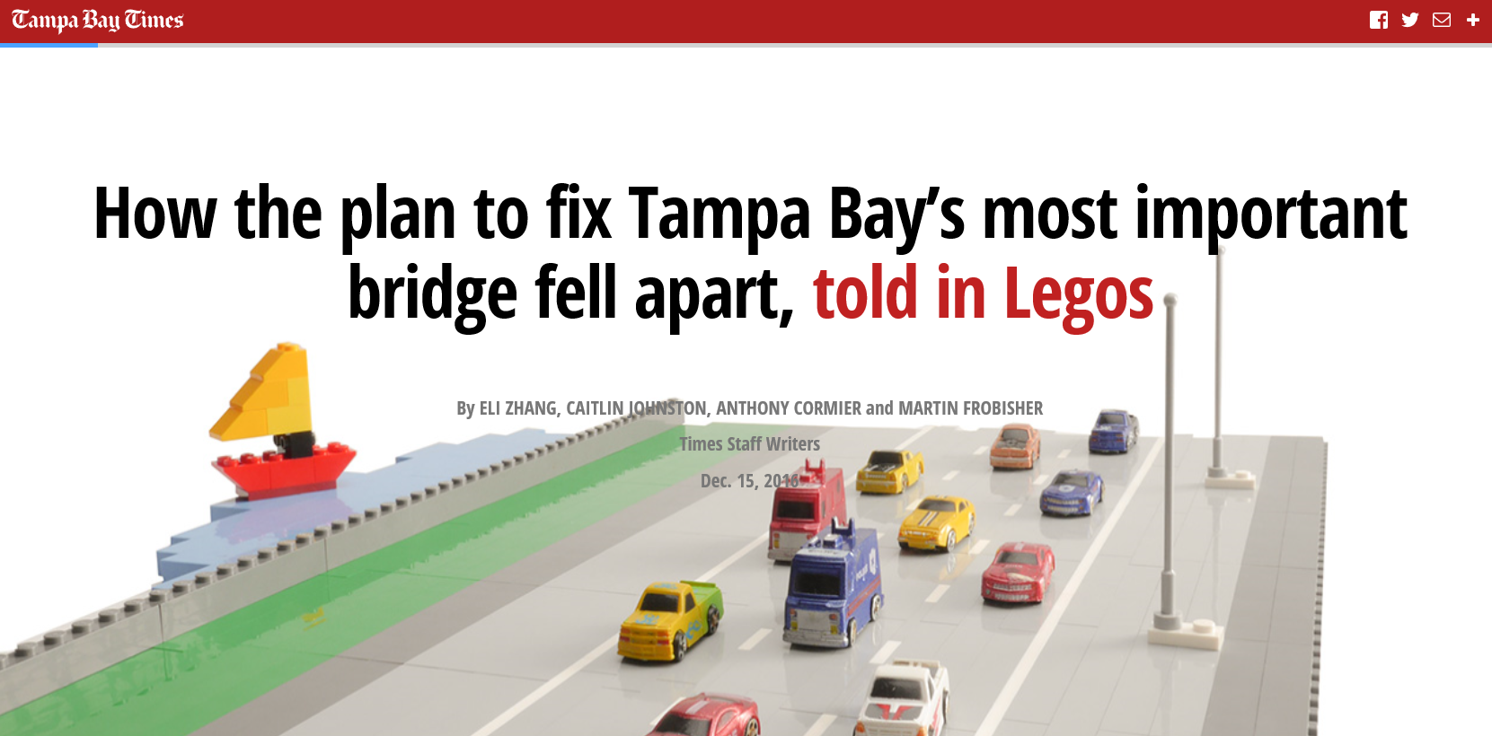
Notes:
Built in 1960 and needs to be replaced.
Express lanes were to be added . The 4 lanes included an auxiliary lane which connected the on-ramp on one side to the off-ramp on the other side. The plan was to keep the 3 “free” lanes and remove the aux. Lane to accommodate the express lanes.

Slide 20
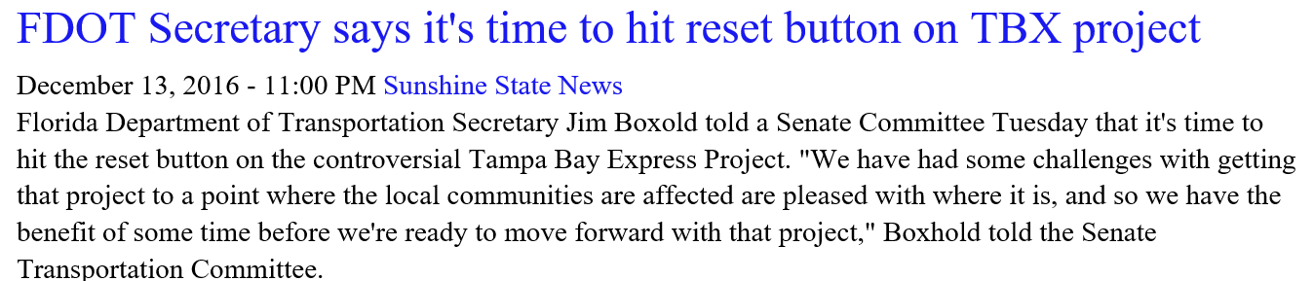
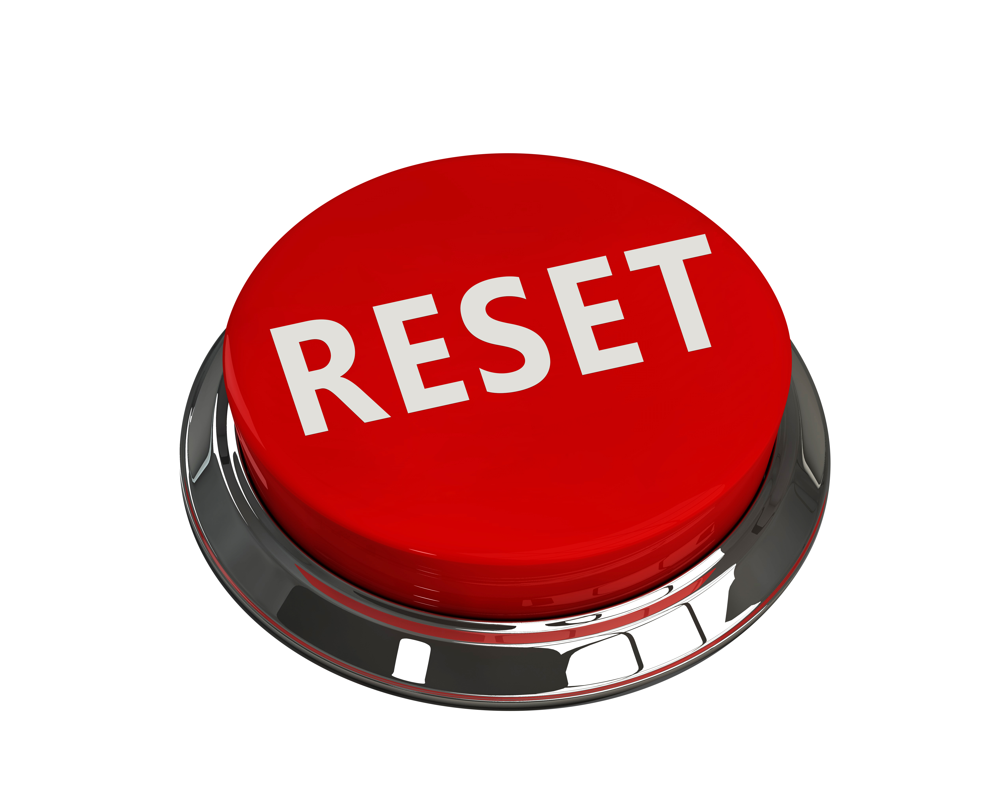

Slide 21
Research
3R
Reevaluate
respond
Notes:
1-RESEARCH: The peer exchange was a turning point in building the first stages of trust outside with our most vocal opponents
2-REEVALUATE (SEIS is currently being developed as well as schedule changes to those projects to allow for reevaluation
3 – RESPOND: Community Working Groups, Holistic Planning/Multimodal/All agencies in the room).

Slide 22


Slide 23
Tampa Bay Next is a program to modernize Tampa Bay’s transportation infrastructure and prepare for the future.

Slide 24



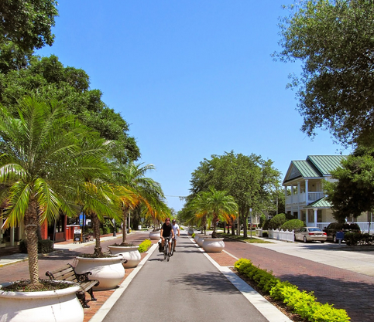
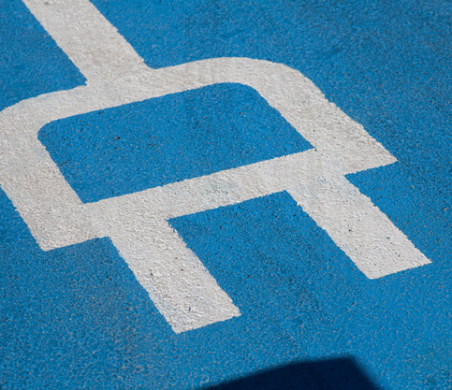
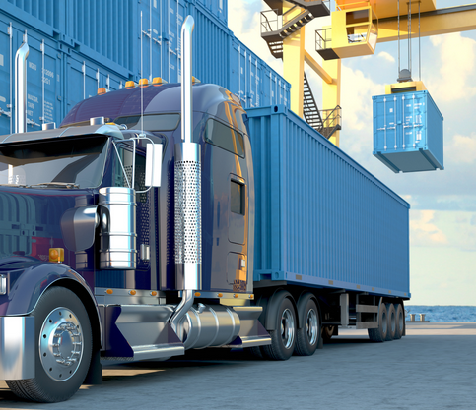
The Program Includes:
Interstate Modernization
Transit
Bicycle/Pedestrian Facilities
Complete Streets
Transportation Innovation
Freight Mobility

Slide 25
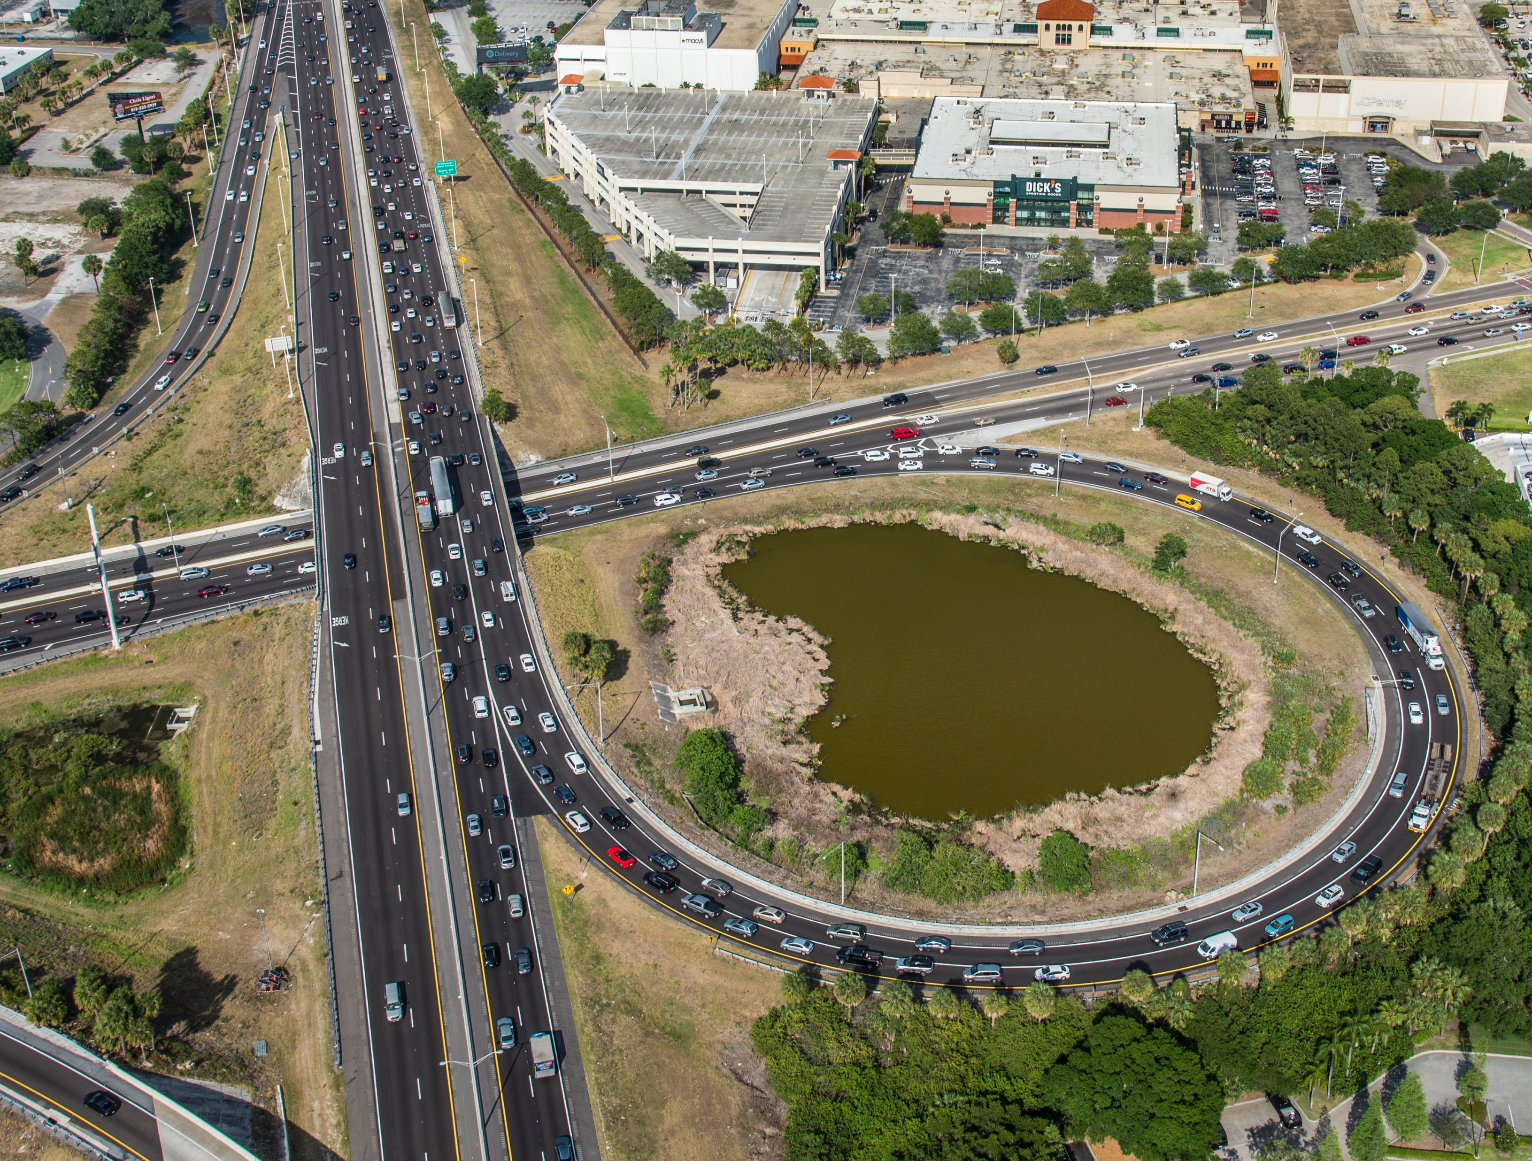
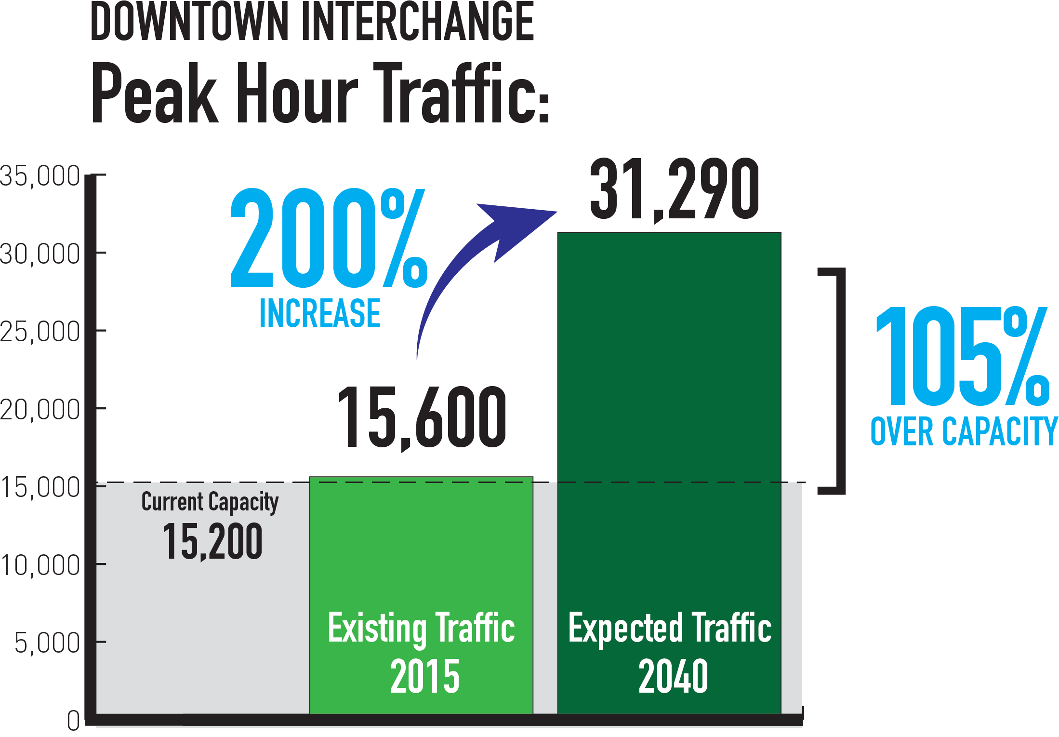
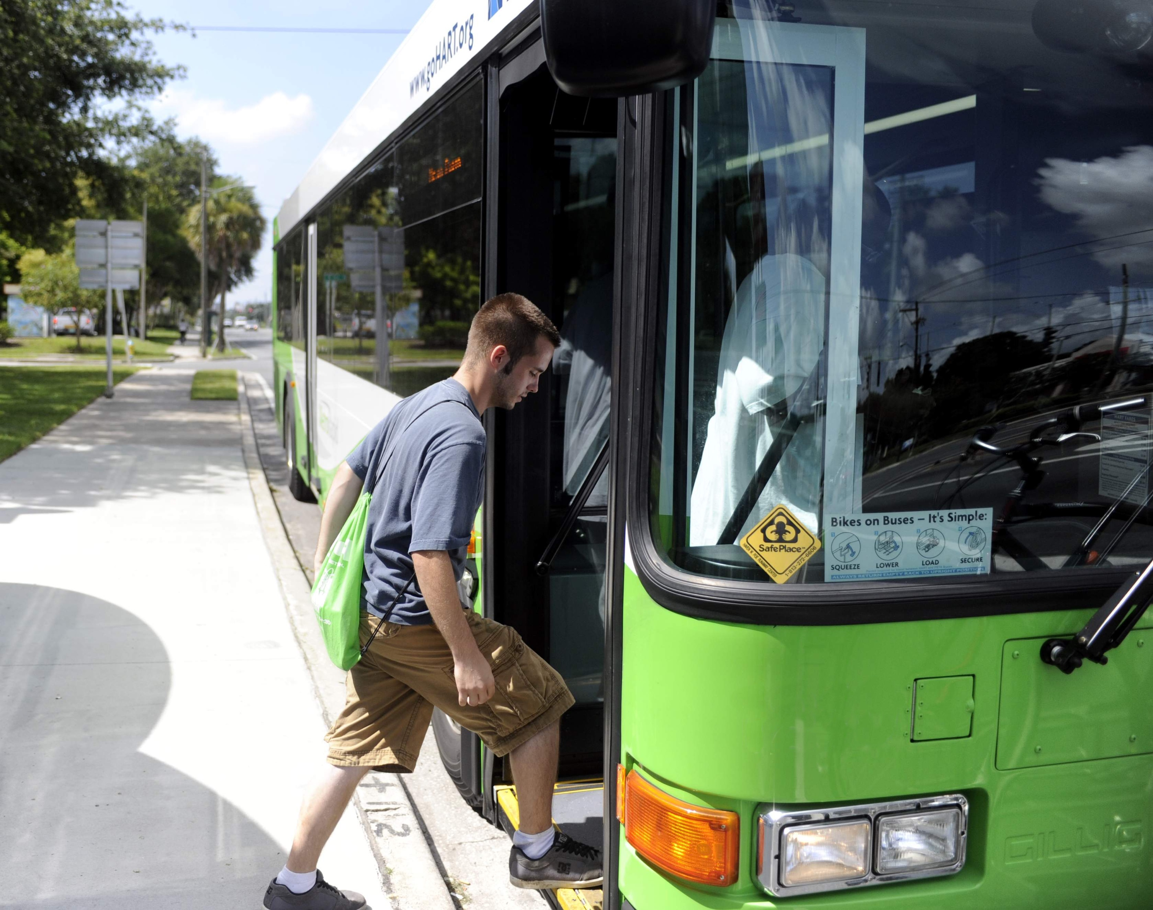

Our Traffic Problem:
Design
Demand
Choice
Consensus
Notes:
Our traffic problem is a combination of four problems:
We have a DESIGN problem. Our two major interchanges (Westshore and Downtown) are bottlenecks due to outdated designs. They need to be modernized.
We have a DEMAND problem. We’re the 5th fastest growing metro area in the U.S., with 58,000 people moving to Tampa Bay last year. Demand for our system is outstripping supply.
We have a CHOICE problem. We don’t have enough choices – both in terms of modes and routes. We need more multimodal choices, and we need more ways of getting around regionally and locally.
We have a CONSENSUS problem. We, as a community, haven’t been able to agree on a plan of action. We know people are tired of talking about transportation and transit. But we need to continue talking until we can reach consensus on a path forward.

Slide 26


Program Update
INTERSTATE IMPROVEMENTS

Slide 27
Tampa Bay Next isn’t about FDOT proposing a new plan…
It’s about working with the community to come up with a new plan together.

Slide 28



Community Engagement
Stakeholder Engagement
Regional and Local Outreach
Community Working Groups

Slide 29

6 Community
Working Groups
Public Involvement
Downtown/East Tampa
Westshore/West Tampa/South Tampa
Pinellas
North and West Hillsborough
East Hillsborough/Polk
Pasco/Hernando
Notes:
Working with all of you, we want to build a comprehensive, multimodal transportation system that achieves regional mobility and meets local needs. To do that, we need to have collaborative conversations both regionally and locally.
To achieve this goal, we created 6 Community Working Groups throughout Tampa Bay.
Downtown/East Tampa
Westshore/West Tampa/South Tampa
Pinellas
North and West Hillsborough
East Hillsborough/Polk
Pasco/Hernando

Slide 30


Workforce Development
Careers in Construction
DBE/SBE/MBE Opportunities

Slide 31

Howard Frankland Bridge
Adjusted design in response to community feedback
Accommodates future transit
Public Hearing – Fall 2017
Construction – 2019/2020
31
Notes:
In the fall of last year, there was a great deal of conversation about the Howard Frankland Bridge. As a part of the reset, we have adjusted the concepts in response to public comments and are planning to build 4 non-tolled lanes and 1 express lane in each direction. The new bridge would accommodate future transit and a public hearing is planned for Fall 2017. Construction is currently scheduled in 2019.

Slide 32
Transparency is key
There is not one silver bullet to solve transportation woes
What Did we Learn?
Balancing local impacts with regional mobility needs
Rebuilding trust is a slow process
Notes:
Branding is critical
Robust, current and clear information needs to be provided
The public needs a seat at the table to provide their wants/needs and challenges

Slide 33
Be open to community solutions/ideas
Relationships and attitude go a long way
What Did we Learn?
The process can be your friend.
Notes:
Branding is critical
Robust, current and clear information needs to be provided
The public needs a seat at the table to provide their wants/needs and challenges

Slide 34



THANK YOU
Christopher Speese
Public Involvement & Bicycle/Pedestrian Coordinator
(813) 975-6405
Christopher.speese@dot.state.fl.us
TampaBayNext
@TampaBayNext

