Slide 1
Stockpile in PrC
Help!!!!!!!

Slide 2
Stockpile
  Standard Specification and Settings in PrC
  Fields
  Pay Item Numbers
      Contract Item Number
      Project Item Number
  Item Recovery Percentage
  Recovery Date
  Pause
  Transaction Types and what triggers them (DWR)
  Correcting entries
      Item not posted on DWR
      Item posted on DWR
  Reference Material

Slide 3

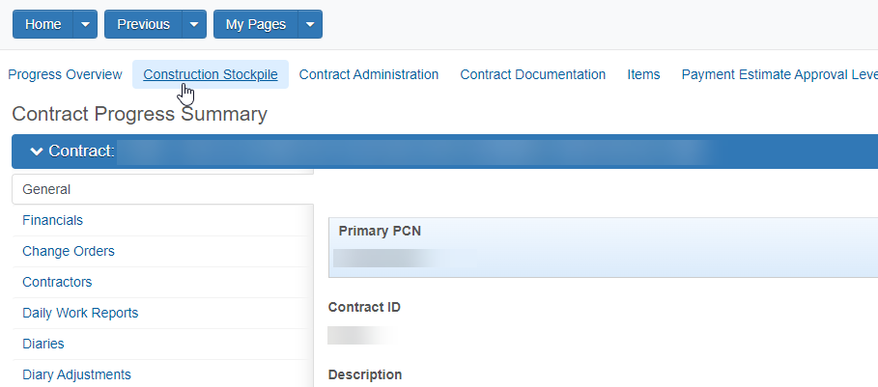
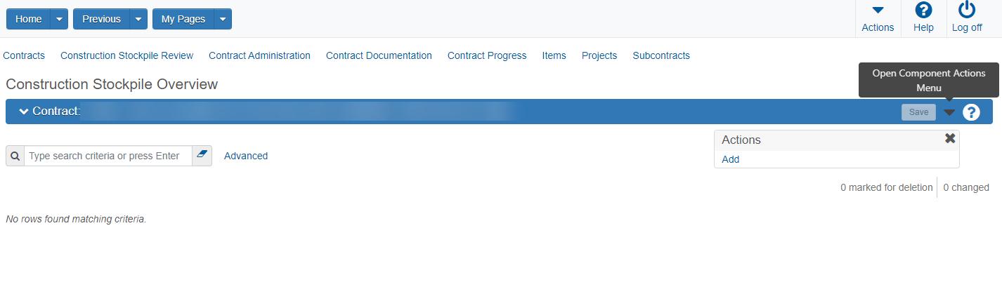



Slide 4
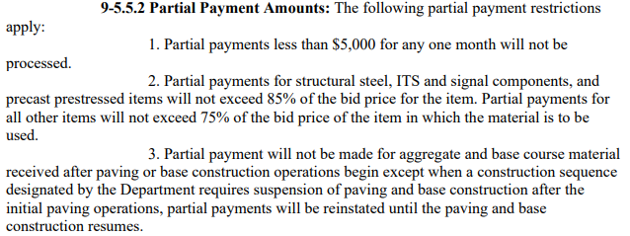


Stockpile Percentages…
  Standard Specifications 9-5.5.2
  Structural steel, ITS, and precast prestressed items not to exceed 85%
  Other items should not exceed 75%
  Percentage of the bid price is calculated manually for entry into PrC
  The “Recovery Percentage” is not tied to the Specification percentages
PrC Error: when the Stockpile Amount is greater than 85% of the unpaid balance on a project item number
PrC can't send an error for the 75% max. Ensure the allowable spec percentage is not exceeded
Notes:
If the bid amount is $100,000 and $50,000 has been posted or paid, only 75% or 85% of the balance is permitted to be stockpiled in PrC ($37,500 – 75%)
Tip: Use the Estimate Detail Report to calculate the percentage of the unpaid amount on the item. If you still get an error, check to see if a quantity has been posted on a DWR but not yet paid.

Slide 5
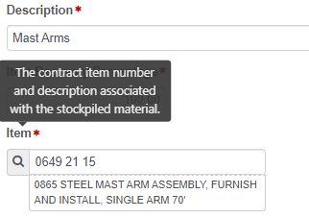
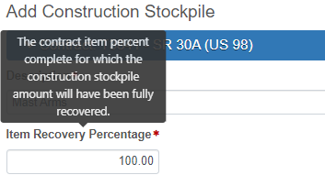
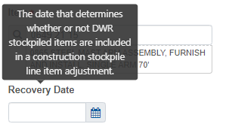
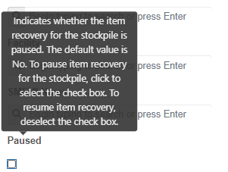
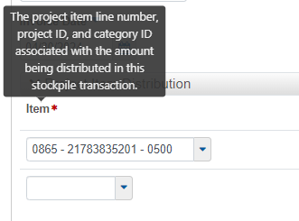
Stockpile Fields…
Contract Item Number
If set to 75%, Stockpile is fully recovered once Item is 75% completed
Date stockpile will begin recovering once item is posted on a DWR
If set to 100%, Stockpile is fully recovered once Item is 100% completed
Hover over any field name for a definition of the corresponding field entry
  Pauses Recovery Adjustments while selected
Project Item Number(s)
  When deselected, PrC Recovers for ALL PAUSED months on the NEXT Estimate
Notes:
Push the recovery date back, if the stockpiled items will not install for a few months
The Pause button will pause system generated recovery adjustments (negative adjustments) on estimates when the item is posted on a DWR. When the Pause is deselected, PrC will automatically recover everything during the paused period on the next estimate. PrC does not recalculate the recovery among the future estimate periods. This will cause a large negative adjustment in one estimate period. Do not select pause unless there is a real need. Remember to unpause to avoid an overpayment at contract completion.

Slide 6
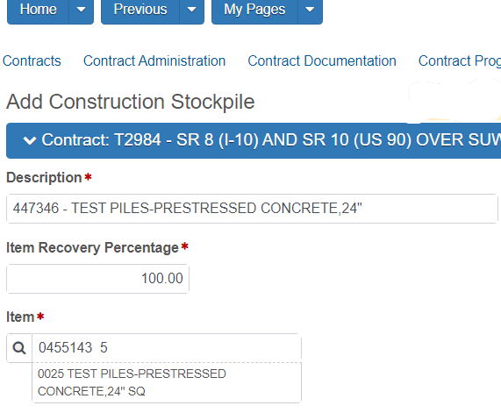
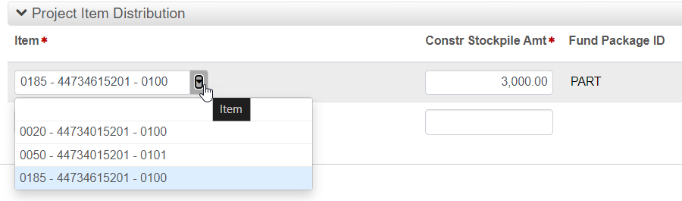
Stockpile Fields – Pay Item Numbers
Remember:
Project Item Distribution:
  Project Item Line Number – Financial Project – Category ID
      For Structures, each Bridge will have a different Category ID
  Selected when adding money to the stockpile transaction
Contract Item Number:
  Can have multiple Project Item Numbers tied to it
  Selected when the new stockpile record is created
Ensure the stockpile amount is being applied to the correct project(s). One or more projects can be entered on the same Stockpile.
Notes:
Tip: Use the Estimate Detail Report to calculate the percentage of the unpaid amount on the project item number. If you still get an error, check to see if a quantity has been posted on a DWR but not yet paid.

Slide 7
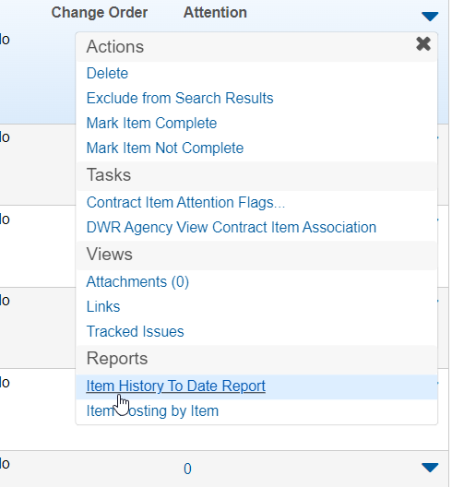
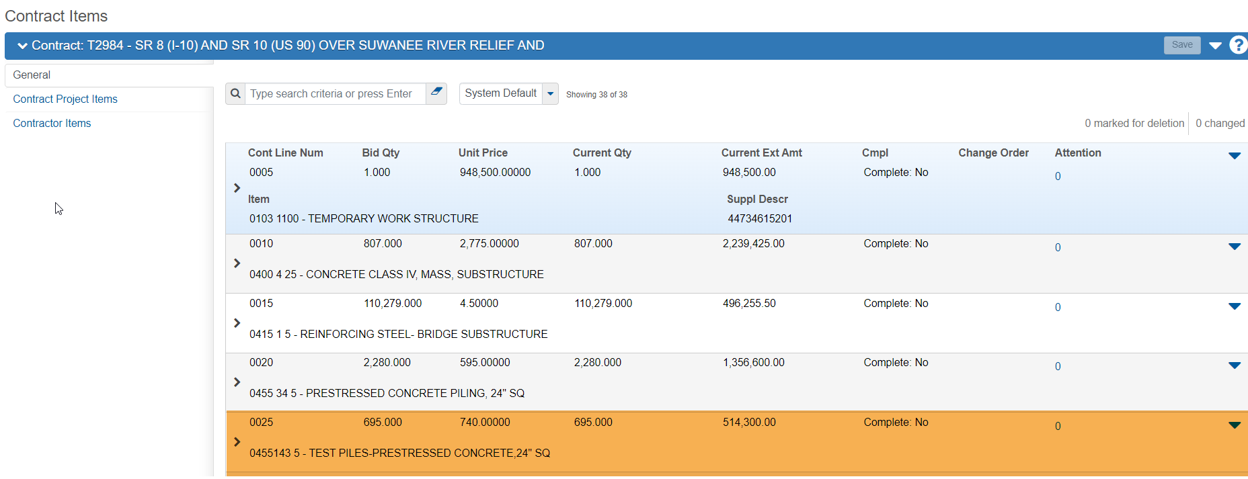
Stockpile Fields – Pay Item Numbers
Tip: Use the Item History To Date Report from PrC
Contract Progress > Items > General > Row Action Menu next to the Contract Item > Reports > Item History to Date Report

Slide 8
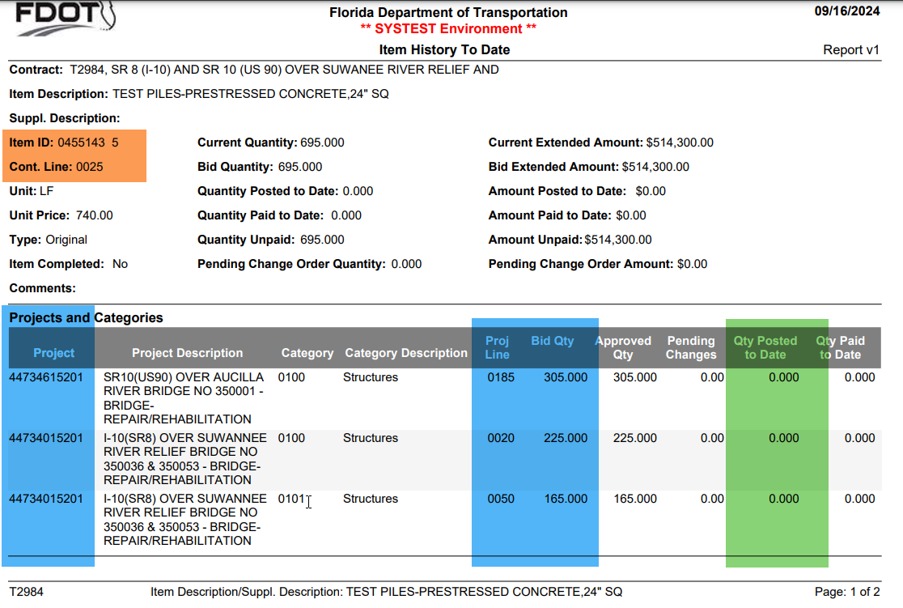
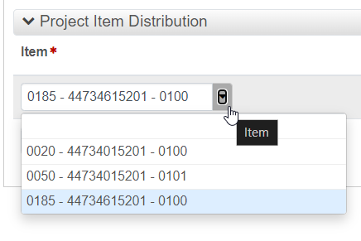
Stockpile Fields – Pay Item Numbers

Slide 9
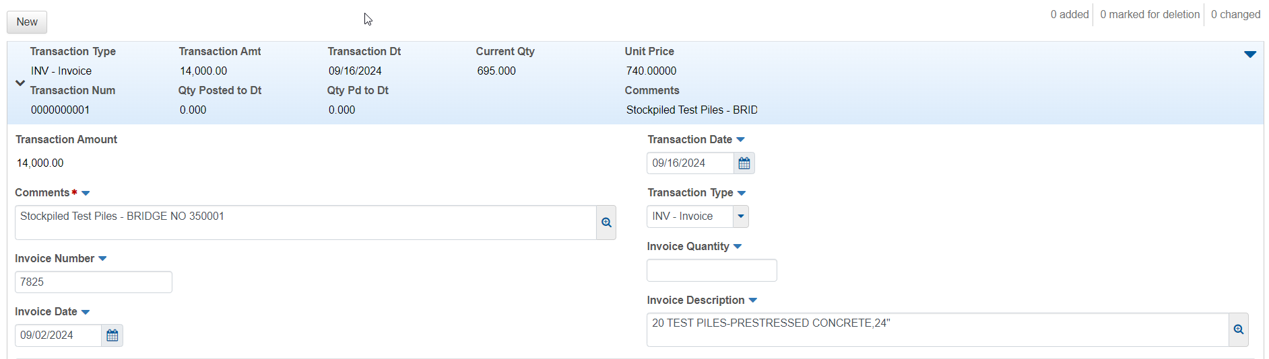
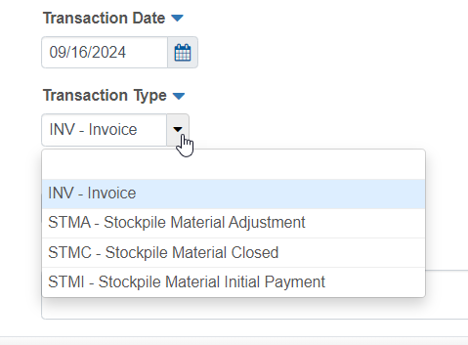
Stockpile Transaction Types
System Generated Adjustments in PrC
INV: Triggers the Initial Payment (STMI)
STMA: Positive pay item posting on a DWR triggers Recovery (negative STMA)
STMA: Negative pay item posting on a DWR triggers reversal of recovery (positive STMA)
STMC: Closes stockpile once contract is 100% complete

Slide 10
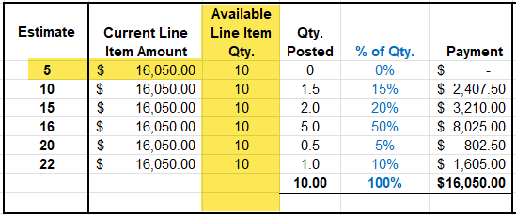
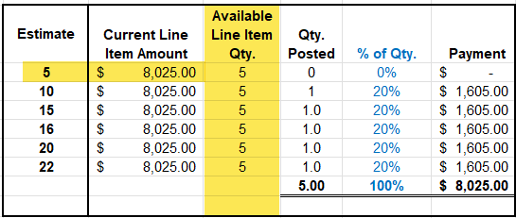
Stockpile Calculations
The Construction Stockpile Module uses Line Item Quantities posted to make calculations.
  When a Stockpile Transaction is entered into the module, the Line Item Quantity which is available (not posted on a DWR) will be the quantity from which calculations will be made.
    Example 1:
    Bid Qty. for Contract Line Item 0100 = Qty. 10
    Bid Amount = $16,050.00
    Qty. Posted = 0
    Example 2:
    Bid Qty. for Contract Line Item 0100 = Qty. 10
    Bid Amount = $16,050.00
    Qty. Posted = 5
vs
PrC Error: When the Stockpile Amount is greater than 85% of the unpaid balance
Notes:
If the bid amount is $100,000 and $50,000 has been posted or paid, only 75% or 85% of the $50,000 is permitted to be stockpiled in PrC ($37,500 – 75%)
Tip: Use the Estimate Detail Report to calculate the percentage of the unpaid amount on the item. If you still get an error, check to see if a quantity has been posted on a DWR but not yet paid.
PrC does not account for the Specification percentages. That percentage is manually calculated.

Slide 11
Stockpile Calculations
Keep In Mind:
The Invoice Transaction Date triggers the Initial Stockpile Material Adjustment (STMI) (initial payment for the material)
The Recovery Date controls when recovery will begin.
  The Recovery Date cannot be changed after the STMI is posted on a Pay Estimate
  A positive posting on a DWR will trigger a Stockpile Material Adjustment (STMA) on the next pay estimate
  A later Recovery Date will drive a larger STMA on a Pay Estimate
Item Recovery Percentage: The Contract Item Percentage completed for which the Stockpile Amount will be fully recovered.
  A lower Recovery % will drive a larger Recovery Amount
If set to 100%, Stockpile is fully recovered once Item is 100% completed
If set to 75%, Stockpile is fully recovered once Item is 75% completed
Notes:
STMA/recovery will only be posted on the estimate when the item is posted as installed on a DWR
If an item is posted in error, create a correction DWR to post the negative qty. The Stockpile Module will make the corrections automatically (positive STMA).

Slide 12
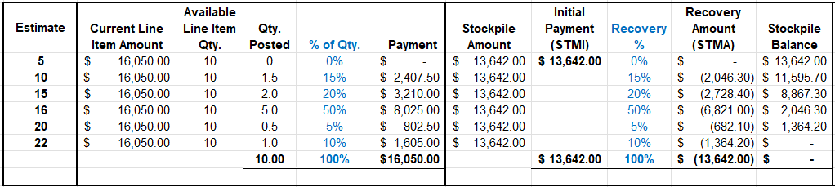
Stockpile Calculations
If set to 100%, Stockpile is fully recovered once Item is 100% completed
If Recovery % is 100%:
The Percentage of the Stockpiled Amount which will be recovered will be the Percentage of the Line Item Quantity which is posted on a DWR each month.
If Recovery % is less than 100%:
The Percentage of the Stockpiled Amount which will be recovered will be greater than the Percentage of the Quantity posted on the DWR. This will allow the recovery of the full Stockpiled Amount prior to 100% of installation.
If set to 75%, Stockpile is fully recovered once Item is 75% completed

Slide 13
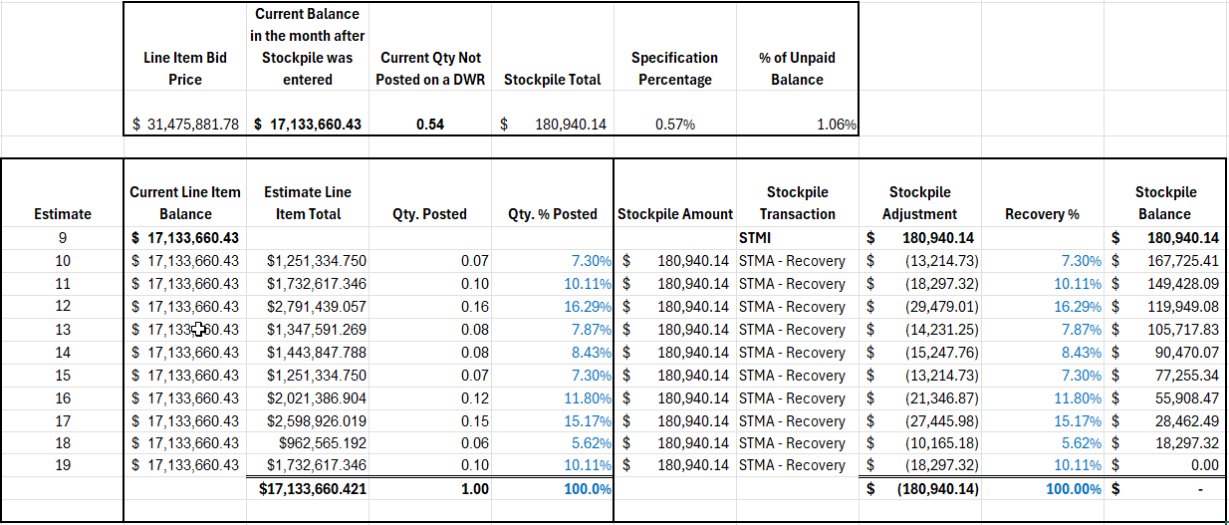
Stockpile Calculations – LS/DB
Recovery Percentage will be based on the Percentage of the LS Line Item Quantity which is posted on the DWR each month
A Stockpile Material Adjustment (STMA) will automatically post on the next pay estimate after the Recovery Date
Will recover on each estimate thereafter until LS Line Item is paid at 100% (or the Recovery %), because there will not be a pay item for the specific material stockpiled.

Slide 14
Stockpile Calculations – LS/DB
Keep In Mind:
The Invoice Transaction Date triggers the Initial Stockpile Material Adjustment (STMI) (initial payment for the material)
The Recovery Date controls when recovery will begin.
  The Recovery Date cannot be changed after the STMI is posted on a Pay Estimate
  A Stockpile Material Adjustment (STMA) will automatically post on the next pay estimate and will continue until the pay item is paid at 100% (or the Recovery %)
  A later Recovery Date will drive a larger STMA on a Pay Estimate
A lower Recovery % will drive a larger Recovery Amount
The LS Line Item may increase or decrease in cost as the project progresses
The amount/quantity posted on a DWR will decrease toward the end of the job

Slide 15
Recommendations
  DON’T PAUSE
  When deselected, PrC Recovers for ALL PAUSED months on the NEXT Estimate
Conventional Projects:
Set the Recovery Date as the Invoice Transaction Date
Set Recovery % to 100%
LS/DB Projects:
Set the Recovery Date to the Invoice Transaction Date – the stockpile will recover each month after
  Communicate with the Contractor. Yes, it will recover before installation begins, but the recovery amount (negative adjustment) will be lower on each estimate
  Recovery will be at a lower rate and prevent a negative estimate at the end of the job
Recovery Date set as expected install date: The system will compensate by increasing the recovery rate on future payments (larger recovery amount/deduction on estimate)
Set Recovery % to a value between 70% and 90% (will completely recover prior to the end of the job when payments may be lower)
Handling underruns: If the lump sum item underruns and is paid out fully before the stockpile is fully recovered, enter a negative transaction within the Stockpile Module to close out the remaining balance.

Slide 16

Correcting Stockpile
Stockpile records and transactions can be corrected in multiple ways, and will depend on…
if a stockpile adjustment has been posted/paid on an estimate and/or
if an item quantity has posted to a DWR
Situations and Examples are provided below and on the next 3 slides.
Initial Stockpile Transaction hasn’t posted to an estimate
Open stockpile record and edit as necessary

Slide 17
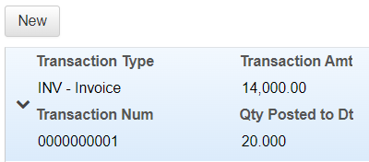
Correcting Stockpile
Initial Stockpile paid on an estimate and Initial Stockpile Payment was too high or too low
Open Stockpile Record and Add a new transaction for STMI and add negative or positive amount to correct the payment
      Example 1: Original SP = $10,000 and should have been $15,000.00
      Add a new STMI Transaction and Enter $5,000.00
      System will generate a STMI for $5,000.00 on the next estimate
      Example 2: Original SP = $10,000 and should have been $5,000.00
      Add a new STMI Transaction and Enter -$5,000.00
      System will generate a STMI for -$5,000.00 on the next estimate

Slide 18
Correcting Stockpile
Incorrect Contract or Project Line Number used for Stockpile and estimate has been approved
Negate the incorrect transaction with a new transaction (bringing balance to $0)
Contract Line Number and Project Number is wrong?
  Create a New Stockpile Record under the correct Contract Line Number
Only the Project Number is wrong?
  Add a positive INV Transaction for the correct Project Number
      Example1: $14,000 was placed in a stockpile record under Contract Line Number 0025 and Project Line Number 0185 (Bridge 350001). It should have been placed under Project Line Number 0020 (Bridge 350053)
      Add a new STMI Transaction for Project Line Number 0185 for -$14,000
      Creates a Negative STMI for -$14,000
      Add a new INV Transaction for Project Line Number 0020 for $14,000
      Creates a Positive STMI for $14,000
      New Estimate will have a Negative STMI and Positive STMI = $0.00
      ($0.00 estimate can be run for correction prior to next estimate period)
      Example 2: $14,000 was placed in a stockpile record under Contract Line Number 0020 and Project Line Number 0123 (Bridge 25001).
      It should have been placed under Contract Line Number 0025 and Project Line Number 0020 (Bridge 350053)
      Add a new STMI Transaction for Project Line Number 0123 for -$14,000
      Creates a Negative STMI for -$14,000 and
      Closes out the stockpile record for Contract Line Number 0123
      NEXT:
      Create a new Stockpile Record for Contract Line Number 0025
      Add a new INV Transaction for Project Line Number 0185 for $14,000
      Creates a Positive STMI for $14,000
      New Estimate will have a Negative STMI and Positive STMI = $0.00
      ($0.00 estimate can be run for correction prior to next estimate period)

Slide 19
Correcting Stockpile
Item quantity posted to a DWR was for the incorrect line item OR quantity posted is too high or too low
Correct the item quantity on a DWR (+ or -)
The system will generate a positive or negative STMA to correspond with the new posted installed percentage for the pay item
      Example: Error in quantity was posted to a DWR.
      50% of the pay item quantity/amount has posted on a DWR, but only 25% is currently installed
      Create DWR for -25% of the quantity/amount for the pay item
      System will generate a STMA for -25% of the stockpiled amount
A negative or positive Posting on a DWR will trigger an automatic positive or negative STMA on the next estimate

Slide 20

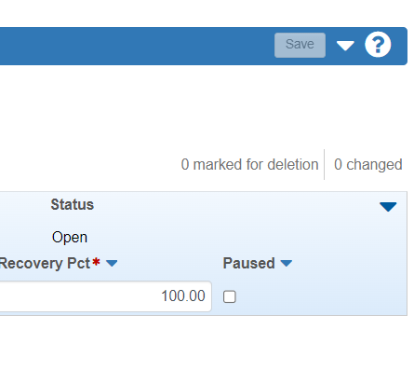
Closing Stockpile
Automatically closes when Contract completion = 100%
Close Manually when 100% of the stockpile has recovered
If a pay item is not 100% installed at the end of the contract, open stockpile record and create a new transaction using STMI
  Enter the negative amount for the balance of the stockpile
  The System will generate a STMI for a negative adjustment on the next estimate
  Manually close the stockpile
  Construction Stockpile Overview > Click Row Action Button for the corresponding Stockpile row> select Close Stockpile

Slide 21
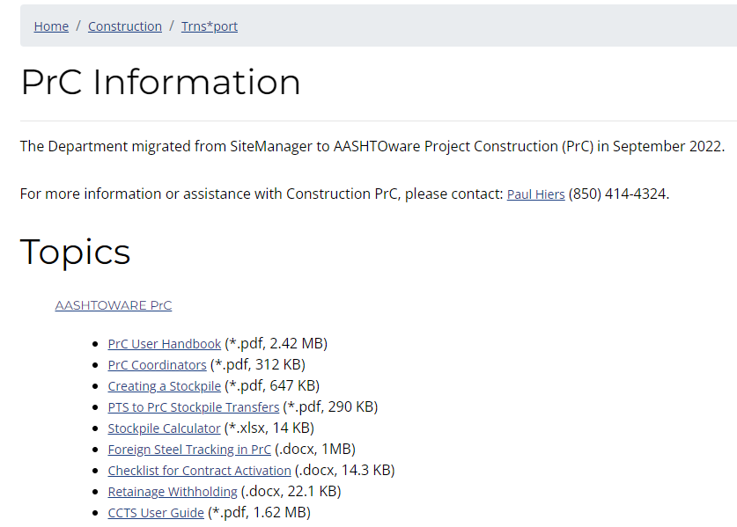
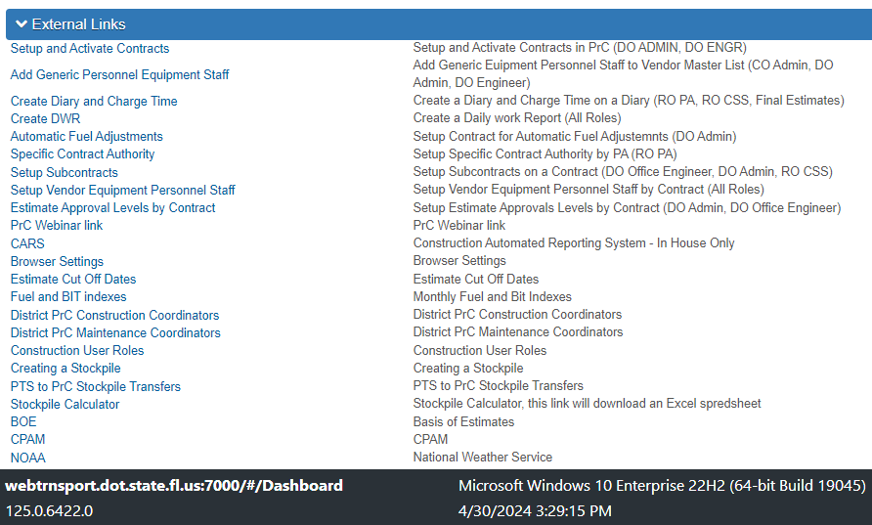
Stockpile Resources
CPAM 5.11.5
Spec 9-5.5
Resource Links in PrC and on SCO Website
PrC System Test – Test in PrC
https://www.fdot.gov/construction/trnsport.shtm

Slide 22
      I was today years old when I learned…
      Stockpile in PrC is (fairly) Easy!!
      Need more help?
      Contact…
      Your District PrC Coordinators
      SCO Systems Section
      SCO Final Estimates Office

