Slide 1
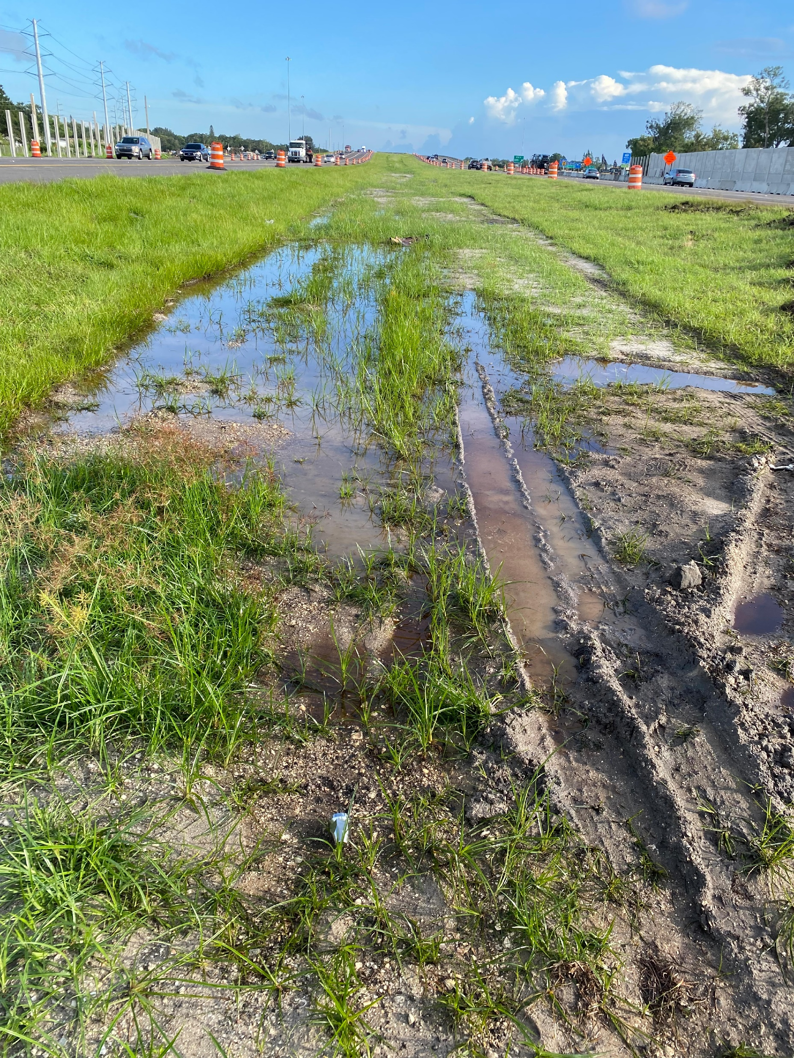
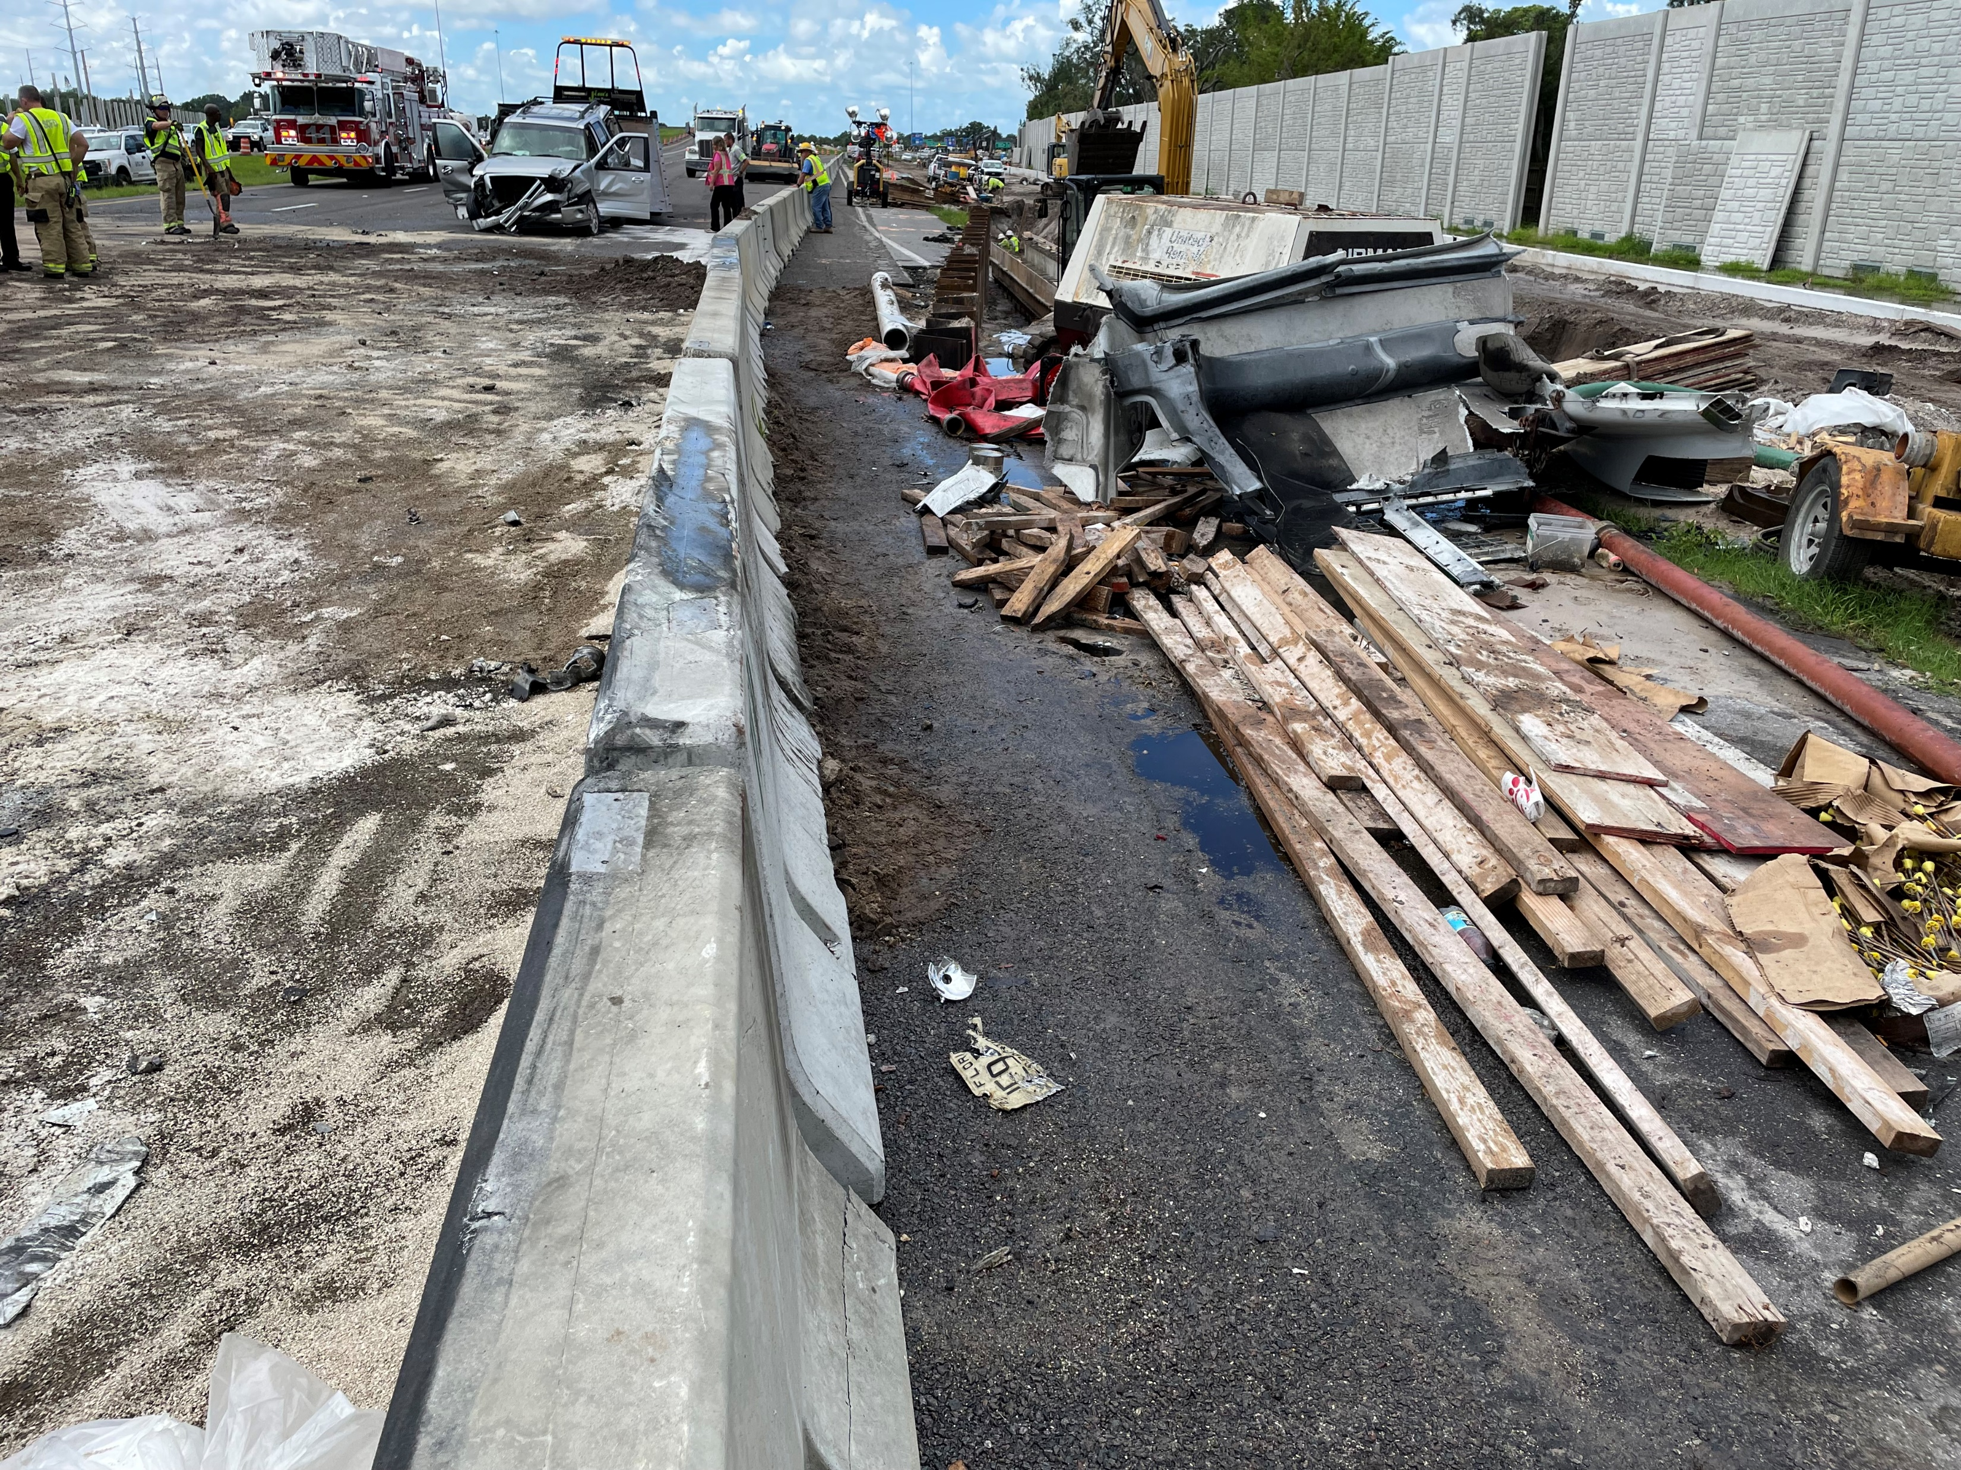
What is contamination?
Per the PD&E manual Chapter 20 - Contamination: Any physical, chemical, biological, or radiological substance present in any medium which may result in adverse effects to human health or the environment or which creates an adverse nuisance, organoleptic, or aesthetic condition in groundwater.
Types of contamination:
  Petroleum, most common.
  Asbestos, found on bridges and other structures.
  Other:
    Heavy metals
    Biomedical waste
    Hazardous waste
    Radiological waste
    Unknown

Slide 2
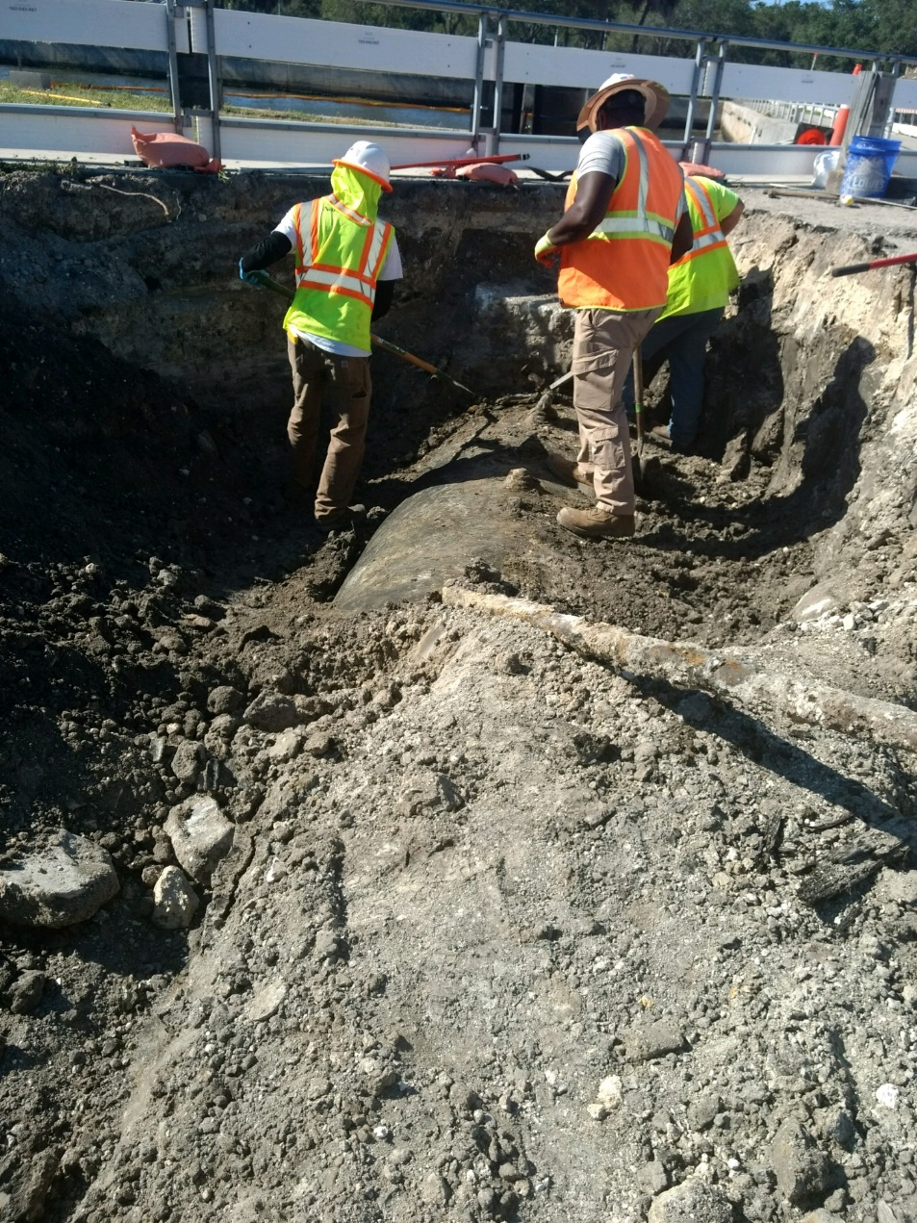
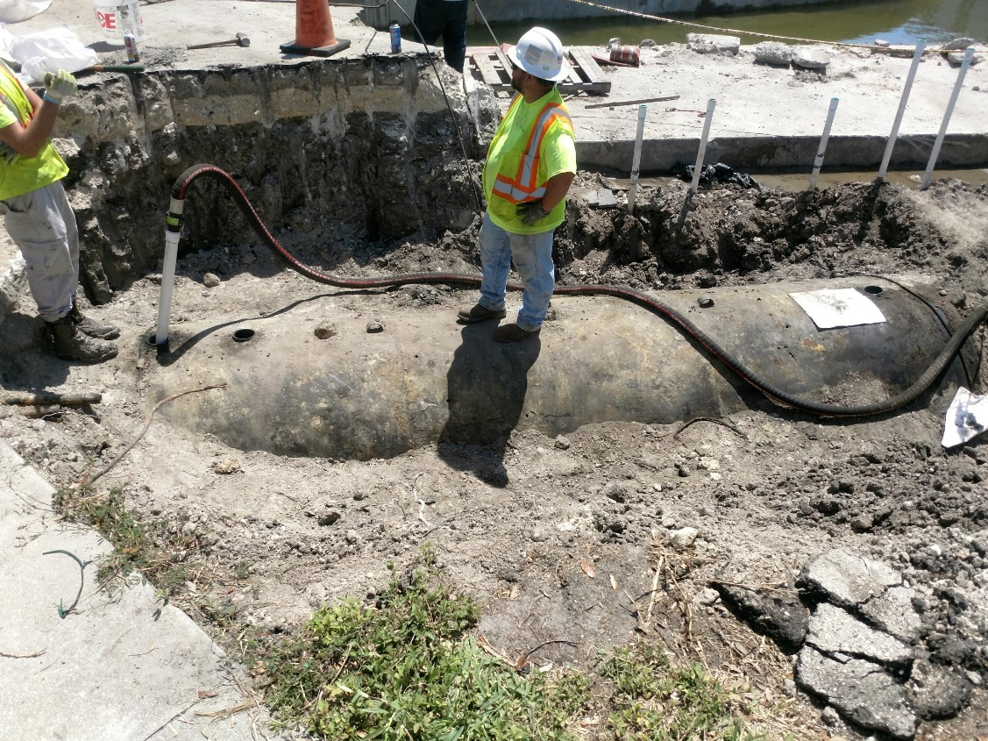
What to do if contamination is encountered?
Stop work in the area and notify the CEI/Construction Project Administrator.
The DCIC, Danielle ‘Nikki’ Vallandingham, will dispatch the district Contamination Assessment & Remediation contractor to assess, clean-up, and then properly dispose of contamination found.

Slide 3
Contact Information
D1 DCIC: Nikki Vallandingham
  Email: danielle.Vallandingham@dot.state.fl.us
  Phone #: 863-519-2375
Assistant Consultant to the DCIC: Christopher Forestt, Intertek PSI
  Email: christopher.forestt@dot.state.fl.us
  Phone #: 863-519-2503
Back up: Jeffrey James, Environmental Manager
  Email: jeffrey.james@dot.state.fl.us
  Phone #: 863-519-2625

