Slide 1

AASHTOWare Project Preconstruction
(PrP)
An Overview

Slide 2
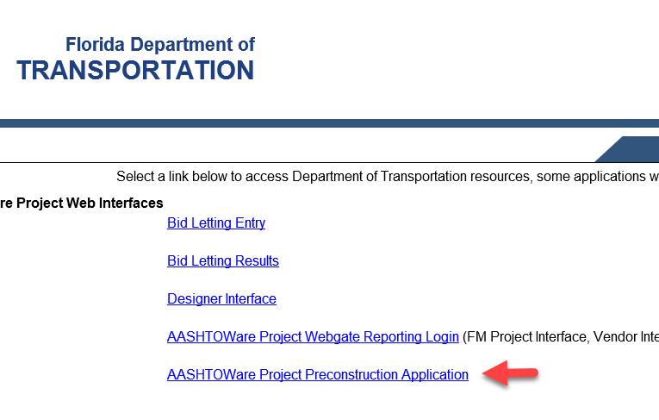
PrP is an online system for managing project information and automating processes during the early phases of a construction project – including proposal preparation, bid letting management, and project award.
This Application can be accessed via the FDOT WebGate.
https://fdotwp1.dot.state.fl.us/wTWebgateReports/WebGate.aspx

Slide 3
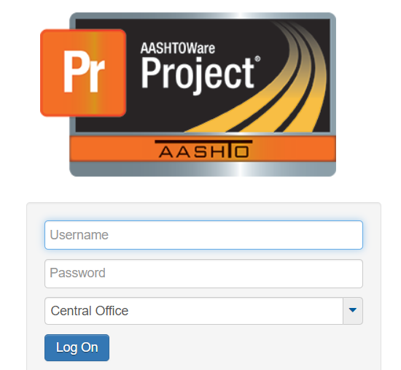
Logging On
The Individual must enter their User Name / Active Directory Password.
Choose the applicable District via the drop-down menu and Click “Log On”.

Slide 4
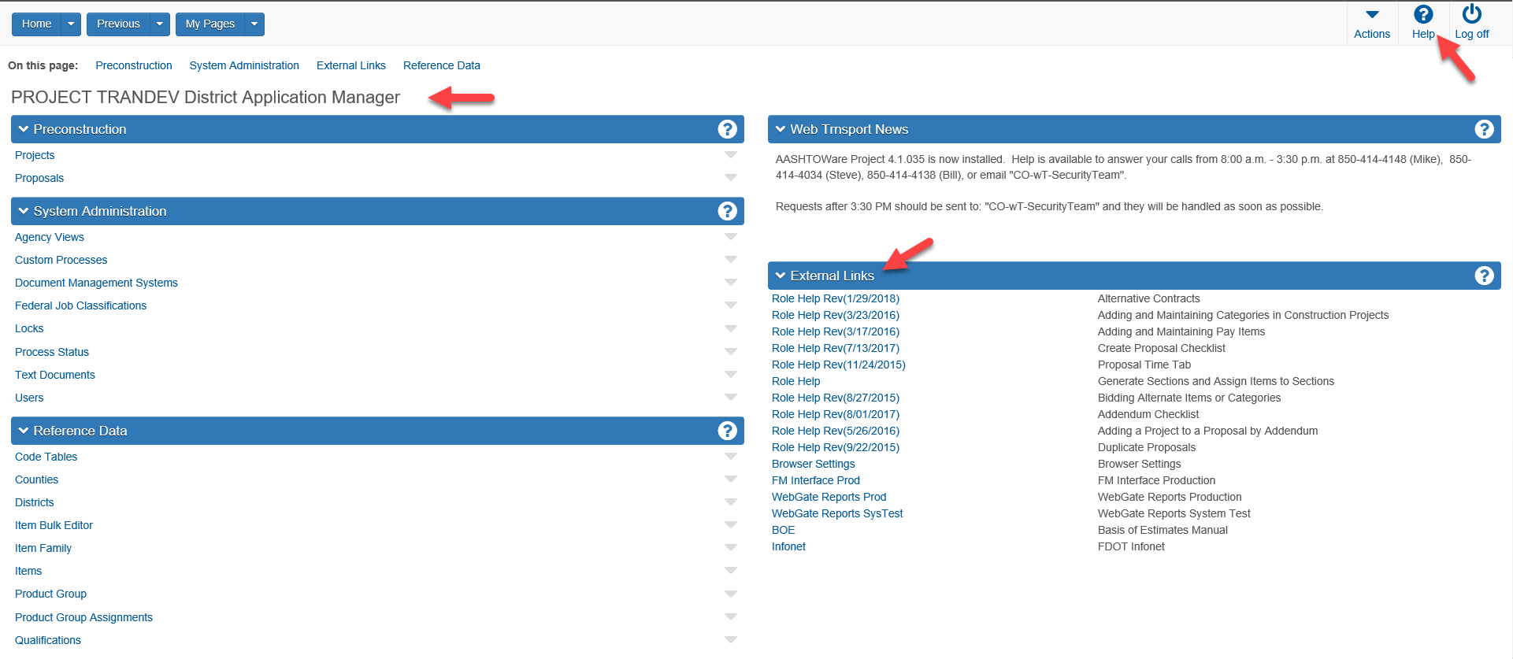

First time Users can get a good start with the Application by clicking the Help Icon and reading the Getting Started Sections: “Setting Up Your Browser”; “Navigating in AASHTOWare Preconstruction” and “Logging Off”.
Home Page
Please note in the example shown below, the Role the User is in when they logged in.
Additionally, The External Links Component on the Home Page has a number of useful Role Help “Snippets” specifically designed to assist Users to perform tasks in their Role within PrP.

Slide 5
PrP Knowledge Base
Navigation
Contents by Section Name
The subject matter in this presentation is arranged in the order it occurs within PrP.
It may be reviewed in sequence by clicking on the “Next Slide” (▶️) or “Previous Slide” (◀️) symbols on each slide.
The User may also jump to any specific section listed on the right by clicking on the
Section Name.
When finished, a “Return” button will bring you back to this page.
Creating, Accessing & Updating a New Project in PrP
Pay Items
Creating a Proposal
The AutoGen Process
Alternative Bidding
Final Review – District Let
Final Plans – Central Let
Contracts Administration
Addendums
Reports Module
WorkFlows and Phases

Slide 6
Working with New Projects in PrP
This section addresses the following activities
Creating and Verifying New Projects
Accessing Projects within PrP
Updating Projects within PrP

Slide 7
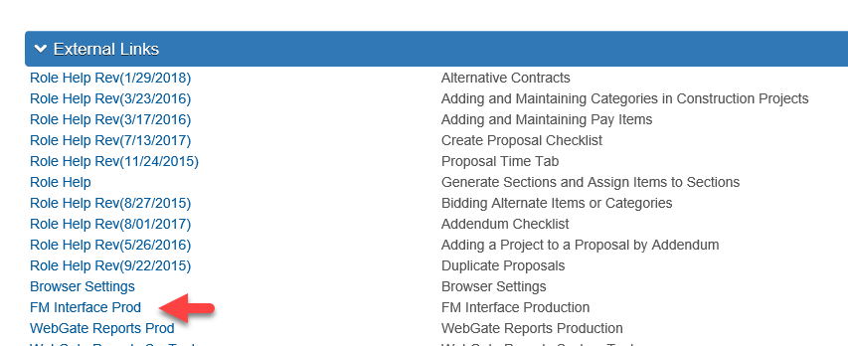
This interface is accessed via the WebGate Reporting Screen which can be reached from within the PrP Home Page/External Links Component if using the Chrome Browser as shown below or via the AASHTOWare Project, (AP) WebGate/WebGate Reports Login referenced previously.
Bringing a new Project into PrP
The FM Project Interface allows Users to bring Projects into AASHTOWare Project Preconstruction, (PrP).
Either method will access the WebGate Reporting Login Screen

Slide 8
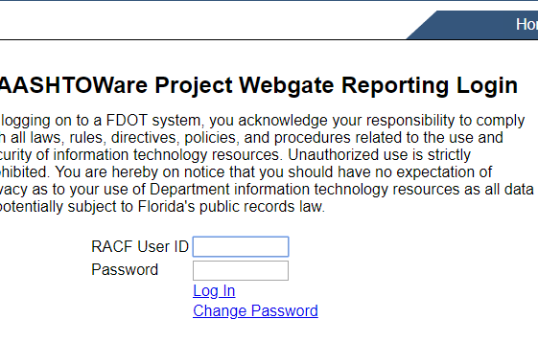
WebGate Reporting Login Screen
Enter your User ID and RACF Password in the fields as required.
Once the User is logged into the WebGate Reporting page, the steps to run this interface are as follows:

Slide 9
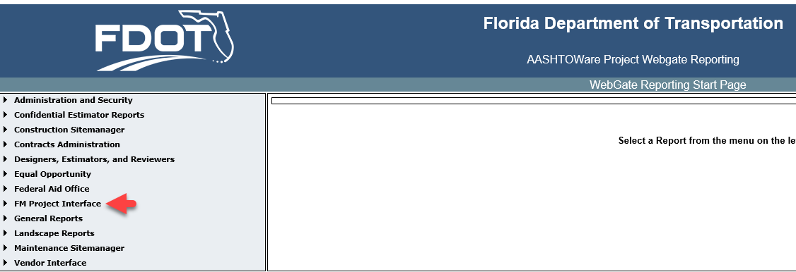
WebGate Reporting Start Page
Start by clicking on the FM Interface section located on the left-hand side of the screen pictured below. The hyperlink will open for the FM Interface. ­­
The FM Project Interface window will open.

Slide 10
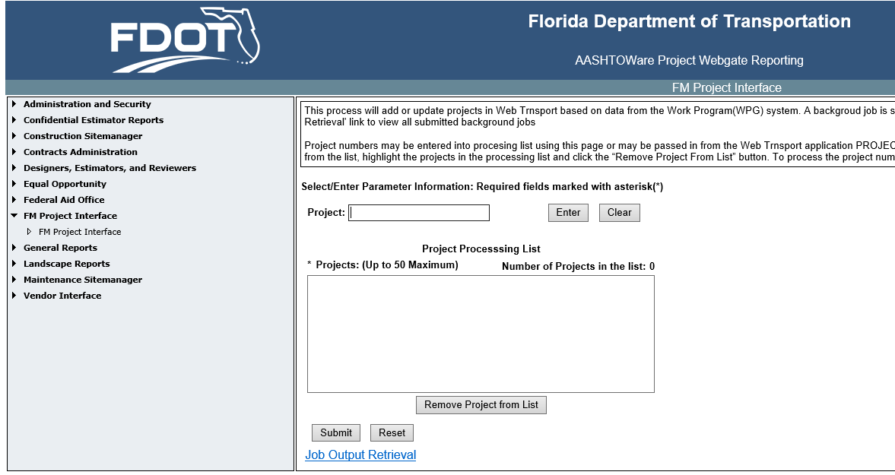
FM Project Interface
Enter each Financial Project Number, (FPN) requested and click enter to transfer the project ID from the original entry box to the Project Processing List.
If a project ID not entered correctly or is unnecessary, it can be removed by clicking CLEAR, (Note the Maximum Project Number Capability).
If necessary - Click RESET to remove all the projects and start anew.
Once all the desired Projects have been loaded to the “Project Processing List”, click SUBMIT to run the process.

Slide 11
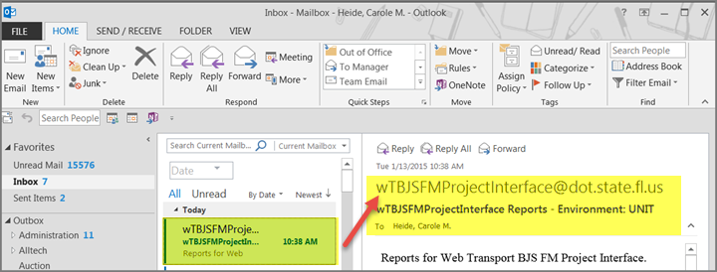
Accessing the Report
The Job Output Retrieval button can be clicked to access the report. An email notice will also be delivered to the User via Outlook, (Recommended Process).
Check the Outlook INBOX for the Notice. When it arrives, click on the notice to open it.
When the email notice is opened, it will contain a message similar to that below:

Slide 12
Accessing New Project within PrP
Go back to PrP Home Page and Click Projects
Key in FPN of the Project, (3-4 Characters will start a Project List that will condense with each keyboarded additional character)
Click on the Project Number when it comes to the screen as a link and it will open to the Project Summary screen.
There is a hierarchical relationship involving Proposals, Projects, Categories, and Items. Projects are subordinate to Proposals. Categories are subordinate to Projects. Pay Items are subordinate to Categories.

Slide 13
Categories
When you create a project in PrP using the FM Interface, that project will receive an initial set of standard categories for construction projects.
0100 STRUCTURES 0550 INTELLIGENT TRANSPORTATION SYSTEM
0200 ROADWAY 0600 LANDSCAPING/PERIPHERAL
0300 SIGNING 0700 ARCHITECTURE
0400 LIGHTING 0800 UTILITIES
0500 SIGNALIZATION 0900 MASS TRANSIT
In many cases there will not be a need to add other categories.
However, if the project contains more than one bridge or structure, additional categories in the 01XX area will be required.
Each bridge or structure will require a separate category and they are to be numbered 0100, 0101, 0102, etc.

Slide 14
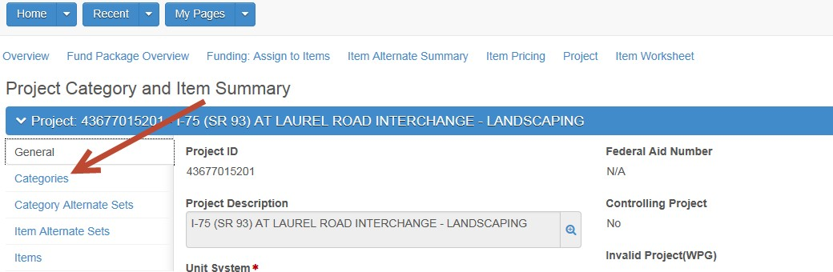
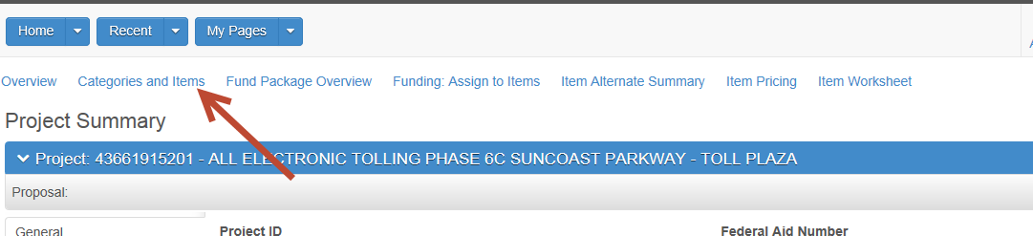
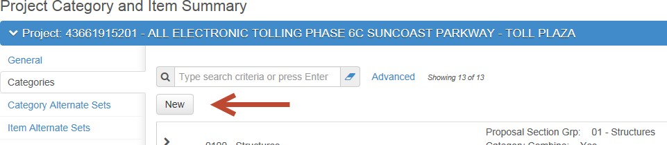
Adding Additional Categories
To add an additional category, go to the general tab of the project and click on the “Categories and Items” link above the blue banner.
Then click the “Categories” Tab in the panel on the left
At the Categories Tab, click “New”

Slide 15
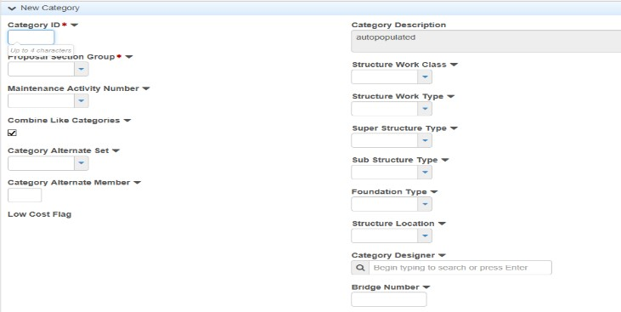
Adding Additional Categories Contd.
A Category Detail screen will appear.
Populate any field marked with the “*” symbol.
This symbol indicates they are required.
In this example, Category ID and Proposal Section Group, located on the top left, are required
The Category Description field will be auto-populated by the system when you save your work.

Slide 16
Special Requirements for Structures Categories
Each structure on a project is to be identified by a separate Category.
If you are adding a structures category, six additional Type Fields are required. They are:
  Work type
  Sub-structure
  Super structure
  Foundation
  Location
  Designer
If these six are not known initially, they may be populated with ZZZZ, as seen here, until they become known.

Slide 17
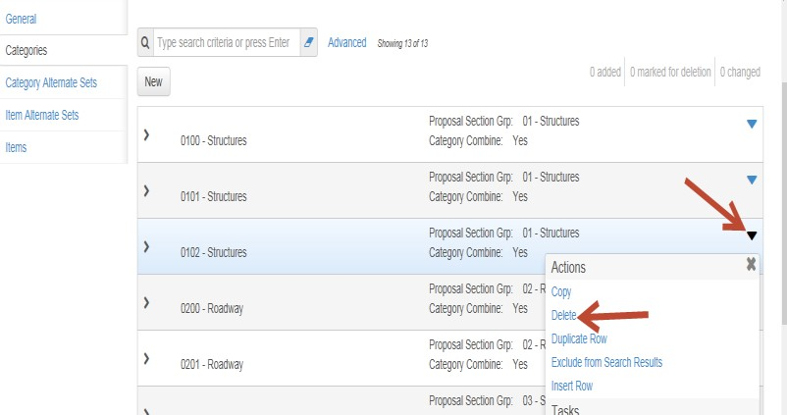
Deleting a Category
If you need to delete a Category, click the Action Button on the right side of the screen at the row to be deleted, then click Delete
Save your work by clicking the Save button on the right side of the blue banner.
The category will be removed from the screen and from the PrP database when the project is saved. Continue deleting categories that are not required.
You may keep "empty" categories in the database while you are creating a project, but you will not be able to run all reports and processes with these "empty" categories. Prior to processing a proposal, delete all unneeded categories.
After Categories are in place Pay Items may be added to them.
Return to
Knowledge Base

Slide 18
Pay Items
This section addresses the following activities
Adding and Maintaining Pay Items
Changing Item Quantities or Deleting Pay Items

Slide 19
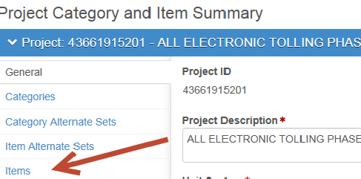
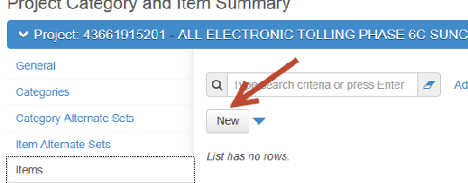
Adding & Maintaining Pay Items contd.
After Categories are in place Pay Items may be added to them.
PrP offers 4 methods of adding Pay Items. They are as follows:
Option 1: Using the New Project Item screen
On the General page of the Project, click on the “Items” Tab.
Click the “NEW” button

Slide 20
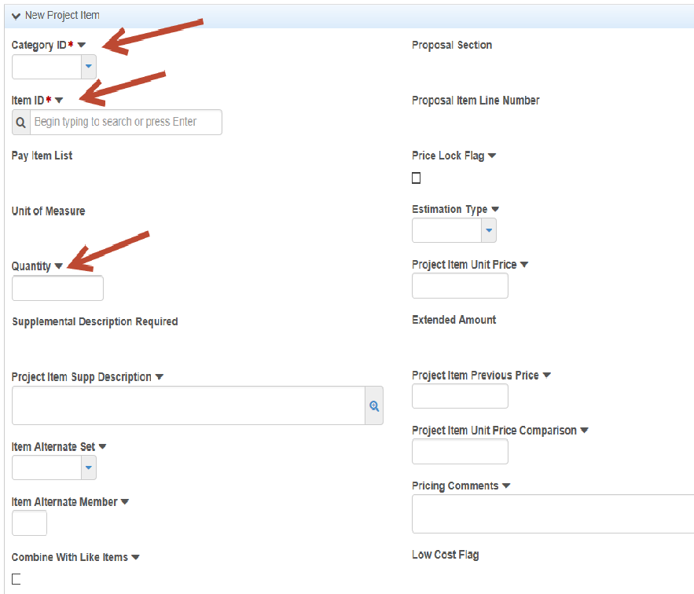
Adding & Maintaining Pay Items Contd.
The New Project Item screen will open.
Note that Category ID * and Item ID * (Pay Item Number) are required fields.
These two fields assist in maintaining the hierarchical relationship.
Of the 29 fields displayed on this screen only three are needed initially. The two required fields and the Quantity.

Slide 21
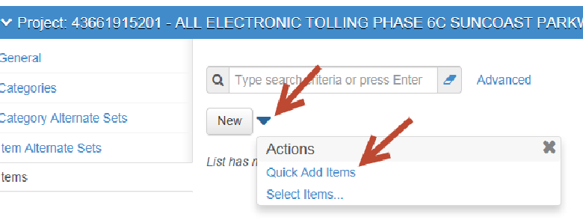
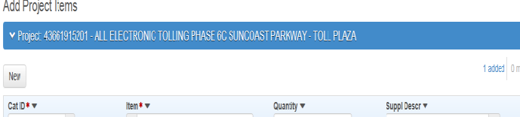
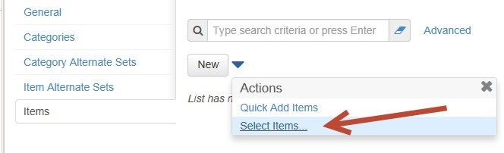
Adding & Maintaining Pay Items contd.
Option 2: Using the Quick Add Items method
Instead of Clicking “New” noted above, click the blue triangular Action Button, then click Quick Add Items.
A screen appears containing only four fields, the two required fields plus Quantity and Supplemental Description.
Enter the category via the dropdown and enter the Pay Item by typing its value.
Enter an appropriate Quantity and a Supplemental Description if appropriate.

Slide 22
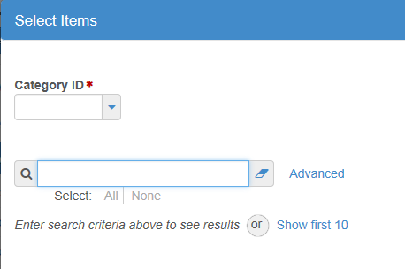
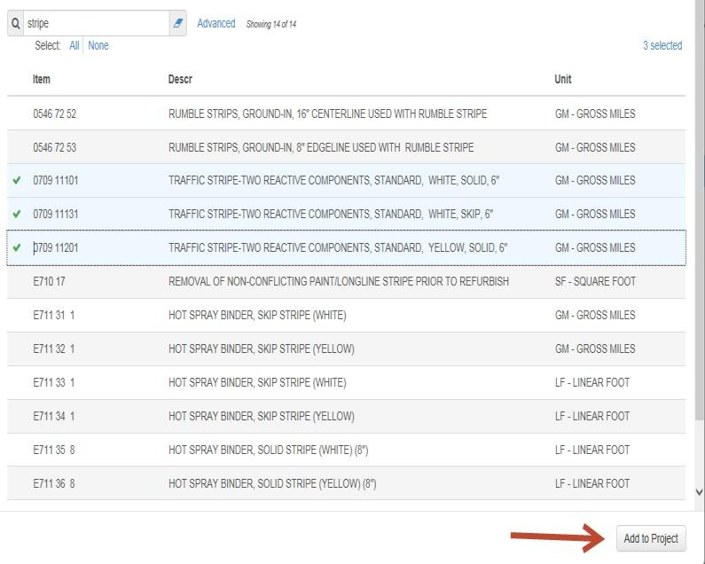
Adding & Maintaining Pay Items contd.
Option 3: Using the Select Items process
Click the blue triangular Action Button, then click Select Items.
This screen will appear.
Select the category using the dropdown.
Enter a fragment of the pay item number or description
An example would be select Category 0200 and you enter ‘Stripe” as a description fragment.
Highlight the rows needed and a green check mark appears.
When you have checked all that are wanted, click Add to Project at the bottom of the screen. All checked items will be added to the Project and Category. Repeat this step for other items and categories as needed.

Slide 23
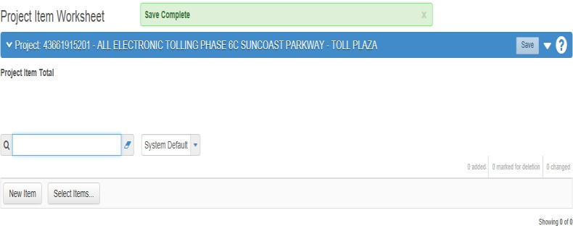
Adding & Maintaining Pay Items contd.
Option 4: Add Items in the Item Worksheet
Click the link “Item Worksheet”.
This screen will appear.
In this particular example no items pre-exist.
Items may be added one of two ways.
Click on the New Items box to add items one at a time… OR:
Click on the Select Items box to select several items at a time.

Slide 24
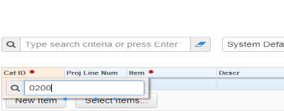
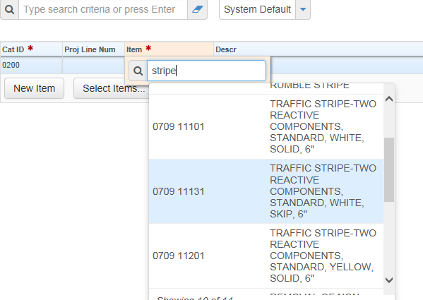
Adding & Maintaining Pay Items contd.
Option 4: Item Worksheet - Using the New Items Option
The New Item choice yields this screen.
Double Click the orange colored Cat ID field and a small window will pop out.
Enter the value of the desired Category.
Click enter on the keyboard and it will be saved.
Double Click on the Item* field and another small window will pop out.
Enter a partial pay item number or partial description and a list will appear.
Choose the appropriate value.

Slide 25
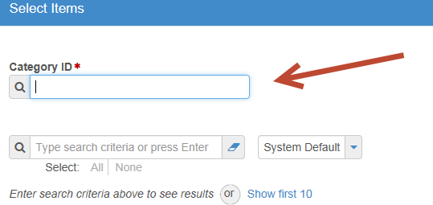
Adding & Maintaining Pay Items contd.
Option 4: Item Worksheet - Using the Select Items Option
Choosing the Select Items button will result in this window with two input areas.
For Category ID * enter the Category Number.
Alternatively, click on the box and press Enter on the keyboard. Pressing enter will produce a list window of all categories on the project.
Select the one that is needed.
Similarly, for the Item field, type part of the ID or description and a short list will open.

Slide 26
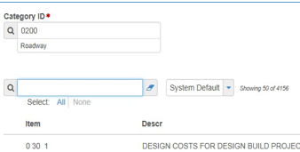
Adding & Maintaining Pay Items contd.
Option 4: Item Worksheet - Using the Select Items Option contd.
Choose the items needed and then click Add to Project at the bottom right corner of the screen and all items checked will be entered.

Slide 27
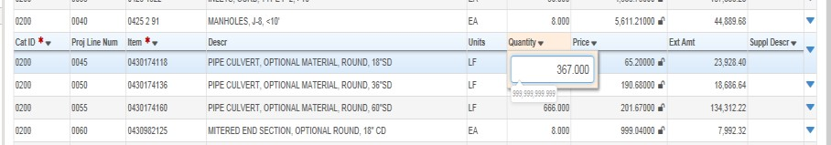
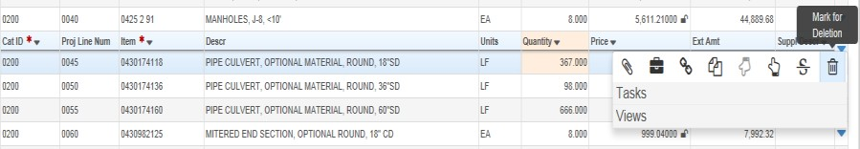
Adding & Maintaining Pay Items contd.
Changing Item Quantities or Deleting Pay Items.
Begin at either the Project Item Worksheet or the Item List at the Categories and Items Tab.
Project Item Worksheet
To change a Quantity go to the row of interest.
Double Click the Quantity field and a window will pop out. Change the value as necessary.
Click save on the blue banner. The change is complete.
To delete a Pay Item, click the blue triangular action button on the right edge of the row of interest. A window will pop out.

Slide 28
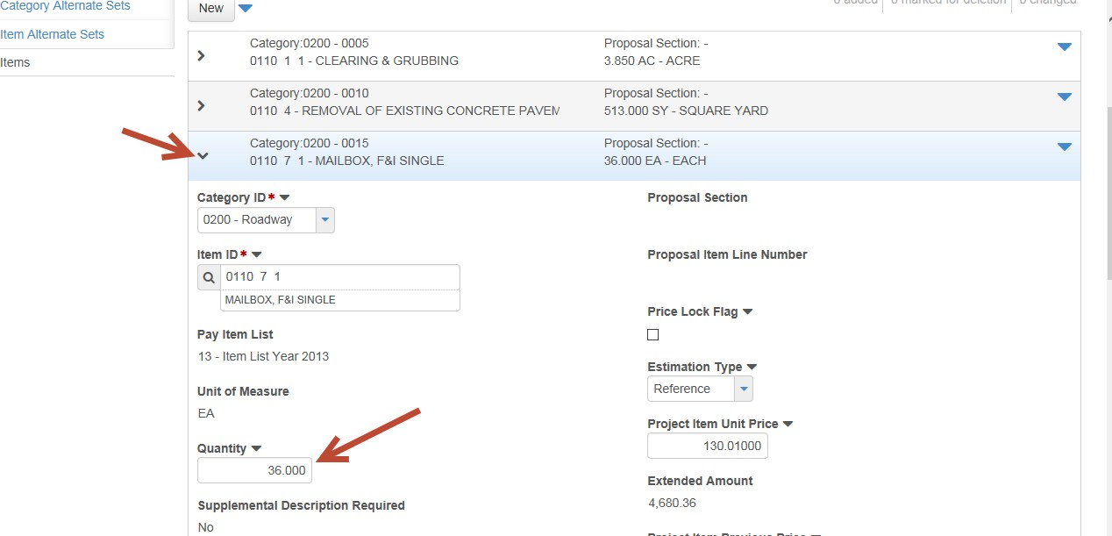
Adding & Maintaining Pay Items contd.
Item List – Changing Quantities
From the Item List on the Categories and Items tab…
Click the arrow on the left side of the row of interest and the detail will display
Click in the Quantity field and change the value as appropriate.
Click Save on the blue banner to save the work.

Slide 29
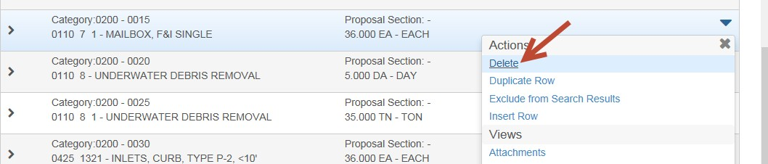
Adding & Maintaining Pay Items contd.
Item List – Deleting a Pay item
To delete a Pay Item,
Click the blue triangular action button on the edge of the row.
Click Delete in the pop out window.
Click Save in the blue banner to save the work.
After the project is associated to a proposal, the process Auto Generate Sections should be run after making item changes in any of the projects. This process is covered in detail later in this Overview.
Notes
The Designer Interface may also be used to update Categories, Pay Items and Quantities. This functionality is covered in a separate training module.
The FM system will refresh the Project nightly until the Proposal/ Contract execution.
Return to
Knowledge Base

Slide 30
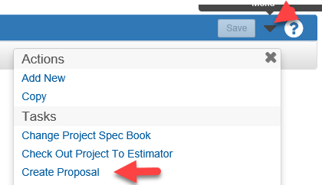
Creating a Proposal
When you are ready to create a proposal in PrP, follow these steps.
Click the triangular Action Menu at the right side of the projects in the Project List Window, or at the right side of the blue Project banner if the project is open.
Click on “Create Proposal from Project”.
Note that when the Proposal is created several fields will be populated with data from the controlling Project Fields.
In the Proposal ID field replace the Financial Project Number with the Proposal Id that has been assigned the work.

Slide 31
Creating a Proposal contd.
In the Proposal Description field, click on the magnifying glass to open the field into a larger window.
Highlight all of the text in the field, and, using the Ctrl and C keys copy all of the text.
Close the window.
Paste the information into the Proposal Long Description field using the CTRL, C and V keys. Descriptive information on project limits, construction limits and intent of the project are to be added here - (See Cautionary Note regarding characters in Proposal Description).
Return to the Proposal Description field and click the magnifying glass again.
If the text in the Proposal Description field exceeds 60 characters, edit the description so that it contains less than 60 characters.
PRP Version 3.5

Slide 32
Creating a Proposal contd.
* In the field Proposal Type, choose a value from the drop-down list.
* In the field Contract Type choose a value from the drop-down list.
* In the field Contract Work Type choose a value from the drop-down list.
Review the other proposal fields and if any need to be populated enter appropriate values.
Click the Save button on the right side of the blue banner.
The Proposal has been created and saved.
* Sources for this information include Project Plans, Specs., Work Program Crosswalk and FDOT Project Mgr.
PRP Version 3.5

Slide 33
Cautionary Note
Please insure the Proposal Description field contains no more than 60 characters. This requirement will continue until both Site Manager and DSS are converted to web based modules.
Note: Please be advised there may problems with apostrophes, ampersands (&), multiple spaces, and single or double quotes in text data copied into fields like the Proposal Long Description.
When encountered, the User can correct directly in the field after pasting the text; keyboard the characters directly; or consider copying the text into a Notepad text file first and then from the Notepad file into Preconstruction.

Slide 34
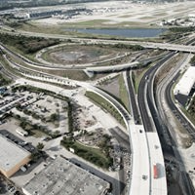
Creating a Proposal contd.
To verify that there are no loose ends in your new proposal run a proposal validation.
  Click on “Proposal”
  Click the triangular Action Menu at the right side of the blue banner
  Under TASKS, click “Validate Proposal”
A screen will appear that says the proposal and strung project(s) are valid, or if not, it will list the deficiencies.
Correct the deficiencies.
Return to
Knowledge Base

Slide 35
The AutoGen Process
All Proposal and App Managers MUST PERFORM the “Auto Generate Sections” and recommended “Assign Items to Sections” processes after any Action listed below is performed:
Attaching a Project(s) that has Items and Quantities to a Proposal
Creating a Proposal for a Project that has Items and Quantities
Any changes to Items and Quantities via Designer Interface
Any changes to Items and Quantities within web Preconstruction including during the Addendum process
Omitting this step runs a risk that Proposal level data not match the Project level data which will cause problems with other Applications reading web Preconstruction data as well as System functions and processes “downstream.”

Slide 36
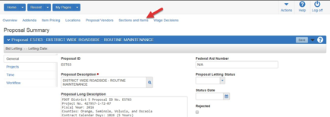
The Auto Generate Process Contd.
From the Proposal Summary screen:
Click on Proposal ID, then
Click on the Proposal’s quick link “Section and Items”.

Slide 37
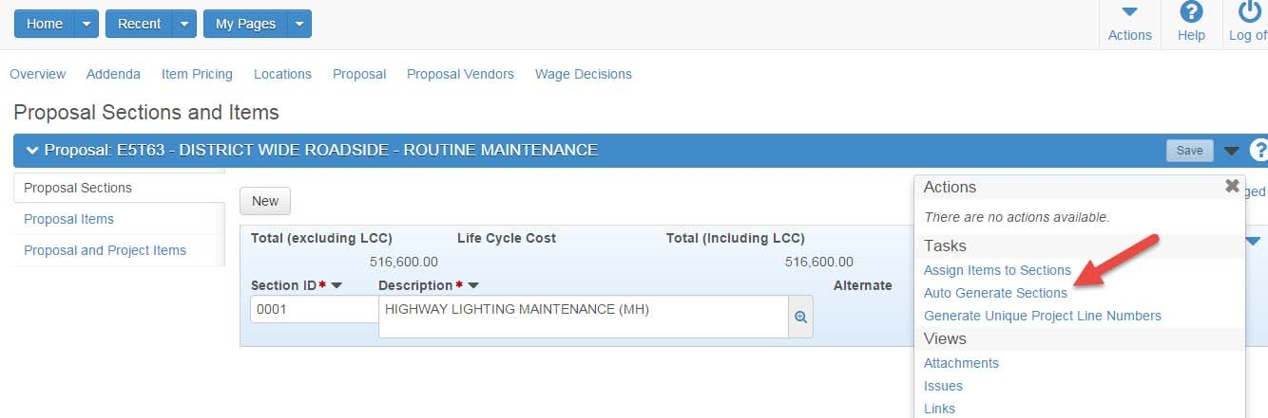
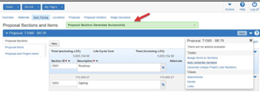
The Auto Generate Process Contd.
From the Actions menu (right side arrow):
Select the process “Auto Generate Sections”.
The system has completed the “Auto Generate Sections” process when the message “Proposal Sections Generated Successfully” shown below appears.

Slide 38
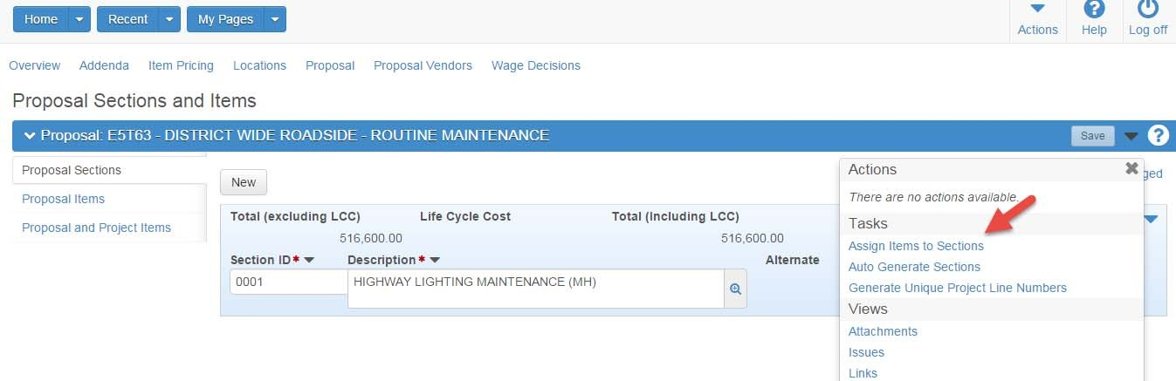
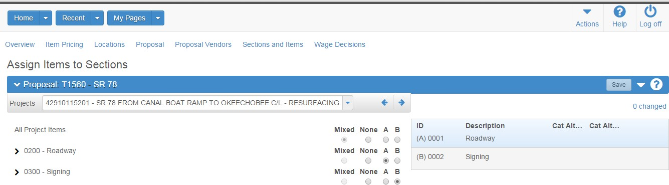
Assigning Items to Sections
The recommended next step is to run the “Assign Items to Sections” process by Clicking on that Quick Link.
The “Assign Items to Sections” process is complete when this screen appears.
Return to
Knowledge Base

Slide 39
Alternative Bidding
This section addresses the following activities
Alternative Contract Types
Proposal General Screen
Time Tab Screen
  A & B Contracts
  Lane Rental Contracts
  Construction Milestones
  Bid Factor Bidding

Slide 40
Alternative Contract Types
The purpose of this section is to address the preparation of the various alternative contract types in AASHTOWare.
Alternative Contract Types A& B, Lane Rental, Construction Milestones and Bid Factor Bidding require entry of specific data for proposals as detailed in the following.

Slide 41
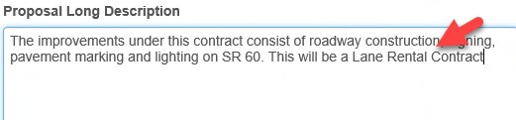
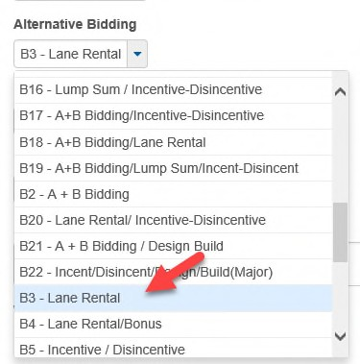
Proposal General Screen
The proposal’s Long Description field should contain a statement regarding the alternative Bidding Method called for in the project’s Intent and Scope.
Example:
Additionally, the Alternative Bidding drop-down field should have the appropriate selection chosen based upon language in the project’s Intent and Scope.

Slide 42
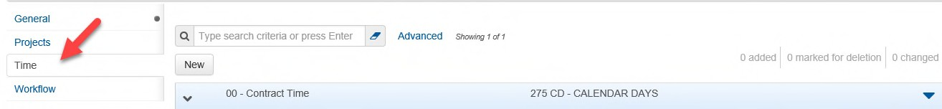
Time Tab Screen
The Time tab information, (accessible via the Proposal Summary screen) transfers to Site Manager and may be used for a variety of reasons including Contract Time, Daily Rates, Incentive and Disincentive information, administrative information, and other data.
The Time tab contains a field called (A+B) Road User Cost Per Day.
This field is to remain blank unless the proposal will be processed under (A+B) and/or Lane Rental processes, in which case it will be filled as described in this document.
When (A+B) Road User Cost Per Day contains a value, the Time tab Sites will be used in the analysis of bids to determine the successful bidder.

Slide 43
A + B Contracts
For A+B contracts there are several items of information to be retained from Preconstruction (PrP) upon transfer of the executed contract to Site Manager.
These are:
The Department’s estimated duration for the contract.
The (A+B) maximum number of days that bidders may bid, if applicable.
The (A+B) Road User Cost per Day

Slide 44
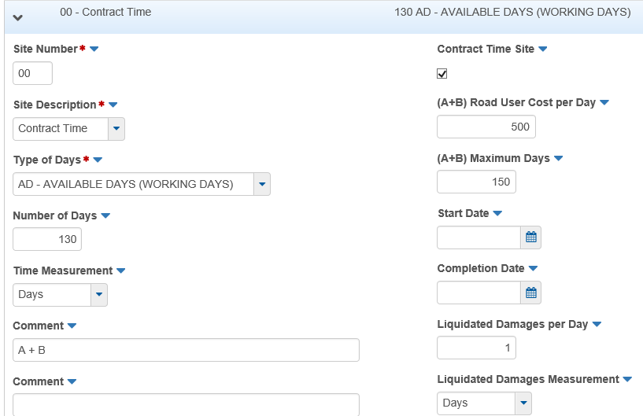
A + B Contracts – Time Tab Data Entry
When the proposal is to be of the A+B type, enter data on the Time tab in the following manner.
Site Number: Use the default value of “00”.
Type of Days: Choose “AD-Available Days” * in the drop-down menu.
Number of Days: Enter the maximum number of days that will be indicated in the Contract Specifications.

Slide 45
A + B Contracts – Time Tab Data Entry
(A+B) Road User Cost Per Day: enter the daily rate determined for the contract.
(A+B) Maximum Days: if applicable, enter figure from Specifications.
Liquidated Damages per Day: there is a default value of $1.00. Do not change this value.
Liquidated Damages will be managed in Site Manager.
Comment field: Enter “A+B”.
Click “Save”.
During the analysis phase of the bidding, the value contained in the (A+B) Road User Cost Per Day times the Number of Days identified for the site will be used to determine the successful Bidder.

Slide 46

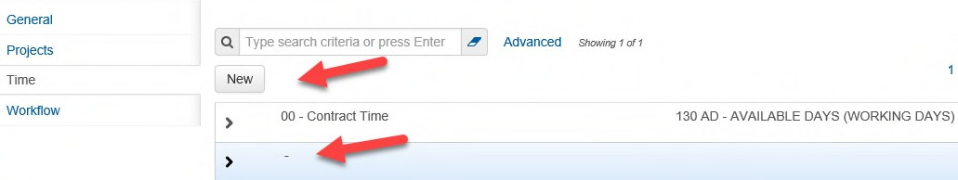
Lane Rental Contracts
When the proposal is to be a Lane Rental type, choose the appropriate Lane Rental choice from the Proposal Summary Alternative Bidding drop down field, create a Site 00 for the contract time in the usual manner on the Time tab screen, then create additional Sites as described here.
Click the New button in the Time tab.

Slide 47

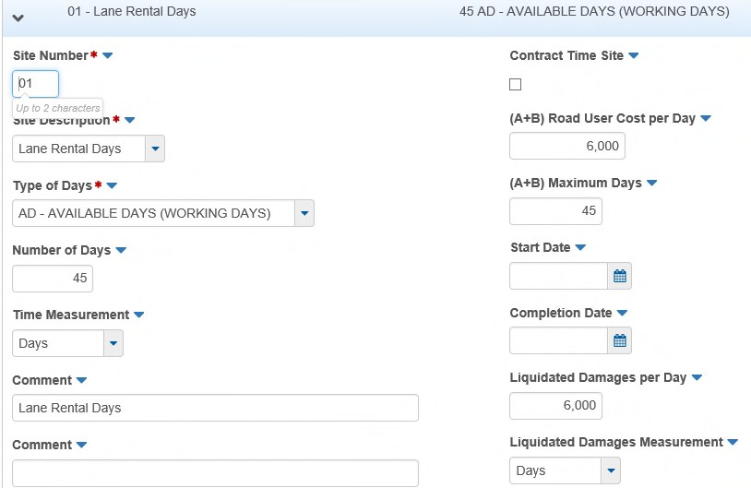
Lane Rental Days Screen
Enter information in the following fields.
See specific field values on the next slides.

Slide 48
Lane Rental Days – Enter the Following Information
Site Number | Use one site for each instance where lane rental is to be managed in Site Manager. Begin with 01.
Site Description | Select “Lane Rental Days”
Type of Days | Choose “AD Available Days” * in the drop-down menu.
Number of Days | Enter the number of days that will be indicated in the Contract Specifications.
Road User Cost Per Day | Enter the daily rate determined for the Lane Rental activity per the specifications
Liquidated Damages per Day | Enter the value identical to the Road User Cost Per Day. This field will transfer to Site Manager as a Disincentive amount.
Comment | Enter "Lane Rental Days". If there are to be multiple instances, identify the location by name.
2nd Comment field | If there is more than one instance of lane rental on the contract, describe the location here. Each Comment field may contain up to 60 characters.
Click | Save.
During the analysis phase of the bidding, the value contained in the Road User Cost per Day times the number of Days identified for the Time tab’ Site record will be used in conjunction with the Total Bid Amount to determine the successful Bidder.

Slide 49
Lane Rental Days – Enter the Following Information
For additional sites create a Site record to contain certain related information.
Click the New button in the Time tab.
Click Save
Enter this information in the following fields.
Site Number | enter 02.
Type of Days | Choose “AD Available Days” * in the drop-down menu.
Number of Days | Enter the number of days estimated for the contract’s duration.
Road User Cost Per Day | Leave this field blank, as the Site is not to be associated with determining the successful bidder.
Liquidated Damages per Day | Enter zero.
Comment | Enter "Engineer’s Estimated Lane Rental Days".
2nd Comment field | if there is more than one instance of lane rental on the contract, describe the location here. Each Comment field may contain up to 60 characters.
Click | Save.

Slide 50
Construction Milestones – With or without Incentives or Disincentives
Create a Site “00” for the contract time in the usual manner. Then create additional Sites as described here.
Site Number | Use one site for each instance where a milestone is to be managed in Site Manager. Begin with Site 10
Type of Days | Choose “AD Available Days” * in the drop-down menu.
Number of Days | Enter the number of days associated with the Milestone. Specified Start date and Specified Completion date may be used in conjunction with this duration.
Road User Cost Per Day | Leave this field blank, as the Site is not to be associated with determining the successful bidder.
Liquidated Damages per Day | If there is an incentive for the Milestone, enter the value. This field will transfer to Site Manager as a Disincentive amount. Otherwise enter zero. The Incentive value will be entered in Site Manager.
Comment | Enter “Milestone".
2nd Comment field | If there is more than one Milestone on the contract, describe the milestone here. Each Comments field may contain up to 60 characters.
Click | Save.
Note re “Type of Days” in Time Tab screen: Utilizing the “AD-Available Days” choice allows the Department to adjust Contract Days based upon issues that arise during the prosecution of work.

Slide 51
Bid Factor Bidding
Project/Proposal Preparation Steps
Load Pay Items and Quantities at the Project level, (do not choose “Fixed Price” for all Pay Items at this stage – This would create errors on the project edit report).
Do not enter Items with Lump Sum Quantities. Item Pricing will be handled utilizing the DQE System.
Create Proposal - Follow “Create Proposal Checklist” Role Help with the following additions:

Slide 52

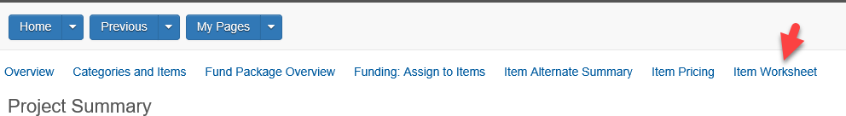
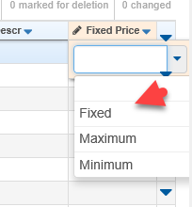
Bid Factor Bidding – Preparation Steps contd.
Choose Alternative Bidding Option “BFB-Contract Work Order” from drop-down menu on the Proposal General screen.
After step 1 is accomplished: Go to Project(s) Worksheet and choose “Fixed” for first Pay Item and Save.
Run Range Fill for rest of Cells in that Column on the Project Worksheet and Save.

Slide 53
Bid Factor Bidding – Preparation Steps contd.
Run AutoGen/Assign Items to Sections processes at Proposal Level and Validate. Run Project Edit Report and address any errors. Run Summary of Pay Items Report.
Follow standard process for moving Proposal package forward in Production pipeline to the Contracts Office.
NOTE: Advertised Proposals that are to be converted to Bid Factor Bidding during an Addendum are to follow the processes described above beginning with “B. Create Proposal” - Items 1.; 2. and 3. as well as the standard process detailed in the Addendum checklist.
Return to
Knowledge Base

Slide 54
Final Review – District Let
When the Proposal packages including the electronic Proposals and their strung Projects are ready for submittal to the District Contracts Office for advertisement they receive a Quality Assessment Review by District Staff.
The purpose of this review is to determine adherence to the requirements of the FDOT Design Manual, Structures Detail Manual, and the Computer Aided Design Drafting (CADD) Manual.
Additionally, this process provides for a last check and necessary corrections as well as insuring required documentation is included in the packages prior to submittal to the District Contracts Office for the commencement of the advertisement of these packages for bidding.
Return to
Knowledge Base

Slide 55
Final Plans – Central Let
When the Proposal packages including the electronic Proposals and their strung Projects are ready for submittal to the Central Contracts Office for advertisement they receive a Quality Assessment Review by Final Plans in the Central Office.
The purpose of this review is to determine adherence to the requirements of the FDOT Design Manual, Structures Detail Manual, and the Computer Aided Design Drafting (CADD) Manual.
Additionally, this process provides for a last check and necessary corrections as well as insuring required documentation is included in the packages prior to submittal to the Contracts Offices for the commencement of the advertisement of these packages for bidding.
Central Office Final Plans serves as the go between for the transfer of the Proposal packages between the Districts and the Central Office Contracts Administration Proposals “Let” in Tallahassee.
Return to
Knowledge Base

Slide 56
Contracts Administration Offices
The Florida Department of Transportation (FDOT) receives bids for competitively bid proposals at a bid letting. The time and place of the bid letting is published in the letting’s Bid Solicitation Notice.
Bid lettings are held on a scheduled basis, and bidders, their authorized agents, and other interested parties are invited to be present.
The Letting processes and all associated activities are managed by the department’s Contracts Administration Offices, (CAO). These Offices are in each District as well as the Central Office.
The Contracts Offices fill orders for Bidding Documents associated with Advertised Proposals utilizing the Contract Proposal Processing Application, (CPP).
Bidding Documents are the Plans, Specification Packages and for the Prime Contractors - the Bid Proposal.
When CPP approves Proposal issuance that automatically makes the Vendor “Valid for Bidding.”
Return to
Knowledge Base

Slide 57
Addendum
After a proposal has been advertised, subsequent changes to proposal information that affect contractors’ bidding, (such as contract time, items, or special provisions) must be tracked and distributed to the proposal holders.
This is accomplished by adding an Addendum to the proposal.
An Addendum allows modifications directly to the proposal information before the bid letting.
The addendum must be provided to plan holders as soon as possible so they can incorporate the changes in their bids as well as acknowledge the receipt of the addendum.
Once the need for an Addendum is identified the appropriate Contracts Office will place the Proposal in Addendum Phase allowing access to the appropriate individuals

Slide 58
Addendum Contd.
Proposal Managers should follow these steps:
This is a good time to run the Proposal Sections and Line Numbers Report if additional Pay items will be required.
On the right end of the blue banner containing the Proposal Id, click on the white triangle for the “Actions Menu”.
Under the heading of “Tasks”, click on the link for ‘Proposal Section and Line Numbers Report’.
The screen may blink a couple of times then on the right end of the blue banner click on the label “Execute”.
A WebGate screen will appear with your Proposal Id highlighted. Choose a report format of Excel, PDF, or HTML. Your report will appear.
Print or save your report.
Using one of the means described in the previous section on adding and maintaining Pay Items, proceed to add or delete Pay Items, or, change item quantities as necessary.

Slide 59
Addendum Contd.
Remember that when processing added pay items in an addendum you must assign the Proposal Line Numbers in their approximate numerical position in the item list.
The section number will be populated by the PrP system when you run the Auto Generate Sections process noted below. Use the Section and Line Number report to find the correct location for these added items.
New Proposal Line Numbers should NOT end in 0 or 5.
If there is a long list of items to be added, they may need to be inserted both before and after the Proposal Line Number of an existing pay item.
After all changes have been completed and saved, from the Actions Menu:
Run the process Auto Generate Sections so that all proposal level changes will be made and be visible to bidders. Also recommend running “Assign Items to Sections” from the same menu as a quick double check.
Run the Proposal Addendum Detail and Proposal Addendum Item Detail reports to confirm that all changes are complete and correct.
Run the Validate Proposal action to ensure that the proposal and all projects remain “valid”.

Slide 60
Addendum
When all actions are completed and checked for accuracy advise the Contracts Office managing the Addendum process.
The CAO staff will close out the addendum and continue with the Advertisement period.
The proposal will no longer be visible to staff outside of the Contracts Office unless an additional Addendum is required.
Bids will be received by the advertising Contracts Office at the appointed time at which point the processes leading to contract award and execution will commence.
Return to
Knowledge Base

Slide 61
Reports Module
    Reports are accessible in PRP, in WebGate, or both.
    PRP reflects reports at the Project and Proposal level.
    Some of these reports are also available in WebGate.

Slide 62

Reports Accessible within PrP
For Projects
 | FHWA Contract Awarded Cost Summary Report | Summarizes all the Participating and Non-Participating Awarded Costs for a particular project based on the awarded bidder prices
* | FHWA District Estimate Cost Summary Report | Summarizes all the participating and non-participating estimated costs for a particular project.
* | Project Edit Report | Performs edits on a Project’s item records and will print a listing of any errors encountered.
* | Summary of Pay Items Report | Produces a summary of pay items and quantities for a selected project
 | Preliminary Project Estimate | Provides Items, Quantities and Prices for Project selected.
* | These reports can also be accessed directly on the WebGate Reporting Page. Generating them from within PrP however, results in the System selecting desired the Project or Proposal, eliminating the need to scroll through the lists directly.

Slide 63
Reports Accessible within PrP
For Proposals
 | Bid Tab Analysis | Provides Vendor, (Bidder) Ranking and a Line Item Tabulation of the Bids
 | Preliminary Proposal Detail Estimate | Provides Funding, Pay Item/Quantity and Price Data
* | Project Cost Distribution Report | Provides a Project Cost Estimate Breakout for a selected Bidder
* | Proposal Section and Line Numbers Report | Lists Current Proposal Section and Line Numbers
 | Proposal Addenda | Lists Addenda Created during Proposal Advertisement
* | These reports can also be accessed directly on the WebGate Reporting Page. Generating them from within PrP however, results in the System selecting desired the Project or Proposal, eliminating the need to scroll through the lists directly.

Slide 64
Reports Accessible within PrP
For Proposals Contd.
 | Proposal Addenda Item Detail | Provides Detail on changes by Addenda during Proposal Advertisement
 | Proposal Addenda Item Detail | Provides Detail on changes at the Pay Item level
 | Proposal Price Schedule | Lists Pay Items and Quantities as Presented to Bidders
 | Quality Sheet Summary | Lists Pay Items and Quantities by Proposal Section

Slide 65
Reports Accessible in WebGate Only
 | Bridge History Report | Lists awarded unit prices for all items on structures that meet the selection criteria.
 | Historical Unbalance Report | All bids are compared to this average and flagged as either 'U' for Unbalanced, 'F' for Front Loaded, or 'A' for Above Tolerance.
 | Unbalanced Items Report | Lists all bids for each pay item in a contract, including the estimate for identification of unbalanced items.
 | Work Class Percentage Report | Lists prequalification work class code percentage breakout based on item work class and project category work class for structure categories only.
 | Comp-Book Master Pay Item Extract | Provides the master pay items into an Excel file based on the selected items, exclusive of obsolete items.
 | Fuel Allocation Report | Shows the estimated fuel quantity required for appropriate pay items by project for all on the selected Letting/Proposal(s).

Slide 66
Reports Accessible in WebGate Only Contd.
 | Historical Bid Item Summary Report | Lists the bids for a given pay item and the average price for that item based upon selections made.
 | Master Pay Item List Report | Lists pay item information from the Pay Item Reference Table.
 | Item Avg. Unit Cost by Item No. Report | Data for selected items in selected counties that have contracts let during the selected time period by Item Number.
 | Item Avg. Unit Cost by Item Range Report | Data for selected items in selected counties that have contracts let during the selected time period by Item Range.
 | Contract Project Directory Report | Lists financial project numbers along with proposal, spec and contract information.
 | Crosswalk Report | A Crosswalk of Project, Proposal, Letting Id, Letting Date, or District and Workflow Phase associations.
Return to
Knowledge Base

Slide 67
WorkFlows and Phases
WorkFlow/Phase - Description
A workflow is a set of relationships between tasks and the order in which those tasks are performed throughout the lifecycle of the project, proposal or contract.
It’s the activity slots that track the different activities, steps, processes and milestones associated to the project, proposal, letting or contract.
These different activities, steps, processes or milestones contained in a workflow are separated into small segments called phases.
There are multiple phases in one workflow.
Phases often involve the completion of a milestone, process or specific activity and with a change in Phase, can require an individual with a different Role to take over the responsibilities of the project or proposal.
There can be a change in the security of the project or proposal with the change in the phase.

Slide 68
WorkFlows and Phases
WorkFlow/Phase - Changes
Changes in the Workflow and/or Phase control several factors:
  Who can do what to the project or proposal or letting.
  What can be accessed.
  What can be changed.
With changes in the workflow and phase activities and processes, specific business rules are sometimes triggered. These will also be outlined for future reference.
Workflow/Phase is controlled by the Proposal, not the Project(s) when the two are associated and will always agree. The workflow and phase control data fields by controlling who can make changes, what can be changed and even what fields can be viewed via Role security.
The workflow and associated phases are built into role security control for PrP.

Slide 69
PrP Project/Proposal Lifecycle
Work Program is the source for basic project data in PrP. Work Program refreshes Projects in PrP nightly.
A Project record is established in PrP (Project Formulation)
Appropriate categories are established. Pay Items and quantities are added. “Enter Items & Quantities” is also the Phase that allows the Designer Interface functional access to a Project’s Categories, Pay Items, and Quantities.
An Estimator begins to generate a current (working) estimate.
Funding is allocated; Location is associated to the project
Associate Project record(s) to Proposal – Proposal Formulation
Official Estimate development commences
Final Review

Slide 70
PrP Project/Proposal Lifecycle contd.
After Final Review, the following steps occur.
Transfer to CAO
Advertise Proposal Package; Addendum Phase if appropriate
Receive and Evaluate Bids
Award Proposal/Contract
Execute and Export to Site Manager/DSS
PreConstruction has Ended
Archive

Slide 71
Workflow Phase Business Rules Chart
This section addresses the business rules put into place by the Application during the lifecycles of Projects, Proposals and lettings
Rule Name |  | Description
 | FixPropItemLineNum | This rule is intended to be used once a proposal has gone out for bid, primarily to prevent changes to existing proposal line numbers. An error in the roll up of proposal items prevents a proposal from entering a phase with this rule. When a proposal is in a phase with the FixPropItemLineNum rule or in any subsequent phase, the proposal line numbers cannot be changed. Biddable items cannot be added to a project without a proposal line number; therefore, importing a project can only be used to change items, not to add new items.

Slide 72
Workflow Phase Business Rules Chart
Rule Name |  | Description
 | Addendum | This rule is intended to be used to prevent changes that affect the published proposal unless an addendum is open. Any data exported is locked, unless allowed by an open addendum. When a proposal is in a phase with the Addendum rule, users with role permission can open, close, and approve addendum until the phase is changed to one that does not have the Addendum rule. The system displays a banner on the project and proposal related pages alerting the user that the addendum phase is in place for that proposal and whether an open addendum exists. All changes that affect the published proposal are tracked during phases with this rule. Different fields in the published information become read-only depending on the user’s access level and whether an addendum is open.

Slide 73
Workflow Phase Business Rules Chart
Rule Name |  | Description
 | Addendum Contd. | If an addendum is open, published information can only be modified by users with Addendum Change access. If no addendum is open, the published information for the proposal is read-only. Because non-bid project items are not considered part of the published information, they can be added or deleted. If the proposal has an unapproved addendum, the proposal cannot be exported to a Bid File. Note: When the Addendum rule is applied to a phase, the FixPropItemLineNum rule is also automatically applied.

Slide 74
Workflow Phase Business Rules Chart
Rule Name |  | Description
 | FixProposalItem | This rule is intended to be used once bids have been received to prevent any changes that would impact the proposal structure on which the bid is based. If a warning is generated in the roll up of proposal items, the proposal is prevented from entering a phase with this rule. When a proposal enters a phase with the FixProposalItem rule, the final calculation of low-cost totals is performed. For this phase and any subsequent phase: Categories, proposal sections, project items, proposal items, and breakdown items can no longer be added, changed, or deleted; therefore, generating proposal sections and importing projects are not allowed. Associating a project to proposal and removing a project from proposal are not allowed.

Slide 75
Workflow Phase Business Rules Chart
Rule Name |  | Description
 | FixBid Calculations | This rule is intended to be used once all bid information is entered in the system and complete. A proposal should not enter a workflow phase with the FixBidCalculations rule until all bids have been entered and adjusted as needed. When a proposal enters a workflow phase with the FixBidCalculations rule, the final calculation of bid item, section, time, and vendor amounts is performed. Bid validation is performed, and bid sections are validated against proposal section. For this phase and any subsequent phase, bid, bid section, and bid time can no longer be changed or deleted. A proposal must be in a workflow phase with the FixBidCalculations rule to use innovative bidding features, including additive section, alternate section, and life cycle cost analysis.

Slide 76
Workflow Phase Business Rules Chart
Rule Name |  | Description
 | PreConstr HasEnded | This rule is intended to be used once all the work on an awarded proposal is complete and the proposal is ready to become a contract. A proposal must be in a workflow phase with the PreConstrHasEnded rule to transition to construction.
 | Active Contract | This rule is intended to be used once a proposal becomes a contract. This system automatically sets the phase of the proposal to the workflow phase with the ActiveContract rule when the contract is initially created, regardless of whether the contract is created manually or by transition.
Return to
Knowledge Base

Slide 77

Thank you for your time and attention
As a reminder, task-oriented Role help is available on the Application’s Home Page under External Links.
Questions or Comments to
co-wTSecurityTeam@dot.state.fl.us

