Slide 1
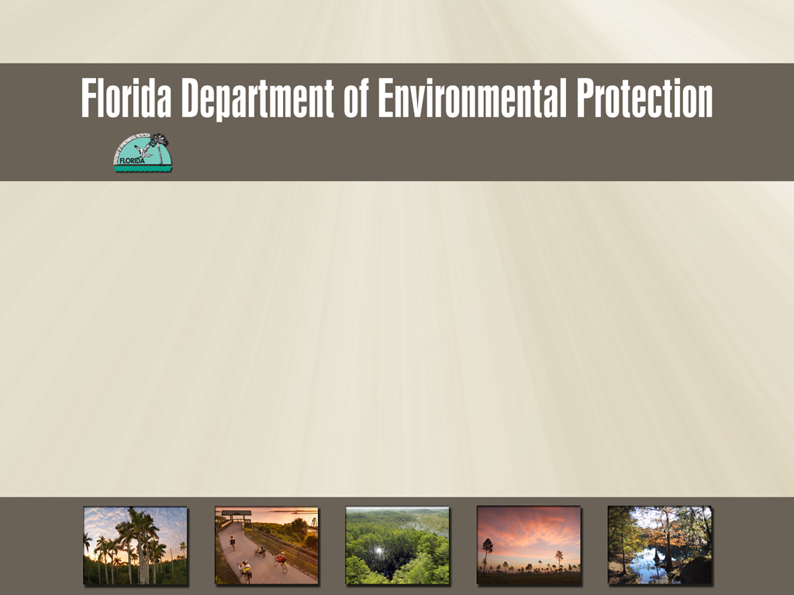
NPDES Generic Permit for Discharge of Ground Water from
Dewatering Operations
Generic Permit for Discharge of Ground Water from
Dewatering Operations
Northeast District Outreach Training from March 5, 2015

Slide 2
Generic Permit for Discharge of Ground Water from Dewatering Operations
  Rule 62-621.300(2), F.A.C.
    Generic Permit for Discharge of Ground Water from Dewatering Operations
      DEP Document 62-621.300(2)(a)
      Covers discharges to surface waters of the State (NPDES)

Slide 3
Generic Permit for Discharge of Ground Water from Dewatering Operations
  Rule 62-621.300(2), F.A.C.
    Generic Permit for Discharge of Ground Water from Dewatering Operations
      DEP Document 62-621.300(2)(a)
      Covers discharges to surface waters of the State (NPDES)
    Notice of Intent to use the Generic Permit for Discharge of Ground Water from Dewatering Operations
      DEP Document 62-621.300 (2)(b)

Slide 4
Generic Permit for Discharge of Ground Water from Dewatering Operations
  Rule 62-621.300(2), F.A.C.
    Generic Permit for Discharge of Ground Water from Dewatering Operations
      DEP Document 62-621.300(2)(a)
      Covers discharges to surface waters of the State (NPDES)
    Notice of Intent to use the Generic Permit for Discharge of Ground Water from Dewatering Operations
      DEP Document 62-621.300(2)(b)
    Notice of Termination Generic Permit for Discharge of Ground Water from Dewatering Operations
      DEP Document 62-621.300 (2)(f)

Slide 5
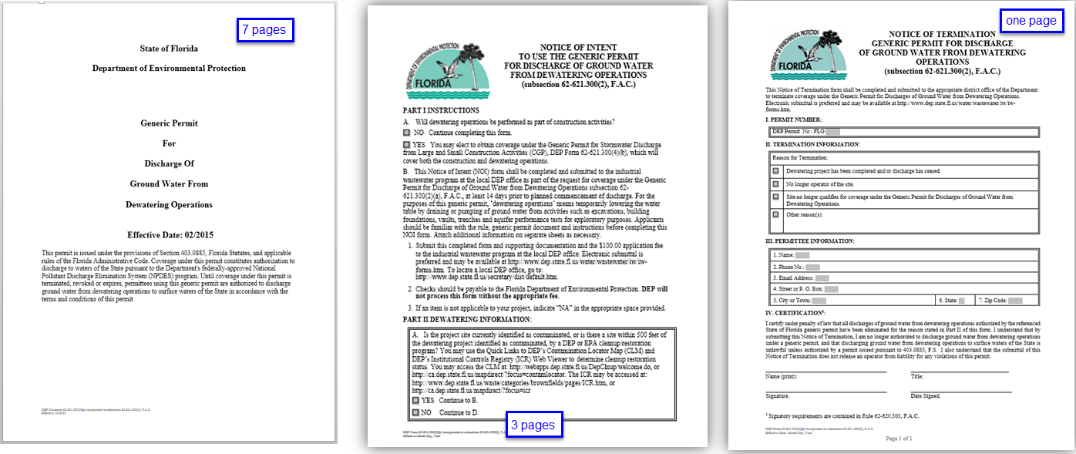
Generic Permit for Discharge of Ground Water from Dewatering Operations
Effective date February 10, 2015

Slide 6
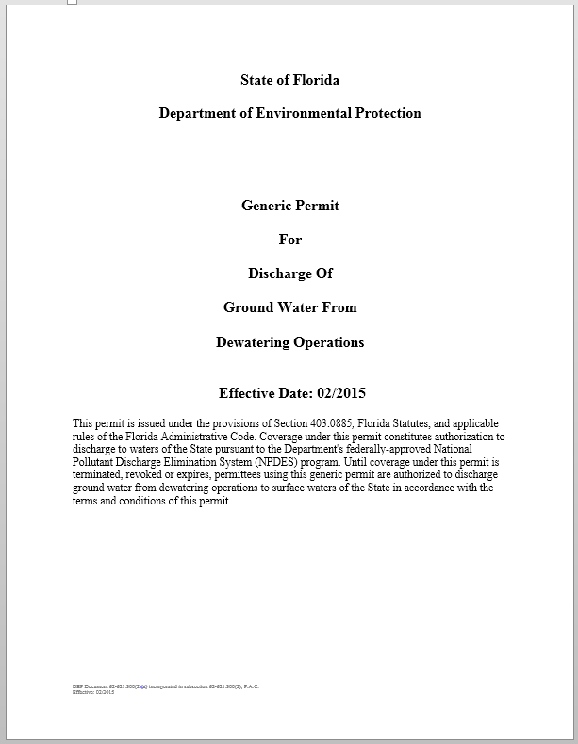
Generic Permit for Discharge of Ground Water from Dewatering Operations
Effective date February 10, 2015
Includes site-specific control measures (Best Management Practices) which are more effective at minimizing or eliminating pollutant discharges from dewatering operations to surface waters of the State

Slide 7
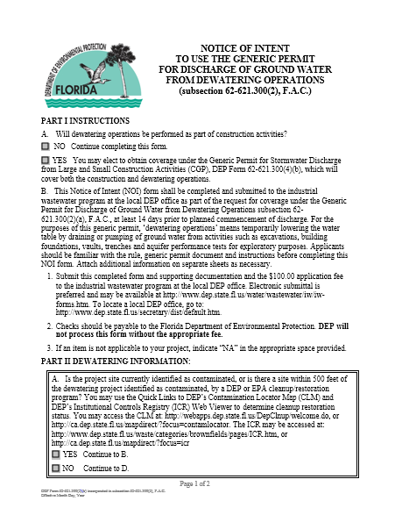
Generic Permit for Discharge of Ground Water from Dewatering Operations
Effective date February 10, 2015
Includes site-specific control measures (Best Management Practices) which are more effective at minimizing or eliminating pollutant discharges from dewatering operations to surface waters of the State
User-friendly Notice of Intent Form 2b (NOI) to standardize application requirements

Slide 8
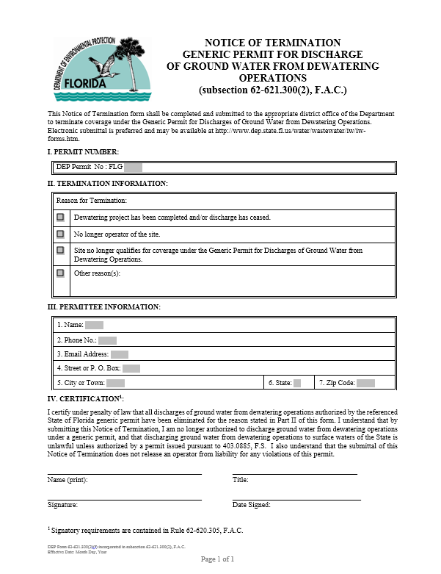
Generic Permit for Discharge of Ground Water from Dewatering Operations
Effective date February 10, 2015
Includes site-specific control measures (Best Management Practices) which are more effective at minimizing or eliminating pollutant discharges from dewatering operations to surface waters of the State
User-friendly Notice of Intent Form (NOI) to standardize application requirements
Notice of Termination Form 2f

Slide 9
Rule 62-621.300(2), F.A.C.
  Dewatering Operations – defined as temporarily lowering the water table by draining or pumping of ground water from activities such as:
  excavations,

Slide 10
Rule 62-621.300(2), F.A.C.
  Dewatering Operations – defined as temporarily lowering the water table by draining or pumping of ground water from activities such as:
  excavations,
  building foundations,

Slide 11
Rule 62-621.300(2), F.A.C.
  Dewatering Operations – defined as temporarily lowering the water table by draining or pumping of ground water from activities such as:
  excavations,
  building foundations,
  vaults,

Slide 12
Rule 62-621.300(2), F.A.C.
  Dewatering Operations – defined as temporarily lowering the water table by draining or pumping of ground water from activities such as:
  excavations,
  building foundations,
  vaults,
  trenches, and

Slide 13
Rule 62-621.300(2), F.A.C.
  Dewatering Operations – defined as temporarily lowering the water table by draining or pumping of ground water from activities such as:
  excavations,
  building foundations,
  vaults,
  trenches, and
  aquifer performance tests for exploratory purposes.

Slide 14
Applicability and Coverage
  Discharge of ground water from dewatering operations through a point source to surface waters of the state.

Slide 15
Applicability and Coverage
  Discharge of ground water from dewatering operations through a point source to surface waters of the state.
  Coverage under the dewatering generic permit shall not be effective until the applicant receives written notification from the Department.

Slide 16
Applicability and Coverage
  Discharge of ground water from dewatering operations through a point source to surface waters of the state.
  Coverage under the dewatering generic permit shall not be effective until the applicant receives written notification from the Department.
  Discharges are limited to a term not to exceed 5 years from the effective date of coverage.

Slide 17
Applicability and Coverage
(Continued)
  Dewatering operations covered under the revised Generic Permit for Stormwater Discharges from Construction Activities (CGP), are no longer required to obtain separate coverage under the dewatering generic permit.
    Permit requirements under the revised CGP are the same permit requirements as the dewatering generic permit.

Slide 18
Applicability and Coverage
(Continued)
  Sites with a current permit under the Generic Permit for the Discharge of Produced Ground Water from any Non-Contaminated Site Activity will have the option to:

Slide 19
Applicability and Coverage
(Continued)
  Sites with a current permit under the Generic Permit for the Discharge of Produced Ground Water from any Non-Contaminated Site Activity will have the option to:
    Continue to meet requirements of their produced ground water generic permit, or

Slide 20
Applicability and Coverage
(Continued)
  Sites with a current permit under the Generic Permit for the Discharge of Produced Ground Water from any Non-Contaminated Site Activity will have the option to:
    Continue to meet requirements of their produced ground water generic permit, or
    Elect to obtain coverage under the new dewatering generic permit (Form 2b or 4b, + fee)

Slide 21
Applicability and Coverage
(Continued)
  Sites with a current permit under the Generic Permit for the Discharge of Produced Ground Water from any Non-Contaminated Site Activity will have the option to:
    Continue to meet requirements of the produced ground water generic permit, or
    Elect to obtain coverage under the new dewatering generic permit
  New dewatering activities and renewals:

Slide 22
Applicability and Coverage
(Continued)
  Sites currently permitted under the Generic Permit for the Discharge of Produced Ground Water from any Non-Contaminated Site Activity will have the option to:
    Continue to meet requirements of the produced ground water generic permit, or
    Elect to obtain coverage under the new dewatering generic permit
  New dewatering activities and renewals:
    Obtain coverage under the terms of the new dewatering generic permit (Form 2b or 4b, + fee)

Slide 23
Fees
  Application fee is $100 as specified in the NOI

Slide 24
Fees
  Application fee is $100 as specified in the NOI
  No annual fee in accordance with 62-4.052, F.A.C.

Slide 25
Fees
  Application fee is $100 as specified in the NOI
  No annual fee in accordance with 62-4.052, F.A.C.
  Transfer of ownership fee is $50 in accordance with 62-4.050, F.A.C.
    Submit fee with completed DEP Form 11 http://www.dep.state.fl.us/water/wastewater/iw/forms/62-620.910_11_FL0.pdf

Slide 26
Dewatering Generic Permit (Bipin)
GENERIC PERMIT FOR DISCHARGE OF GROUND WATER FROM DEWATERING OPERATIONS
DEP Permit Document
62-621.300 (2)(a)

Slide 27
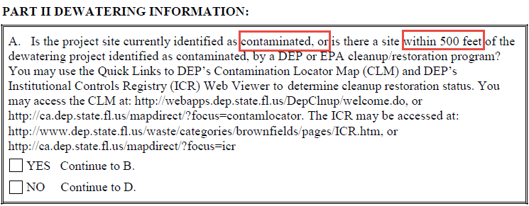
NOI for Dewatering Generic Permit
  Authorization to Discharge
    The generic permit authorizes discharge of ground water from a dewatering operation through a point source to surface waters of the State.
  Definitions (The 500-foot distance is based on provisions of Chapter 62-521, F.A.C., Wellhead Protection. 500 feet is the distance from the dewatering site to where the contamination is observed. )
Notes:
62-621.300(2)(b) NOI Form Part II. A. “Is the project site currently identified as contaminated, or is there a site within 500 feet of the dewatering project identified as contaminated, by a DEP or EPA cleanup/restoration program?”
Is there further guidance regarding the reference points of the 500 feet distance?
The 500 foot distance is based on provisions of Chapter 62-521, F.A.C., Wellhead Protection. The 500 feet is the distance from the dewatering site to where the contamination is observed.

Slide 28
Dewatering Generic Permit
  Authorization to Discharge
    The generic permit authorizes discharge of ground water from a dewatering operation through a point source to surface waters of the State.
  Definitions
  General Provisions
    Limited to a term not to exceed 5 years from effective date of coverage.
    Coverage is effective upon notification from the Department.
    Submittal of a N.O.T. within:
      14 days completion of discharge or,
      upon expiration of coverage

Slide 29
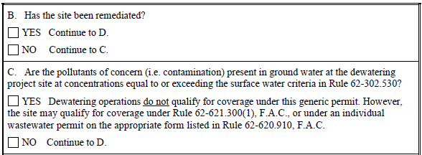
Dewatering Generic Permit
  Authorization to Discharge
  When the pollutants of concern are not present in ground water at the dewatering project site at concentrations equal to or exceeding the surface water criteria in Rule 62-302.530, dewatering at the site can commence.
Notes:
62-621.300(2)(b) NOI Form Part II. C. “Are the pollutants of concern (i.e. contamination) present in ground water at the dewatering project site at concentrations equal to or exceeding the surface water criteria in Rule 62-302.530?”
If dewatering occurs on a site that has a plume “next door,” but the plume is not on the dewatering site, then dewatering can continue without restriction?
When the pollutants of concern are not present in ground water at the dewatering project site at concentrations equal to or exceeding the surface water criteria in Rule 62-302.530 dewatering at the site can commence. However, please note that in accordance with Parts VI.B. of the Dewatering Generic Permit, the permittee is required to report any characteristic in the effluent that could indicate the presence of a pollutant or pollutants not previously identified or anticipated, (e.g., visible oil sheen, odor), and the occurrence, or new knowledge of, any spills, leaks or contamination in the vicinity of the project that could impact the water quality of the effluent. Reporting procedures are listed in Part VII.I., of the generic permit. In addition, in accordance with Parts VI.C. of the Dewatering Generic Permit, if contamination in the vicinity of the site that causes or contributes to violations of water quality standards is encountered, the permittee shall cease dewatering operations and contact the Department.

Slide 30
Dewatering Information
Tools an applicant can use to determine cleanup restoration status.
  Contamination Locator Map (CLM)
    http://webapps.dep.state.fl.us/DepClnup/welcome.do
    http://ca.dep.state.fl.us/mapdirect/?focus=contamlocator
  Institutional Controls Registry (ICR) Web Viewer
    http://www.dep.state.fl.us/waste/categories/brownfields/pages/ICR.htm
    http://ca.dep.state.fl.us/mapdirect/?focus=icr
Applicant may use other sources to determine whether contamination is present.
Notes:
62-621.300(2)(b) NOI Form Part II. C. “Are the pollutants of concern (i.e. contamination) present in ground water at the dewatering project site at concentrations equal to or exceeding the surface water criteria in Rule 62-302.530?”
If dewatering occurs on a site that has a plume “next door,” but the plume is not on the dewatering site, then dewatering can continue without restriction?
When the pollutants of concern are not present in ground water at the dewatering project site at concentrations equal to or exceeding the surface water criteria in Rule 62-302.530 dewatering at the site can commence. However, please note that in accordance with Parts VI.B. of the Dewatering Generic Permit, the permittee is required to report any characteristic in the effluent that could indicate the presence of a pollutant or pollutants not previously identified or anticipated, (e.g., visible oil sheen, odor), and the occurrence, or new knowledge of, any spills, leaks or contamination in the vicinity of the project that could impact the water quality of the effluent. Reporting procedures are listed in Part VII.I., of the generic permit. In addition, in accordance with Parts VI.C. of the Dewatering Generic Permit, if contamination in the vicinity of the site that causes or contributes to violations of water quality standards is encountered, the permittee shall cease dewatering operations and contact the Department.
If the answer to a. is “No,” then is there a specific distance or other guidance about the dewatering separation distance from an existing plume?
What if plume data in OCULUS is outdated (> 5 or 10 years)?
The links the Department included in the Notification form to the Contamination Locator Map Institutional Controls Registry (ICR) Web Viewer were provided as tools that can be used by permittees when completing the form. The permittee may use other information available to them to complete the application such as Environmental Assessments that may be available for the site which is common in real estate transactions and bank loans.

Slide 31
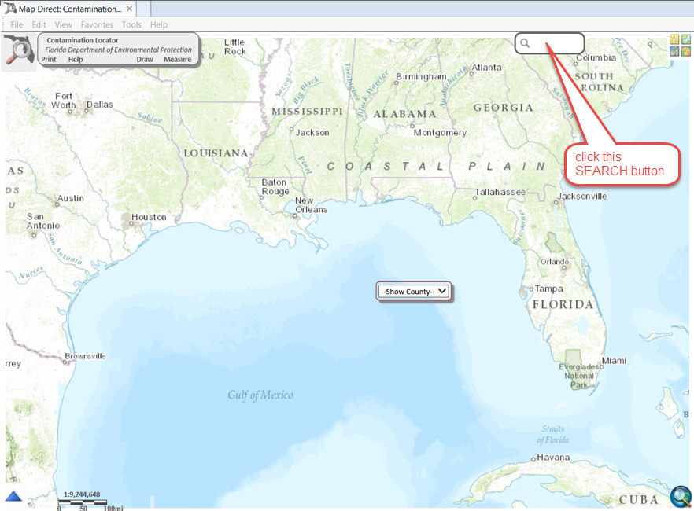
Contamination Locator Map
    http://ca.dep.state.fl.us/mapdirect/?focus=contamlocator

Slide 32
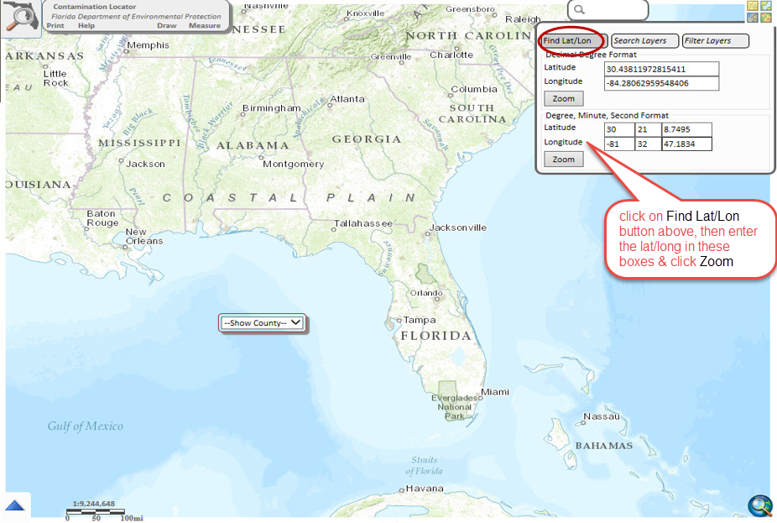

Slide 33
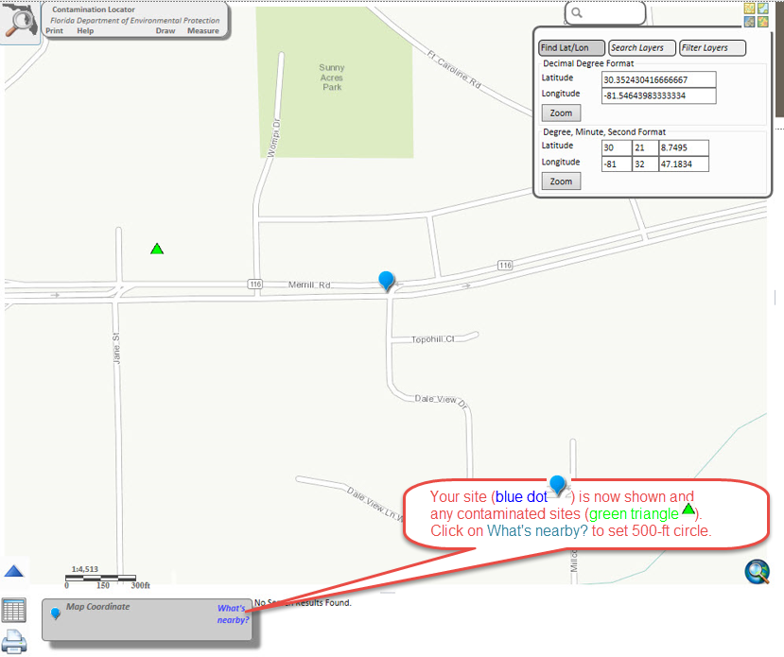

Slide 34
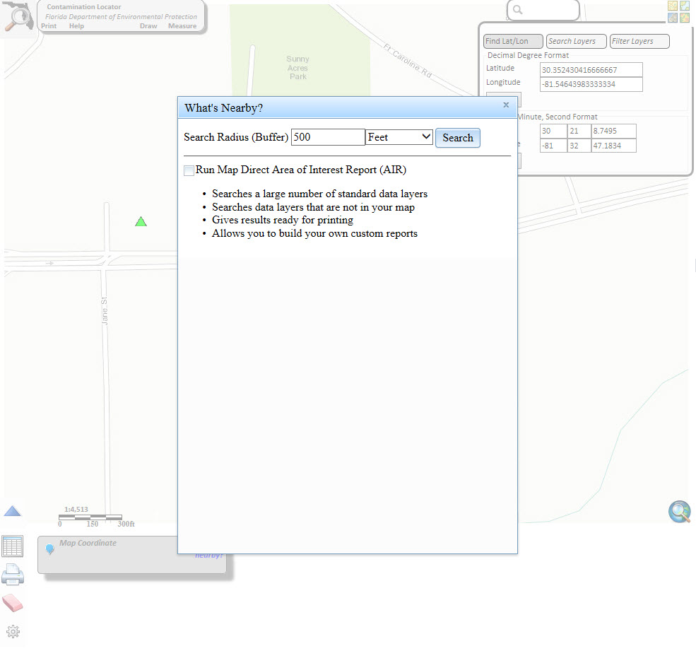

Slide 35
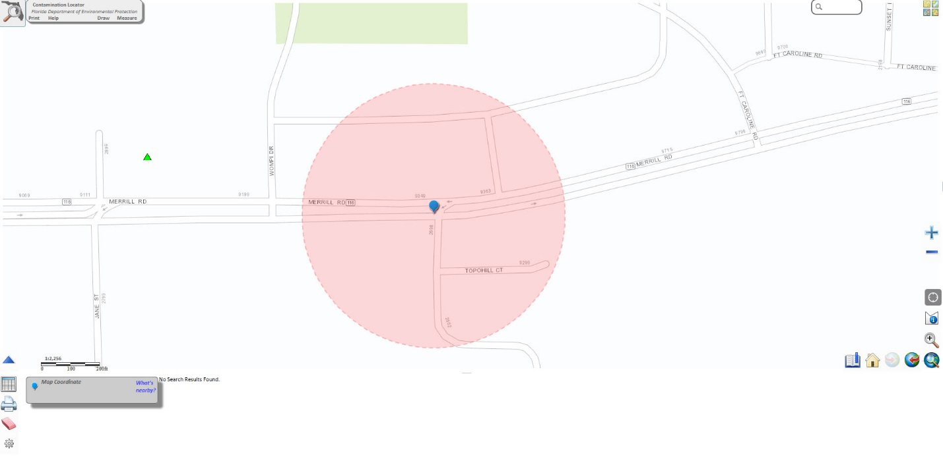
Contamination Locator Map http://ca.dep.state.fl.us/mapdirect/?focus=contamlocator

Slide 36
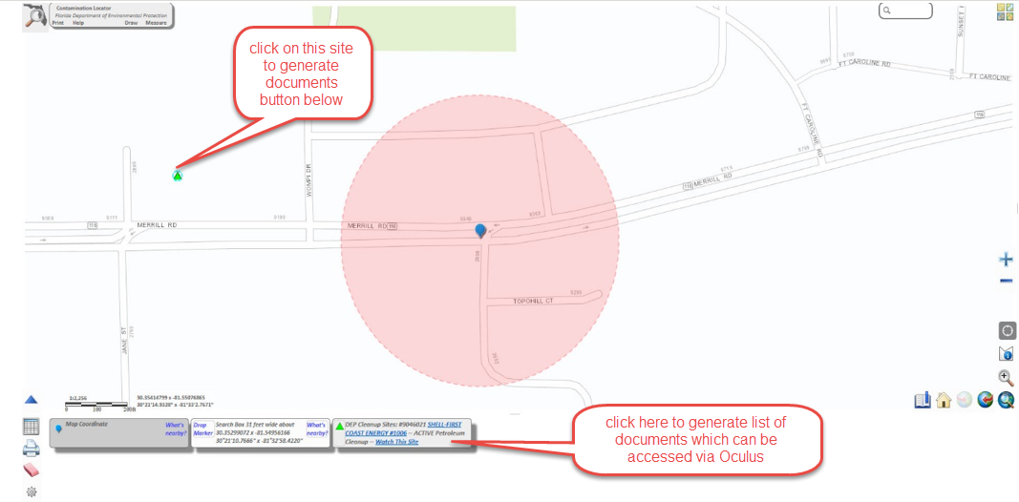
Contamination Locator Map http://ca.dep.state.fl.us/mapdirect/?focus=contamlocator

Slide 37
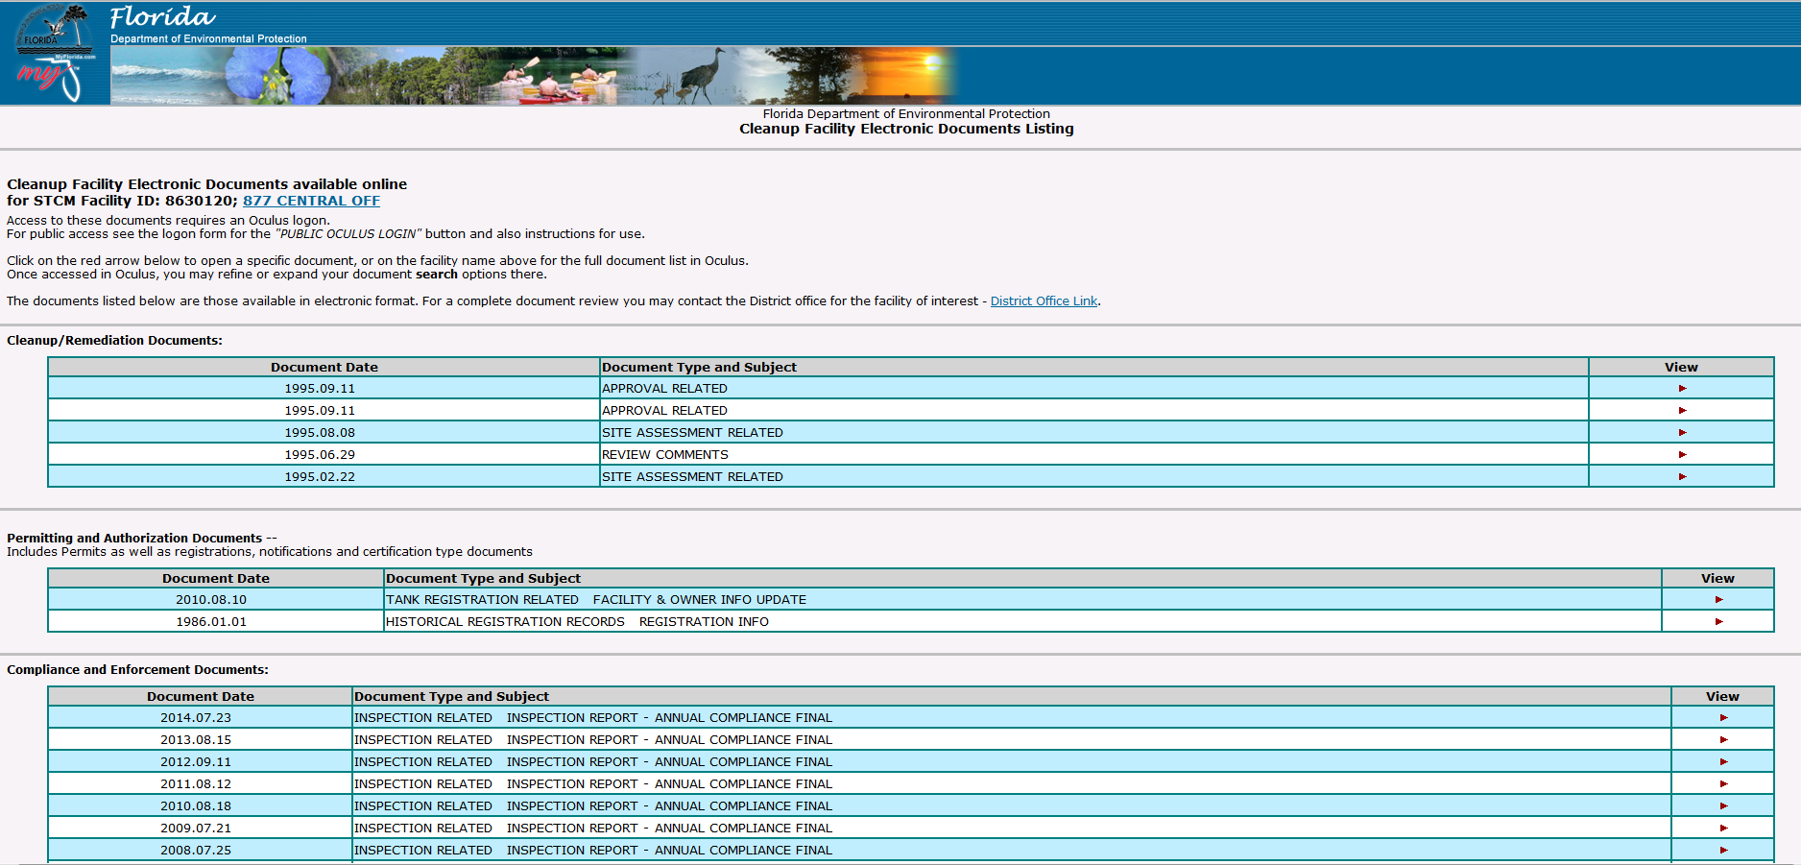

Slide 38
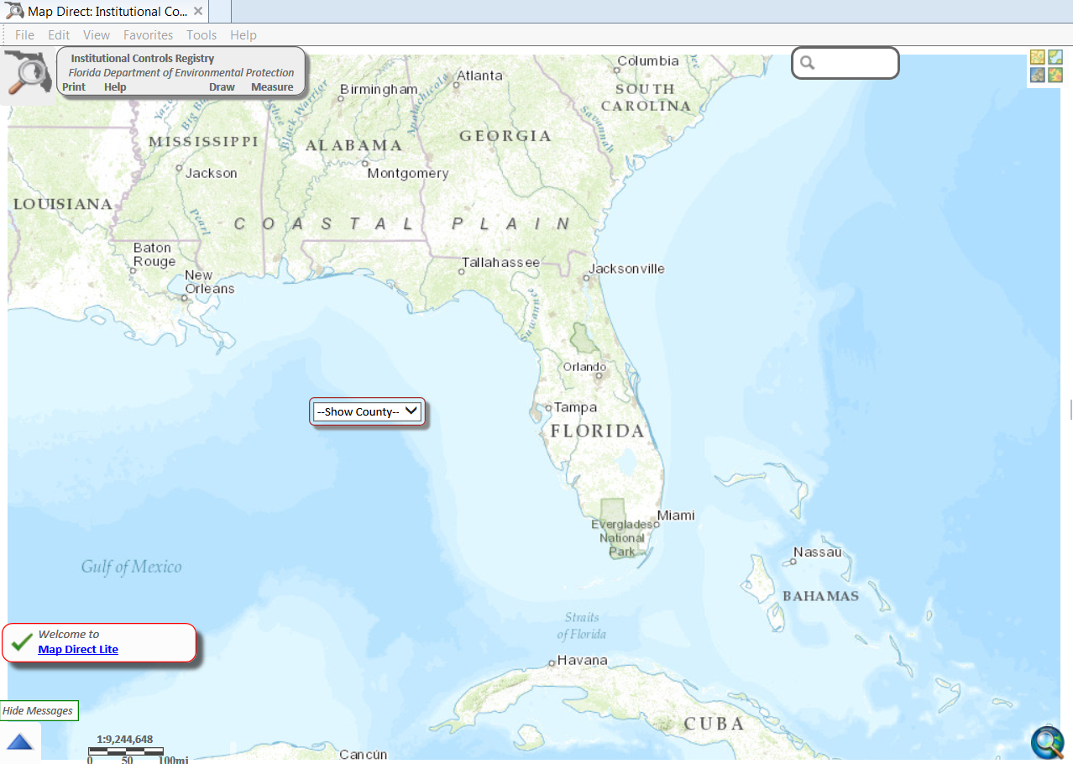
    Institutional Controls Registry http://ca.dep.state.fl.us/mapdirect/?focus=icr

Slide 39
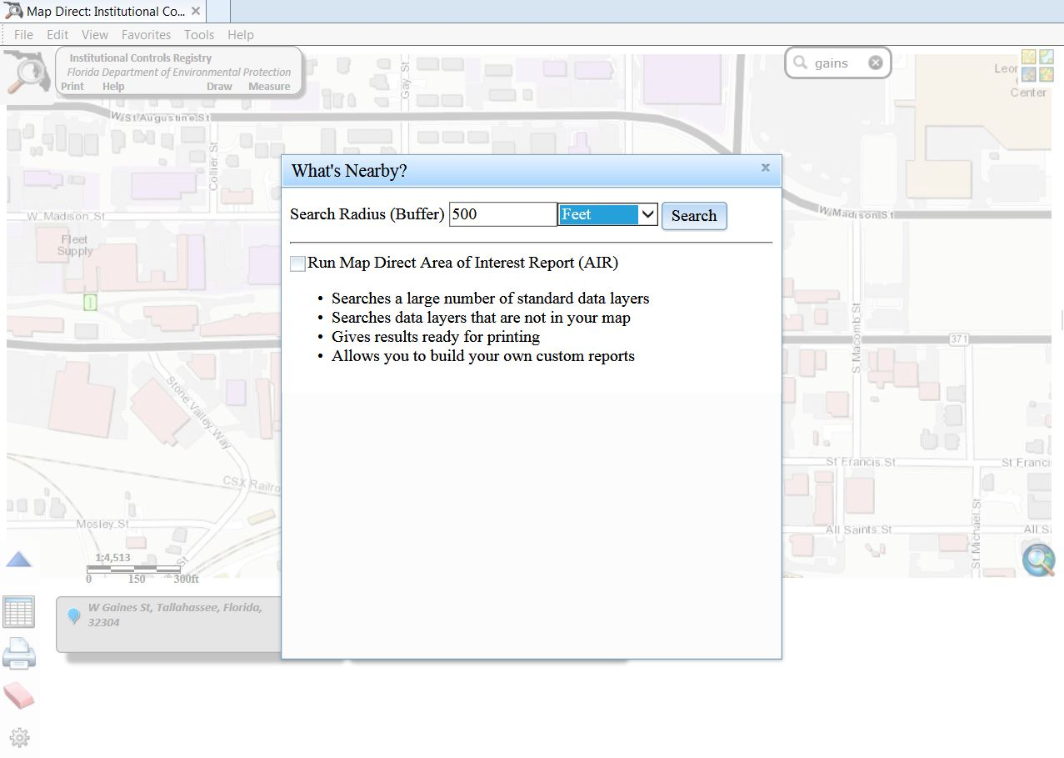

Slide 40
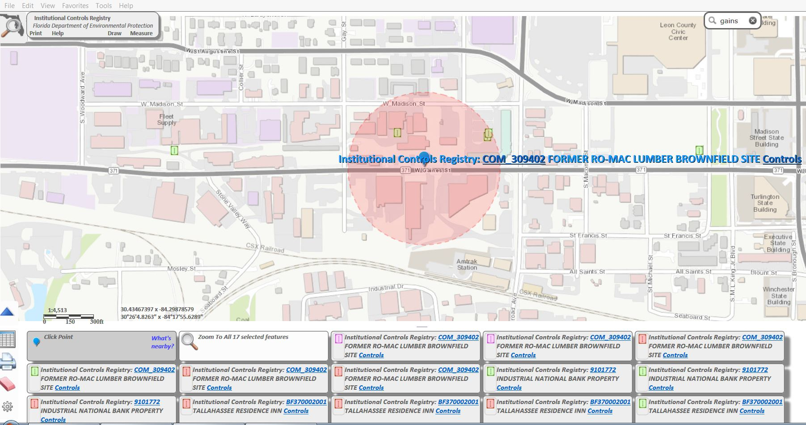

Slide 41
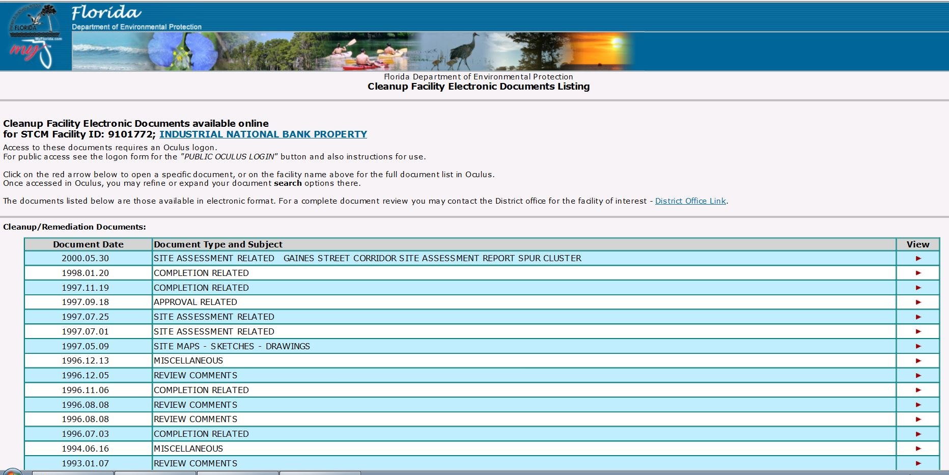
Institutional Control Registry
Data

Slide 42
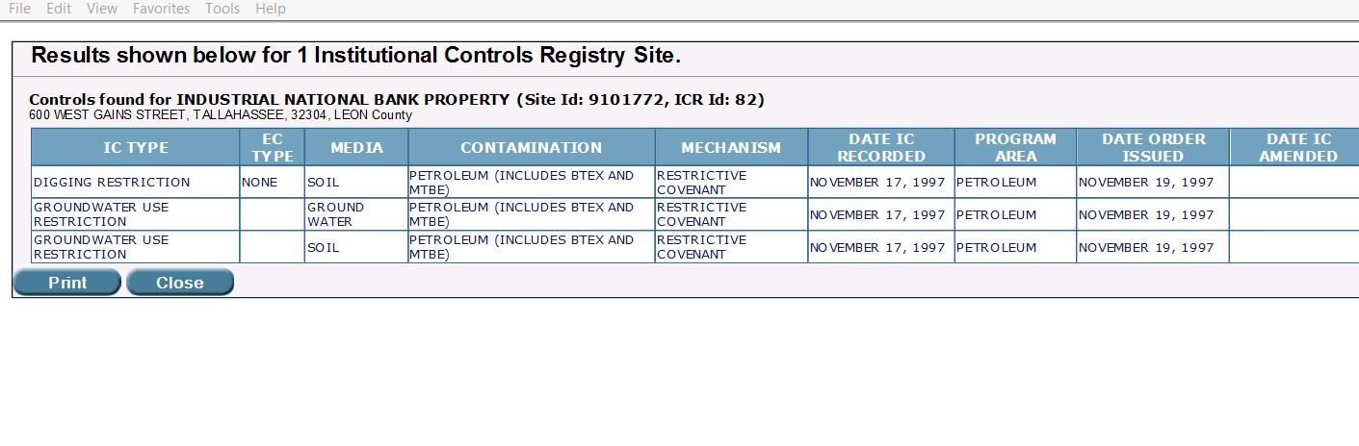
Institutional Control Registry
Data

Slide 43
Part II Dewatering Information
Dewatering Site
Site Remediated
Parameters of concern above
Surface Water Criteria
Contaminated
Yes
No
Yes
No
Eligible
Yes
Contamination within 500 feet
No
Site is not eligible for coverage under this GP

Slide 44
Notice of Intent
If dewatering operations are to be performed as part of construction activities > 1 acre, the applicant may elect to obtain dewatering coverage under the Generic Permit for Stormwater Discharges from Construction Activities, 2015 revision (CGP).

Slide 45
Notice of Intent
If dewatering operations are to be performed as part of construction activities > 1 acre, the applicant may elect to obtain coverage under the Generic Permit for Stormwater Discharges from Construction Activities, 2015 revision.
NOI for the dewatering permit has to be completed and submitted at least 14 days prior to commencement of discharge.

Slide 46
Notice of Intent
If dewatering operations are to be performed as part of construction activities > 1 acre, the applicant may elect to obtain coverage under the Generic Permit for Stormwater Discharges from Construction Activities, 2015 revision.
NOI for the dewatering permit has to be completed and submitted at least 14 days prior to commencement of discharge.
Dewatering permit application fee is $100

Slide 47
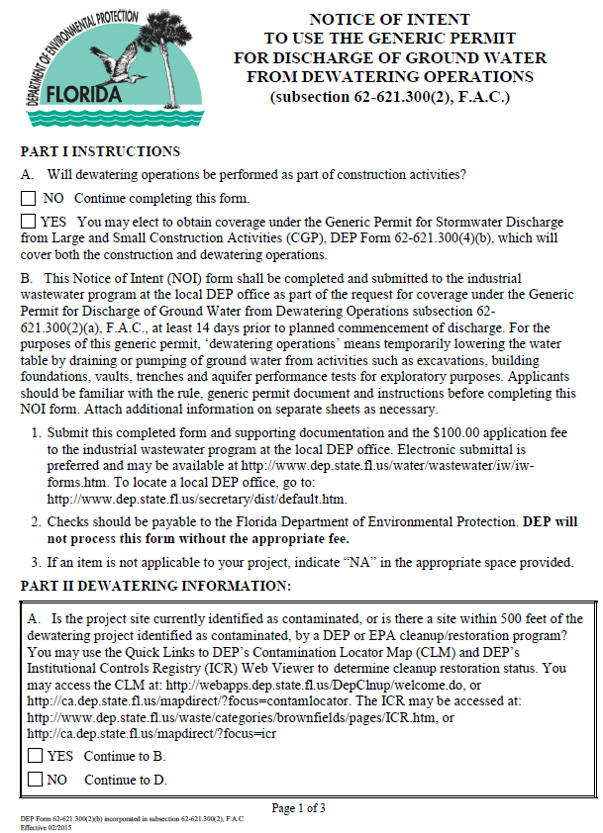
Notice of Intent (NOI)
NOTICE OF INTENT TO USE THE GENERIC PERMIT FOR DISCHARGE OF GROUND WATER FROM DEWATERING OPERATIONS
DEP Document
Form 62-621.300 (2)(b)

Slide 48
Effluent Limitations
Parameter | Units | Discharge Limitation | Monitoring Frequency | Sample Type
Flow | Gallons per day | Report | 1/week when discharging | Actual or Estimated
Notes:
62-621.300(2)(a) III.B.1. Flow monitoring.
How is this required to be measured or estimated? The Department does not require a specific method for flow measurement.
If there is no required method, what are acceptable methods for measurement or estimation? There are many methods for measuring or estimating flow. Flow can be measured with a measurement device (flow meter) or it can be estimated based on the control technology selected for the project, pump data, well point capacity, etc.

Slide 49
The NOI: Part II.D.
Dewatering Information, BMPs
Chemical Treatment
  The use of chemicals such as polymers, alum and other flocculants are authorized by the dewatering generic permit.
  Polymers (e.g. polyacrylamide) and alum can be used to reduce turbidity and other pollutants.
  Polyacrylamide (PAM) is typically used in conjunction with other BMPs to increase their performance.

Slide 50
The NOI: Part II.D.
Dewatering Information, BMPs
Cationic Treatment Chemical
  Polymers, flocculants, or other chemicals that contain an overall positive charge.
  Common examples of cationic treatment chemicals are
    chitosan,
    cationic polyacrylamide (C-PAM) and
    PolyDADMAC
      (POLYDIALLYLDIMETHYLAMMONIUM CHLORIDE).

Slide 51
The NOI: Part II.D.
Dewatering Information, BMPs
Suggestions when reviewing request to use cationic treatment chemicals
  Check if treatment chemicals have been approved by FDEP for potable water use.
  Ask if laboratory data tests were conducted to demonstrate that turbidity reduction necessary to meet the receiving water criteria will be achieved.
  Obtain information from permittee on the proposed dosage of the cationic chemical.

Slide 52
The NOI: Part II.D.
Dewatering Information, BMPs
Site specific BMPs developed prior to the submittal of the NOI or addressed in an existing BMP plan, in accordance to the requirements of the dewatering generic permit.
NOI specifies that the BMPs must be implemented upon commencement of discharge.

Slide 53
Best Management Practices (Kim)
Developed prior to the submittal of the NOI and implemented upon commencement of the discharge.
Site specific to minimize or eliminate pollutant discharges to surface waters of the State.
Require periodic inspections and maintenance to maintain treatment efficiency and recordkeeping.
Most common types of sediment control technologies
  Sediment Traps and Basins
  Weir and Dewatering Tanks
  Filters
  Chemical Treatment

Slide 54
Best Management Practices
Sediment Traps and Sediment Basins
Sediment Traps
  Sediment traps are usually smaller than sediment basins.
  Effective for the removal of large- and medium-sized particles and metals that settle out with the sediment.
  Design flow rates are 25 to 500 gpm.

Slide 55
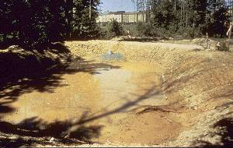
Best Management Practices
Sediment Basin
  Temporary earthen basins formed by the excavation and/or construction of an embankment to detain runoff containing sediment and allow sediments to settle out before discharging.
  Effective for the removal of large- and medium-sized particles and metals that settle out with the sediment.
  Design flow rates are 25 to 500 gpm.

Slide 56
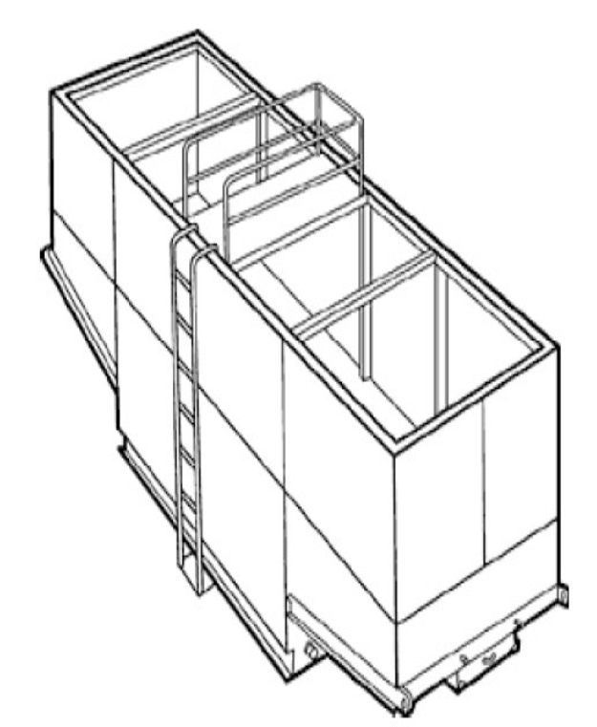
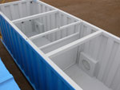

Best Management Practices
Weir Tanks
  Use a series of over-flow and under-flow weirs to maximize the residence time in the tank and achieve efficient settling and removal of sediments including gravel, sand, silt and metals (with the removed sediment).
  Design flow rates are 60 to 100 gpm.

Slide 57
Best Management Practices
Dewatering Tanks
  Equipped with a fabric filter.
  Water enters the tank through the top, passes through the filter, and is discharged through the bottom of the tank.
  Remove trash, gravel, sand, and silt, visible oil and grease, and metals.
  Design flow rates vary.

Slide 58
Best Management Practices
Dewatering Tanks

Slide 59
Best Management Practices
Gravity Bag
  Effective for the removal of sediments (gravel, sand, and silt).
  Metals are removed with the sediment.
  Higher initial design flow rates (300 gpm) when compared to other filters.
  Design flow rates are 300 to 800 gpm.

Slide 60
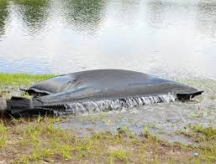
Best Management Practices
Gravity Bag

Slide 61
Best Management Practices
Sand Media Filters
  Water is treated by passing it through canisters filled with sand media.
  Effective for the removal of trash, gravel, sand, and silt and metals, as well as the reduction of BOD and turbidity.
  Often used as a secondary or higher level of treatment after a significant amount of sediment and other pollutants have been removed using other methods.
  Design flow rates are 80 to 1000 gpm.

Slide 62
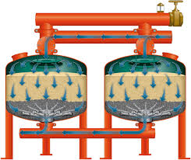
Best Management Practices
(Filters Continued)
Sand Media Filters

Slide 63
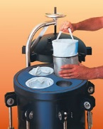
Best Management Practices
Pressurized Bag
  Unit composed of single filter bags made from polyester felt material.
  Water filters through the unit and is discharged through a header.
  Effective for the removal of sediment (sand, silt, and some clays) and metals, as well as the reduction of BOD and turbidity.
  50 to 1000 gpm.

Slide 64
Best Management Practices
Pressurized Bag

Slide 65
Best Management Practices
Cartridge Filters
  High degree of pollutant removal by using a number of individual cartridges as part of a larger filtering unit.
  Often used as a secondary or higher polishing level of treatment after a significant amount of sediment and other pollutants are removed.
  Units come with various cartridge configurations (for use in series with bag filters) or with a larger single cartridge filtration unit (with multiple filters within).
  Design flow rates are 50 to 1000 gpm.

Slide 66
Best Management Practices
Chemical Treatment
  Includes the addition of carefully selected chemicals such as polymers (e.g., polyacrylamide, PAM), alum, or other flocculants to aid in the reduction of turbidity by the removal of smaller particulates such as clay and fine silt.
  Chemical treatment should be considered where turbid discharges to surfaces waters cannot be avoided using other available BMPs and turbidity needs to be reduced to levels less than the water quality standard of 29 nephelometric turbidity units (NTUs) above background.

Slide 67
Best Management Practices
(Chemical Treatment Continued)
Chemical Treatment - Factors to Consider
  The right chemical used at the right dosage.
    Will not cause or contribute to WQS violations.
  Flocculant mixed rapidly into the water to ensure proper dispersion and floc formation.
  Withdrawal system designed to minimize outflow velocities and prevent floc discharge.
    If possible, discharge directed through a physical filter such as a vegetated swale to catch any unintended floc discharge.

Slide 68
Best Management Practices
(Chemical Treatment Continued)
Chemical Treatment - Factors to Consider
  pH adjusting chemical shall be added, if needed.
  Systems can be designed as flow-through continuous or batch-treatment systems.
  Chemicals approved for potable water use
  Primary sediment basins may be required if the water to be treated has a high percentage of suspended solids.

Slide 69
Best Management Practices
(Chemical Treatment Continued)
Continuous Treatment Systems
  Consist of the collection system, a chemical mixing system, sediment collection device, and interconnecting conveyances.
  May include pump(s)
  Primary settling in a sediment basins prior to treatment is recommended if the water to be treated has a high percentage of suspended solids.
  The size of the continuous treatment system has to allow for continuous mixing for the length of time required to complete the reaction at the flow rate expected through the system.

Slide 70
Best Management Practices
(Chemical Treatment Continued)
Batch Treatment Systems
  Consists of the collection system, a sediment basin or sediment trap, pumps, a chemical feed system, treatment cells, and interconnecting piping.
  May be designed using ponds or portable trailer mounted tanks.
  Multiple treatment cells (at a minimum two) to allow clarification of treated water while other cells are filled or emptied.
  The combination of the sediment basin or other holding area and treatment capacity should be large enough to treat the volume of water anticipated

Slide 71
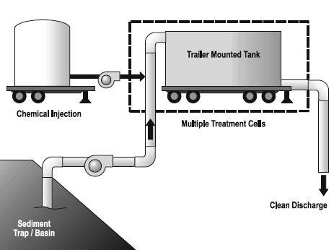
Best Management Practices
(Chemical Treatment Continued)
Chemical Treatment System

Slide 72

Best Management Practices
(Chemical Treatment Continued)

Slide 73
Part II.D. Dewatering Information
(BMP Continued)
Note about Chemical Treatment
  Sites that use cationic treatment chemicals are not eligible unless concurrence from local DEP office is obtained in advance of the submittal of the NOI.
    The site specific BMPs shall include appropriate controls and implementation procedures designed to ensure that the use of cationic treatment chemicals will not cause or contribute to a violation of water quality standards.

Slide 74
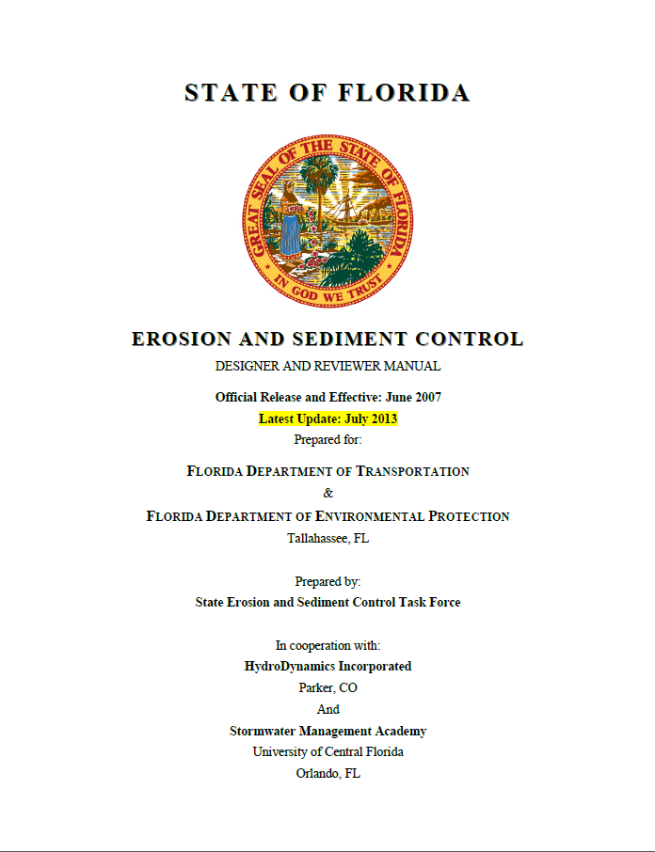
Best Management Practices
Additional Information
State of Florida
Erosion and Sediment Control Designer and Reviewer Manual
2013
http://www.stormwater.ucf.edu/publications/2013RevisedDesignerManual.pdf

Slide 75
Inspection and Maintenance
Visual inspections of earthen embankments and discharge flumes or swales to prevent washout, scouring, and embankment blowouts. Areas subject to erosion shall be grassed or covered with some type of erosion control material.
Sediments accumulated in sediment traps and basins shall be removed as necessary to maintain treatment efficiency.
Sediments removed during the maintenance of a dewatering device shall be handled in accordance with the BMPs developed for the site.
Periodic cleaning of tanks and associated piping and equipment shall be performed based on visual inspection or reduced flow.

Slide 76
Inspection and Maintenance
(Continued)
Gravity filter bags shall be inspected for proper performance at a reasonable frequency based on amount of use. The bag shall be replaced when it no longer filters sediments or passes water at a reasonable rate.
Filters shall be operated and maintained in accordance with manufacturer’s recommendation especially with respect to:
  cleaning,
  backwashing, and
  replacing overused filter media to ensure an acceptable level of efficiency.
The permittee shall maintain records of weekly inspections and maintenance activities required to maintain treatment efficiency.
Notes:
62-621.300(2)(a) IV.B. 6. Weekly Inspection Records.
Is there a recommended or suggested form for this activity? There is no recommended or suggested form for documenting the weekly inspection records. Each permittee will keep the records in the form best suited for their project as long as the required information is maintained.

Slide 77
THE SITE INSPECTION
Ask yourself these basic questions
before & after each inspection
Is the project permitted ?
Are all BMP’s properly installed & maintained?
Is on-site erosion being controlled ?
Is off-site sedimentation and/or turbidity being controlled?
Do your records confirm items 1-4 above?
If “YES” to all, the site is probably in Compliance
If “NO” to any, the site is in Violation

Slide 78
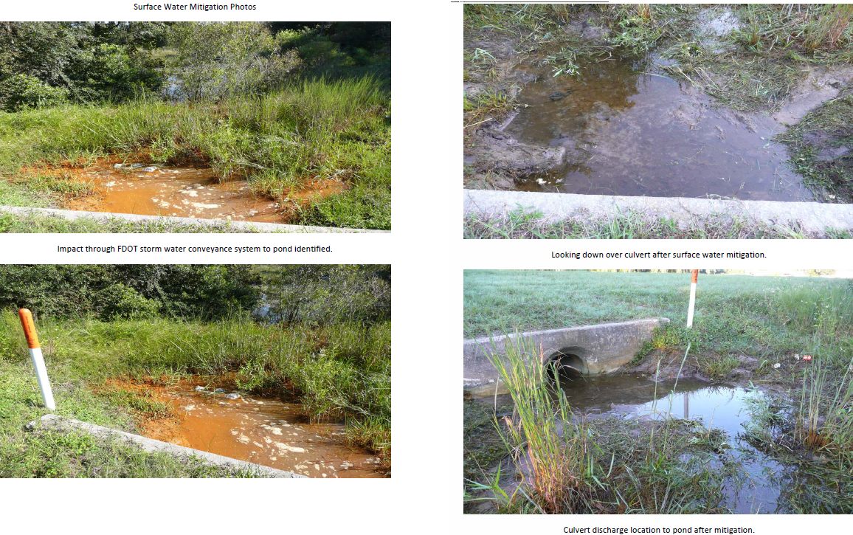
Result of non-BMPs
BEFORE: no visual inspection of discharge and inadequate BMPs
AFTER: expensive cleanup of receiving water

Slide 79
Recordkeeping Requirements
Records of all data, including reports and documents, used to complete the NOI requesting coverage under the permit for at least 3 years from the date the Notice of Intent was filed.
Records of flow monitoring as required in Part III.B.1., records of chemicals used for treatment, if any, and records of inspections and maintenance activities identified in Part IV.B.6. of the generic permit for at least 3 years from the date the record was created.
Copy of the permit.
Copy of cover letter issued by the Department.

Slide 80
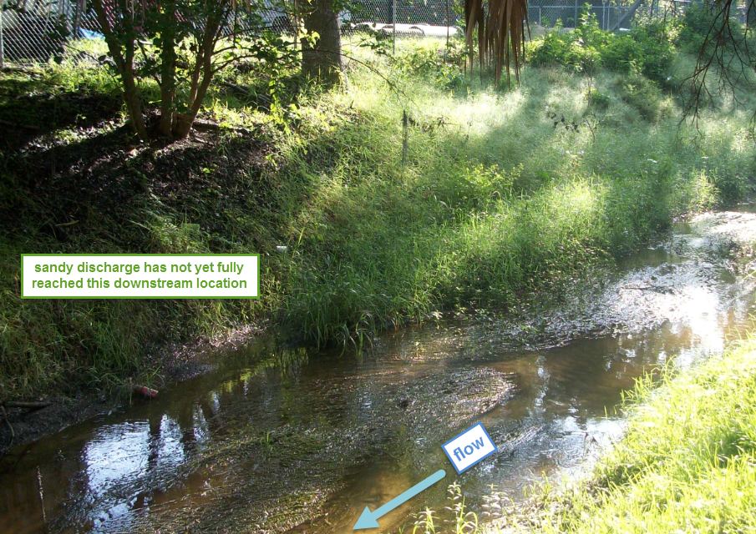
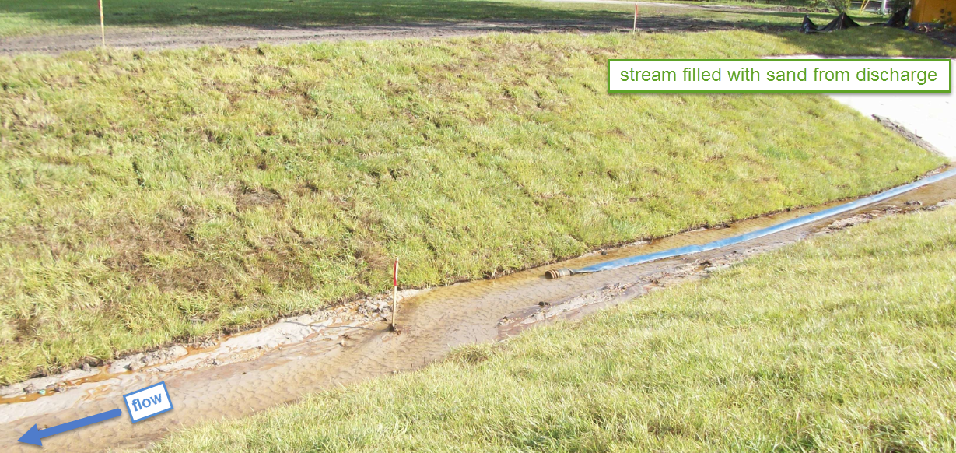
Compliance Assurance
FDEP Northeast District has several trained inspectors for stormwater and dewatering compliance
Cross-training of FDEP inspectors increases the likelihood that more sites will be visited

Slide 81
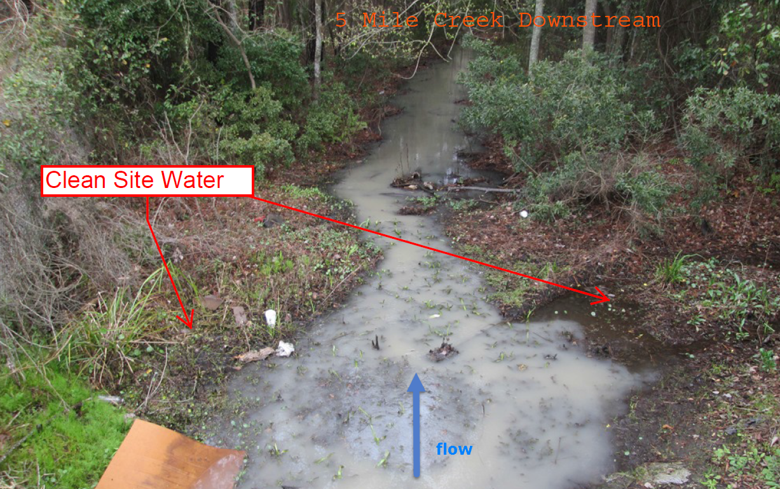
Compliance Assurance
FDEP Northeast District has several trained inspectors for stormwater and dewatering compliance
Cross-training of FDEP inspectors increases the likelihood that more sites will be visited
Citizen complaints can draw attention to a site

Slide 82
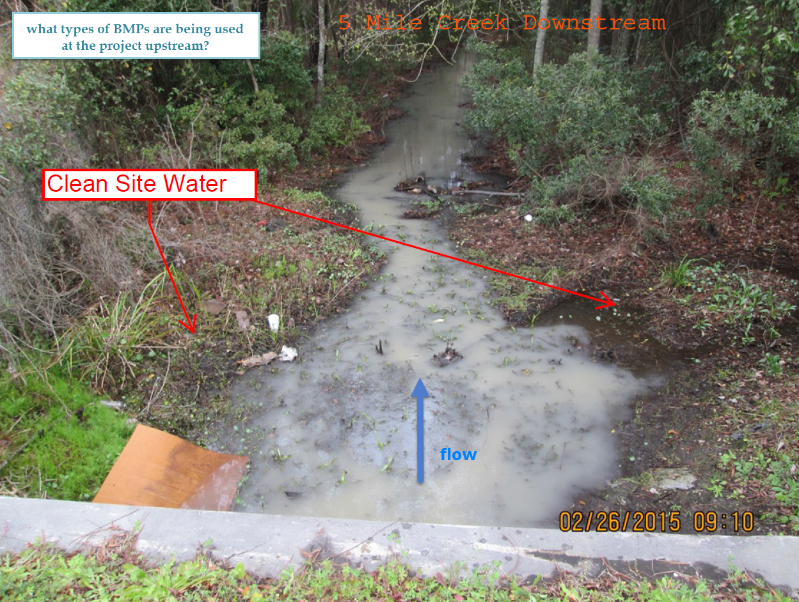
Compliance Assurance

Slide 83
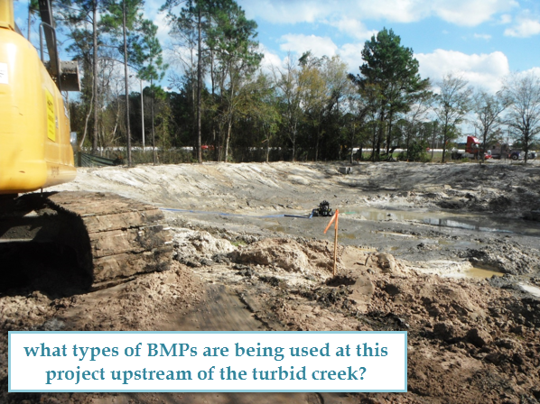
Compliance Assurance
FDEP Northeast District has several trained inspectors for stormwater and dewatering compliance
Cross-training of FDEP inspectors increases the likelihood that more sites will be visited

Slide 84
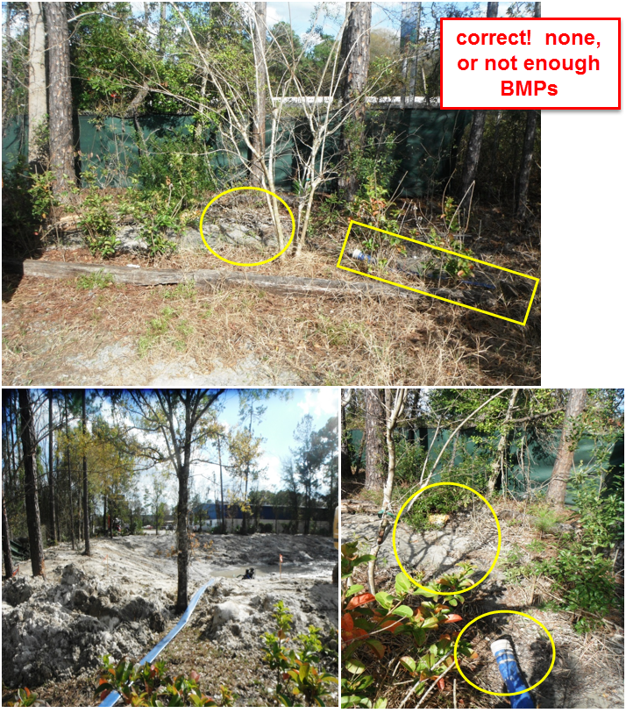
Compliance Assurance
FDEP Northeast District has several trained inspectors for stormwater and dewatering compliance
Cross-training of FDEP inspectors increases the likelihood that more sites will be visited
Citizen (and contractor) complaints can draw attention to a site

Slide 85
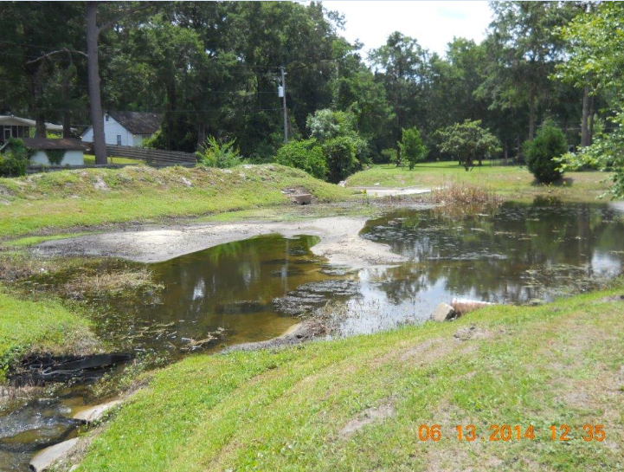
Result of non-BMP’s
Stormwater pond used incorrectly as a sedimentation basin

Slide 86
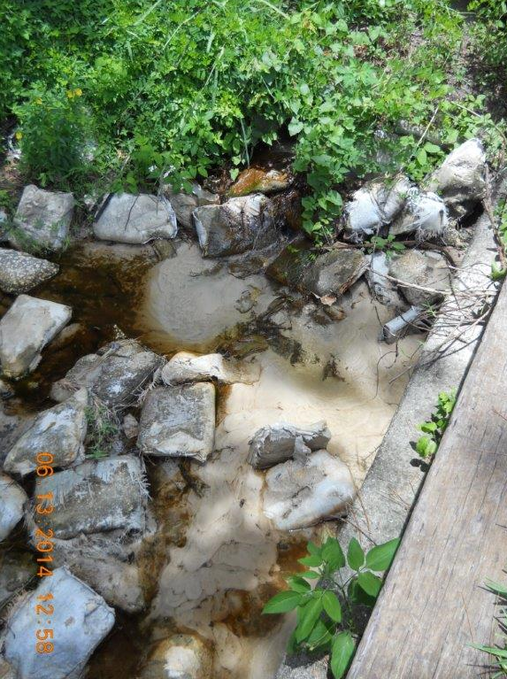
Result of non-BMP’s
Sedimentation downstream results from not using correct BMPs at construction site upstream

Slide 87
Other Conditions
The discharge shall not cause a violation of surface water quality standards.
Report any characteristic in the effluent that could indicate the presence of a pollutant(s) not previously identified or anticipated, and the occurrence, or new knowledge of, any spills, leaks or contamination in the vicinity of the project that could impact the water quality of the effluent.
If contamination in the vicinity of the site that causes or contributes to violations of water quality standards is encountered, the permittee shall cease dewatering operations and contact the Department.
Other Specific Conditions as outlined in Part VI. of the permit.

Slide 88
General Conditions
Including those general conditions applicable to dewatering operations, such as;
  Notification Requirements.
  Bypass Provisions
  Upset Provisions

Slide 89
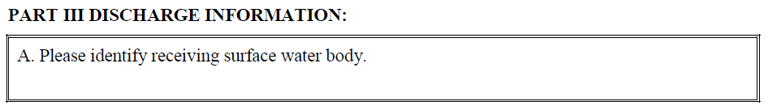
The NOI: Parts III-V.
Additional Information (Bipin)
Receiving Surface Water Body Identification

Slide 90
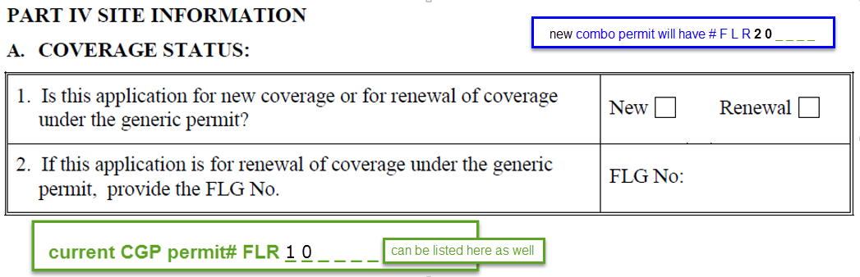
The NOI: Parts III-V.
Additional Information
Receiving Surface Water Body Identification
Coverage Status

Slide 91

The NOI: Parts III-V.
Additional Information
Receiving Surface Water Body Identification
Coverage Status
Site Name

Slide 92
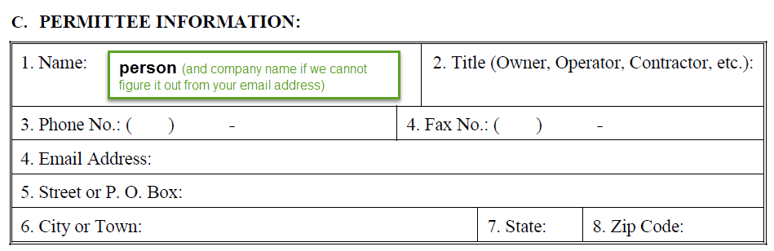
The NOI: Parts III-V.
Additional Information
Receiving Surface Water Body Identification
Coverage Status
Site Name
Permittee Information

Slide 93
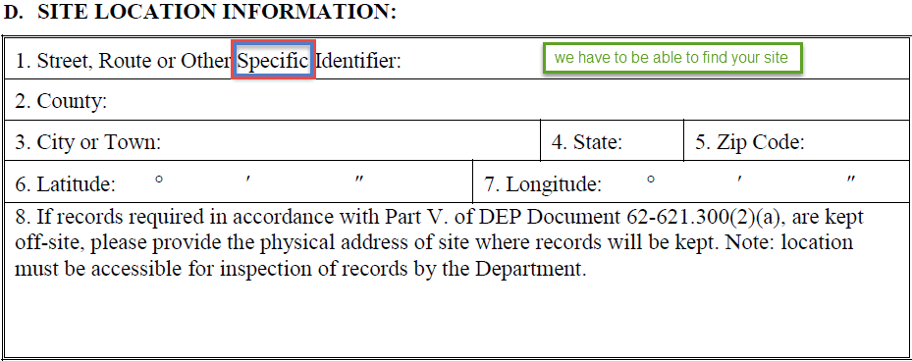
The NOI: Parts III-V.
Additional Information
Receiving Surface Water Body Identification
Coverage Status
Site Name
Permittee Information
Site Location Information – include whether records will be off-site
  If records are kept off-site, then list the physical address of site where records will be kept.

Slide 94
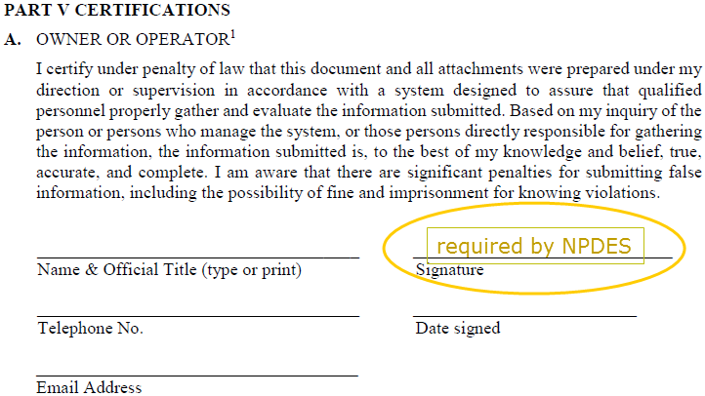
The NOI: Parts III-V.
Additional Information
Receiving Surface Water Body Identification
Coverage Status
Site Name
Permittee Information
Site Location Information
Certification

Slide 95
Processing of NOI
Dewatering operations only
  Form(2)(b) processed by DEP District Office
  Send fee with form (paper/paper)

Slide 96
Processing of NOI
Dewatering operations only
  Form(2)(b) processed by DEP District Offices
  Send fee with form
Dewatering operations as part of construction activities at sites which require CGP coverage
  Form (4)(b) processed by Tallahassee NPDES Stormwater Program
  Apply online & pay online

Slide 97
Termination of Coverage
NOTICE OF TERMINATION GENERIC PERMIT FOR DISCHARGE OF GROUND WATER FROM DEWATERING OPERATIONS
DEP Document
Form 62-621.300 (2)(f)

Slide 98
Questions
Questions?
Contact Information
  Bipin Adhyaru
  904.256.1667
  Bipin.Adhyaru@dep.state.fl.us
  Kim Pearce
  904.256.1686
  Kimberly.Pearce@dep.state.fl.us
  Ed Jamro
  904.256.1617
  Edward.Jamro@dep.state.fl.us

