Slide 1
Florida Department of
TRANSPORTATION
FLORIDA DEPARTMENT OF TRANSPORTATION
THIRD PARTY DAMAGES
Rudy Powell, P.E., State Construction Engineer
2014 FTBA Construction Conference February 2014 Orlando, FL

Slide 2
Florida Department of
TRANSPORTATION
Road Map
What is third party damage?
What is existing property and installed material?
Why change?
What are the changes?
What is the process?

Slide 3
Florida Department of
TRANSPORTATION
What is third party damage?
Damage caused by an individual not associated with the contract. The prime, subcontractor, supplier, vendor, etc. are associated with the contract so they are not third parties.

Slide 4
Florida Department of
TRANSPORTATION
What is existing property and installed material?
Existing property is public or private property within the project limits which is not part of the project.
Installed material is material placed, built, erected, or deployed as part of the project. Installed material is not tools, equipment, vehicles, or stored or stockpiled material.

Slide 5
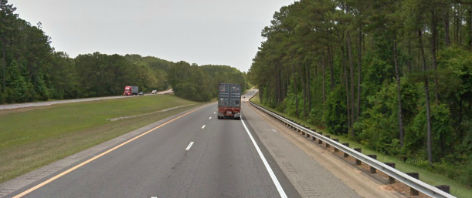
Florida Department of
TRANSPORTATION
What is existing property and installed material?
Installed Material
Existing Property
New Guardrail

Slide 6
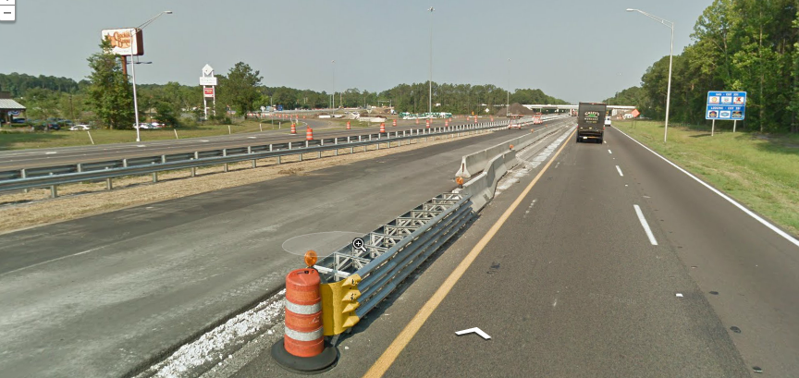
Florida Department of
TRANSPORTATION
What is existing property and installed material?
Installed Material
Existing Property

Slide 7
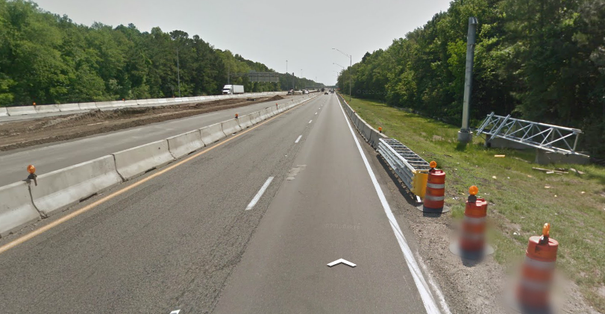
Florida Department of
TRANSPORTATION
What is existing property and installed material?
Installed Material
Not Installed Material

Slide 8
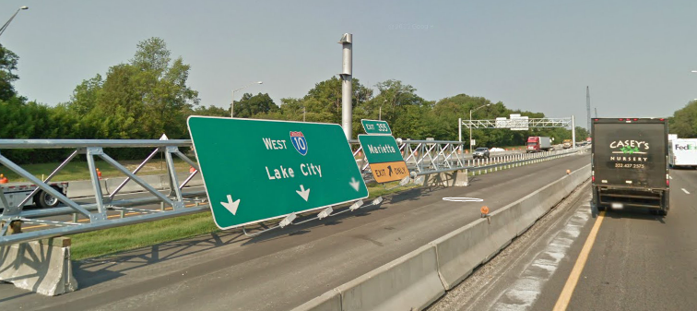
Florida Department of
TRANSPORTATION
What is existing property and installed material?
Not Installed Material
Installed Material

Slide 9
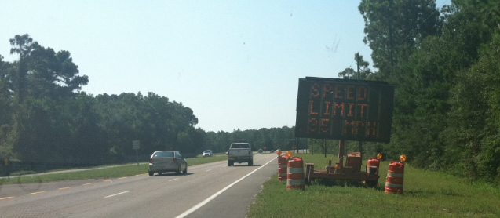
Florida Department of
TRANSPORTATION
What is existing property and installed material?
Installed Material

Slide 10
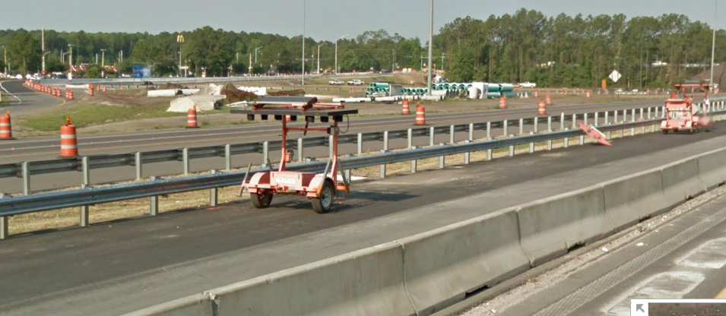
Florida Department of
TRANSPORTATION
What is existing property and installed material?
Not Installed Material

Slide 11
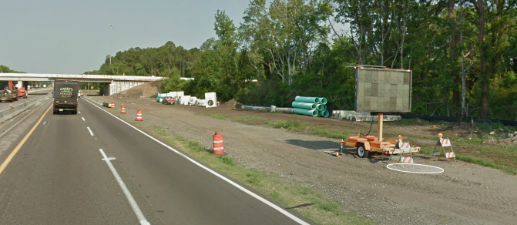
Florida Department of
TRANSPORTATION
What is existing property and installed material?
Not Installed Material

Slide 12
Florida Department of
TRANSPORTATION
Why change?
To establish a more equitable risk allocation.
Absorb the risk
Bid the risk
Insure the risk
Change approach
RISK
Assign risk to the party best suited to handle the risk.

Slide 13
Florida Department of
TRANSPORTATION
What are the changes?
Third Party Damage | Prior to January 1, 2014 |  | After January 1, 2014
 | Responsible Party | Reference | Responsible Party | Reference
Existing Property | Department | Subarticle 7-11.4 | Department | Subarticle 7-11.1 (language moved from 7-11.4)
Installed Material | Contractor | Article 7-14 |  | Article 7-14
Department/ Contractor
Repair of damage to existing property and installed material caused by the contractor, subcontractor, vendor, supplier, etc. was and is the responsibility of the contractor.

Slide 14
Florida Department of
TRANSPORTATION
What are the changes?
Third Party Damage to Existing Property
Subarticle 7-11.1
The contractor will either restore the existing property to a condition equal to or better, or provide access and coordinate with the Department’s maintenance Contractor as directed by the Engineer.
The Department will compensate in accordance with Article 4-4.
Theft and vandalism are considered third party damage.

Slide 15
Florida Department of
TRANSPORTATION
What are the changes?
Third Party Damage to Installed Material
Article 7-14
The contractor may pursue recovery from the third party or seek reimbursement from the Department, but not both.
Requirements for reimbursement from the Department:
Contact law enforcement
Receive a completed Florida Traffic Crash Report
Provide the report to the Department within 14 calendar days of receipt
Upon submission of the report, the Department solely retains the right to pursue recovery.

Slide 16
Florida Department of
TRANSPORTATION
What are the changes?
Third Party Damage to Installed Material
Article 7-14
If damage to installed material is caused by a known third party, the Department will reimburse the Contractor for costs associated with the repair after reducing the amount of the repair cost by a $2000.00 deductible for each occurrence, borne solely by the Contractor.
If the Department is successful in recovery, the Contractor may be reimbursed proportionally, up to the amount of the deductible.

Slide 17
Florida Department of
TRANSPORTATION
What are the changes?
Third Party Damage to Installed Material
Article 7-14
Known Third Party Example 1
Damage cost= $10,000
Reimbursement to contractor= $10,000- $2,000= $8,000
Department recovery= $10,000
Deductible reimbursed to contractor= $2,000
Total reimbursement to contractor= $10,000

Slide 18
Florida Department of
TRANSPORTATION
What are the changes?
Third Party Damage to Installed Material
Article 7-14
Known Third Party Example 2
Damage cost= $10,000
Reimbursement to contractor= $10,000- $2,000= $8,000
Department recovery= $6,000
Deductible reimbursed to contractor= $2,000x 0.6= $1,200
Total reimbursement to contractor= $9,200

Slide 19
Florida Department of
TRANSPORTATION
What are the changes?
Third Party Damage to Installed Material
Article 7-14
If damage to installed material is caused by an unknown third party, the Department will reimburse the contractor for 50% of the cost of the repair after reducing the amount of the repair cost by a $2000.00 deductible for each occurrence, borne solely by the Contractor.

Slide 20
Florida Department of
TRANSPORTATION
What are the changes?
Third Party Damage to Installed Material
Article 7-14
Unknown Third Party Example
Damage cost= $10,000
Reimburse. to contractor= ($10,000- $2,000)x 0.5= $4,000

Slide 21
Florida Department of
TRANSPORTATION
What are the changes?
Third Party Damage to Installed Material
Article 7-14
Theft and vandalism are considered damage caused by an unknown third party.
Repair cost will be determined in accordance with Article 4-4.

Slide 22
Florida Department of
TRANSPORTATION
What are the changes?
Repair Cost of Third Party Damage
Article 4-4
When the Department requires work that is not covered by a price in the Contract and …, the Department will make an adjustment to the Contract. The Engineer will determine the basis of payment for such an adjustment in a fair and equitable amount.
For the most cases “a fair and equitable amount” will be based labor, material, equipment, and indirects in accordance with subarticle 4-3.2.

Slide 23
Florida Department of
TRANSPORTATION
What is the process?
Third Party Damage
Repair work and cost via Work Order or Supplemental Agreement
Money encumbered and deductible reimbursed via line item adjustment
Prime Contractor
Project Administrator/
Resident Engineer
CPAM Section 7.7
Notice of deduct. recovered
Office of General Counsel
Procedure 225-085-002
Known Third Party

Slide 24
Florida Department of
TRANSPORTATION
Review
What is third party damage?
What is existing property and installed material?
Why change?
What are the changes?
What is the process?

Slide 25
Florida Department of
TRANSPORTATION
Questions/ Comments?
For more information contact:
Rudy Powell, P.E.
State Construction Engineer
Florida Department of Transportation
(850) 414-4280
rudy.powell@dot.state.fl.us

