Slide 1
Section 330-12.3 Cross Slope
District 1

Slide 2
Cross Slope Control
Cross slope can play a major role in safety and ride quality of a roadway.
Not enough slope can contribute to poor drainage resulting in hydroplaning or lateral drift of passing vehicles.
To much slope can result in sway of large body vehicles and driver discomfort.
Inconsistent or sudden changes in cross slope can have a negative impact on the ride quality and driver comfort.

Slide 3
What We’ll Cover Today
Goal of the revised spec.
QC role and requirements
CEI & Verification role and requirements
Measurements and tolerances.
What’s acceptable and what’s not
Corrective actions

Slide 4
Goal of 330-12.3 Revised
Clarify QC and VT processes for Tangent Section and Super-elevated Section
Realistic and meaning full requirements for accuracy
Specify process of Calibration and comparisons
Finalize the criteria of cross slope acceptance and removal and replacement of the defect area

Slide 5
Requirements of 330-12.3
Measuring device
Level
Digital read out
Minimum length 4 feet
Accuracy to 0.1 degrees
Calibrate a minimum of once per day
Record all measurements on an approved form

Slide 6
QC Requirements
Tangent Sections
Minimum Frequency: One measurement every 100 feet.
Calculate the deviation cross slope at each
measurement
Deviation = ׀Measured cross slope –Design cross slope׀.
Average the deviation of ten consecutive measurements
Compare Average deviation to table 330-2.
If acceptable reduce frequency to 200’ if approved by Engineer

Slide 7
QC
Super-Elevated Sections
One measurement every 100 feet in the full super elevation.
For transitions one measurement at every control point as specified in the plans.
If no control points are specified or transition is less than 250’ take a minimum of three measurements: start of transition, 0% point, and end of transition, (same for full super)
Average the deviation separately for the transition and the full super.
Compare Average deviation to table 330-2.

Slide 8
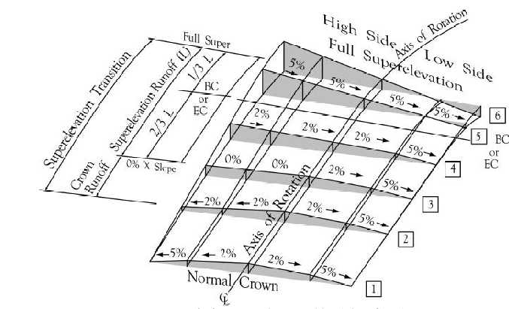
Transitions
End transition
Location of 0%
Start transition

Slide 9
Verification
Minimum Frequency:
Tangent sections, Randomly select ten cross slope measurements per lane mile, (one every 500 feet)
Super-elevated sections, Verify all control points in transitions, and a minimum of three points on the full-super.

Slide 10
Summary
Tangent
QC: Start every 100’,
Every 200’ if approved by the engineer.
VT: Minimum 10 per mile
Transition
QC: measure each design control point. If no control points given measure beginning, 0%, and end.
VT: Same
Full Super
QC: measure every 100’ a minimum of 3 points.
VT: Minimum of 3 points.

Slide 11
Acceptance Tolerance

Slide 12
Exceptions
For intersections, tapers, crossovers, transitions at the beginning and end of the project, bridge approaches and similar areas; unless specified in the plans adjust the cross slope to match the actual site conditions, or as directed by the Engineer.

Slide 13
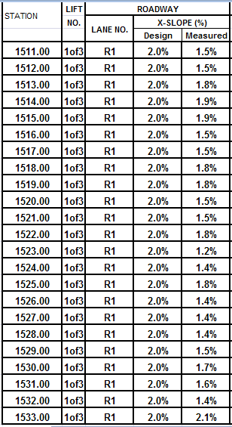
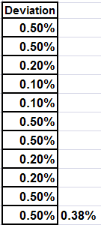
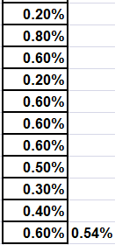
Example Tangent
Area Fails both the absolute average and individual measurement.
> .02%
Area Fails both the absolute average and individual measurement.
>.0 2%

Slide 14
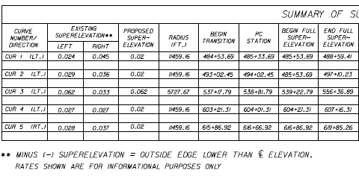
Example Super-elevation
Design Control Point

Slide 15
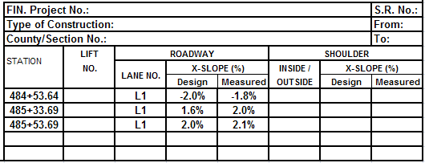
What’s Acceptable
Transition Example

Slide 16
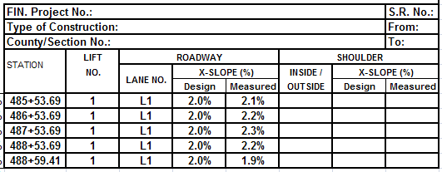
What’s Acceptable
Example Full Super

Slide 17
Corrective Action
Notify the Engineer immediately if any measured sections do not meet criteria of table 330-2.
Engineer will determine if the deficiency poses an impact to the overall traffic safety, surface drainage, or ride quality. If the deficiencies are sufficiently separated and do not pose an impact, Engineer may waive corrections at no reduction in pay. If not request to have it corrected per 330-12.5.
Engineer reserves the right to check the cross slope measurements at any time or location.

Slide 18
Corrective Action
For those instances corrective action may unnecessarily mar the appearance of the finished pavement the contractor request to leave deficient cross slope (Friction Course only) in place & the Engineer approves said requests, it should be handled as a pay reduction in accordance with 330-12.5.1.2 & 330-12.5.2. The reduction form (700-050-71).

Slide 19
Questions ?

