Slide 1
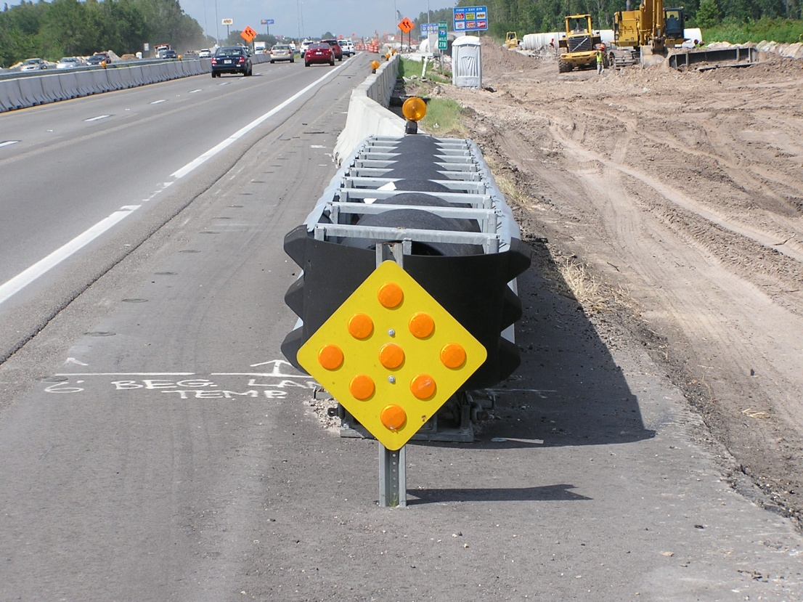
2012 Update training
Contact Information:
Marshall Douberley
863-519-2382
marshall.douberley@dot.state.fl.us
Earl Taylor
863-519-2231
earl.taylor@dot.state.fl.us
Maintenance
of Traffic
Notes:
My name is Ezzell Benghuzzi,
I work in the Criteria Section and I’m responsible for Maintenance of Traffic.
See my contact information

Slide 2

2012 Design Standards
Summary of Major Changes
Effective July 1, 2012
Notes:
In this session we will discuss the updates to the Maintenance of traffic 2012/2013 Design Standards. That will be effective July 1, 2012

Slide 3
Index 600 Sheet 3
High-Visibility Safety Apparel
Shall meet ANSI/ISEA 2010 and 2004
– No changes to the Performance Class scheme
– Requirements for rainwear background fabric
– Changes related to design features
– Optional criteria for Flame Resistant items
– Guidance on service life of apparel
Notes:
The safety vests updated to ANSI/ISEA 2010 requirements, 2004 garments that are serviceable are still ok. When we order new garments require 2010 label.
(American National Standards Institute, International National Safety Institute,)

Slide 4
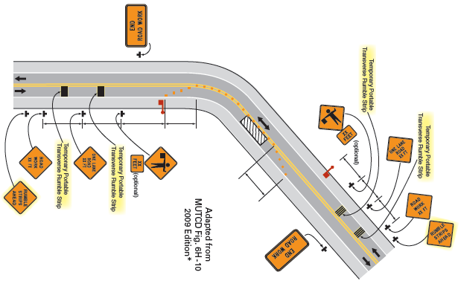
Index 600 Sheet 4
Notes:
The designer should consider the use of rumble strips if additional driver alertness is needed for example at Limited stopping sight distance at horizontal and vertical curves

Slide 5
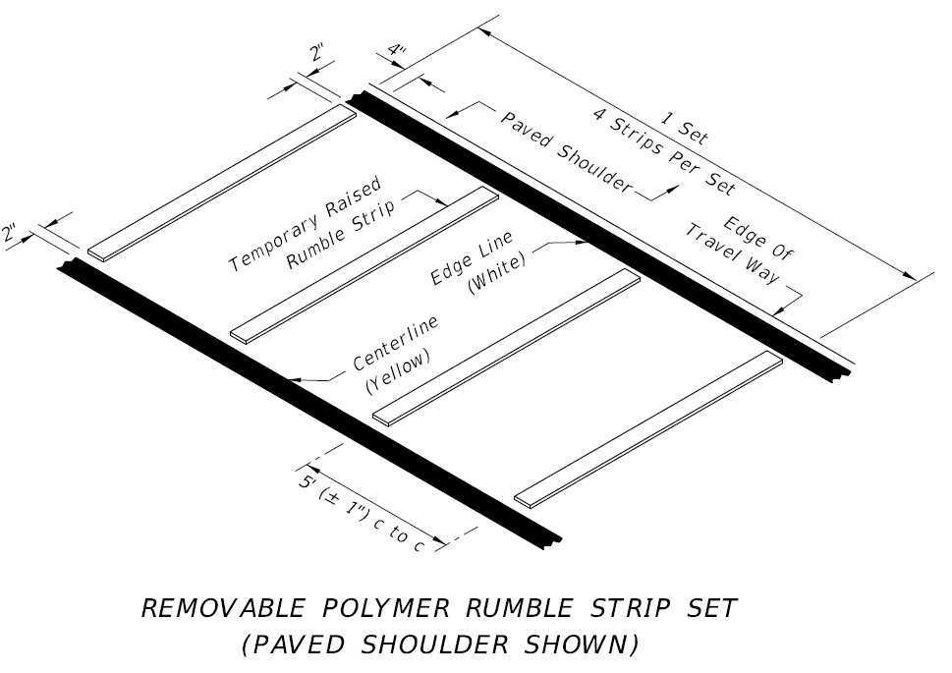
Index 600 Sheet 4
Removable Polymer Rumble Strip
Notes:
on a 2 way 2 lane facility lane closure, The designer has the option of using rumble strips. Index 600 sheet 4 shows the removable Polymer Rumble strips:
250 mil or .25 inch thick
4 inch wide
11 feet long

Slide 6
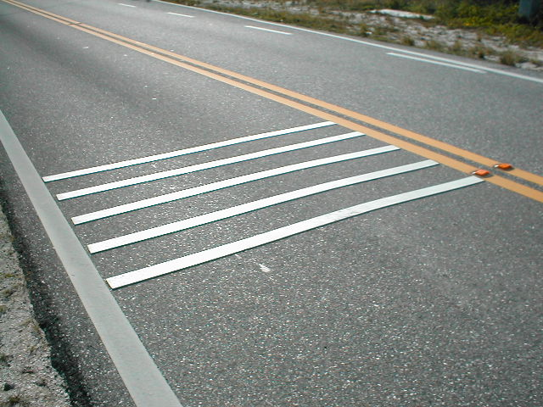
Index 600 Sheet 4
Removable Polymer Rumble Strip
Notes:
This pictures shows a set of the Removable Polymer rumble strips made by Advanced Traffic marking

Slide 7
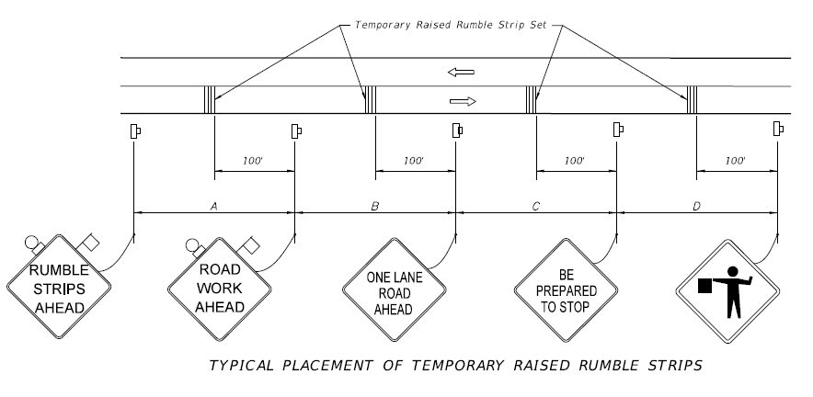
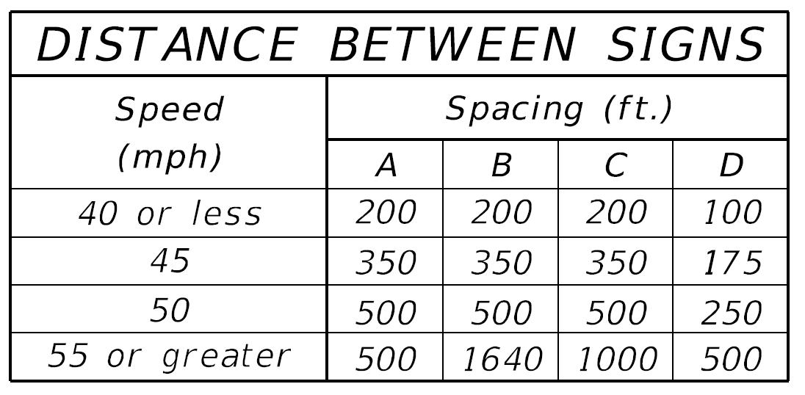
Index 600 Sheet 4
Removable Polymer Rumble Strip
Notes:
Included in index 600 sheet 4 the signs and the distances between the sets. There are 4 sets and each set is made up of 4 stripes. Light on signs are required for night operation

Slide 8
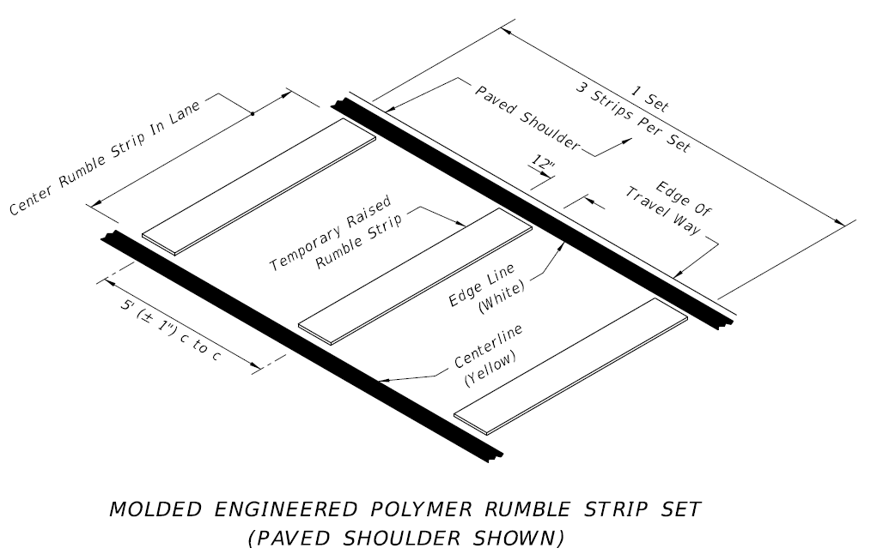
Index 600 Sheet 4
Molded Engineered Polymer Rumble Strip
Notes:
Another type of Rumble Strips is the Molded Engineered Polymer Rumble Strips:
1 inch High
12 inch wide
11 feet
weight 100 lb and do not require anchoring and they are reusable.

Slide 9
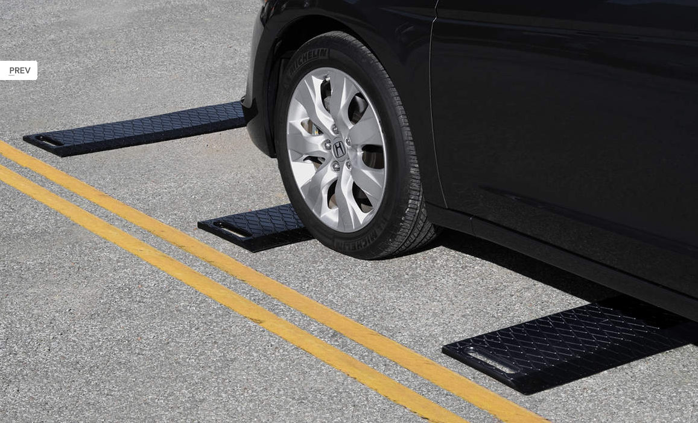
Index 600 Sheet 4
Molded Engineered Polymer Rumble Strip
Notes:
Close picture of the rumble strips

Slide 10
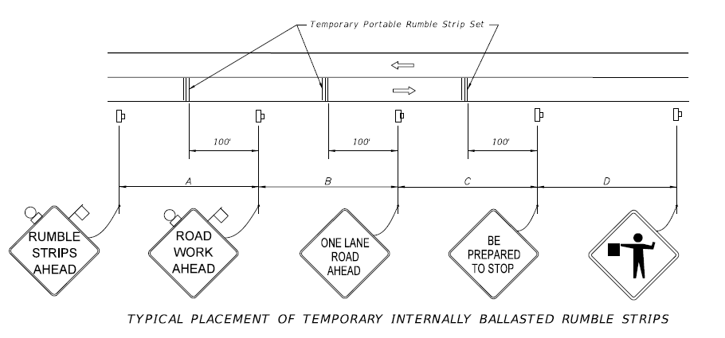
Index 600 Sheet 4
Molded Engineered Polymer Rumble Strip
Notes:
Included in index 600 sheet 4 the signs and the distances between the sets. There are 3 sets and each set is made of 3 stripes. . The reason for the reduction of sets and strips, because this type of rumble strips is thicker and provide greater level of sound and vibration.

Slide 11
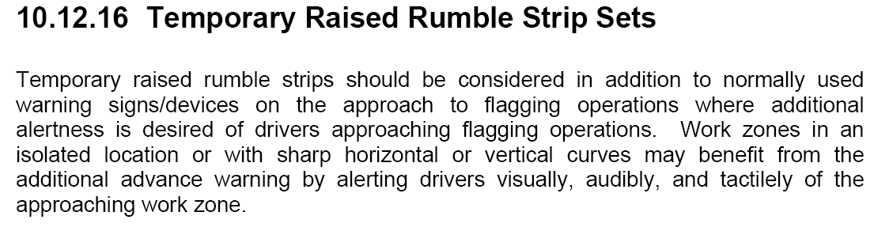
Index 600 Sheet 4
PLAN PREPARATION MANUAL
PAY ITEM
102-910- TEMPORARY RAISED RUMBLE STRIP SET
Notes:
The designer should consider the use of rumble strips if additional driver alertness is needed for example at Limited stopping sight distance at horizontal and vertical curves

Slide 12
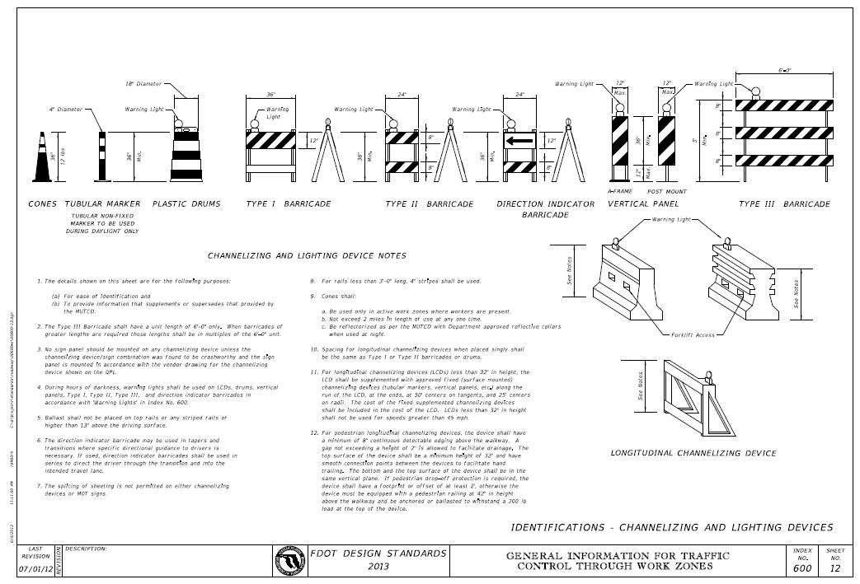
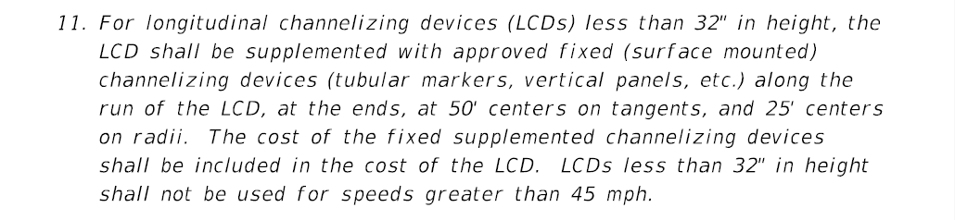
Index 600 Sheet 12
Longitudinal Channelizing Devices (LCD)
Notes:
Added to the 600 index , the Longitudinal Channelizing Devices (an empty water filled Barrier) can be used interlocked or stand alone in lieu of Drums or barricades

Slide 13
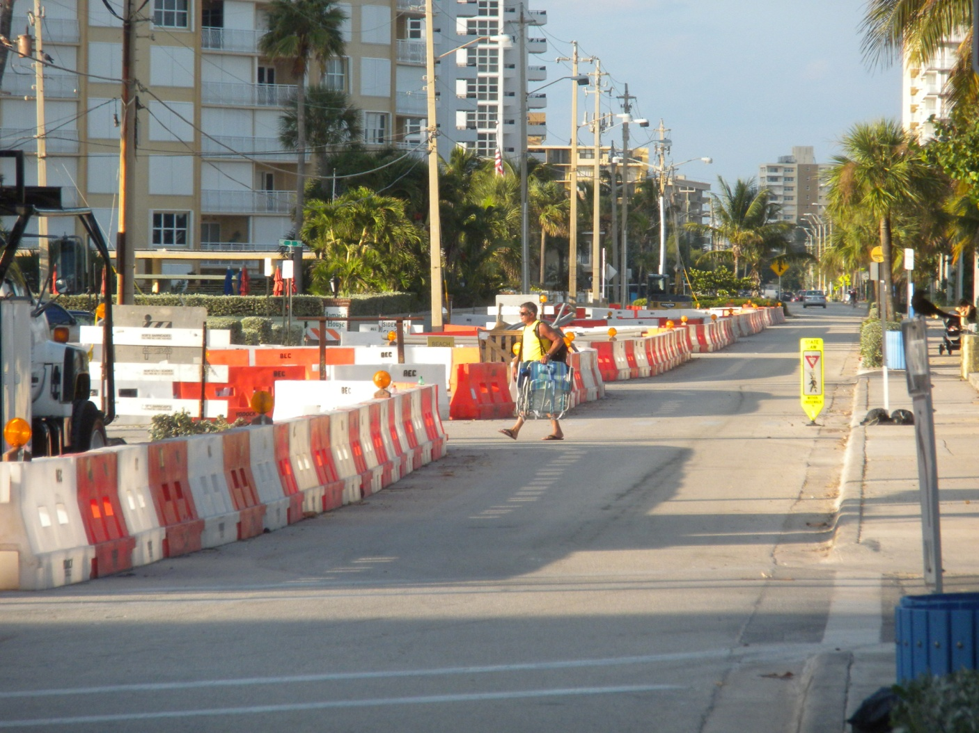
Index 600 Sheet 12
Longitudinal Channelizing Devices (LCD)
Vehicle Longitudinal Channelizing Devices
Notes:
This is an example of LCD used in South Florida

Slide 14
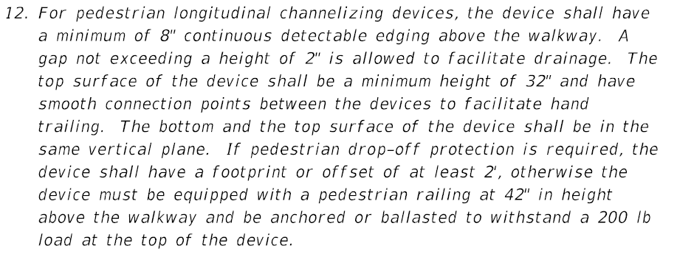
Index 600 Sheet 12
Longitudinal Channelizing Devices (LCD)
Notes:
Added to the 600 index , the Longitudinal Channelizing Devices (an empty water filled Barrier) can be used interlocked or stand alone in lieu of Drums or barricades

Slide 15
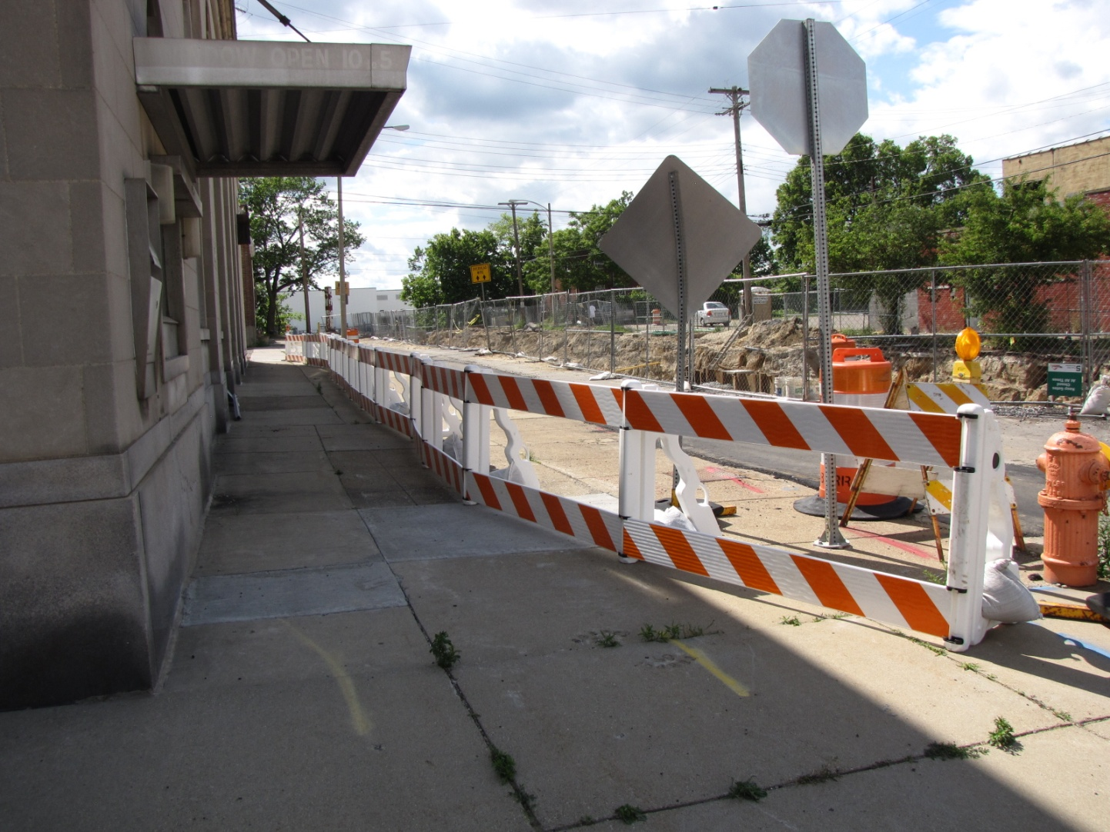
Index 600 Sheet 12
Longitudinal Channelizing Devices (LCD)
Pedestrian Longitudinal Channelizing Devices
Notes:
This is an example of LCD used in South Florida

Slide 16
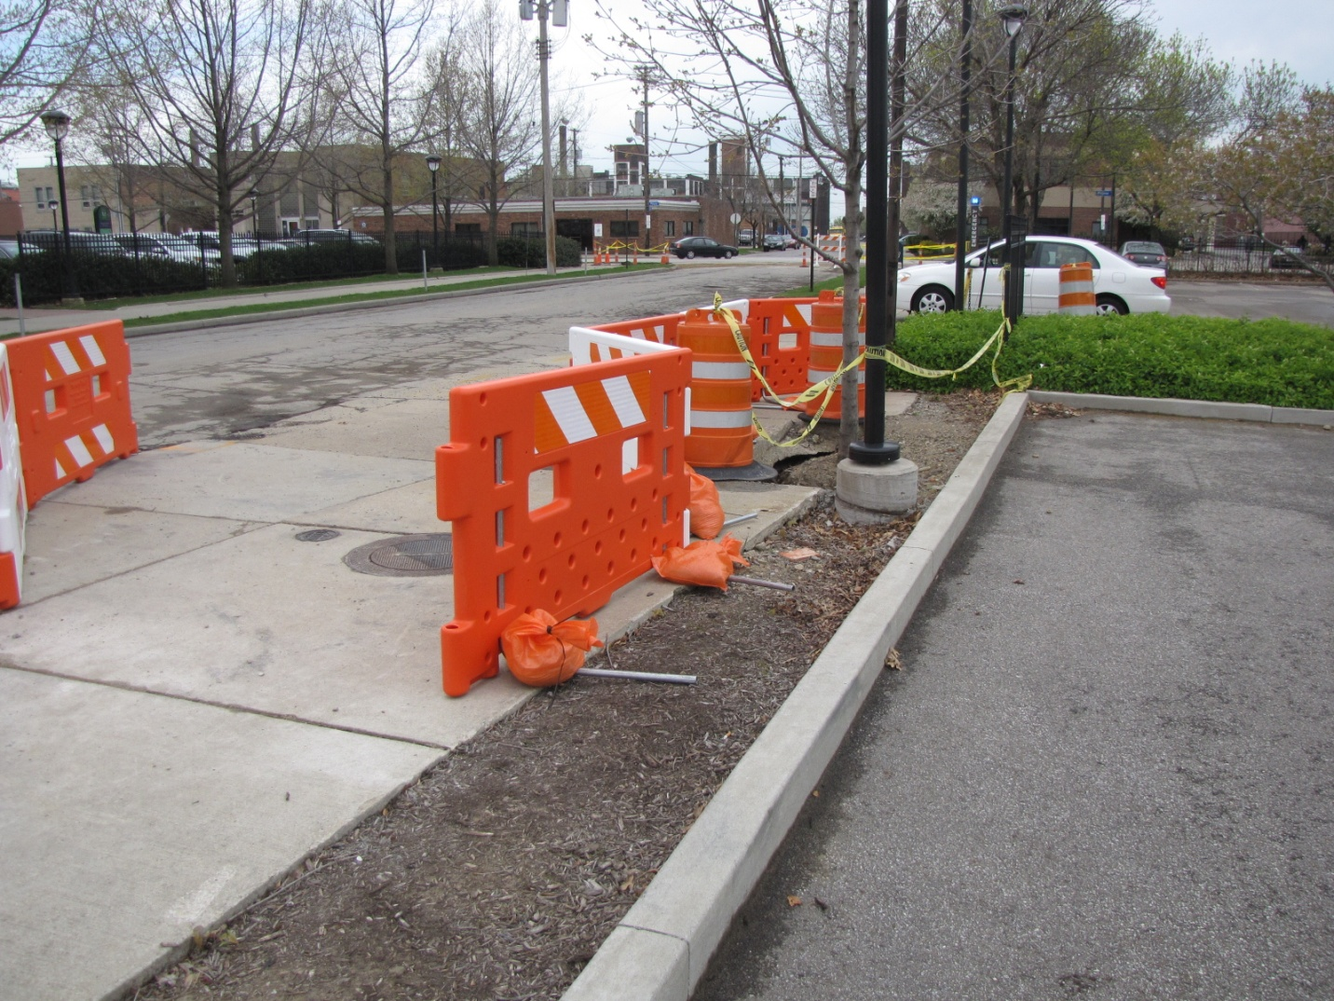
Index 600 Sheet 12
Longitudinal Channelizing Devices (LCD)
Pedestrian Longitudinal Channelizing Devices
Notes:
This is an example of LCD used in South Florida

Slide 17
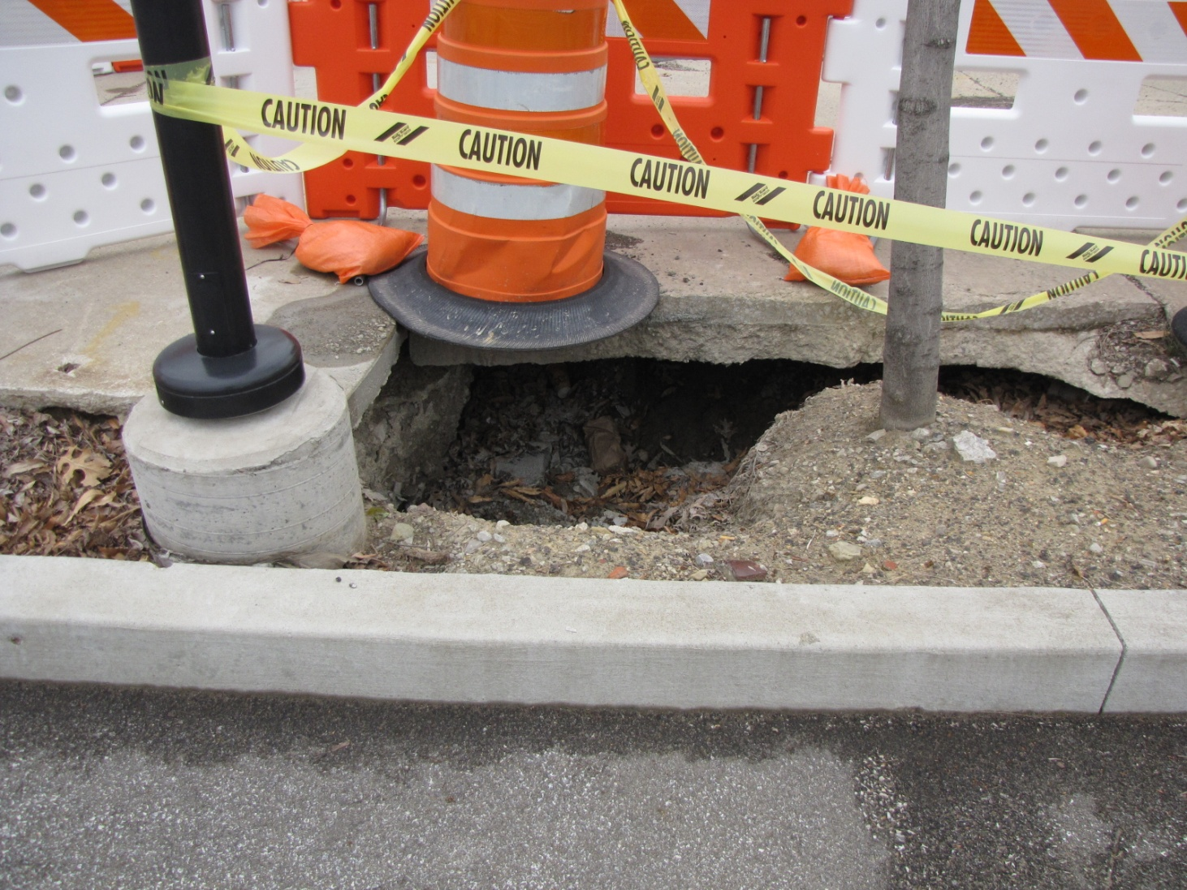
Index 600 Sheet 12
Longitudinal Channelizing Devices (LCD)
Pedestrian Longitudinal Channelizing Devices
Notes:
This is an example of LCD used in South Florida

Slide 18
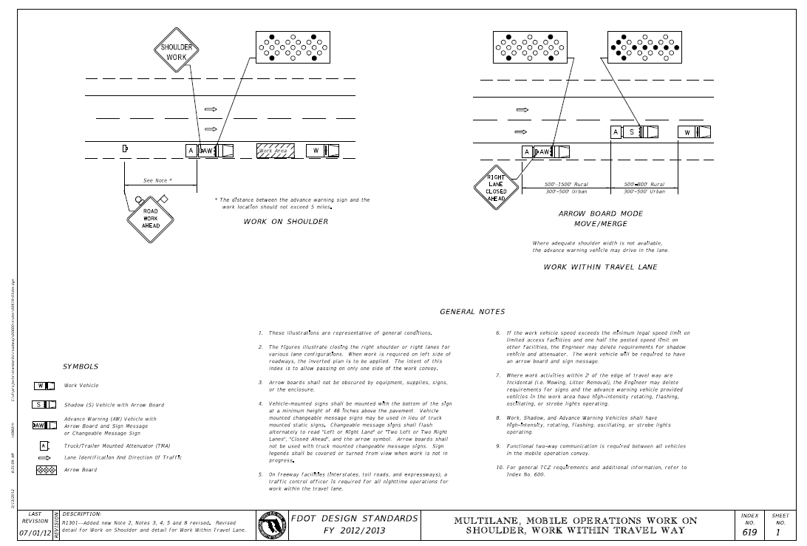

Index 619 Sheet 1
Multilane, Mobile Operations Work on Shoulder, Work Within Travel Way
Notes:
Index 619 multi lane Mobile operations work on shoulder, work within Travel way has been modified to require additional TMA (truck Mounted Attenuators) for more than two lanes facility in each direction. I would like to stress on note 5: traffic control officer is required on freeway facility for night time operation.

Slide 19
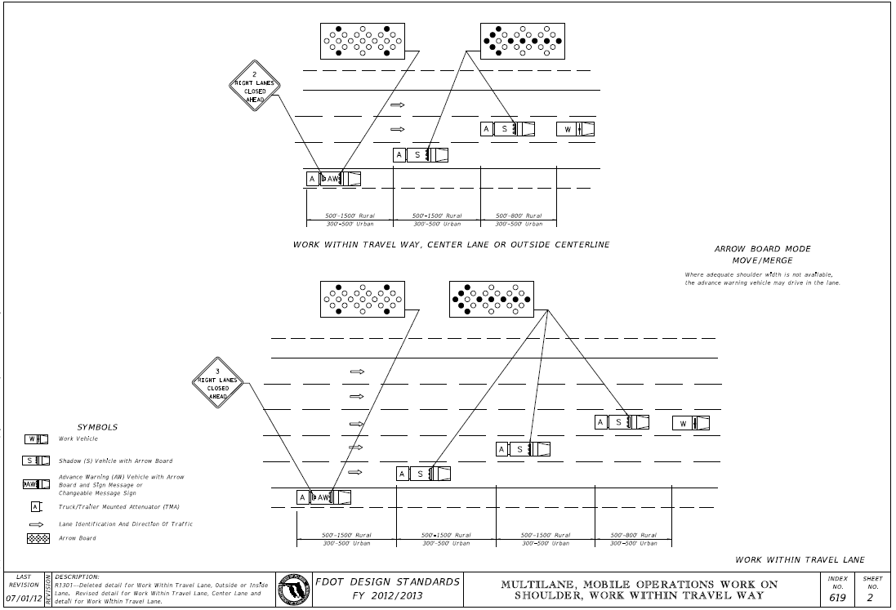
Index 619 Sheet 2
Multilane, Mobile Operations Work on Shoulder, Work Within Travel Way
Notes:
On three and five lane in each direction facilities. The TMA (truck Mounted Attenuators) restrict motorists to one side of the moving operation

Slide 20
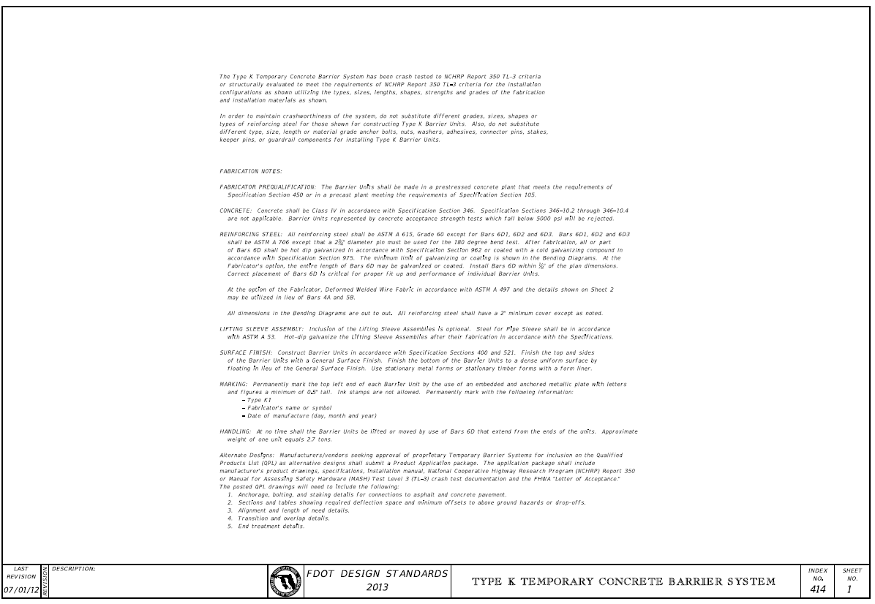
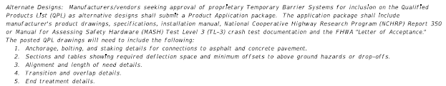
Concrete Barrier System Index 414
Notes:
This is a detail out of index 415 showing a crash cushion abutting 4 units of type K barrier . If we look closer to the type K barrier we notice the stakes are in the barrier side closer to the traffic. We do not need to show staking pattern in the plans. The contractor should get this information from the standards index.

Slide 21
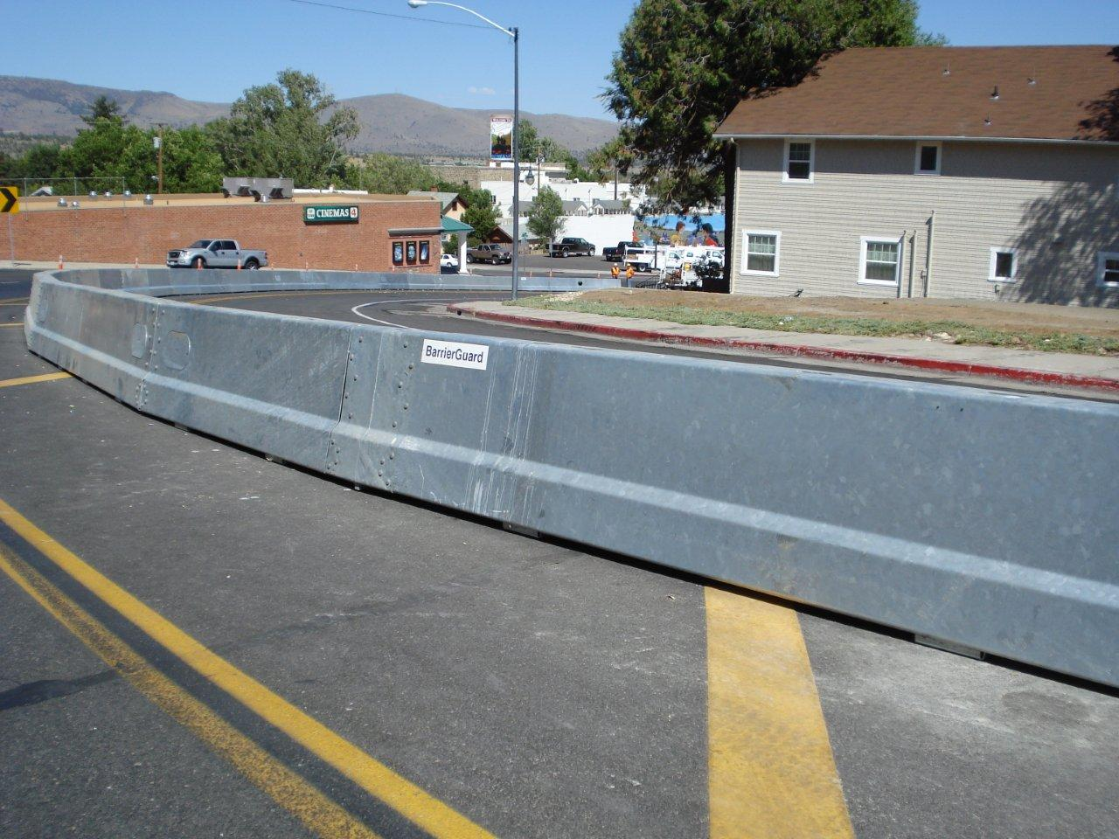
Steel Barrier System Index 414
Notes:
This is a detail out of index 415 showing a crash cushion abutting 4 units of type K barrier . If we look closer to the type K barrier we notice the stakes are in the barrier side closer to the traffic. We do not need to show staking pattern in the plans. The contractor should get this information from the standards index.

Slide 22
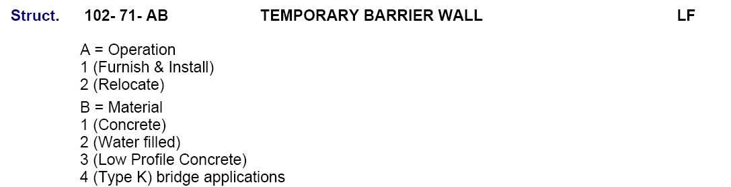
Steel Barrier System Index 414 & QPL
Steel Barrier is alternate design to Type K Barrier!
Notes:
This is a detail out of index 415 showing a crash cushion abutting 4 units of type K barrier . If we look closer to the type K barrier we notice the stakes are in the barrier side closer to the traffic. We do not need to show staking pattern in the plans. The contractor should get this information from the standards index.

Slide 23
Concrete Barrier System Index 415
415
Temporary Barriers
Temporary Barriers
Index 415 units constructed prior to October 1, 2002 may be used until September 30, 2012 THROUGH JUNE 30, 2012 LETTING with usage of ‘FDOT Snake Pin’ Interconnection
Notes:
As you know by now that barrier system in index 415 or the old FDOT 415 barrier should not be used for projects Let after July 01, 2012. the standard index specifies type k or approved products on the QPL (qualified product list) for example the (JJ hook Barrier)

Slide 24
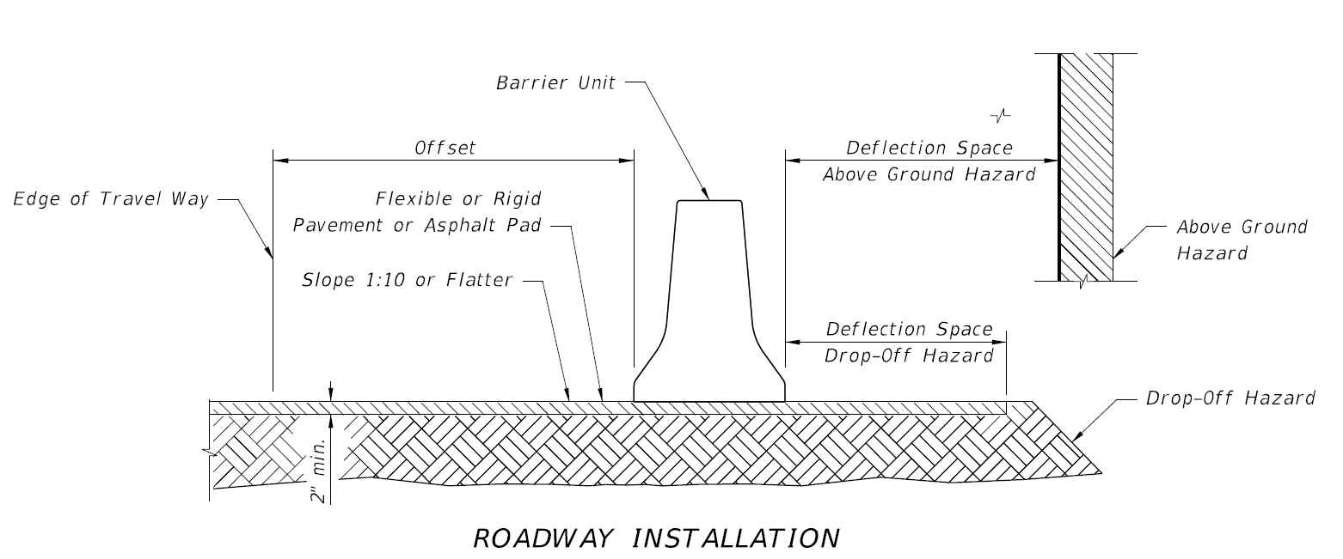
Concrete Barrier System Index 415
Notes:
Added the offsets from the travel way to the barrier. As a designer always show the asphalt pad under the temporary concrete barrier. The cost of Asphalt included with the barrier system.

Slide 25
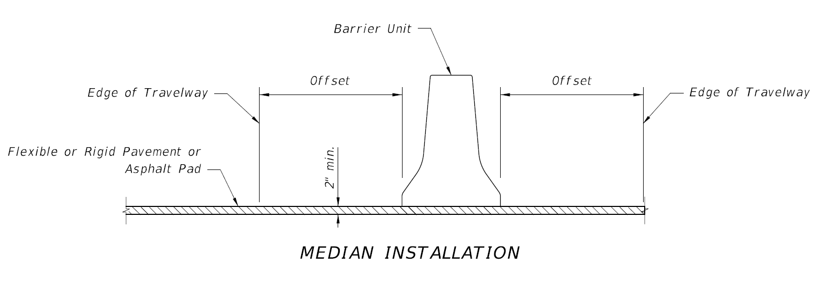
Concrete Barrier System Index 415
Notes:
This detail shows Median barrier with the offset from the travel way to the barrier.

Slide 26
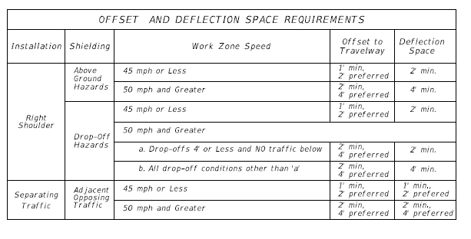
Concrete Barrier System Index 415
Notes:
Added a Table showing the barrier deflections distance and offsets from travel way. Make sure that you accommodate the deflection and offset distances in your design.

Slide 27
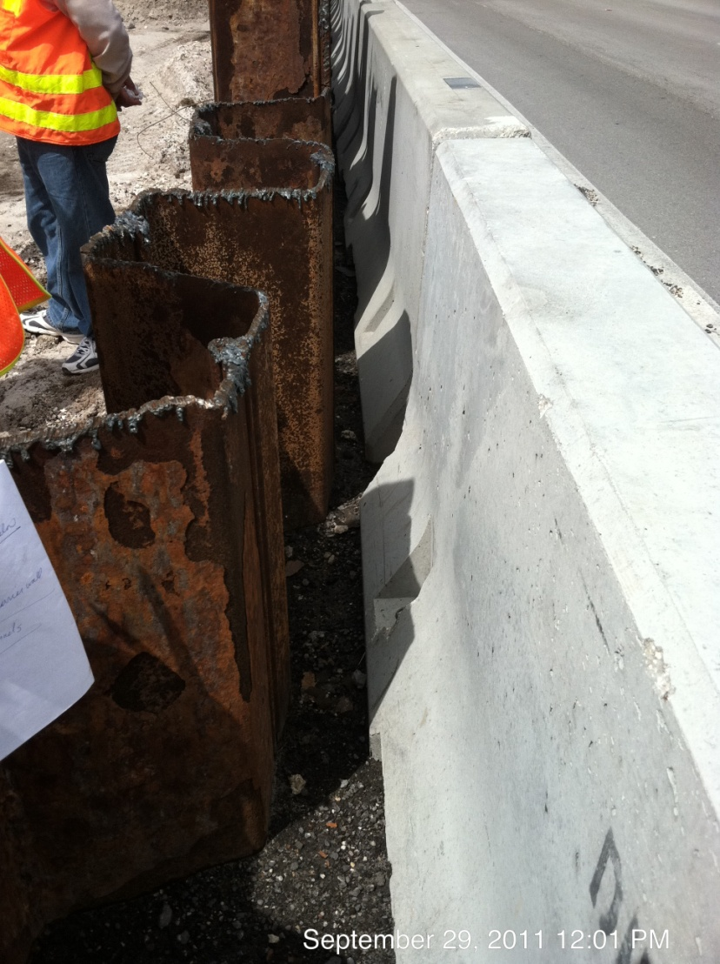
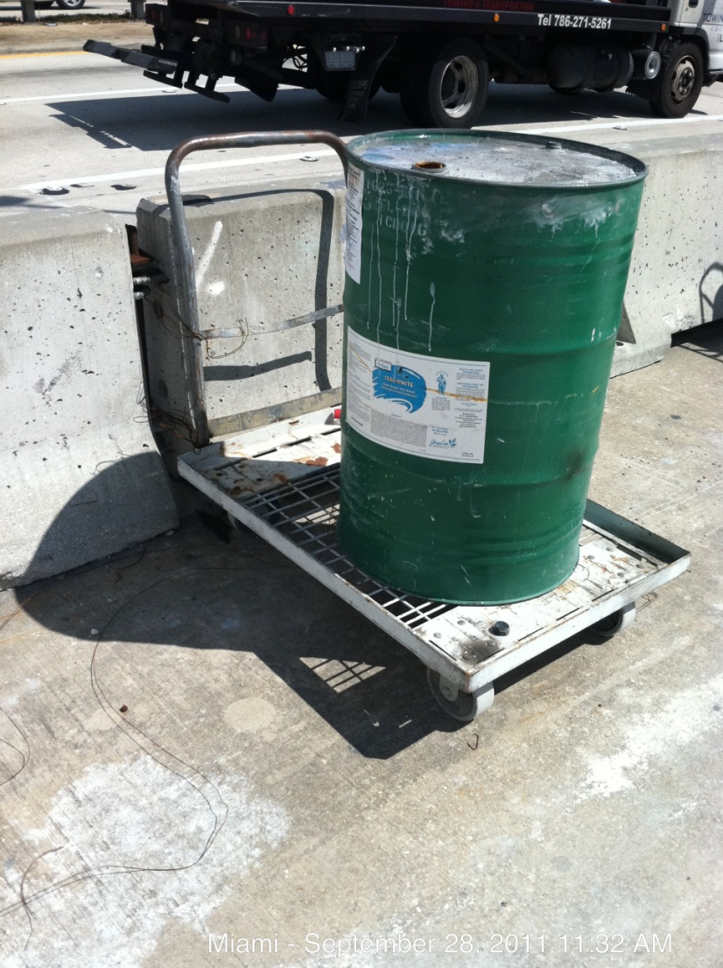
Concrete Barrier system Index 415

Slide 28
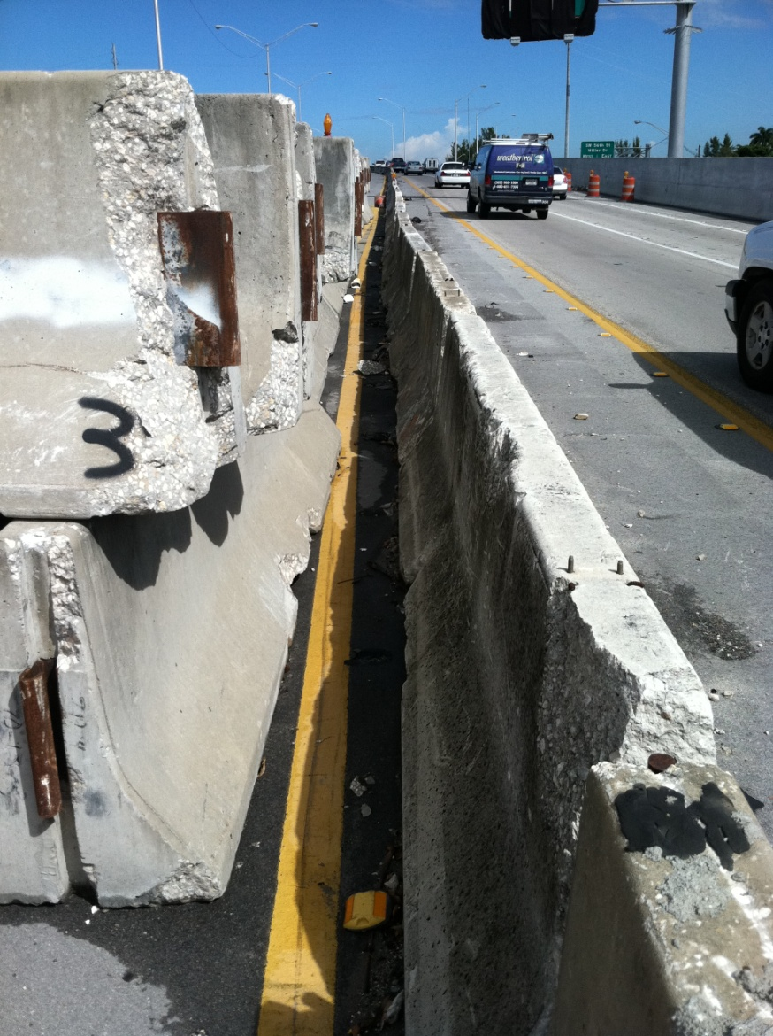
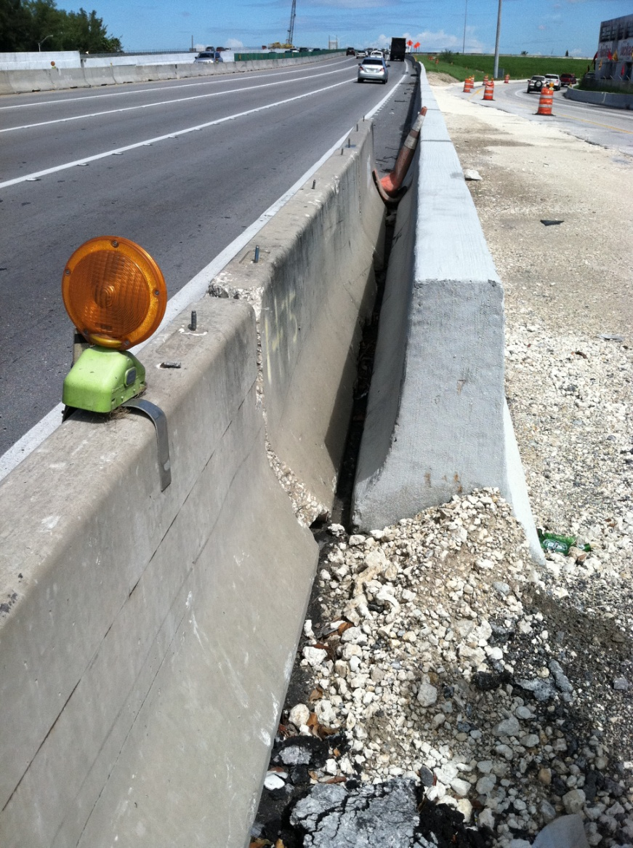
Concrete Barrier system Index 415

Slide 29
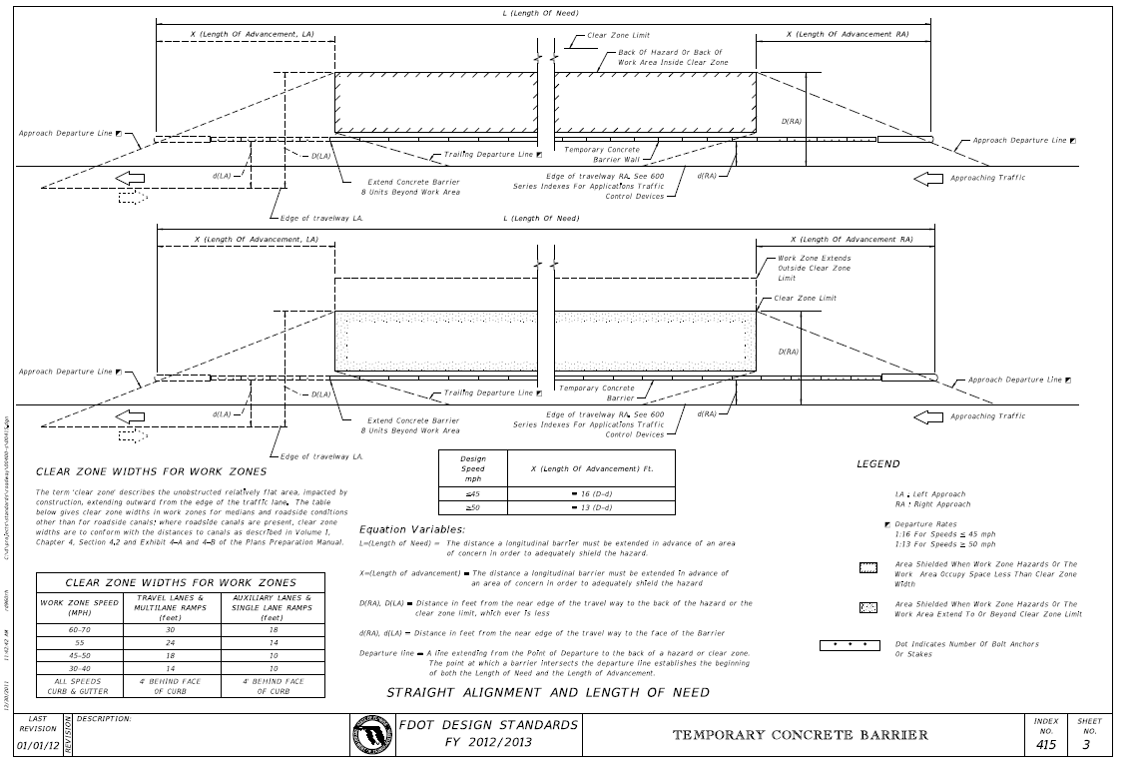
Concrete Barrier System Index 415
Notes:
Added new sheet with the equation of how to calculate the Length of need and included the distance of the clear zone required for the work zone. Notice that every time a crash cushion is used, the abutting four barrier units are staked or bolted type k Barrier.

Slide 30
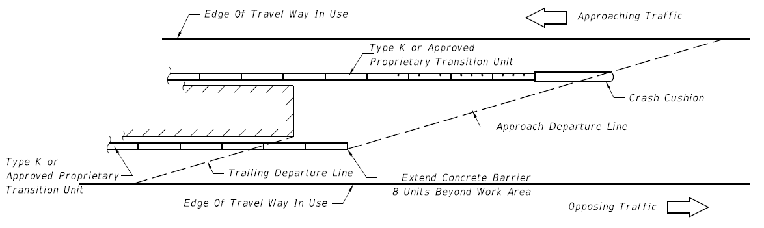
Concrete Barrier System Index 415
Notes:
Added new sheet with the equation of how to calculate the Length of need and included the distance of the clear zone required for the work zone. Notice that every time a crash cushion is used, the abutting four barrier units are staked or bolted type k Barrier.

Slide 31
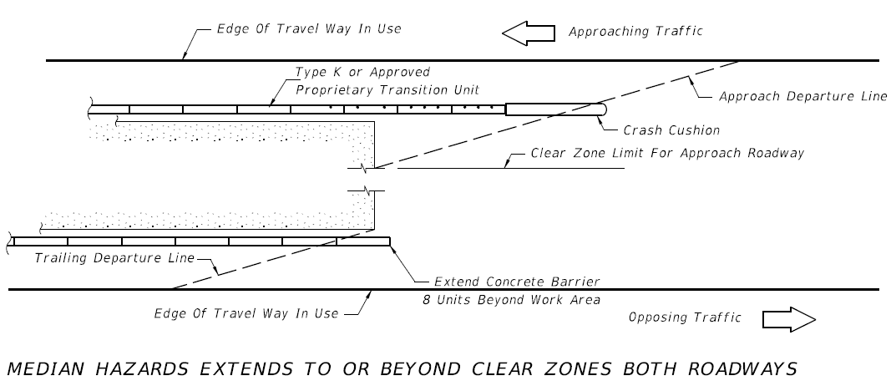
Concrete Barrier System Index 415
Notes:
Added new sheet with the equation of how to calculate the Length of need and included the distance of the clear zone required for the work zone. Notice that every time a crash cushion is used, the abutting four barrier units are staked or bolted type k Barrier.

Slide 32
Temporary Crash Cushions
FDOT Criteria
  VENDOR DRAWINGS
    TL-2 (45 mph or less)
    TL-3 (50 mph or greater)
  SPEEDS
    Interpolating at 5 mph increments
    Extrapolating for speeds above 60 mph is no longer allowed

Slide 33
Temporary Crash Cushions
FDOT Design Requirements
Station/Offset
Type of Crash Cushion (TL-2 or TL-3)
Speed
Width - Narrow vs. Wide
Length Restrictions
MOT Phase (Temporary)
Use Type K barrier pay item

Slide 34
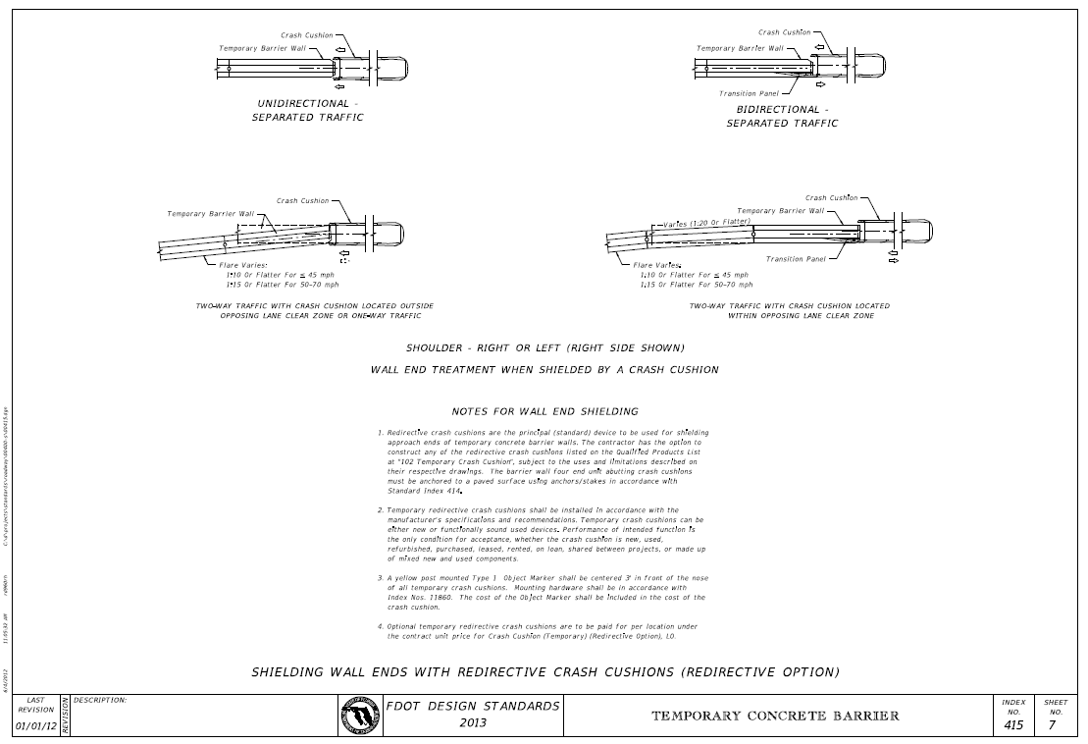
Crash Cushions (QPL)

Slide 35
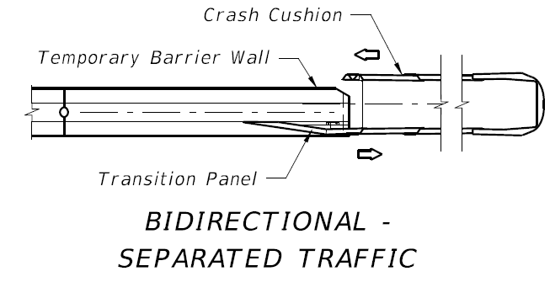
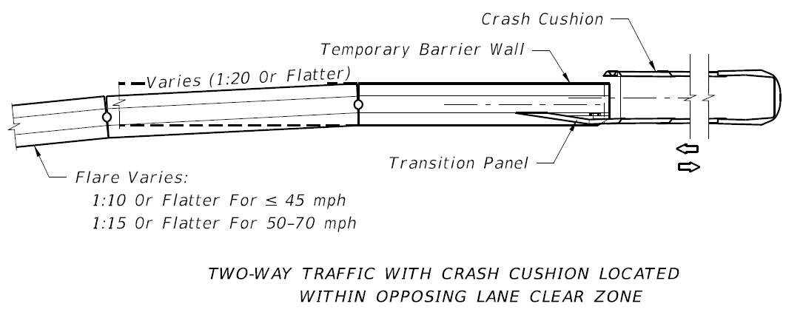
Crash Cushions (QPL)

Slide 36
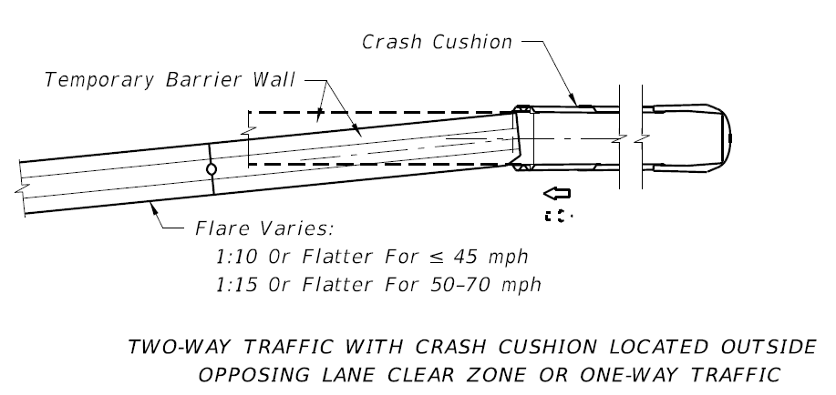
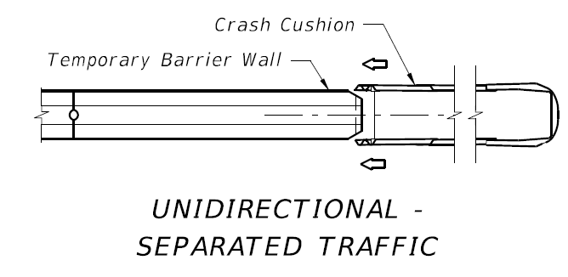
Crash Cushions (QPL)

Slide 37
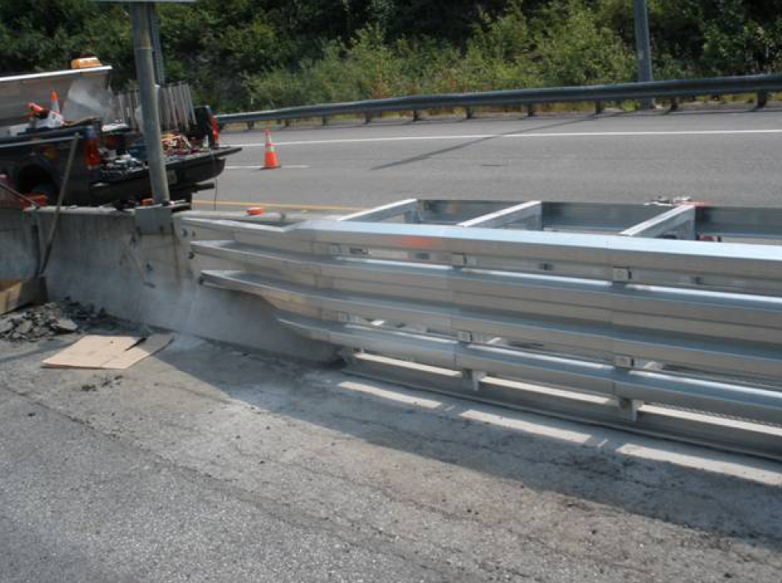
Crash Cushions (QPL)
Notes:
Where speeds are specified, the designer should use charts currently in the vendor drawings.

Slide 38
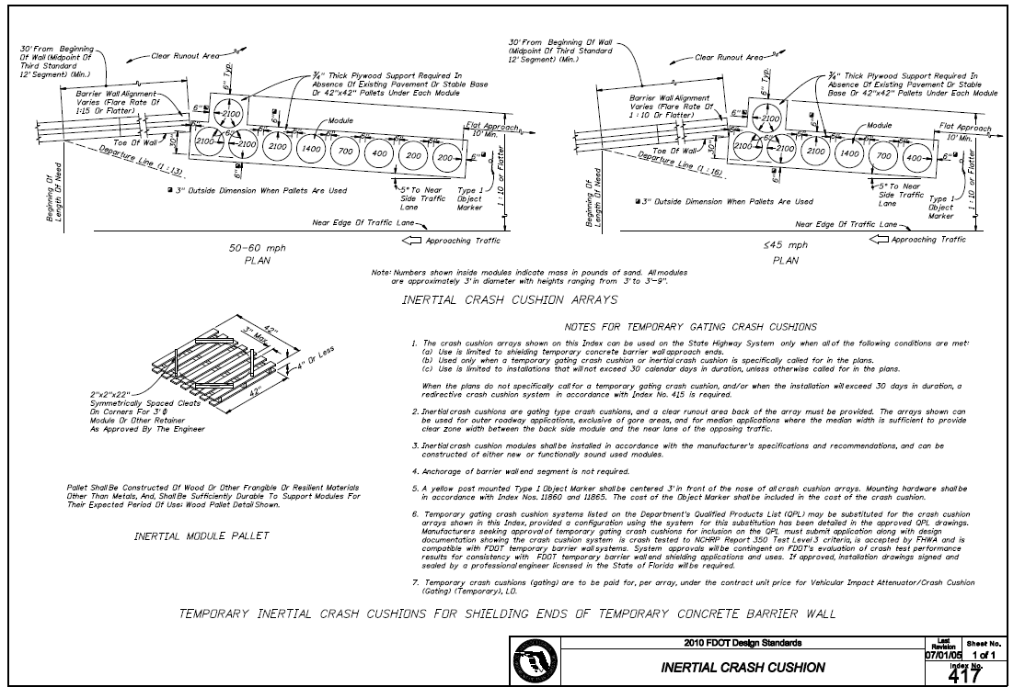
Crash Cushions (QPL)
Notes:
Standard index 417 was removed because it limits site distance at intersection & Driveways

Slide 39
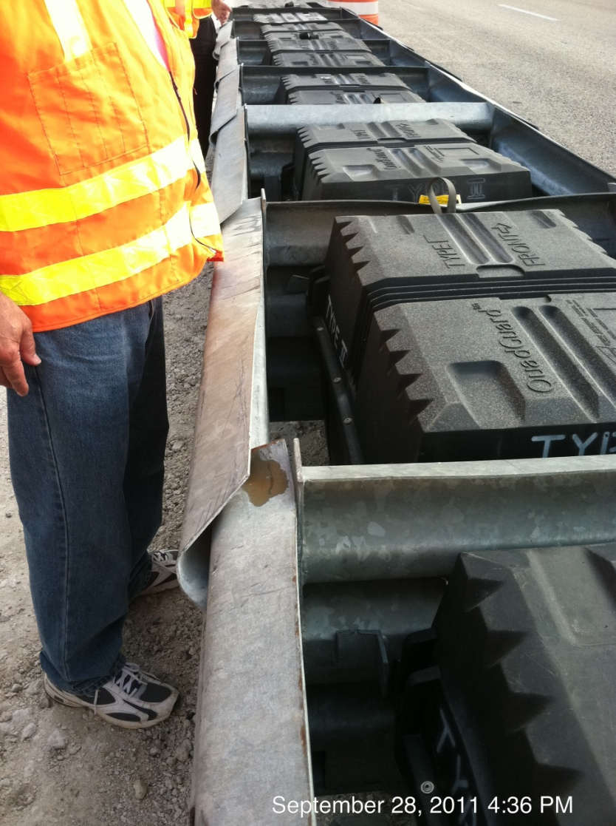
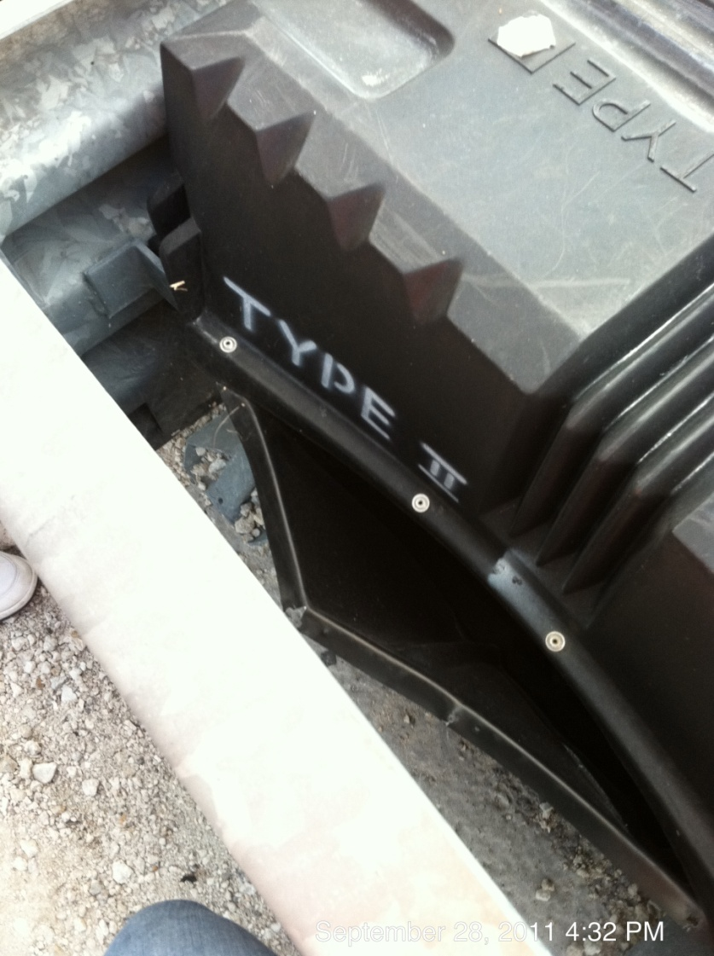
Crash Cushions (QPL)

Slide 40
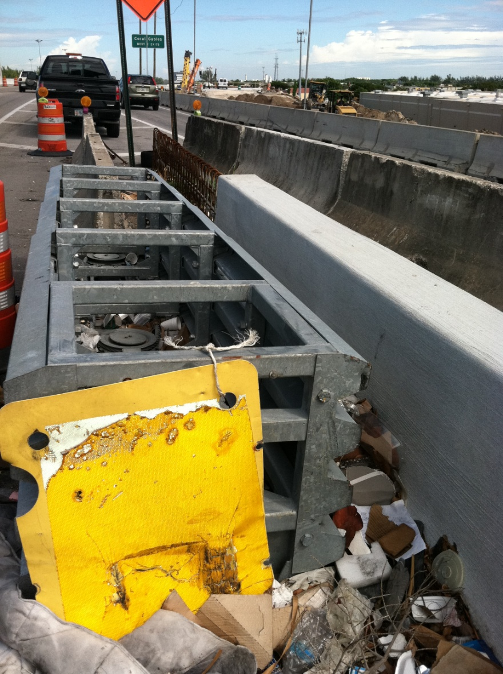
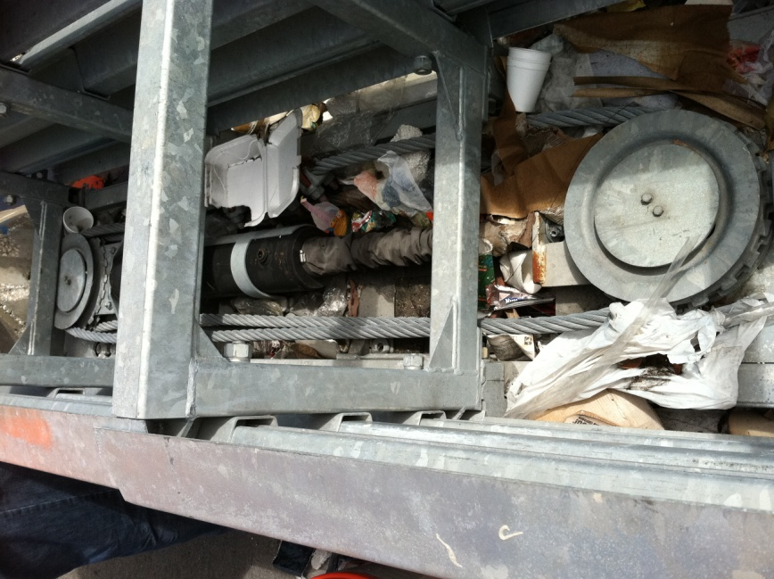
Crash Cushions (QPL)

Slide 41
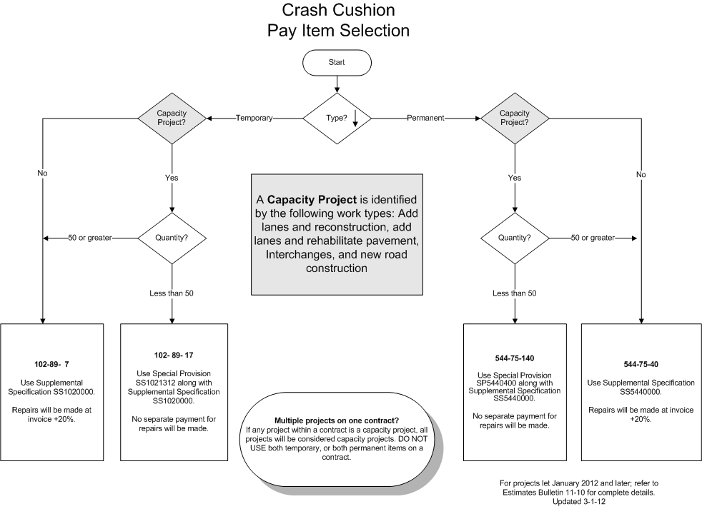
Temporary Crash Cushions
41

Slide 42
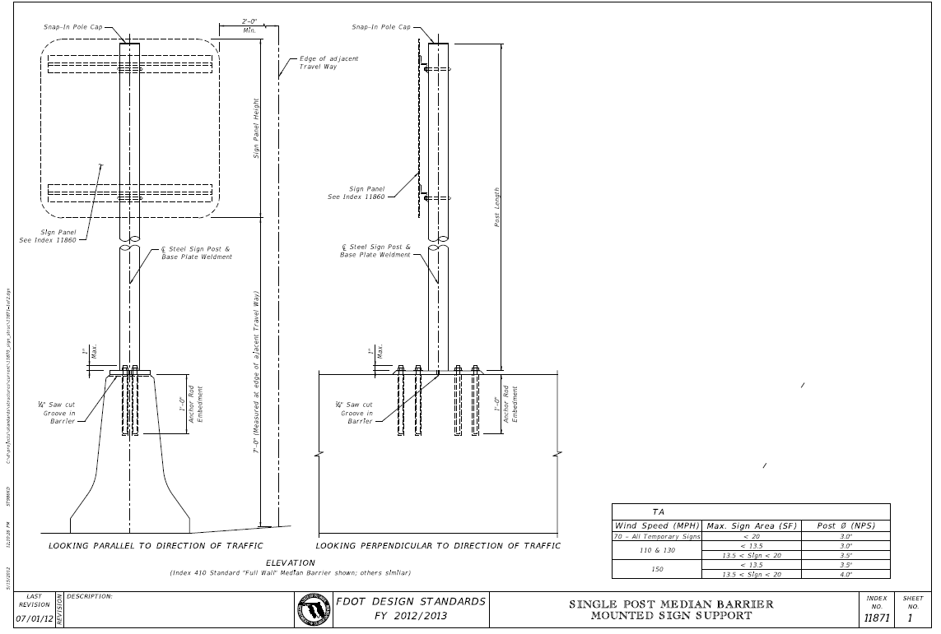
Temp. Signs Mounted on Barrier

Slide 43
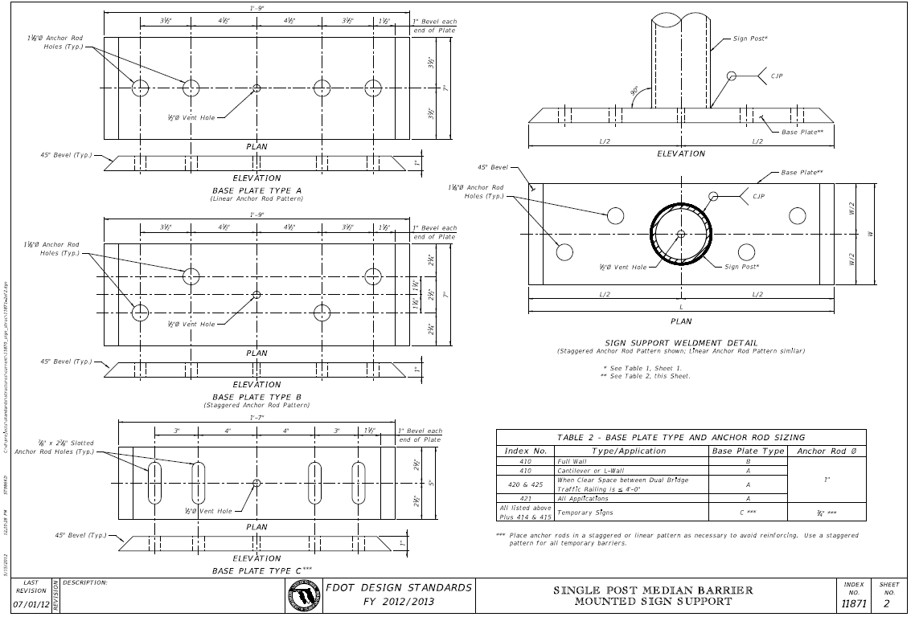
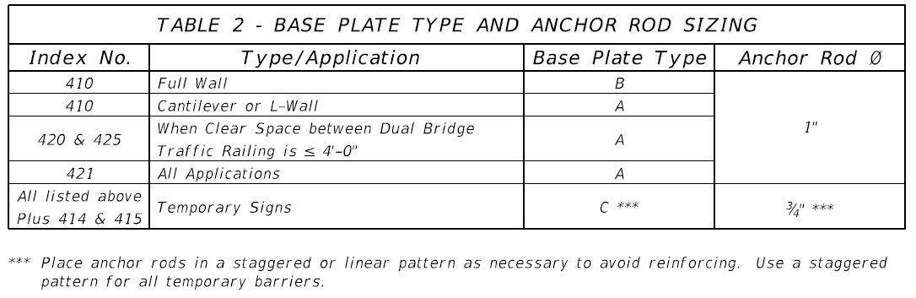
Temp. Signs Mounted on Barrier

Slide 44

Questions …………..

