Slide 1
How to Include Revised Index Drawings in Plans
As required by:
ROADWAY DESIGN BULLETIN 12-16
STRUCTURES DESIGN BULLETIN 12-13
http://www.dot.state.fl.us/rddesign/updates/files/RDB12-16.pdf

Slide 2
Steps Required
Download the Revised Index Drawings (RID)
Add RID Index to Key Sheet
Print Key Sheet Postscript
Insert RID into Project Index
Create Basic HTML Index
Create Project PDF
Rotate RID in Project PDF

Slide 3
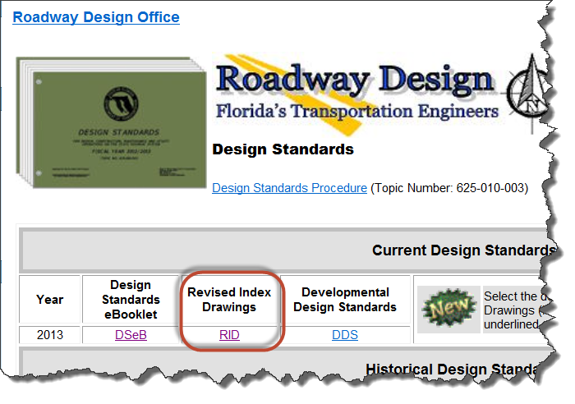
1. Download RID
Save Revised Index Drawings (RID) that apply to your project into the eng_data directory of the lead component.
http://www.dot.state.fl.us/rddesign/updates/files/updates.shtm

Slide 4
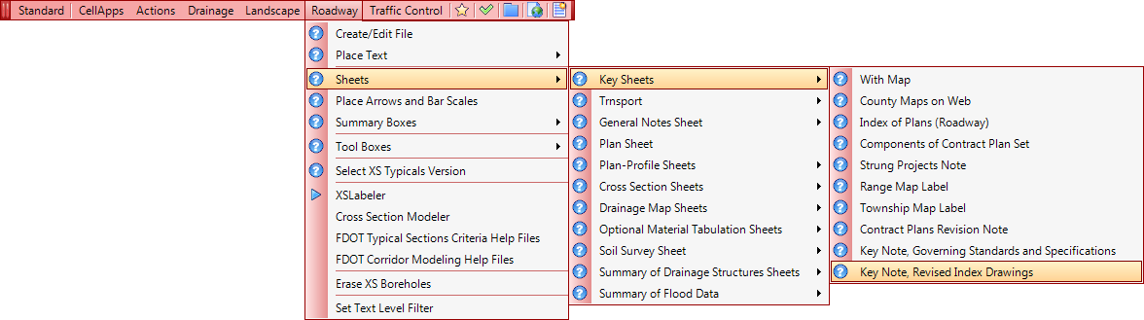
2. Add RID Index to Key Sheet
Add the required note and list of revised index drawings to the key sheet.
Place cell by selecting “Roadway > Sheets > Key Sheets > Key Note, Revised Index Drawings” from the FDOT menu or right click and select “Revised Index Drawings” from the context menu.
Enter index number and sheet number.

Slide 5
3. Print Key Sheet Postscript
If you have already created the Postscript file for your Key Sheet it will have to be recreated.
Start EDI and open the project.
On the “Sheet Files” tab, right click on the key sheet file and select “Create Plot Files > All”.

Slide 6
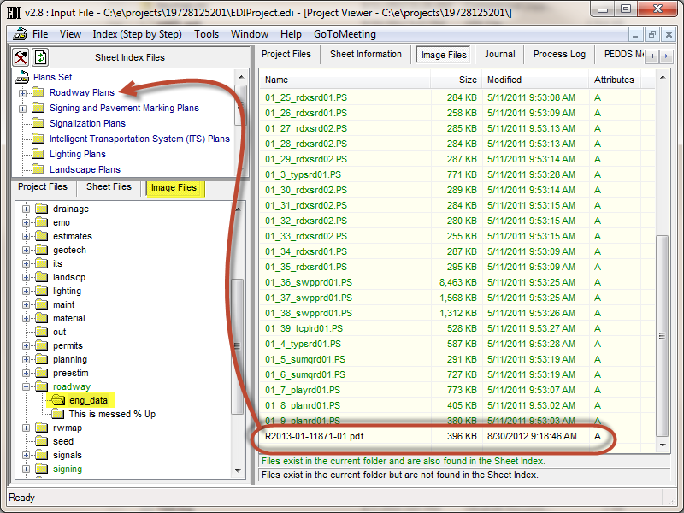
4. Insert RID into Project Index
On the “Image Files” tab, navigate to the eng_data folder of the lead component.
Drag and drop the RID PDF file into lead component folder in the Sheet Index Files pane.

Slide 7
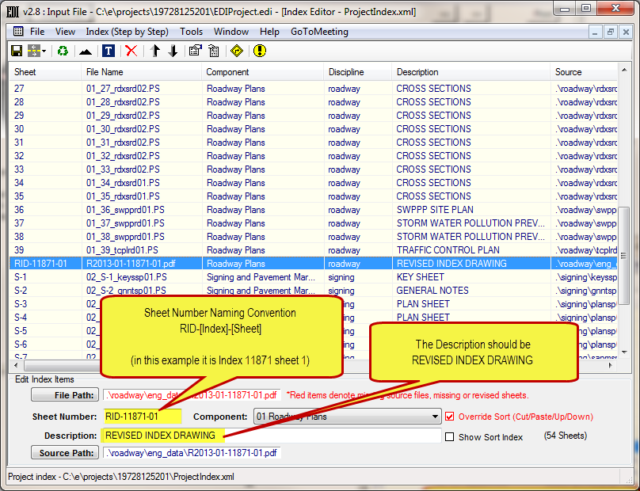
4. Insert RID into Project Index
Select “Index (Step by Step) > 5) Index Editor (Edit and Save Index)”.
Select the RID and update the Sheet Number and Description
Click the Save icon.

Slide 8
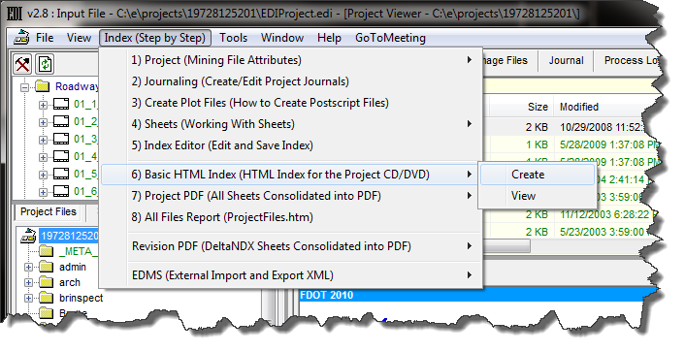
5. Create Basic HTML Index
Create the SheetNDX.htm file by selecting “Index (Step by Step) > 6) Basic HTML Index (HTML Index for the Project CD/DVD) > Create”.

Slide 9
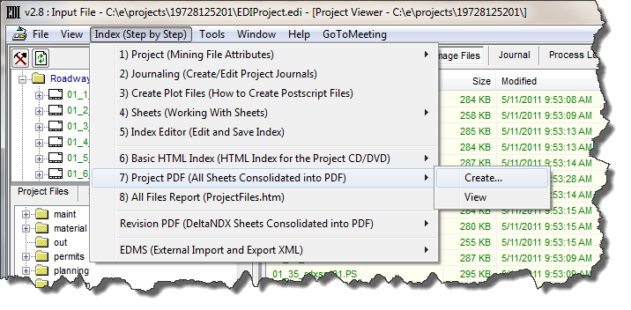
6. Create Project PDF
Select “Index (Step by Step) > 7) Project PDF (All Sheets Consolidated into PDF) > Create

Slide 10
7. Rotate RID in Project PDF
The RID PDF files have a different rotation than all of the plotted CADD sheets so the Project PDF file will need to be edited to manually rotate the RIDs to match the other sheets.

Slide 11
Questions
Questions about this process can be sent to
ecso.support@dot.state.fl.us.

